Slide 1
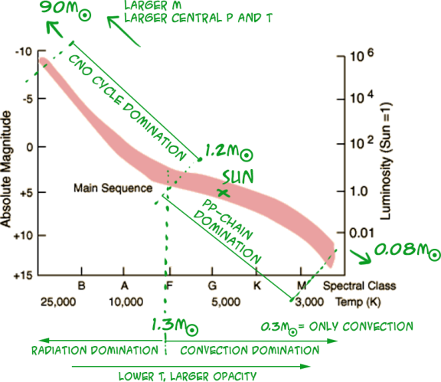
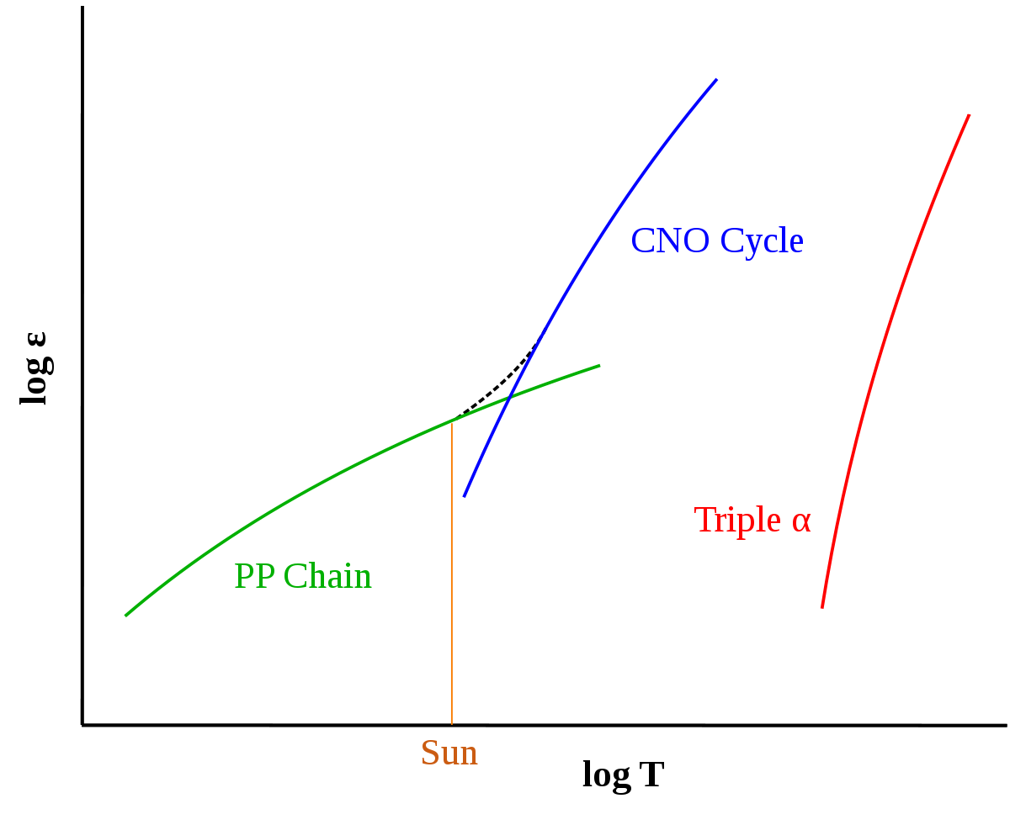
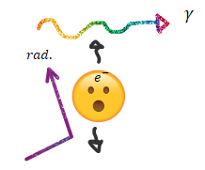
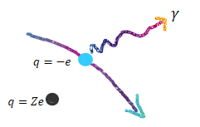


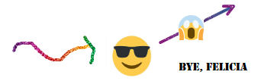
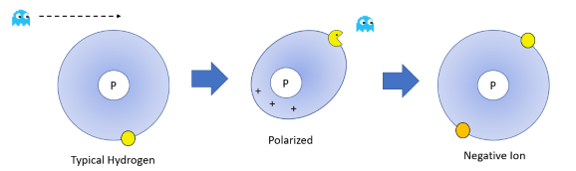
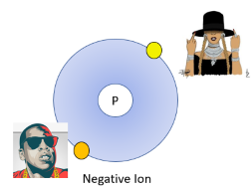

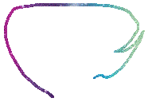














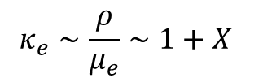

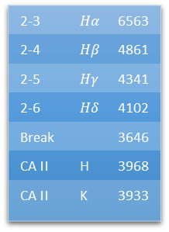


















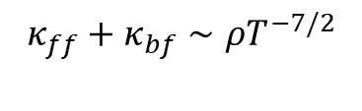












Stellar Structure Equations
Energy Generation
C*
D*
A*
B*
F
Hydrostatic
Equilibrium
$$ε=ε_{0}ρ^{m}T^{n}−ε_{ν}$$
- Area under Gamow peak (MaxB x Tunneling) determines rxn rate of particles that can quantum tunnel through coulomb barrier.
c
$$\frac{dP}{dr}=−G\frac{M_{r}ρ}{r^{2}}→ P∝\frac{Mρ}{R}$$
E
$ε_{0},m,n$depend on rxn and abundance
$−ε_{ν} :$ loss of energy by escaping neutrinos
D
Mass
Conservation
B
$$\frac{dM}{dr}=4πr^{2}ρ → M∝R^{3}ρ$$
- Unstable if degenerate gas ($P≠P\left(T\right)$ thermo. runaway) or very thin shell (solar thermostat).
$4 H to 1 He$, $∼$26 MeV:
$$ε_{pp} :\sim ρT^{4}$$
A
Energy
Generation
G
$$\frac{dL}{dr}=4πr^{2}ρ ε→ L∝Mε$$
bottleneck: a p must beta decay (weak force) into neutron at collision.
$$10^{−6}$$
$$ε$$
0
$${\frac{dT}{dr}}_{rad}=−\frac{3}{4ac}\frac{κρ}{T^{3}}\frac{L}{4πr^{2}}→T^{4}∝\frac{ρL}{R}$$
40,000
Radiative
Transport
$$ε_{cno}:\sim {ρT}^{18}$$
carbon catalyst
$3 He to 1 C$, $∼$7 MeV:
$ε_{triple α}$: $∼ρ^{2}T^{40}$
$${\frac{dT}{dr}}_{ad}=\frac{γ−1}{γ}\frac{T}{P} \frac{dP}{dr}$$
Convective
Transport
Core T (million K)
Spectra (Balmer Absorption)
Evolution
O
Equations Of State
2-3 | $$Hα$$ | 6563
2-4 | $$Hβ$$ | 4861
2-5 | $$Hγ$$ | 4341
2-6 | $$Hδ$$ | 4102
Break |  | 3646
CA II | H | 3968
CA II | K | 3933
Strong Balmer Lines
A*: H Shell fusion
Hertzsprung gap
I
$$P_{radiation}=\frac{a}{3}T^{4}$$
$$P_{polytrope}=K ρ^{γ}$$
$$P_{ideal gas }=\frac{ρk_{B}T}{μm_{H}}∝\frac{ρT}{μ}$$
A: Sub-giant: H shell fusion
A
10
B: RGB: H shell fusion
100
radiation
B*: He Core, H shell fusion
G
10
CaII
1 $M_{⊙}$
C: He *: He core fusion
Brown Dwarf
0.1
C*: Heavy Element Fusion
3646
6563
$$λ$$
D: HB: He core fusion
Flat in optical
Bright in IR
M
Log T
Ideal Gas
D*: Supernova
T
$$γ=1+\frac{1}{n}=C_{p}/C_{v}$$
4
Degenerate
E: AGB: He + H shell fusion
NR $(n=\frac{3}{2})$
F: EE: Pulsations destabilize outer envelope
R $(n=3)$
4000
9000
$$ΔxΔp≥ℏ/2$$
-10
Log $ρ$
10
G: WD
Opacity
$$κ=κ_{ff}+κ_{bf}+κ_{e}$$
Eddington Limit
Time Scales & Virial Theorem
$$κ_{e}$$
$$κ_{ff}$$
(Kramers)
$$f_{rad}=\frac{κL}{4πcr^{2}}$$
$$τ_{ff}=\sqrt{\frac{R^{3}}{GM}}$$
Dynamical / Free Fall
$$γ$$
$$κ_{ff}+κ_{bf}∼ρT^{−7/2}$$
How fast things change once HSE is violated.
(Thompson)
$$f_{grav}=\frac{GM}{r^{2}}$$
Thermal / Kelvin Helmholtz
$$κ_{e}∼\frac{ρ}{μ_{e}}∼1+X$$
$$τ_{KH}≈\frac{GM^{2}}{2RL}$$
How fast changes in the thermal structure can occur. Contraction
$$κ_{bf}$$
$$f_{rad}=f_{grav}$$
$$l_{mfp}=\frac{1}{κρ}=\frac{1}{nσ}$$
$$τ_{nuc}=\frac{E_{nuc}}{L}$$
Nuclear Timescale
$\frac{κL}{4πcr^{2}}$ = $\frac{GM}{r^{2}}$
How long fuel lasts/How quickly composition changes.
$L$= $\frac{4 πcGM}{κ}$
$$τ_{nuc}≫τ_{KH}≫τ_{dyn}$$
$$E_{int}=−\frac{1}{2}E_{grav}$$
$$E_{int}=\frac{3}{2}\frac{k_{B}T}{μm_{H}}$$
$$E_{gr}=−\frac{αGM^{2}}{R}$$
$$κ_{H−}$$
Implies mass loss in massive stars. Humphrey-Davidsons limit.
$$L=−\frac{dE_{tot}}{dt}=−\frac{1}{2}\frac{dE_{gr}}{dt}=\frac{dE_{int}}{dt}$$
(For Ideal Gas)

Slide 2

















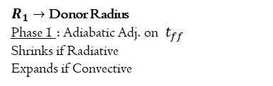















































Solar Central Temp.
Asteroseismology
Pulsations
Luminosity Sources
$$P∝\frac{Mρ}{R}$$
HSE
- The study of stars by the observation of natural, resonant oscillations.
- Determines evolutionary state, density, core rotation, mass. By comparing $ν$ to time scales or comparing to models of evolutionary tracks.
The sol’s to time dependent eqs of stellar structure given a displacement/perturbation from equilibrium.
Pre MS: No Int. E Source! Per virial thm contraction heats up star.
BB rad.
Convective, travels along Hayashi line.
Kappa: In H/He Ionization layers opacity can trap heat in, pressure increases, star expands past equilibrium, but as the temp goes up so does ionization, opacity decreases, temp cools, core contracts, atoms recombine. Heat engine cycle starts again.
$$L=4πR^{2}σT^{4}$$
$$E_{gr}=−\frac{αGM^{2}}{R}$$
$$P∝\frac{ρT}{μ}$$
Ideal Gas
MS: Nuclear Fusion in Core. $L∝M ε$
Moves on MS as comp. changes.
$$\frac{Mρ}{R} ∝\frac{ρT}{μ}$$
$$μ_{H}=\frac{1}{2}$$
$$μ_{He}=1$$
Pressure (P) Waves
Epsilon: Fluctuations in energy generation in massive evolved stars could drive perturbations. No current class of star that does this.
Homology $L=μ^{4}M^{3}$
$$T∝μ\frac{M}{R}$$
Driven by Turbulence, Restored by Pressure, Convective Envelopes, Radial
Stochastic Driving: In solar like or RGB stars, the star resonates in some of its natural oscillation frequencies where some of the stochastic noise is transferred to energy of global oscillation. Irl you can add white noise to a signal in order to boost it.
Giant: H shell burning. Isothermal Core,
no E source. After Schonberg-Chandrasekhar Core Mass Limit is exceeded: Mirror principle: Core contracts & star expands, cools up to Hayashi Line.
Gravity (G) Waves
$$T=1.2×{10}^{7}K$$
Driven by Buoyancy, Restored by Gravity, Central Region, Non Radial, Cant travel in convection
Binaries: Binaries in highly elliptical orbits can disturb each other tidally when in close contact. Heartbeat Stars.
$$T_{neutrinos}=1.5×{10}^{7}K$$
Supernovae & Compact Objects
All instances depend on mass and composition.
(Could also use virial thm)
Pop Synth
Central Pressure
Assume $μ,κ$ are constant
PISN: Photons are absorbed in the process of creating electron-positron pairs. Reduced photons means less pressure. Star obliterates, no object left.
Stellar Evolution Models: Initial Conditions for stars. Mass Loss and Mixing can be uncertain and have large impacts for observed properties and lifetimes. Binary interactions – SN kicks, CEE outcomes, Mass Transfer
10
BH
$$Fe↔α$$
$$P_{gas}∝ρT$$
$$M^{2}∝ε∝ρ^{n} T^{m}$$
BH
PISN
CCSN
$$P_{hse}∝\frac{ρM}{R}$$
$$M^{2}∝\frac{M}{R^{3}}{\left(\frac{M}{R}\right)}^{m}$$
$$2γ↔e^{+}e^{−}$$
Theoretical
$$500 M_{⊙}$$
ECSN
Statistical Distributions: Initial conditions for a population of stars. IMF. Star Formation History – Instantaneous (cluster) Continuous (galaxy), complex. Chemical distribution/evolution – initial composition of stars, how the composition changes with time. Initial Rotation Rates. Binaries – Fraction, q, Period, a
$$T∝\frac{M}{R}$$
ECSN: Fusion goes on to make O-Ne-Mg core/wd. Could explode through same EC.
$\log{T}$
$$200 M_{⊙}$$
$$R^{m+3}∝M^{m−1}$$
$$60 M_{⊙}$$
$e^{−}$
capture
limit
$$T^{4} ∝\frac{ρL}{R}$$
Radiative Transfer
8
$$15 M_{⊙}$$
$$R∝M^{\left(\frac{m−1}{m+3}\right)}$$
$$9M_{⊙}$$
$$5M_{⊙}$$
WD
2
NR ED
Energy Generation
$$P∝\frac{M^{2}}{R^{4}}∝M^{2}{\left(M^{\left(\frac{m−1}{m+3}\right)}\right)}^{−4}$$
6
10
$$L∝Mε$$
CCSN: Iron fusion and neutrinos cause energy loss. Core collapses. Outer layers bounce off dense neutron core, shock wave.
$\log{ρ}$
Stellar atmosphere Models: Model for spectrum given surface conditions: composition, temp, surface gravity, luminosity, rotation
$${\left(\frac{M}{R}\right)}^{4} ∝\frac{M^{2}ε}{R^{4}}$$
1a: Accreting White Dwarfs
1bc: Stripped/WR Star CC
BH/NS: IBC or 2
$$P∝M^{\frac{\left(10−2m\right)}{m+3}}$$
$$m_{pp}=4$$
$$m_{cno}=18$$
Mass-Radius Relation
Mass Transfer
Ex. Blue Stragglers, X-ray Binaries, Thorn – Zytkow, Stripped Stars
Convection
R,S - Process
$$P∝\frac{Mρ}{R}∝\frac{M^{2}}{R^{4}}$$
HSE
$$ρ∝\frac{M}{R^{3}}$$
Case A:
During MS
Stable: $R_{1}$ shrinks faster than $R_{L1}$. System detaches.
Efficient method of energy transport. Triggers when temp. gradient exceeds the adiabatic temperature gradient – superadiabacity. Temp. gradient can relax to adiabatic temp. gradient after convection is initiated. Useful for mixing. Hayashi Line.
Neutron Capture & Beta Decay Nucleosynthesis
Case B:
After H exhaustion
(R)apid
$β$-decay < Neutron Capture (fast)
$$P∝ρ^{γ}∝{\left(\frac{M}{R^{3}}\right)}^{γ}$$
Case C:
After He exhaustion
Requires high energy and high number of neutrons – CCSN and Kilonovae. Lanthanides
PolyTrope
$q=\frac{M_{1}}{M_{2}}→$ Mass Fraction
UnStable: Convective stars expand on mass exchange.
$a→$Orbital Separation
Widens : Winds only - carries away L
Tightens : Conservative Mass Transfer
(S)low
$β$-decay > Neutron Capture (slow)
$${\left(\frac{M}{R^{3}}\right)}^{γ}∝\frac{M^{2}}{R^{4}}$$
$$M_{2}$$
For composition:
$P∝{\left(\frac{ρ}{μ_{e}}\right)}^{γ}$
L
Blue Straggler
Neutrons are from normal c/o burning stages. Low neutron density, takes years. A< 60
$$M_{1}$$
Stripped Star
Abundances: On island of stability are magic numbers: places of complete shells in nucleus. Expect increased abundances in these places. Confirmed with asteroid comp. + stellar spectra
Neutron
Capture
Stability against convection
P
$$R^{4−3γ}∝M^{2−γ}$$
$R_{L1}\left(a,q\right)→$ Roche Lobe Radius
Shrinks : If $q>q_{crit}=0.78$
$β^{−1}$ decay
Ledoux criteria
For ideal gas.
Island of stability
$γ=\frac{5}{3}$ NR WD, BD
$γ=\frac{4}{3}$ R WD
$$R∝M^{−1/3}$$
T
$$∇_{rad}<∇_{ad}+∇_{μ}$$
N
$M∝$ $R^{0}$
$R_{1}→$ Donor Radius
Phase 1 : Adiabatic Adj. on $t_{ff}$
Shrinks if Radiative
Expands if Convective
Phase 2 : Thermal Adj. on $t_{KH}$
Shrinks: On MS.
Expands: Post MS
Metallicity has a stabilizing effect.
Bubbles displaced upward will have higher densities and be pushed back down.
Abundances
Chandrasekhar Mass: 1.4 $M_{⊙}$
Brown Dwarf: 0.1 $M_{⊙}$
$$R∝M^{\left(\frac{m−1}{m+3}\right)}$$
$$∇_{rad}<∇_{ad}$$
$$R∝M^{−1/3}$$
Schwarzschild Criteria
Mass N

Slide 3
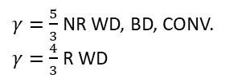
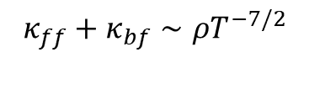














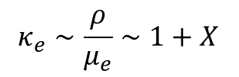









Stellar Structure
Equations Of State
Energy Generation
Opacity
$$μ_{H}=\frac{1}{2}$$
$$μ_{He}=1$$
$$P∝\frac{M}{R}ρ$$
Hydrostatic
Equilibrium
$$P∝\frac{a}{3}T^{4}$$
$$P∝\frac{T}{μ}ρ$$
$$P∝K ρ^{γ}$$
$$ε=ε_{0}ρ^{m}T^{n}−ε_{ν}$$
$$κ=κ_{ff}+κ_{bf}+κ_{e}$$
Radiation
$$L=4πR^{2}σT^{4}$$
Mass
Conservation
Ideal Gas Law
$$m,n=1, 4$$
Pp chain
$$κ_{ff}+κ_{bf}∼ρT^{−7/2}$$
$$L=μ^{4}M^{3}$$
$$M∝R^{3}ρ$$
Energy
Generation
Polytrope
$$m,n=1, 18$$
CNO
$$κ_{e}∼\frac{ρ}{μ_{e}}∼1+X$$
$$H_{α(2→3)}=6563$$
$$L∝Mε$$
Balmer Break $=3646$
$γ=\frac{5}{3}$ NR WD, BD, CONV.
$γ=\frac{4}{3}$ R WD
Radiative
Transport
$$m,n=2, 40$$
Triple Alpha
$$T^{4}∝\frac{L}{R}ρ$$
Mass Radius
Eddington Limit
Virial Theorem
$${\frac{dT}{dr}}_{ad}=\frac{γ−1}{γ}\frac{T}{P} \frac{dP}{dr}$$
Convective
Transport
Ideal Gas
$$E_{int}=−\frac{1}{2}E_{grav}$$
$$E_{int}=\frac{3}{2}\frac{k_{B}T}{μm_{H}}$$
$$E_{gr}=−\frac{αGM^{2}}{R}$$
$$R∝M^{\left(\frac{m−1}{m+3}\right)}$$
$$P∝M^{\frac{\left(10−2m\right)}{m+3}}$$
$$f_{rad}=\frac{κL}{4πcr^{2}}$$
$$f_{grav}=\frac{GM}{r^{2}}$$
$$∇_{rad}<∇_{ad}$$
Schwarzschild Criteria
$$R^{4−3γ}∝{μ_{e}^{γ}M}^{2−γ}$$
Polytrope
$$μ_{e}=\frac{2}{1+x }$$
$L$= $\frac{4 πcGM}{κ}$
$$L=−\frac{dE_{tot}}{dt}=−\frac{1}{2}\frac{dE_{gr}}{dt}=\frac{dE_{int}}{dt}$$

