Slide 1
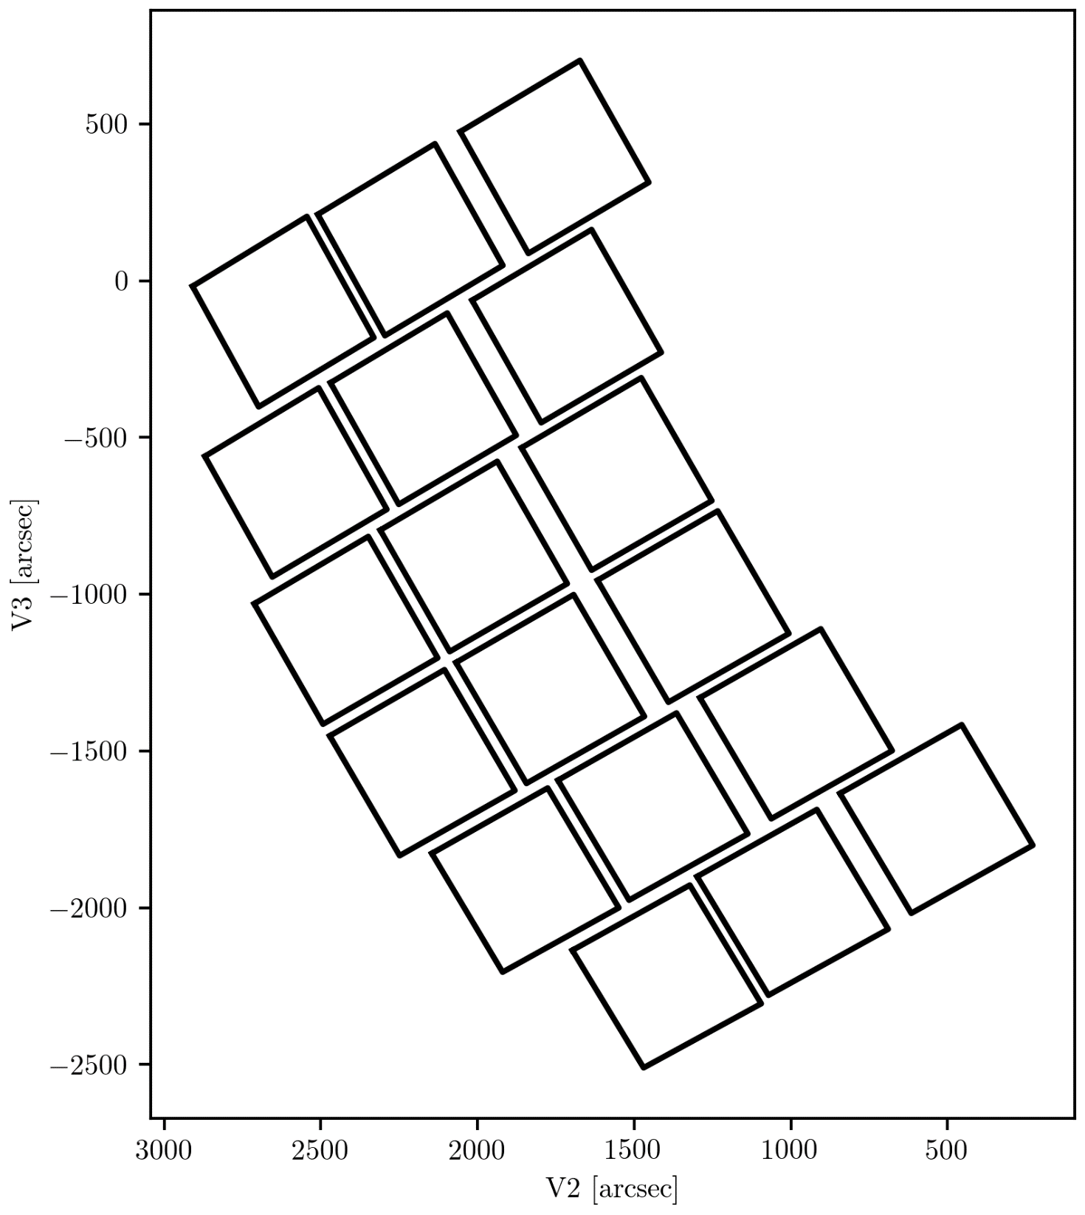





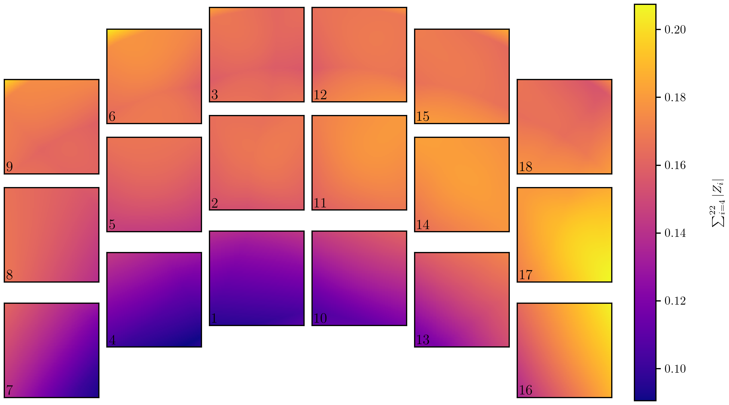














Slide 2
1.060 microns: central wavelength of F106 filter

Slide 3


















1.293 microns: central wavelength of F129 filter

