Slide 1


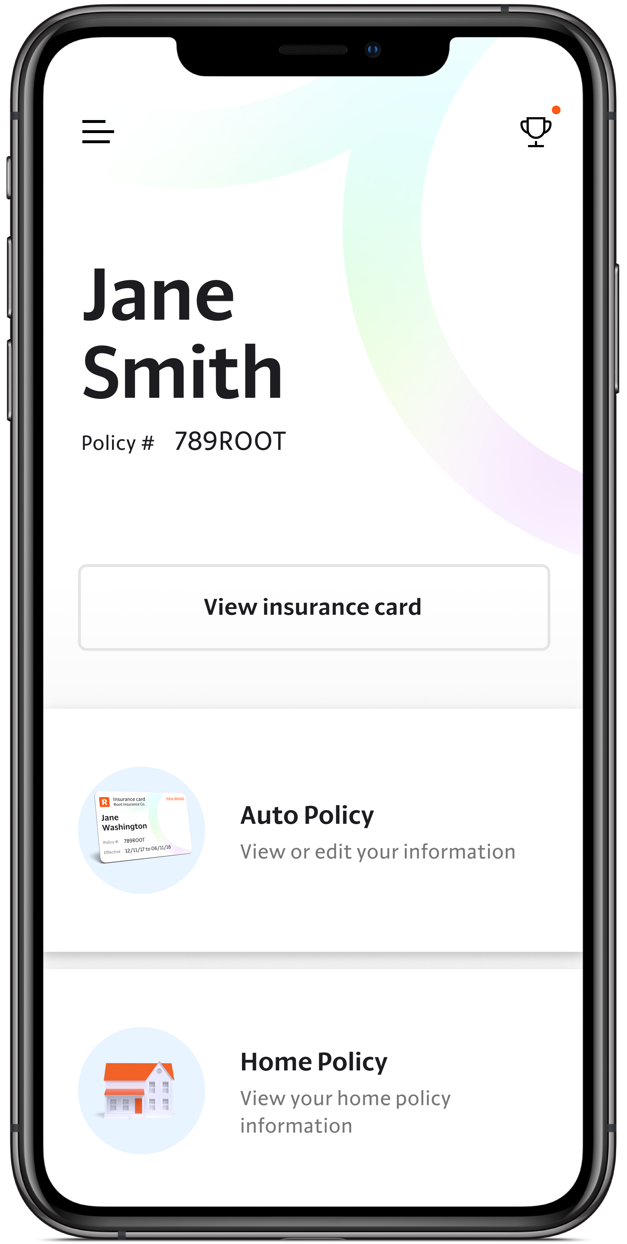
Erdős Institute Data Science Boot Camp May 30, 2021
Challenge
Patrick Vallely
The Ohio State University

Slide 2
The Problem – Vertical Search Advertising
Customers self-report various pieces of information about themselves into a website and are then shown ads from 5 different insurance companies
Companies bid based on the customer’s information, and the customer is shown ads in rank order of the companies’ bids
Companies are only charged for bids if the customer actually clicks on their ad
Acme Insurance has been utilizing a flat $10 bidding strategy and has a data set of 10,000 previously shown ads, including whether each ad was clicked on and subsequently produced a policy sale
Acme would like us to optimize their bidding strategy such that it costs as little as possible to obtain new customers, while ensuring that for every 10,000 ads shown they expect to sell 400 new policies

Slide 3
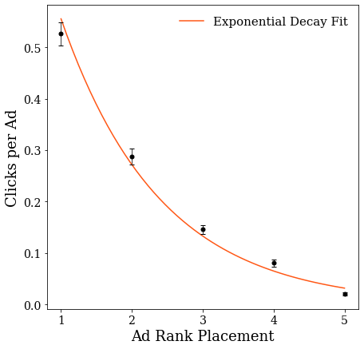
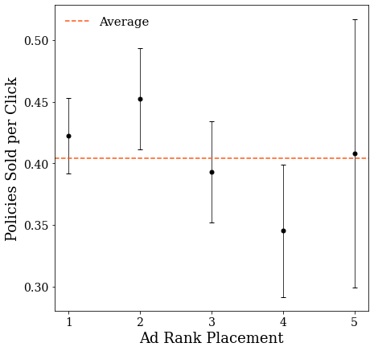
Ad Rank Placement Drives Clicks, Not Sales

Slide 4
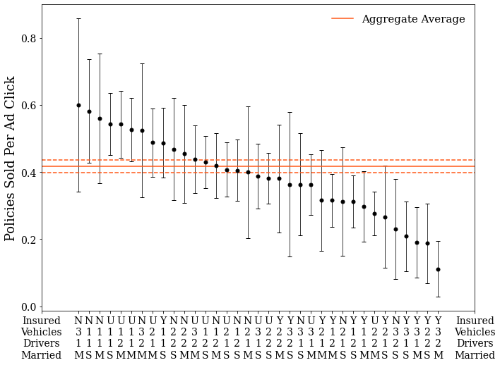
Critical Customers – Who’s Buying Policies?

Slide 5
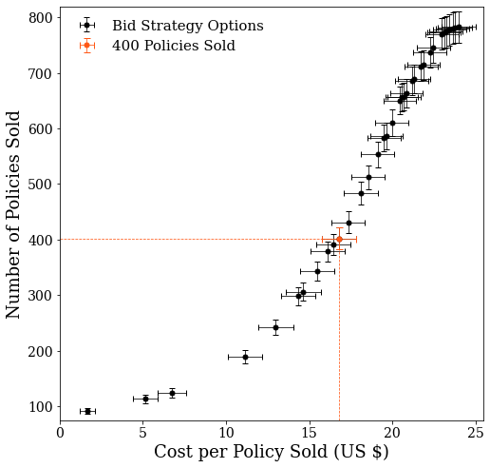
Simplest Strategy – Targeted Minimum Bids
Main Idea: Save on ad costs by bidding $0.01 for customers that are unlikely to purchase a policy after clicking on an ad
$10 bids are still submitted for customers that are likely to purchase a policy
Cuts the cost per policy sold from $23.98 to $16.79, a savings of just under 30%

Slide 6
Simplest Strategy – Targeted Minimum Bids
Only assumptions for this strategy are that customer demographics and competitor bid strategies will remain the same
Also provides a range of options if Acme would rather aim for a different number of policies sold
Only capable of building strategies that can sell up to about 783 policies, the total sales for a flat $10 bid strategy

Slide 7
Building a Variable Bidding Model
Since Acme utilized a flat $10 bid strategy for the ads in this data set, we cannot directly estimate how changing bids will shift the expected rank
We can, however, build a reasonable model around the assumption that increasing a bid by $2.50 would shift the expected display ranks for a given ad up one slot
That is, if a $10 bid produced 150 rank 3 ads and 50 rank 4 ads for a given customer demographic, this model assumes that increasing the bid to $12.50 would yield 150 rank 2 ads and 50 rank 3 ads
And vice versa for decreasing the bid by $2.50 worsening the expected ranks
In the real world we would talk with the marketing team to get a better estimate for the average cost to move up an ad rank, but for the purposes of this challenge $2.50 is a natural scale for the problem

Slide 8
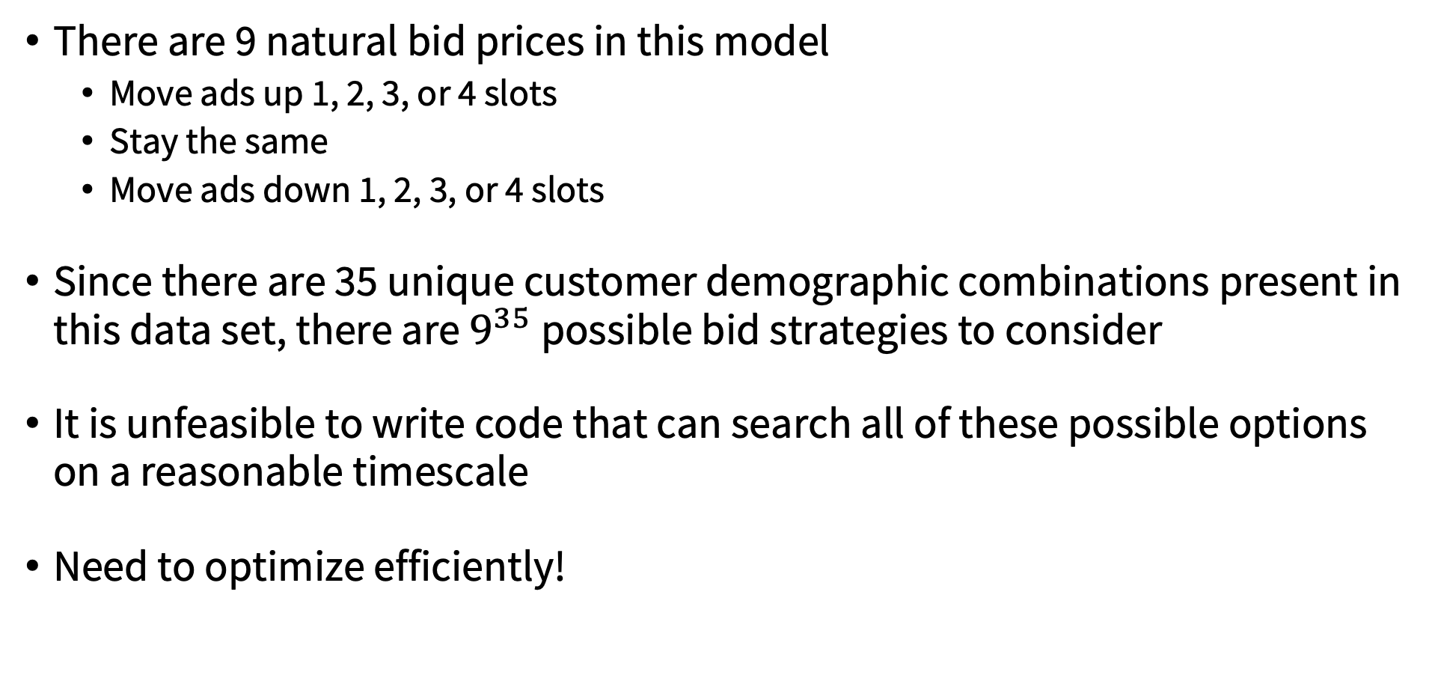
Difficulties of this Approach
There are 9 natural bid prices in this model
Move ads up 1, 2, 3, or 4 slots
Stay the same
Move ads down 1, 2, 3, or 4 slots
Since there are 35 unique customer demographic combinations present in this data set, there are $9^{35}$ possible bid strategies to consider
It is unfeasible to write code that can search all of these possible options on a reasonable timescale
Need to optimize efficiently!

Slide 9
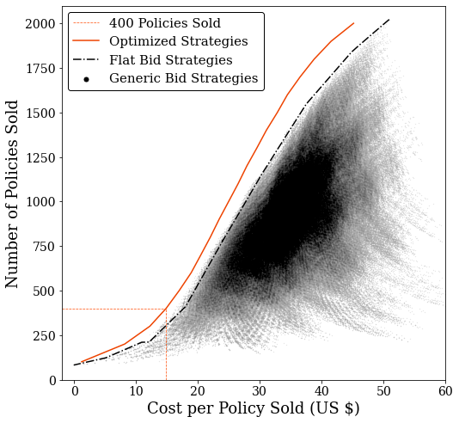
Optimizing the Variable Bid Model
We can compress the effective size of the parameter space by combining similar features and ignoring those with minimal impact
35 parameter combinations compressed to 7
Surprisingly, flat bid strategies are close to the optimal approach
Easy-to-calculate starting point for optimization
Optimized strategies can then be found using a series of random walks
First in the compressed parameter space, and then in the full 35 combination space

Slide 10
Utilizing the Variable Bid Model
Effectiveness of this model is entirely dependent on the accuracy of our assumption that increasing a bid by $2.50 will shift an ad’s expected display ranks one slot
Could determine this directly with intentional experimentation in future ad campaigns
If our assumption holds, we can obtain 400 policy sales at a cost per policy of $14.85
38% savings compared to flat $10 bids
11% savings compared to targeted minimum bids
Very generalizable, allowing Acme to choose strategies efficiently targeting anywhere from less than 100 to upwards of 2000 policy sales

Slide 11
Practical Recommendations
If Acme Insurance’s only goal for the next ad campaign is to obtain 400 policy sales as cheaply as possible, they should probably utilize our targeted minimum bid strategy
The uncertainty in the underpinning pricing assumption of the variable bid model makes it somewhat risky for a relatively small projected 12% savings
If instead Acme Insurance wants to focus on achieving more sales, then using the optimized variable bid strategies becomes more compelling
Targeted minimum bid strategies achieve smaller and smaller savings as sales goals increase, and they are incapable of achieving sales of 800 policies or more
In either case, it would likely be a worthwhile investment to include an experimental component in the next ad campaign to directly study how changing bid prices impact an ad’s display rank

