Slide 1
The Limits of Our Telescopes: The Case of NGC 5907

Slide 2
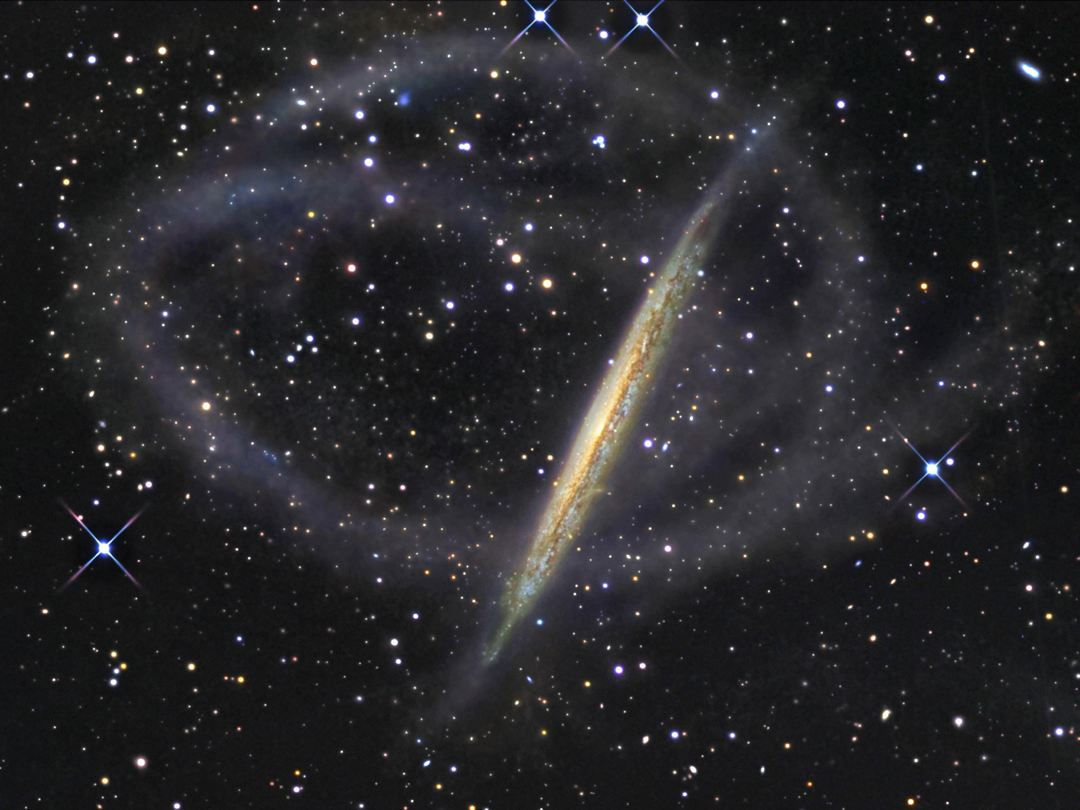
Introduction: NGC 5907
11
Famous Galaxy with large double loop stellar stream.
Likely a remnant of some long ago minor merger.
Photo taken by famous amateur astronomer in Australia.

Slide 3
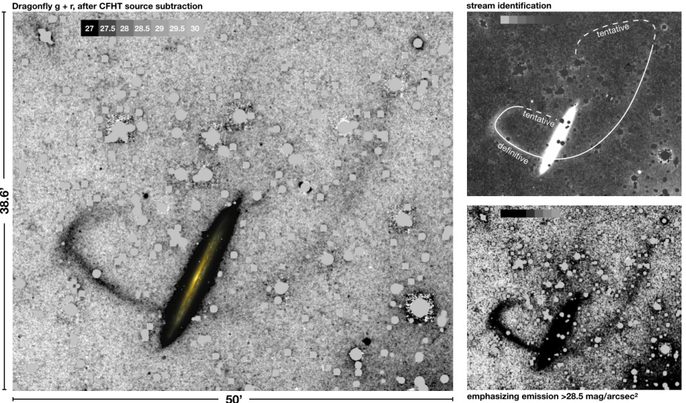
Introduction: NGC 5907
11
New observations from van Dokkum et al (2019).
No double loop, only single stellar stream: much simpler LSB system.
Easier to model and investigate.
Used very deep imagery from DragonFly telescope.
So, what’s going on here?

Slide 4
What We Will Do
11
Tension between observations. We will investigate in 3 ways.
By direct image reduction.
By using ‘new’ astronomy software.
Investigating photographic plates.

Slide 5
Path 1: Brute Force
11
Will be doing the image reduction directly.
For this, we will be using archival Hyper-Suprime Cam data from the Subaru Strategic Program (HSC-SSP).
This will require the following steps:
Individual frame reduction (the main bit) of raw data.
Stitching the image together.
Creating a function of the sky to make a further subtraction and attempt to get to a sensitivity of 28 mag / arcsec².
Image of mosaic

Slide 6
Route 2: Being Clever(?)
11
Will require the reduced image described previously.
Then, we will use software from the GNU Astro package: NoiseChisel.
NoiseChisel has been successfully used to find low surface brightness comet tails in Hubble imaging.
Can this be done for low surface brightness features?
May involve testing on other HSB systems.
Can be provided or you can find if necessary.

Slide 7
Route 3: Looking to the Past
11
Finally, we will begin liasing directly with the RAS for old photographic plates of this system.
It was discovered by William Herschel in 1788 – so, reason the RAS would have imaging of it.
Old photographic plates are surprisingly good at picking up LSB features.
We will contact early, as this route may come to a quick end.

Slide 8
Layout of Project
11

Slide 9
If We Have Time
11
Could we model the tidal stream?
Have a very cheap numerical simulation for smashing galaxies together.
Would need to utilize the HEC for this part.
Very much a last minute part, if we blast through the project very quickly.

Slide 10
What’s Needed
11
List the programs and Python packages.

Slide 11
Extras: The Experience
11
Some Details about the department.

