Slide 1
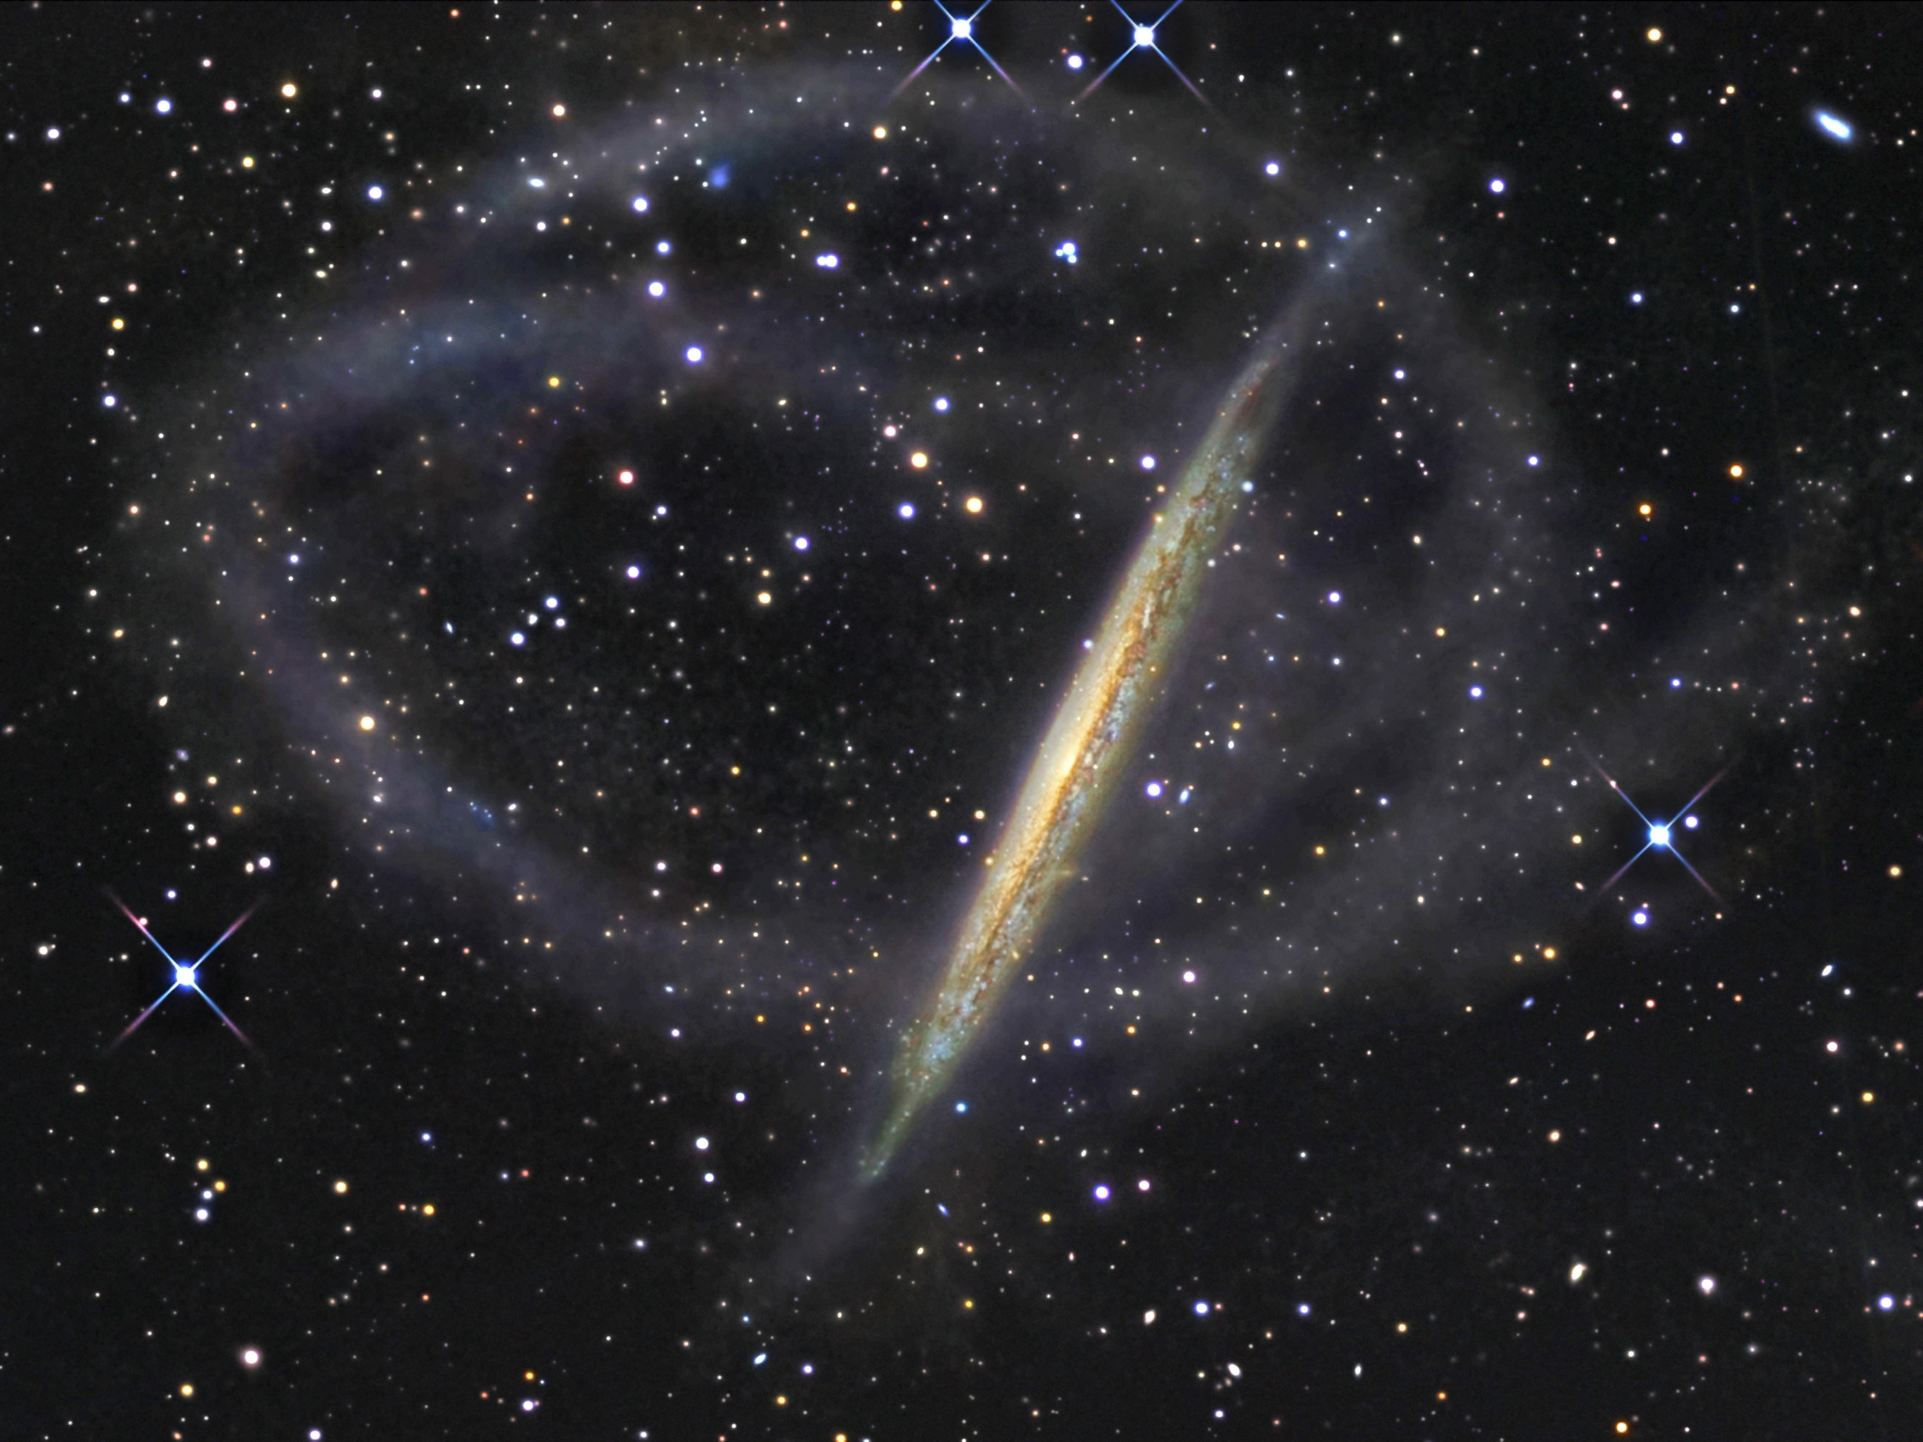
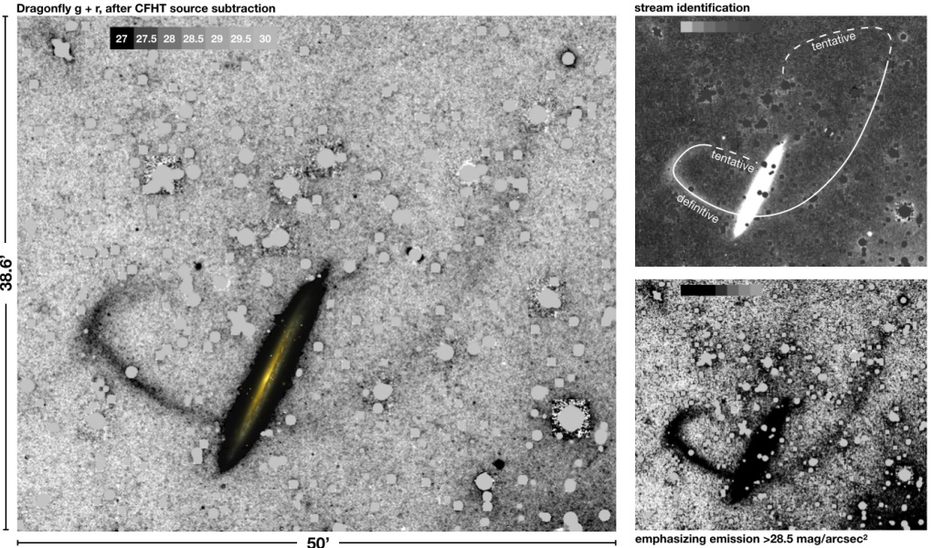
Project 5: Deep Dive on NGC 5907
12
Idea:
Current tension about the existence of a corkscrew stellar stream in NGC 5907.
Look for it in legacy HSC data!
Need novel ways of sky subtraction and getting out LSB structures (ArXiv: 2301.05793).
Project Aim:
To say whether the corkscrew stellar stream exists in Subaru data.
Requirements:
Have downloaded the Subaru data to provide to student.
Would need to have lots of code pre-written.
Project Stages:
Begin by reducing Subaru data.
Create mosaic of full system.
Put through something like NoiseChisel/SourceExtractor/Follow paper to get structure out.
Do we recover one?
Do we recover both sides?

