Slide 1
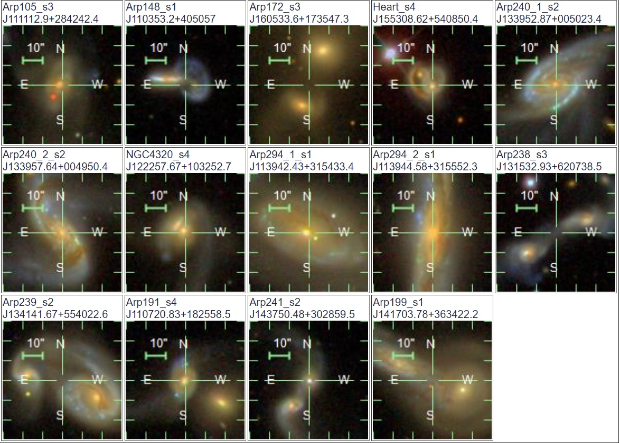
Targets
Close Pairs – 3
Close to Pericentre – 3
Close to Apocentre – 4
Mergers – 2
Redshift Range: 0.004 – 0.047

Slide 2

Observing Prep Schedule
Catalogue converted to WASP Friendly FITS file
Observing for Semester 2024A2 Begins
Submit Proposals
Accepted / Decline
Select Catalogue Template
Upload Catalogue
10/03/2024
23/04/2024
23/04/2024
01/05/2024

Slide 3
