Slide 1
Segmentation Tool Training
Benjamin Green
Johns Hopkins University

Slide 2
What we will go over
Background info
Installing the tool
Setting the proper directory format
Training image location
Starting up the tool
Using the tool

Slide 3
Background info
The segmentation and phenotype for mIF images with commonly available software is both:
not very accurate
time consuming.
We aim to develop a neural network, or AI, that will both increase the accuracy and speed of analysis. (No more inForm!!!)
This first step in doing this is to create a “ground truth” or true training set

Slide 4
Background info cont.
Manually annotating every cell in an image is time consuming and exhausting\ boring
Seyoun created a very nice unsupervised cell segmentation, but it is not good enough for a perfect ground truth and needs to be manually modified
Modifying only one algorithm for ground truth leads to bias in the trained AI
Comparing Seyoun’s algorithm to inForm’s algorithm allows us to accept the cells where the two algorithms agree and decide which cells we want to accept

Slide 5
Installation
Download the installer from \\halo1\TaubeLab\Ben\Code\SegmentationTool\dist\SegmentationTool_installer_2.0.11
Double click the installer to start it, be sure to install the desktop short cut
Note: If the install fails, try to install the matlab runtime. To do this:
Download the following folder:
\\halo1\Taubelab\Ben\Code\SegmentationTool\dist\MATLAB_Runtime_R2020a_win64
After the download has completed, double clicking on the ‘setup.exe’ file inside that folder
Alternatively, a .zip file for the matlab runtime has been added to that folder. For slower internet connection it may be faster to download the .zip file. Once the .zip file is download, extract the files and run the ‘setup.exe’ from there

Slide 6

Directory format & initial training images
Your training images are in a folder located here:
\\halo1\TaubeLab\Ben\Code\SegmentationTool\training_images\SegmentationImages_YourIntials
You can either use the images straight from that folder or download the entire folder to your desktop and open the images from there
The code is looking for the following directory structure:
ImageName_[Xcoord, Ycoord]_component_data_w_seg.tif
ImageName_[Xcoord, Ycoord]_component_data_seg.tif
When using the tool you can open either the inform version or the superpixel version and the code will find the matching image in the adjacent directory
I typically recommend using the image file in the superpixel directory for simplicity
If you Deviate from this directory structure the code will not find the matching image file in the adjacent directory and a fatal error will appear.

Slide 7
Results files
The code generates two results files located here:
If you download the images to work on them, either:
Upload the entire directory tree and overwrite your folder on the server
OR upload these two files after each session to the same folder tree position in your folder on the server
Doing this keeps a backup copy of your work and provides me with access to the files if I need it
ImageName_[Xcoord, Ycoord]_comparison_seg_data.tif
ImageName_[Xcoord, Ycoord]_comparison_seg_data.csv

Slide 8
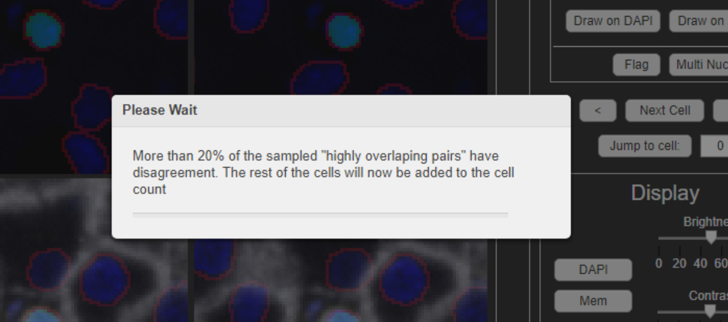
Highly overlapping cells dialog
The code is predicated on comparing two sets of segmentation on the same slide.
When the segmentation algorithms agree on 80% of the area of a particular cell we assume that cell to be correctly segmented by both algorithms and the user does not need to review those cells.
In order to assess this measurement per slide, a subset of these cells are randomly added to for review
if the user selects anything other than “A=B” for 20% of these randomly selected cells the user must annotate the remaining cells. The following dialog will appear and additional cells will be added to the cell count.
Note: This means you benefit from being lenient about differences!

Slide 9
Training Images
The following set of images will be added to your folders for initial training, please complete them in the order displayed here. (Each image introduces increasing complications)
Liver_TMA_145_24_01.30.2020_[5976,53791]
Liver_TMA_145_23_01.30.2020_[6489,53781]
Melanoma_TMA_1215_55_01.30.2020_[5393,65755]
Lung_SCC_TMA_1314_6_01.30.2020_[6505,55245]

Slide 10
Notes on Training Images
Only complete up to cell object 500 for each image.
If you finish an image a dialog will appear asking you to review the whole image.
I do not go over this in the initial training. Please email me when you reach a “final image review” stage to set up a time to walk through it and address any questions you may have.

