Slide 1
A-STEP DEE
Zac Metzler Dec 11, 2025
https://github.com/AstroPix/A-STEPdee

Slide 2
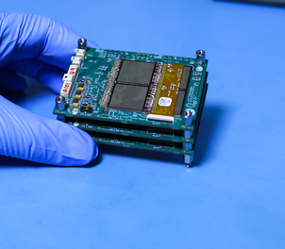

What is it?
DEE.py
ASTEP_Effects.py
Handle Coincidence
csv or h5 output file
Measured BG Data
ASTEP_Add_BG.py
Add BG (optional)
Source Simulation
ASTEP_RevCal.py
Convert (x,y,z,E) to (layer, chip, pixel, ToT)

Slide 3
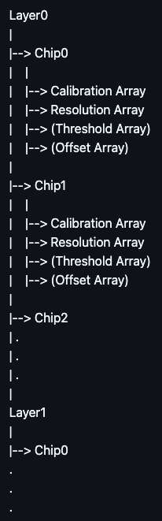
How do I use it?
The calibration file format:
DEE.py <.sim file name> <Calibration & Resolution file name>
(--ASTEP_BG_filename <path to a csv ASTEP background data>)
(-h5) (--seed <a seed number for smearing>)
Calibration Array: (E [keV]) = Slope x (ToT [us]) + Intercept
Row # | Column # | Slope | Intercept
Resolution Array: (sigma_ToT [us]) = Slope x (ToT [us]) + Intercept
Row # | Column # | Slope | Intercept | minimum sigma [us]
Threshold Array (optional):
Row # | Column # | ToT Threshold [us]
Offset Array (optional): defined as (column ToT [us]) - (row ToT [us])
Row # | Column # | Offset [us]

Slide 4
What are the outputs?
A-STEP DEE
C)
Handle Coincidence
csv or h5 output file
B)
Measured BG Data
Add BG (optional)
csv or h5 output file
A)
Source Simulation
Convert (x,y,z,E) to (layer, chip, pixel, ToT)
csv or h5 output file

Slide 5
What are the outputs?
Simulated source only. Row & column entries occur simultaneously. File name is <.sim filename>.ASTEP.<csv or h5>
Simulated source + empirical background. Simulated row & column entries occur simultaneously. Source & background are combined and sorted by FPGA timestamp. Some cleaning of the FPGA timestamps does occur to make it possible to do the sorting. File name is <.sim filename>.ASTEP_wBG.<csv or h5>
Simulated source + empirical background. Row & column entries that previously occurred within 1 FPGA readout time (currently 42 clock cycles) are sorted & spaced 1 FPGA readout time apart. File name is <.sim filename>.ASTEP(_wBG)_wEff.<csv or h5>

Slide 6
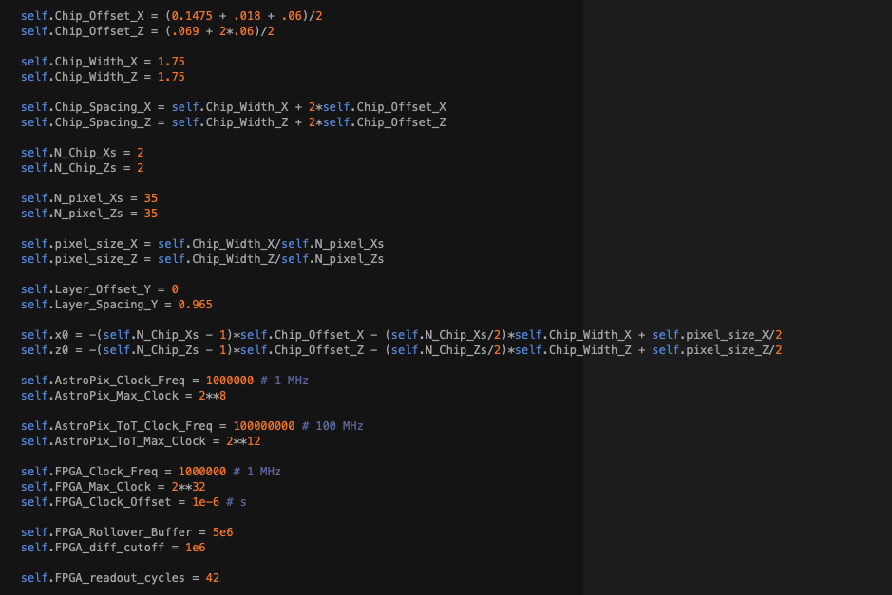
What might need changing?
All the parameters live in ASTEP_RevCal.py
  Even if they are used in one of the other scripts, not RevCal
  RevCal is always called first, so it is always instantiated before the other scripts. Whereas Add_BG is sometimes not used but might share needed parameters with Add_Effects.

Slide 7
What are the parameters?
Distance from x,z = 0 to inner edge of chip
Distance between centers of chips
X,Z positions of first pixel
Fixed time delay between (AstroPix timestamp + ToT) and FPGA timestamp
Used for FPGA timestamp cleaning
How many FPGA clock ticks it takes to read out 1 entry

