Slide 1


UE19CS204 -WEB TECHNOLOGIES
MINI-PROJECT
LEGITMISER</>
Your fun portal to the geek world :D
Section-G
Sai Ramya Paturi - PES1UG19CS419
Saileshwar Karthik - PES1UG19CS421
Shashank UM - PES1UG19CS452

Slide 2

ABSTRACT
We have designed a web application that can be used to
Sign in can be done with the help of google accounts.
Upload and download/view project related files.
View graphs to quickly analyse various stats such as activity tracking, types of files, etc.
Post issues (add/edit/delete) to be aware of problems faced by various teammates.

Slide 3
TECHNOLOGIES USED
Mongoose - MongoDB object modeling tool designed to work in an asynchronous environment.
Passportjs - Used to authenticate requests
Handlebars - Template engine
MethodOverride - Allows use of HTTP verbs such as put or delete in places where the client doesn’t
support it
Session - Express.js uses a cookie to store a session id (with an encryption signature) in the user’s
browser and then, on subsequent requests, uses the value of that cookie to retrieve session
information stored on the server.
Gridfs - It is a specification for storing and retrieving files that exceed the BSON document size
limit(16MB).
Multer - node.js middleware for handling ‘multipart/form-data’ , which is primarily used for uploading
files.
BodyParser - Body-parser is the Node.js body parsing middleware. It is responsible for parsing the
incoming request bodies in a middleware before you handle it.

Slide 4


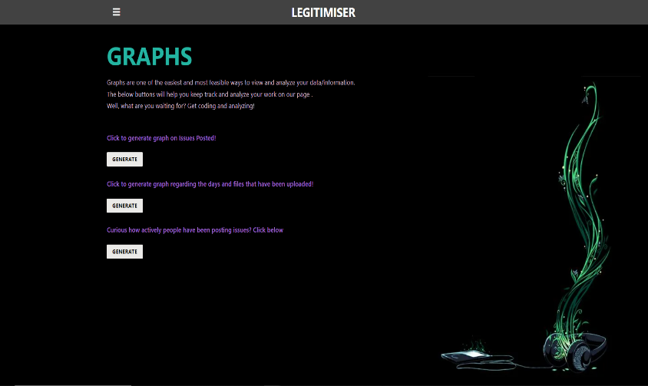
RAMYA
Worked on the graphs and helped design the web page(s)

Slide 5
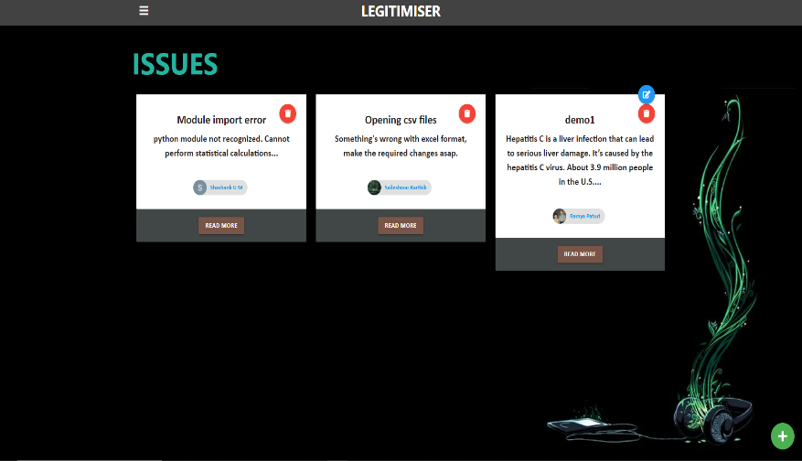
SAILESH
Worked on the issues and the authentication features, helped merge the different aspects of the project

Slide 6
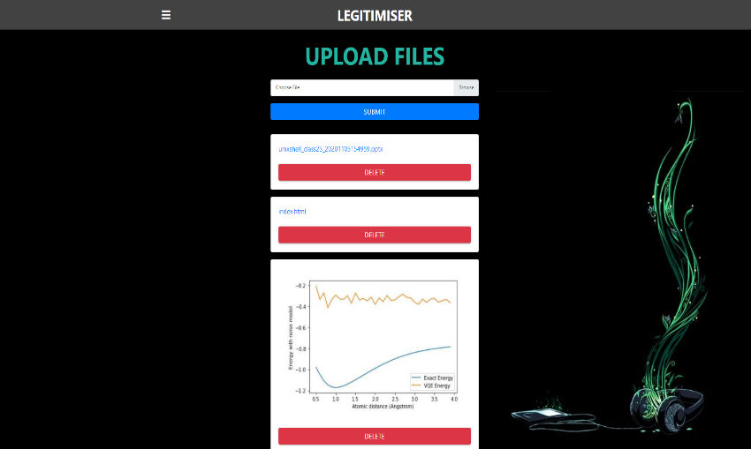
SHASHANK
Worked on the front-end and the back-end of file upload and download/view functionality.

Slide 7
THANK YOU!
Click this link to be redirected to our website: LEGITMISER

