Slide 1
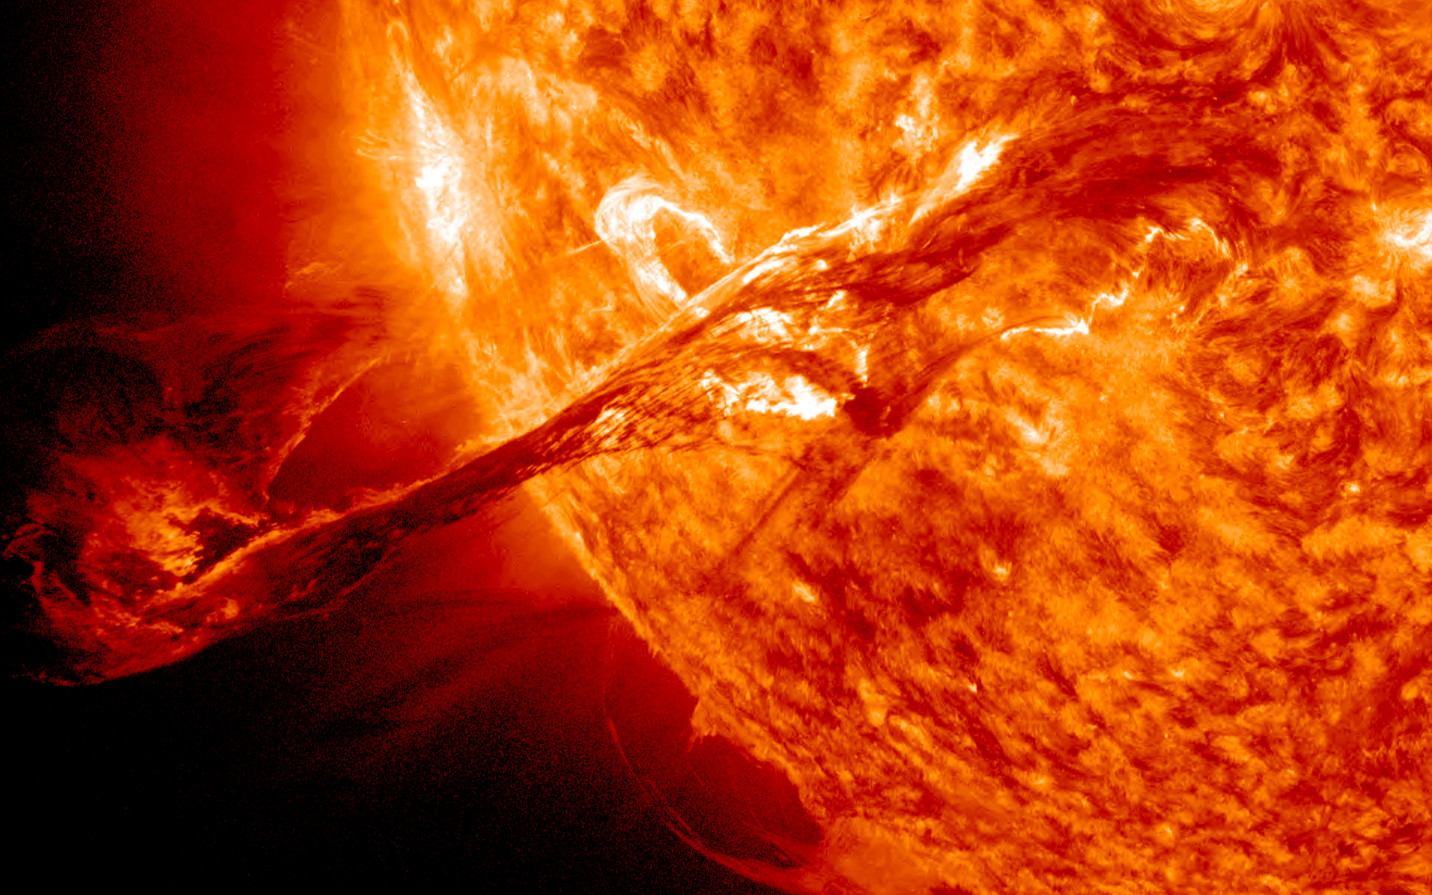
The Explosive Sun
Ben Snow
24th May 2023, Pint of Science

Slide 2
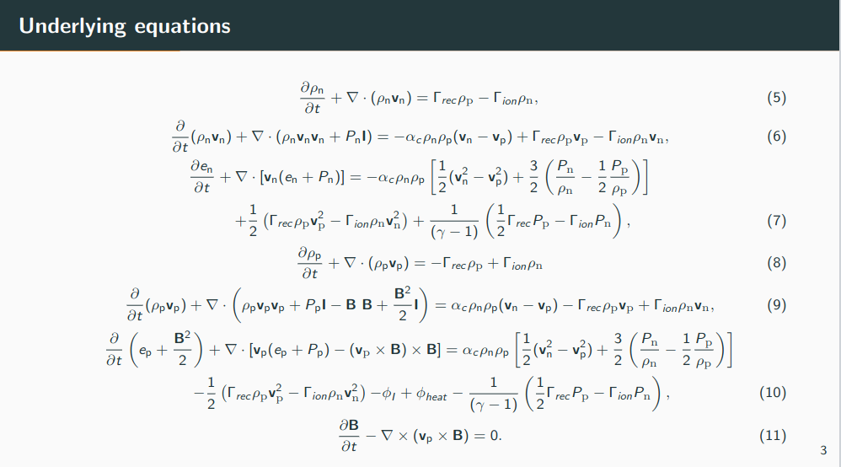

Slide 3
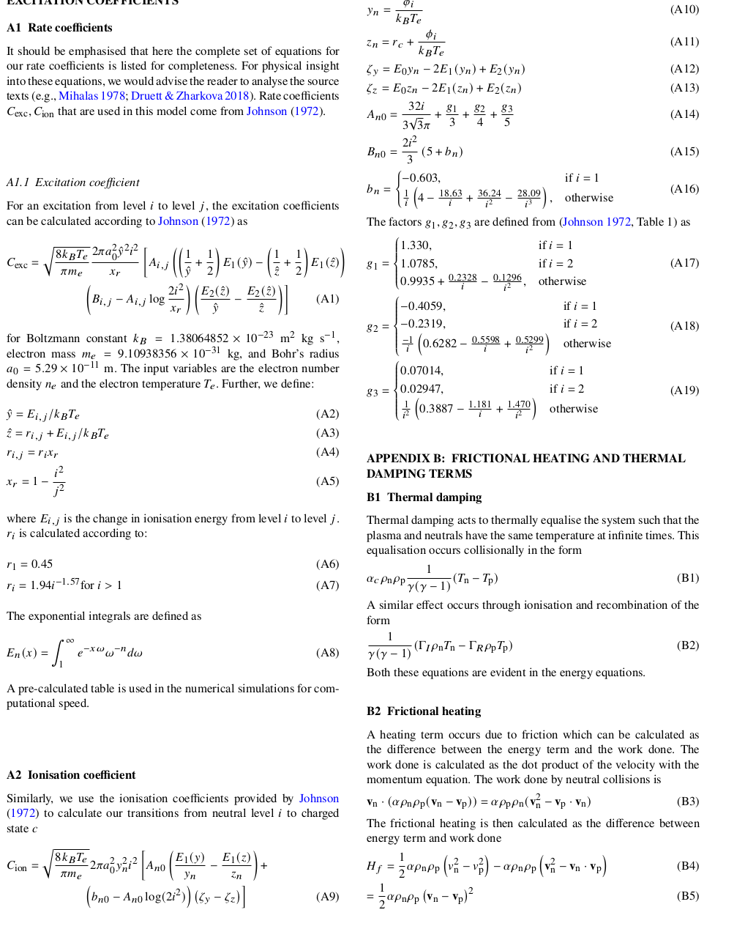

Slide 4
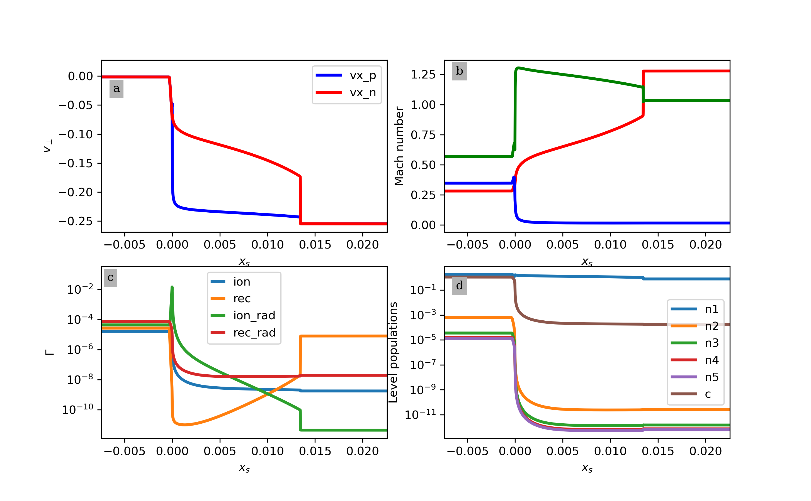

Slide 6
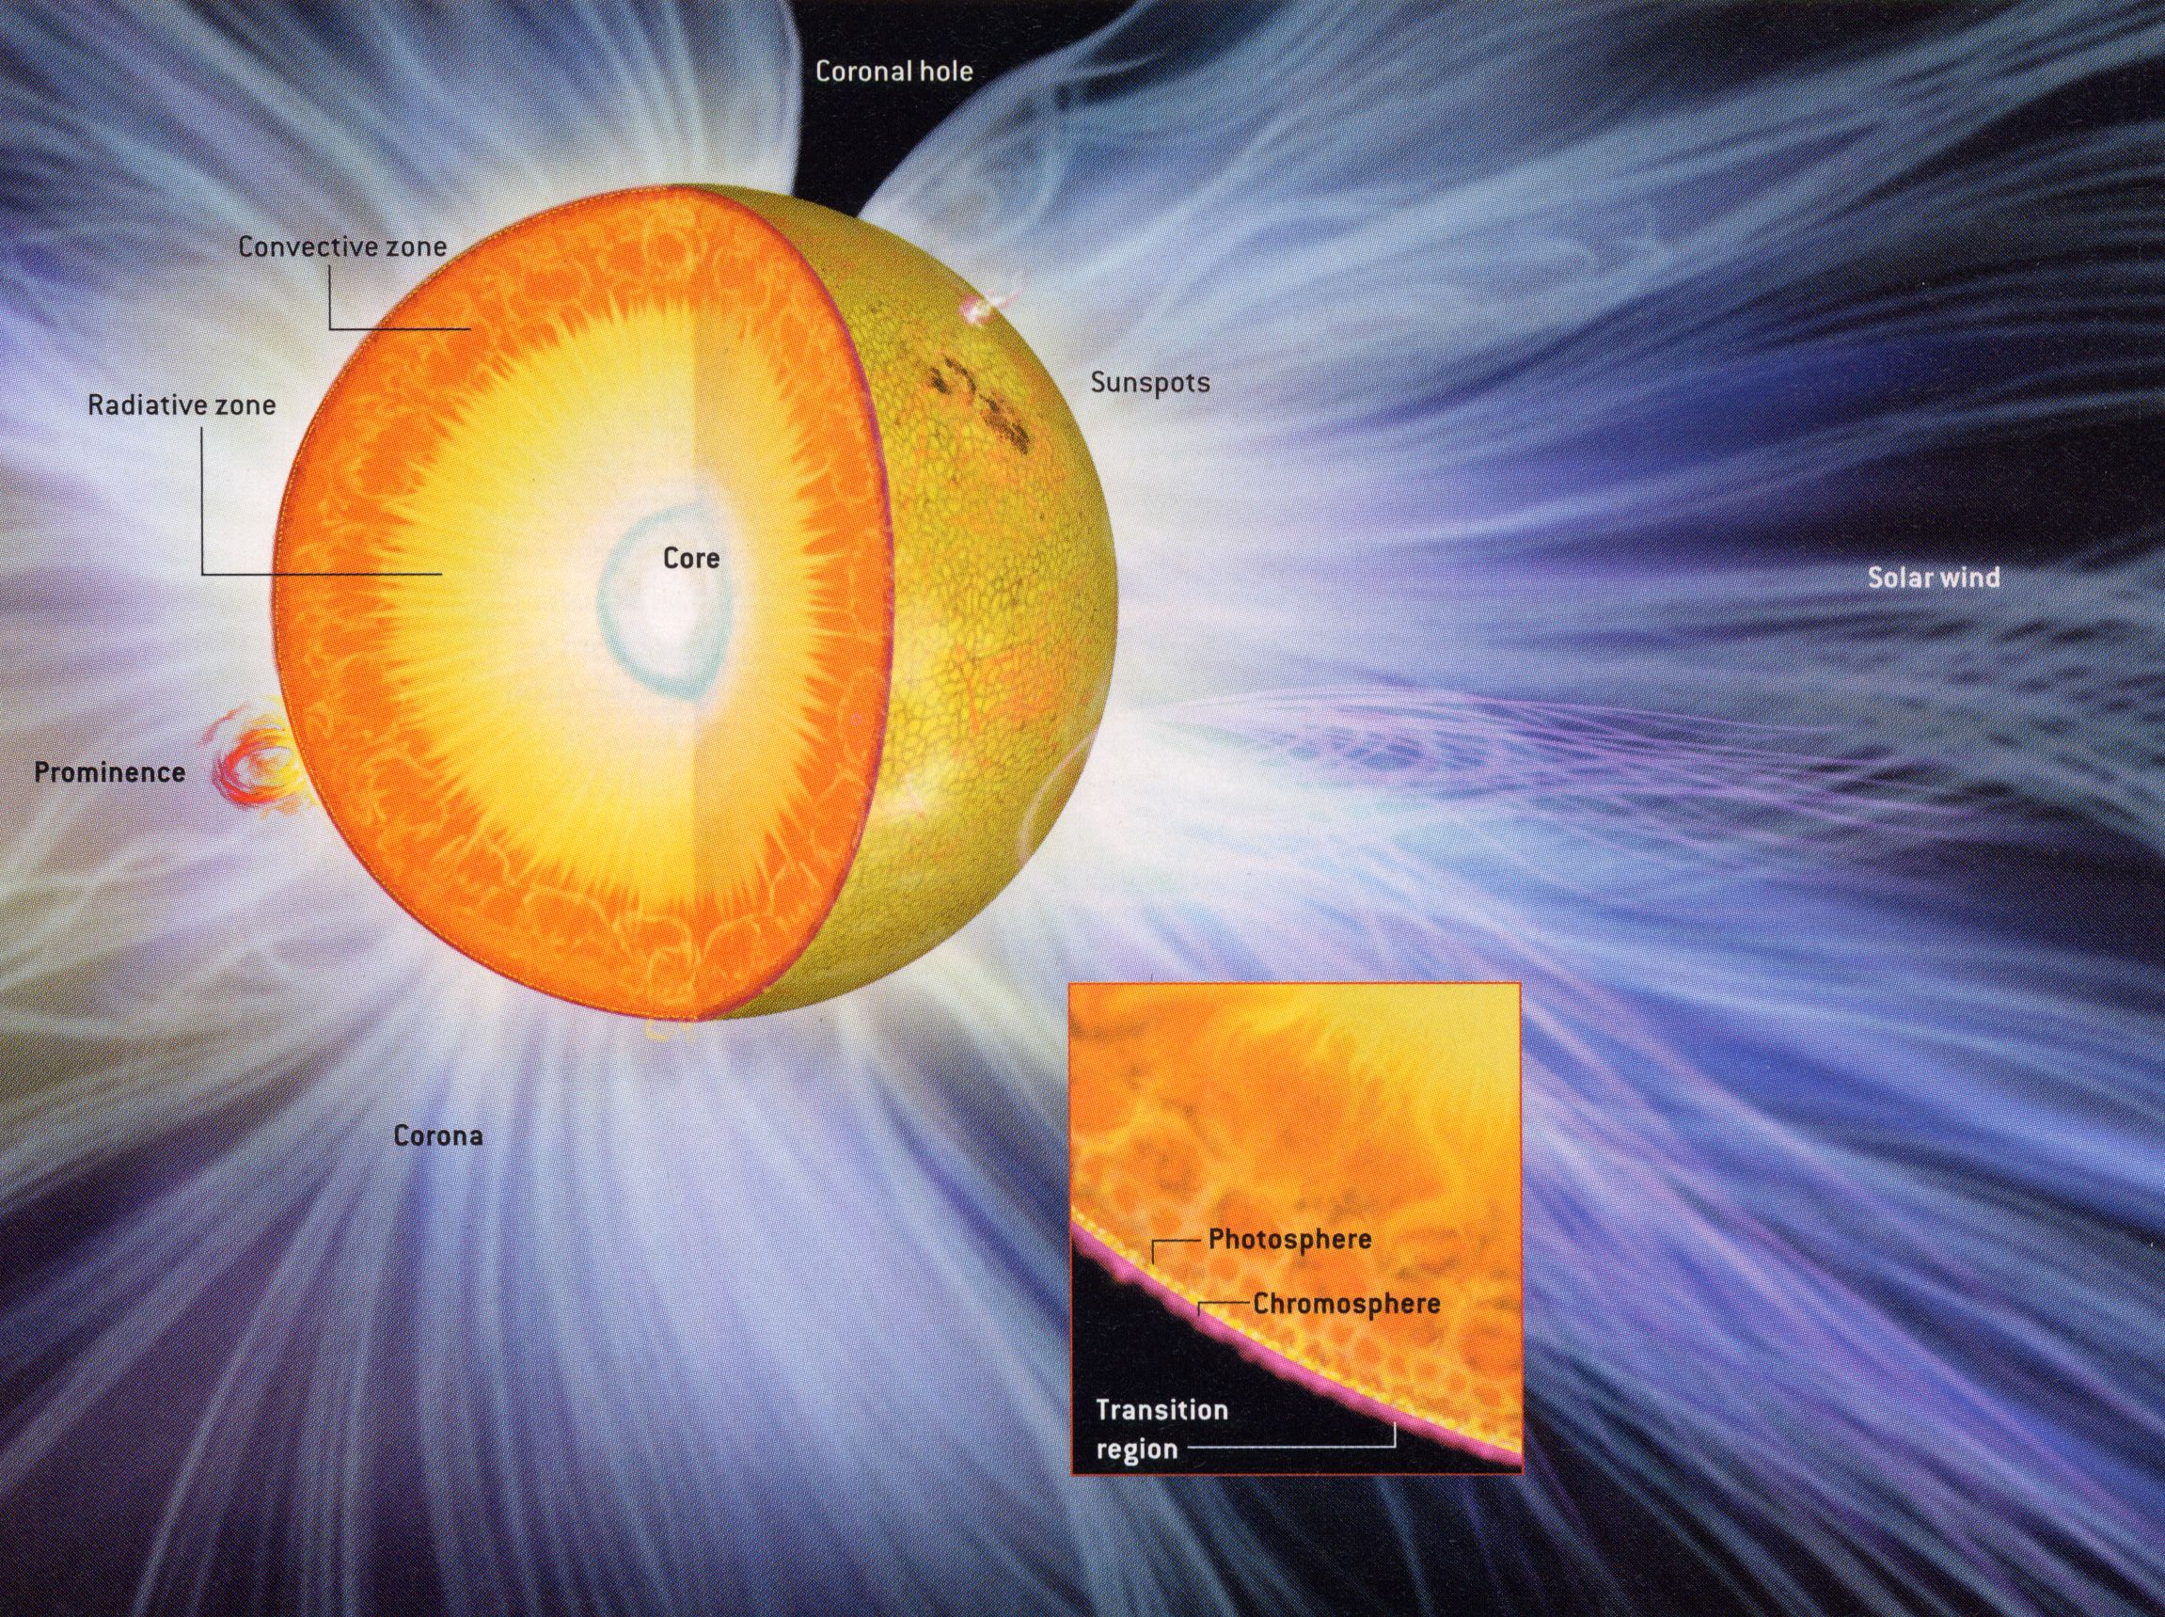
What is the Sun?
Solar surface ~5000K
Corona ~ 1 million K
Energy transported through the atmosphere through magnetic fields

Slide 7
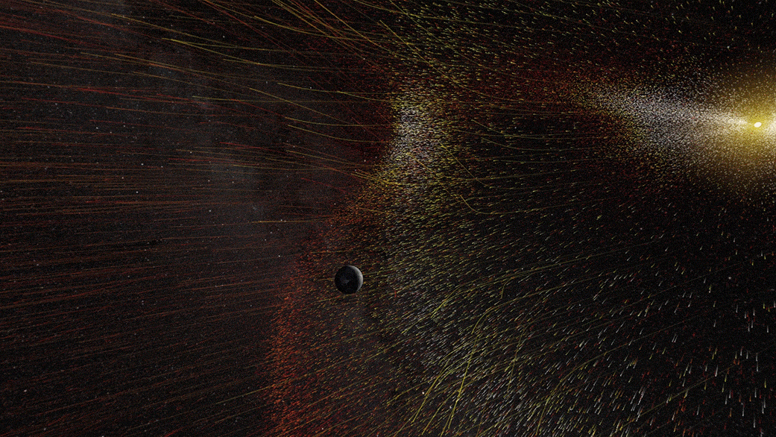
The Sun and solar system
Solar system is not as quiet as it seems
Continuous outflow of material – solar wind
Defines the edges of our solar system

Slide 8
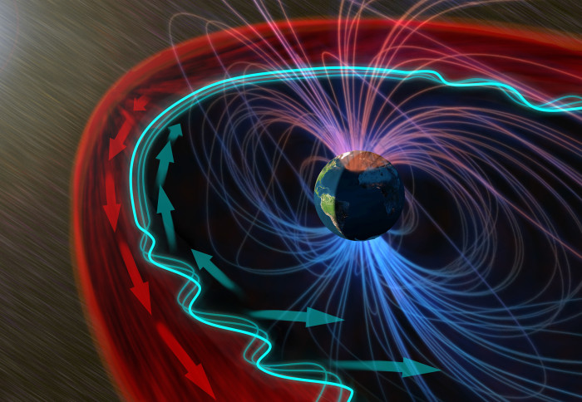
The Magnetic Solar System
Interaction between sun and Earth
Magnetic field around Earth allows particles to stream in causing Aurora near the poles
Geomagnetic storms

Slide 9
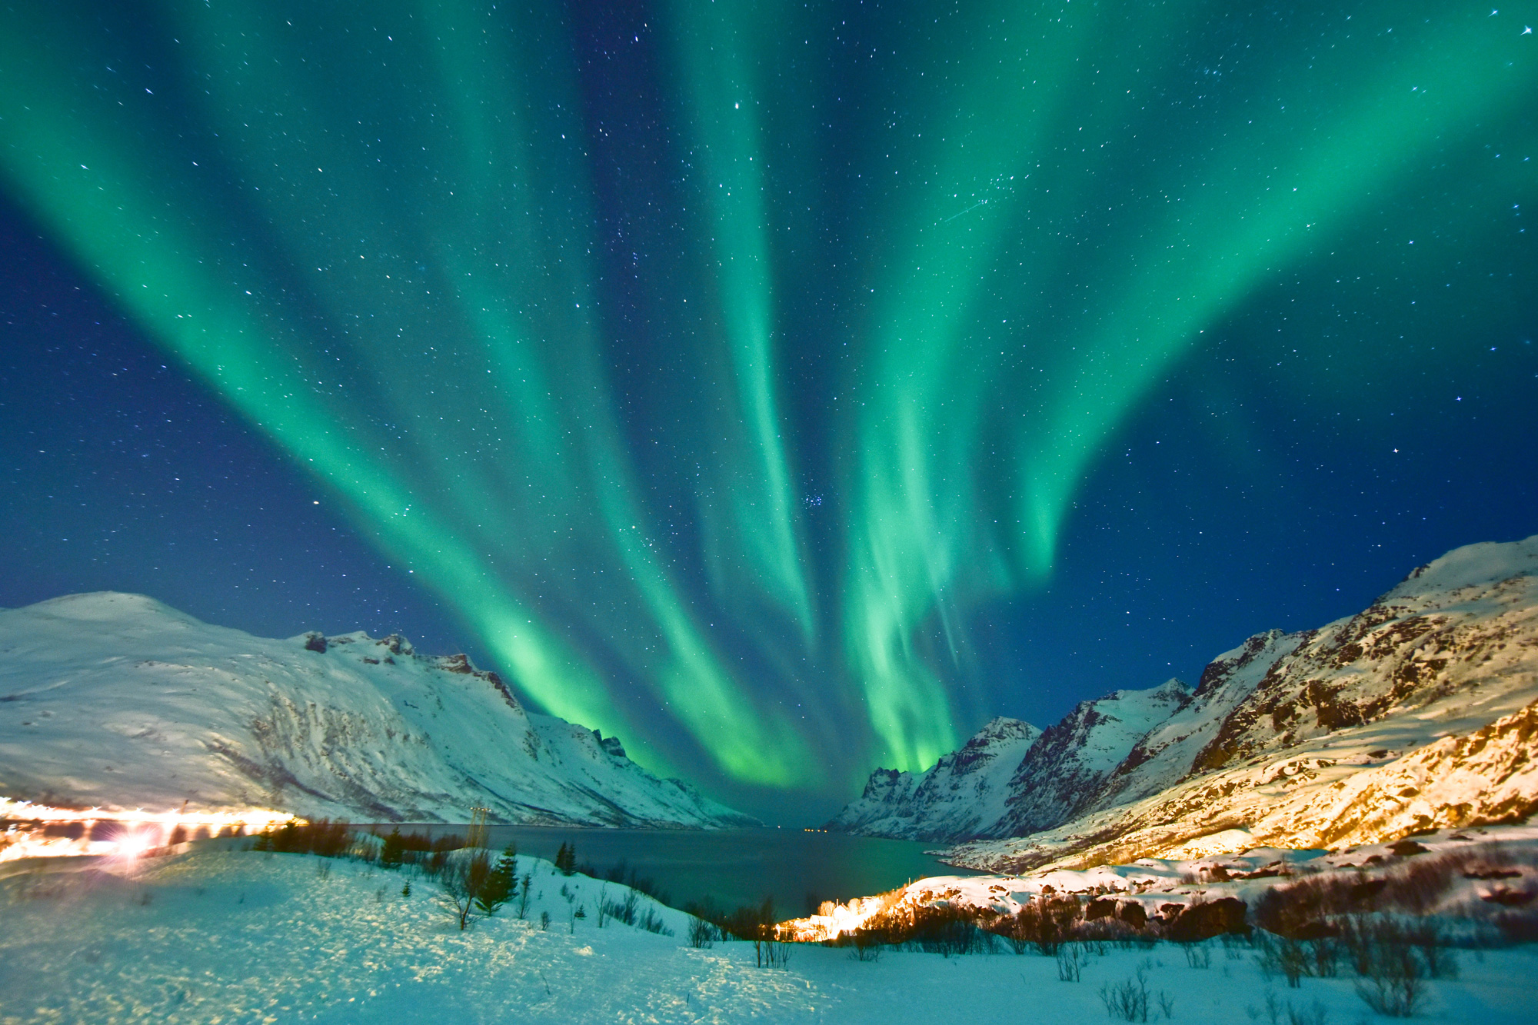
Aurora (Northern/Southern Lights)
Interaction between sun and Earth
Magnetic field around Earth allows particles to stream in causing Aurora near the poles
Geomagnetic storms

Slide 10
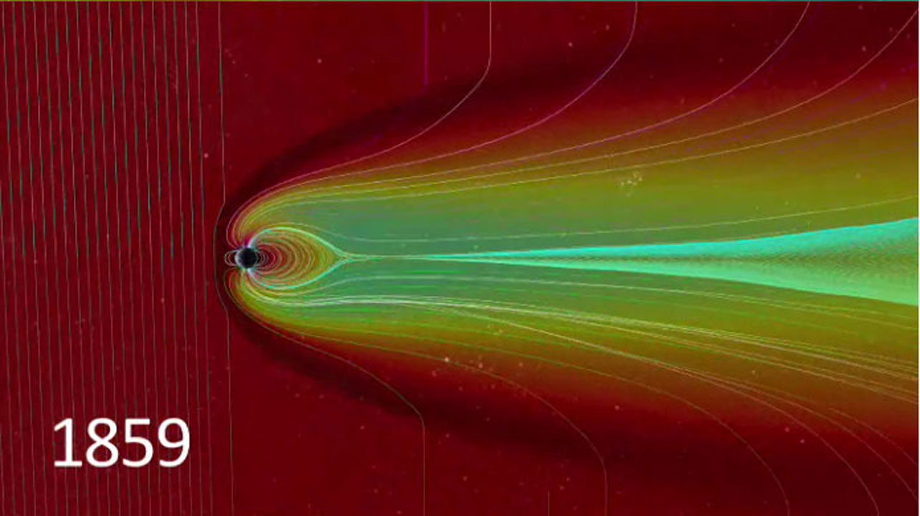
Carrington Event
In 1859, the most intense geomagnetic storm ever recorded occurred, creating Aurora visible around the world and causing sparking and fires at telegraph machines

Slide 11
Aims
What drives Coronal Mass Ejections (CMEs) on the Sun?
How often do potentially damaging events occur?
What are we doing about it?

Slide 12
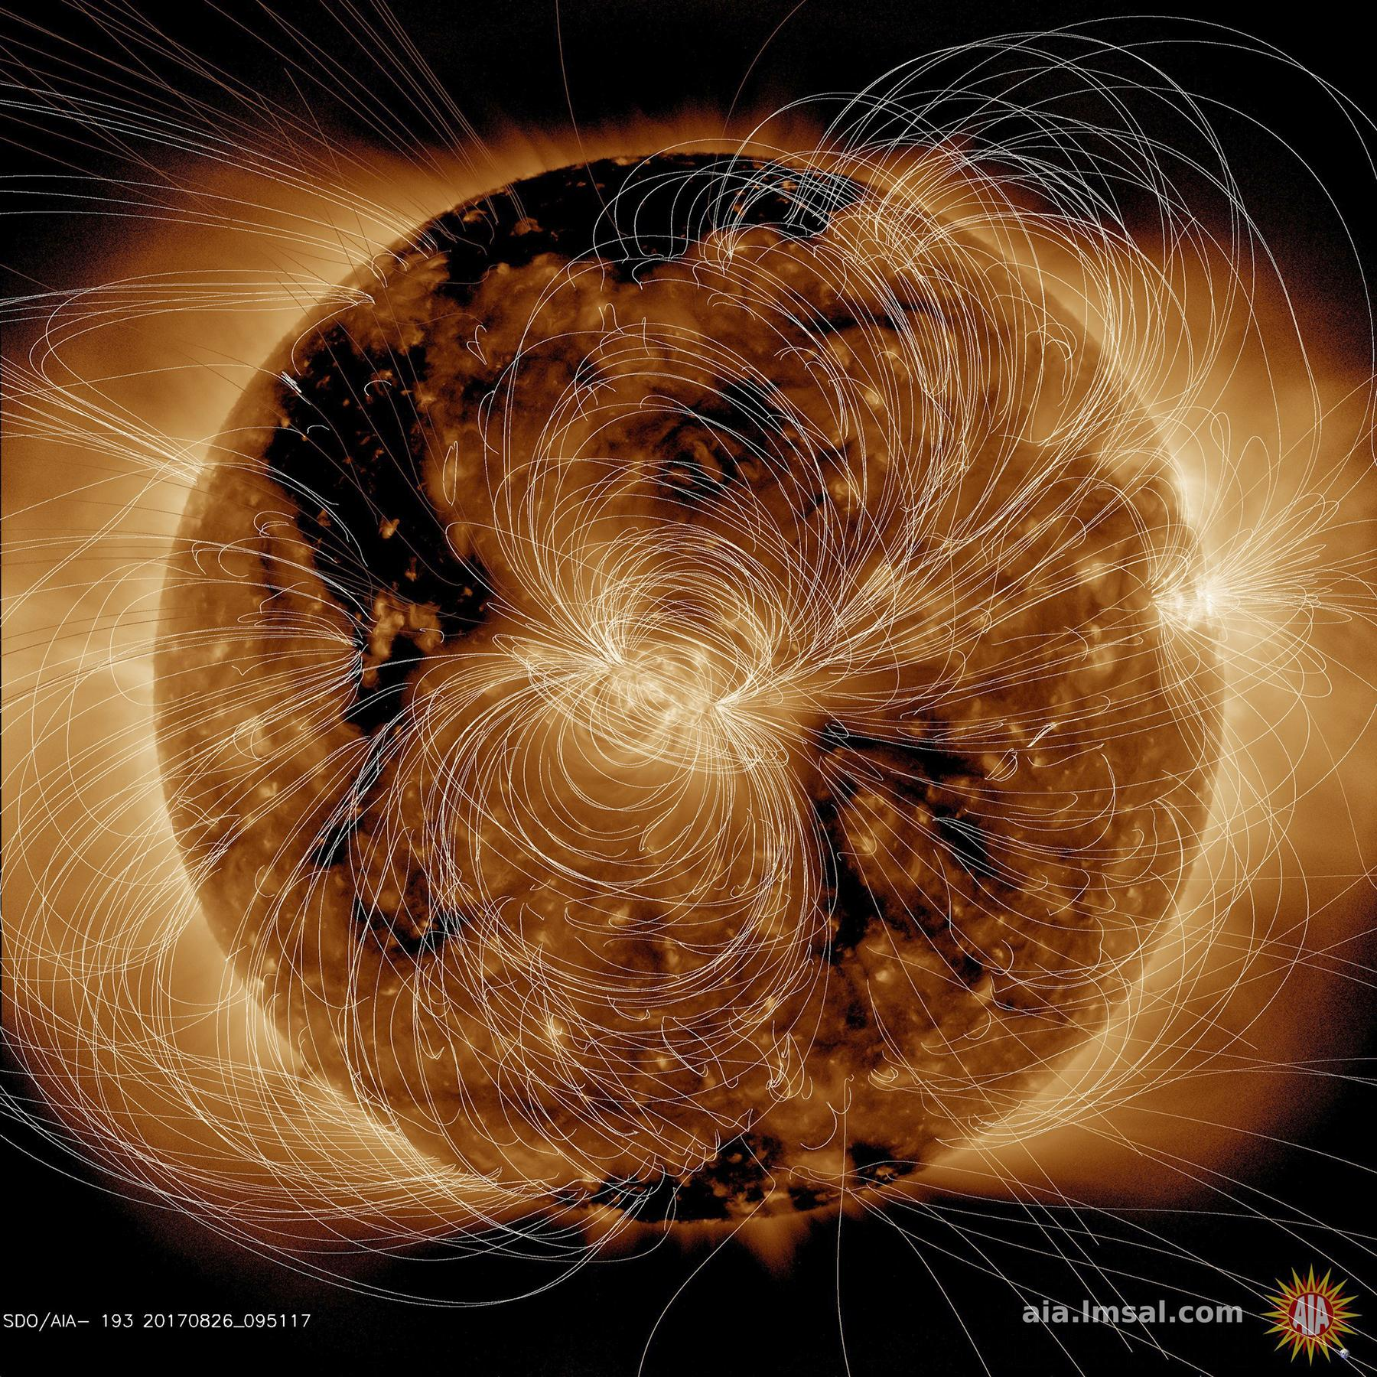
Magnetic fields on the Sun
Sun is a plasma – magnetic fields important
Huge amounts of energy stored in magnetic field

Slide 13
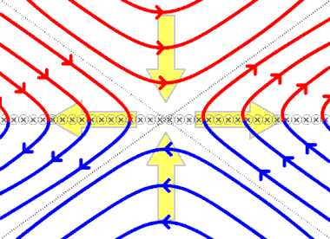
Magnetic reconnection
Oppositely directed magnetic fields undergo magnetic reconnection
Driving force behind explosive events in the Sun

Slide 14
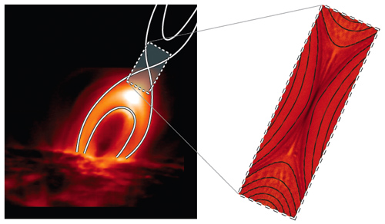
Reconnection schematic
Sun is more complicated then the simple picture
Similar structures exist
Magnetic energy released as kinetic and thermal energy

Slide 15
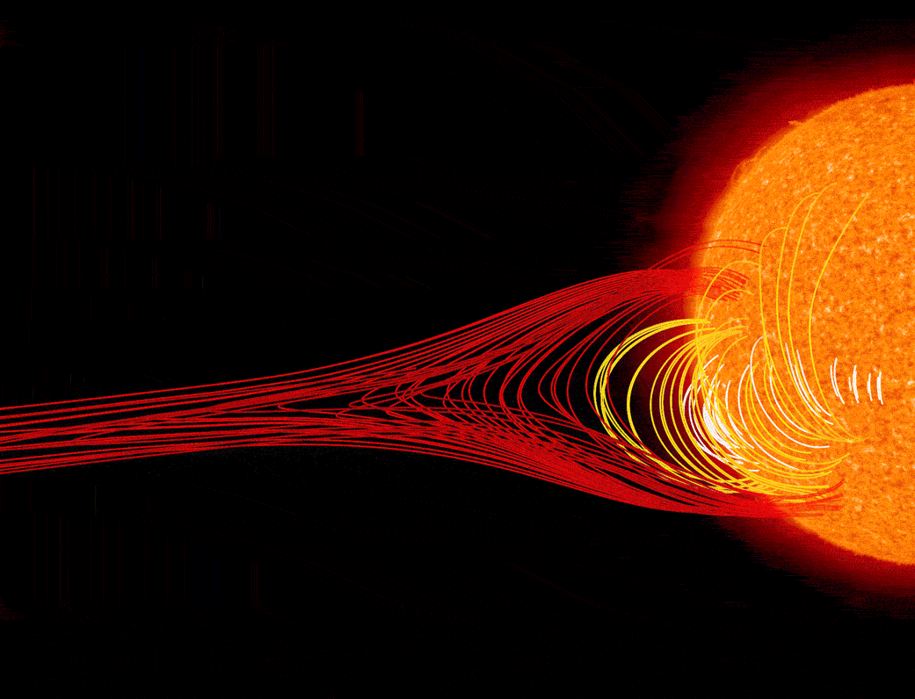
Explosive events in the Sun
Magnetic reconnection releases huge amounts of energy that propagates through the solar system

Slide 16
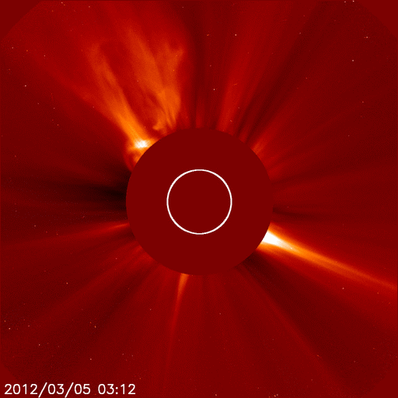
CMEs in the solar system
Huge amounts of material/energy flung through the solar system

Slide 17
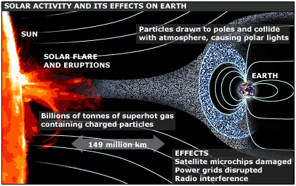
CMEs affecting Earth
Can impact Earth bombarding us with high energy particles
Changes structure of Earths magnetic field

Slide 18
Carrington event

Slide 19
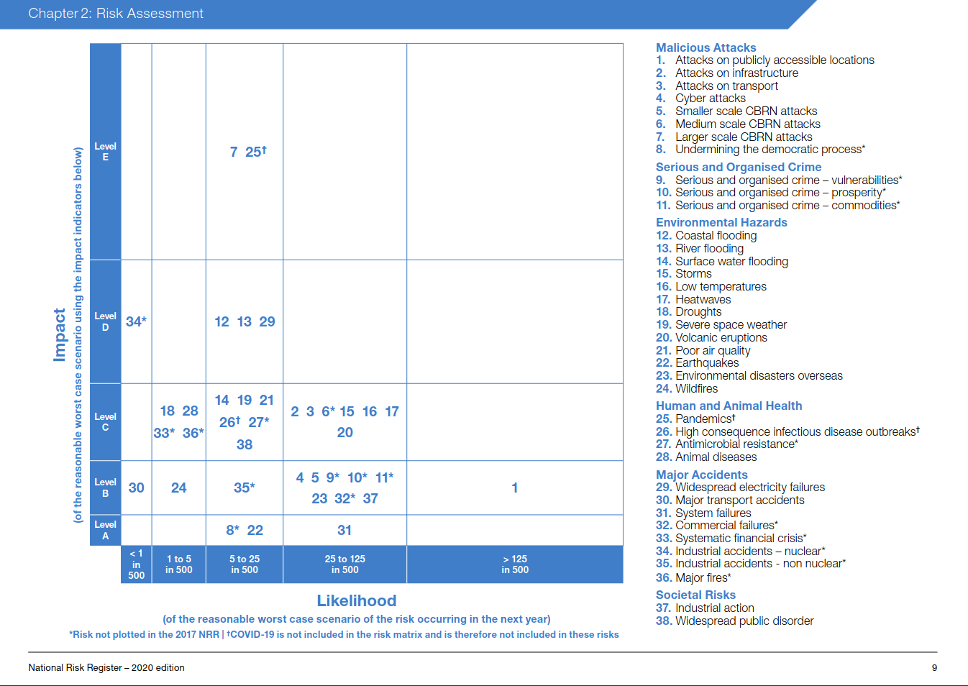
‘Credible threat’
National Risk Register 2020
‘Typical’ CME risk

Slide 20
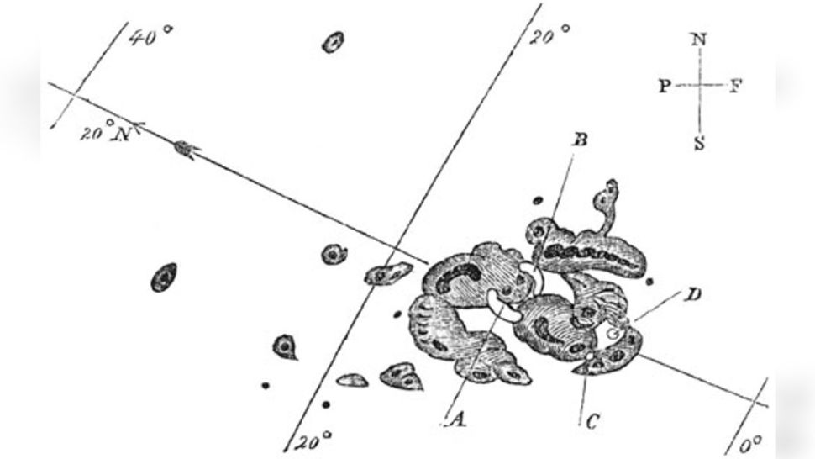
Examples - 1859
Carrington Event
Largest documented storm in the last 500 years
Severe interruptions in telecommunications
Aurora visible in the Caribbean

Slide 21
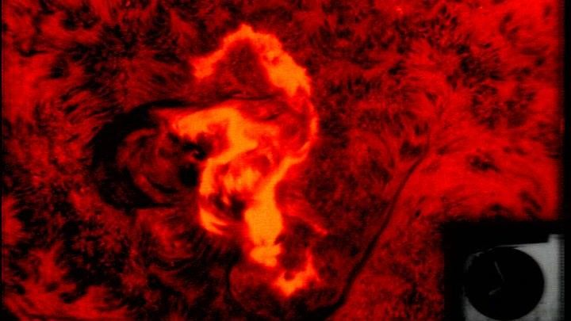
Examples - 1972
Seahorse flare
Knocked out communications across some states
Lead to redesign of transatlantic cables

Slide 22
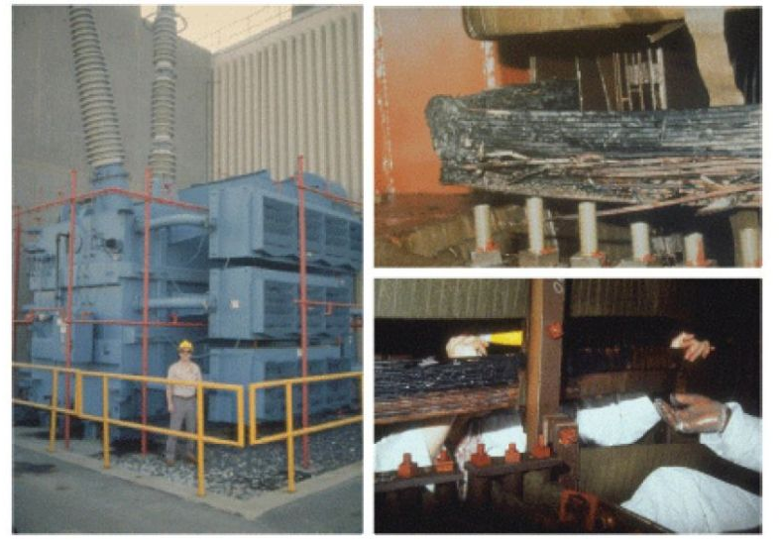
Examples - 1989
Caused blackout in Canada
Melted power transformers
6 million people without electricity for nine hours
Far weaker than CE

Slide 23
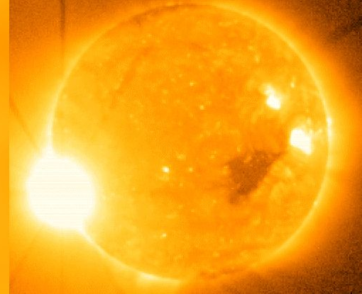
Examples - 2006
Christmas storm
Disrupted satellite-to-ground communications (e.g., GPS)
Damaged observing instrument (GOES 13)

Slide 24
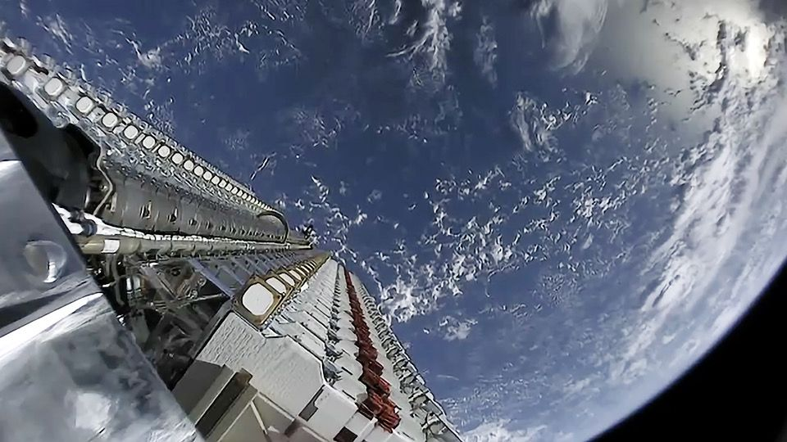
Examples - 2022
Geomagnetic storm destroyed ~40 Starlink (SpaceX) satellites worth ~$50 Million
Increased drag caused satellites to fall to Earth

Slide 25
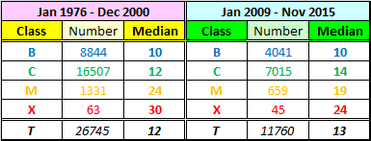
Likelihood
Flares classified by strength
Flares and CME’s sometimes occur together
Flares – light flashes (8 minutes)
CME – Matter expulsion (3 days

Slide 26
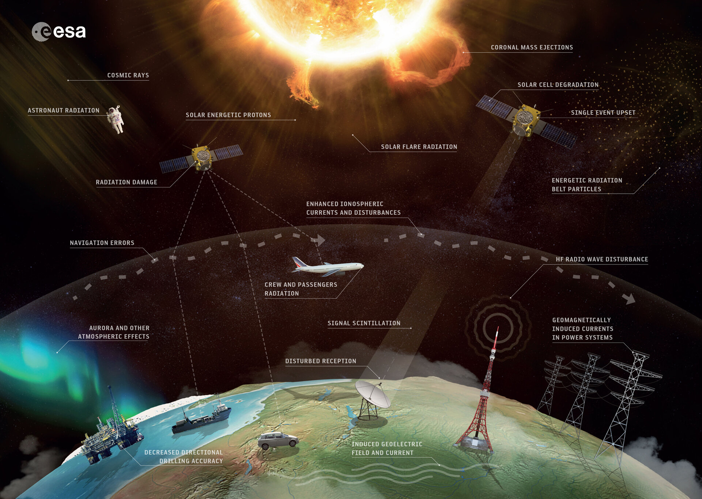
What can we do about it
Government space weather preparedness strategy (2021)
Assess, Prepare, Respond & Recover
Forecasting

Slide 27
Should we be worried?
Short answer – no
Known risk – unknown magnitude
Preparation strategy
Not ‘life ending’

