Slide 1
Surveying the Dynamic Sky with the LSST
Vishal Kasliwal
2016 KARL LSST Workshop

Slide 2
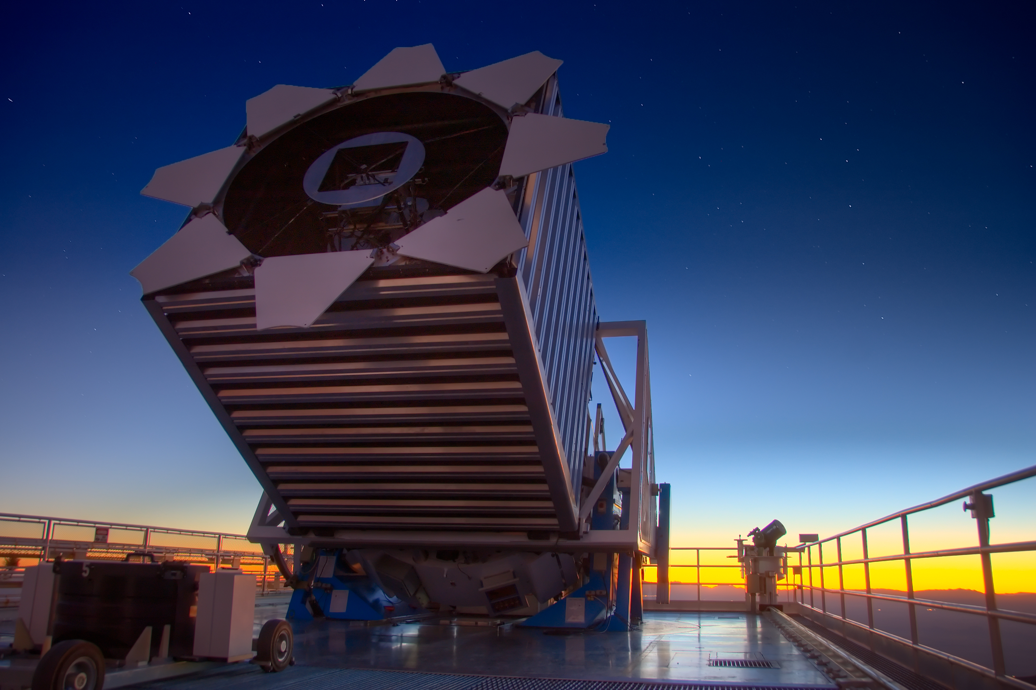
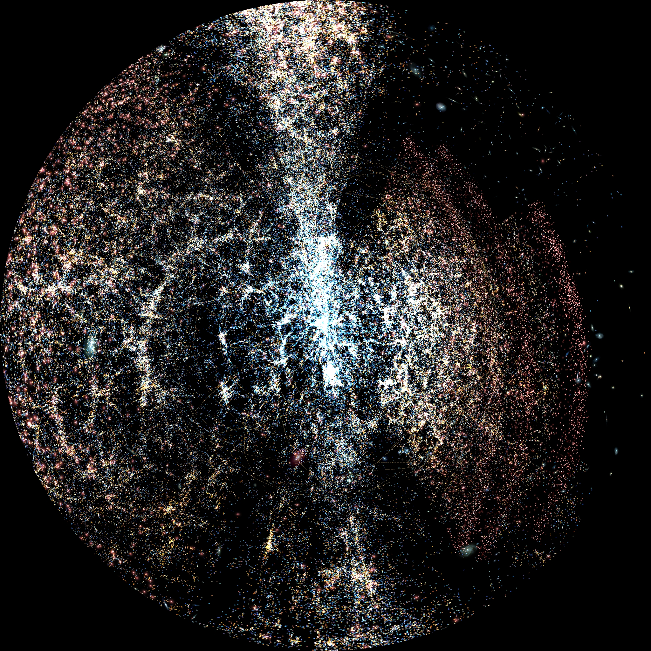
Sloan Digital Sky Survey
2.5 m, 10,000 deg², r < 22.5, 15 years
> 6600 refereed papers
~ 300000 citations
100s of PhD theses

Slide 3
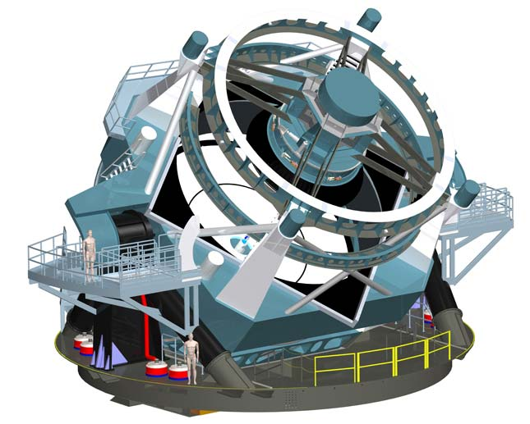
Large Synoptic Survey Telescope
Modified Paul-Baker three-mirror system
8.4 m f/1.234 (6.8 m clear aperture)
3.5º FOV
50.9 micron/arcsec plate scale.

Slide 4
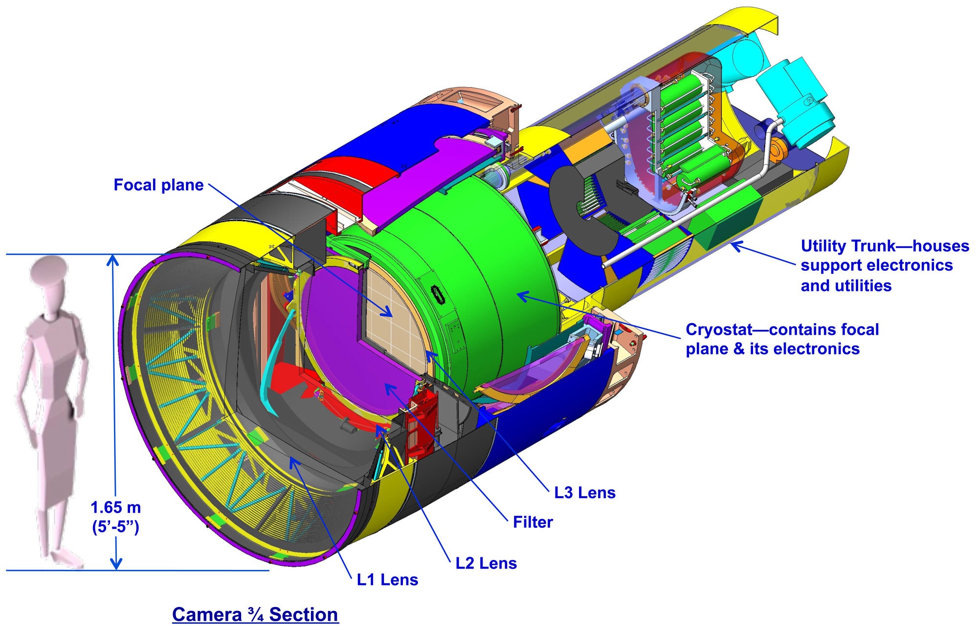
LSST Camera
3.2 Gigapixel
10 micron pixels (0.2 arcsec)
189 4K x 4K CCDs
0.64 m diameter focal plane

Slide 5
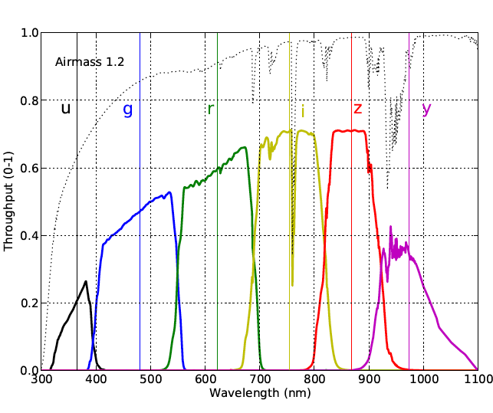
Filter System
ugrizy
320-1050 nm

Slide 6
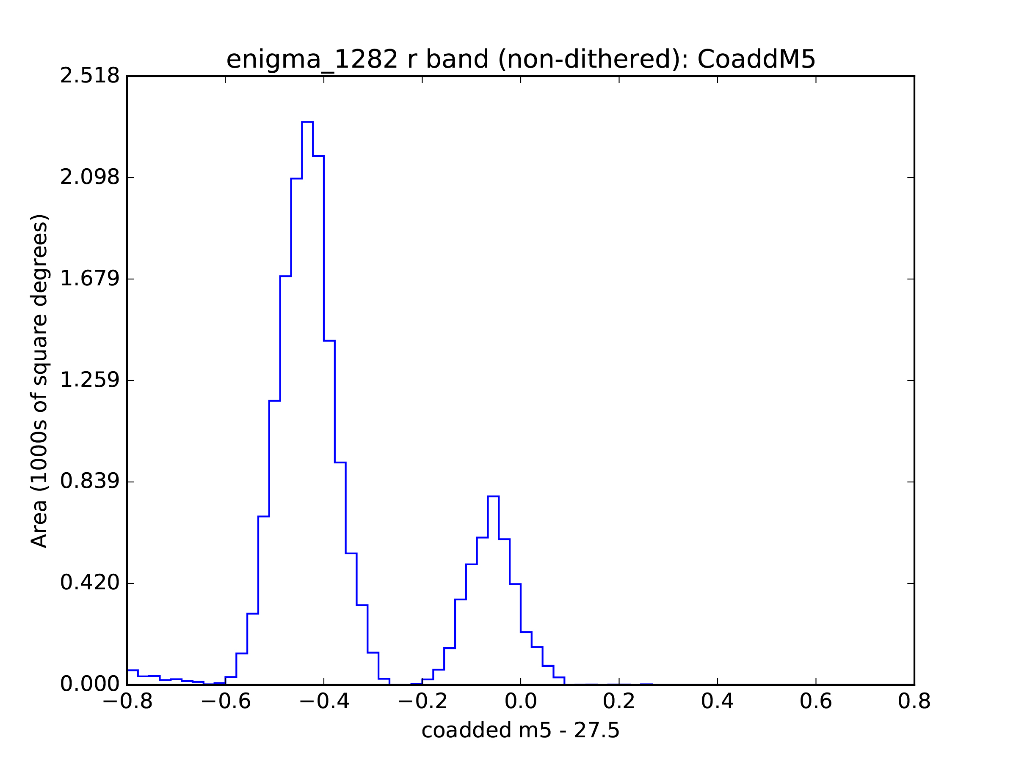
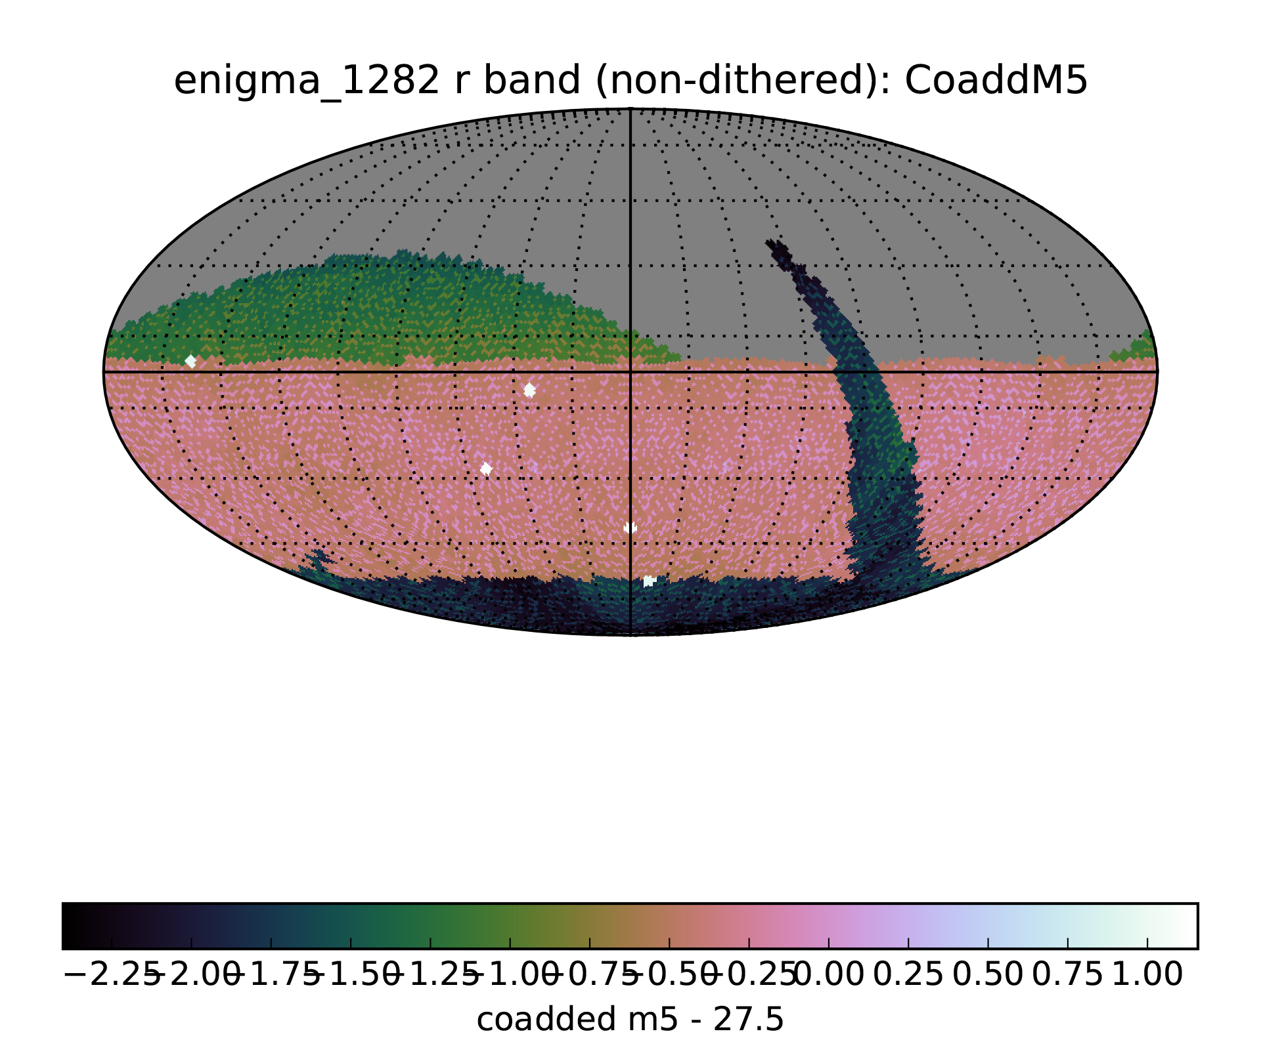
Survey Strategy
2 x 15 sec. Exposures
1000 visits/night
20,000 deg² deep-wide-fast

Slide 7
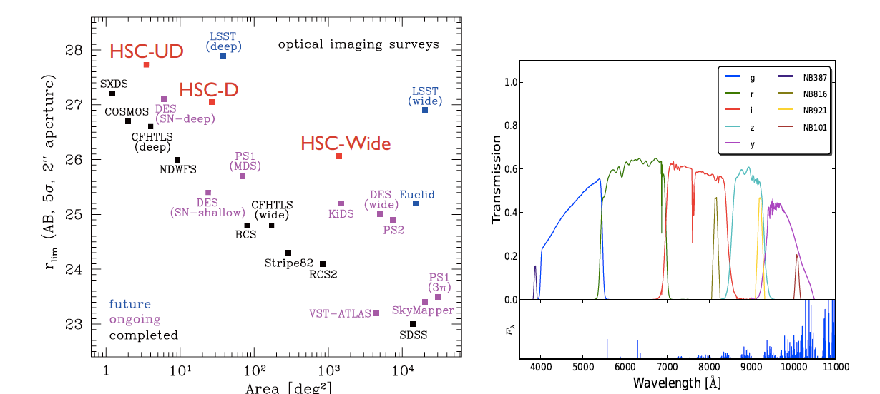
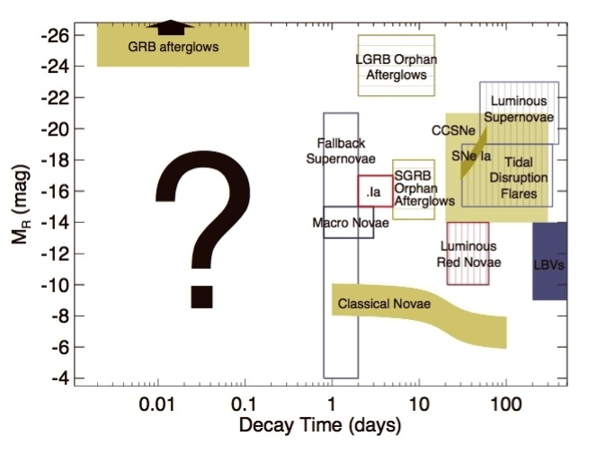
LSST Discovery Space

Slide 8
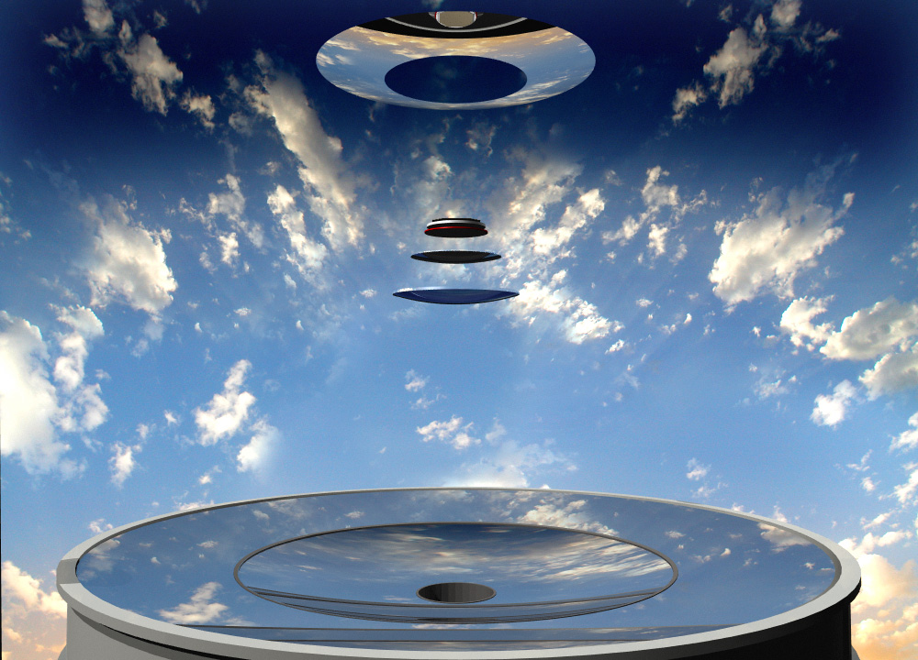
LSST Optical Train

Slide 9
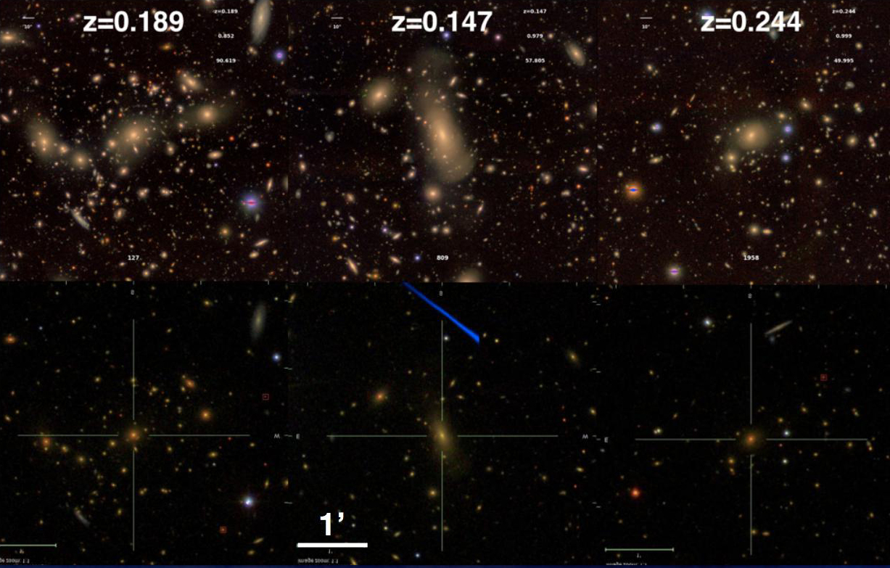
SDSS vs HSC – LSST will provide similar IQ
image credit Song Huang

Slide 10
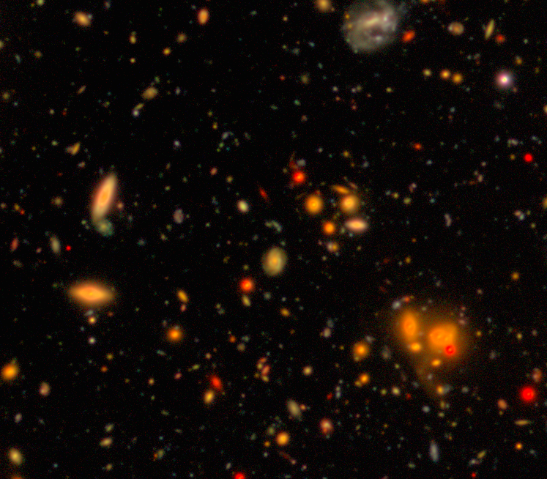
Another HSC image...
1.5 hrs in each filter (grizy)
little less than LSST full depth
0.6 – 0.7 arcsec seeing
lots of blending!
image credit Lauren MacArthur

Slide 11
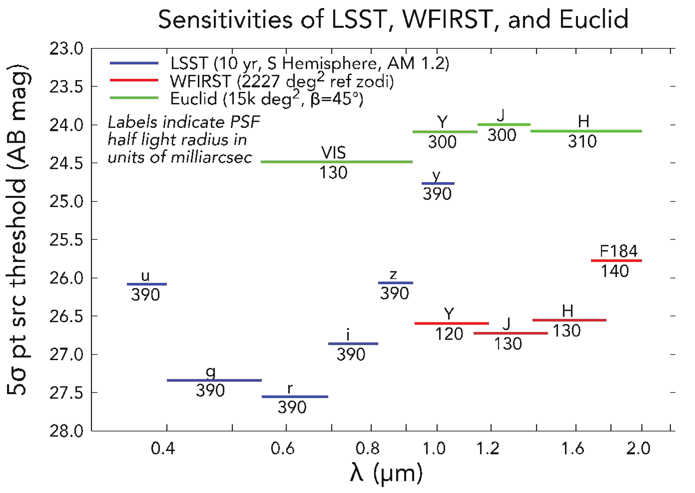
Synergy with IR Surveys

Slide 12
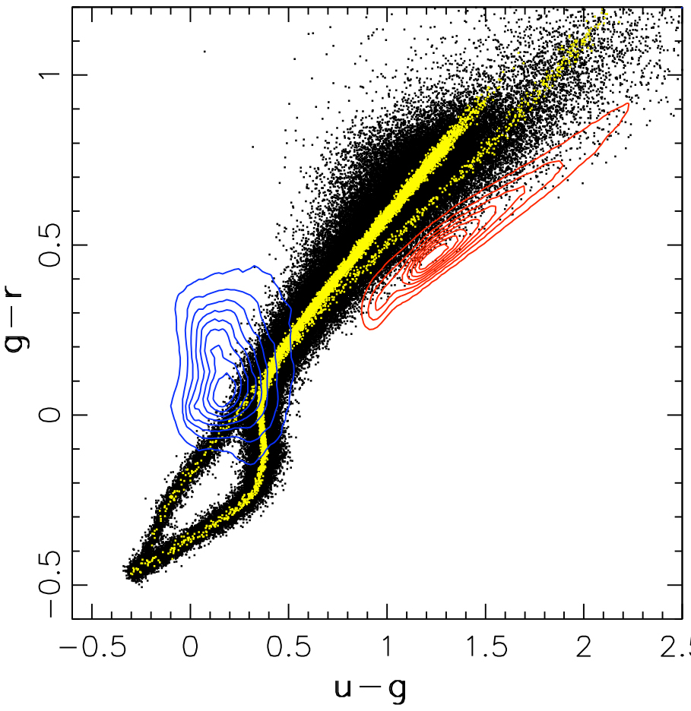
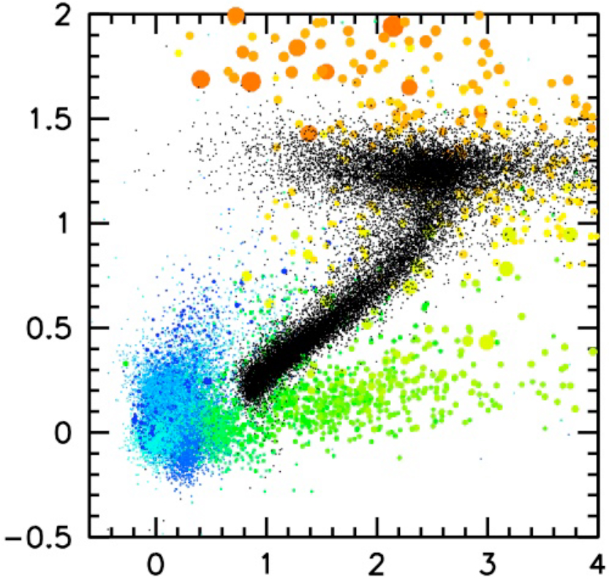
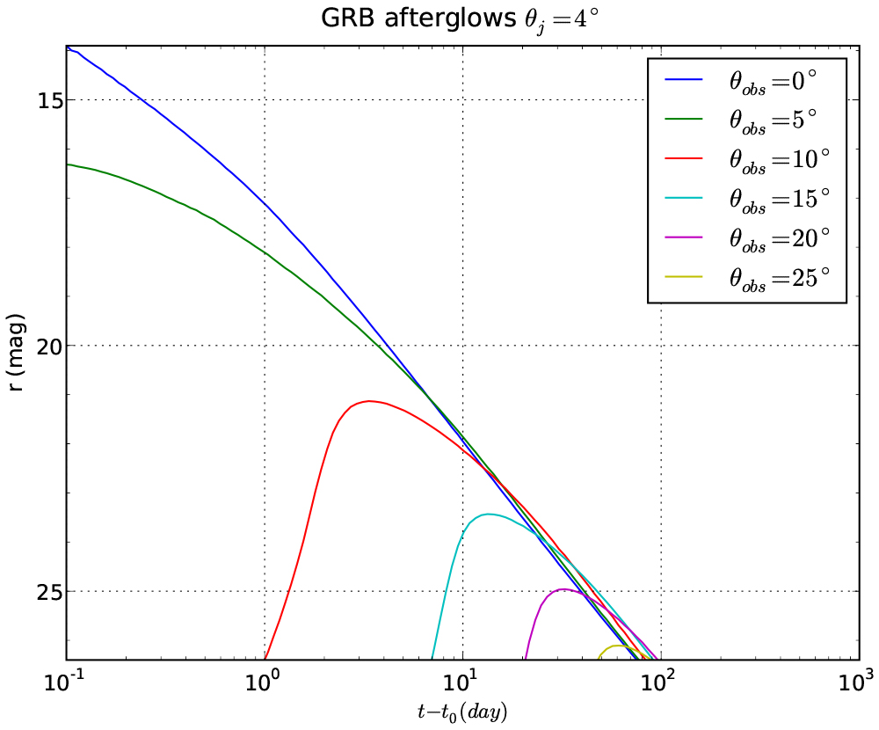
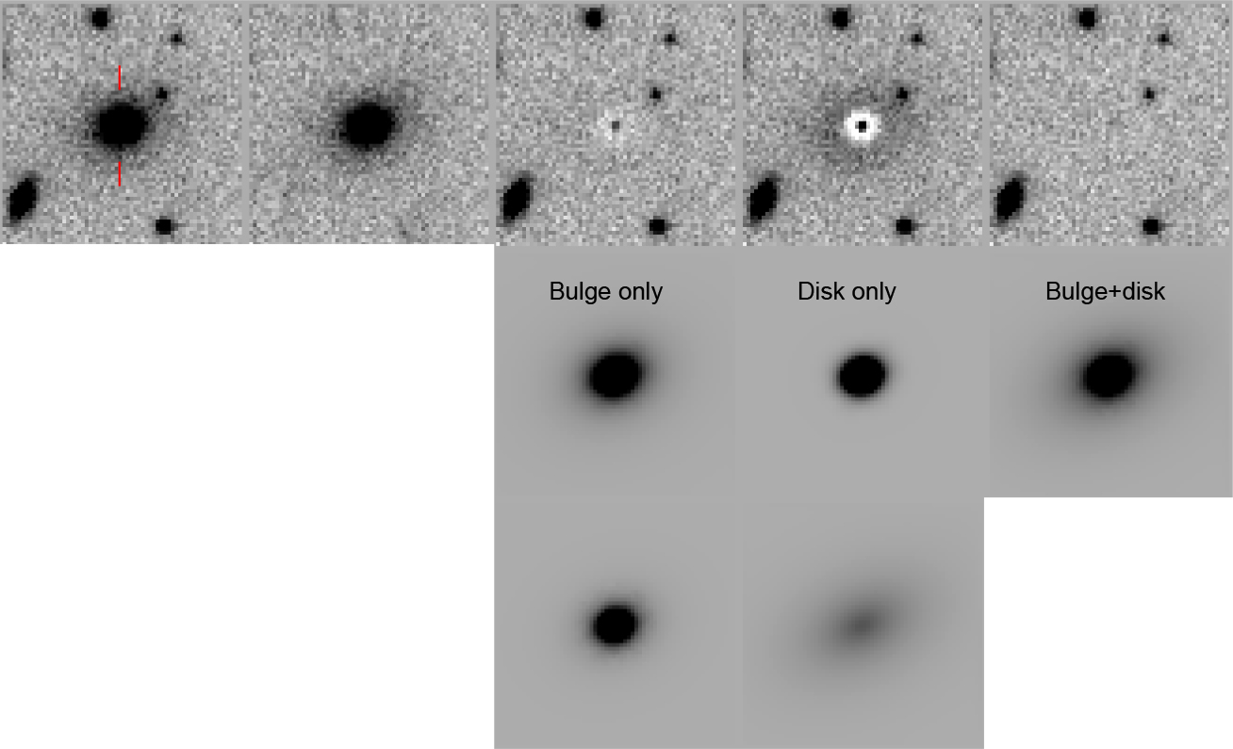
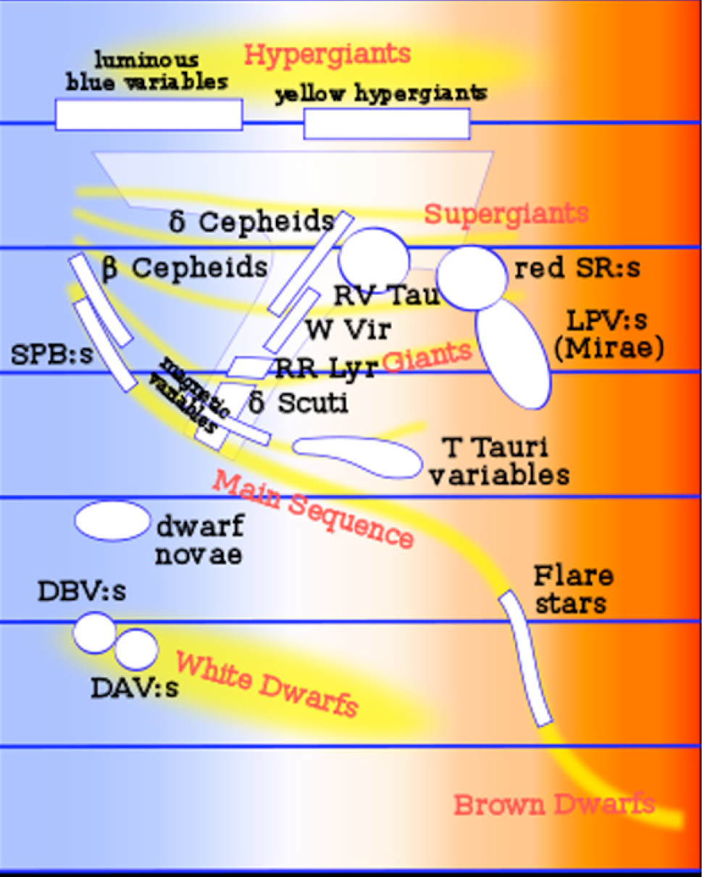
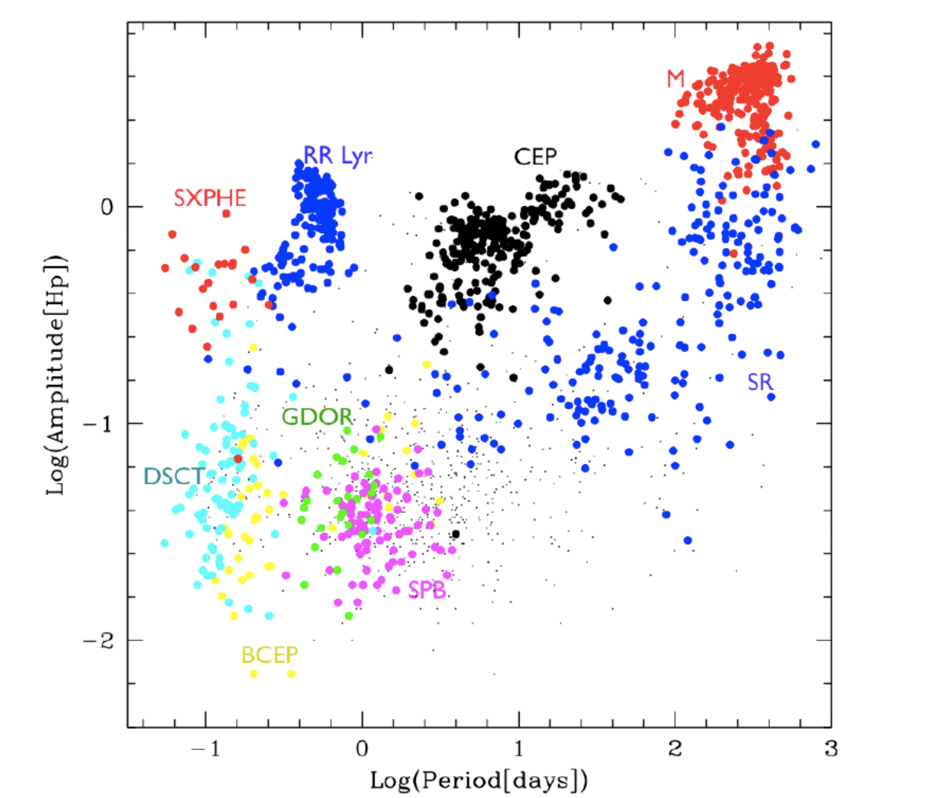
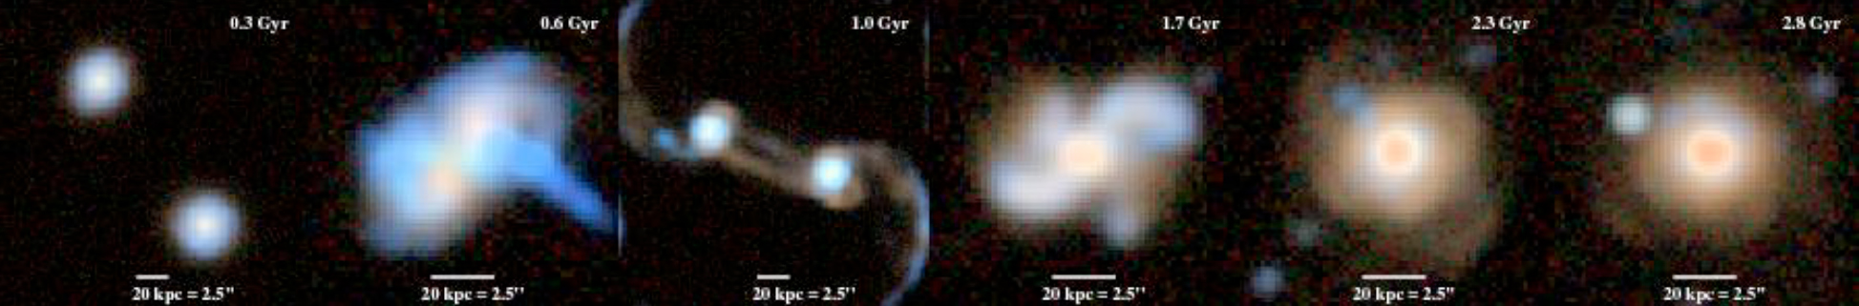
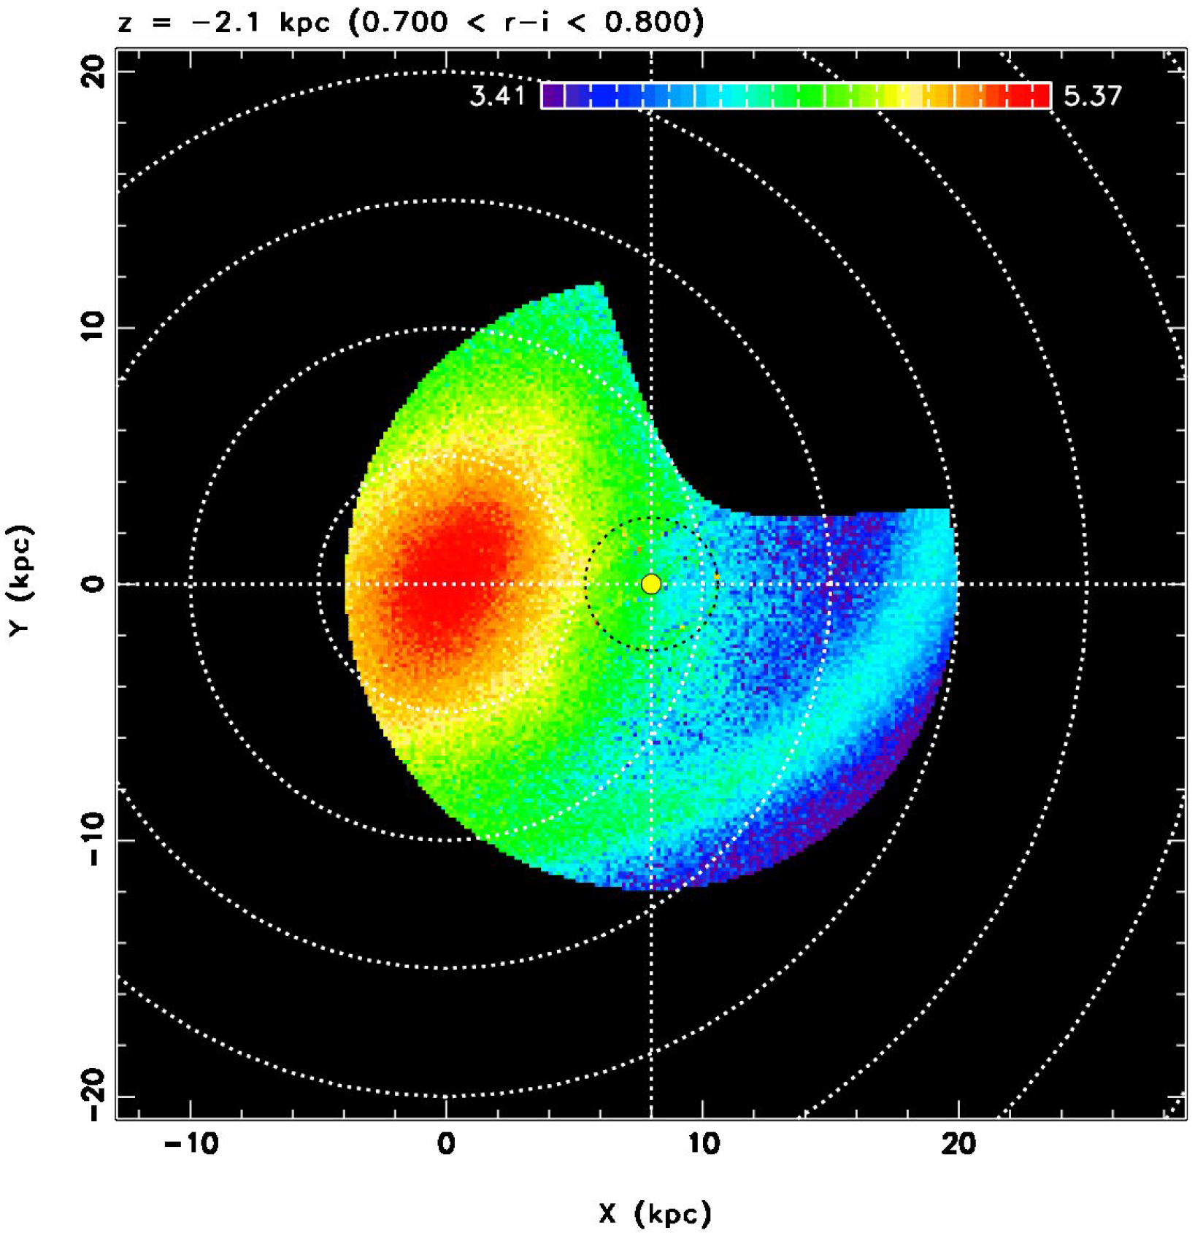
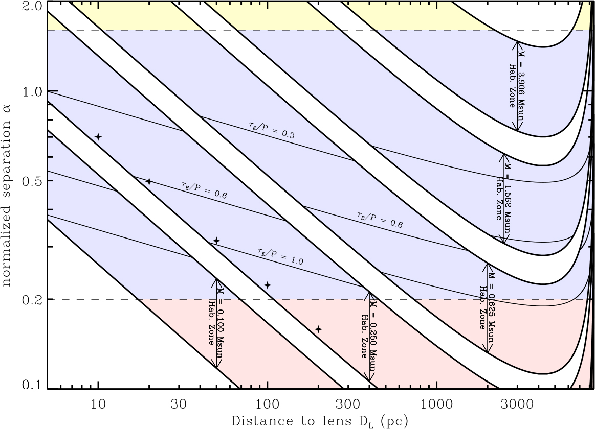
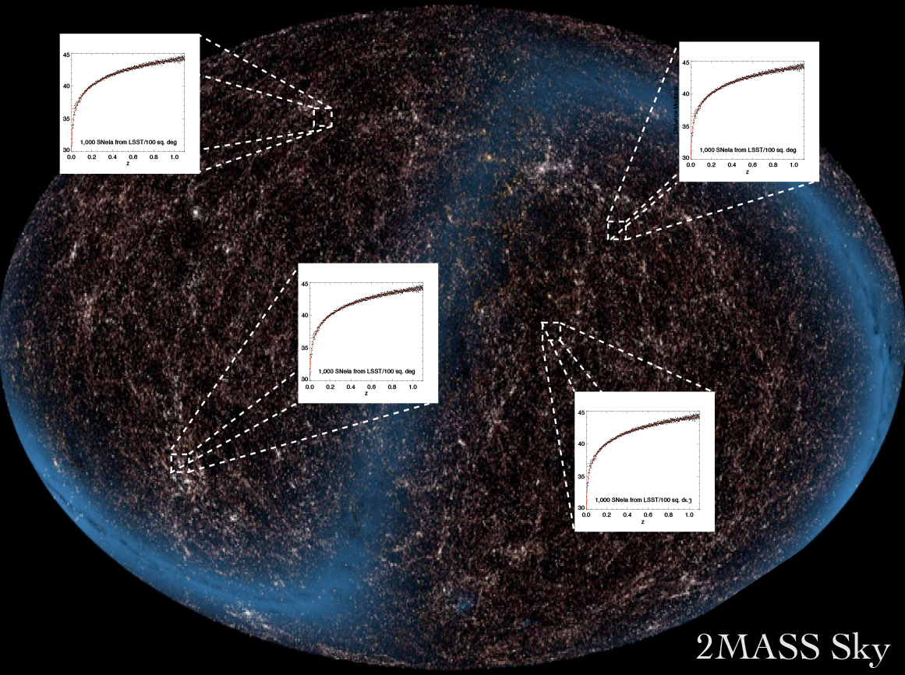
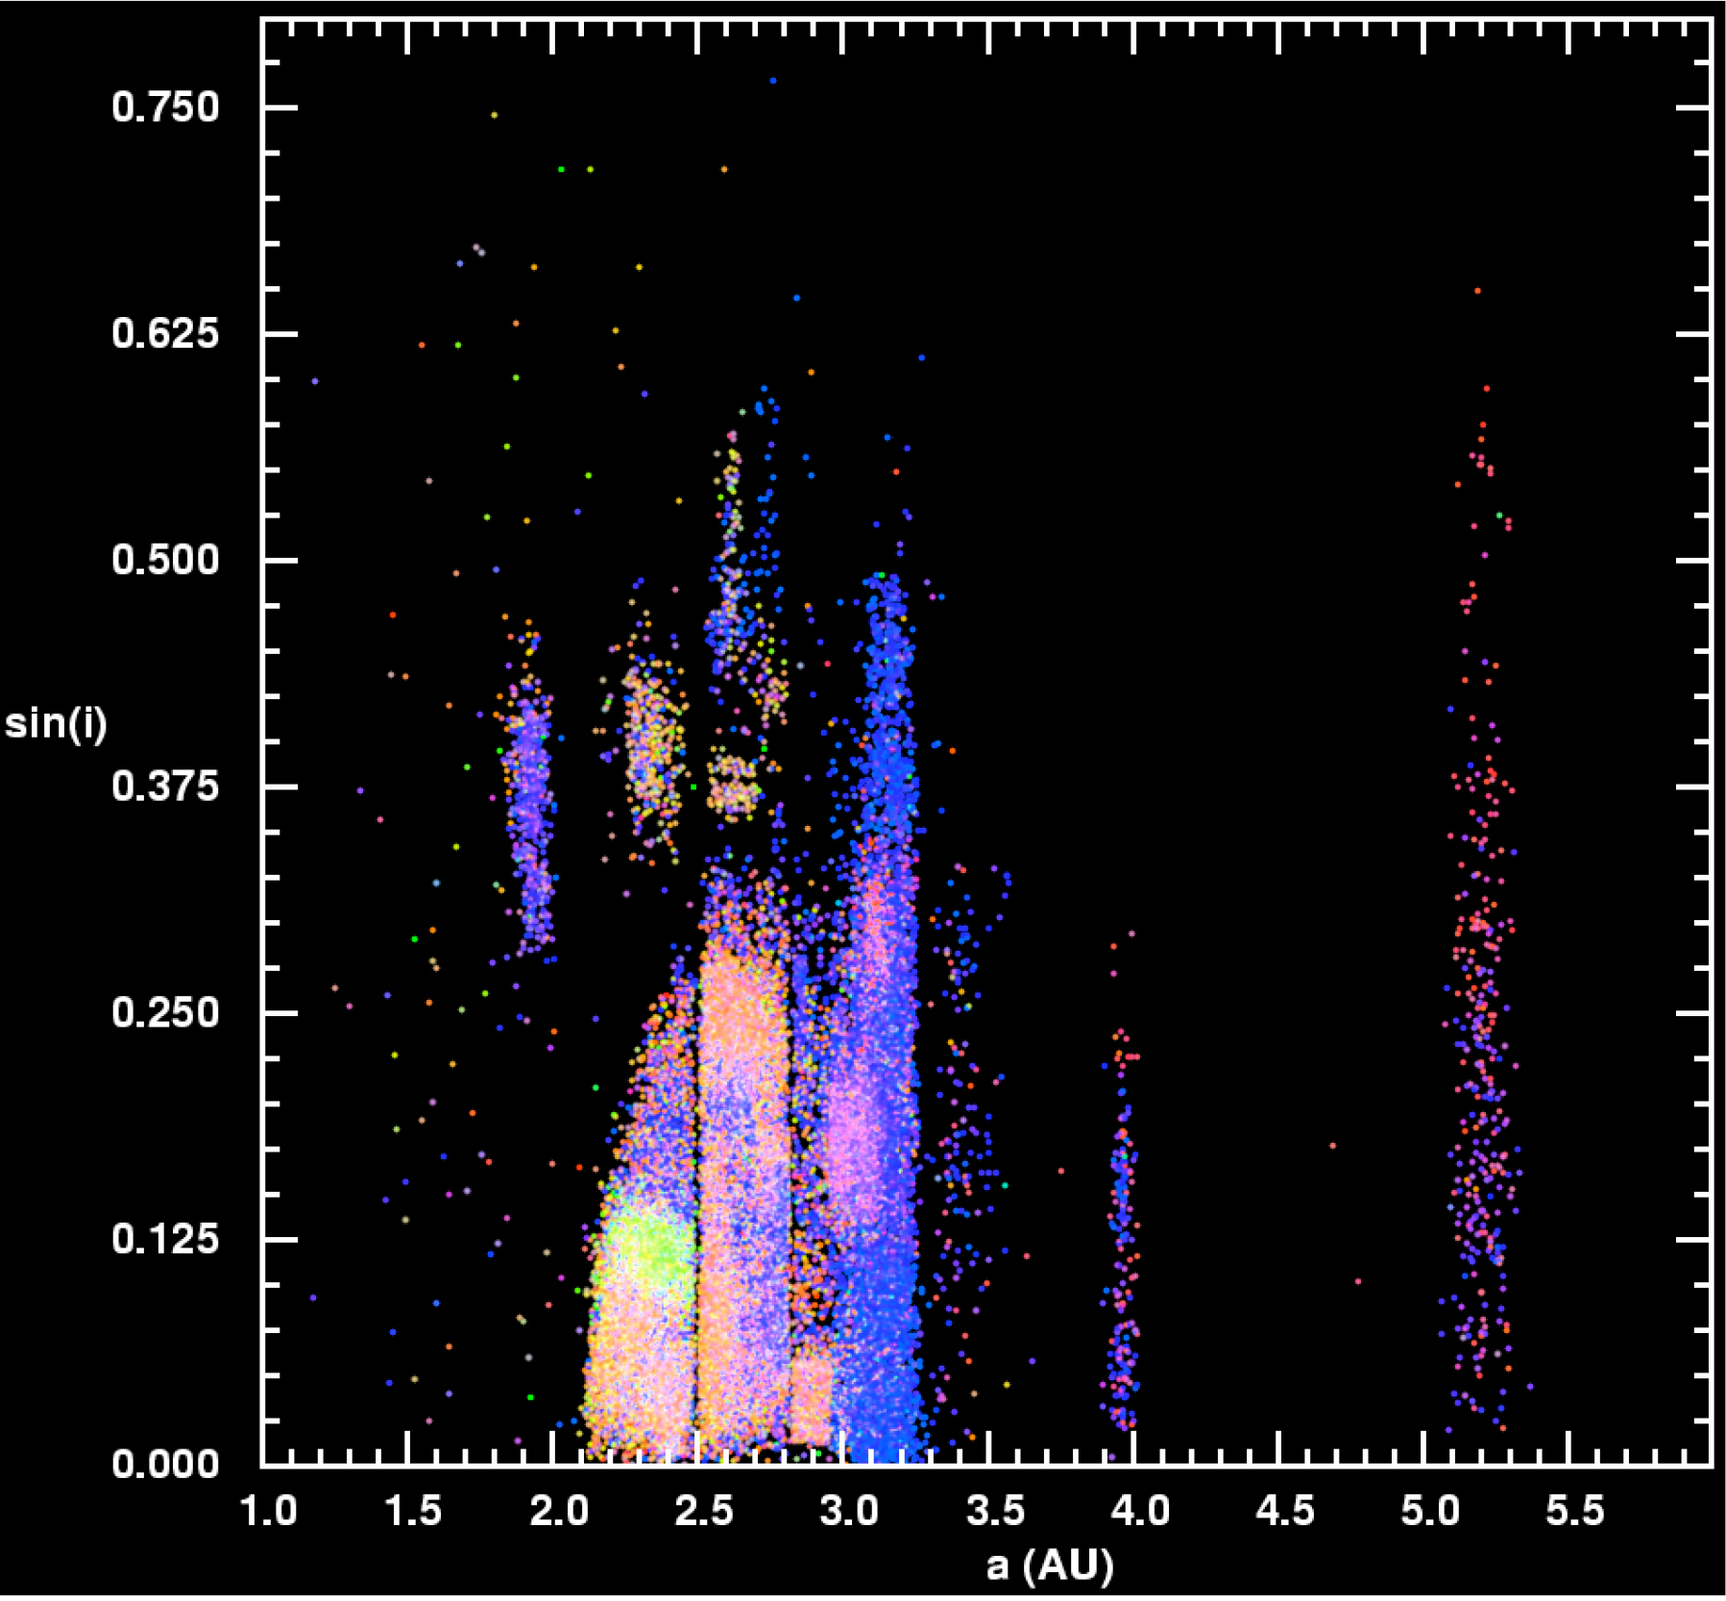
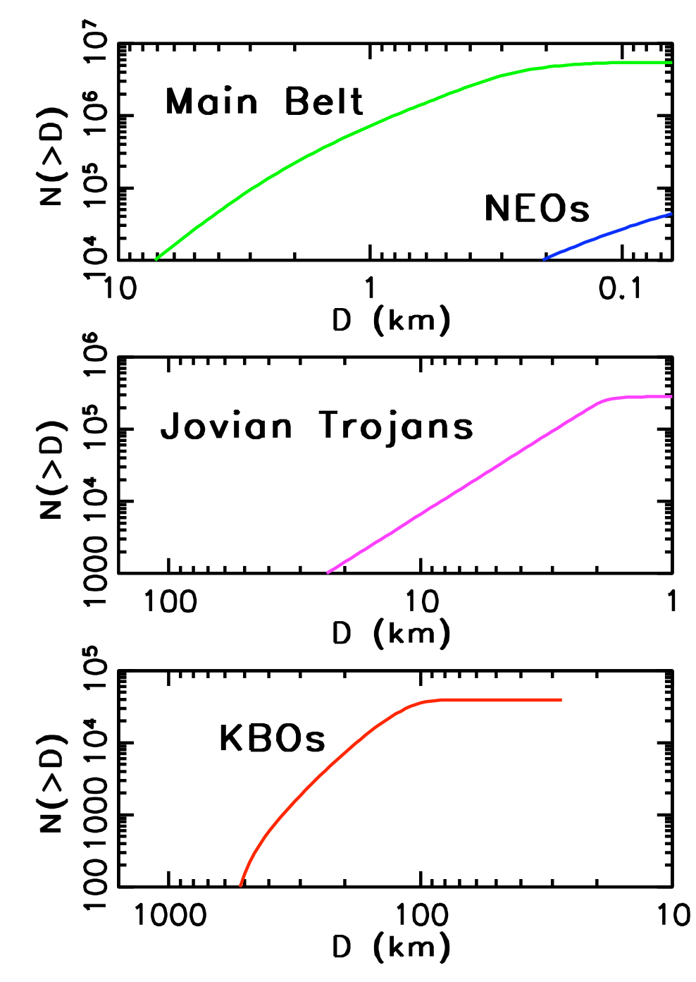
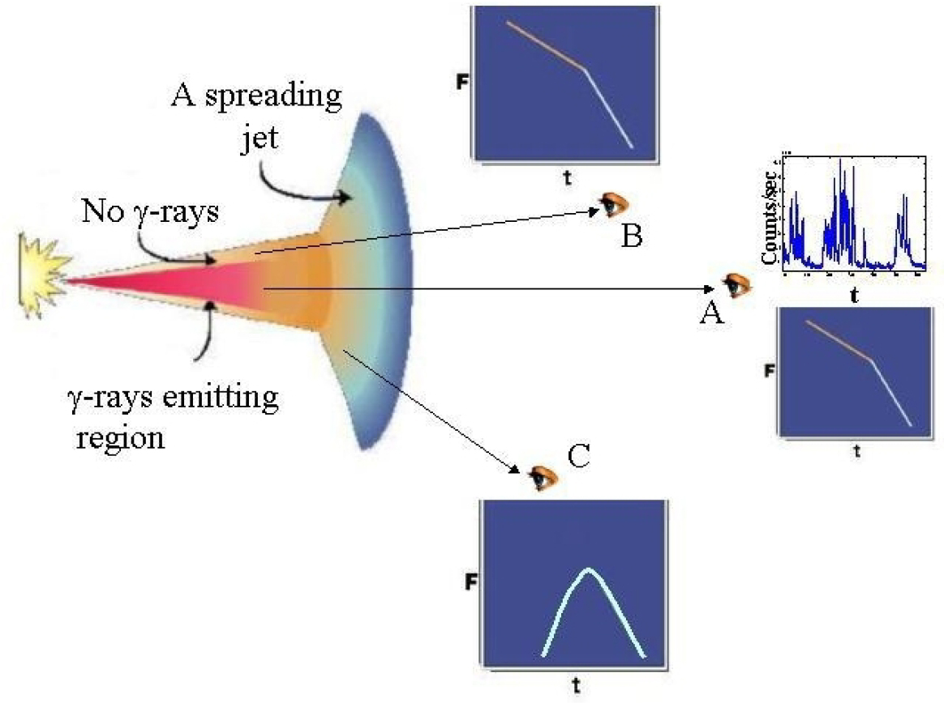
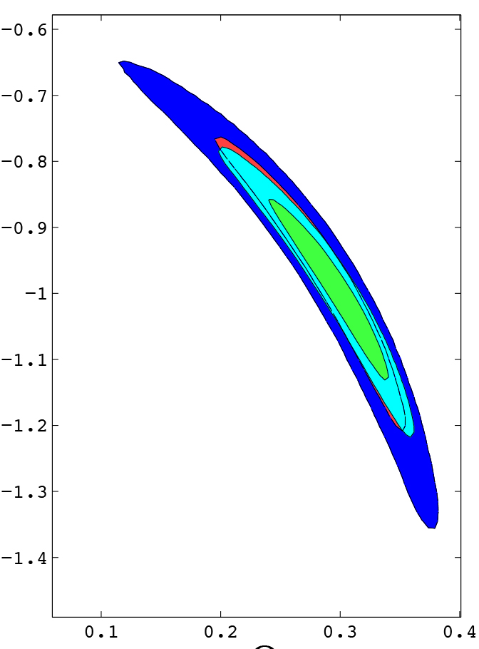
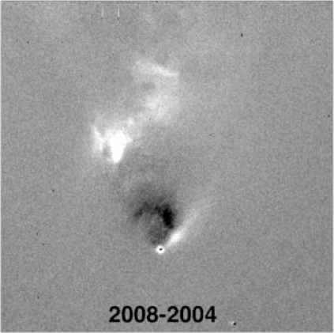
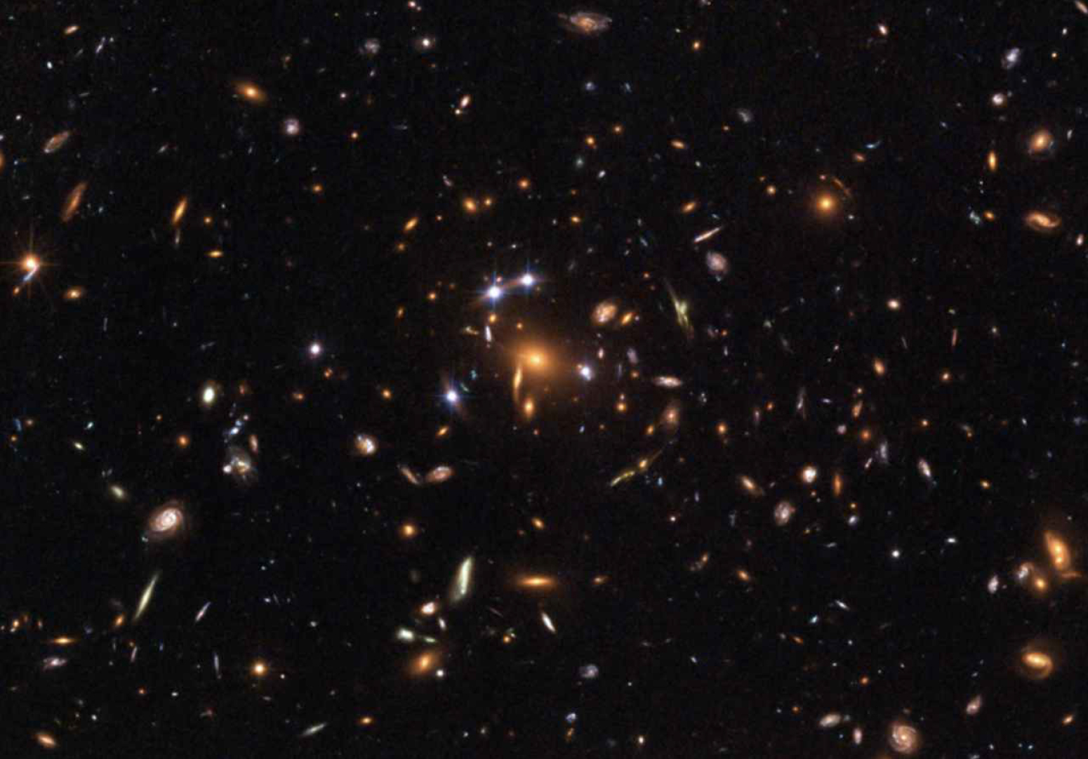
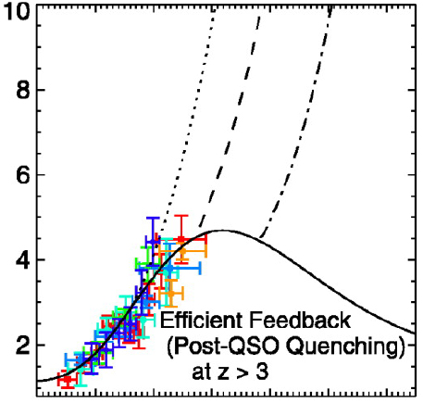
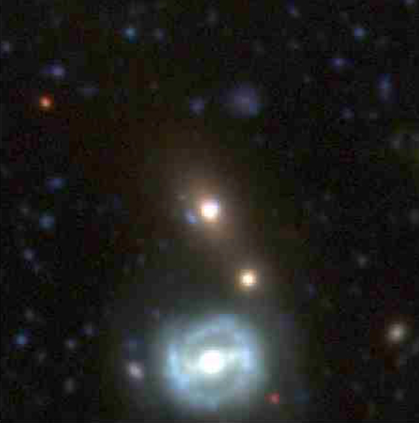
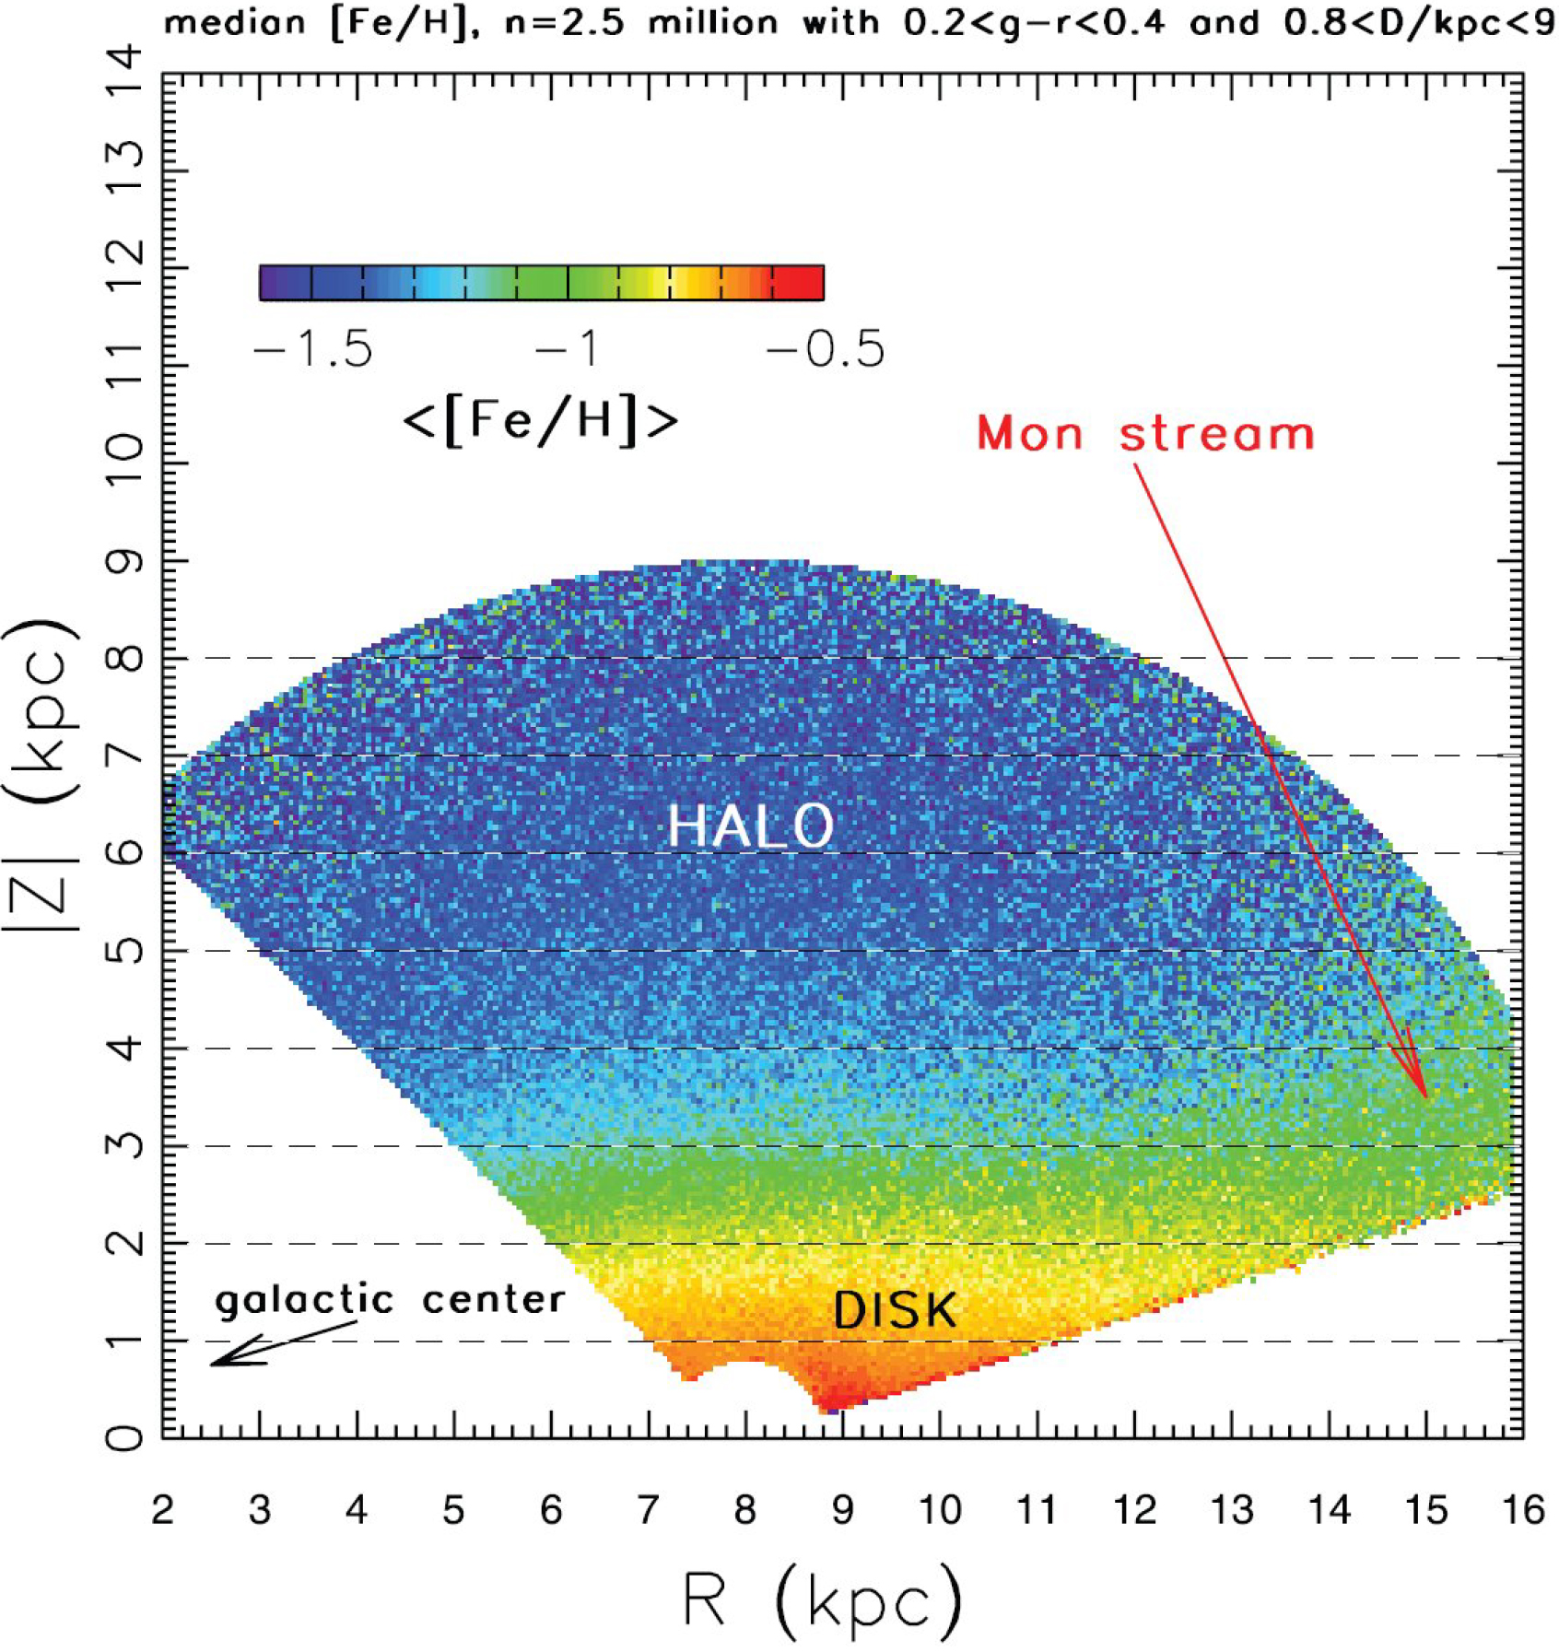
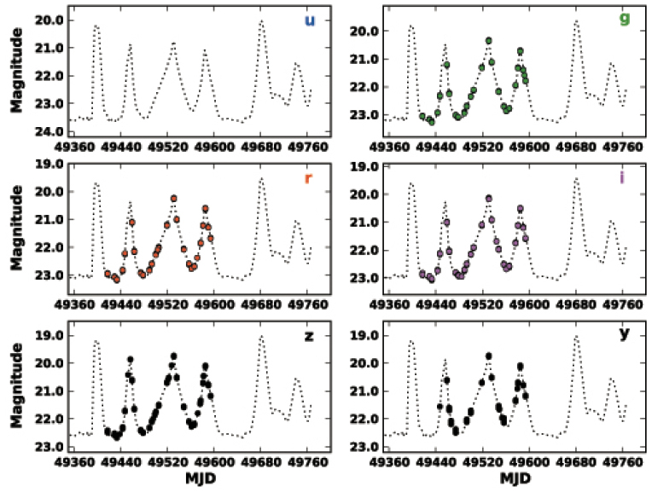
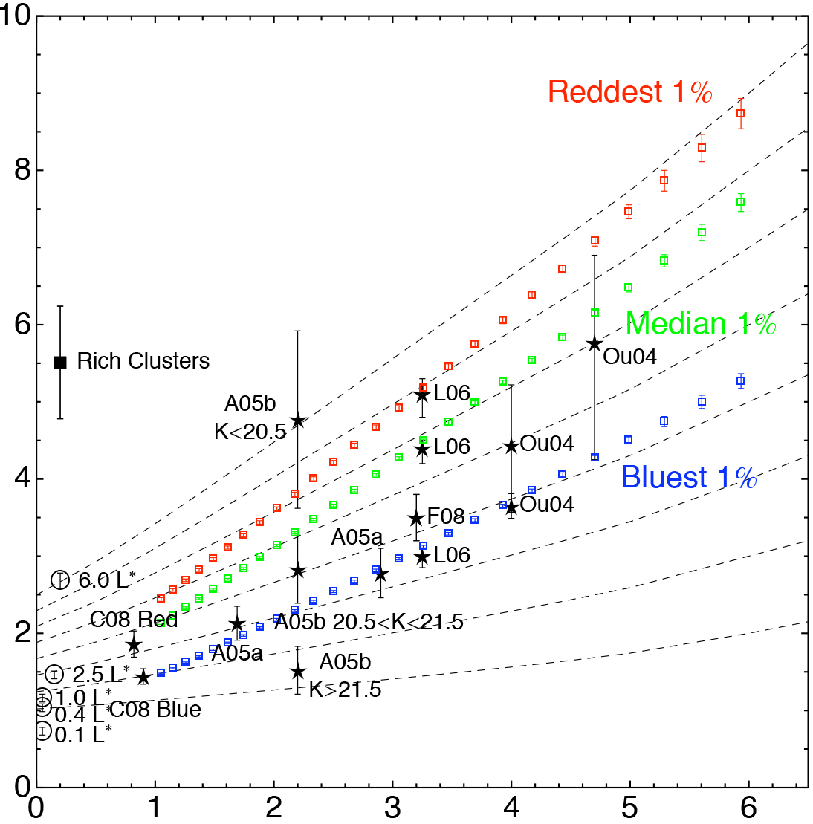
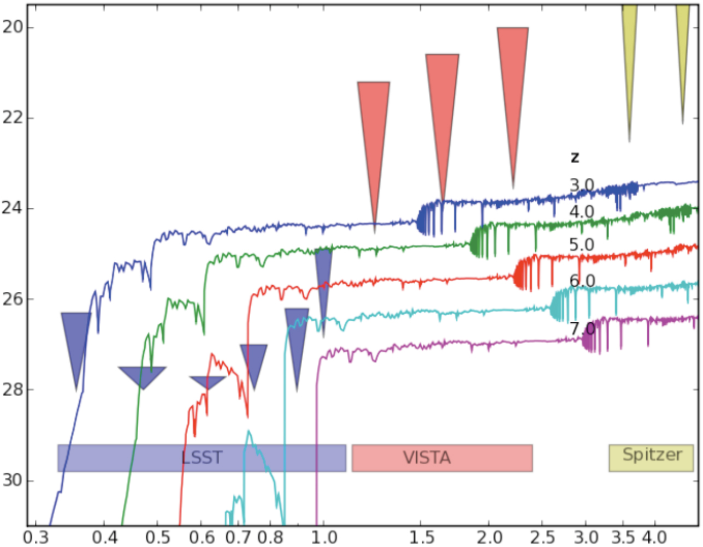
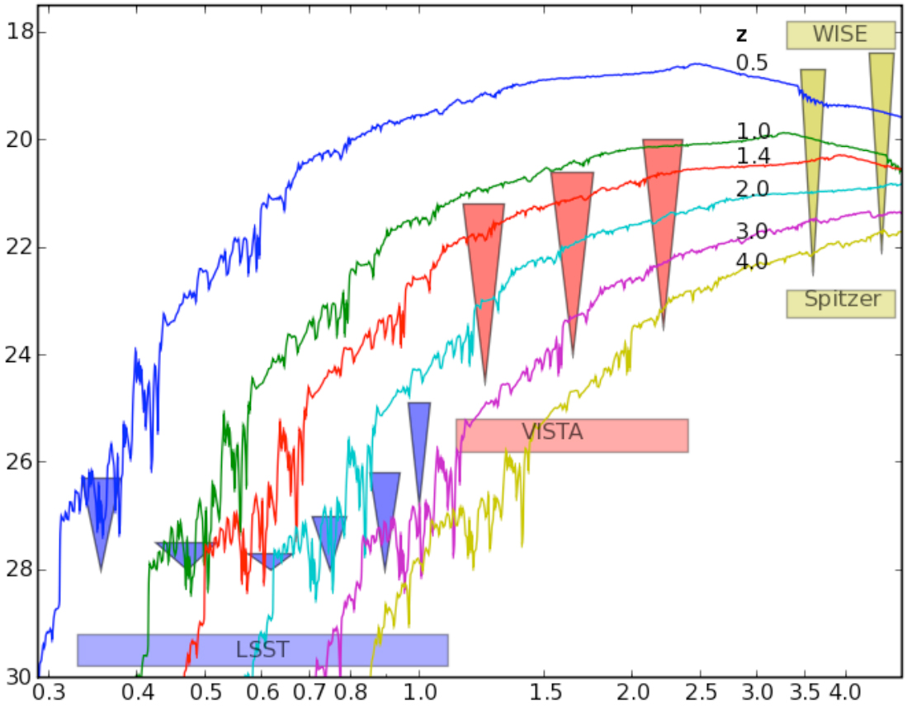
LSST Science

Slide 13
The ultimate deliverable of LSST is not just the telescope, nor the camera, but the fully reduced science-ready data.
- Zeljko Ivezic

Slide 14
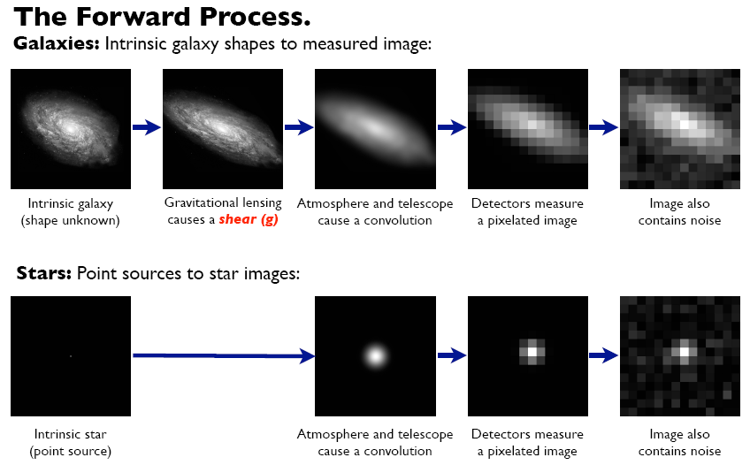
A Game of Cosmic Telephone
Figure from S. Bridle

Slide 15
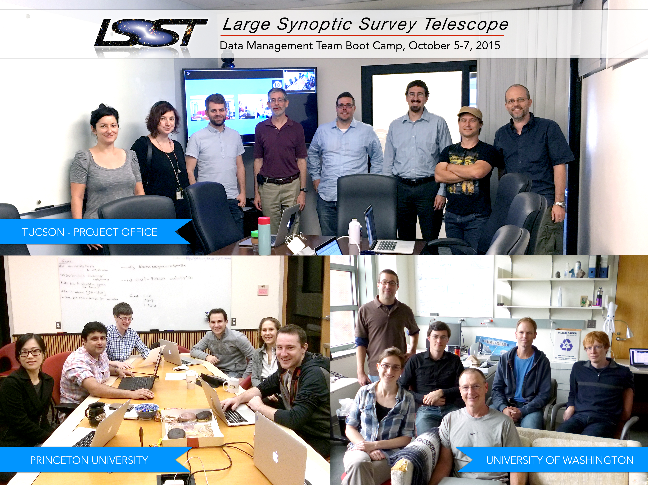
LSST Data Management (LSST DM)

Slide 16








LSST Data Management (LSST DM)
UI
Database
Mgmt, I&T, and Science QA
Core Algorithms (“Apps”)
Middleware
Infrastructure

Slide 17
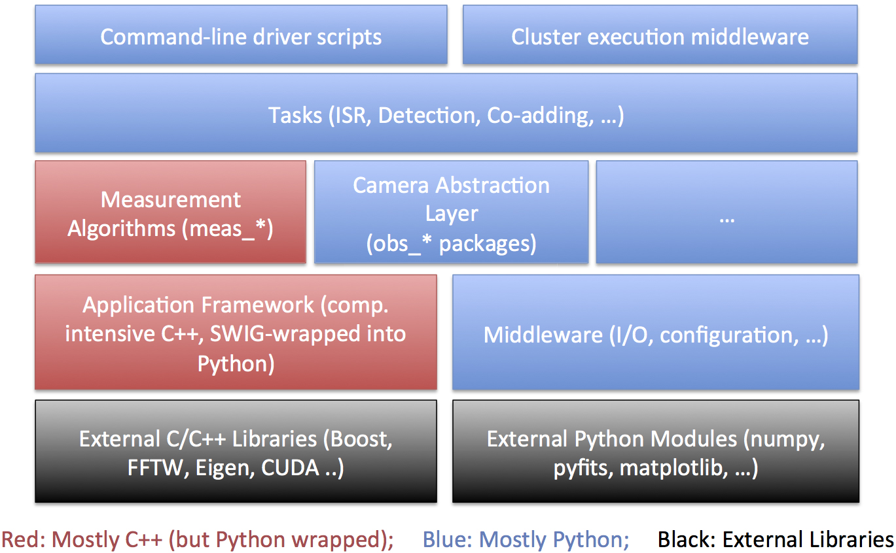
LSST Software Stack

Slide 18
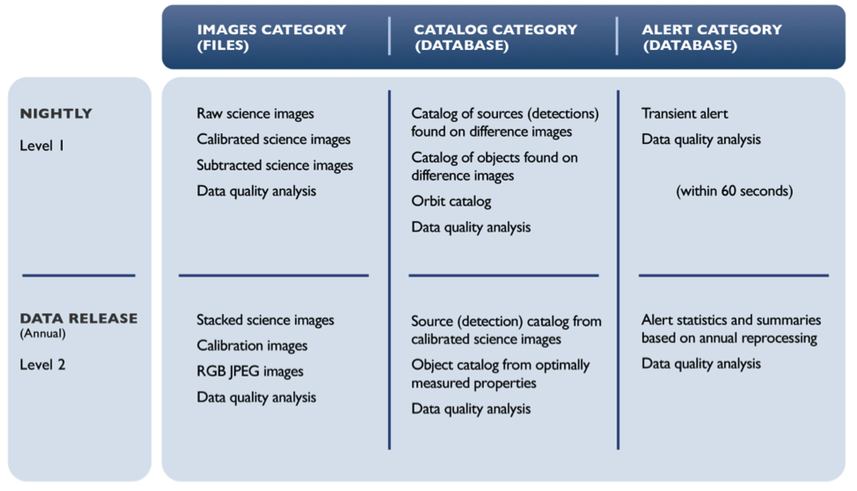
Data Products Overview

Slide 19
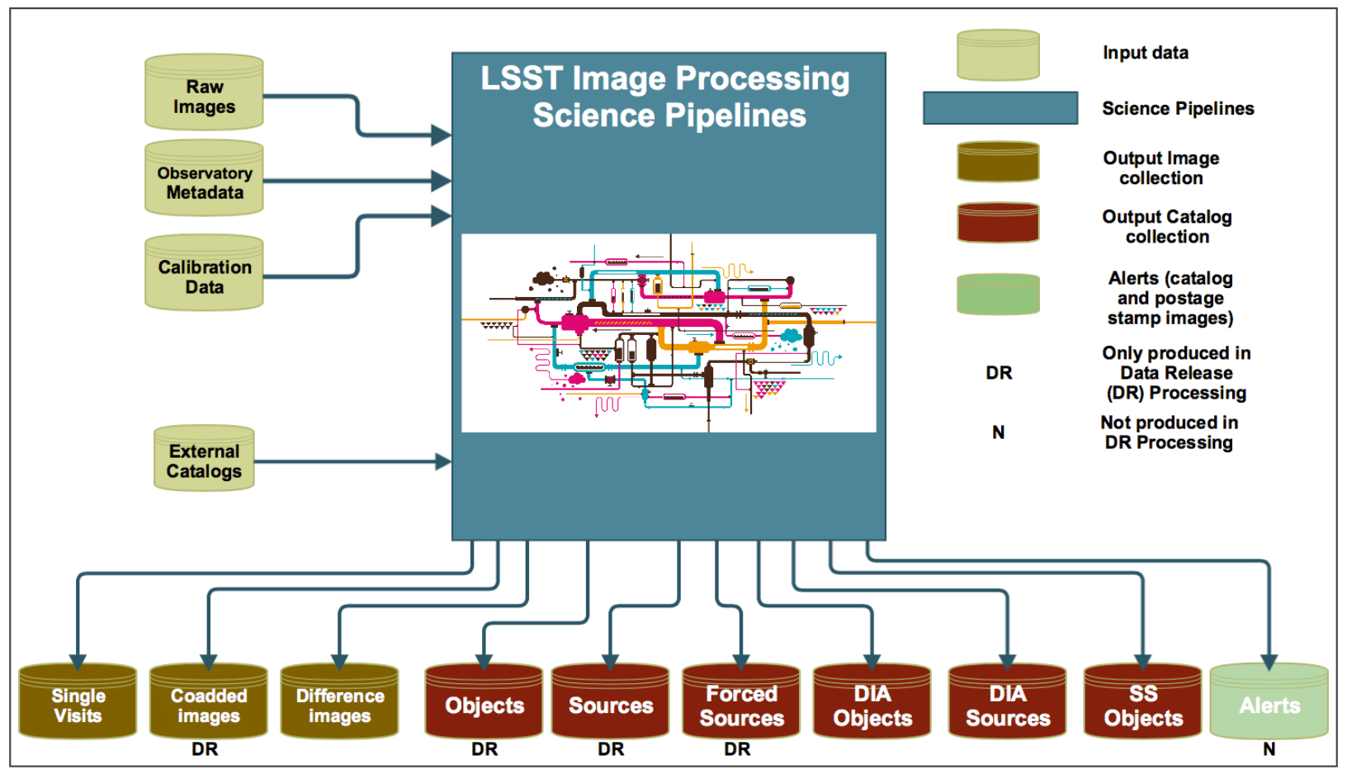
Data Products Overview

Slide 20
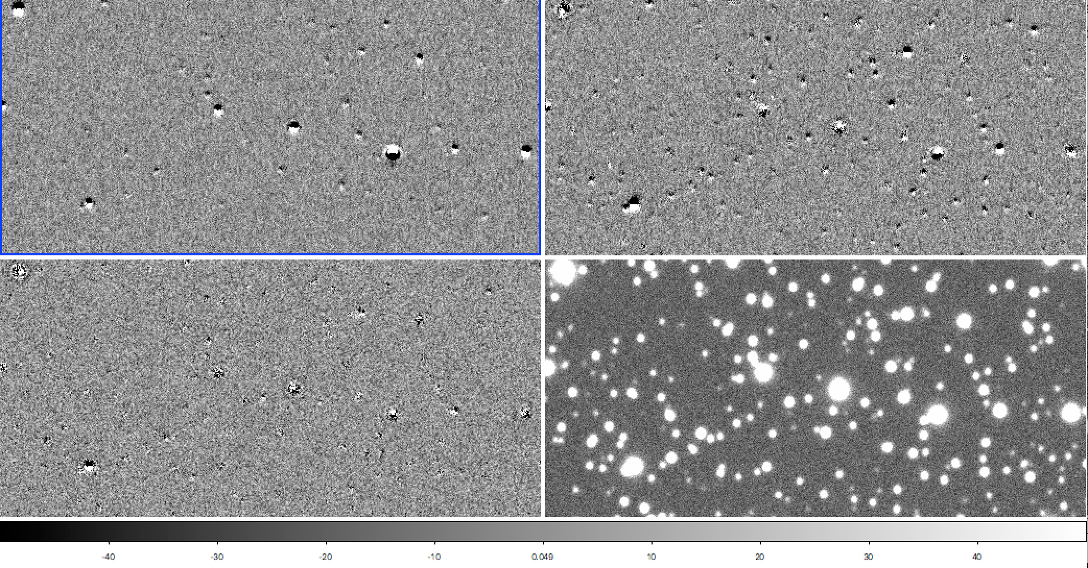
Level 1 (Nightly) Data Products
Detection & follow up of transients
Near real-time processing
Continuously generated
Updated nightly
Maximal automation
Difference images: Bottom right is g-band template. Bottom left is g-band difference image. Upper panels are u & r band. Dipoles in upper difference images are due to Differential Chromatic Refraction (DCR).
From DMTN-019 (Ian Sulivan)

Slide 21
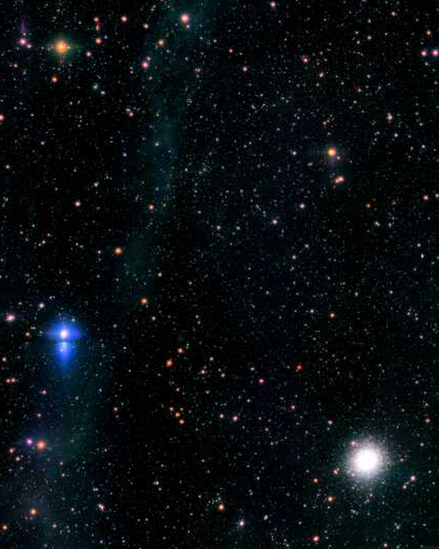
Level 2 (Yearly) Data Products
Extensive computation required
May combine multiple exposures
Significant human interaction (may be) needed at key-points
Includes re-processed Level 1 products
SDSS Stripe 82 Re-processing in vicinity of M2

Slide 22
Level 1 Pipeline
Single Frame Processing (SFM)
  Reduce visit (single CCD PSF estimation ) + Detect + Characterize
Image Differencing Pipeline
  Create image differences + Detect + Characterize
Association Pipeline
  Associate detected sources with known objects
Alert Generation Pipeline
  Generate + Transmit alerts
Moving Object Pipeline
  Identify + Link + Compute orbits of SS bodies

Slide 23
Level 2 Pipeline
PSF Estimation Pipeline
  Full visit PSF estimation
Image Coaddition Pipeline
  Generate + Characterize coadds & Create difference imaging templates
Object Detection & Deblending
  Detect + Deblend
Object Characterization Pipeline
  Characterize objects in both visits & coadds

Slide 24
Auxiliary Pipelines
Calibration Pipelines
  Calibration Products Pipeline: flats + biases + atmospheric models
  Photometric Calibration Pipeline
  Astrometric Calibration Pipeline
Science Data Quality Assessment Pipelines & Toolkits
Common Image & Catalog Processing Framework
  Application Framework (afw)
Science Pipeline Toolkit
  Enables Level 3 Data Products

Slide 25
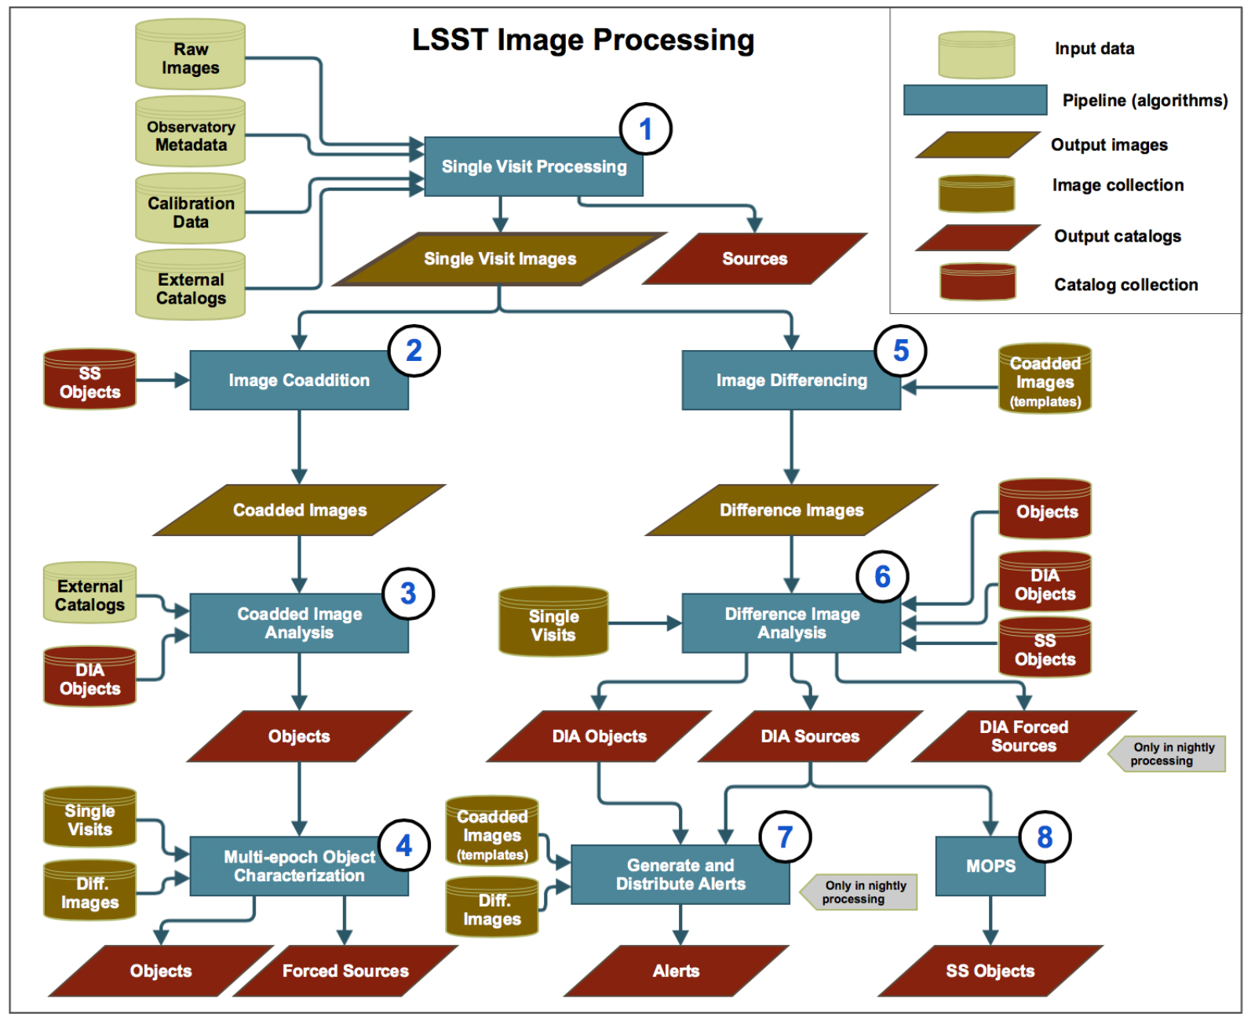
Pipeline Data Flow

Slide 26
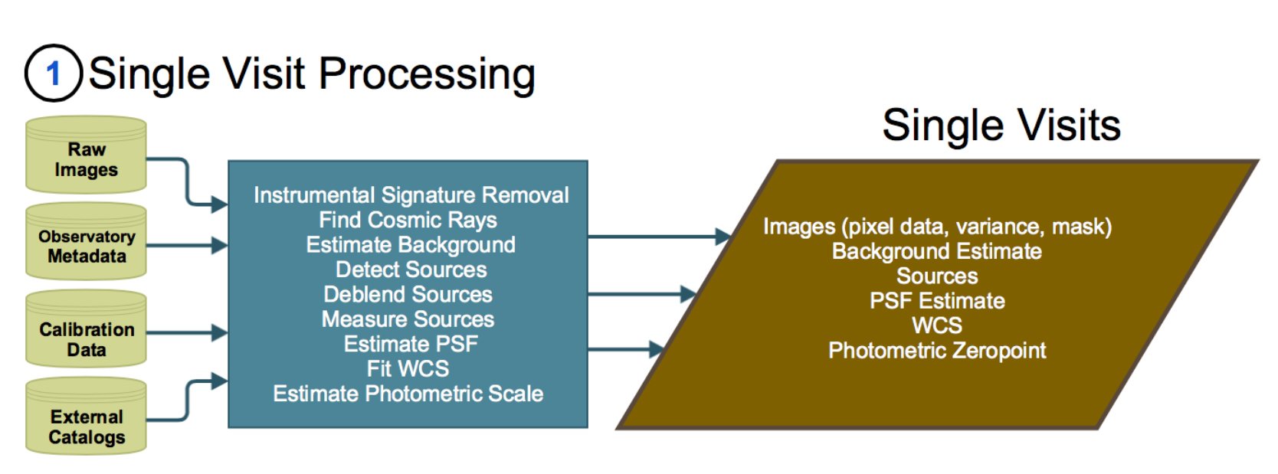
Single Visit Processing

Slide 27
Pipeline Data Flow

Slide 28
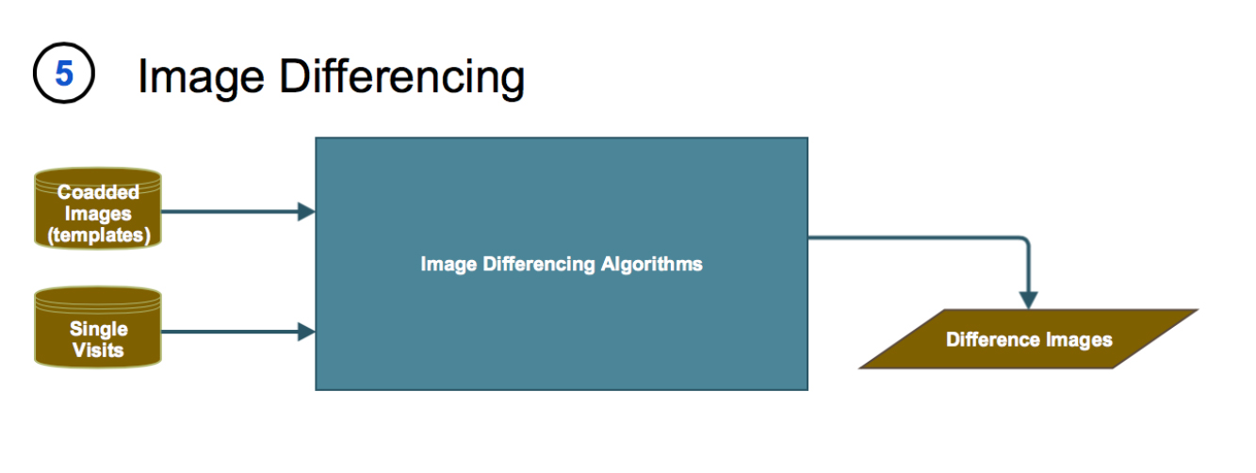
Image Differencing

Slide 29
Pipeline Data Flow

Slide 30
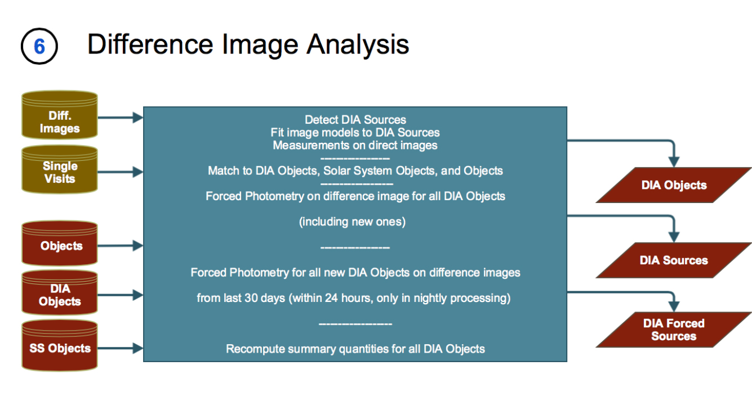
Difference Image Analysis

Slide 31
Pipeline Data Flow

Slide 32
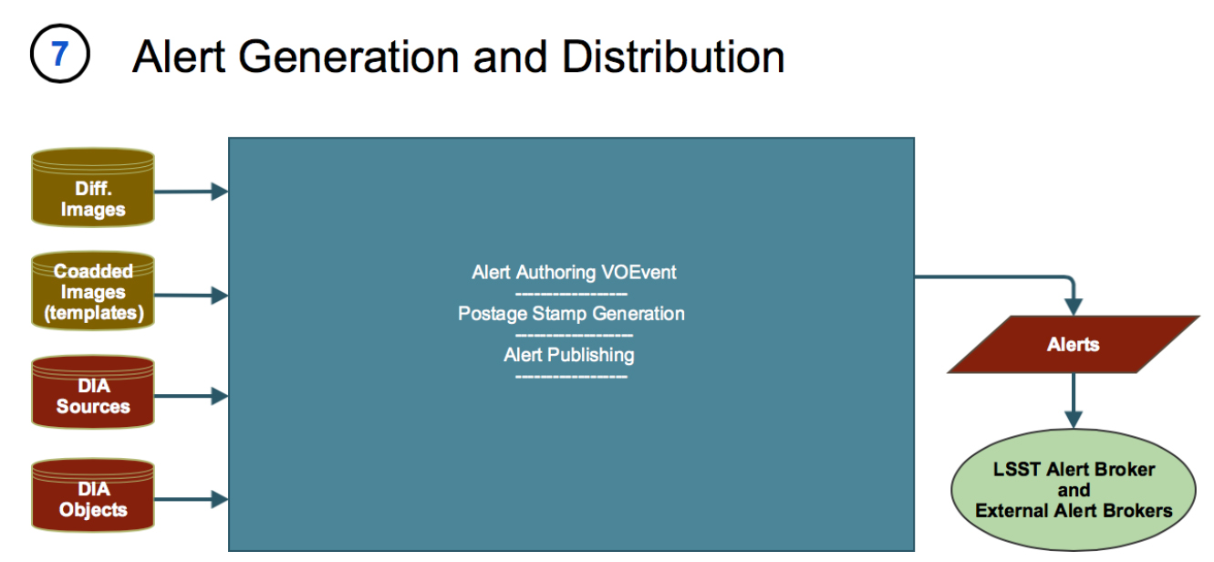
Alert Generation & Distribution

Slide 33
Pipeline Data Flow

Slide 34
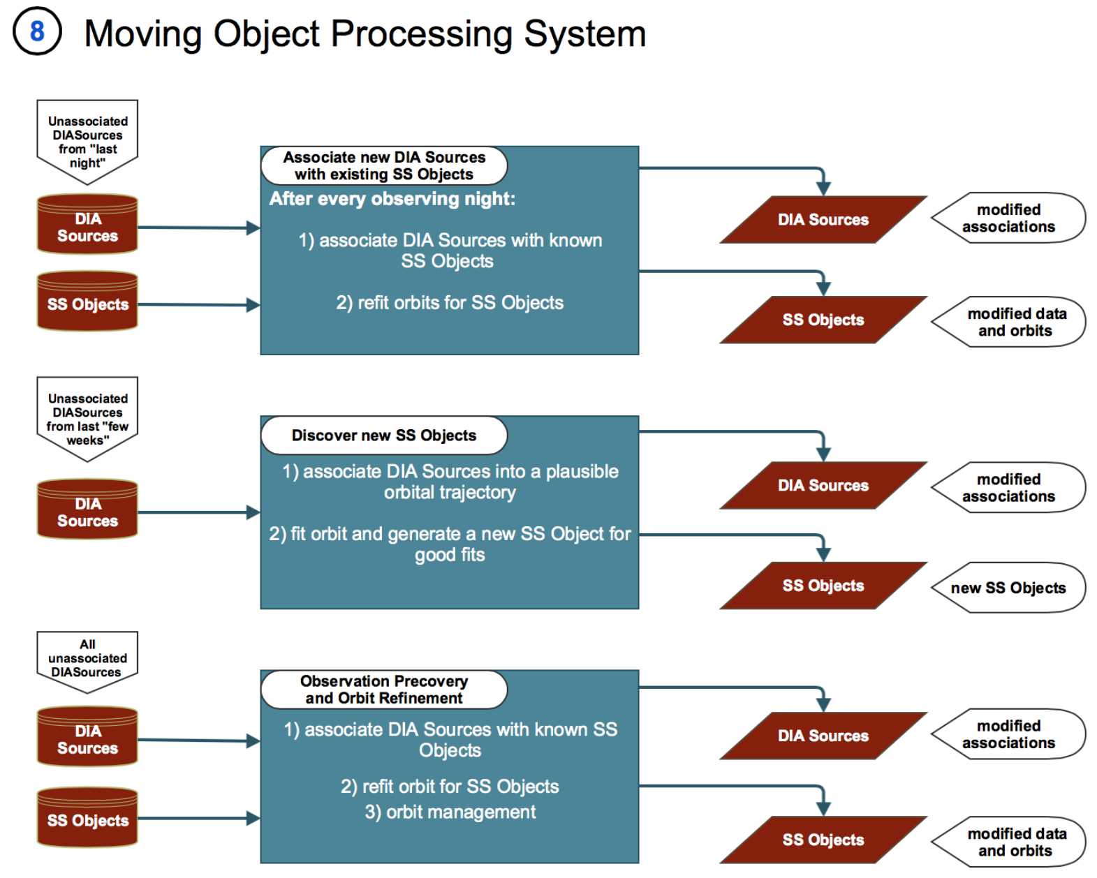
Moving Object Processing System

Slide 35
Pipeline Data Flow

Slide 36
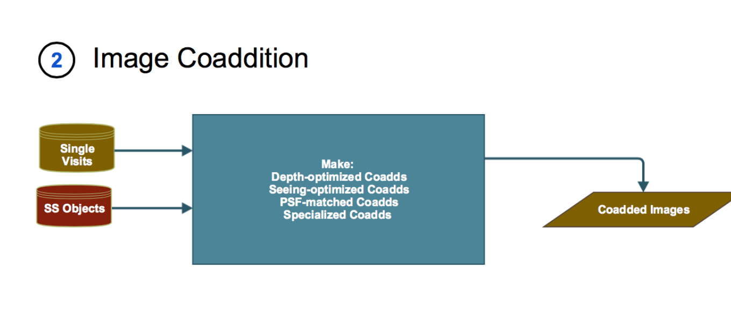
Image Coaddition

Slide 37
Pipeline Data Flow

Slide 38

Coadd Image Analysis

Slide 39
Pipeline Data Flow

Slide 40

Multi-Epoch Object Characterization

Slide 41

Level 2 Pipeline Data Flow
Single Frame Processing
Relative Calibration
Coadd Creation
Coadd Source Detection
Coadd Source Deblending & Characterization
Multi-Epoch Object Characterization
Forced Photometry

Slide 42
Object Characterization Pipeline Products
Single Epoch + Multifit
Normal + Forced + Crowded Field Photometry
Deblending (TBD...)
Centroids
Adaptive Moments
Aperture Surface Brightness
Petrosian Flux
Kron Flux
Variability Characterization
Point Source Fits
Bulge+Disk Fits
Trailed Fits
Dipole Fits
Standard Colors (seeing insensitive)

Slide 43

The Cadence Wars
  OpSim + MAF (Metric Analysis Framework)
  LSST Cadence Whitepaper

Slide 44
Take Home Message
Giant Community Survey
Targets Most Areas-of-Interest
Raw Data Available
Alerts Broadcast in Near Real-Time
Fully Calibrated Data Available
LSST Science Book, LDM-151 & LSE-163
User Products Supported
Optimal Scan Strategy?
Acknowledgements
LSST DM Team
LSST Science Community

