Slide 1

Visum Technical Guide

Slide 2



Tech Stack
Python
Media pipe
OpenCV

Slide 3
What is Mediapipe ?
What is Open-CV?
MediaPipe is an Open Source By Google to provides a suite of Solution and tools for you to quickly apply artificial intelligence (AI) and machine learning (ML) techniques in your applications.
OpenCV is Library to process image in code & deal with Computer Vision

Slide 4
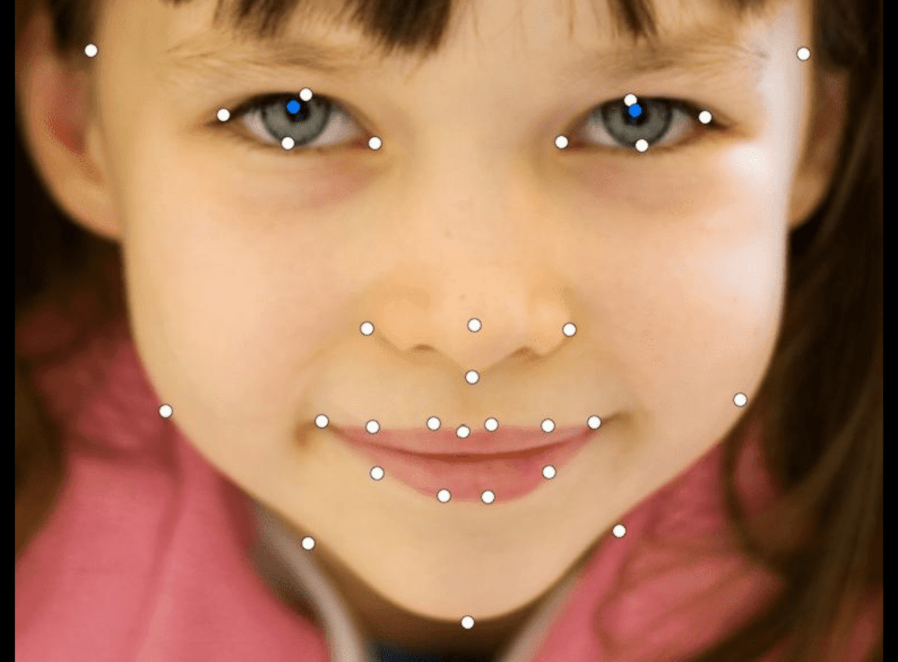
Why Mediapipe ?
Using Landmark on face we Can Calculate Eye Aspect Ratio and Best Way to Find Eye Blink According to Research by Czech Technical Universityh Technical University
It has Facial Landmark
Detection

Slide 5
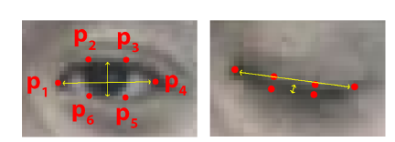
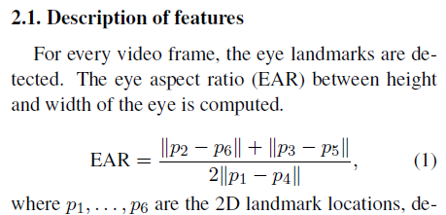
What is Eye Aspect Raito?
Calculates the ratio based on Euclidian distance
6 Landmark Points around Each Eye

Slide 6
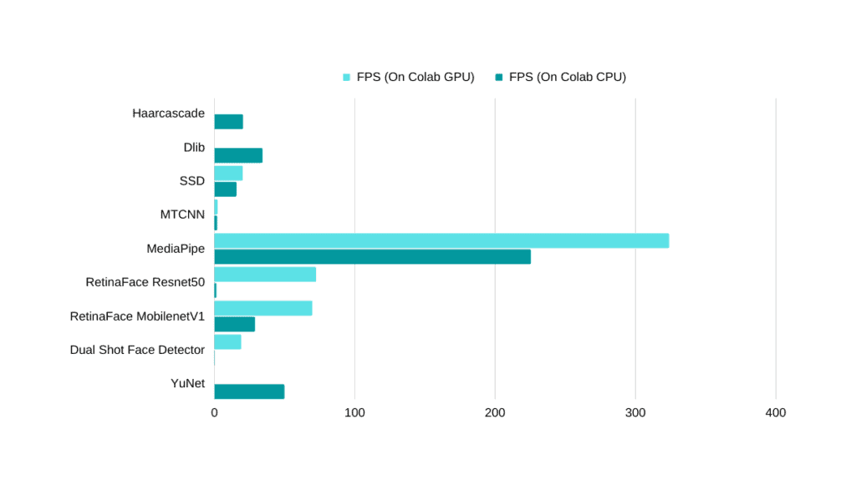
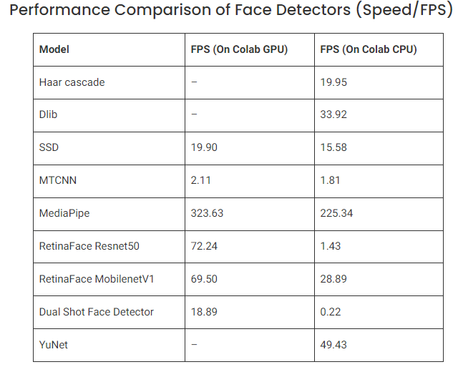
Why Mediapipe Not other Model?
Inference Speed
Low Hardware Capable*

Slide 7
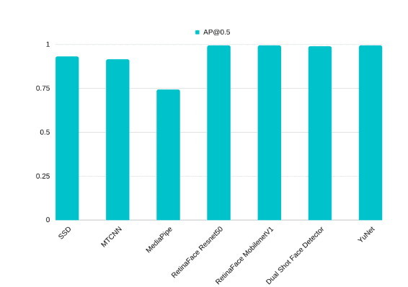
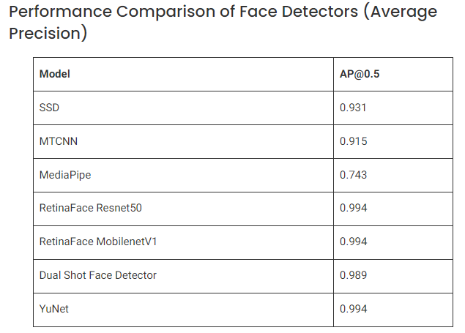
Why Mediapipe Not other Model?
Model Performance
Good AP Rating @ 0.5 confidence

Slide 8
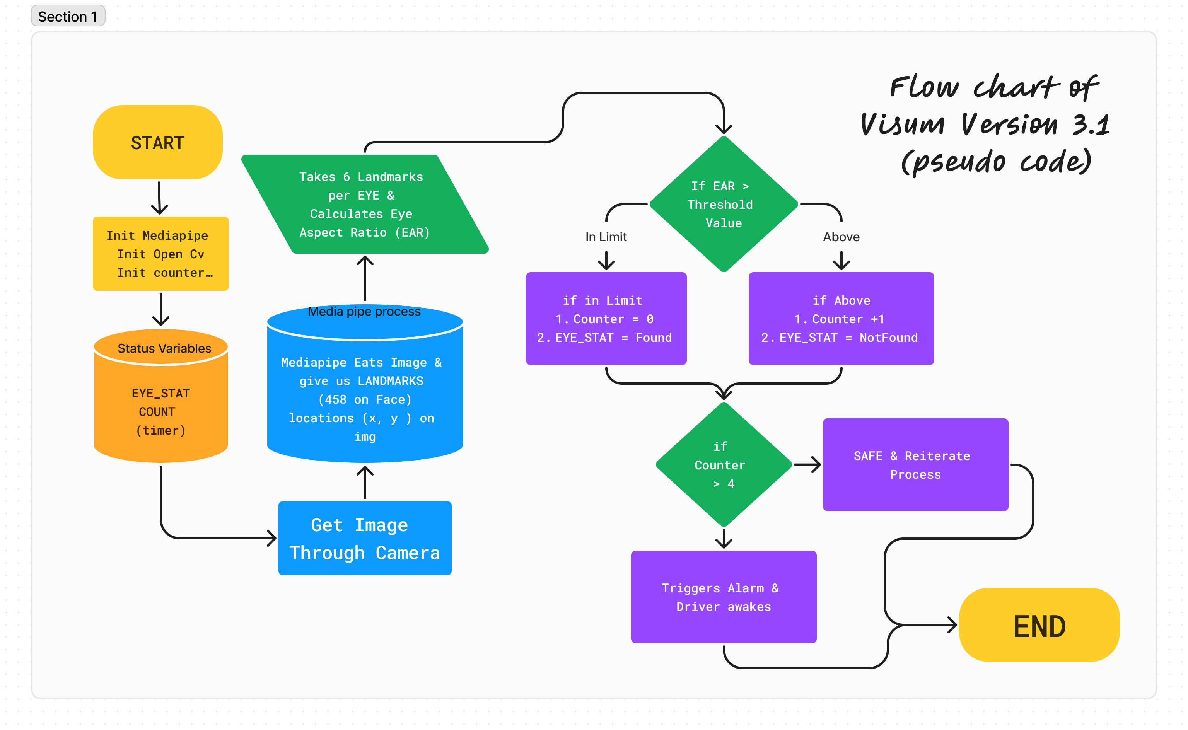

Slide 9

It’s Not a Bug .. It’s an Undocumented Feature @.@
Anonymous

Slide 10


Thank you
Team Visum

