Slide 1
Read normalization

Slide 2
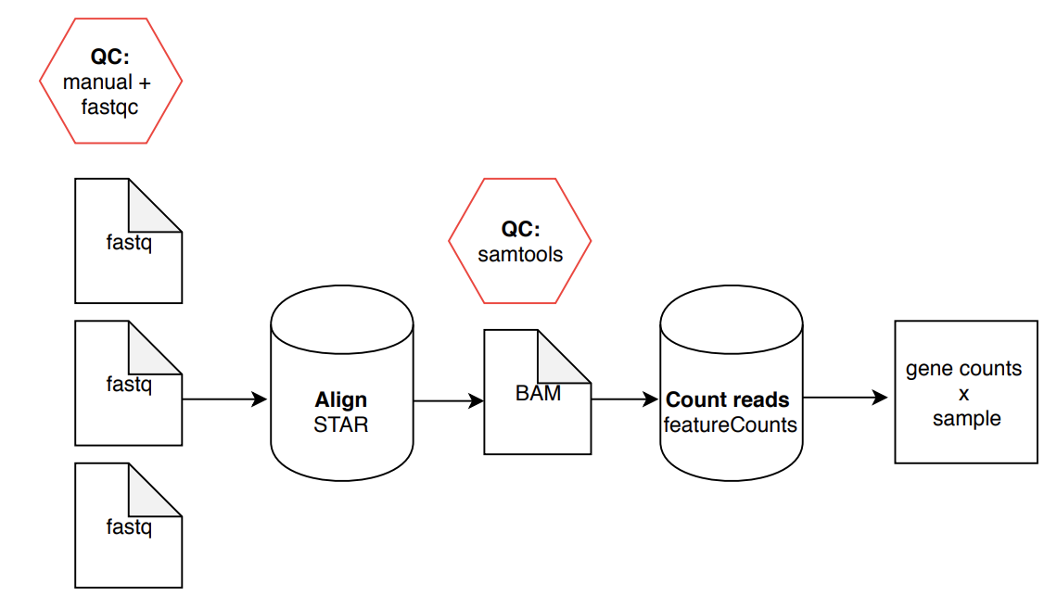
RNA-Seq Analysis Overview:
Can we use the raw gene counts x sample matrix?
Why or why not?

Slide 3
Why normalize reads?
Gene name | Rep 1 read counts | Rep 2 | Rep 3
A (2kb) | 10 | 12 | 30
B (4kb) | 20 | 25 | 60
C (1kb) | 5 | 8 | 15
D (10kb) | 0 | 0 | 1
Want to aggregate information across different replicates
Want to compare expression of different genes
Issues:
Different sequencing depth between replicates
Different gene length (bias towards larger genes)
Solution: FPKM / TPM
http://www.rna-seqblog.com/rpkm-fpkm-and-tpm-clearly-explained/

Slide 4
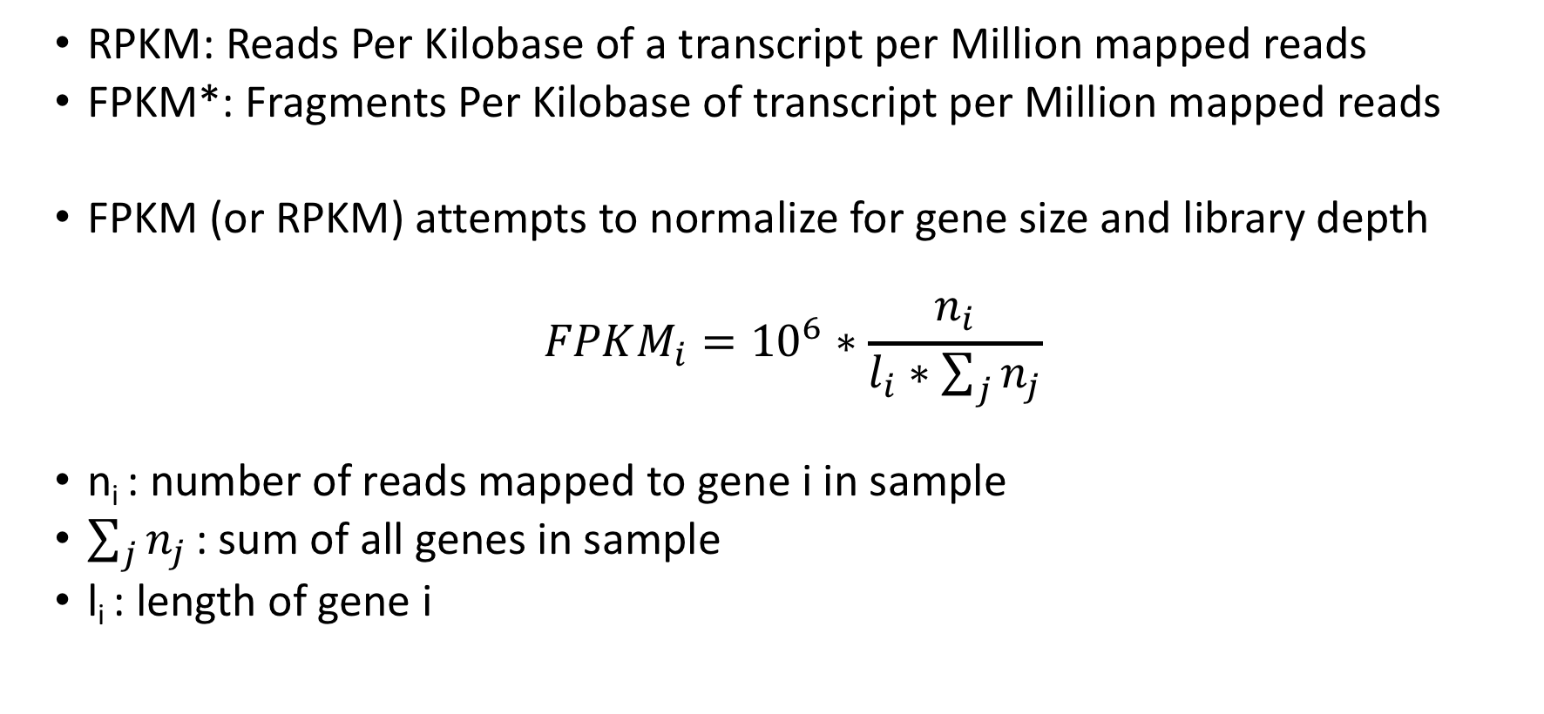
What is RPKM/FPKM?
RPKM: Reads Per Kilobase of a transcript per Million mapped reads
FPKM*: Fragments Per Kilobase of transcript per Million mapped reads
FPKM (or RPKM) attempts to normalize for gene size and library depth
$$FPKM_{i}={10}^{6}∗\frac{n_{i}}{l_{i}∗\sum_{j}{n_{j}}}$$
n_{i} : number of reads mapped to gene i in sample
$\sum_{j}{n_{j}}$ : sum of all genes in sample
l_{i} : length of gene i
* Fragments can mean either individual reads (SE) or paired-reads that map together (PE)

Slide 5
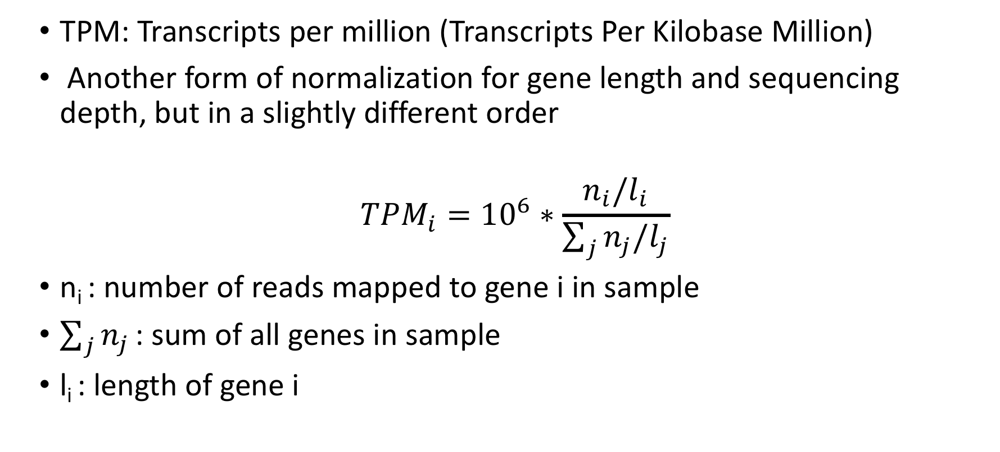
What is TPM?
TPM: Transcripts per million (Transcripts Per Kilobase Million)
Another form of normalization for gene length and sequencing depth, but in a slightly different order
$$TPM_{i}={10}^{6}∗\frac{n_{i}/l_{i}}{\sum_{j}{n_{j}/l_{j}}}$$
n_{i} : number of reads mapped to gene i in sample
$\sum_{j}{n_{j}}$ : sum of all genes in sample
l_{i} : length of gene i

Slide 6
Gene name | Rep 1 read counts | Rep 2 | Rep 3
A (2kb) | 10 | 12 | 30
B (4kb) | 20 | 25 | 60
C (1kb) | 5 | 8 | 15
D (10kb) | 0 | 0 | 1
RPKM:
Sum total # reads
Divide total by 10^6
Divide each count by this #
Divide each count by length of the gene (kb)
TPM:
Divide each count by length of the gene (kb)
Sum RPK values
Divide total by 10^6
Divide each RPK this #

Slide 7
Try it on your own!
Gene name | Rep 1 read counts | Rep 2 | Rep 3
A (2kb) | 10 | 12 | 30
B (4kb) | 20 | 25 | 60
C (1kb) | 5 | 8 | 15
D (10kb) | 0 | 0 | 1
RPKM:
Sum total # reads
Divide total by 10
Divide each count by this #
Divide each count by length of the gene (kb)

Slide 8
RPKM Calculation
Gene name | Rep 1 read counts | Rep 2 | Rep 3
A (2kb) | 10 | 12 | 30
B (4kb) | 20 | 25 | 60
C (1kb) | 5 | 8 | 15
D (10kb) | 0 | 0 | 1
Total: 35 45 106
Tens of Reads: 3.5 4.5 10.6
(Millions of reads)
Reads Per Million
Gene name | Rep 1 | Rep 2 | Rep 3
A (2kb) | 2.86 | 2.67 | 2.83
B (4kb) | 5.71 | 5.56 | 5.66
C (1kb) | 1.43 | 1.78 | 1.42
D (10kb) | 0 | 0 | 0.09

Slide 9
RPKM Calculation
Reads Per Kilobase Million
Gene name | Rep 1 RPKM | Rep 2 | Rep 3
A (2kb) | 1.43 | 1.33 | 1.42
B (4kb) | 1.43 | 1.39 | 1.42
C (1kb) | 1.43 | 1.78 | 1.42
D (10kb) | 0 | 0 | 0.009

Slide 10
Try it on your own!
Gene name | Rep 1 read counts | Rep 2 | Rep 3
A (2kb) | 10 | 12 | 30
B (4kb) | 20 | 25 | 60
C (1kb) | 5 | 8 | 15
D (10kb) | 0 | 0 | 1
TPM:
Divide each count by length of the gene (kb)
Sum RPK values
Divide total by 10
Divide each RPK by this #

Slide 11
TPM Calculation
Gene name | Rep 1 read counts | Rep 2 | Rep 3
A (2kb) | 10 | 12 | 30
B (4kb) | 20 | 25 | 60
C (1kb) | 5 | 8 | 15
D (10kb) | 0 | 0 | 1
Reads Per Kilobase
Gene name | Rep 1 | Rep 2 | Rep 3
A (2kb) | 5 | 6 | 15
B (4kb) | 5 | 6.25 | 15
C (1kb) | 5 | 8 | 15
D (10kb) | 0 | 0 | 0.1
Total RPK: 15 20.25 45.1
Tens of RPK 1.5 2.025 4.51
(Millions of RPK)

Slide 12
TPM Calculation
Transcripts Per Million
Gene name | Rep 1 TPM | Rep 2 | Rep 3
A (2kb) | 3.33 | 2.96 | 3.326
B (4kb) | 3.33 | 3.09 | 3.326
C (1kb) | 3.33 | 3.95 | 3.326
D (10kb) | 0 | 0 | 0.1

Slide 13
Comparison of RPKM/FPKM and TPM
Reads Per Kilobase Million
Gene name | Rep 1 RPKM | Rep 2 | Rep 3
A (2kb) | 1.43 | 1.33 | 1.42
B (4kb) | 1.43 | 1.39 | 1.42
C (1kb) | 1.43 | 1.78 | 1.42
D (10kb) | 0 | 0 | 0.009
Total: 4.29 4.5 4.25
Transcripts Per Million
Gene name | Rep 1 TPM | Rep 2 | Rep 3
A (2kb) | 3.33 | 2.96 | 3.326
B (4kb) | 3.33 | 3.09 | 3.326
C (1kb) | 3.33 | 3.95 | 3.326
D (10kb) | 0 | 0 | 0.1
Total: 10 10 10

Slide 14
(Luckily DeSEQ2 normalizes for us)
But you should know this!

