Slide 1
Count Data and DESeq2

Slide 2
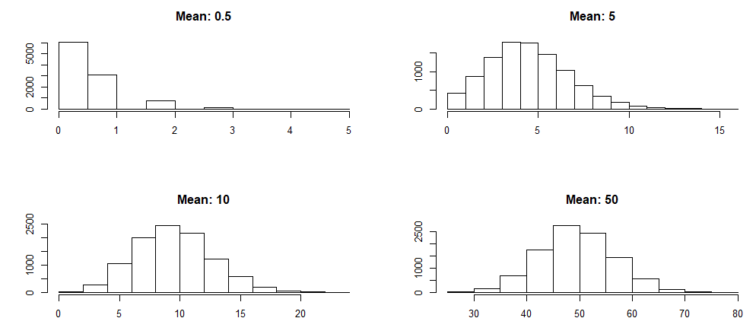

Count Data
Count data is modeled using a Poisson distribution
In Poisson distributions the mean is equal to the variance
$P\left(k number of events\right)= \frac{{λ^{k}e}^{−λ}}{k!}$
$λ=mean$
$k=observed counts$
$e=$ Euler’s number

Slide 3
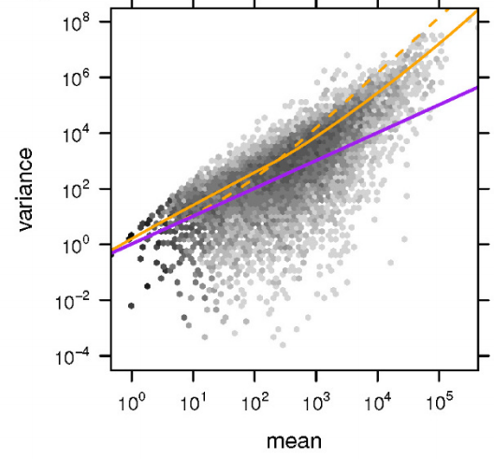
Count Data
Biological Data is often ‘overdispersed’
With increasing mean the variance grows disproportionally
- - : estimate using DESeq
: fit to data
: Poisson variance for each mean
Anders & Huber, 2010
Notes:
Simon Anders and Wolfgang Huber 2010

Slide 4
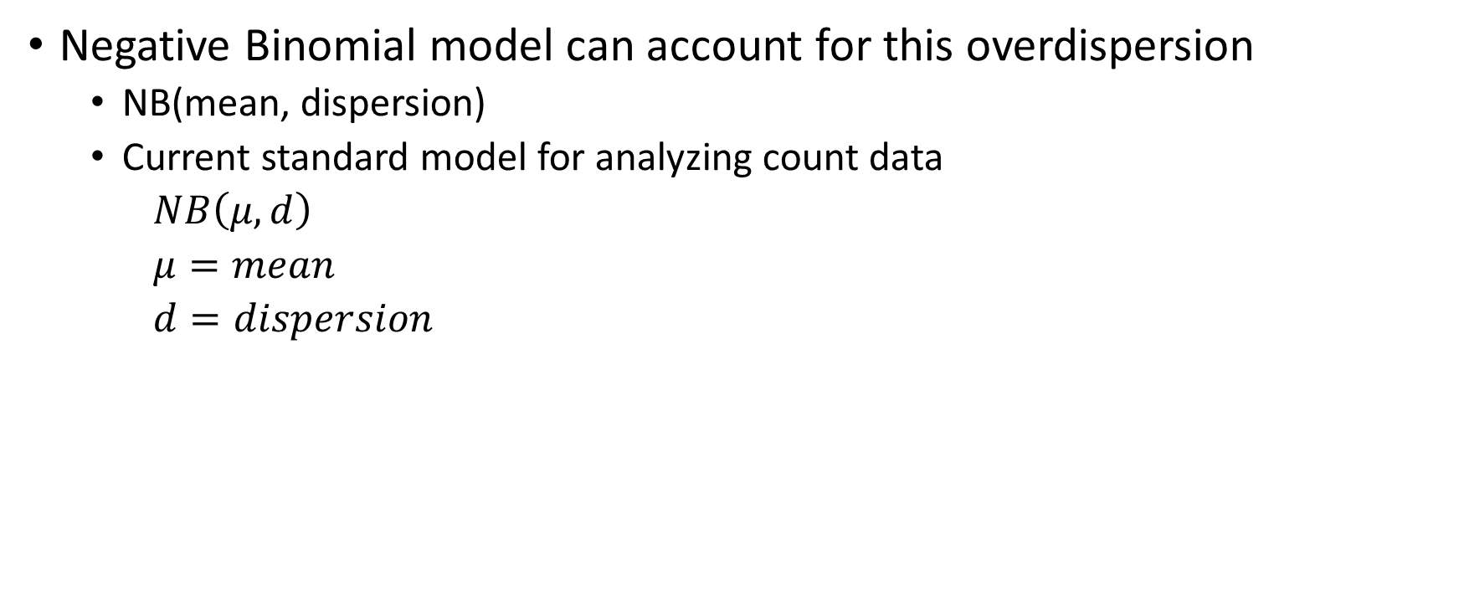
Count Data
Negative Binomial model can account for this overdispersion
NB(mean, dispersion)
Current standard model for analyzing count data
$NB\left(μ, d\right)$
$μ=mean$
$d=dispersion$

Slide 5
DESeq2
Program for differential gene expression
Utilizes negative binomial model to model distribution of each gene
Extensive documentation and examples available online
Documentation: https://bioconductor.org/packages/release/bioc/manuals/DESeq2/man/DESeq2.pdf
Examples: https://bioconductor.org/packages/release/bioc/vignettes/DESeq2/inst/doc/DESeq2.html

Slide 6
DESeq2: Approach
Normalize per-sample
Calculate a mean /variance per gene (using NB + fancy tricks)
Do two means explain data better than one ?
 | L1 | L2 | H1 | H2
G1 | r_{1C} | r_{1C} | r_{1C} | r_{1C}
G2 | r_{2C} | r_{2C} | r_{2C} | r_{2C}
G3 | r_{3C} | r_{3C} | r_{3C} | r_{3C}
Normalized Counts
 | L1 | L2 | H1 | H2
G1 | k₁₁ | k₁₂ | k₁₃ | k₁₄
G2 | k₂₁ | k₂₂ | k₂₃ | k₂₄
G3 | k₃₁ | k₃₂ | k₃₃ | k₃₄
H₀: per gene mean
 | H1 | H2
G1 | r_{1H} | r_{1H}
G2 | r_{2H} | r_{2H}
G3 | r_{3H} | r_{3H}
 | L1 | L2
G1 | r_{1L} | r_{1L}
G2 | r_{2L} | r_{2L}
G3 | r_{3L} | r_{3L}
H_{A}: per experiment mean
Notes:
Geometric mean: accounts for highly overexpressed genes when normalizing the samples

Slide 7
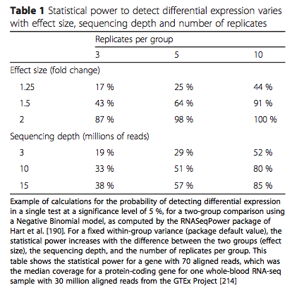
Note on replicates
Conesa et al., Genome Biology 2016

