Slide 1
MAST Kepler data archive
張瀚元

Slide 2
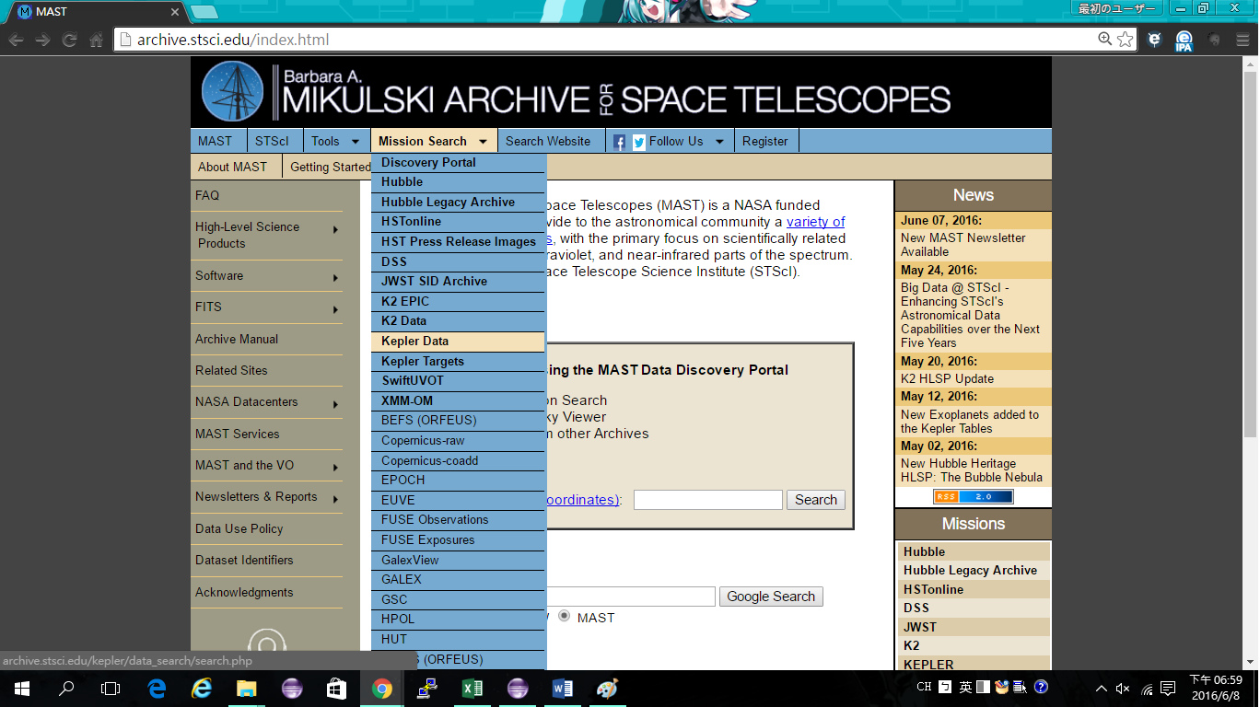
Kepler Data acquiring and selection
Mikulski Archive for Space Telescopes (MAST) https://archive.stsci.edu/
We use the data from MAST (https://archive.stsci.edu/)
We selected 3130 M dwarfs by 2500 < Teff < 3800 and log (g) > 4 from Huber et al. 2014.
We have matched the LAMOST M dwarf targets with those with Kepler light curves, 144 can be identiﬁed.

Slide 3
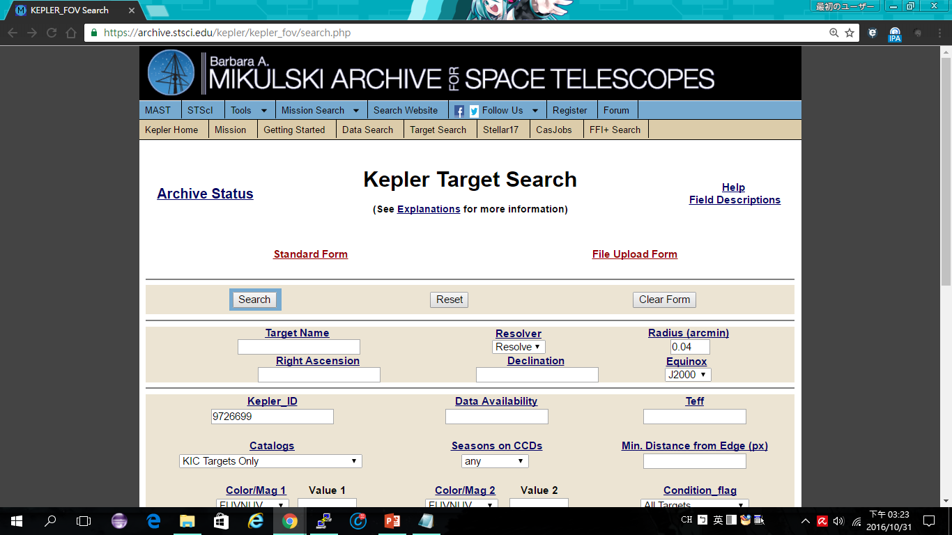

Slide 4
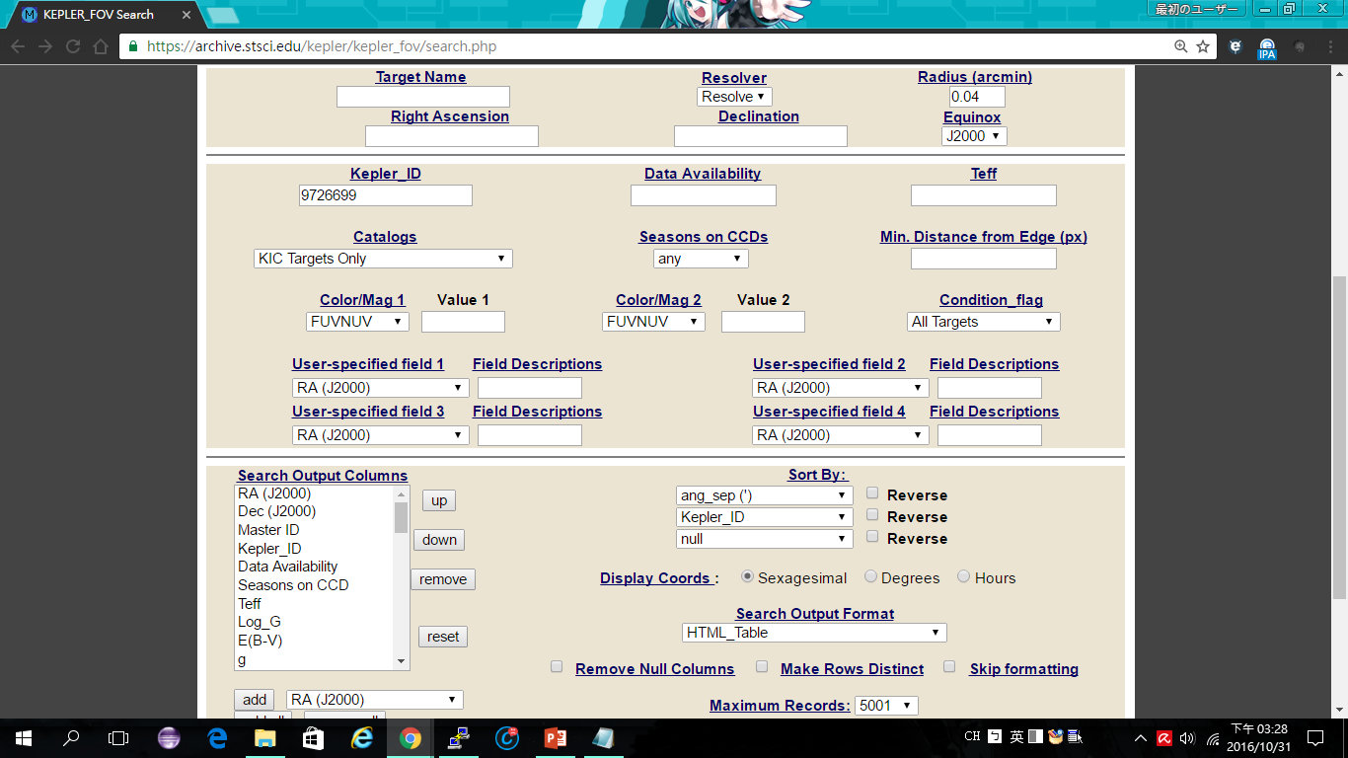

Slide 5
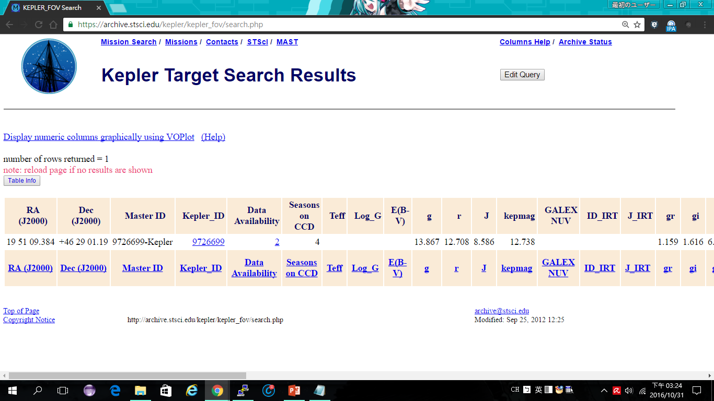

Slide 6
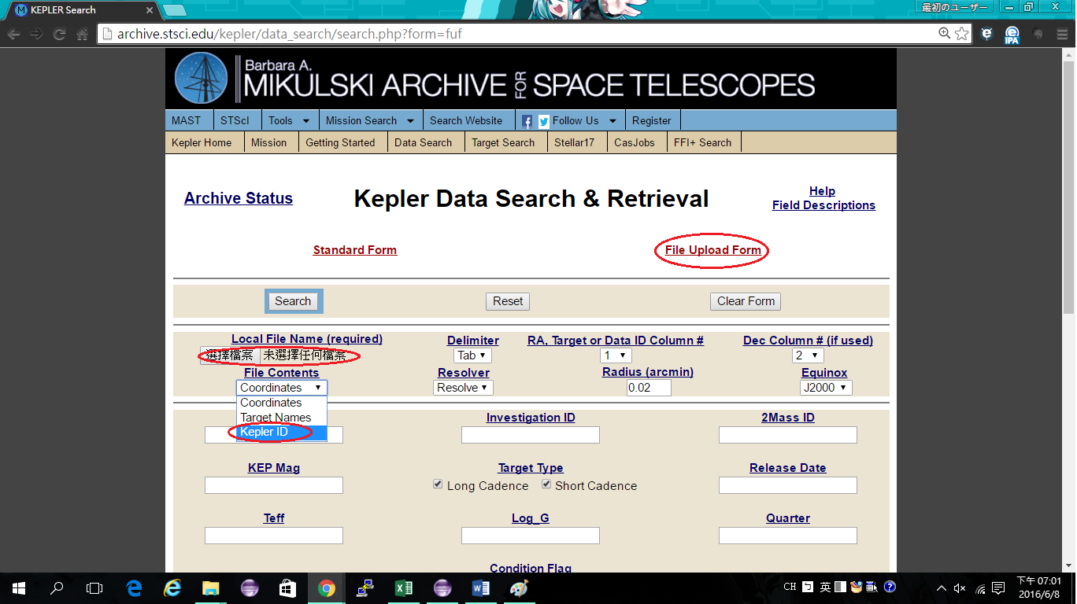
Kepler Data acquiring and selection

Slide 7
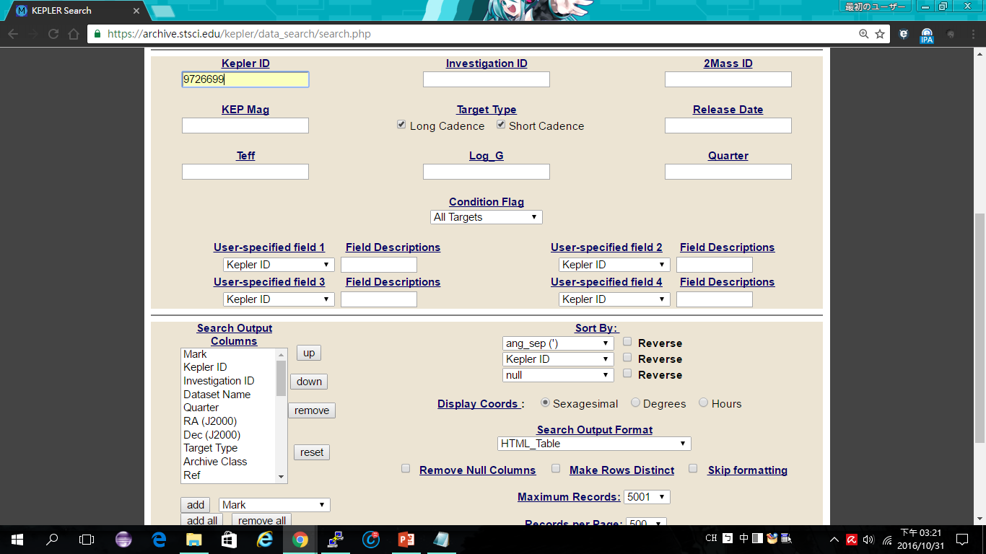

Slide 8
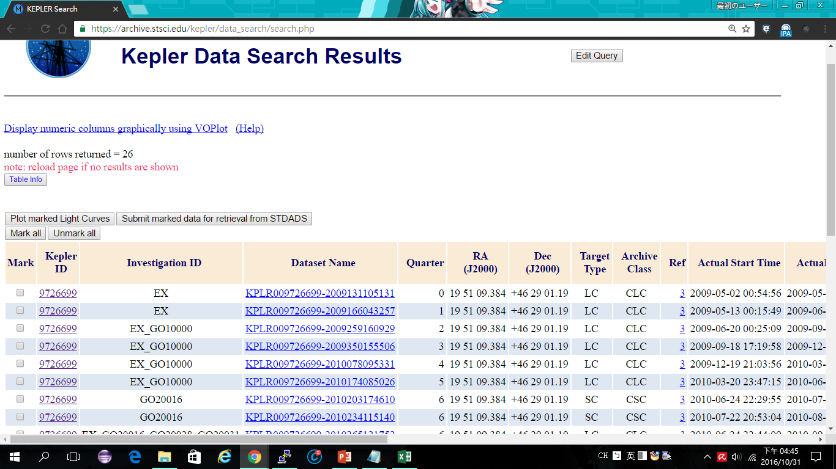

Slide 9
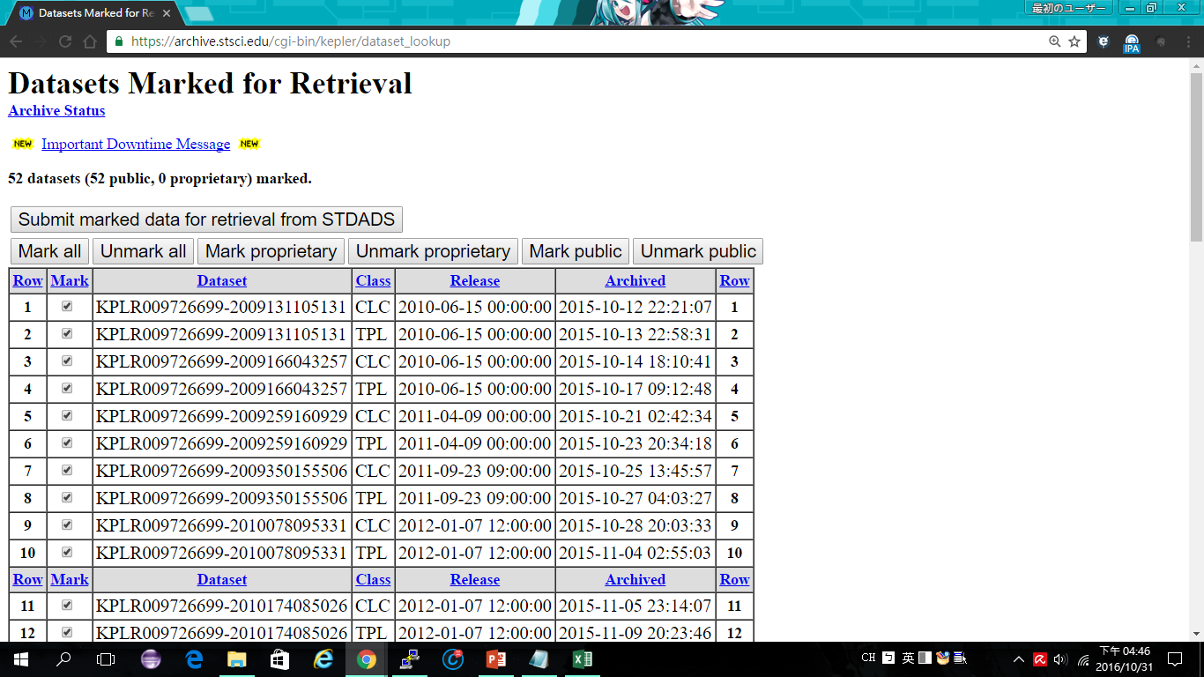

Slide 10
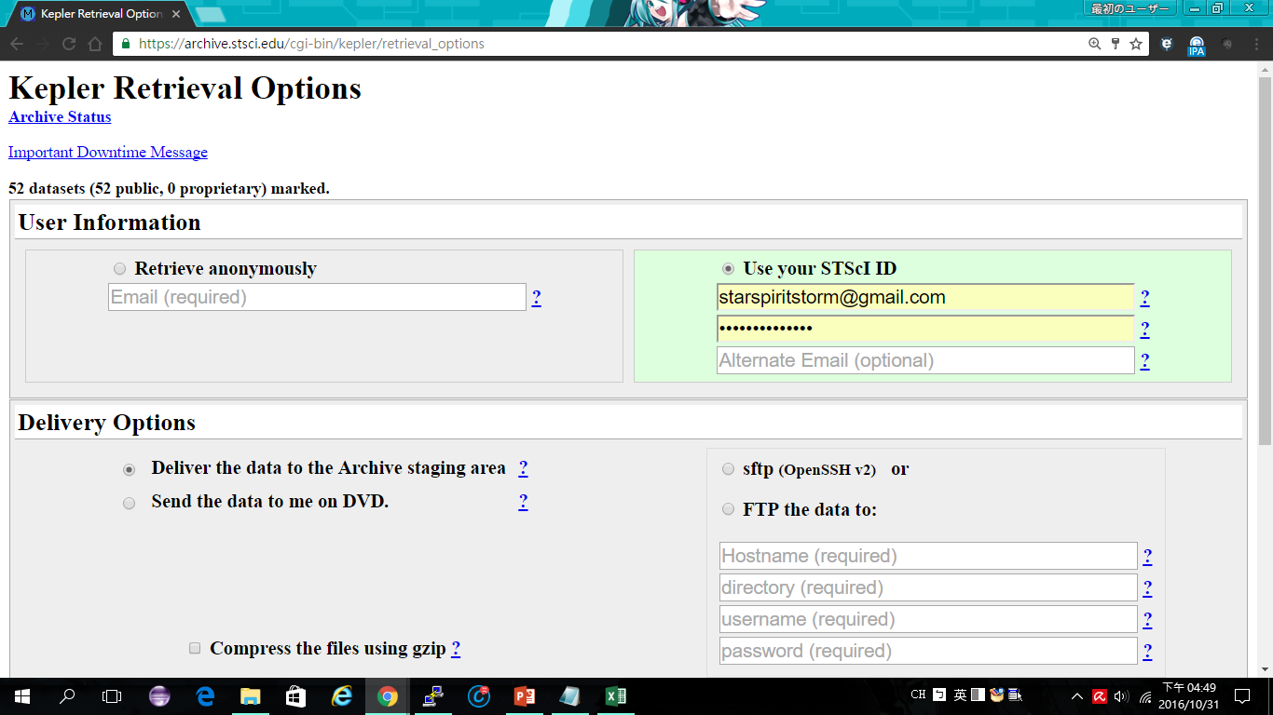

Slide 11
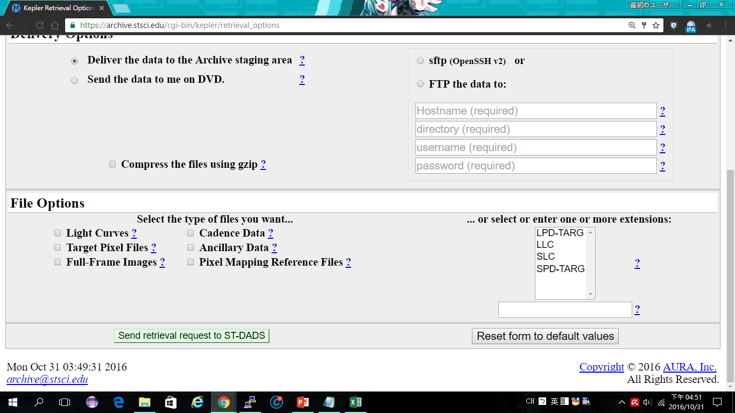

Slide 12
LLC&SLC are combined target pixel file LPD&SPD-TARG are target pixel file
They are all in .fits file form

Slide 13
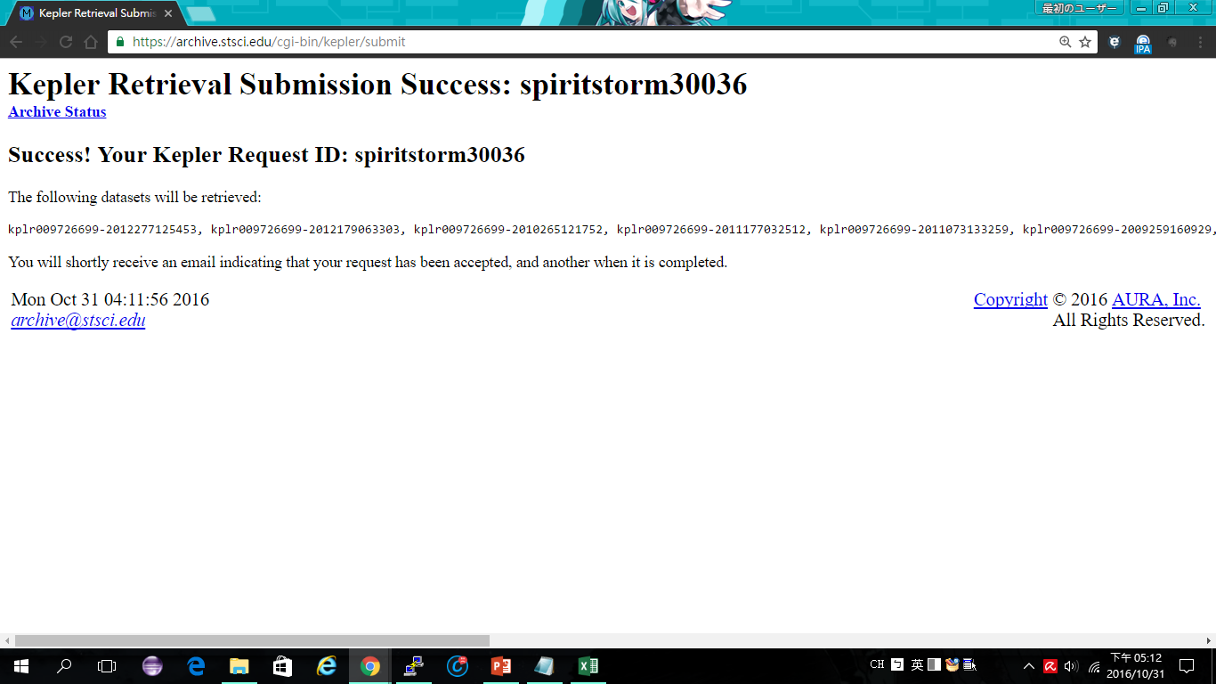

Slide 14
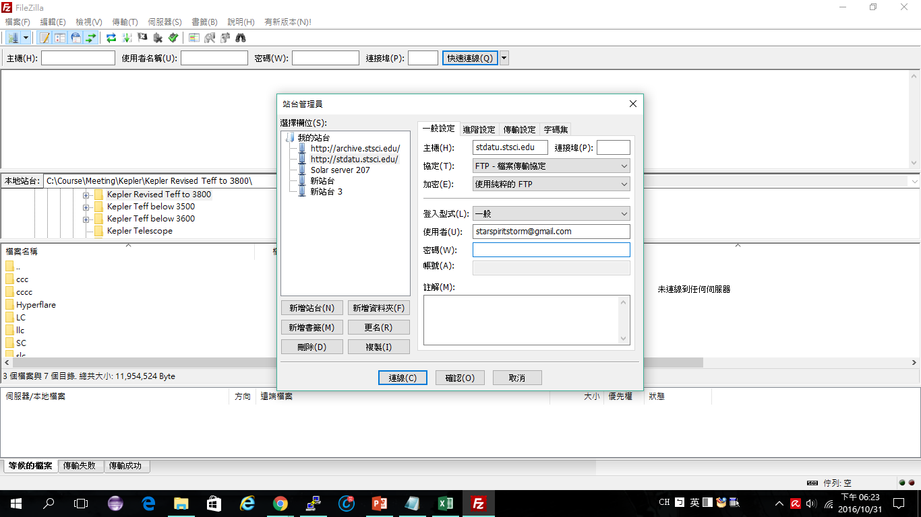

Slide 15
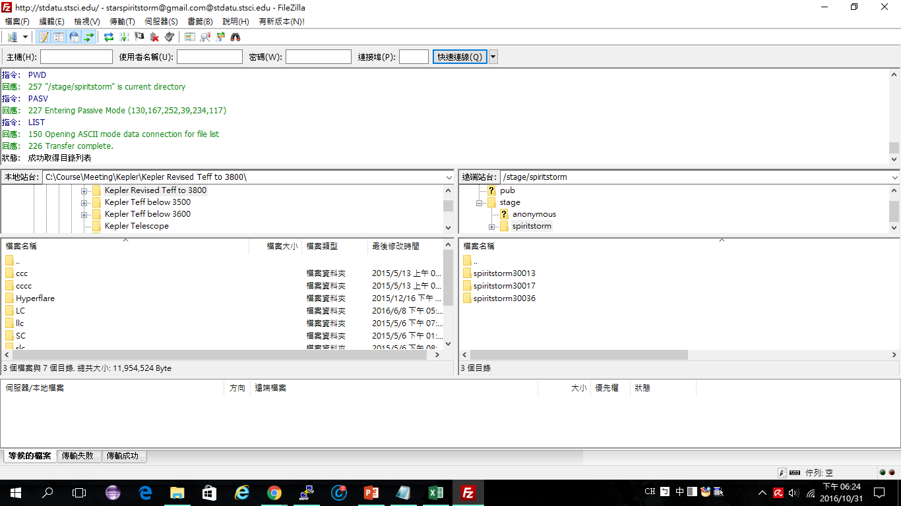

Slide 16
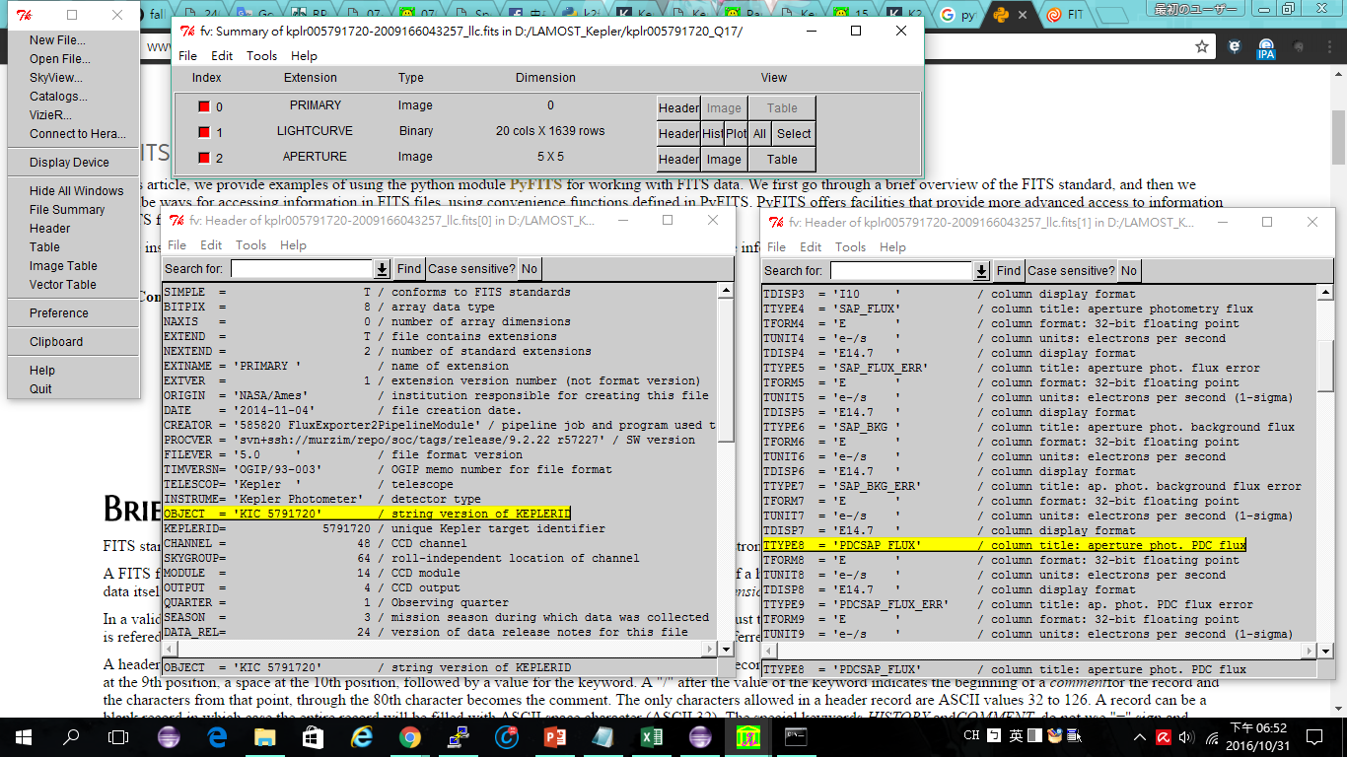

Slide 17
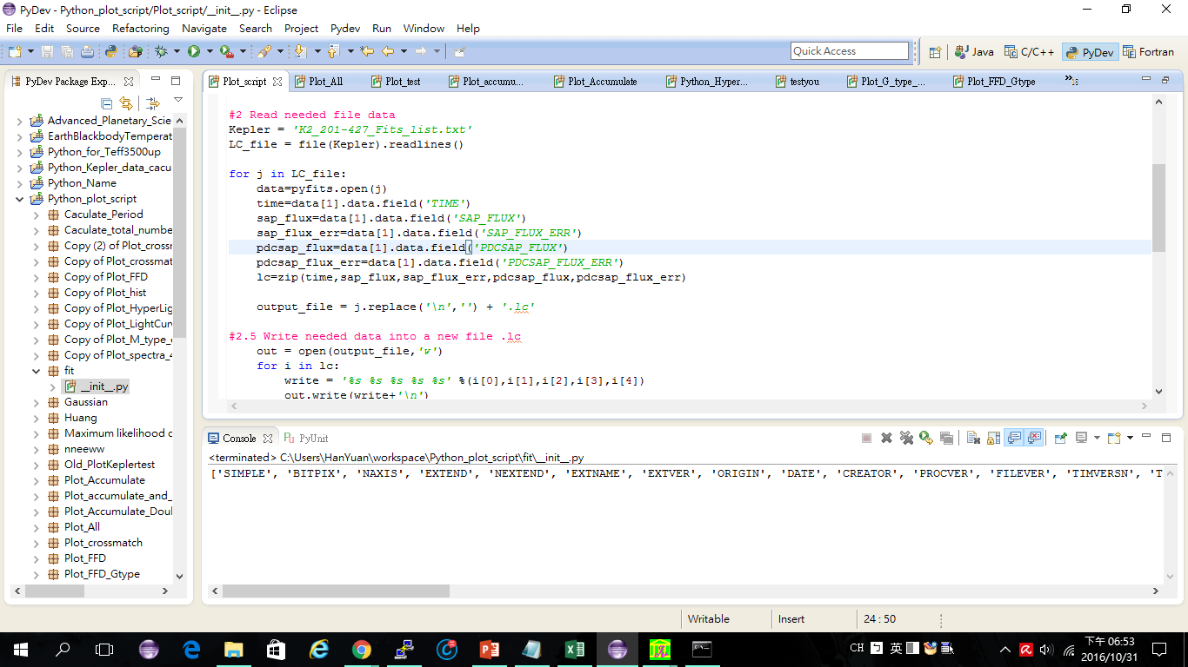

Slide 18
Sample list of the Kepler M dwarfs with LAMOST spectra listed in DR3
Kepler ID | T_{eff}ª | R_{star}ª (in R⊙) | P_{rot}^{b} (day) | Type^{c} | EW^{d} (Hα) | ΔF/<F>^{e} (Max) | FFD k^{f}
5791720 | 3702 | 0.569 | 0.77 | M3 | 4.52 | 0.93 | 1.63
8507979 | 3661 | 0.556 | 1.22 | M3 | 3.78 | 0.62 | 1.73
11495571 | 3304 | 0.26 | 13.76 | M3 | 2.60 | 0.35 | 1.3
6286466 | 3244 | 0.199 | 30.27 | M2 | -0.57 | --- | ---

Slide 19
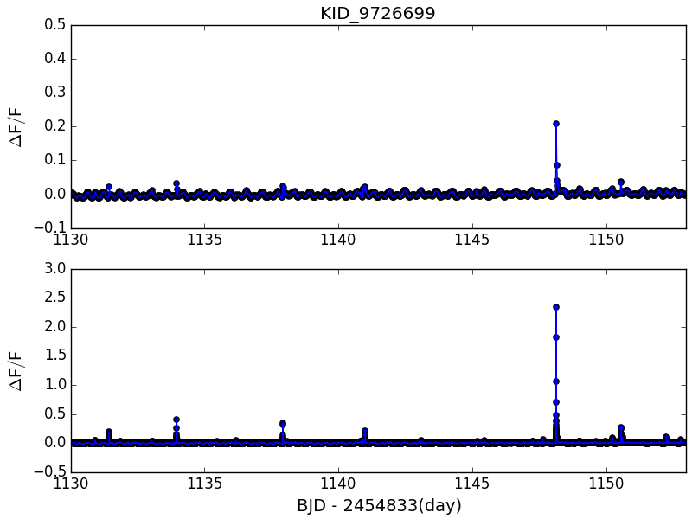
GJ 1243 LC and SC light curve comparison
LC
SC

Slide 20
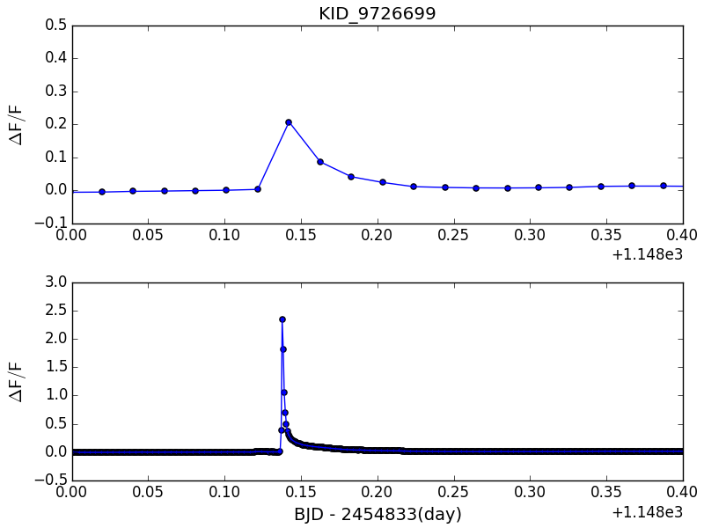
GJ 1243 LC and SC light curve comparison
LC
SC

Slide 21
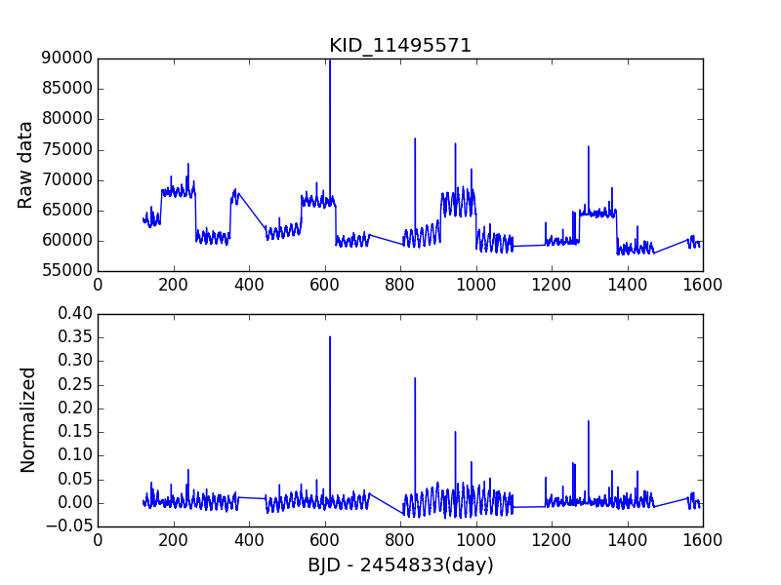
Normalize Kepler light curve
There are some offsets between different quarter data.
Therefore, we need to normalize the light curves from different quarter data to derive the rotation period.
Notes:
Active and inactive light curve

Slide 22
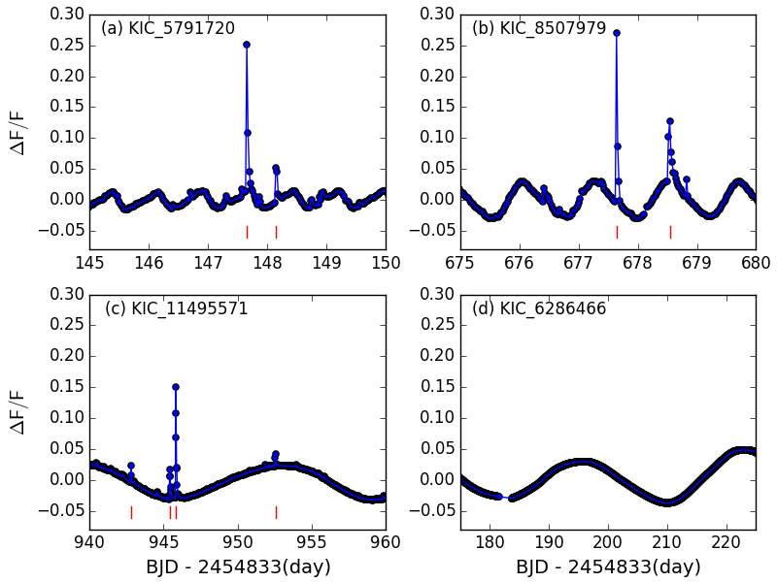
Kepler Light Curve Example
The normalize formula is
∆F/ <F> = (F_{i}− <F>) / <F>
Where <F> is the median flux of single quarter, F_{i} is the flux at each time i, ∆F is the difference between the each data points F_{i} and the median flux <F>.
Notes:
Active and inactive light curve

Slide 23
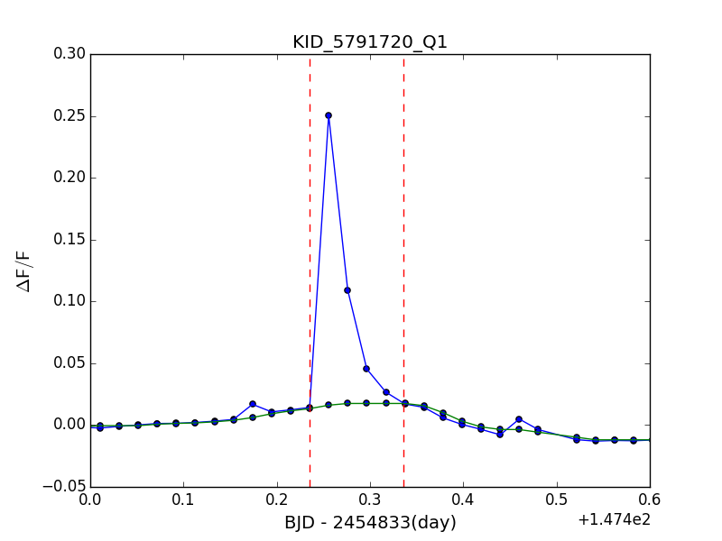
Detrending
In order to calculate the flare amplitude, we use moving average method to remove the small trend in light curve within a short period of time.
If the rotation period is less than 2.5 days, we use the 9 data points as the moving average boxcar.
Then, the median of the 9 data points of each boxcar is used to construct the smoothed light curve.
If the rotation period is longer than 2.5 days, the boxcar is 21 data points.

Slide 24
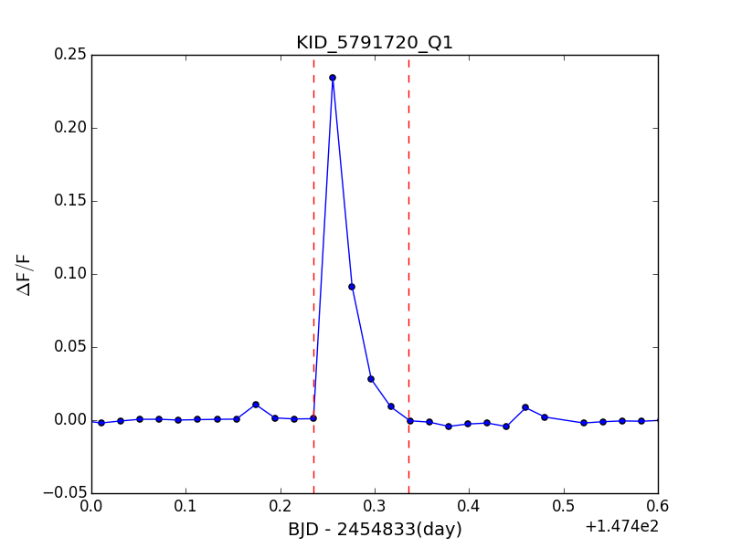
Detrending
Clean light curve without the rotation period.

Slide 25
Flare Detection
To calculate the energy of each flare, we add up the area below the clean light curve.
Typically, one flare has a duration of 2.5 hours to 3 hours and the energy ranges from 10³¹ erg to 10³³ erg.
However, there are some “hyperflares”, which is comparable to the G dwarf superflare event (Meahara et al. 2012, Wu et al. 2015).
These “hyperflares” have longer duration and they can release energy up to ∼10³⁶ erg.
Notes:
Superflare event first, then hyperflare

Slide 26
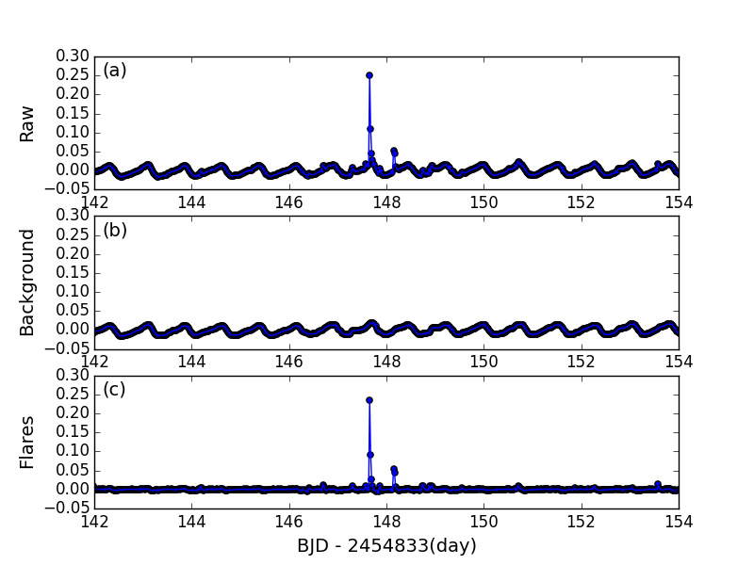
Flare Detection
Because we have the raw light curve, and the raw light curve after moving average .
We can easily subtract the raw light curve and raw light curve after moving average to get the clean flare without the rotation period.

Slide 27
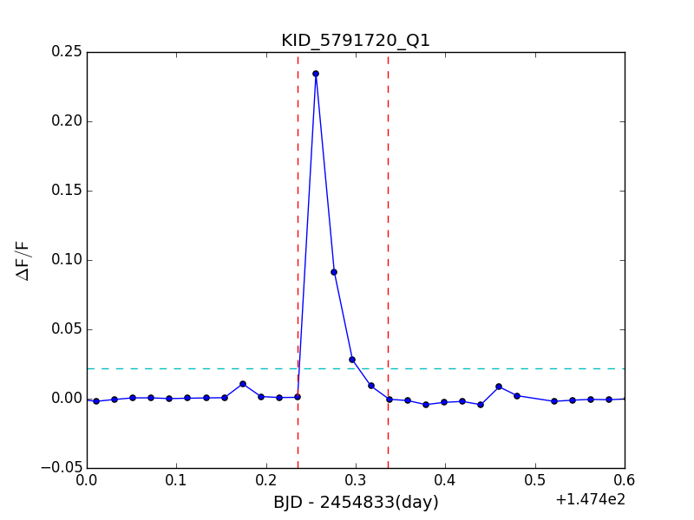
Flare Detection
The flare detection method is similar with Wu et al. (2015).
The flare can be identified by searching for significant brightness increases which is out of three-time standard deviation (i.e., 3σ).
Notes:
To avoid false positive and cosmic ray, we define a flare at least 3 points out of 3σ
0.02

Slide 28
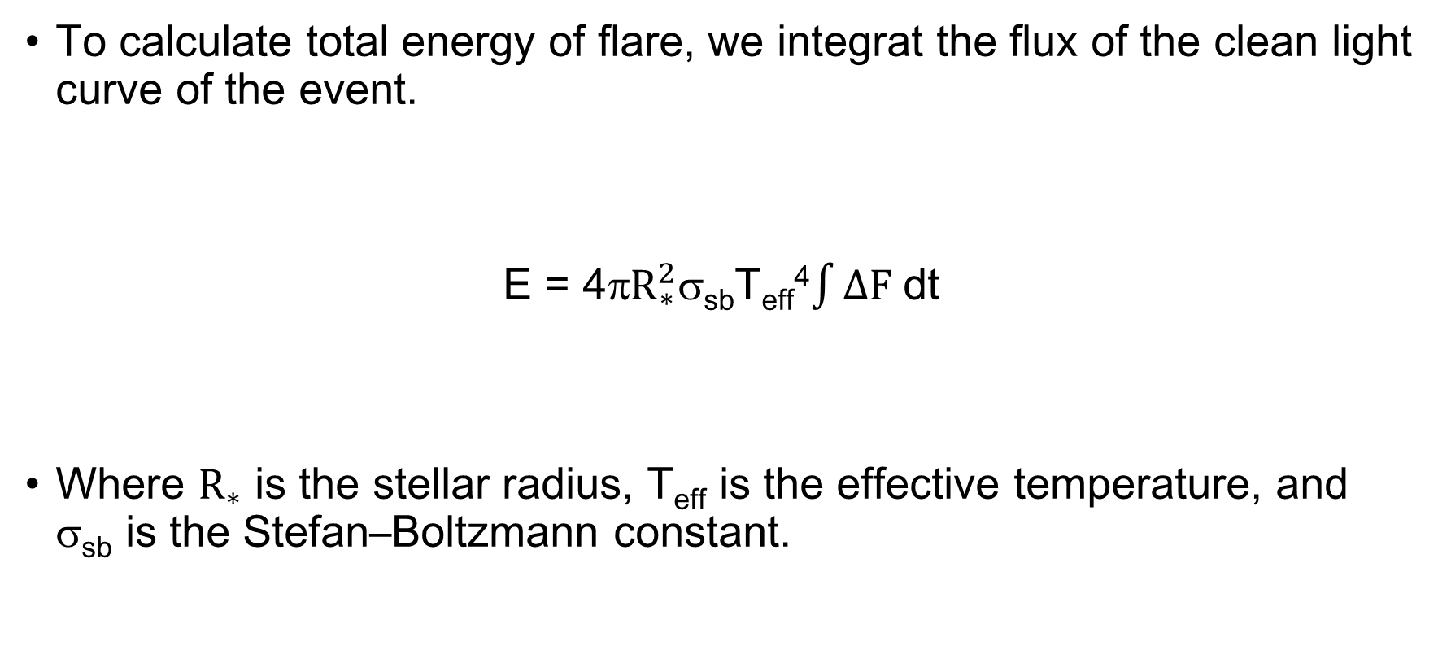
Flare energy
To calculate total energy of flare, we integrat the flux of the clean light curve of the event.
E = 4π$R_{∗}^{2}$σ_{sb}T_{eff}⁴$\int{ΔF }$dt
Where $R_{∗}$ is the stellar radius, T_{eff} is the effective temperature, and σ_{sb} is the Stefan–Boltzmann constant.

Slide 29
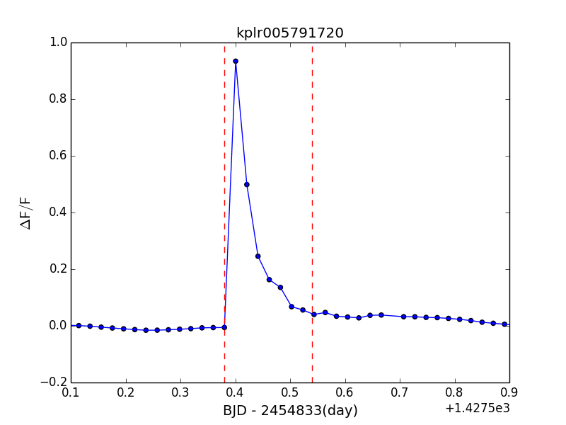
M dwarf hyper flare example
KID 5791720 with the peak ﬂux reaching almost the same level as the stellar luminosity of this M3 star.
The two red dashed lines indicate the time interval for the ﬂare energy calculation.
This flare has 3.5 hour duration and energies 7.6x10³⁵ ergs.

Slide 30
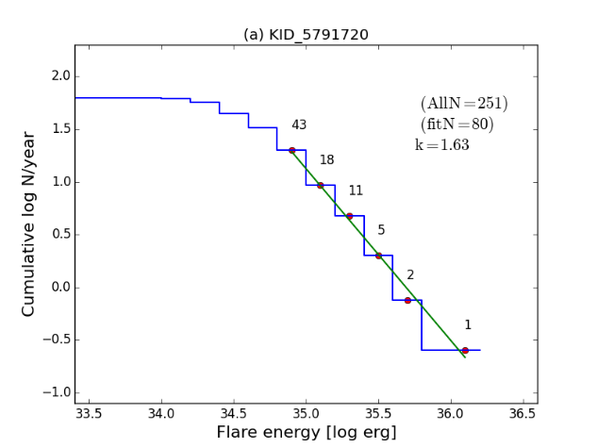
Flare frequency distribution
The total 4 years observation by Kepler can provide a good quantities of flare events so that the ﬂare frequency distributions (FFDs) can be constructed.
N(E) ∝ E^{-k}

Slide 31
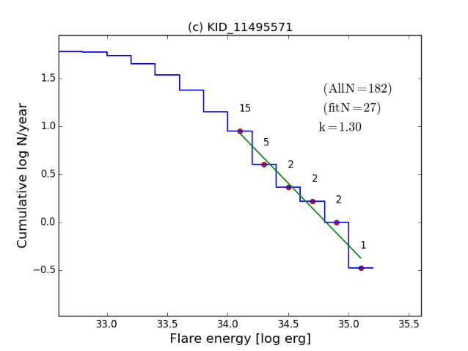
Flare frequency distribution
The reason here we only use the first six bins to extrapolate a power law distribution is because of the limitation of counting the small flares.
Many small flares may excluded by 3σ condition.

Slide 32
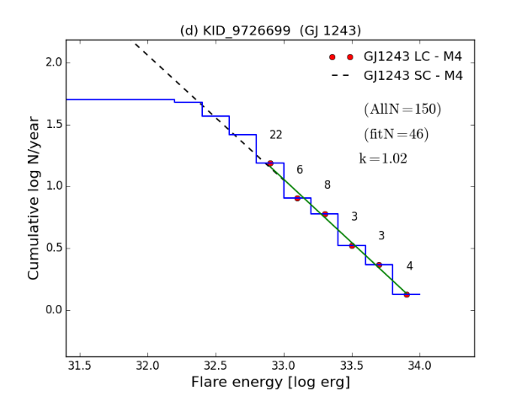
Flare frequency distribution
The flattening at lower energy could caused by the limitation in counting small ﬂares of short duration ( < 30 min).
Davenport et al. (2015) analyzed the short-cadence ( ∼1 min) light curves of GJ 1243 (M4) and produced a FFD with a power-law index of k ∼ 1.01 for energy between 10³⁰ and 10³³ ergs .

Slide 33
GJ 1243 LC and SC light curve comparison
LC
SC
Notes:
0.02

Slide 34
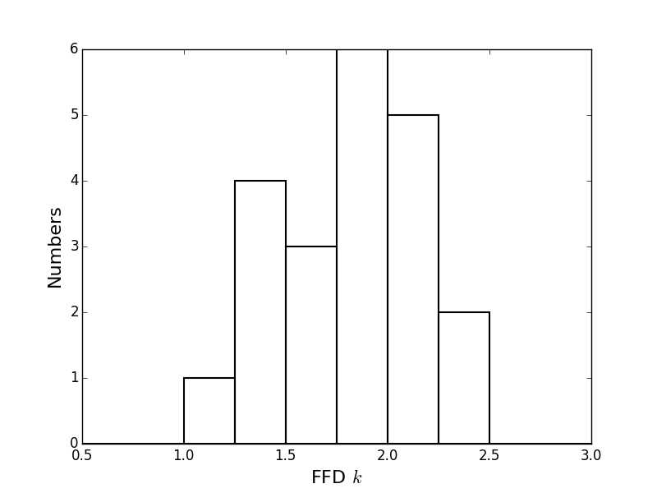
Flare frequency distribution
A histogram of the power law index (k) value. The k values vary between 1.0 and 2.5.

Slide 35
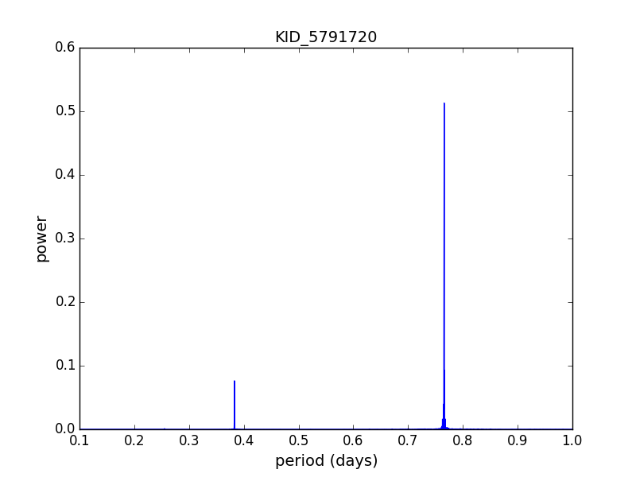
Rotation period
The rotation period of these M dwarf are calculated by the Lomb-Scargle periodograms for the 4 years Kepler data set for each target.

