Slide 1

KSC Morning Weather Briefing
7 November 2026
Mark Burger
Launch Weather Officer

Slide 2
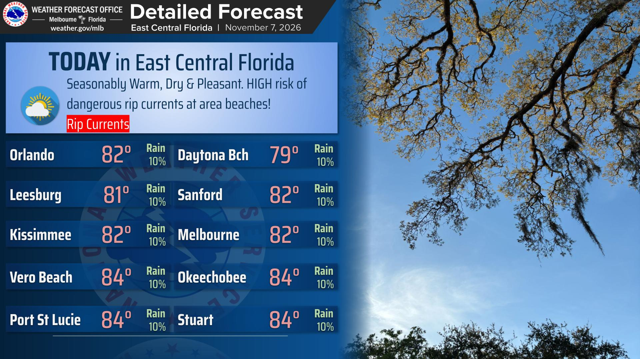
Today’s Tidbits
Your first weather tidbit here
Your second weather tidbit here
Your third weather tidbit here
Your fourth weather tidbit here
Current a/o: 10/30/2026 7:18 AM OPR: 45 Weather Sq
Notes:
https://www.weather.gov/images/mlb/graphicast/3.png

Slide 3
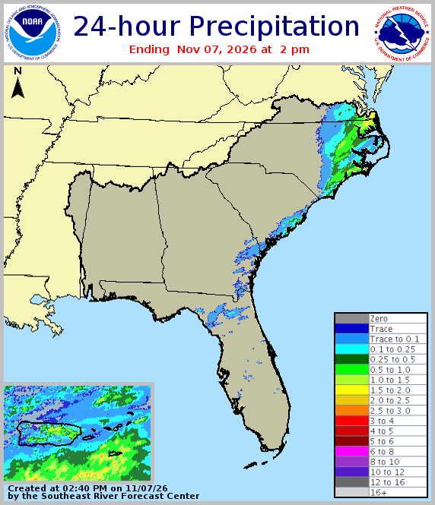
Daily Almanac
KSC Past 24 Hour Data
KSC Peak Wind | 20 KT
KSC Max Rainfall | 0.00”
KSC High/Low Temp | 86/70 °F
Melbourne NWS Almanac
Normal High/Low | 79/63 °F
Record High | 87 °F (1972, 2015)
Record Low | 41 °F (1970)
Sunrise | 6:38 AM EST
Sunset | 5:34 PM EST
Current a/o: 10/30/2026 7:18 AM OPR: 45 Weather Sq
Notes:
https://www.weather.gov/serfc/wxobsfcst_past_precipitation
*NOAA Rainfall Map should auto update if link isn’t broken

Slide 4
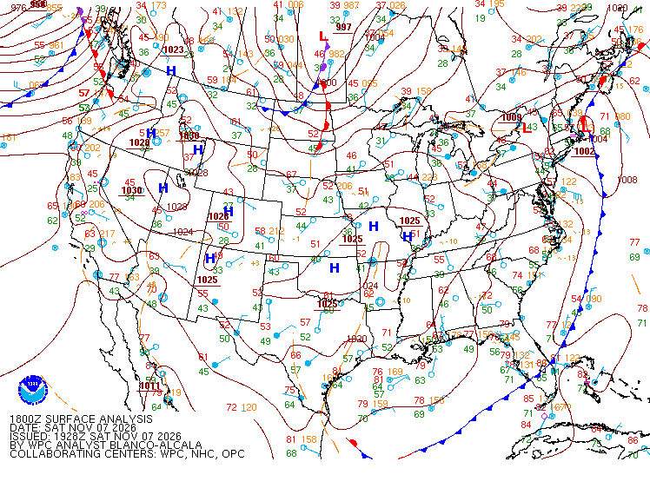
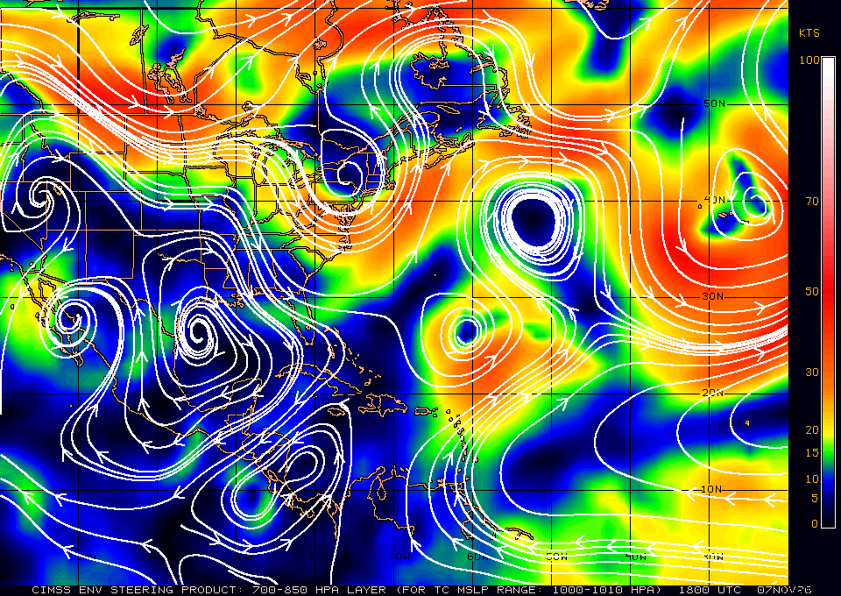
Current Pattern
Surface
Steering Layers (700-850mb)
Current a/o: 10/30/2026 7:18 AM OPR: 45 Weather Sq
Notes:
https://www.weather.gov/oun/sfcmaps
http://tropic.ssec.wisc.edu/real-time/dlmmain.php?&basin=atlantic&sat=wg8&prod=dlm1&zoom=&time
*Steering Layers should auto update if links aren’t broken

Slide 5
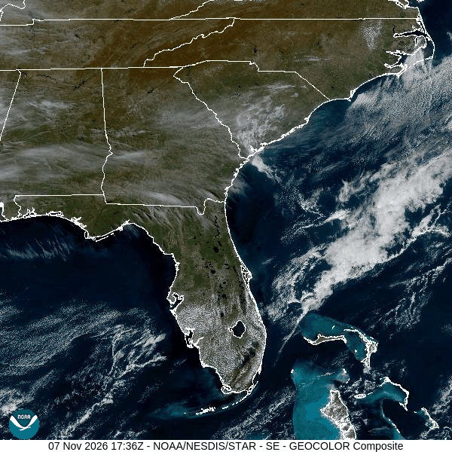
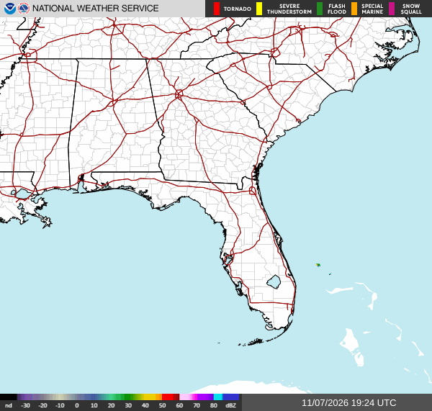
Recent Satellite & Radar
Current a/o: 10/30/2026 7:18 AM OPR: 45 Weather Sq
Notes:
Satellite picture is linked to (refreshes on open: GOES-19 GeoColor loop, ~4 hr, updated by NOAA every ~30 min). If the loop ever stops updating, the latest still image is: https://cdn.star.nesdis.noaa.gov/GOES19/ABI/SECTOR/se/GEOCOLOR/1200x1200.jpg
https://cdn.star.nesdis.noaa.gov/GOES19/ABI/SECTOR/se/GEOCOLOR/GOES19-SE-GEOCOLOR-600x600.gif
https://radar.weather.gov/ridge/standard/KMLB_loop.gif
https://www.star.nesdis.noaa.gov/goes/sector_band.php?sat=G19&sector=se&band=DayNightCloudMicroCombo&length=12&dim=1&refresh=true
https://www.star.nesdis.noaa.gov/goes/sector_band.php?sat=G19&sector=se&band=GEOCOLOR&length=12&refresh=true
https://www.star.nesdis.noaa.gov/goes/sector_band.php?sat=G19&sector=se&band=02&length=12&dim=1

Slide 6
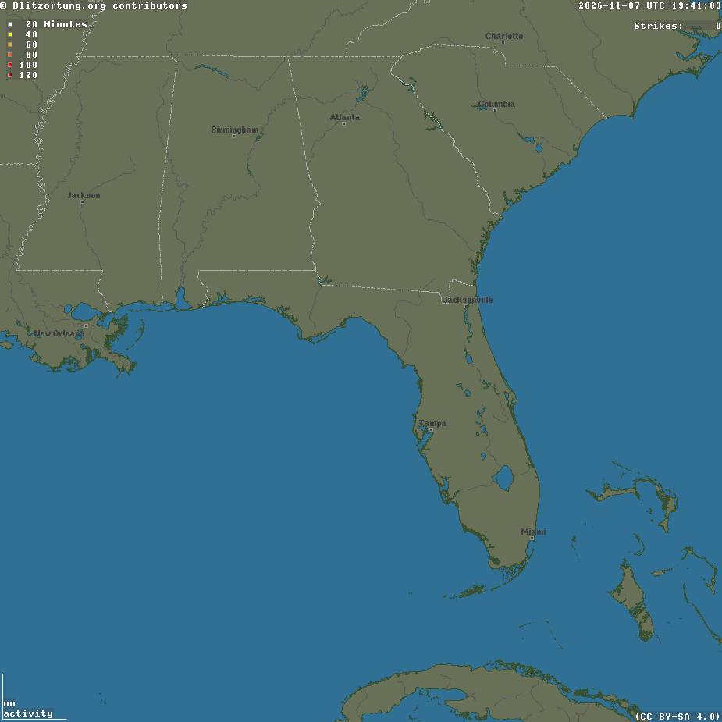
Recent Lightning
Current a/o: 10/30/2026 7:18 AM OPR: 45 Weather Sq
Notes:
https://www.blitzortung.org/Images/image_b_fl.png?nocache=5535

Slide 7
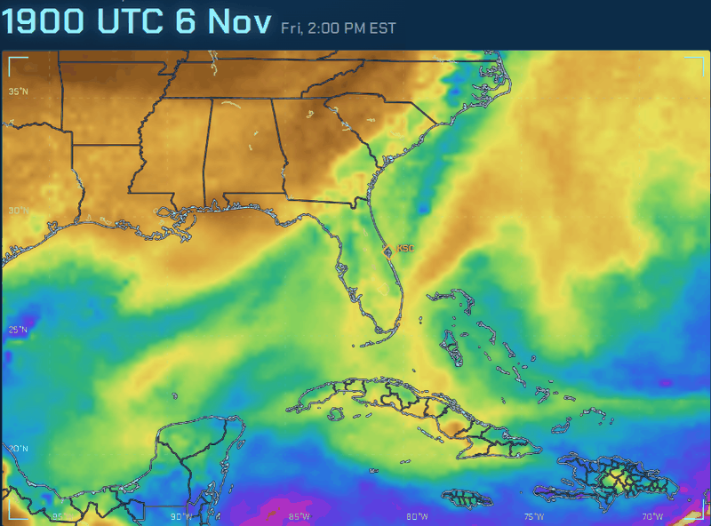
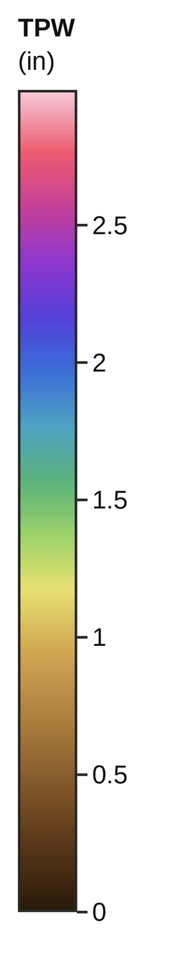
Precipitable Water
Developed by Nick Luchetti, 45 WS
Current a/o: 10/30/2026 7:18 AM OPR: 45 Weather Sq
Notes:
Source: https://nluchetti1.github.io/TPWViewer/#dom=se&base=tpw&pal=nrl&units=in&ovl=none&span=24&op=1.00&mode=loop&fc=hrrr
Southeast domain, MIMIC total precipitable water (inches, NRL color scale), last 24 h observed plus HRRR 12-h forecast tail. Marker relabeled KSC (28.57N 80.65W).
Note: this viewer draws its maps in the browser, so there is no image address for PowerPoint to link to. This loop is a snapshot captured 31 Oct ~18Z (MIMIC through 17Z, HRRR 16Z) and needs to be recaptured for each brief. If this site is down or stale, use hidden slide 8 (CIMSS MIMIC-TPW2 backup, live-linked).

Slide 8
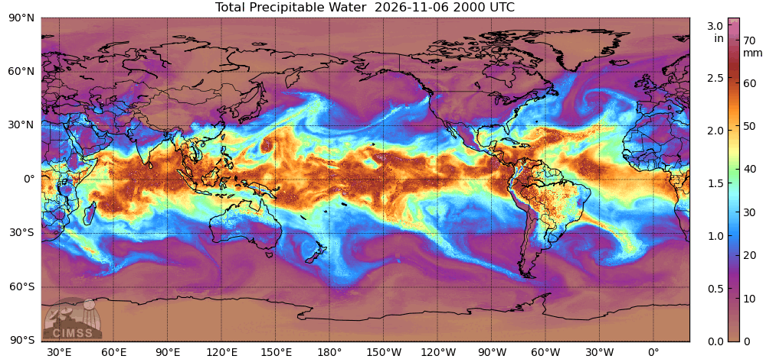
Precipitable Water (Backup)
Current a/o: 10/30/2026 7:18 AM OPR: 45 Weather Sq
Notes:
BACKUP for slide 7. Hidden by default. If the slide 7 loop is stale or the TPWViewer site is down, right-click this slide in the thumbnail pane > Unhide Slide (and hide slide 7).
Live-linked: CIMSS MIMIC-TPW2 global 24-h loop, refreshes on open. Color scale (in and mm) is built into the image.
Source page: https://tropic.ssec.wisc.edu/real-time/mtpw2/product.php?color_type=tpw_nrl_colors&prod=global2&timespan=24hrs&anim=html5
Image: https://tropic.ssec.wisc.edu/real-time/mtpw2/webAnims/tpw_nrl_colors/global2/mimictpw_global2_latest.gif

Slide 9
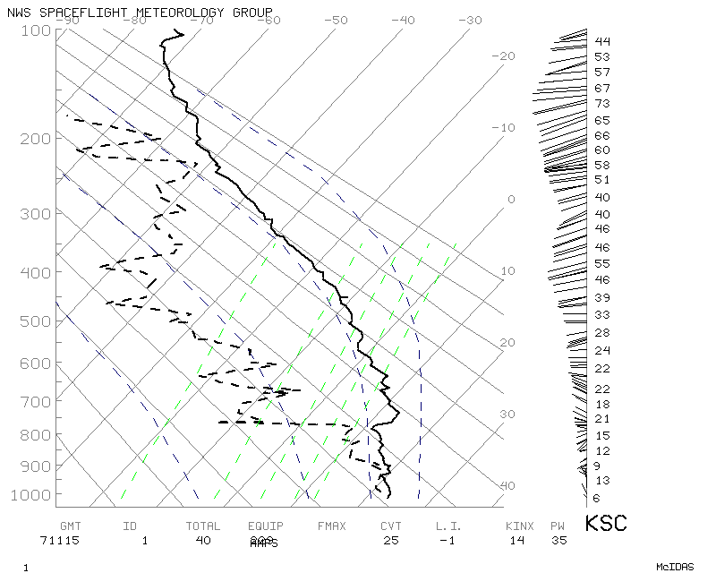
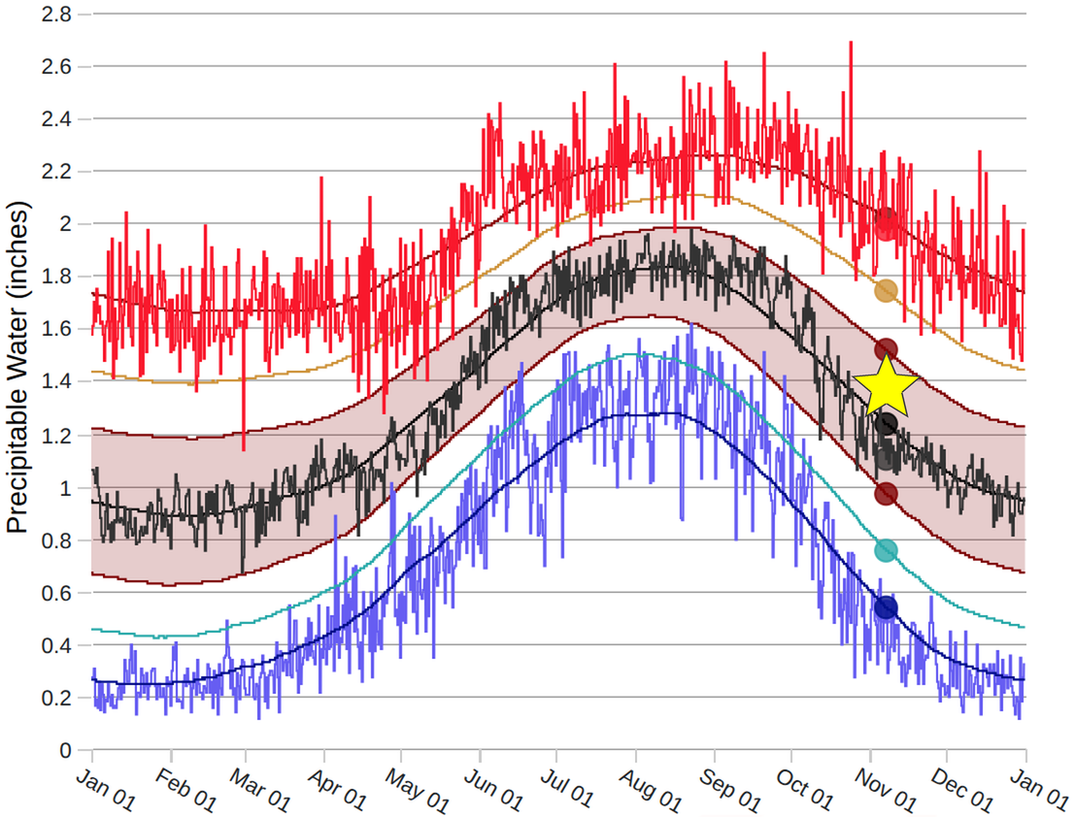
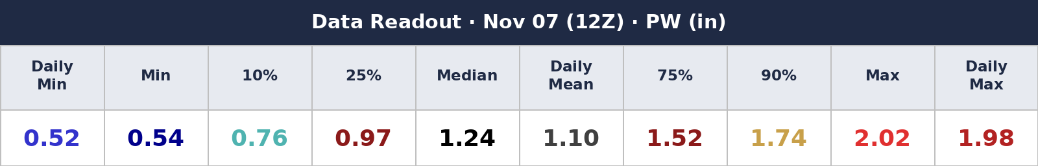
10Z KXMR Balloon Sounding
KXMR Precipitable Water Climatology
Precipitable Water = 1.38 in
Source: SPC Sounding Climatology v2 · dots = today
Current a/o: 10/30/2026 7:18 AM OPR: 45 Weather Sq
Notes:
https://www.spc.noaa.gov/exper/soundingclimov2/ (Station: Cape Kennedy, FL; Parameter: Precipitable Water; Data Readout: Go to Current Date 12Z)
Left side: paste the 10Z KXMR sounding into the placeholder.

Slide 10
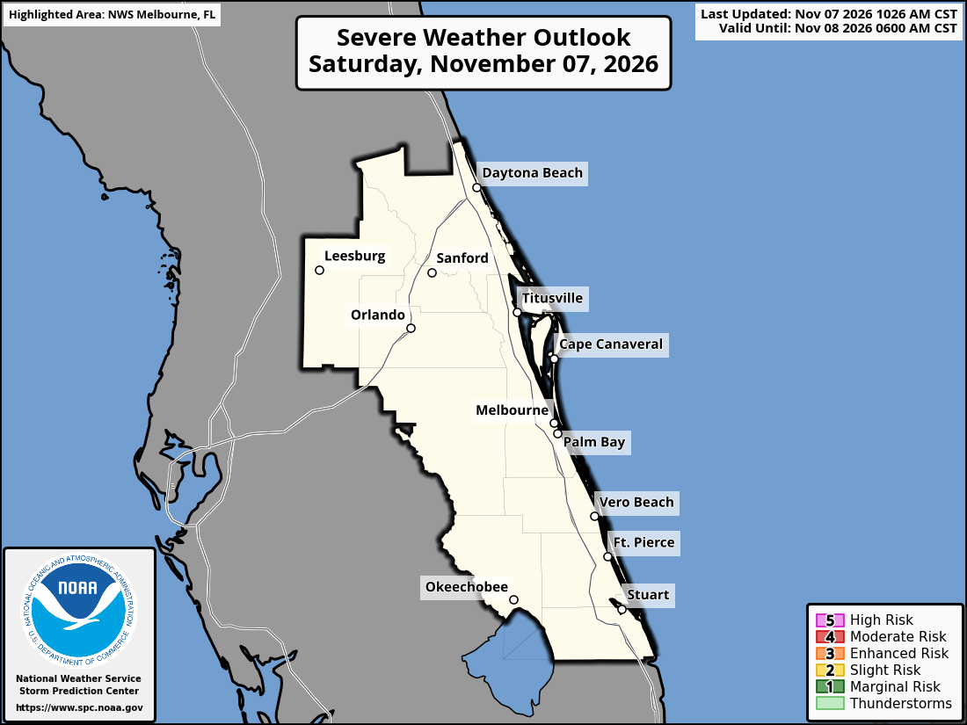
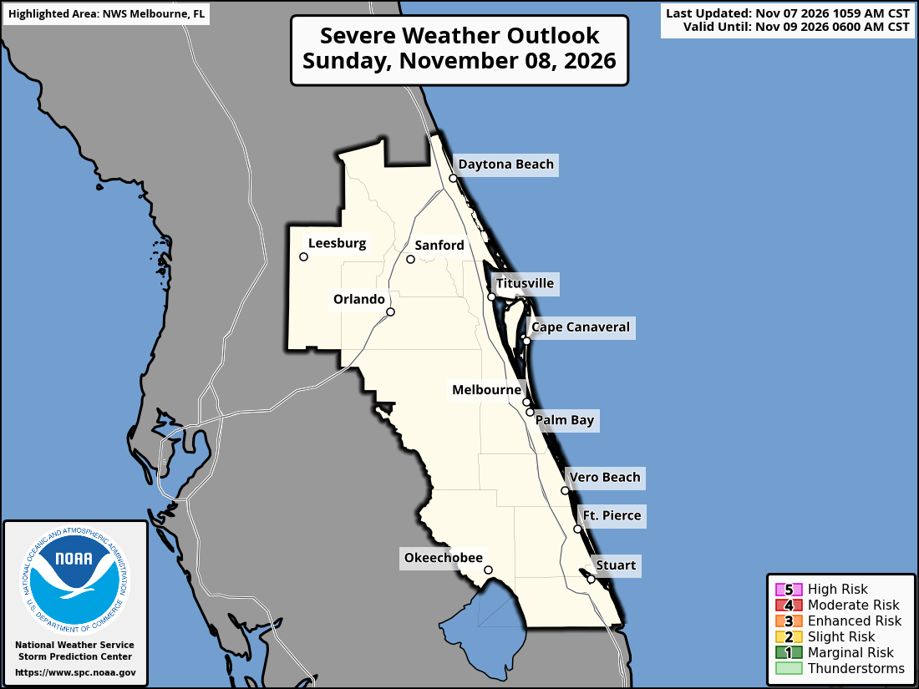

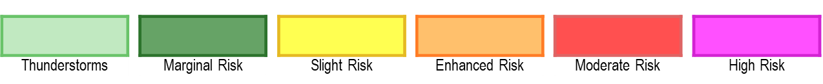
SPC Thunderstorm Outlook
1
2
3
4
5
Current a/o: 10/30/2026 7:18 AM OPR: 45 Weather Sq
Notes:
spc.noaa.gov/partners/outlooks/cwa/MLB/

Slide 11
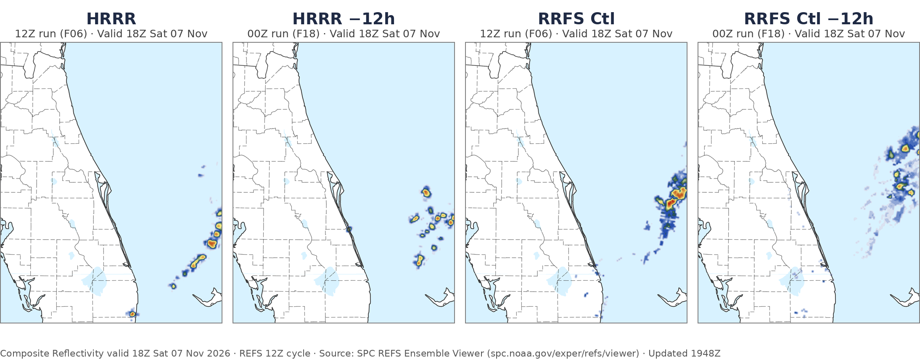
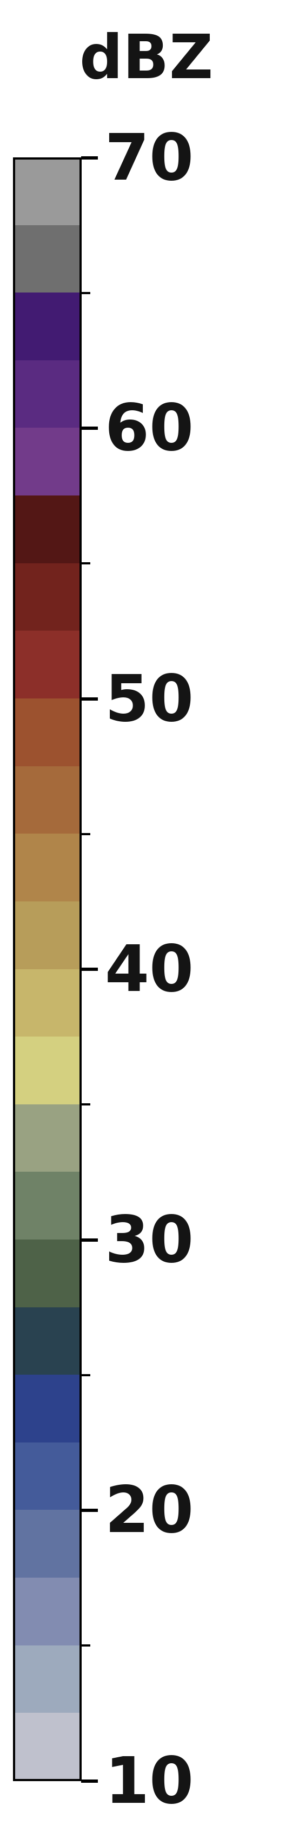
Modeled Future Radar
Current a/o: 10/30/2026 7:18 AM OPR: 45 Weather Sq
Notes:
Source: https://www.spc.noaa.gov/exper/refs/viewer/
Members > Composite Reflectivity; members HRRR, HRRR -12h, RRFS Ctl, RRFS Ctl -12h; valid 18Z; map zoomed to Florida.
Note: the REFS viewer draws its maps in the browser, so there is no image address for PowerPoint to link to. These panels are snapshots from the 12Z 31 Oct cycle and need to be recaptured for each brief.

Slide 12
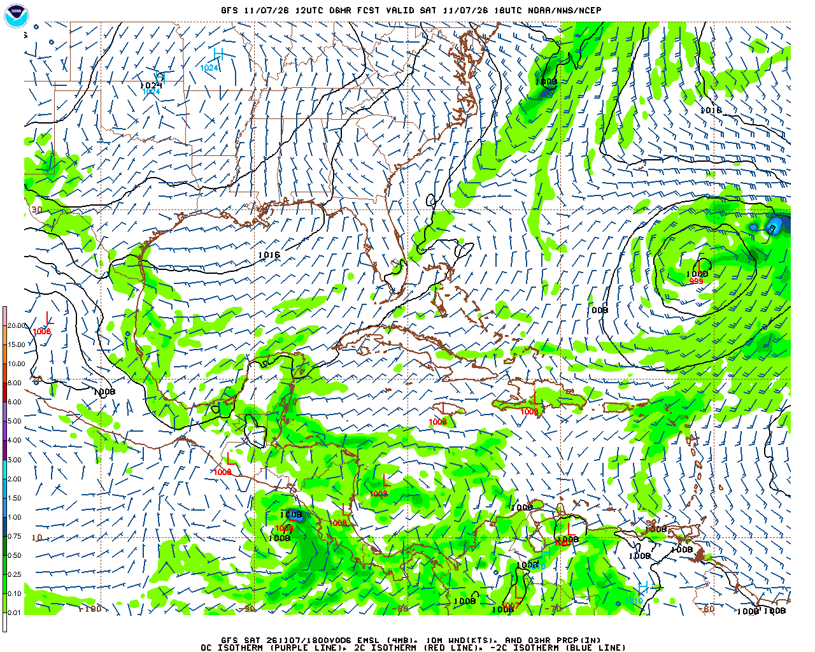
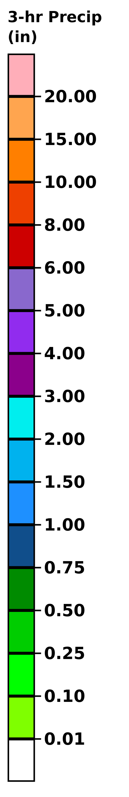
GFS Model : This Afternoon
KSC
Current a/o: 10/30/2026 7:18 AM OPR: 45 Weather Sq
Notes:
Primary:
https://mag.ncep.noaa.gov/data/gfs/06/west-atl/10m_wnd_precip/gfs_west-atl_012_10m_wnd_precip.gif
NOAA/NCEP GFS 06Z run, F012 (valid 18Z), Western N Atlantic domain: MSLP, 10 m winds (kt) and 3-hr precip (in). The /06/ folder is overwritten with each day's 06Z run, so this link always shows the latest 06Z map (complete by ~10:20Z).
Product page (all forecast hours): https://mag.ncep.noaa.gov/model-guidance-model-parameter.php?group=Model%20Guidance&model=GFS&area=WEST-ATL&param=10m_wnd_precip&ps=area
Backup (ECMWF, latest run, F18 from 00Z):
Precip & MSLP: https://www.tropicaltidbits.com/analysis/models/?model=ecmwf&region=watl&pkg=mslp_pcpn&fh=18
10 m wind & MSLP: https://www.tropicaltidbits.com/analysis/models/?model=ecmwf&region=watl&pkg=mslp_wind&fh=18

Slide 13
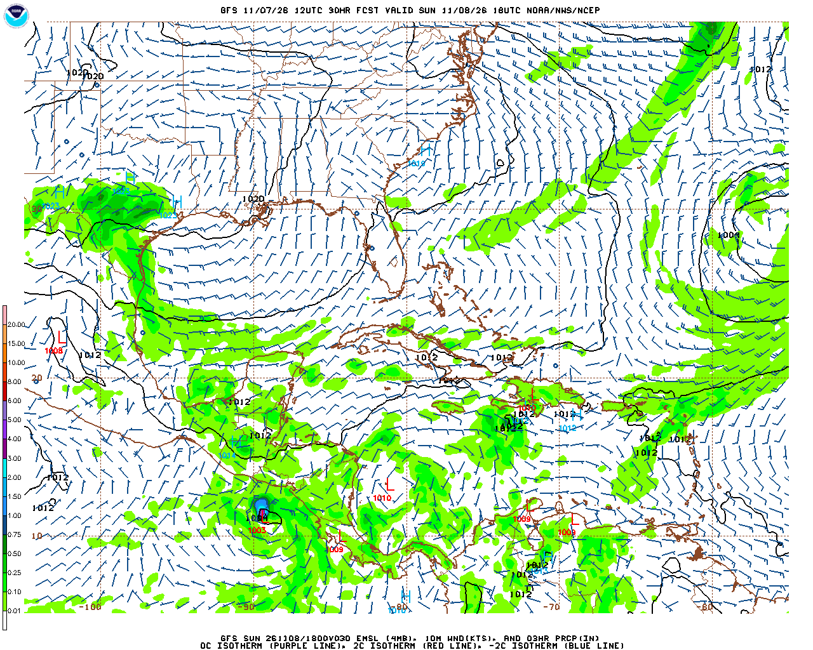
GFS Model : Tomorrow Afternoon
KSC
Current a/o: 10/30/2026 7:18 AM OPR: 45 Weather Sq
Notes:
Primary:
https://mag.ncep.noaa.gov/data/gfs/06/west-atl/10m_wnd_precip/gfs_west-atl_036_10m_wnd_precip.gif
NOAA/NCEP GFS 06Z run, F036 (valid 18Z), Western N Atlantic domain: MSLP, 10 m winds (kt) and 3-hr precip (in). The /06/ folder is overwritten with each day's 06Z run, so this link always shows the latest 06Z map (complete by ~10:20Z).
Product page (all forecast hours): https://mag.ncep.noaa.gov/model-guidance-model-parameter.php?group=Model%20Guidance&model=GFS&area=WEST-ATL&param=10m_wnd_precip&ps=area
Backup (ECMWF, latest run, F42 from 00Z):
Precip & MSLP: https://www.tropicaltidbits.com/analysis/models/?model=ecmwf&region=watl&pkg=mslp_pcpn&fh=42
10 m wind & MSLP: https://www.tropicaltidbits.com/analysis/models/?model=ecmwf&region=watl&pkg=mslp_wind&fh=42

Slide 14
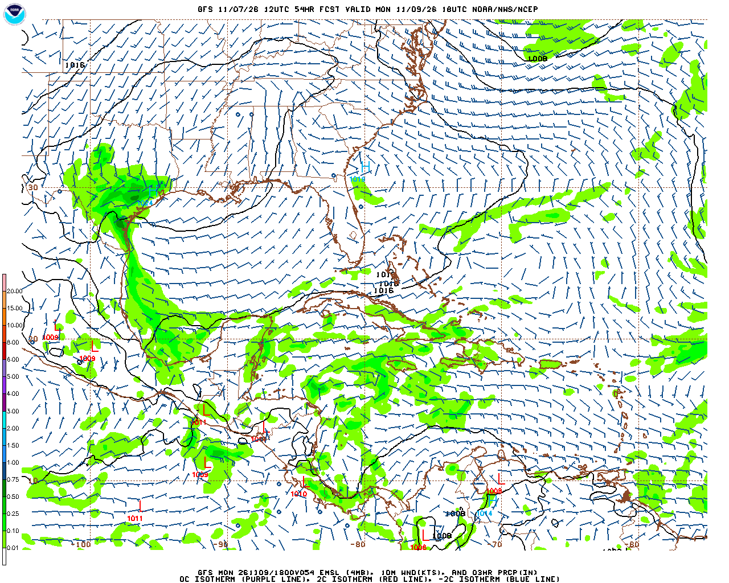
GFS Model : Monday Afternoon
KSC
Current a/o: 10/30/2026 7:18 AM OPR: 45 Weather Sq
Notes:
Primary:
https://mag.ncep.noaa.gov/data/gfs/06/west-atl/10m_wnd_precip/gfs_west-atl_060_10m_wnd_precip.gif
NOAA/NCEP GFS 06Z run, F060 (valid 18Z), Western N Atlantic domain: MSLP, 10 m winds (kt) and 3-hr precip (in). The /06/ folder is overwritten with each day's 06Z run, so this link always shows the latest 06Z map (complete by ~10:20Z).
Product page (all forecast hours): https://mag.ncep.noaa.gov/model-guidance-model-parameter.php?group=Model%20Guidance&model=GFS&area=WEST-ATL&param=10m_wnd_precip&ps=area
Backup (ECMWF, latest run, F66 from 00Z):
Precip & MSLP: https://www.tropicaltidbits.com/analysis/models/?model=ecmwf&region=watl&pkg=mslp_pcpn&fh=66
10 m wind & MSLP: https://www.tropicaltidbits.com/analysis/models/?model=ecmwf&region=watl&pkg=mslp_wind&fh=66

Slide 15
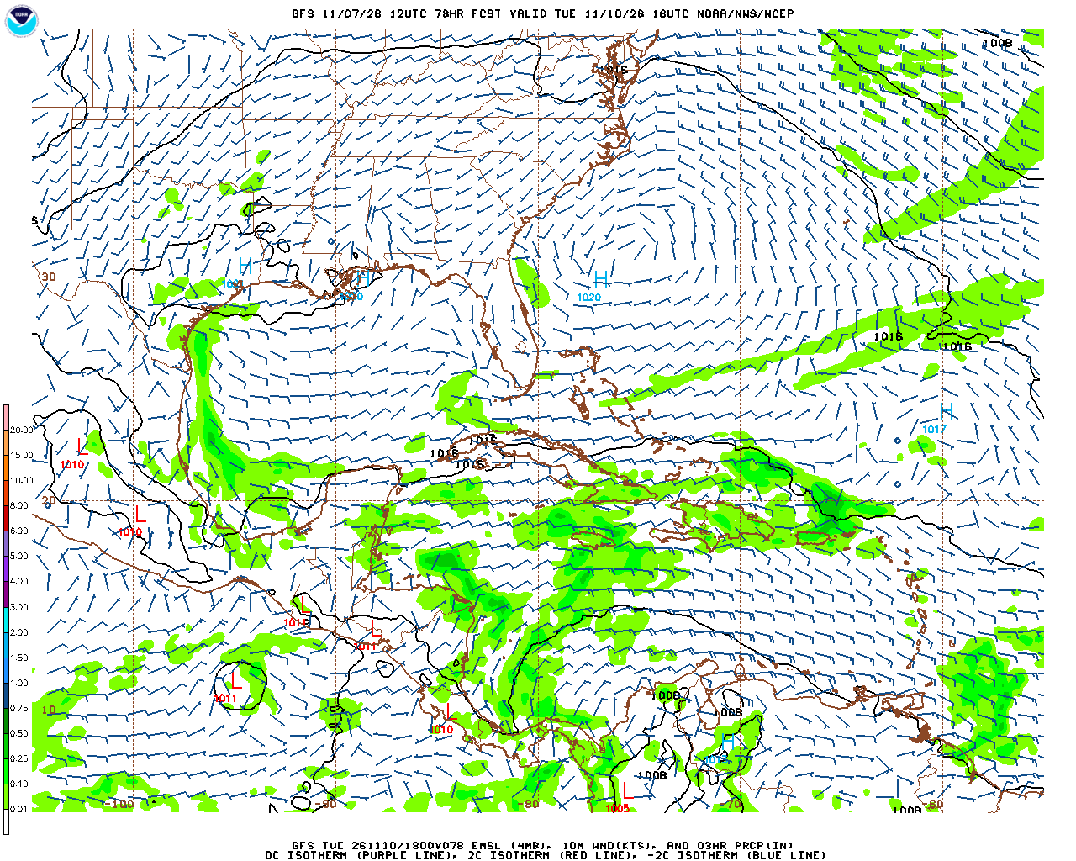
GFS Model : Tuesday Afternoon
KSC
Current a/o: 10/30/2026 7:18 AM OPR: 45 Weather Sq
Notes:
Primary:
https://mag.ncep.noaa.gov/data/gfs/06/west-atl/10m_wnd_precip/gfs_west-atl_084_10m_wnd_precip.gif
NOAA/NCEP GFS 06Z run, F084 (valid 18Z), Western N Atlantic domain: MSLP, 10 m winds (kt) and 3-hr precip (in). The /06/ folder is overwritten with each day's 06Z run, so this link always shows the latest 06Z map (complete by ~10:20Z).
Product page (all forecast hours): https://mag.ncep.noaa.gov/model-guidance-model-parameter.php?group=Model%20Guidance&model=GFS&area=WEST-ATL&param=10m_wnd_precip&ps=area
Backup (ECMWF, latest run, F90 from 00Z):
Precip & MSLP: https://www.tropicaltidbits.com/analysis/models/?model=ecmwf&region=watl&pkg=mslp_pcpn&fh=90
10 m wind & MSLP: https://www.tropicaltidbits.com/analysis/models/?model=ecmwf&region=watl&pkg=mslp_wind&fh=90

Slide 16
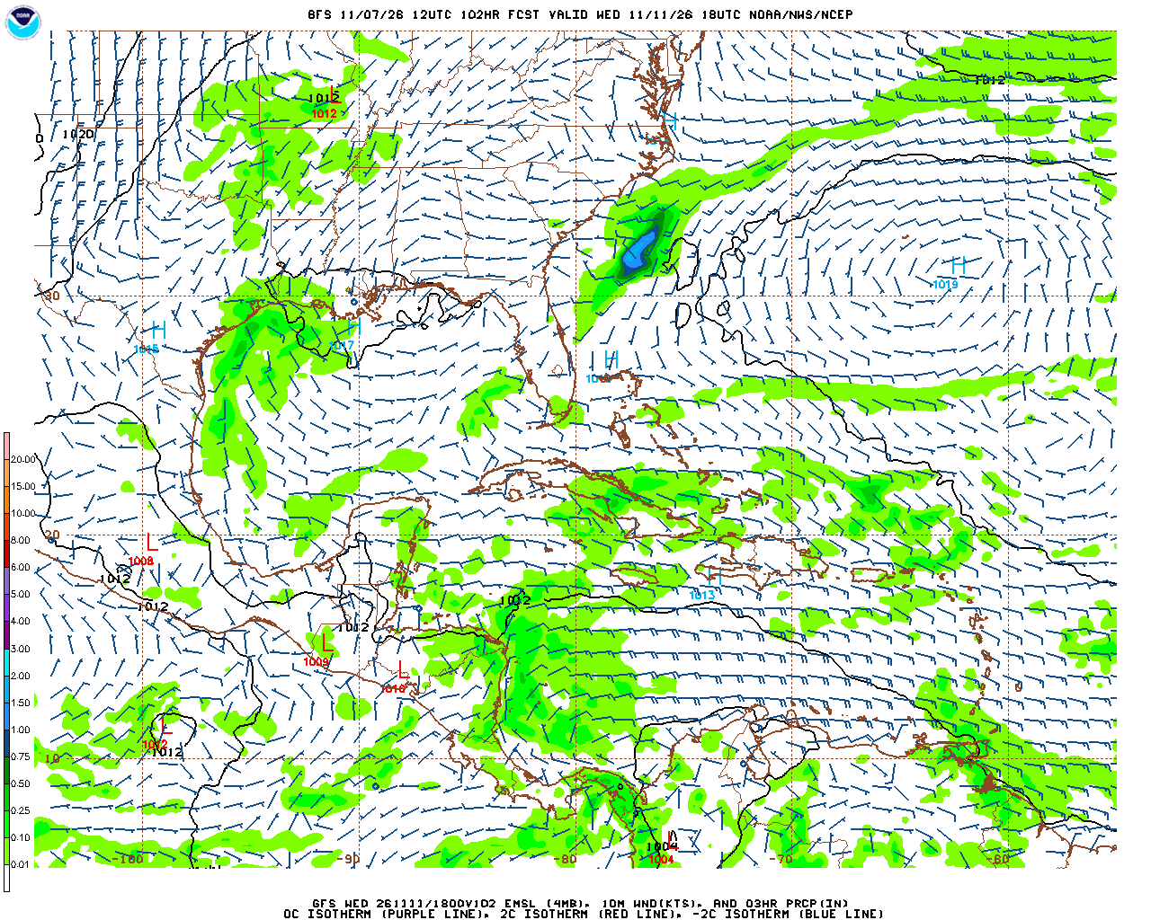
GFS Model : Wednesday Afternoon
KSC
Current a/o: 10/30/2026 7:18 AM OPR: 45 Weather Sq
Notes:
Primary:
https://mag.ncep.noaa.gov/data/gfs/06/west-atl/10m_wnd_precip/gfs_west-atl_108_10m_wnd_precip.gif
NOAA/NCEP GFS 06Z run, F108 (valid 18Z), Western N Atlantic domain: MSLP, 10 m winds (kt) and 3-hr precip (in). The /06/ folder is overwritten with each day's 06Z run, so this link always shows the latest 06Z map (complete by ~10:20Z).
Product page (all forecast hours): https://mag.ncep.noaa.gov/model-guidance-model-parameter.php?group=Model%20Guidance&model=GFS&area=WEST-ATL&param=10m_wnd_precip&ps=area
Backup (ECMWF, latest run, F114 from 00Z):
Precip & MSLP: https://www.tropicaltidbits.com/analysis/models/?model=ecmwf&region=watl&pkg=mslp_pcpn&fh=114
10 m wind & MSLP: https://www.tropicaltidbits.com/analysis/models/?model=ecmwf&region=watl&pkg=mslp_wind&fh=114

Slide 17
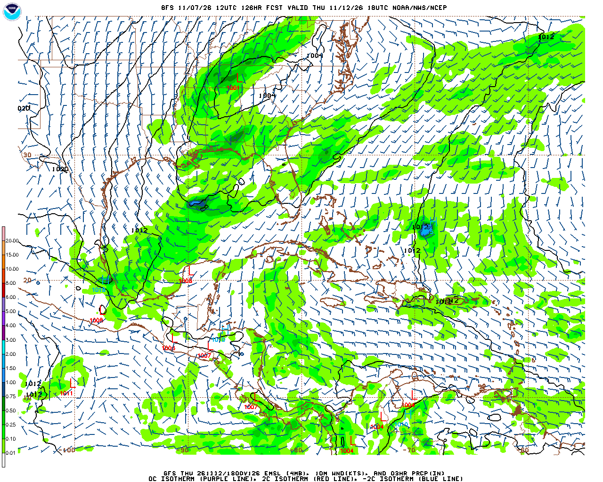
GFS Model : Thursday Afternoon
KSC
Current a/o: 10/30/2026 7:18 AM OPR: 45 Weather Sq
Notes:
Primary:
https://mag.ncep.noaa.gov/data/gfs/06/west-atl/10m_wnd_precip/gfs_west-atl_132_10m_wnd_precip.gif
NOAA/NCEP GFS 06Z run, F132 (valid 18Z), Western N Atlantic domain: MSLP, 10 m winds (kt) and 3-hr precip (in). The /06/ folder is overwritten with each day's 06Z run, so this link always shows the latest 06Z map (complete by ~10:20Z).
Product page (all forecast hours): https://mag.ncep.noaa.gov/model-guidance-model-parameter.php?group=Model%20Guidance&model=GFS&area=WEST-ATL&param=10m_wnd_precip&ps=area
Backup (ECMWF, latest run, F138 from 00Z):
Precip & MSLP: https://www.tropicaltidbits.com/analysis/models/?model=ecmwf&region=watl&pkg=mslp_pcpn&fh=138
10 m wind & MSLP: https://www.tropicaltidbits.com/analysis/models/?model=ecmwf&region=watl&pkg=mslp_wind&fh=138

Slide 18
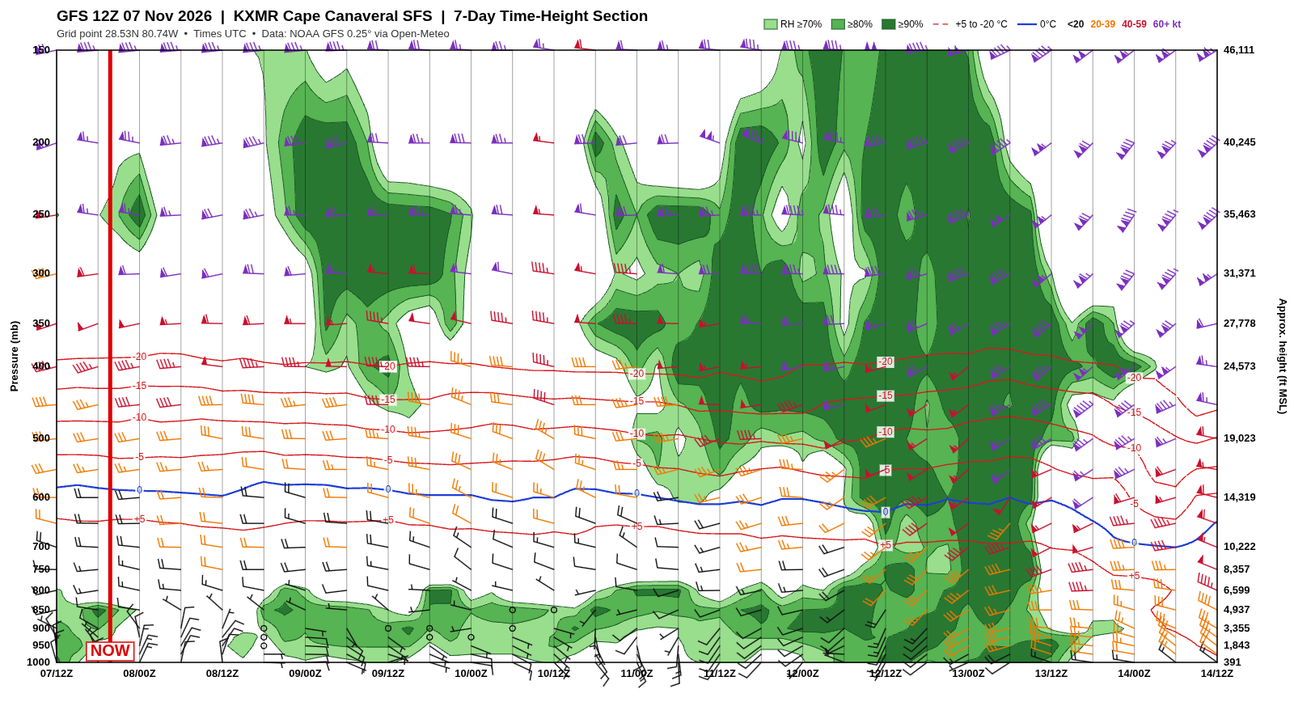
7-Day Meteogram: GFS
F9 CRS-35
Current a/o: 10/30/2026 7:18 AM OPR: 45 Weather Sq
Notes:
Primary: GFS 7-day time-height meteogram, KXMR (KMLB available)
To refresh: open Meteogram_Tool.html in any web browser, choose GFS and KXMR or KMLB, click Download PNG, then right-click this picture > Change Picture > From a File. (Fully automatic once the GitHub page is set up.)
Fields: RH shaded green (70/80/90%); isotherms +5, -5, -10, -15, -20 °C (red dashed) and 0 °C (blue); wind barbs in kt at each level colored by speed (<20 black, 20-39 orange, 40-59 red, 60+ purple); 1000-150 mb with approx. heights in ft. Times UTC. Red vertical line labeled NOW marks the time the chart was made.
Data: GFS via Open-Meteo: https://open-meteo.com/en/docs/gfs-api
Previous (GALWEM): https://weather.af.mil/services/WMS/?DIM_STATION=KTTS&MODEL=GALWEM&DURATION=7-Day+Standard&Layers=GALWEM_Meteogram_7day_Std_Std&portland=on&BBOX=0%2C0%2C1%2C1&SERVICE=WMS&REQUEST=GetMap&CRS=CRS%3A1&FORMAT=image%2Fpng%3B+mode%3D8bit&VERSION=1.3.0&HEIGHT=1685&WIDTH=1148

Slide 19
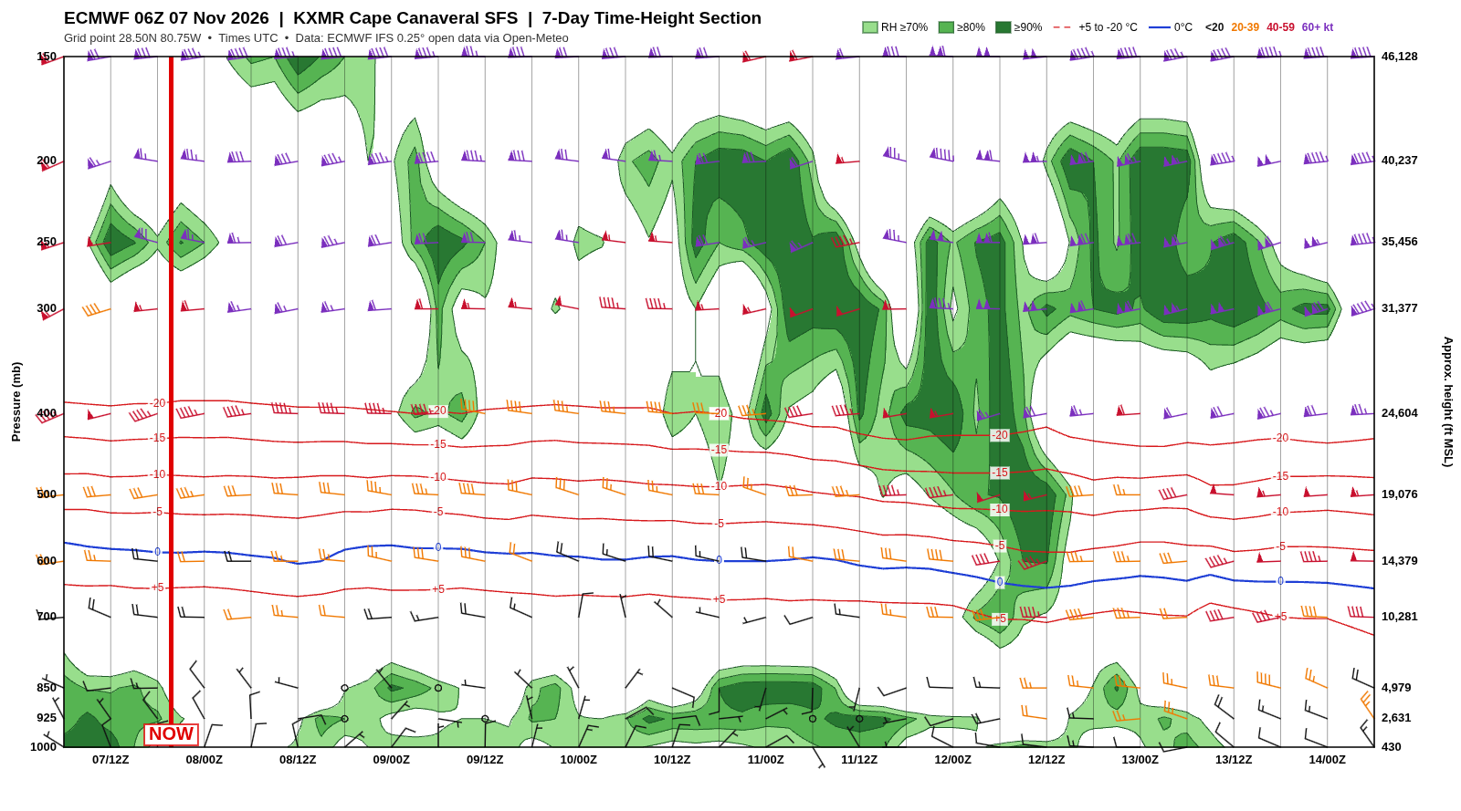
7-Day Meteogram: ECMWF
F9 CRS-35
Current a/o: 10/30/2026 7:18 AM OPR: 45 Weather Sq
Notes:
Primary: ECMWF 7-day time-height meteogram, KXMR (KMLB available)
To refresh: open Meteogram_Tool.html in any web browser, choose ECMWF and KXMR or KMLB, click Download PNG, then right-click this picture > Change Picture > From a File. (Fully automatic once the GitHub page is set up.)
Fields: RH shaded green (70/80/90%); isotherms +5, -5, -10, -15, -20 °C (red dashed) and 0 °C (blue); wind barbs in kt at each level colored by speed (<20 black, 20-39 orange, 40-59 red, 60+ purple); 1000-150 mb with approx. heights in ft. Times UTC. Red vertical line labeled NOW marks the time the chart was made.
Data: ECMWF via Open-Meteo: https://open-meteo.com/en/docs/ecmwf-api
ECMWF open data has fewer pressure levels (1000, 925, 850, 700, 600, 500, 400, 300, 250, 200, 150 mb), so the chart is the same layout with less vertical detail than the GFS.

Slide 20
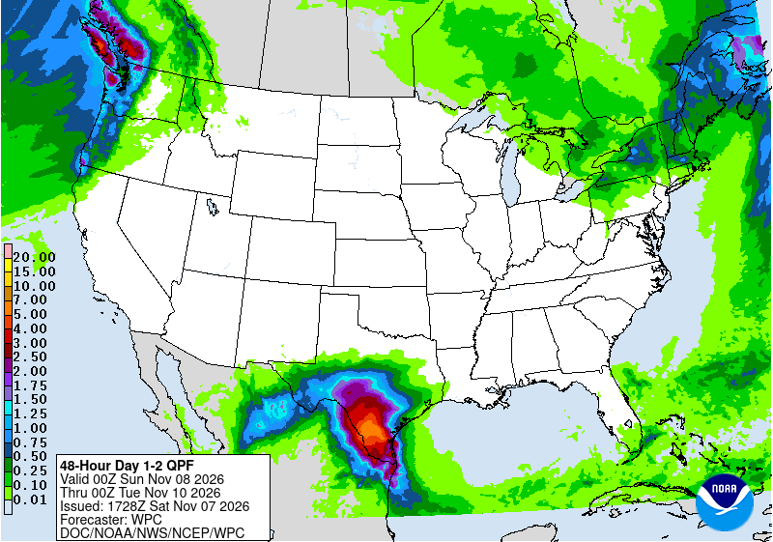
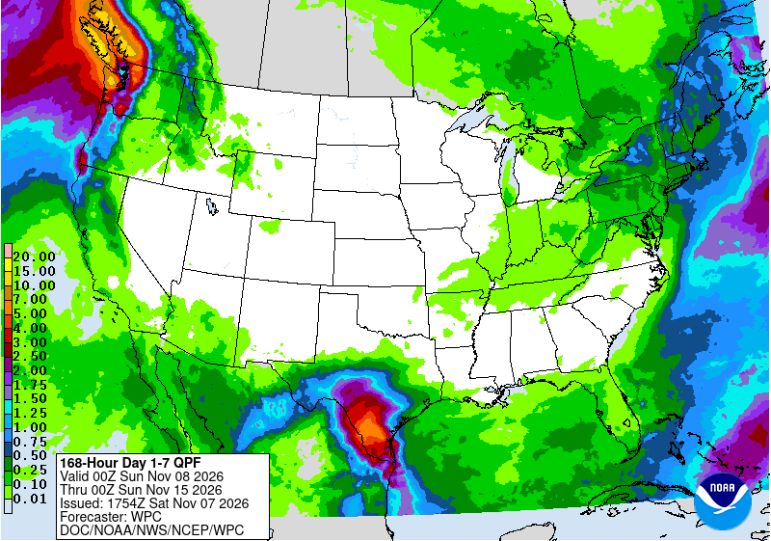
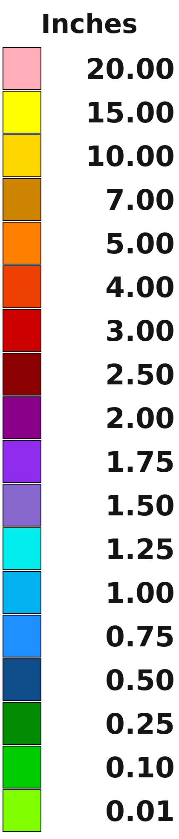
Precipitation Amount Forecast
Next 48 hours
Next 7 days
Current a/o: 10/31/2026 2:22 PM OPR: 45 Weather Sq
Notes:
https://www.wpc.ncep.noaa.gov/qpf/day1-7.shtml
https://www.cpc.ncep.noaa.gov/

Slide 21
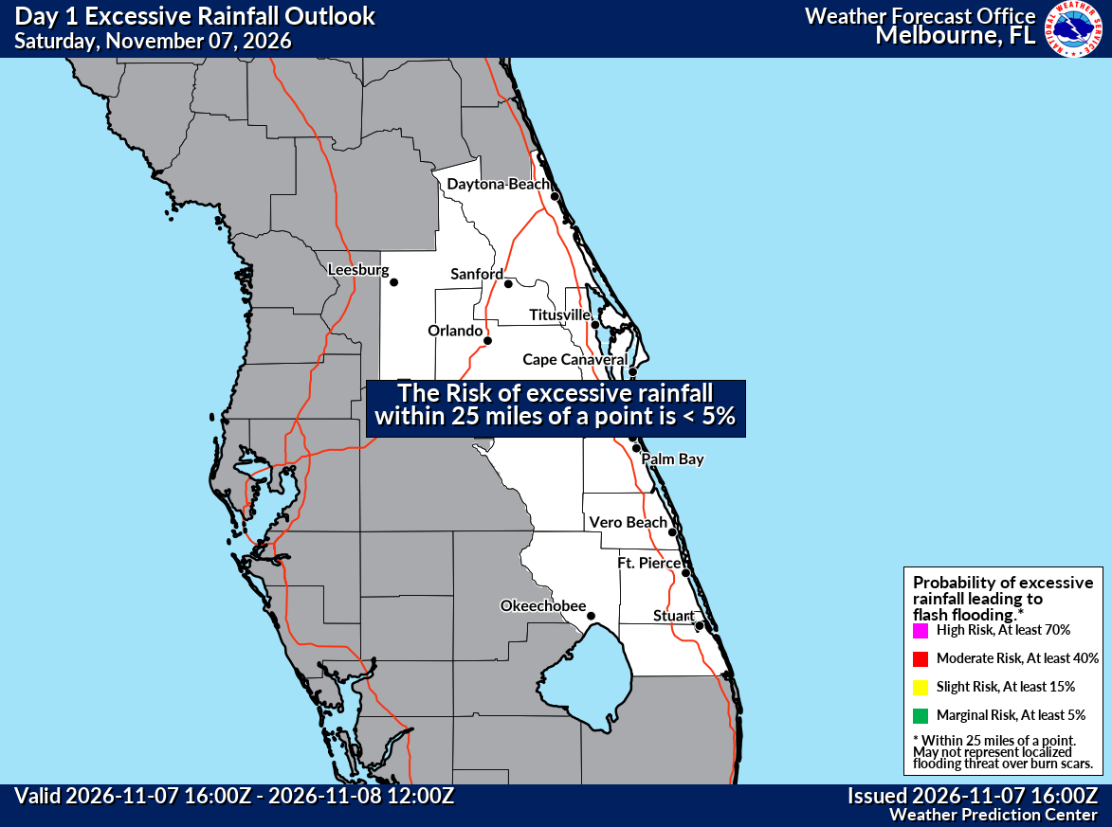




WPC’s Excessive Rain Outlook
Current a/o: 11/1/2026 9:45 AM OPR: 45 Weather Sq

Slide 22
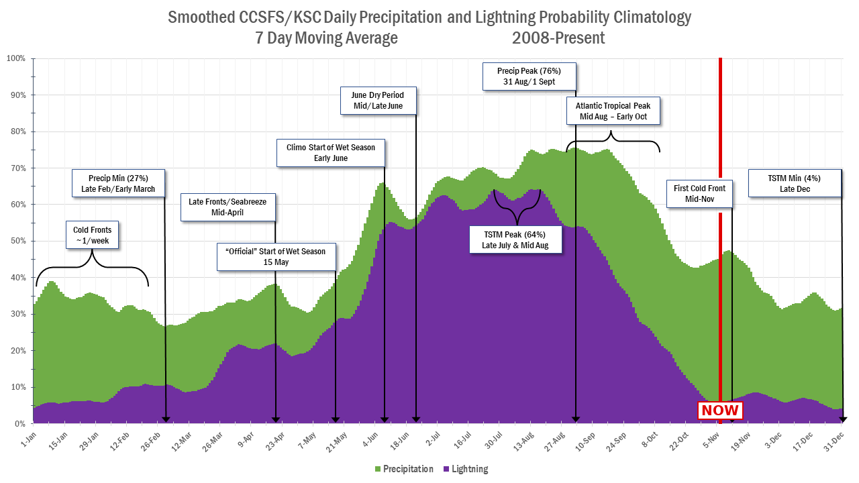
Precipitation & Lightning Climatology
Developed by Arlena Moses, 45 WS
Current a/o: 10/31/2026 2:22 PM OPR: 45 Weather Sq

Slide 23
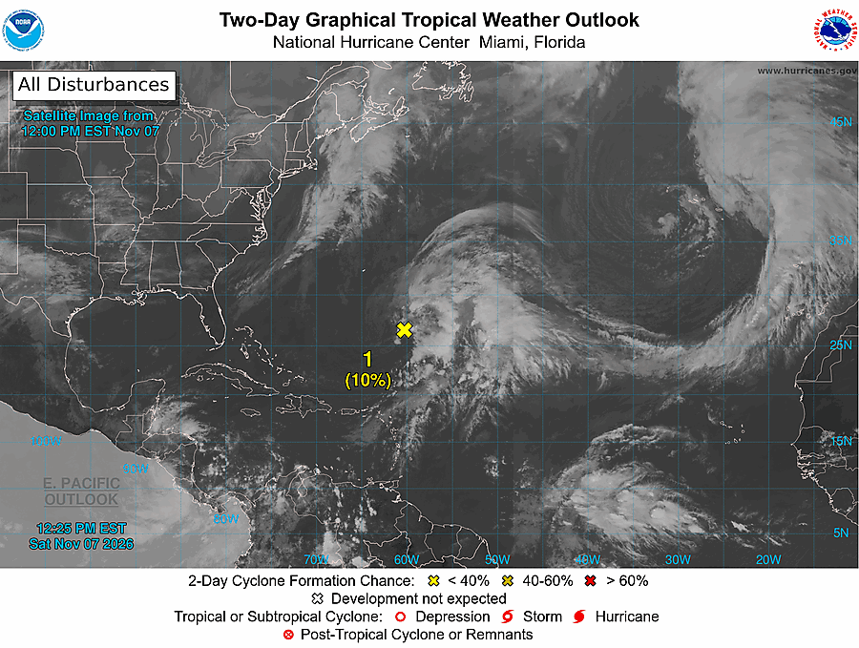
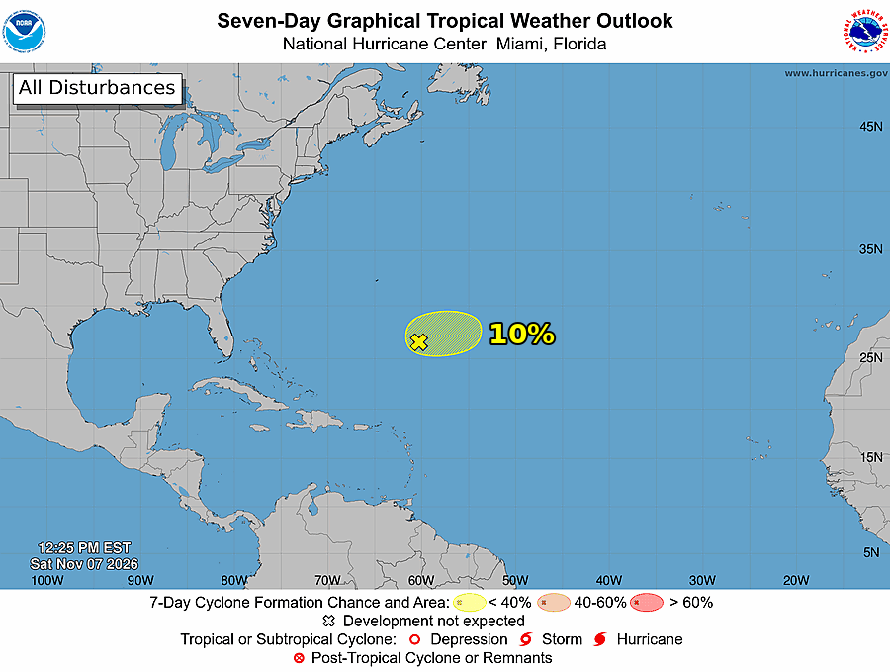
NHC Tropical Outlooks
Current a/o: 10/30/2026 7:18 AM OPR: 45 Weather Sq
Notes:
https://www.nhc.noaa.gov/gtwo.php?basin=atlc&fdays=5
https://www.nhc.noaa.gov/xgtwo/two_atl_7d0.png

Slide 24
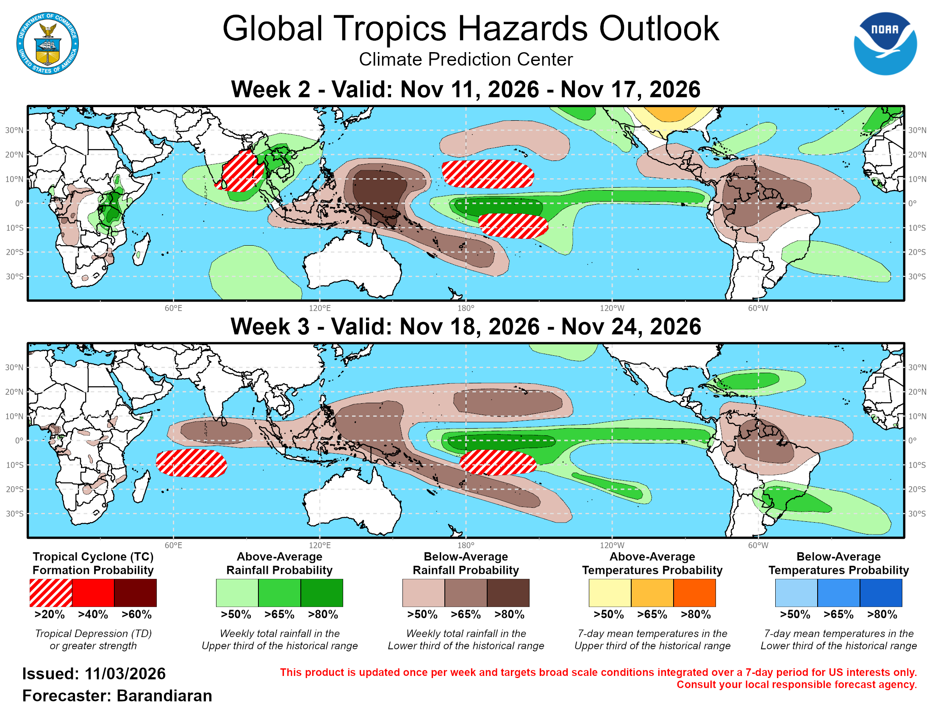
Global Tropics Outlook
Current a/o: 10/31/2026 2:22 PM OPR: 45 Weather Sq
Notes:
https://www.cpc.ncep.noaa.gov/products/precip/CWlink/ghaz/gth_full.png

Slide 25
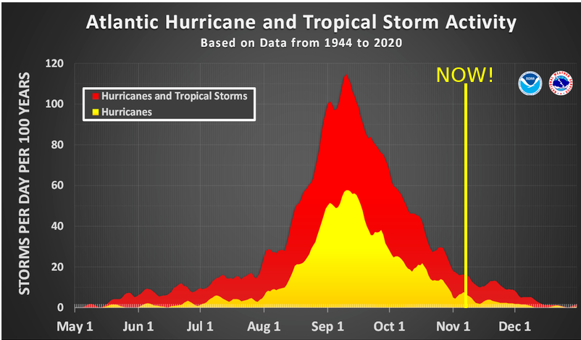
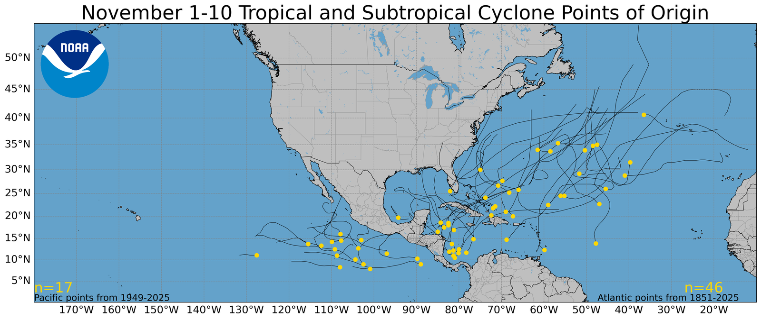
Tropical Cyclone Climatology
Current a/o: 10/30/2026 7:18 AM OPR: 45 Weather Sq
Notes:
https://www.nhc.noaa.gov/climo/#bac

Slide 26
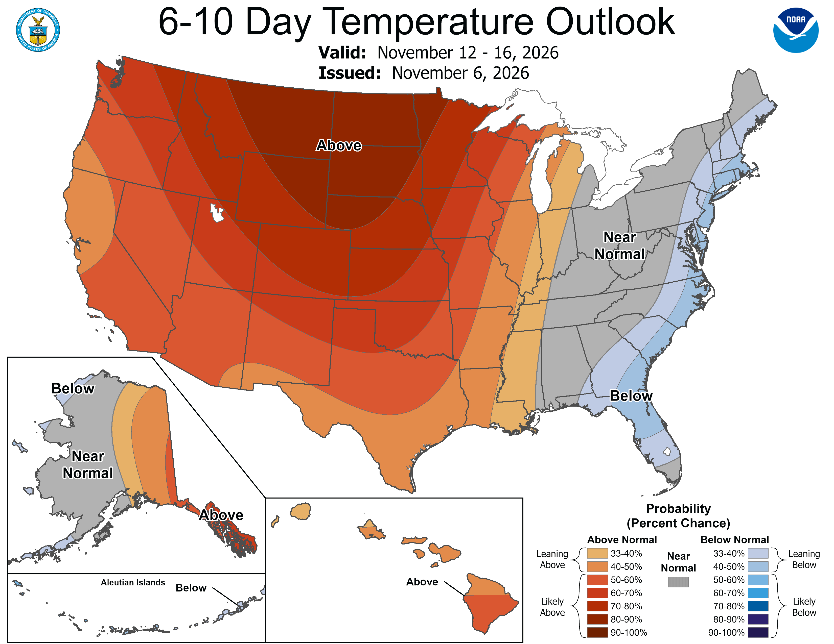
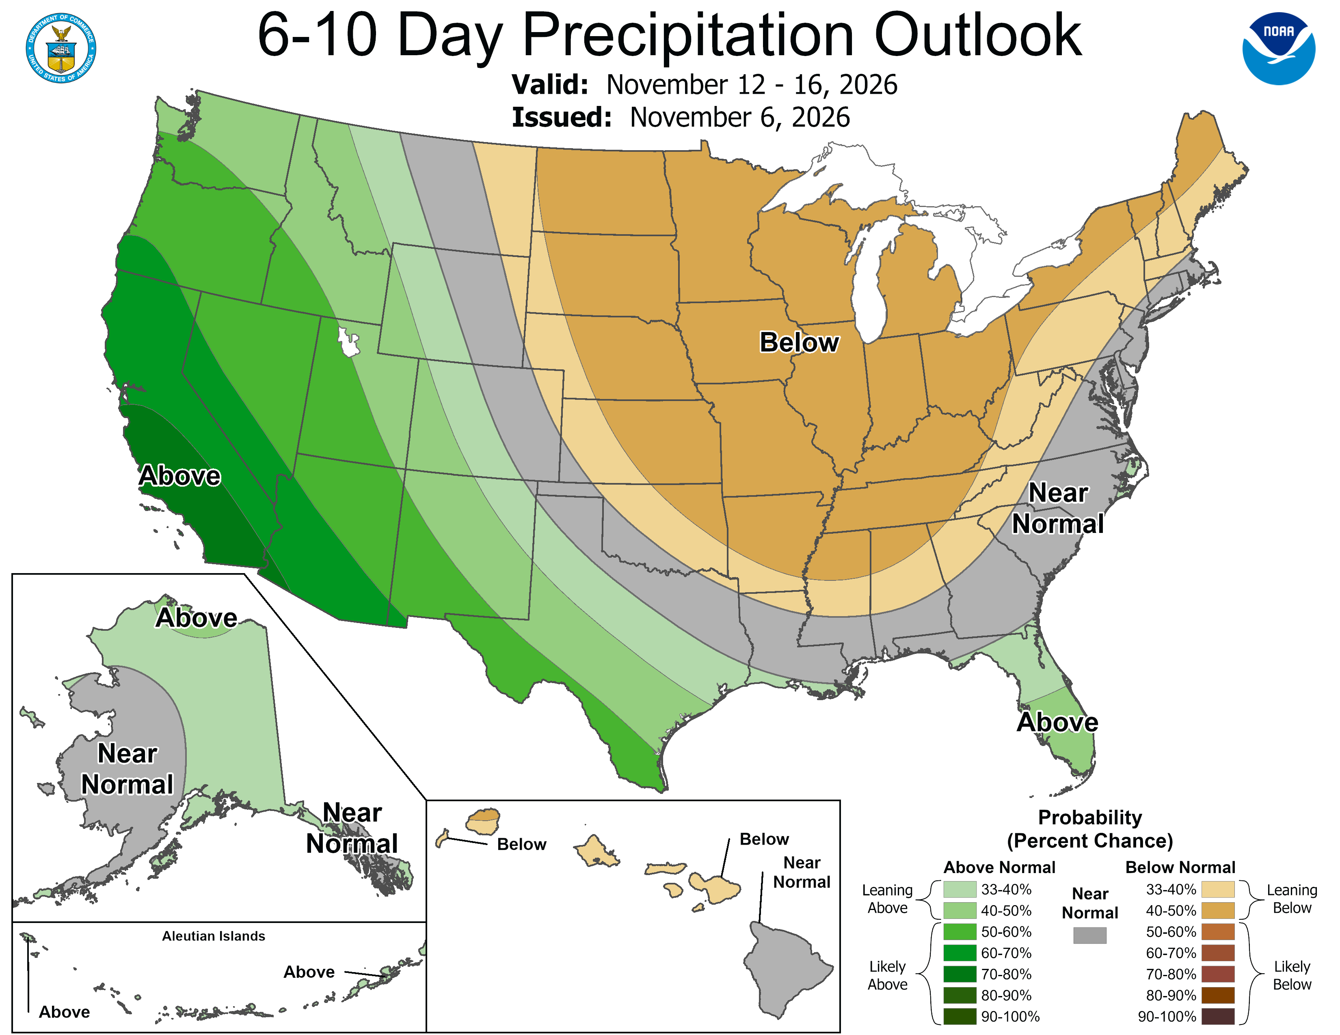
6-10 Day Outlook
Temperatures
Rainfall
Current a/o: 10/30/2026 7:18 AM OPR: 45 Weather Sq
Notes:
https://www.cpc.ncep.noaa.gov/products/predictions/610day/

