Slide 1







Slide 2


Susan Scrum
Log Count: 17
Streak: 3
Log Emotion

Slide 3

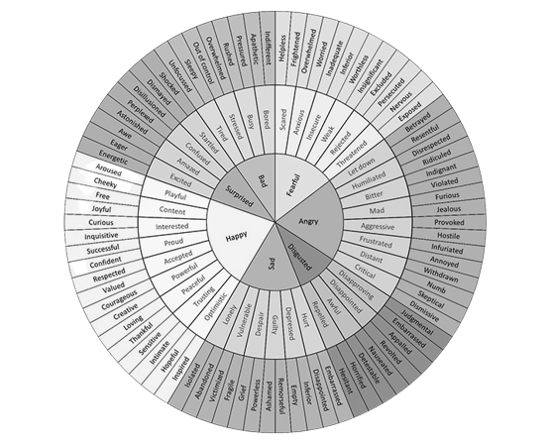

Susan Scrum
Susan Scrum
Susan Scrum
Log Emotion
Log Emotion
Log Emotion
Describe your emotion
Food
Yo I feel so rushed
Water
Sleep
Create Question
+
Social Activity
Describe your emotion
Food
Free Time
Yo I feel so rushed
Water
Submit Log

Slide 4

Susan Scrum
Food
Water
Sleep
Social Activity
Free Time
Food
Responses
Select Question
v

Slide 5

Susan Scrum
Susan Scrum
Day | Week | Month | Year
Day | Week | Month | Year
February
+
+
Sun | Mon | Tue | Wed | Thu | Fri | Sat
 |  |  | 1 | 2 | 3 | 4
5 | 6 | 7 | 8 | 9 | 10 | 11
12 | 13 | 14 | 15 | 16 | 17 | 18
19 | 20 | 21 | 22 | 23 | 24 | 25
26 | 27 | 28
January 13th
Reminder: Pillz
Test 2
Log

