Slide 1
FAST-FISH
PSR backend
Narrow Band
Extract NOISE INJECTION
Reframe velocity to LSRK
Quality check
Quality check
(NOISE_ON – NOISE_OFF)/NOISE_OFF
Subtract spectral/spatial baseline
NOISE Diode file
Regrid to regular WCS
HI cube
T_{sys,psr}
SPEC backend
Wide Band
Match T_{sys,psr} and T_{sys,spec}
Quality check
L-band continuum image
Beam shape reconstruction
Convert (x,y,z) to celestial coordinate

Slide 2
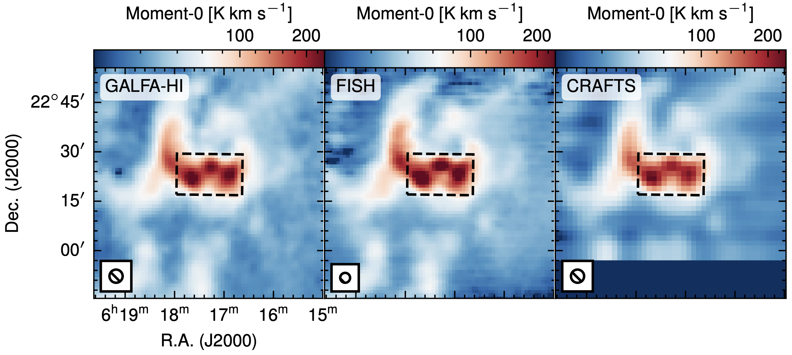
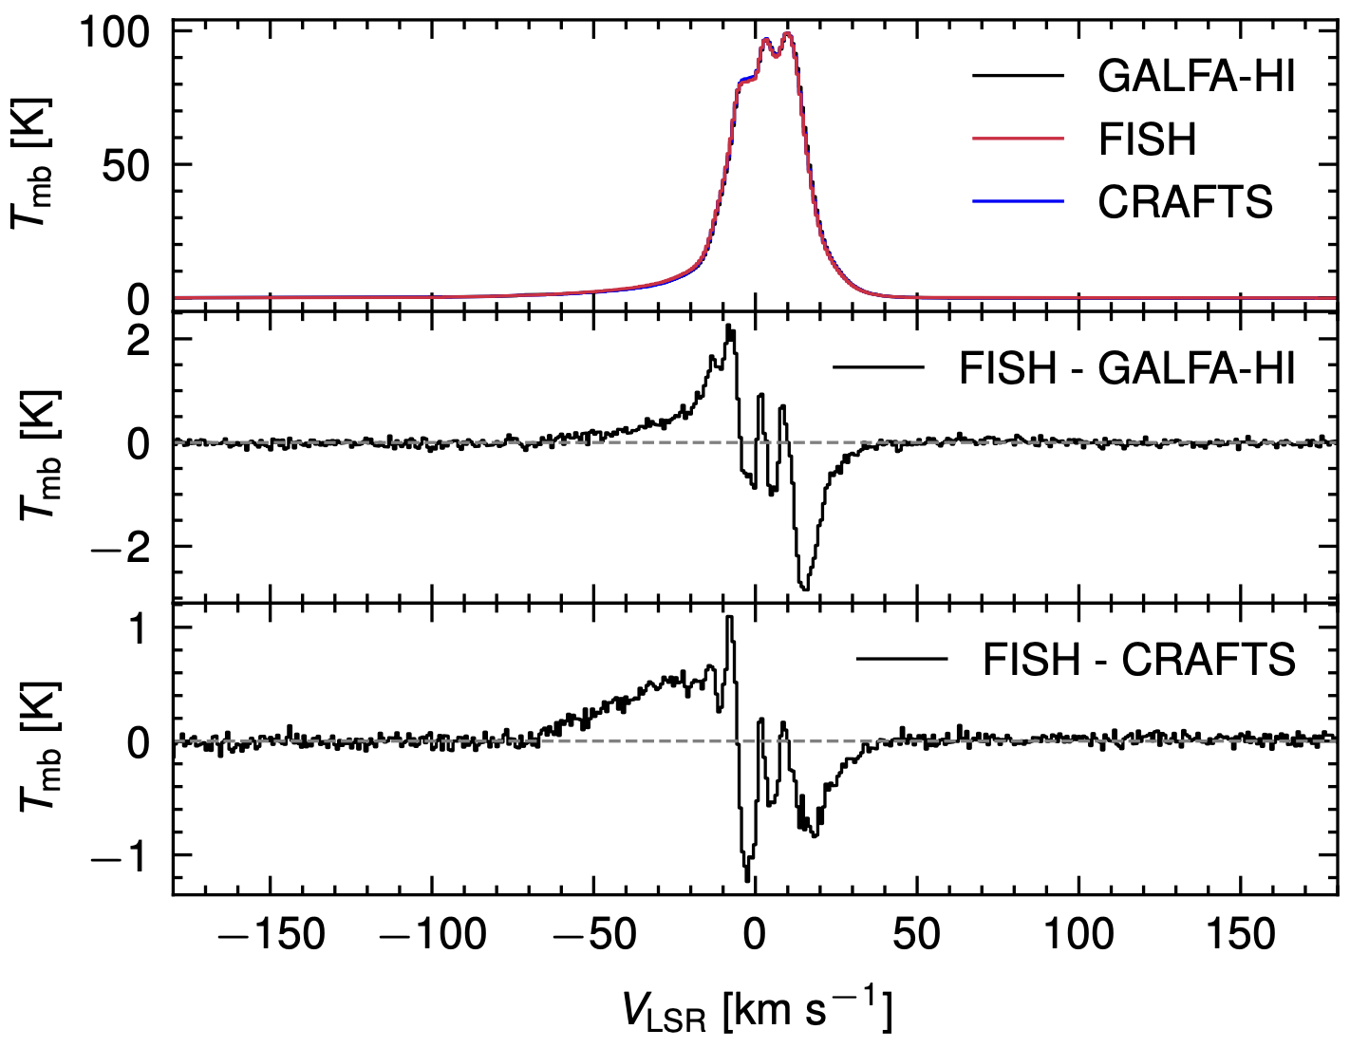
HI 21-cm emission
Supernova remnant IC 443

Slide 3
HINSA

Slide 4
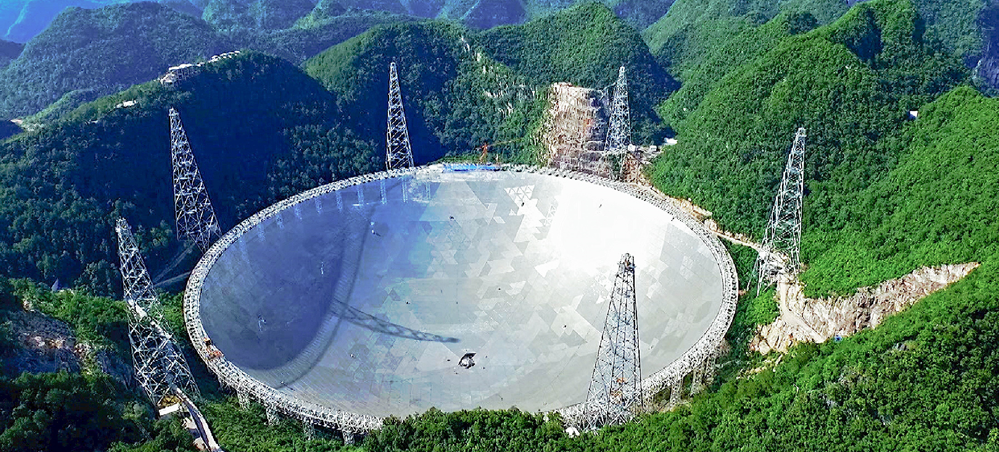
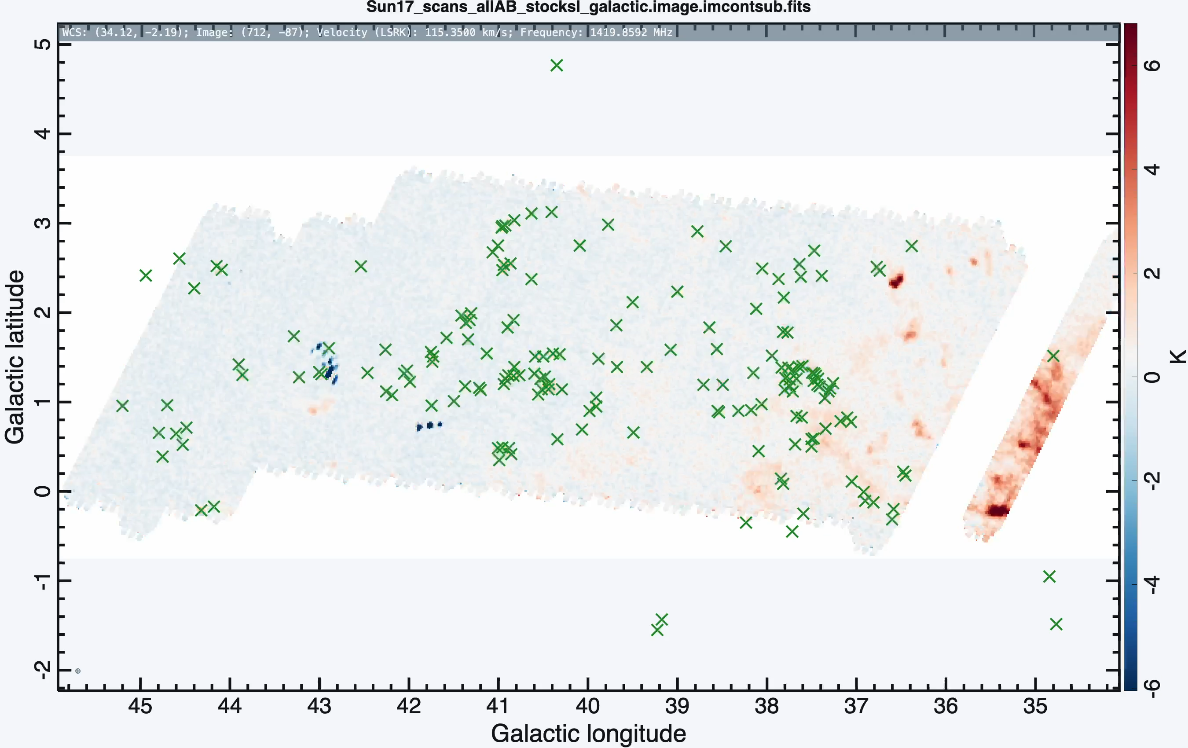
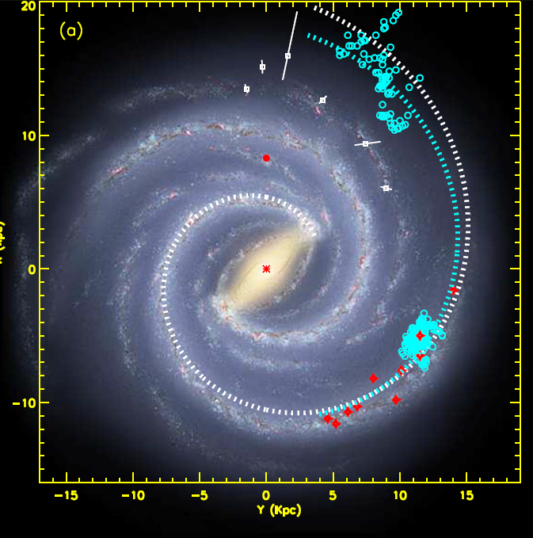
FAST observations
Drift scan towards a 12 deg x 4.5 deg celestial region
RMS ~ 0.2 K @ 0.15 km s⁻¹
The FAST data calibration and imaging was done using our FAST InterStellar HI (FISH) pipeline.
165 molecular clouds covered by Drift Scan Mode (R_{gc} = 11 - 14 kpc)

Slide 5
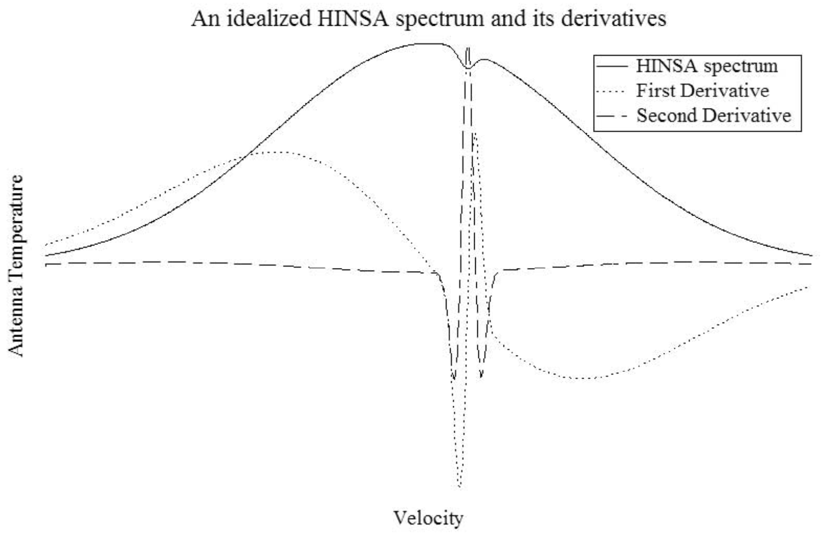
HINSA identification
Only narrow features (e.g., HINSA) are prominent in the 2nd-derivative of HI spectrum
To find a set of HINSA parameters (optical depth, central velocity, and velocity dispersion) so that the recovered (non-absorption) HI spectrum has minimized 2nd-derivative.
Krčo et al. (2008)

Slide 6
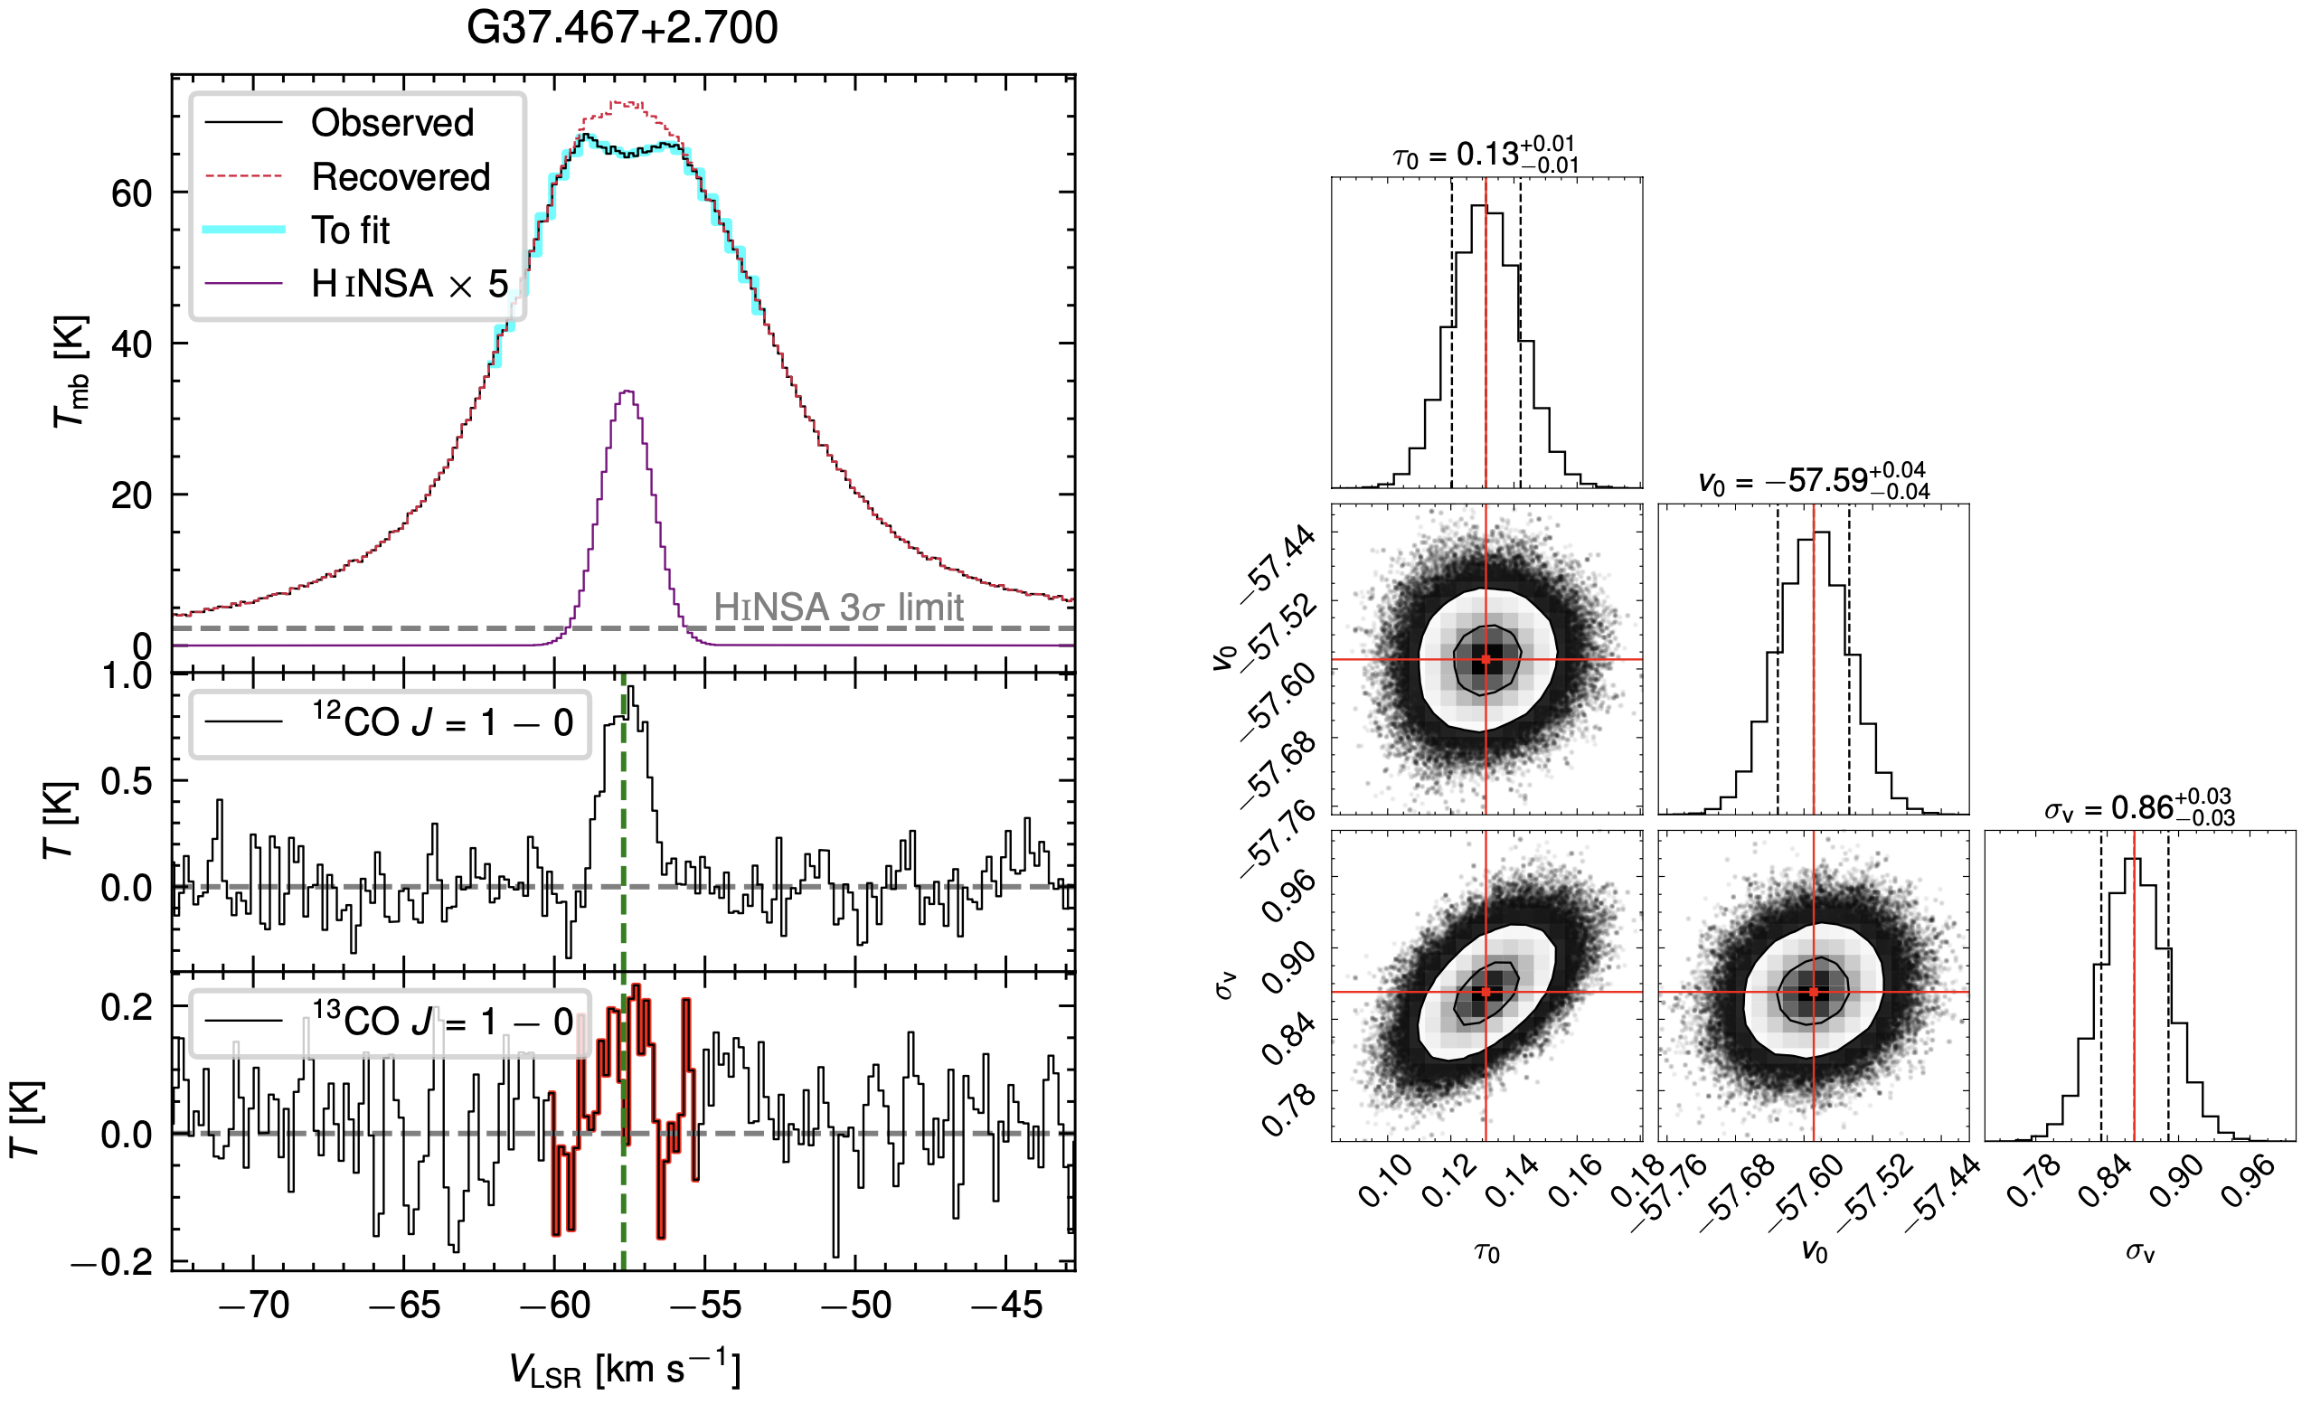
A decent example
Optical depth
FAST
Central velocity
Velocity dispersion
MWISP

Slide 7
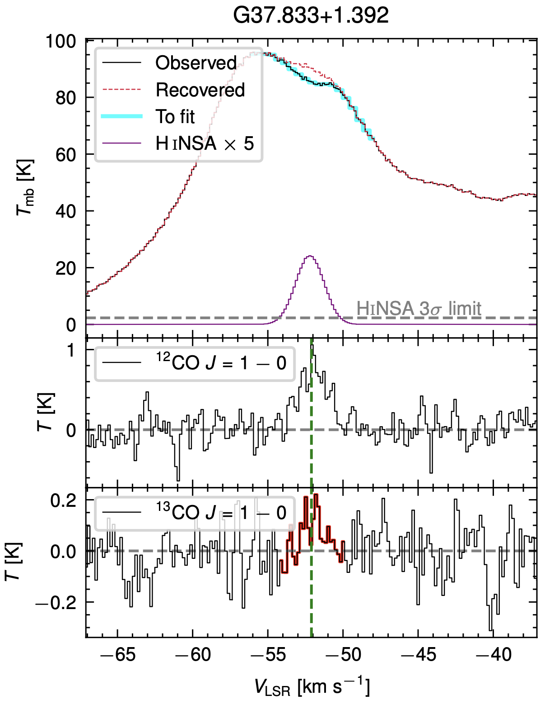
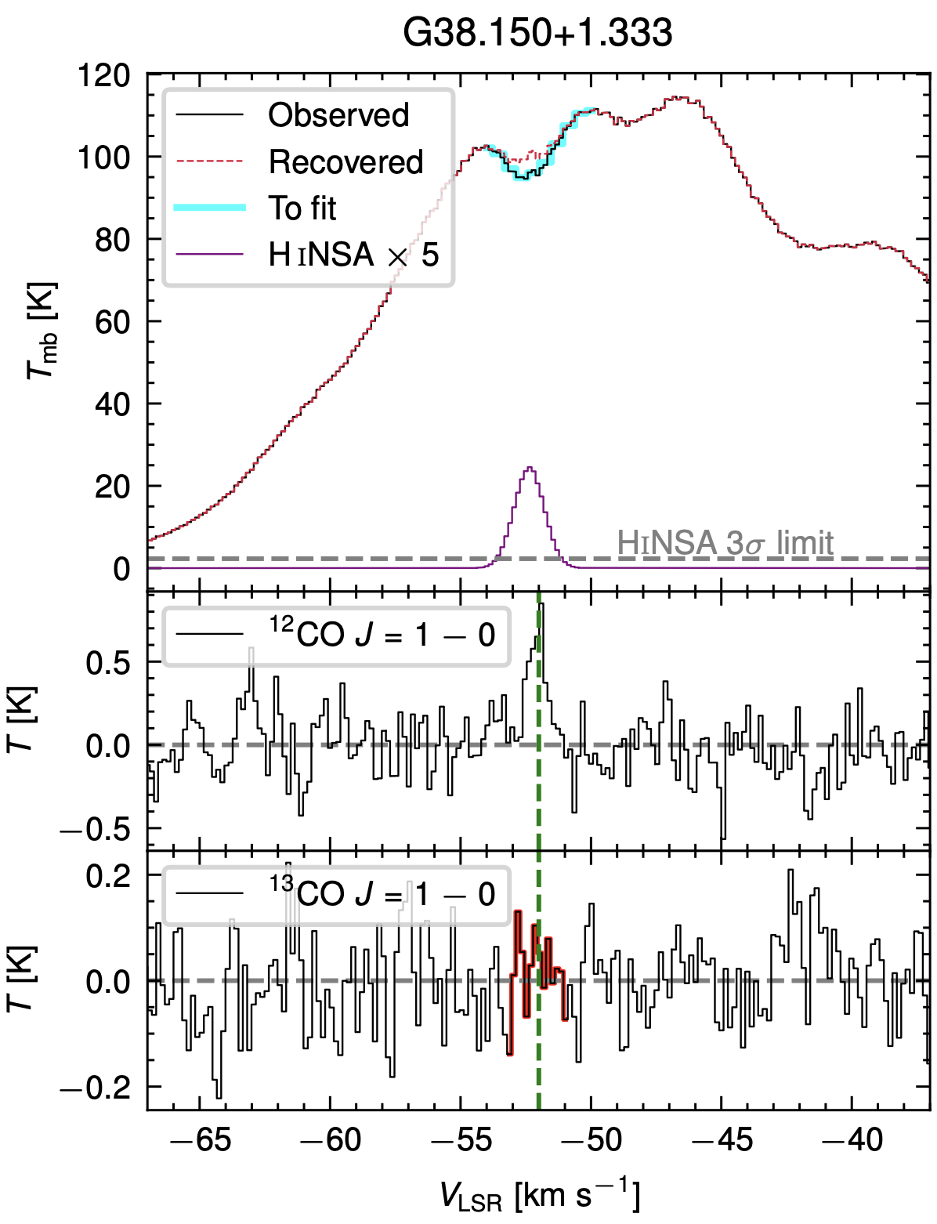
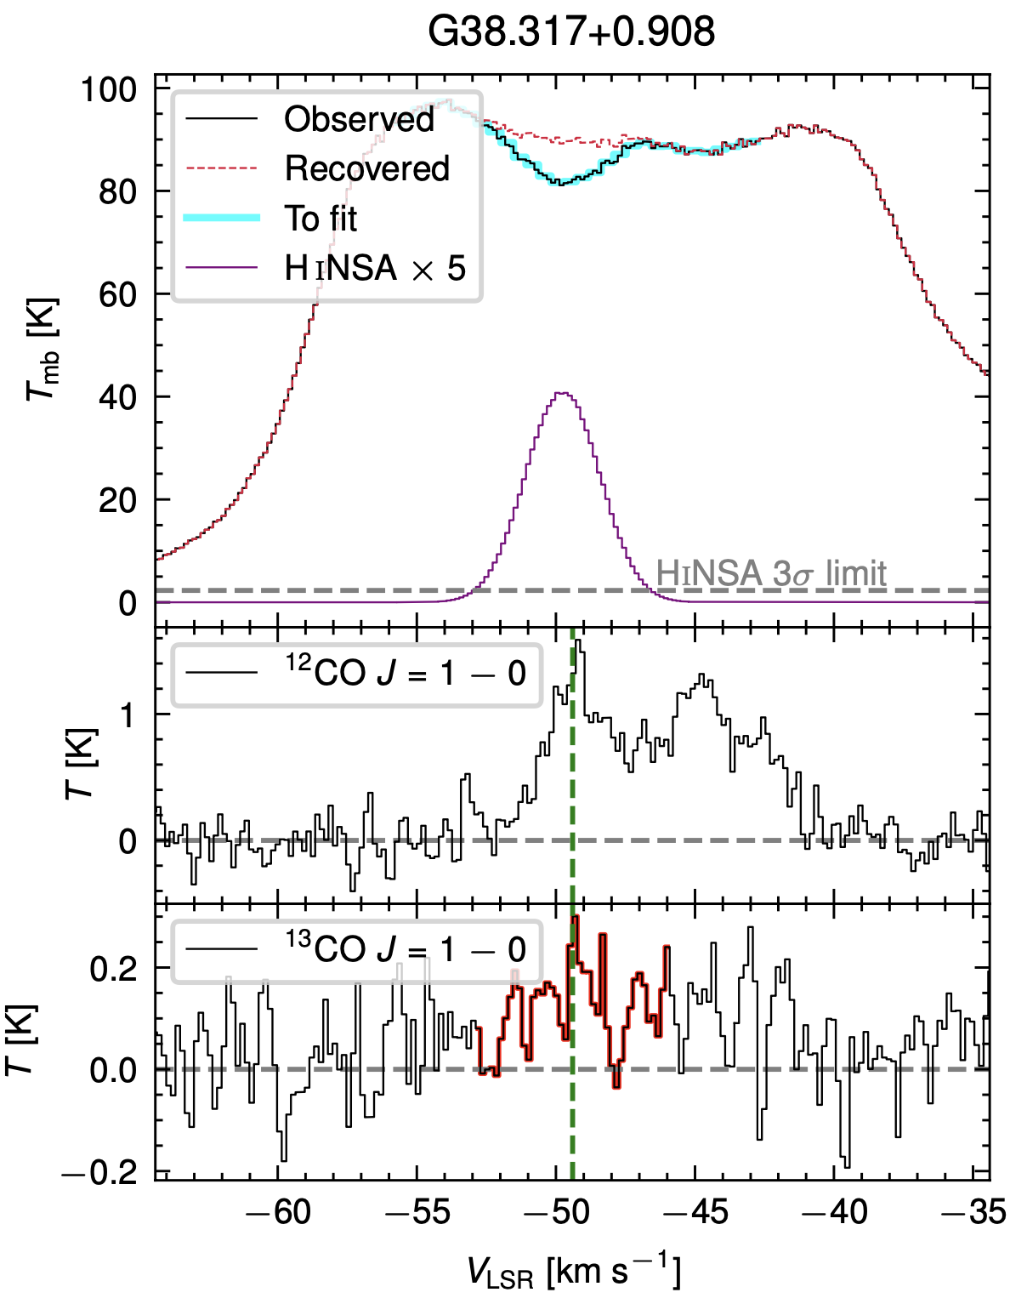

Slide 8
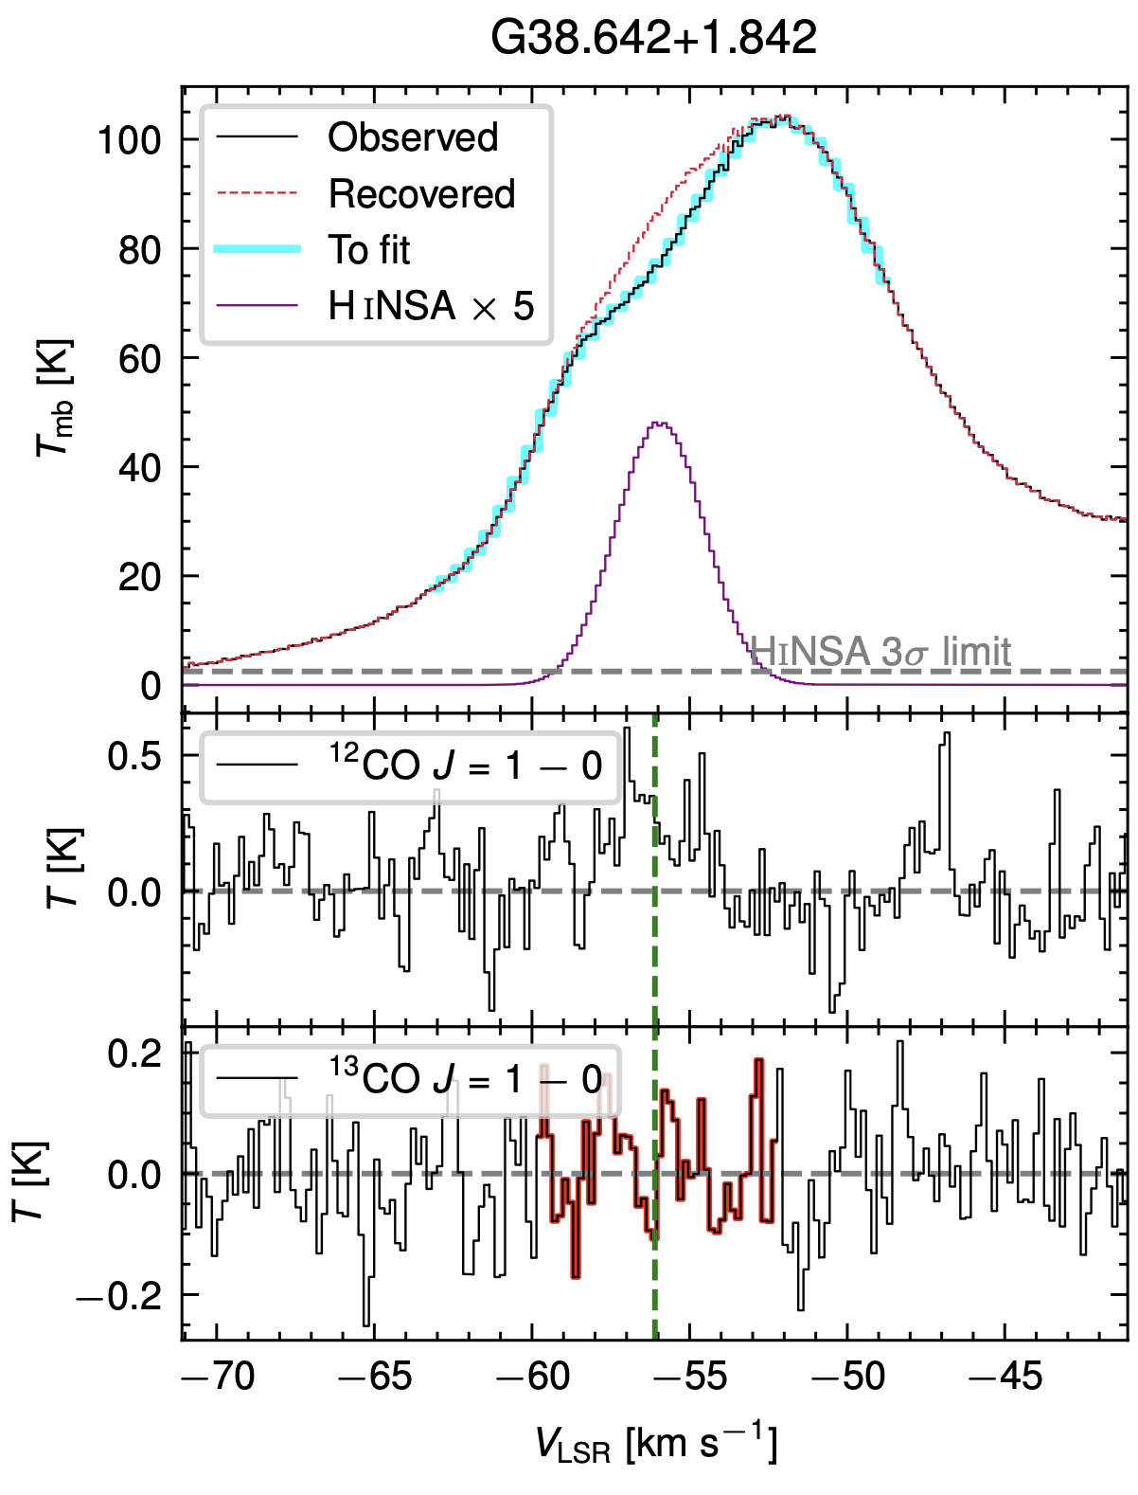
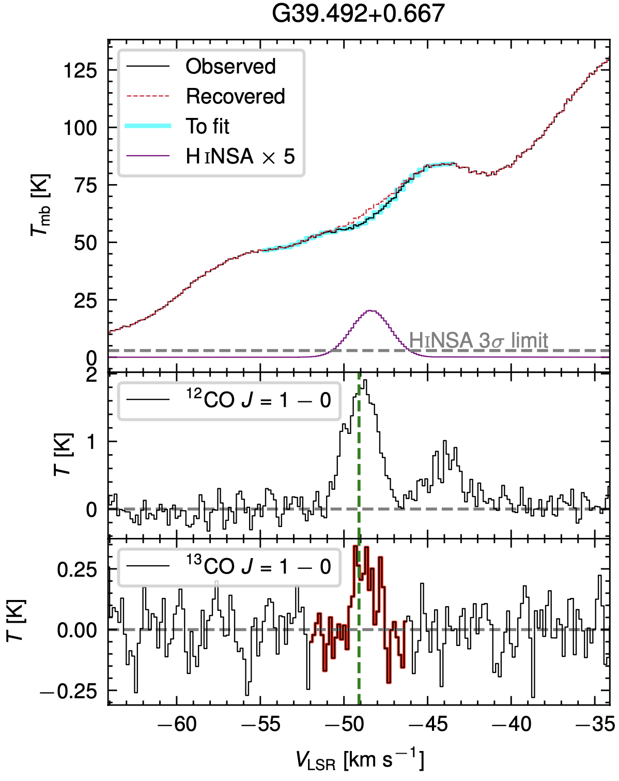
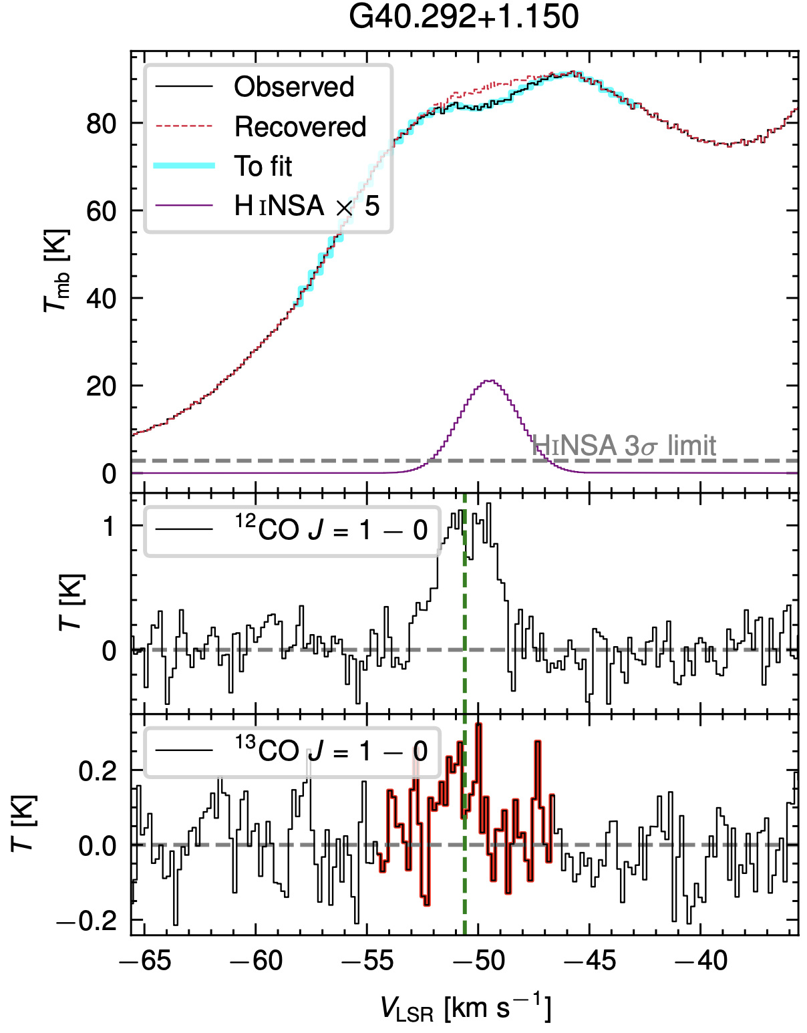

Slide 9
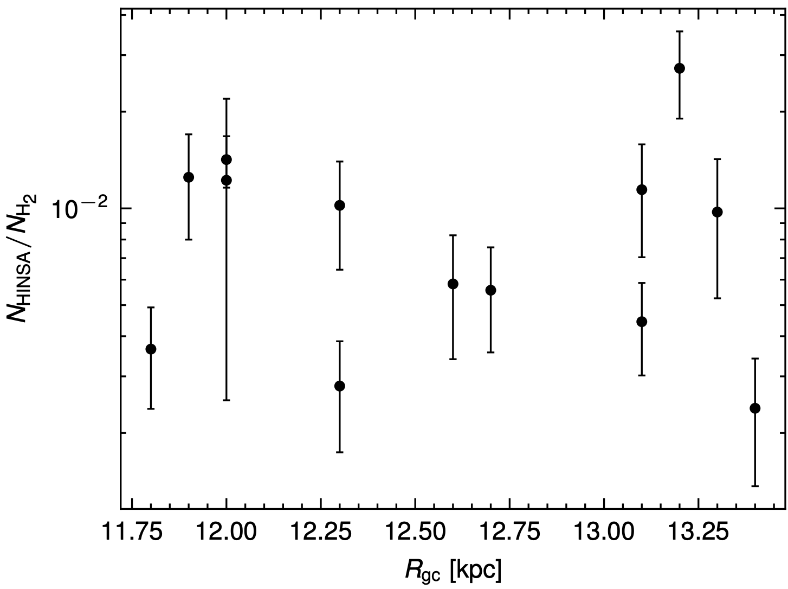
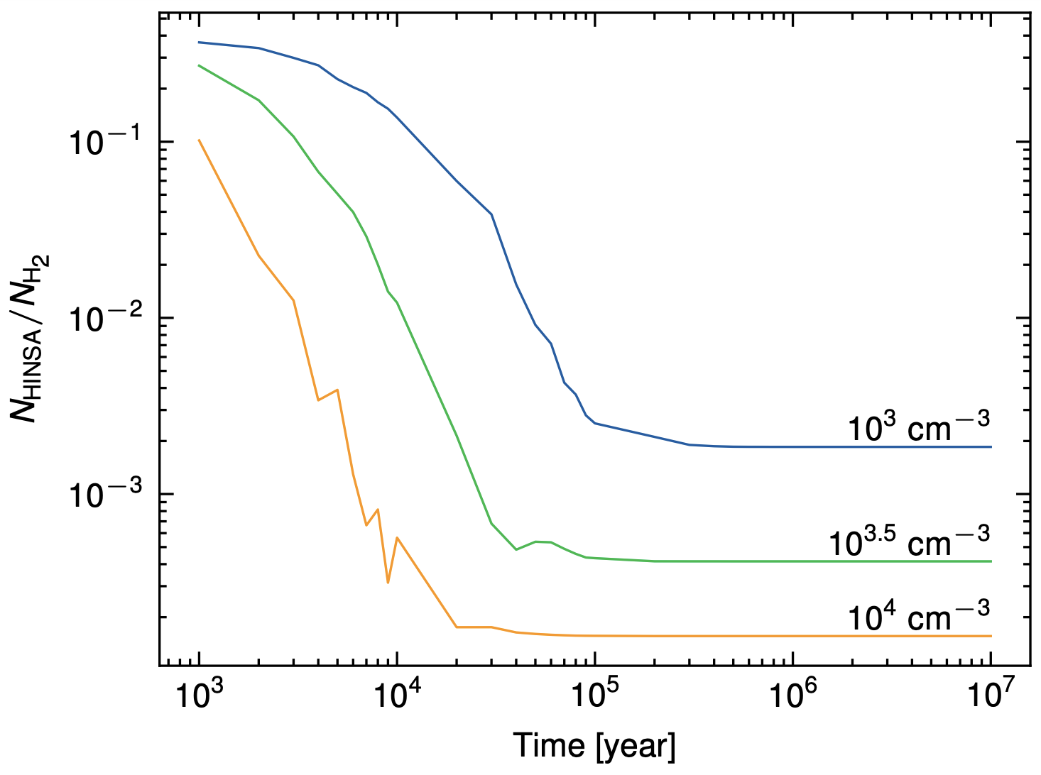
HINSA from 21-cm spectra
H2 from integrated intensity of 13CO 1-0

