Slide 1
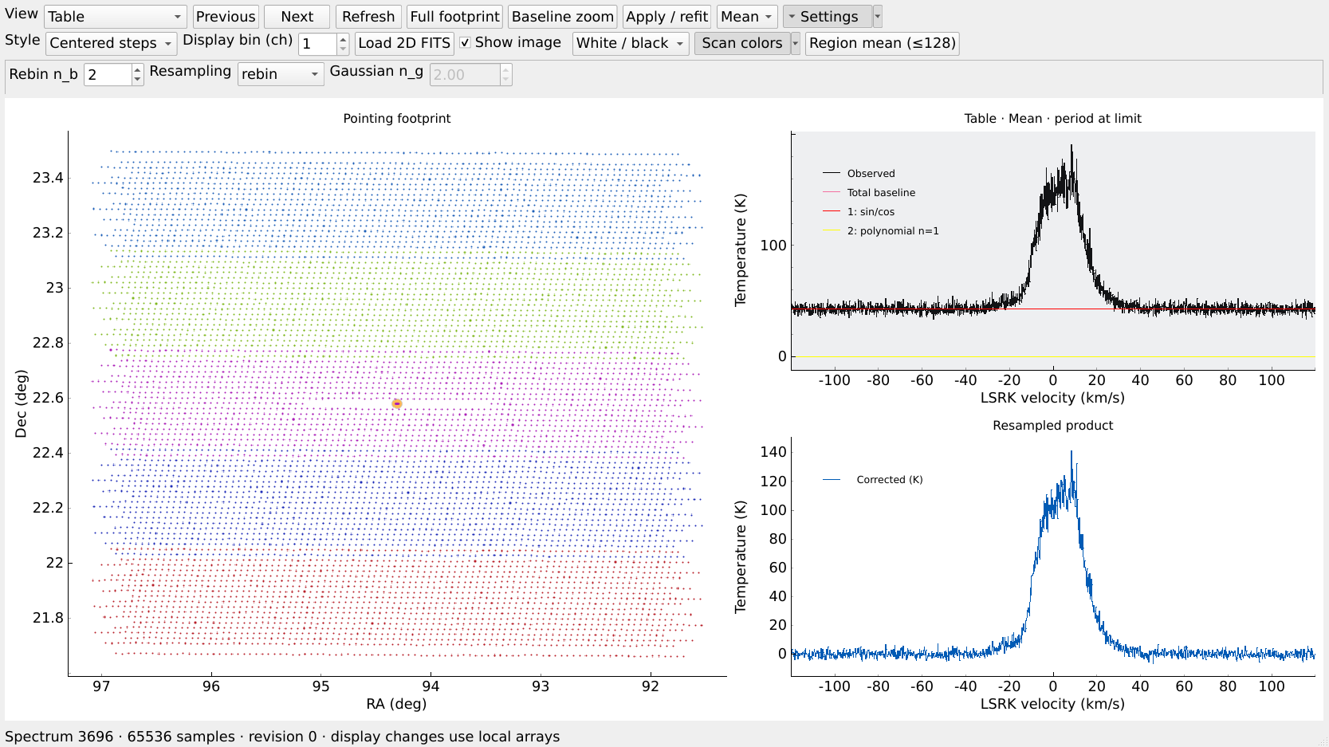
FISH for IC443
Interactive reduction on
114.212.167.114
N_000[234].fits
285 science files
5 scans and 19 beams
Window previews and settings
FISH commands for full processing
Illustrated with real IC443 previews. The screenshot footprint samples pointings for readability.
01
Notes:
Scope: interactive reduction of N_0002, N_0003 and N_0004 from all five IC443 scans and all 19 beams. Full telemetry-supported footprint, no small spatial crop. Source: /bb8/lingrui/my_projects/FAST_pipeline_v0.0/src/fastfish/commands/shell.py and /bb8/lingrui/my_projects/FAST_pipeline_v0.0/src/fastfish/viewer/qt_viewer.py.
Screenshots: actual FISH Qt controls rendered offscreen on lingrui@114.212.167.114, 2026-10-25. The documentation selection uses 32 exact timestamp pointings per SCI file (9120 total), while the production file pattern selects 285 files and 583680 input timestamps. The displayed spectrum is Dec+2234_06_05/M01/N_0003, raw row 1024, RA 94.30880173455088 deg, Dec 22.579295011444458 deg. No science batch stages or new cube were run to make this guide.

Slide 2
The IC443 project
All paths below are on 114.212.167.114
/bb8/lingrui/my_projects/FAST_IC443
org_spec/
Science spectra, including N_0002–0004
org_cal/
Extracted ON/OFF CAL, organized by scan and date
feed_info/
Five telemetry .xlsx files for the scan pointings
fish_runs/
Your session, coordinate cache, stage records and cubes
The software lives separately in FAST_pipeline_v0.0.
02
Notes:
/bb8/lingrui/my_projects/FAST_pipeline_v0.0/src/fastfish/io/project_input.py locates org_spec, org_cal and feed_info. Extracted CAL discovery is in calibration/extracted.py. No raw PSR extraction is required. The inventory was read on 2026-10-25: 285 SCI files, 95 scan-beam groups, 583680 raw input timestamps, 65536 native channels.
Screenshots: actual FISH Qt controls rendered offscreen on lingrui@114.212.167.114, 2026-10-25. The documentation selection uses 32 exact timestamp pointings per SCI file (9120 total), while the production file pattern selects 285 files and 583680 input timestamps. The displayed spectrum is Dec+2234_06_05/M01/N_0003, raw row 1024, RA 94.30880173455088 deg, Dec 22.579295011444458 deg. No science batch stages or new cube were run to make this guide.

Slide 3
The server desktop and terminal
Open a terminal inside the .114 graphical desktop, then start FISH
1
cd /bb8/lingrui/my_projects/FAST_IC443
2
export LD_PRELOAD=/astrosoft/anaconda/anaconda3/lib/libstdc++.so.6
This selects the C++ library already installed on .114.
3
~/.local/bin/fish --viewer qt
The prompt becomes fish>. Qt windows need a graphical desktop or a working display connection.
03
Notes:
Use a terminal inside the .114 server graphical desktop/VNC session. A non-graphical SSH shell does not display Qt automatically. Commands are ordinary server-shell commands, before the fish> prompt.
cd /bb8/lingrui/my_projects/FAST_IC443
export LD_PRELOAD=/astrosoft/anaconda/anaconda3/lib/libstdc++.so.6
~/.local/bin/fish --viewer qt
The existing .114 SciPy installation can fail with CXXABI_1.3.9 not found if it loads /lib64/libstdc++.so.6. The export selects the already-installed newer libstdc++ for this terminal and its children. It changes no system libraries or pipeline science settings. Tested import of scipy.interpolate, pyqtgraph and fastfish.viewer.worker passed with this setting. Existing LD_PRELOAD entries can be retained if needed. Source launcher /home/lingrui/.local/bin/fish uses /usr/bin/python3 and exports the pipeline src path.
Screenshots: actual FISH Qt controls rendered offscreen on lingrui@114.212.167.114, 2026-10-25. The documentation selection uses 32 exact timestamp pointings per SCI file (9120 total), while the production file pattern selects 285 files and 583680 input timestamps. The displayed spectrum is Dec+2234_06_05/M01/N_0003, raw row 1024, RA 94.30880173455088 deg, Dec 22.579295011444458 deg. No science batch stages or new cube were run to make this guide.

Slide 4
Opening N_0002, N_0003 and N_0004
Enter these commands at the fish> prompt
project /bb8/lingrui/my_projects/FAST_IC443
file in org_spec/*/*/*_N_000[234].fits --run-root fish_runs/IC443_0002_0004
list
Expected inventory: 285 files and 583,680 input timestamps.
The valid pointing count appears after go where. A new run needs an empty directory.
04
Notes:
The server shell must already be in /bb8/lingrui/my_projects/FAST_IC443, as on the preceding slide. The project command sets discovery paths and does not change cwd.
project /bb8/lingrui/my_projects/FAST_IC443
file in org_spec/*/*/*_N_000[234].fits --run-root fish_runs/IC443_0002_0004
list
The named run directory must be empty or absent. For another reduction choose another run-root name. To reopen your saved session use restore rather than file in over a nonempty workspace. file in reads metadata rather than all spectral arrays. N_* are narrow-band science files, and [234] selects precisely the three sequence numbers. Source commands/shell.py and io/file_input.py.
Screenshots: actual FISH Qt controls rendered offscreen on lingrui@114.212.167.114, 2026-10-25. The documentation selection uses 32 exact timestamp pointings per SCI file (9120 total), while the production file pattern selects 285 files and 583680 input timestamps. The displayed spectrum is Dec+2234_06_05/M01/N_0003, raw row 1024, RA 94.30880173455088 deg, Dec 22.579295011444458 deg. No science batch stages or new cube were run to make this guide.

Slide 5
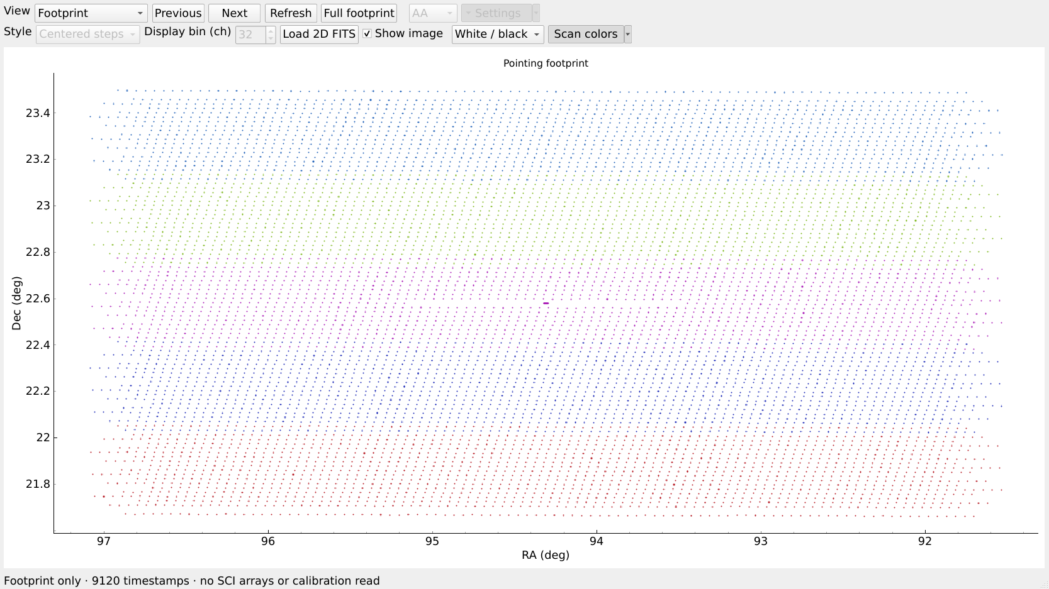
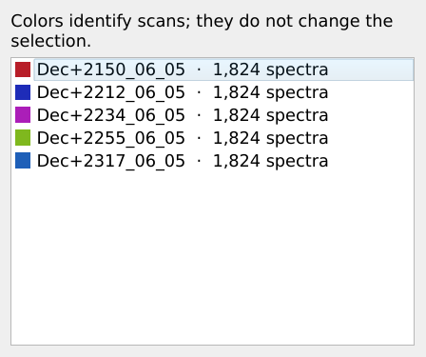
Footprint and scan colors
fish> go where /workers 64
1
2
1 View: Footprint
2 Scan colors menu
Show scan legend
Screenshot: 32 exact pointings per SCI file. The production selection contains all valid timestamps.
05
Notes:
go where computes valid pointings and chooses an ICRS/TAN cube footprint automatically. A repeated calculation can reuse the validated project coordinate cache. The screenshot uses a separate sampled documentation selection, not the full science selection. The production command processes all loaded rows. Current point-worker count is a direct ceiling, so select a count appropriate to available RAM and storage. The tutorial preparation used bounded timestamp-prefix reads to avoid a slow full metadata traversal. Source: io/project_input.py, pointing/cache.py, viewer/qt_viewer.py.
Screenshots: actual FISH Qt controls rendered offscreen on lingrui@114.212.167.114, 2026-10-25. The documentation selection uses 32 exact timestamp pointings per SCI file (9120 total), while the production file pattern selects 285 files and 583680 input timestamps. The displayed spectrum is Dec+2234_06_05/M01/N_0003, raw row 1024, RA 94.30880173455088 deg, Dec 22.579295011444458 deg. No science batch stages or new cube were run to make this guide.

Slide 6
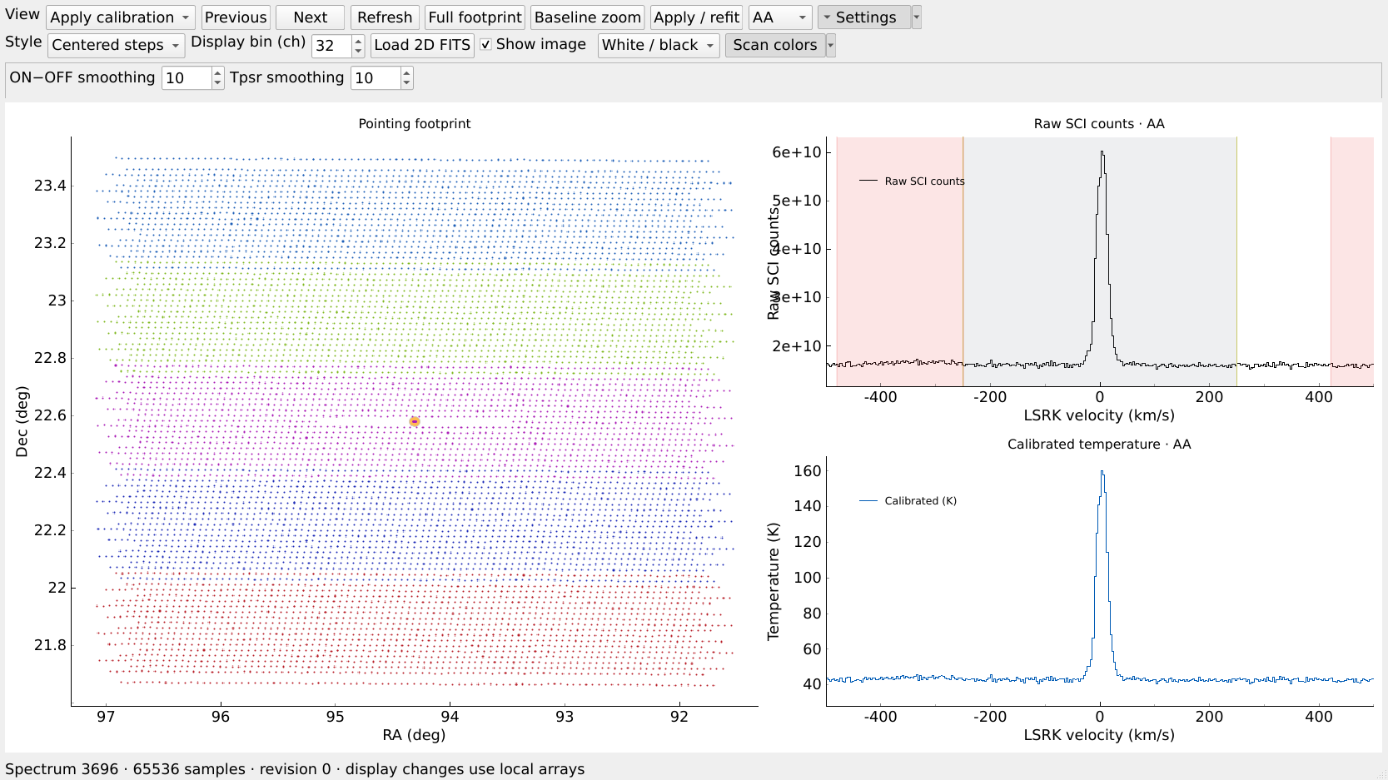
A pointing and its spectrum
Choose a processing view before clicking on the map
1
3
1
Choose a view
Select Apply calibration or Baseline.
2
Click a pointing
2
The yellow marker identifies the selected spectrum.
3
Step through time
Use Previous and Next to inspect neighboring samples.
06
Notes:
Source viewer/qt_viewer.py clicked() ignores map clicks in Footprint view. Choose Apply calibration or Baseline, then click a pointing. Yellow marks the selected location. Previous/Next step through the loaded selection. The sample shown is real IC443 M01 N_0003 row 1024. Its documentation-session index differs from a full selection, so no index is prescribed.
Screenshots: actual FISH Qt controls rendered offscreen on lingrui@114.212.167.114, 2026-10-25. The documentation selection uses 32 exact timestamp pointings per SCI file (9120 total), while the production file pattern selects 285 files and 583680 input timestamps. The displayed spectrum is Dec+2234_06_05/M01/N_0003, raw row 1024, RA 94.30880173455088 deg, Dec 22.579295011444458 deg. No science batch stages or new cube were run to make this guide.

Slide 7
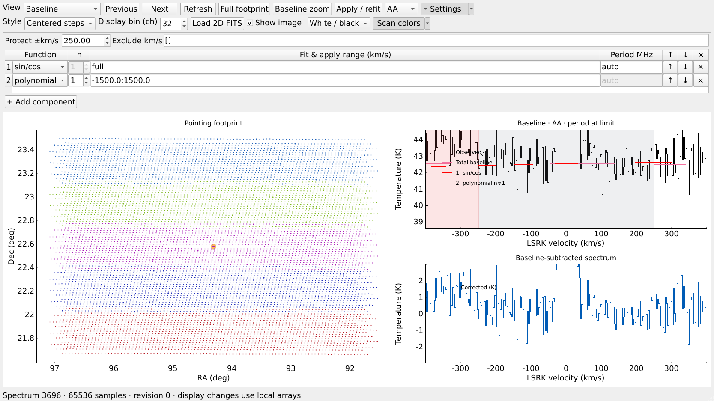
Zoom and vertical range
Click the plotting canvas and place the cursor over the panel you want to change
Z
Drag to zoom velocity only.
Shift + Z
Drag to change velocity and intensity.
B F Escape
Previous view, full view, cancel zoom.
Exact Y limits: right-click the spectrum, open Y axis, choose Manual, then enter the limits.
07
Notes:
Source viewer/keyboard.py. Z arms a drag rectangle, horizontal-only on spectra. Shift+Z changes both axes. B restores previous view, F full extent, Escape cancels an armed zoom. Free pan and wheel navigation are disabled. Exact limits: right-click spectrum, Y axis, Manual, set min/max and press Enter. Keyboard commands do not apply while typing in parameter fields. This image intentionally clips the bright H I peak to show baseline residuals.
Screenshots: actual FISH Qt controls rendered offscreen on lingrui@114.212.167.114, 2026-10-25. The documentation selection uses 32 exact timestamp pointings per SCI file (9120 total), while the production file pattern selects 285 files and 583680 input timestamps. The displayed spectrum is Dec+2234_06_05/M01/N_0003, raw row 1024, RA 94.30880173455088 deg, Dec 22.579295011444458 deg. No science batch stages or new cube were run to make this guide.

Slide 8
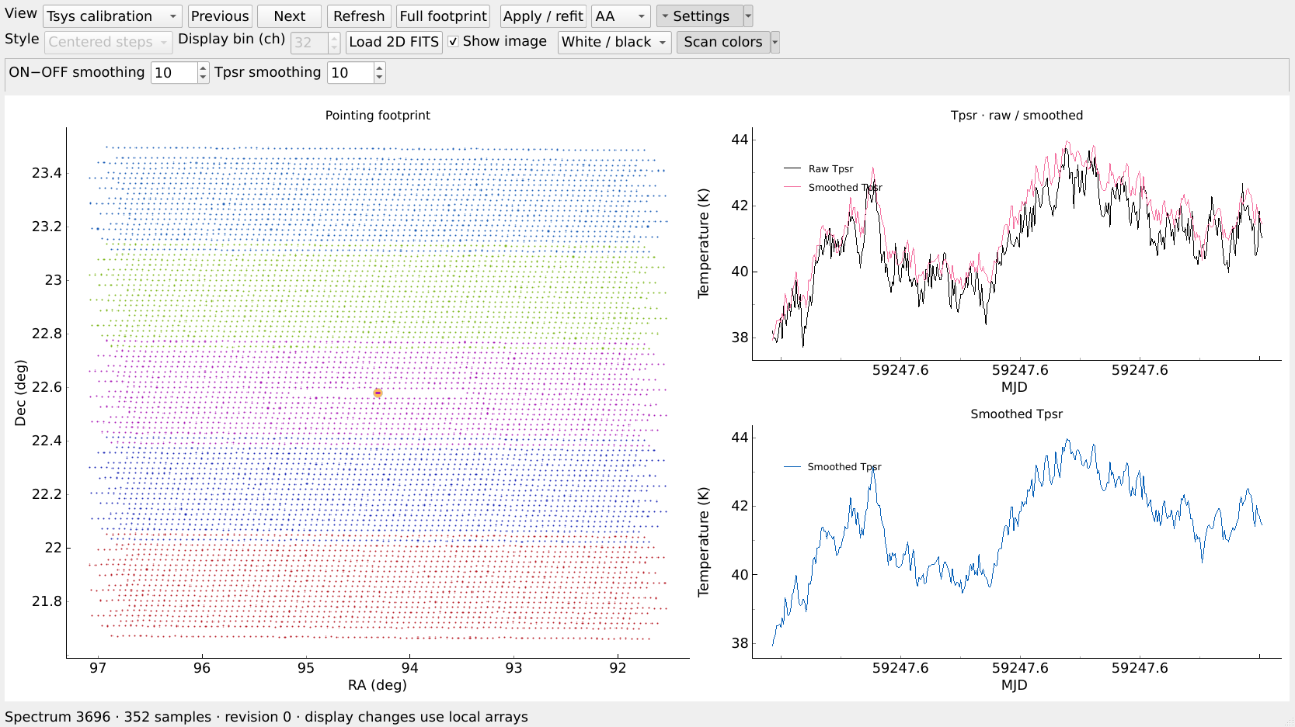
The two smoothing controls
View: Tsys calibration
3
1
2
1
ON−OFF smoothing
n_t_cal = 10
Filters ON−OFF before deriving Tpsr.
2
Tpsr smoothing
n_t_apply = 10
Filters Tpsr before science calibration.
3
Apply / refit
Click to commit settings.
10 CAL timestamps ≈ 2.01 s.
These curves summarize frequency medians. The filters operate on each frequency channel.
08
Notes:
Source calibration/extracted.py rebuild_reference and processing/preview.py reference_display. ON-OFF smoothing acts before deriving temperature from the extracted CAL. Tpsr smoothing filters the temperature reference in time before applying calibration. Each acts per frequency channel, then diagnostic curves summarize the band with a median. Therefore a smoothed diagnostic median need not equal smoothing the plotted raw median. Actual median CAL spacing 0.2013266087 s, so ten timestamps span approximately 2.01 s. AA/BB time traces are selected with the polarization control. Changes need Apply/refit and appropriate batch stages rerun under the new fingerprints.
Screenshots: actual FISH Qt controls rendered offscreen on lingrui@114.212.167.114, 2026-10-25. The documentation selection uses 32 exact timestamp pointings per SCI file (9120 total), while the production file pattern selects 285 files and 583680 input timestamps. The displayed spectrum is Dec+2234_06_05/M01/N_0003, raw row 1024, RA 94.30880173455088 deg, Dec 22.579295011444458 deg. No science batch stages or new cube were run to make this guide.

Slide 9
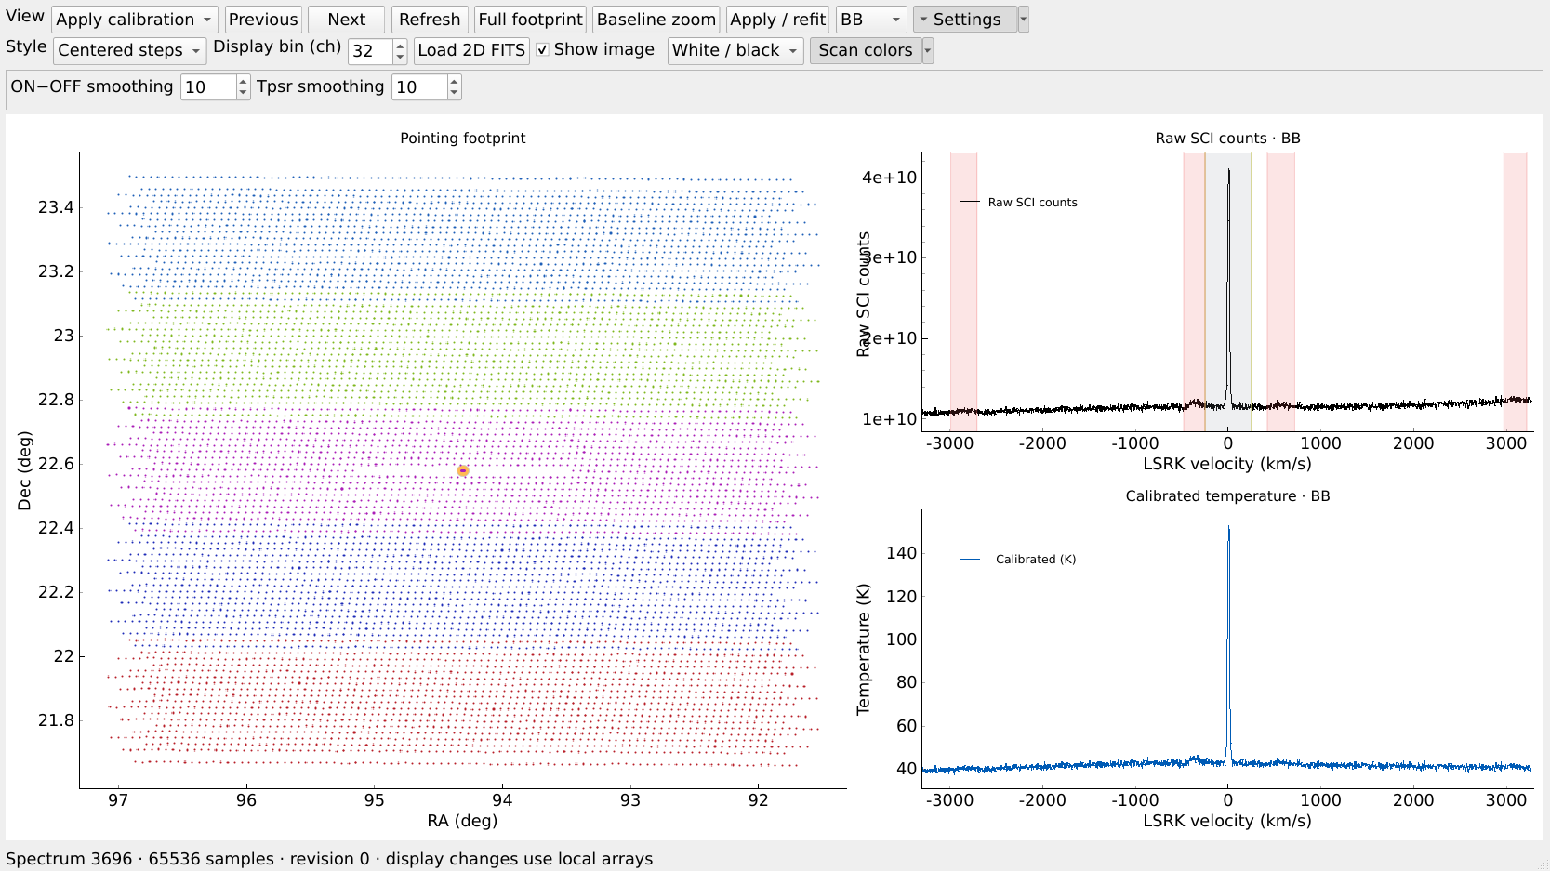
Applied calibration
View: Apply calibration
1
1
AA, BB or Mean
2
Compare the two polarizations before accepting calibration.
2
Upper spectrum
3
Raw science counts at the selected timestamp.
3
Lower spectrum
Calibrated temperature in kelvin. Baseline subtraction comes next.
09
Notes:
Source viewer/worker.py preview_arrays and processing/preview.py calibrate. Upper panel is raw SCI counts, lower panel calibrated temperature in K at the same selected time and native frequency grid. AA, BB and Mean change display, not the underlying selection. Baseline fits remain independent in AA/BB and the pipeline averages corrected polarizations later. Detected RFI masks affect gain/baseline fitting anchors; science values stay retained.
Screenshots: actual FISH Qt controls rendered offscreen on lingrui@114.212.167.114, 2026-10-25. The documentation selection uses 32 exact timestamp pointings per SCI file (9120 total), while the production file pattern selects 285 files and 583680 input timestamps. The displayed spectrum is Dec+2234_06_05/M01/N_0003, raw row 1024, RA 94.30880173455088 deg, Dec 22.579295011444458 deg. No science batch stages or new cube were run to make this guide.

Slide 10
Display averaging and spectral rebinning
Two controls with different effects
Display bin (ch)
32 reduces drawing points. Set 1 when you want to inspect individual channels.
Rebin n_b
2 combines native spectral channels in the science product.
10
Notes:
Source viewer/qt_viewer.py display_values and processing/spectral.py. Display bin(ch)=32 averages only the plotted channel groups. n_b=2 performs overlap-aware science rebinning after Doppler alignment. Changing Display bin does not alter stored data, fits or cube resolution. The true output spacing with native 476.837158 Hz channels and n_b=2 is about 0.201283589 km/s. Screenshot strips are crops of the real viewer, not reconstructed UI.
Screenshots: actual FISH Qt controls rendered offscreen on lingrui@114.212.167.114, 2026-10-25. The documentation selection uses 32 exact timestamp pointings per SCI file (9120 total), while the production file pattern selects 285 files and 583680 input timestamps. The displayed spectrum is Dec+2234_06_05/M01/N_0003, raw row 1024, RA 94.30880173455088 deg, Dec 22.579295011444458 deg. No science batch stages or new cube were run to make this guide.

Slide 11
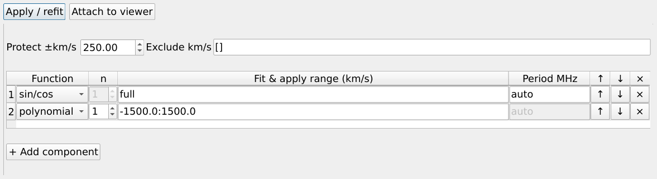
Baseline components
View: Baseline. Settings menu: Detach parameter console
2
3
4
1
1 Add component
2 Polynomial n
3 Fit & apply range
4 Period MHz
Choose sin/cos or polynomial.
Use the row controls to reorder or remove.
0 constant, 1 linear,
2 quadratic, 3 cubic.
Fit and subtract only here.
Example: -1500:1500 km/s.
auto, a fixed period,
or a search range.
Components fit in list order. Each range also limits where that component is subtracted.
11
Notes:
Source baseline/components.py and viewer/qt_viewer.py. Components fit sequential residuals in list order, not a simultaneous joint model. Every component excludes protected HI, detected RFI and baseline-only manual exclusions. Range specifies both fit and application domain; no component extrapolates beyond that range. The shown defaults are sine/cosine plus constant on the full band, then degree-1 polynomial on [-1500,1500] km/s. Automatic sine periods are shared by a short chunk and polarization; amplitudes are independent per timestamp and polarization. n is polynomial degree, with n=0 constant, 1 linear, 2 quadratic, 3 cubic. Period uses native-frequency MHz: auto, a fixed number, or a search range such as 8:30. The screenshot is the actual detached console.
Screenshots: actual FISH Qt controls rendered offscreen on lingrui@114.212.167.114, 2026-10-25. The documentation selection uses 32 exact timestamp pointings per SCI file (9120 total), while the production file pattern selects 285 files and 583680 input timestamps. The displayed spectrum is Dec+2234_06_05/M01/N_0003, raw row 1024, RA 94.30880173455088 deg, Dec 22.579295011444458 deg. No science batch stages or new cube were run to make this guide.

Slide 12
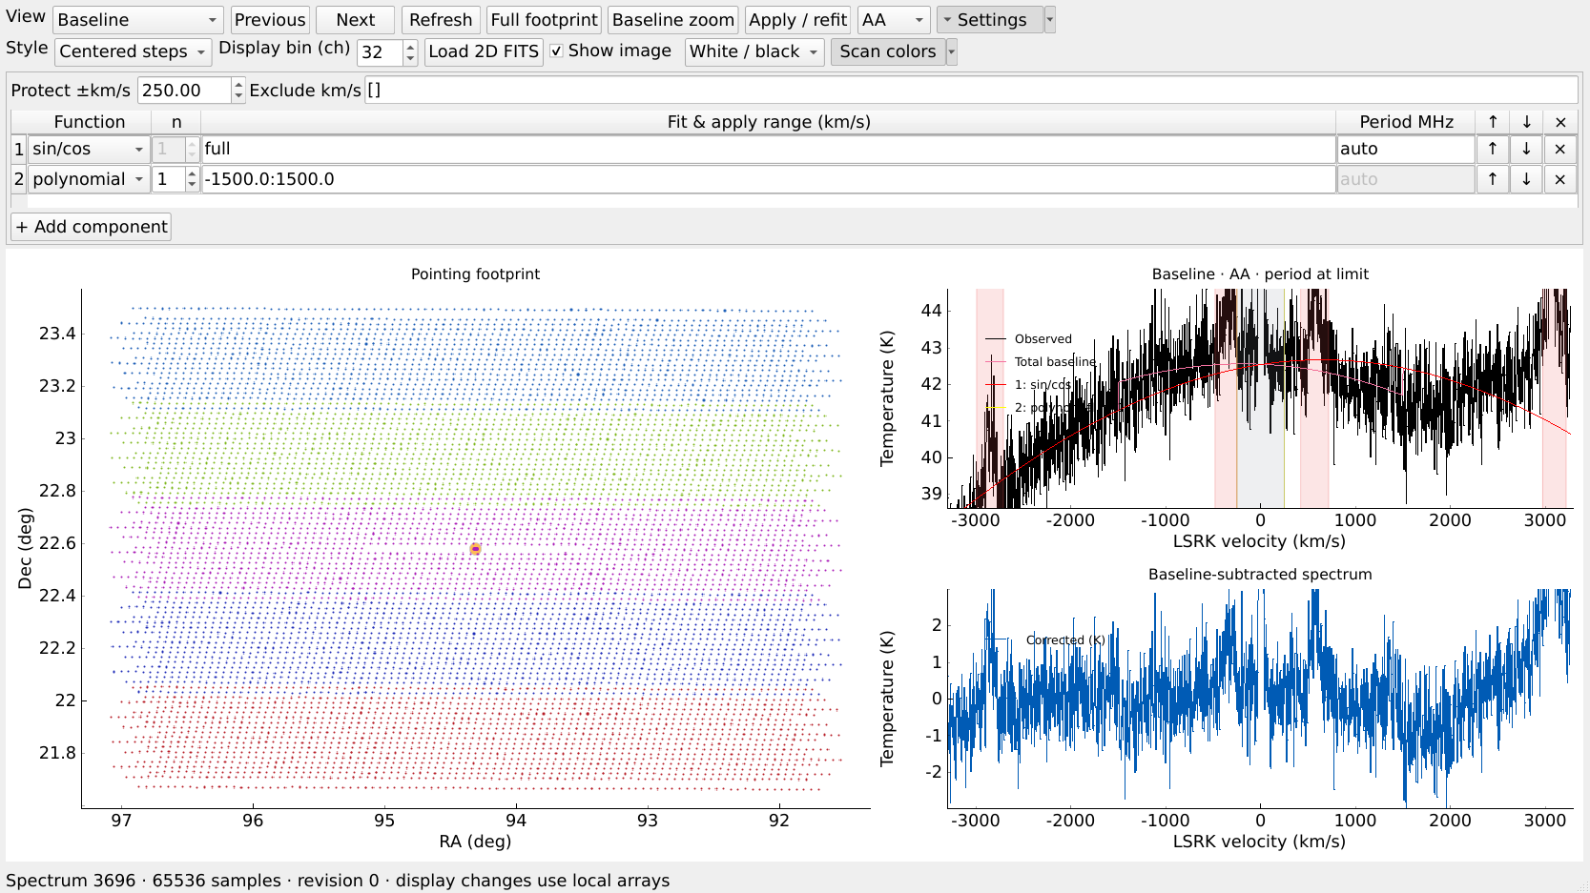
Protected H I and RFI exclusions
Masks remove fitting anchors while retaining the science channels
1
2
1
Protect ±250 km/s
H I stays out of baseline fitting anchors.
3
2
Extra exclusions
Enter additional baseline-only windows as JSON pairs, then Apply / refit.
3
Inspect the masks
Catalog bands are priors. Only detected features trigger automatic masks.
12
Notes:
Source rfi/detection.py track_intervals, rfi/catalog.py and baseline/components.py. Catalog entries are search priors and do not force masks when no signal is detected. This actual chunk produced intervals in MHz: [[1405.0042613983155,1406.1756481170655],[1416.8619762420653,1418.2606090545655],[1421.4370250701904,1422.5330699920655],[1433.0973278045653,1434.4349254608155]]. The protected HI half-width is 250 km/s. The screenshot's red-tinted bands mark detected intervals and the neutral region marks protected HI. Manual Exclude km/s accepts JSON pairs such as [[700,900]], but that is syntax only, not a recommendation for an actual IC443 feature. Manual exclusions affect baseline fits, do not delete science channels, and do not retroactively remove contamination from calibration or the cube.
Screenshots: actual FISH Qt controls rendered offscreen on lingrui@114.212.167.114, 2026-10-25. The documentation selection uses 32 exact timestamp pointings per SCI file (9120 total), while the production file pattern selects 285 files and 583680 input timestamps. The displayed spectrum is Dec+2234_06_05/M01/N_0003, raw row 1024, RA 94.30880173455088 deg, Dec 22.579295011444458 deg. No science batch stages or new cube were run to make this guide.

Slide 13
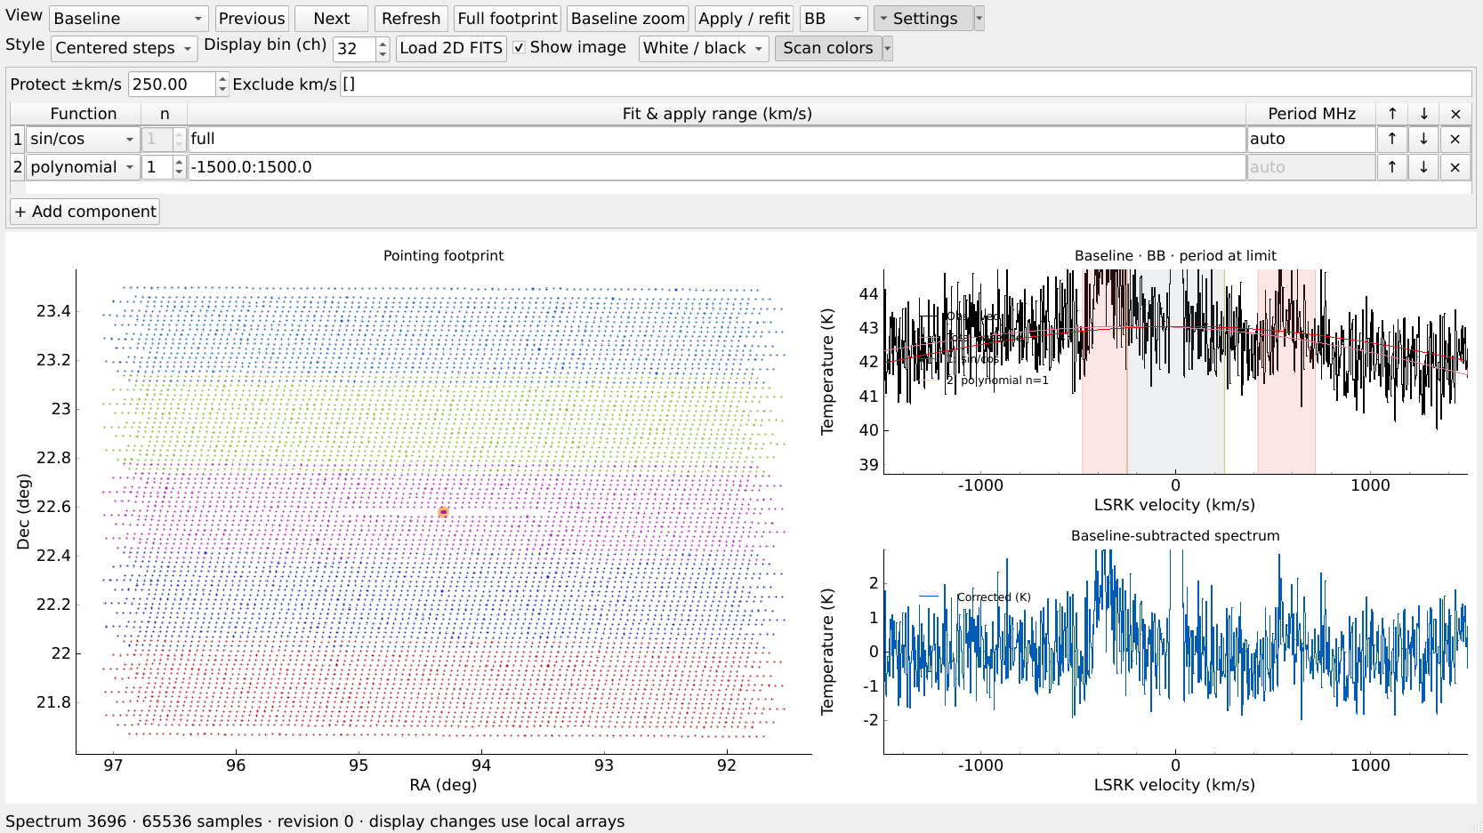
Baseline inspection before batch processing
Structured residuals or a period-limit warning need review
3
1
Read the warning
period at limit means the search reached a boundary. Inspect the model choice.
1
2
Inspect residuals
Look for coherent ripples and offsets in clean channels. Noise alone is expected.
2
3
Compare AA and BB
A good-looking average can hide a problem in one polarization.
13
Notes:
Actual sample report has at_search_boundary/period-at-limit warning in the displayed fit. This guide does not claim the default model is scientifically adequate. Use AA/BB comparison, alternative components and justified windows before accepting the fit. Check clean channels outside protected HI and detected RFI. Do not require zero within protected HI, where real emission contributes. Model uncertainty there cannot be inferred simply from a flat residual outside the line. Source: viewer/qt_viewer.py and baseline/components.py.
Screenshots: actual FISH Qt controls rendered offscreen on lingrui@114.212.167.114, 2026-10-25. The documentation selection uses 32 exact timestamp pointings per SCI file (9120 total), while the production file pattern selects 285 files and 583680 input timestamps. The displayed spectrum is Dec+2234_06_05/M01/N_0003, raw row 1024, RA 94.30880173455088 deg, Dec 22.579295011444458 deg. No science batch stages or new cube were run to make this guide.

Slide 14
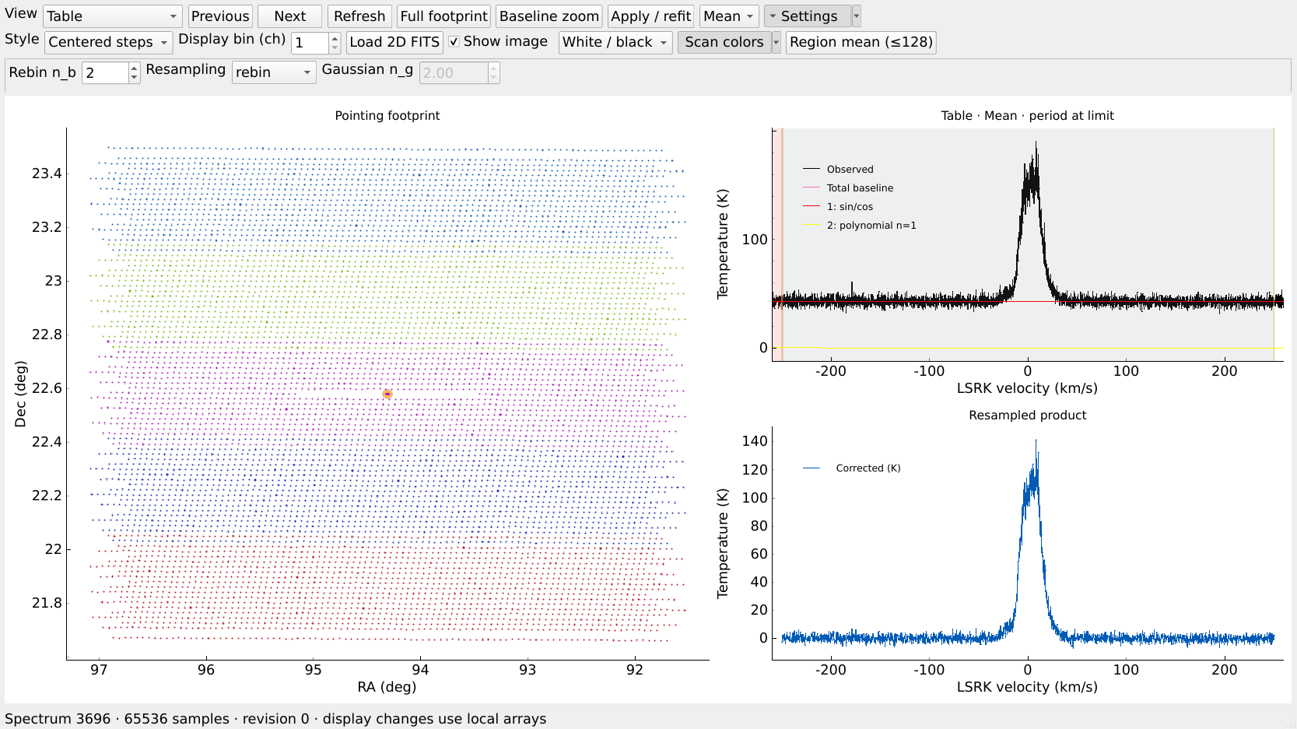
Table and the output velocity range
fish> set velocity_range_kms [-250,250]
1
3
1
Choose Table
2
Set the range in the terminal, then click Refresh in the viewer.
2
Choose resampling
rebin with n_b = 2.
Gaussian is optional, with n_g as final FWHM.
3
Inspect the channels
Display bin = 1.
The rebin example gives about 0.2013 km/s spacing.
14
Notes:
Source commands/shell.py defaults and do_set, processing/preview.py output_grid/resample and processing/spectral.py. Enter set velocity_range_kms [-250,250] in the FISH terminal, then use Refresh in the viewer to read the session. This velocity-range control is not a current GUI field. Rebin n_b=2 gives approximately 0.2013 km/s output channel spacing. In gaussian mode n_g is final FWHM in native-channel units, and output spacing equals that width. It assumes native_fwhm_chan=1 unless configured otherwise. Display bin=1 here reveals output channels. table run writes disk-backed spectra after Doppler alignment; this preview does no spatial gridding.
Screenshots: actual FISH Qt controls rendered offscreen on lingrui@114.212.167.114, 2026-10-25. The documentation selection uses 32 exact timestamp pointings per SCI file (9120 total), while the production file pattern selects 285 files and 583680 input timestamps. The displayed spectrum is Dec+2234_06_05/M01/N_0003, raw row 1024, RA 94.30880173455088 deg, Dec 22.579295011444458 deg. No science batch stages or new cube were run to make this guide.

Slide 15
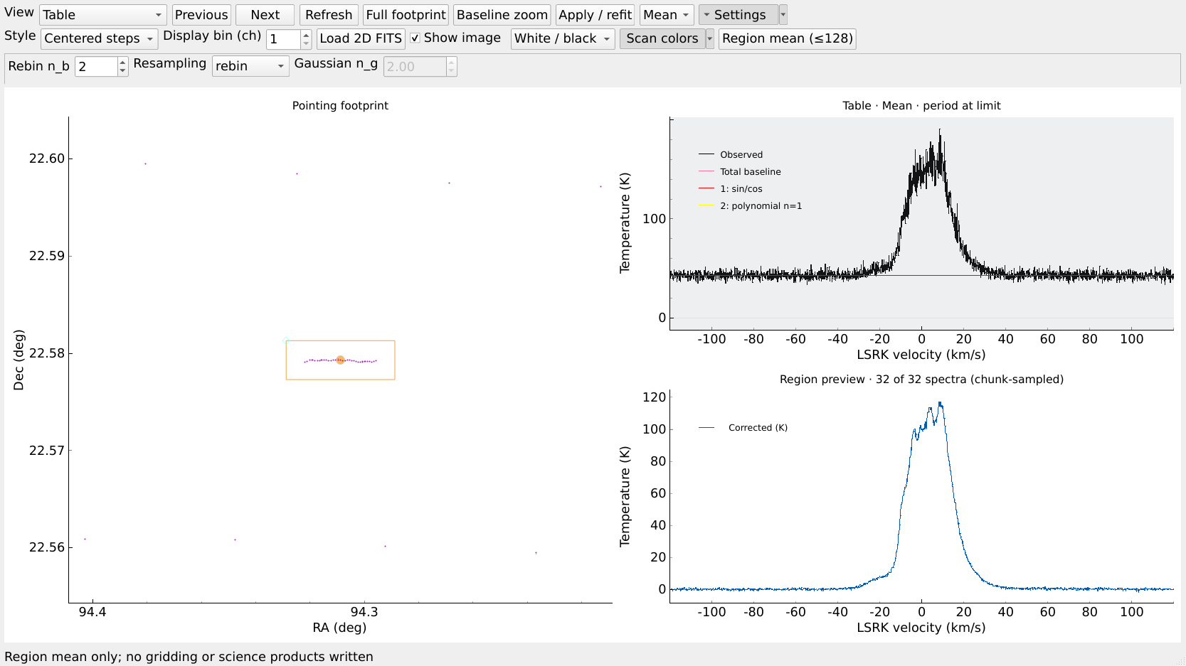
A region mean preview
The region box does not crop the final cube
2
1
Draw the region
Move over the map. Press R or P, then adjust the handles.
2
Region mean
1
Click Region mean (≤128) to compute a sampled spectrum.
3
3
Read the preview
No spatial gridding occurs. The loaded selection remains unchanged.
15
Notes:
Source viewer/qt_viewer.py select_region/region_mean and processing/preview.py region_spectrum. In a processing view, put cursor over map and press R for rectangle or P for polygon. Adjust handles and choose Region mean (<=128). This computes a chunk-sampled preview using at most 128 spectra, no spatial gridding. The screenshot region contains 32 pointings and uses all 32. It does not alter the batch input selection, cube footprint or spectral grid. The production run in this guide keeps the full telemetry-supported footprint of the selected 285 files.
Screenshots: actual FISH Qt controls rendered offscreen on lingrui@114.212.167.114, 2026-10-25. The documentation selection uses 32 exact timestamp pointings per SCI file (9120 total), while the production file pattern selects 285 files and 583680 input timestamps. The displayed spectrum is Dec+2234_06_05/M01/N_0003, raw row 1024, RA 94.30880173455088 deg, Dec 22.579295011444458 deg. No science batch stages or new cube were run to make this guide.

Slide 16
Processing the full loaded selection
Finish your settings in the window, click Apply / refit, then run these FISH commands
1
tsyscal run
Temperature references
wait
2
applycal run
Frequency-dependent calibration
wait
3
baseline run
Independent AA/BB baseline fits
wait
4
table run
Doppler alignment and spectral resampling
wait
5
xy_map run --validate
Scan gridding, combination and checks
wait
Heavy stages use memory admission and the default I/O cap of 4. The worker ceiling is 64.
16
Notes:
Source commands/shell.py _run and processing/stages.py. Current Qt has no Run all button. Run stages from the same shared fish session. Wait after each stage; dependencies require completion with matching fingerprints. Commands:
tsyscal run
wait
applycal run
wait
baseline run
wait
table run
wait
xy_map run --validate
wait
Current project defaults: processing worker ceiling64, I/O ceiling4, memory admission can reduce actual heavy-stage concurrency. A larger ceiling does not force64 heavy tasks. Pointing worker selection is separate. Do not start parallel copies of the same run.
Screenshots: actual FISH Qt controls rendered offscreen on lingrui@114.212.167.114, 2026-10-25. The documentation selection uses 32 exact timestamp pointings per SCI file (9120 total), while the production file pattern selects 285 files and 583680 input timestamps. The displayed spectrum is Dec+2234_06_05/M01/N_0003, raw row 1024, RA 94.30880173455088 deg, Dec 22.579295011444458 deg. No science batch stages or new cube were run to make this guide.

Slide 17
Progress and saved sessions
The FISH terminal remains the place to check the run
status
Stage progress, current job log and output paths
settings
Confirm the committed parameters before running
wait
Wait for the active stage. Ctrl-C leaves the job running.
save fish_runs/IC443_0002_0004/session_saved.json
restore fish_runs/IC443_0002_0004/session_saved.json
17
Notes:
Commands: status shows pending/complete stage checkpoints, current job and paths. settings shows the shared session, including committed GUI settings. wait blocks on the identified active job; Ctrl-C returns to the prompt without stopping it. stop is the explicit termination command. save and restore operate on a small JSON session and retain the run root. Source commands/shell.py do_status/do_wait/do_save/do_restore. A summary file is not proof of correct astrophysical baseline or absolute calibration. No current new IC443 cube was run as part of preparing this deck.
Screenshots: actual FISH Qt controls rendered offscreen on lingrui@114.212.167.114, 2026-10-25. The documentation selection uses 32 exact timestamp pointings per SCI file (9120 total), while the production file pattern selects 285 files and 583680 input timestamps. The displayed spectrum is Dec+2234_06_05/M01/N_0003, raw row 1024, RA 94.30880173455088 deg, Dec 22.579295011444458 deg. No science batch stages or new cube were run to make this guide.

Slide 18
The cube and supporting products
fish> xy_map reports the current cube directory
FAST_IC443_cube.fits
Calibrated spectral cube in kelvin
coverage.fits
Geometric coverage weights
rfi_contribution_fraction.fits
Fraction of contribution flagged by RFI tracking
validation.json
Numerical checks and direct/merged differences
Default grid: RA/Dec (TAN), 1′ pixels, Gaussian kernel FWHM 1.5′.
Component-list fits mark the old baseline-sensitivity diagnostic as NaN.
The missing-fraction map records that unavailability.
Numerical validation does not establish baseline accuracy or absolute calibration. Inspect the science separately.
18
Notes:
Expected files are produced only after a successful new run. Source processing/pipeline.py combine/validate and processing/stages.py. For the project import cfg.name is FAST_IC443, hence FAST_IC443_cube.fits. The folder is fish_runs/IC443_0002_0004/stages/cube/<fingerprint>/. Coverage is geometric kernel weight, not an uncertainty map. RFI fraction is a weighted flag contribution, not an RFI-cleaned cube. With configurable baseline components the former +/-1000 versus +/-1500 sensitivity statistic is undefined, so baseline_sensitivity.fits is NaN and a missing-fraction map makes this explicit. Validation.json passed=true checks arithmetic/support/fractions and optional direct versus merged grid agreement, not true baseline, real-RFI classification or absolute calibration. Current automatic geometry uses ICRS/TAN and 1 arcmin pixels, gridding Gaussian FWHM1.5 arcmin with3sigma support. Inspect maps and scan/beam overlaps separately.
Screenshots: actual FISH Qt controls rendered offscreen on lingrui@114.212.167.114, 2026-10-25. The documentation selection uses 32 exact timestamp pointings per SCI file (9120 total), while the production file pattern selects 285 files and 583680 input timestamps. The displayed spectrum is Dec+2234_06_05/M01/N_0003, raw row 1024, RA 94.30880173455088 deg, Dec 22.579295011444458 deg. No science batch stages or new cube were run to make this guide.

