Slide 1

GENXHACK -26 HACKATHON
Problem Statement Theme: Next – Gen Cyber Defense
Problem Statement Title: Corporate Insider Threat Monitoring system
Team Name: Cyber Pirates
Team Members:
1ST23CY002 – Abhishek P
1ST23CY020 – Himanshu K R

Slide 2
BEHAVIORAL FIM (AI-Powered File Integrity Monitoring)
Proposed Solution:
• AI-powered context-aware File Integrity Monitoring system
• Learns normal user and role-based behavior
• Detects real anomalies instead of rule-based alerts
How it Addresses the Problem:
• Reduces alert fatigue
• Differentiates good vs malicious changes
• Detects insider threats effectively
Innovation & Uniqueness:
• Behavioral-based detection
• ML anomaly detection (Isolation Forest)
• Dynamic risk scoring

Slide 3
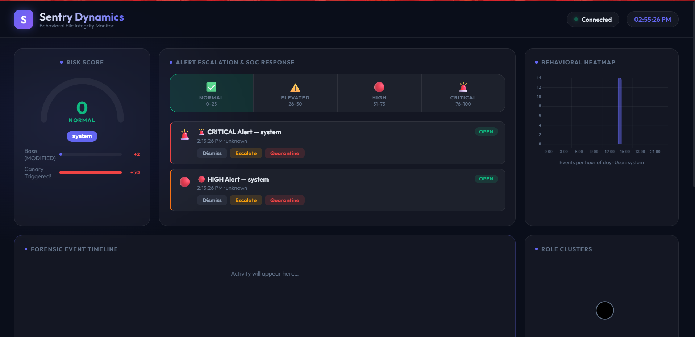
Representation of Image

Slide 4
TECHNICAL APPROACH
Technologies Used:
• Backend: Python, FastAPI
• ML: scikit-learn, numpy, pandas
• Frontend: HTML, CSS, JavaScript (Jinja2)
• Real-time: WebSockets
• Monitoring: watchdog, psutil
Implementation Process:
1. Monitor file events
2. Collect user activity data
3. Apply K-Means clustering
4. Use Isolation Forest for anomaly detection
5. Generate dynamic risk score
6. Display alerts on dashboard

Slide 5
FEASIBILITY AND VIABILITY
Feasibility:
• Open-source ML libraries
• Scalable backend architecture
• Easy integration with enterprise systems
Challenges:
• Training data quality
• Initial anomaly calibration
• Legacy system integration
Mitigation Strategies:
• Continuous model retraining
• Role-based baseline calibration
• Docker/Kubernetes deployment

Slide 6
IMPACT AND BENEFITS
Target Audience:
• SOC Teams
• Enterprises handling sensitive data
• Critical infrastructure organizations
Benefits:
• Reduces false positives
• Faster incident response
• Improved compliance
• Actionable security intelligence

