Slide 1
Seifert Surfaces
Aaryan Sukhadia
Recap
Motivation & Definition
Seifert’s Algorithm
Knot Genus
Surprising Link
Road Map

Slide 2
Seifert Surfaces
Aaryan Sukhadia
Recap
Motivation & Definition
Seifert’s Algorithm
Knot Genus
?
Road Map

Slide 3
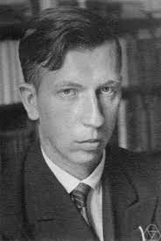
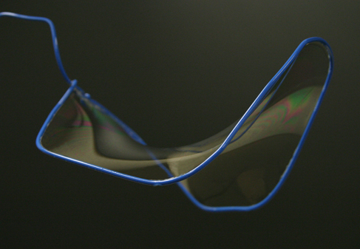
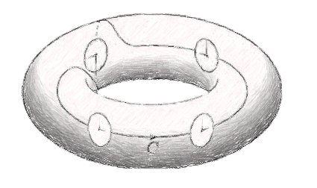
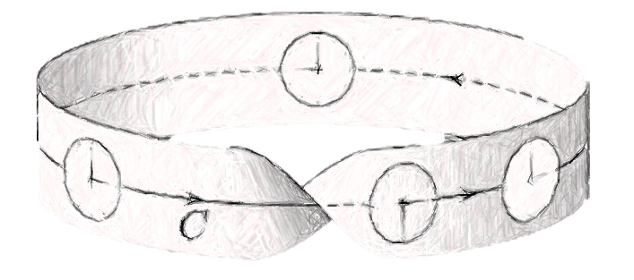
Seifert Surfaces
Knot: S^1 -> R^3
Surface (w/ Boundary)
Orientable Surface (w/ Boundary)
The complement of a knot is a surface!
Recap
Motivation & Definition
Seifert’s Algorithm
Knot Genus
?
Orientable
Non-Orientable

Slide 4
Seifert Surfaces
Knot: S^1 -> R^3
Surface (w/ Boundary)
Orientable Surface (w/ Boundary)
The complement of a knot is a surface!
Recap
Motivation & Definition
Seifert’s Algorithm
Knot Genus
?
Orientable
Non-Orientable

Slide 5
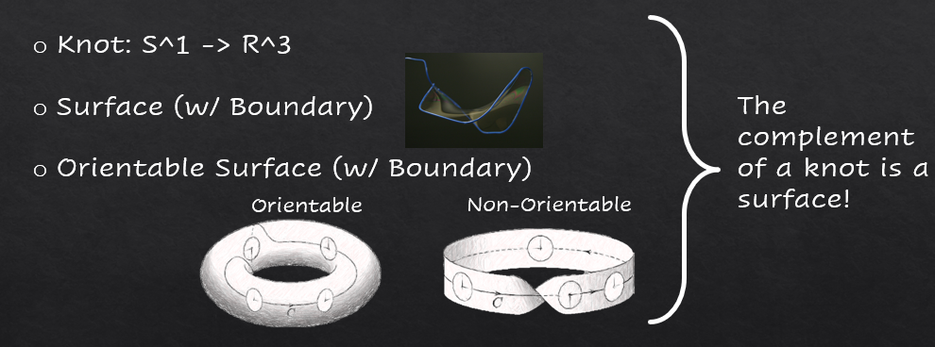
Seifert Surfaces
Recap
Motivation & Definition
Seifert’s Algorithm
Knot Genus
?

Slide 6
Seifert Surfaces
Def: Given a knot K, a Seifert surface for K satisfies:
Orientable
Has one boundary component
Boundary component is K
Idea: Given a knot, construct a surface whose boundary is the knot
Recap
Motivation & Definition
Seifert’s Algorithm
Knot Genus
?
Herbert Seifert

Slide 7
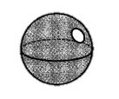
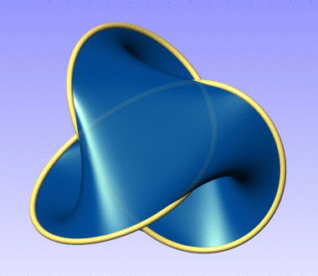
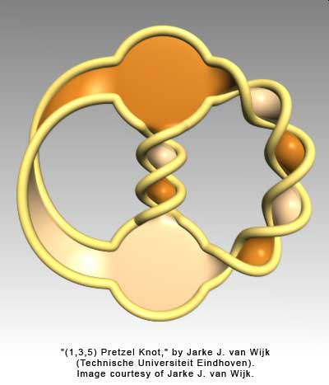
Seifert Surfaces
Seifert’s Algorithm
Def: Given a knot K, a Seifert surface for K satisfies:
Orientable
Has one boundary component
Boundary component is K
Recap
Motivation & Definition
Seifert’s Algorithm
Knot Genus
?
Idea: Given a knot, construct a surface whose boundary is the knot
Herbert Seifert

Slide 8

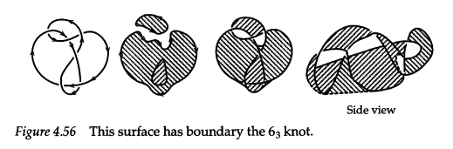
Seifert Surfaces
Seifert’s Algorithm
Notes
Def: Given a knot K, a Seifert surface for K satisfies:
Orientable
Has one boundary component
Boundary component is K
Take an oriented projection of K
“Smooth out” crossings according to orientation:
Resulting loops are Seifert cycles
Fill each loop to form a closed disk
Connect disks by twisted strip at each former crossing
Recap
Motivation & Definition
Seifert’s Algorithm
Knot Genus
?

Slide 9
Seifert Surfaces
Seifert’s Algorithm
Prop: If a projection D has c crossings and the Seifert algorithm produces s Seifert cycles, then Σ_{D} has genus
(1-s+c)/2
Notes
Take an oriented projection of K
“Smooth out” crossings according to orientation:
Resulting loops are Seifert cycles
Fill each loop to form a closed disk
Connect disks by twisted strip at each former crossing
This algorithm always produces a Seifert surface
Different projections can produce different surfaces
The surface from a projection D is denoted Σ_{D}
Recap
Motivation & Definition
Seifert’s Algorithm
Knot Genus
?

Slide 10

Seifert Surfaces
Prop: If a projection D has c crossings and the Seifert algorithm produces s Seifert cycles, then Σ_{D} has genus
(1-s+c)/2
Seifert’s Algorithm
Notes
proof:
Take an oriented projection of K
“Smooth out” crossings according to orientation:
Resulting loops are Seifert cycles
Fill each loop to form a closed disk
Connect disks by twisted strip at each former crossing
Exercise for the reader $∎$
This algorithm always produces a Seifert surface
Different projections can produce different surfaces
The surface from a projection D is denoted Σ_{D}
Recap
Motivation & Definition
Seifert’s Algorithm
Knot Genus
?
Def: The genus of a knot K is the minimal genus of a Seifert surface of K

Slide 11
Seifert Surfaces
Prop: If a projection D has c crossings and the Seifert algorithm produces s Seifert cycles, then Σ_{D} has genus
(1-s+c)/2
proof:
Exercise for the reader $∎$
Recap
Motivation & Definition
Seifert’s Algorithm
Knot Genus
?
Def: The genus of a knot K is the minimal genus of a Seifert surface of K

Slide 12
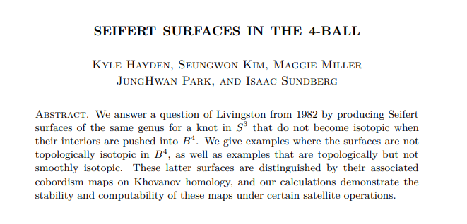

Seifert Surfaces
Prop: If a projection D has c crossings and the Seifert algorithm produces s Seifert cycles, then Σ_{D} has genus
(1-s+c)/2
Recap
Motivation & Definition
Seifert’s Algorithm
Knot Genus
?
proof:
Exercise for the reader $∎$
Def: The genus of a knot K is the minimal genus of a Seifert surface of K

