Slide 1
PRESENTATION TOPIC
DARK MATTER &DARK ENERGY

Slide 2
We know about only normal matter which is only 5% of the composition of universe and the rest is
DARK MATTER & DARK ENERGY

Slide 3
DARK MATTER
-Is hypothetical matter that cannot be seen directly by any means(e.g. telescope).
It is about 27% of composition of the universe.
Does not show any significant interaction with light.

Slide 4
Detection methods
It is detected using Gravitational lensing.
It’s existence is known by galaxy notion curves.
It’s exsistance is also known by Velocity dispersions of galaxies

Slide 5
Velocity dispersions of galaxies
The calculated velocity curve from GR is much lower then that of observed velocity.
This is solved by assuming dark matter in the galaxy.
This dark matter provide extra gravitational field so velocity is increases.

Slide 6
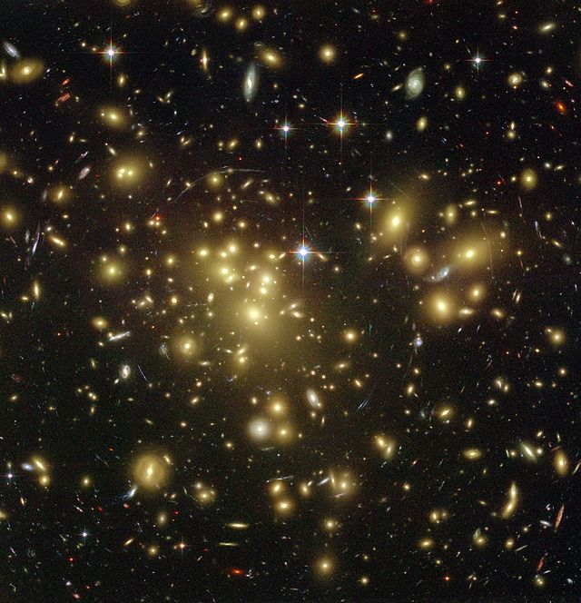
Gravitational Lensing
Strong gravitational lensing as observed by the Hubble Space Telescope in Abell 1689 indicates the presence of dark matter—enlarge the image to see the lensing arcs.
It is bending of light when it pass through gravitational field.
Lensing relies on the effects of general relativity to predict masses without relying on dynamics, and so is a completely independent means of measuring the dark matter.
, the observed distortion of background galaxies into arcs when the light passes through a gravitational lens, has been observed around a few distant clusters including Abell 1689.
With this method we can make the maps of dark matter.

Slide 7
Properties.
It is commonly known that dark matter is made up of baryonic and non-baryonic bodies.
Non-baryonic elements would not only include particles found in atoms, but also axions and Weakly Interacting Massive Particles (WIMPs).
It exists and probably composed of weakly interacting particles(WIMP’s).
WIMP’s interact through gravitational and weak forces.

Slide 8
DARK ENERGY
Unexplained force that is drawing galaxies away from each other, against pull of gravity at an accelerated rate.
A bit like anti gravity.

Slide 9
What is dark energy?
How it is observed ?(detection methods).
What are its properties ?

Slide 10
- Hypothetical form of energy permeated all the space.
It is a prominent theory to support the expansion of the universe.
It occupies a major portion of the universe of about 69%.
It is uniformly separated all over the universe.

Slide 11
Detection methods
Supernova.
Cosmic microwave background.
Late time integrated sachs-wolfe effect.

Slide 12
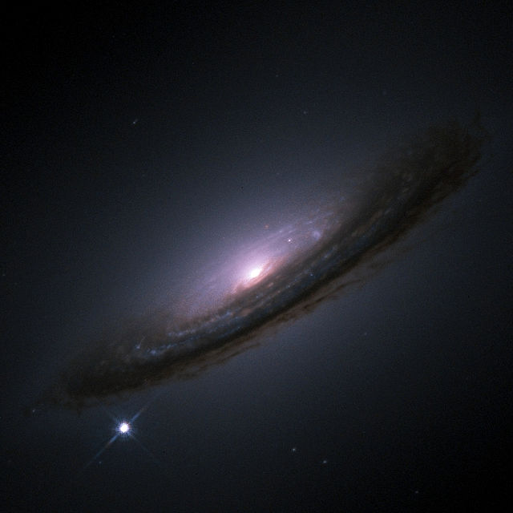
Supernova-
A Type Ia supernova (bright spot on bottom left)near galaxy.
- Supernovae are useful for cosmology because they are excellent standard candles across cosmological distances.
- allow the expansion history of the universe to be measured by looking at the relationship between the distance to an object and its red-shift.
- Type 1a supernovae are the best-known standard candles across cosmological distances because of their extreme and consistent luminosity.

Slide 13
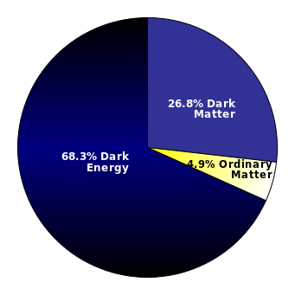
CMB-
Estimated distribution of matter and energy in universe.
Measurements of cosmic microwave background (CMB) anisotropies indicate that the universe is close to flat.
For the shape of the universe to be flat, the mass/energy density of the universe must be equal to the critical density.
The total amount of matter in the universe (including baryons and dark matter), as measured from the CMB spectrum, accounts for only about 30% of the critical density.
This implies the existence of an additional form of energy to account for the remaining 70%.

Slide 14
Alternatives-
The simplest explanation is that it is simply the “cost of having space”.
That is a volume of space has some intrinsic fundamental energy. This is cosmological constant.
Cosmological constant has negative pressure equal to its energy density and so causes the expansion of universe to accelerate.

Slide 15
Properties.
The density of dark energy is very low, much less than the ordinary matter and dark matter.
It is filled homogeneously through out the universe.
Distance measurements and their relation to redshift, which suggest the universe has expanded more in the last half of its life.
Since it is rarefied ,it is unlikely to be detectable in the laboratory experiments.

Slide 16
THANK YOU

