Slide 1
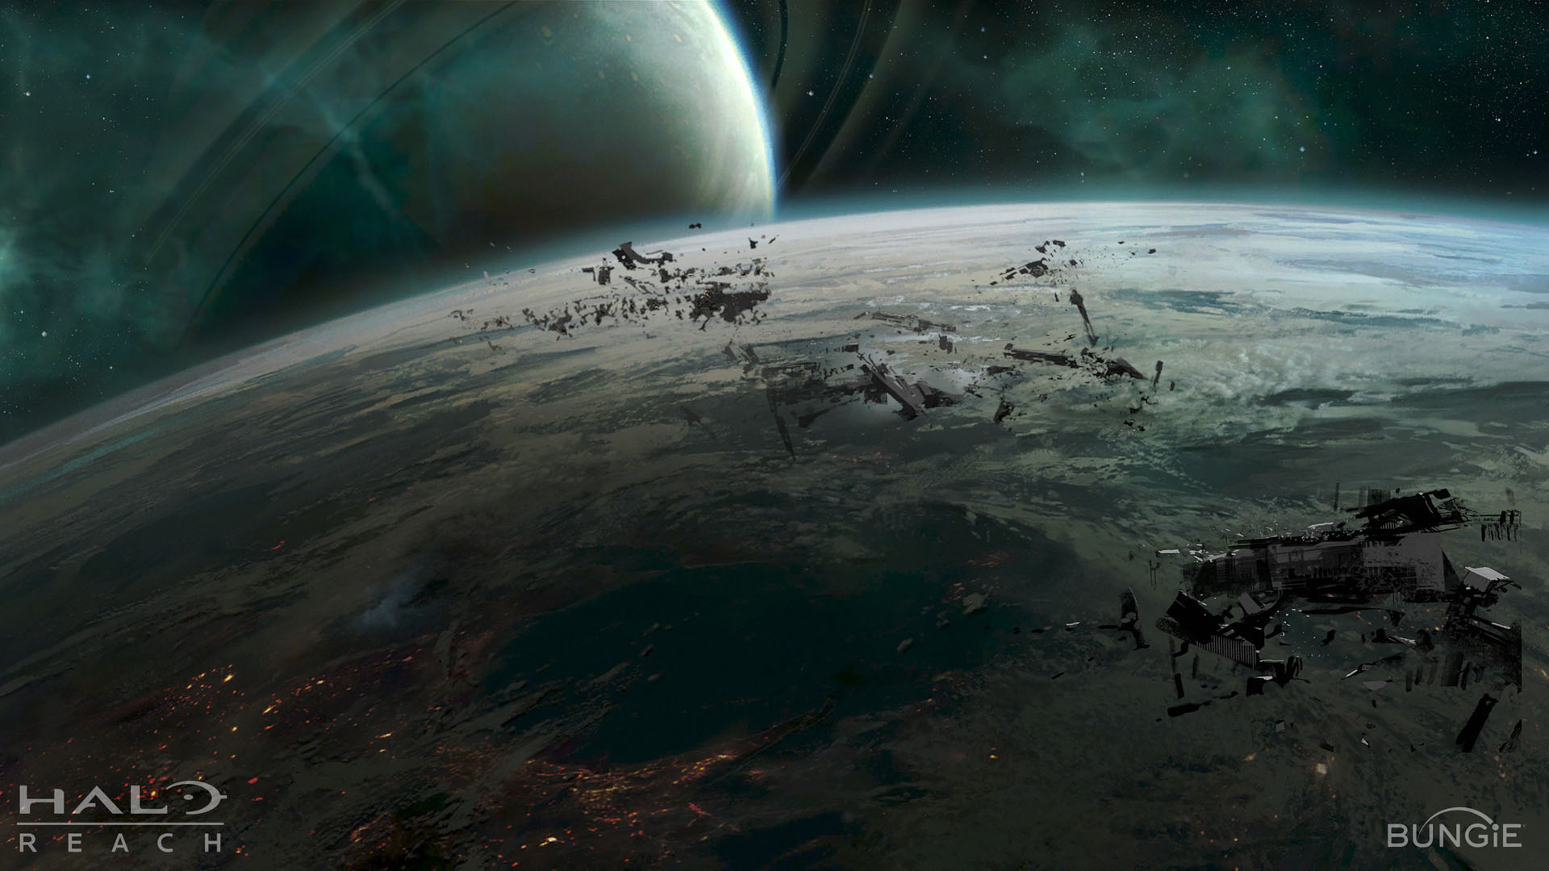
Space Junk
VAGISH KUMAR CHOUDHARY
KARTIKEYA SRIVASTAVA

Slide 2
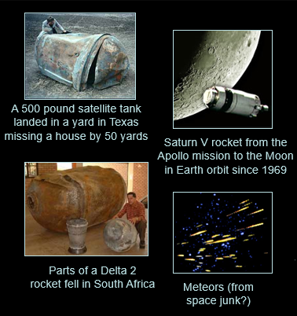
What is out there?
Space debris is also called orbital debris, space junk and space waste.
They are man-made objects that are in orbit around the Earth that no longer serve any useful purpose to us.
They can include anything from entirely used rocket stages and defunct satellites to explosion fragments, paint flakes, dust, slag from solid rocket motors, coolants released by RORSAT nuclear powered satellites, deliberate insertion of small needles, and other small particles from equipment.

Slide 3
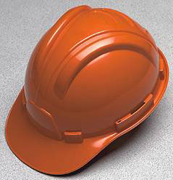
Why is this bad?
“Sandblasting” or erosive damage, can occur on objects that are both being used and unused when they come into contact with clouds of very small particles in space.
Collisions can be highly damaging to functioning satellites due to the extremely high orbital velocities at which this “junk” travels. Some debris have been recorded moving along at 17,500 mph! . Collisions are known to produce even more space junk. This phenomenon is called the Kessler Syndrome.

Slide 4
Why to worry?
In 1999 it was estimated there were 4 million pounds of space junk in low-Earth orbit, made up of 110,000 objects larger than 1 cm. -- large enough to damage a satellite or a space-based telescope. Currently, about 100-200 new objects get added annually.
Space Debris in general (debris can have extraterrestrial origins as well) can move at speeds up to 22,000 miles an hour.
It means that even a small piece can cause a lot of damage to a Space Shuttle.
It can cripple satellites worth billions of dollars.
It can even kill astronauts.
Large pieces may smash into each other, breaking into hundreds of pieces and creating a dramatic cascade of collisions that can create chaos, threaten satellites and future human space travel.

Slide 5
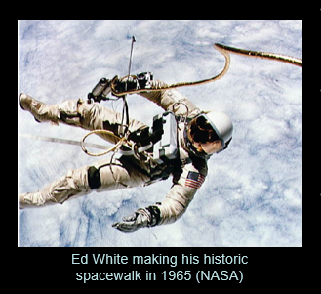
Interesting Facts
A tiny speck of paint from a satellite dug a pit in a space shuttle window nearly a 1/4 in. wide.
The risk that a person will be hit and injured by falling space junk is less than one in 1 trillion (In 2006 a woman in Tulsa, Oklahoma was hit, but not injured, by a small piece of charred metal mesh that was later confirmed to be part of a Delta II rocket launched in 1996)
The “most dangerous garment in history” orbited with a speed of 28,000 km/h for one month in 1965. Edward White, a Gemini 4 astronaut, lost this glove during the 1st American space walk.

Slide 6
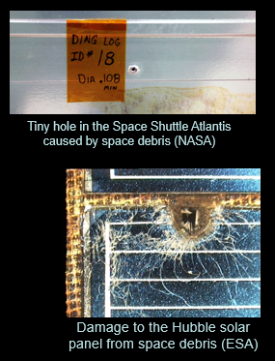
Interesting Facts
In July 2006 astronaut Piers Sellers reported that he lost a spatula (it is nicknamed “spatsat”)
In 2006 a couple of bolts “escaped” as astronauts were adding a part to the ISS (at 17,000 mph even a small bolt can hit a space shuttle with the impact of a hand grenade)
The oldest piece of space junk still in orbit is the second U.S. satellite, Vanguard I, launched on March 17, 1958, which worked for only 6 years
In June 2000, the total number of trackable space objects included 90 space probes, 2,671 satellites and 6,096 pieces of space junk.

Slide 7
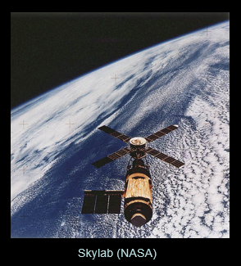
“Re-Entry” of Skylab
The most spectacular re-entry was Skylab, the U.S. space station that was launched in 1973
Most of it splashed down in the Indian Ocean in 1979, but some landed in sparsely populated western Australia
No one was injured but the U.S. Department of State received a $400 fine for littering the town of Esperance, Australia

Slide 8
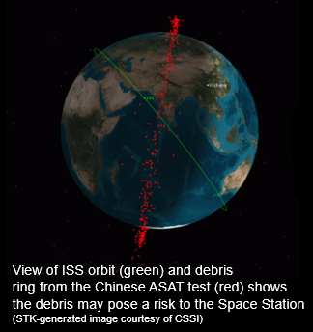
Chinese Chain Reaction
China’s test on January 11, 2007 of an anti-satellite (ASAT) rocket shattered an old weather satellite into thousands of large fragments
This is the worst such episode in space history
Today, next year, or next decade some of this debris may start a cascade of collisions that may expand for centuries, putting billions of dollars of advanced satellites at risk

Slide 9
Current Situation
Space agencies continue to monitor the debris in space as new objects are added every few days from launches, collisions and explosions
As of now, there are no regulations controlling the generation of junk, only recommendations are about minimizing it
The U.S. Space Command monitors space debris and informs NASA and other agencies when there is a threat

Slide 10
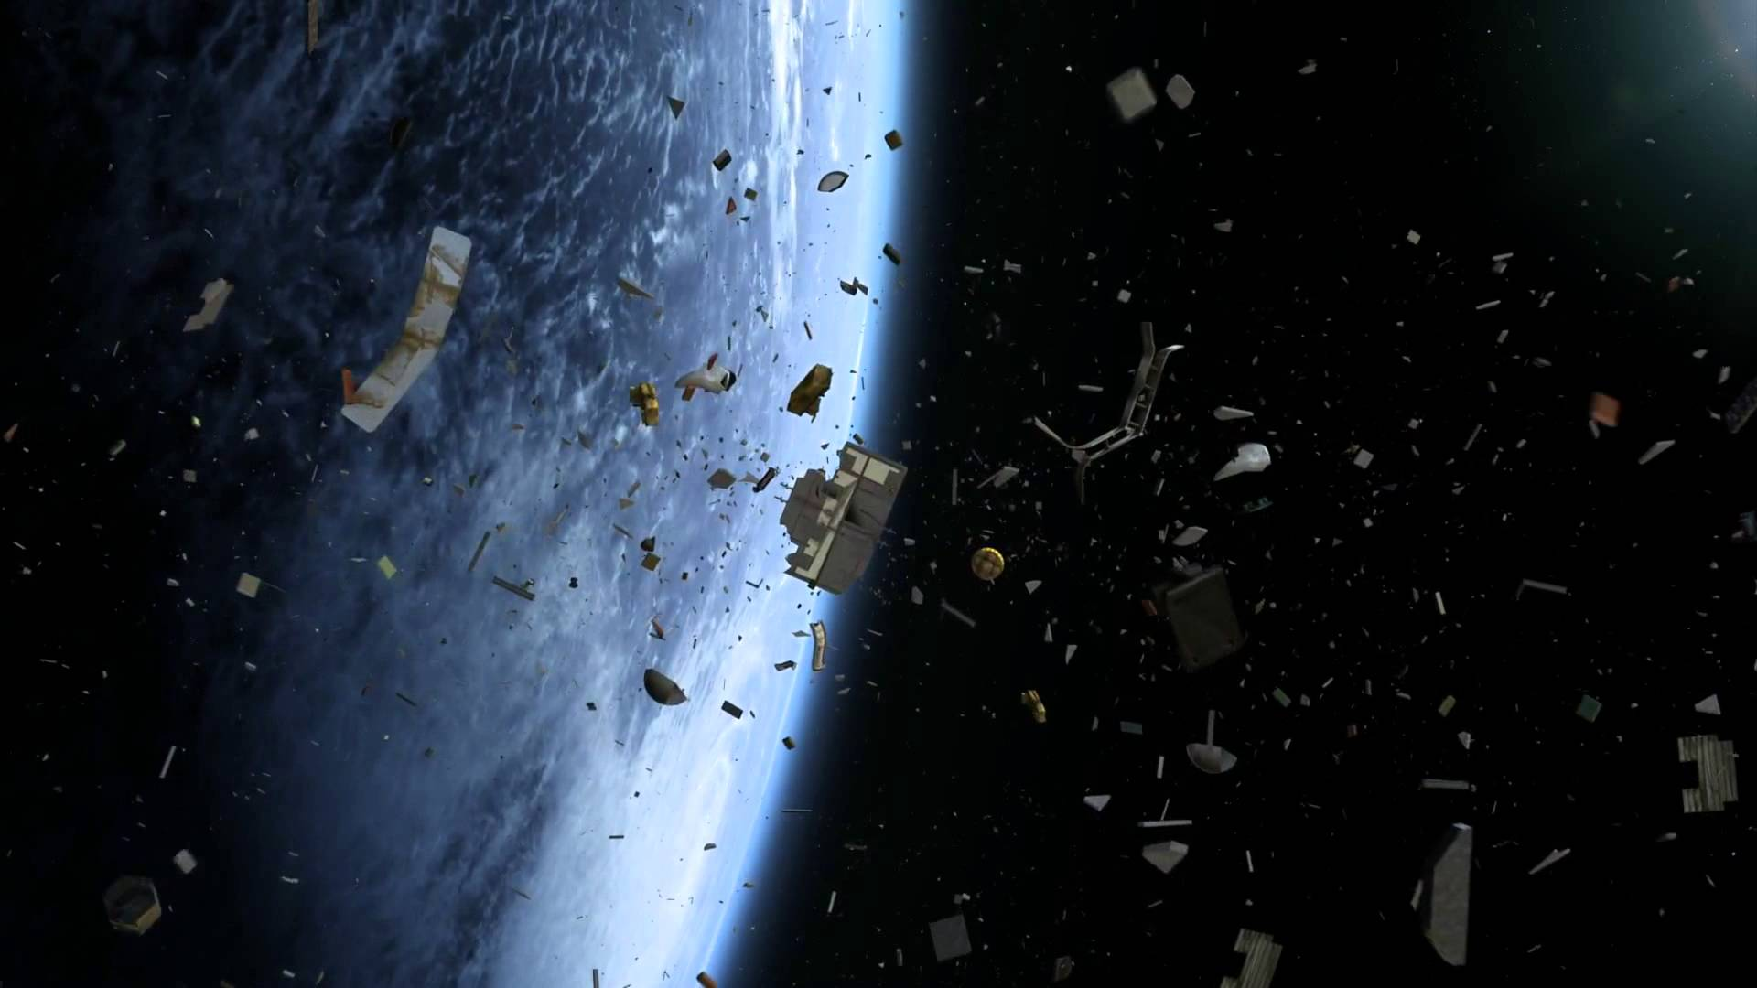
How to Deal?

Slide 11
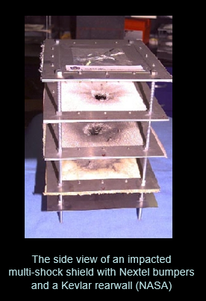
Armouring
Some ideas for protecting items in space have come from NASA’s Hypervelocity Impact Technology Facility
They have developed many advanced shielding concepts that will be used on the ISS

Slide 12
Alternate Orbit
Sometimes it would require too much fuel to de-orbit a satellite from its path. In these cases, it can also be brought to an orbit where atmospheric drag would cause it to de-orbit after some years.
This has been done! The French Spot-1 satellite, brought its time to atmospheric reentry down from an estimated 200 years to about 15 years by lowering its perigee from 830 km to about 550 km.

Slide 13
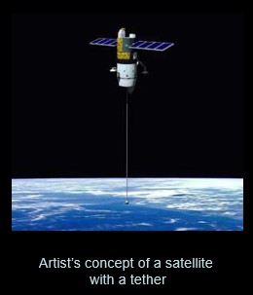
Terminator Tether
When a satellite has completed its task, it could be brought back down to Earth where it could be properly disposed of and/or recycled.
This could be done with the use of a "terminator tether," also called an “electro-dynamic tether” that is rolled out, and slows down the spacecraft

Slide 14
Other Ideas
Unfortunately, many other ideas are either too expensive or unrealistic. These involve pulling space debris back into Earth's atmosphere by:
Using laser brooms to vaporize or nudge particles into rapidly-decaying orbits also called the Orion Project
Huge aero-gel blobs to absorb impacting junk and eventually fall out of orbit with them trapped inside
Instead, NASA currently focuses on preventing collisions by keeping track of the larger debris, and preventing more debris from littering space.

Slide 15
Sources
http://www.nasa.gov/
http://www.space.com/spacewatch/space_junk.html
http://www.space.com/scienceastronomy/planetearth/space_junk_000901.html
http://en.wikipedia.org/wiki/Space_debris
http://images.google.com

Slide 16
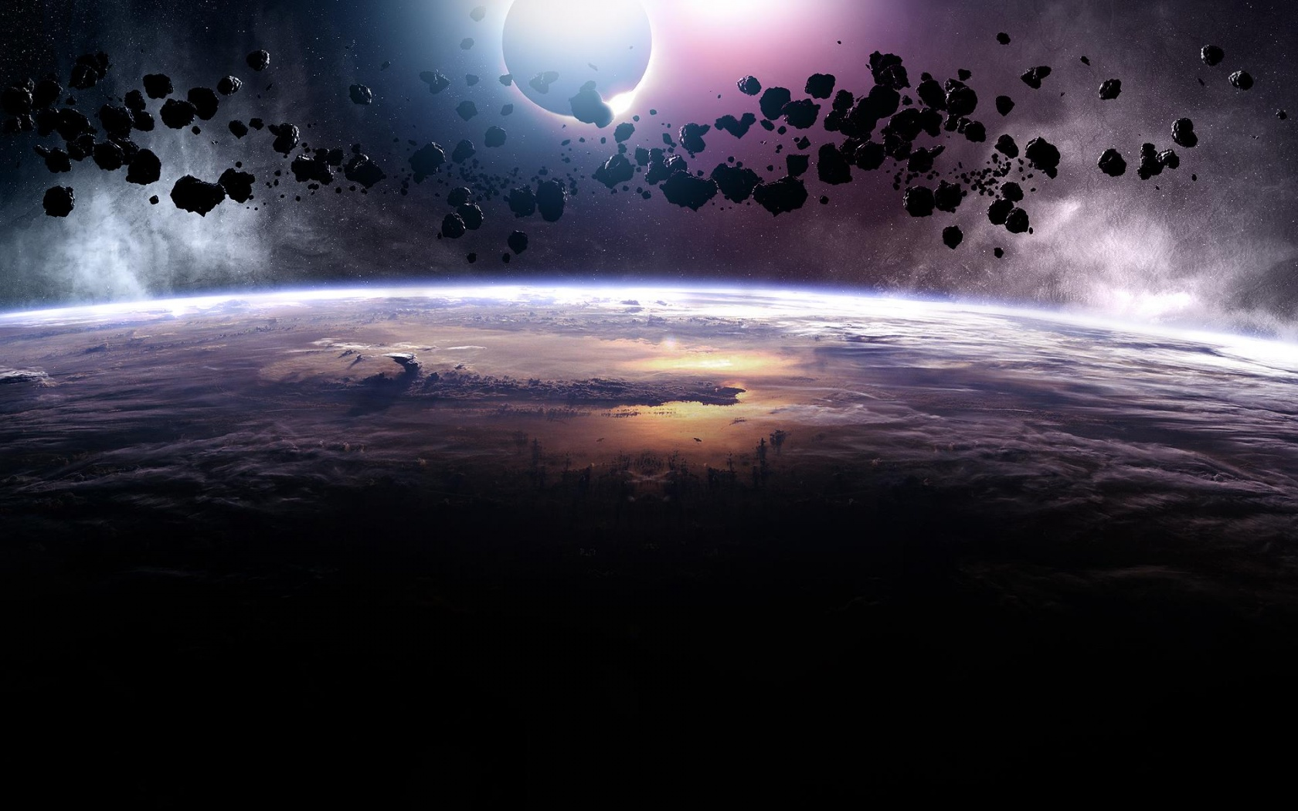
Thank You!

