Slide 1
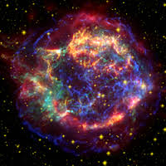
X Ray Astronomy
Presented by:-
Mohit
Shashwat
Ankit

Slide 2
What is X-ray Astronomy?
X ray astronomy is an observational branch of astronomy which deals with the study of x ray observation and detection from astronomical objects.
X rays are observed by earth surfaces and hence instruments to detect x rays are taken to higher altitudes using balloons , rockets etc.

Slide 3
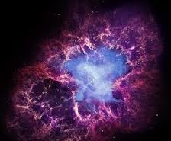
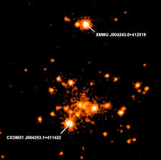
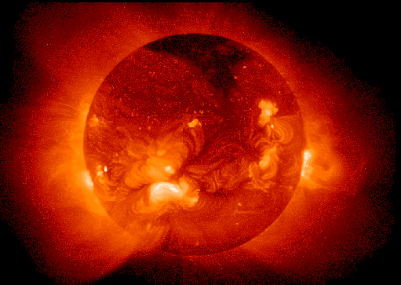
Astronomical Sources:-
Nebulae
Active stars
Super novas
Sun’s C orona

Slide 4
Sources of X Rays:-
X ray emmission is expected from astronomical objects that contain extremely hot gases at temperatures from about a million kelvin (K) to hundreds of millions of kelvin (MK).
Gravity also contributes in productional of X Rays .
Infalling gas and dust is heated by the strong gravitational fields of these and other celestial objects.
Plasmas are also good sources of x rays. plasma contains ions. If the gas cloud is dense there will be large number of electron - proton interaction(when an electron gazes around a proton large amount of energy is released as x ray photons),and the luminosity of the gas cloud will be high.

Slide 5
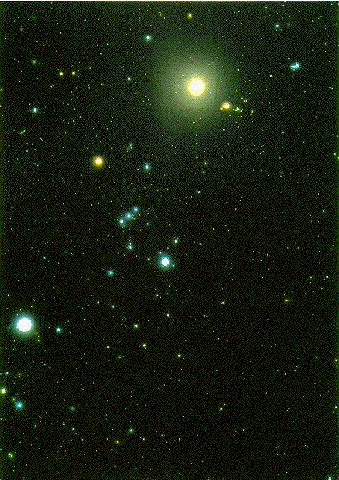
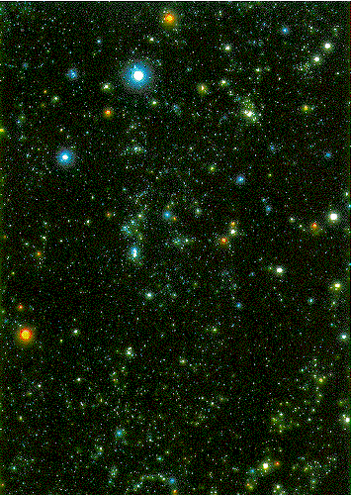
Difference between an optical and X Ray Sky
Orion in optical light
Orion in X Ray

Slide 6
X Ray Classification
Astronomers classify x-rays by their energy in following ways:-
0.1 - 1.0 kev => soft x rays
1.0 - 100 kev => hard x rays
>100 kev soft gamma rays

Slide 7
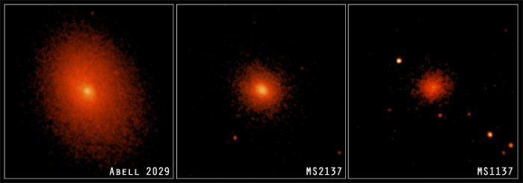
What do we get from x ray observations?
X-ray observations produce a wide range data in many forms .
IMAGES

Slide 8
Images are the most easily accessible result from X-ray missions. The raw output of an X-ray detector is the "events" file - which shows how many photons hit each pixel of the detector. However the extra information, for example the energies of the photons, give a greater insight into what is going on in the object under study
SPECTRA
This can show information like how many X-rays are coming from the object at a particular energy. There are also some electron transitions which have lines in the "soft" (low-energy) X-ray band. If these are not there then we can tell that, for example, there is very little (or even no) cool X-ray gas in Clusters of galaxies. The analysis of spectra can tell about the composition of a star system and provide information for thermo analysis of a star system.

Slide 9
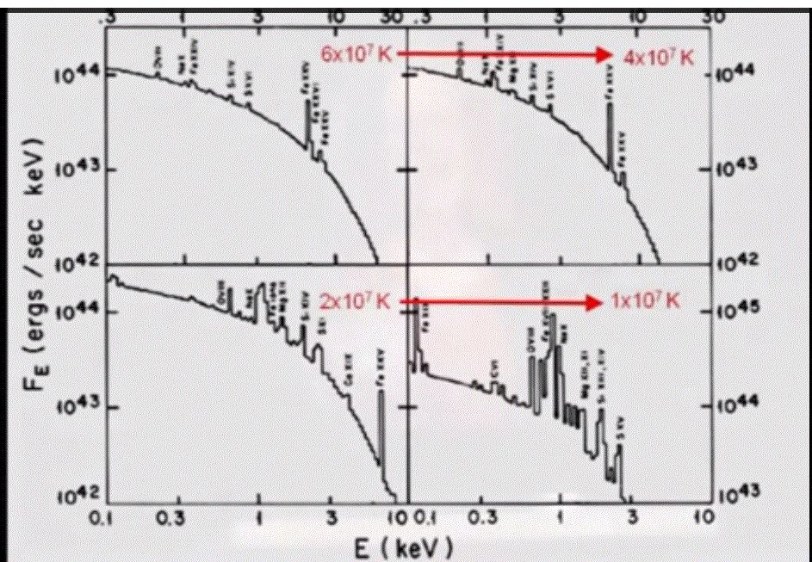

Slide 10
TIME SERIES
As the detectors can tell when each photon hit, it is trivial to see if a sources' emission is varying in time. In the case of a stellar X-ray source, an X-ray binary for example, or the emission from an Active Galactic Nucleus (AGN), this is useful to show the orbital period of the source (or part of it).

Slide 11
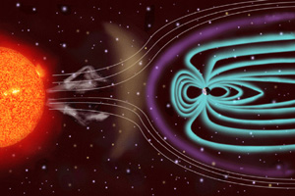
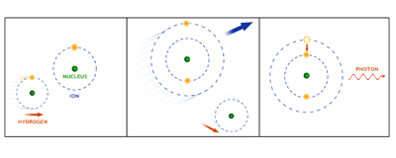
How X-Rays helped in exploring our Solar system
Earth’s Geocorona:-
Very close to home, Chandra has detected evidence of X-rays from Earth's geocorona (extended outer atmosphere) through which Chandra moves. The geocoronal X-rays are caused by collisions between hydrogen atoms in the geocorona with carbon, oxygen and neon ions that are streaming away from the Sun in the solar wind.

Slide 12

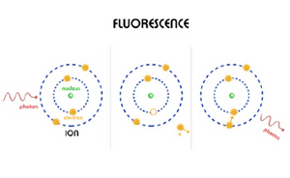
COMETS
By observing X-rays due to charge exchange in the cometary atmosphere, it is possible to study the elements present in the solar wind, the structure of the comet's atmosphere, and cometary rotation. In the future it may be possible to detect X-radiation from collections of hundreds of comets around stars other than the Sun. Young stars would be the most promising candidates because they have vigorous stellar winds.
Imaging of a comet

Slide 13
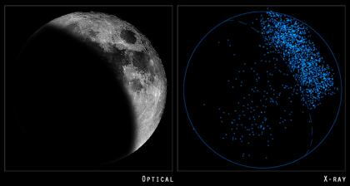
OUR MOON IN X-RAY
X-rays give a direct measurement of elements present, independent of assumptions about the type of mineral or other complications.

Slide 14
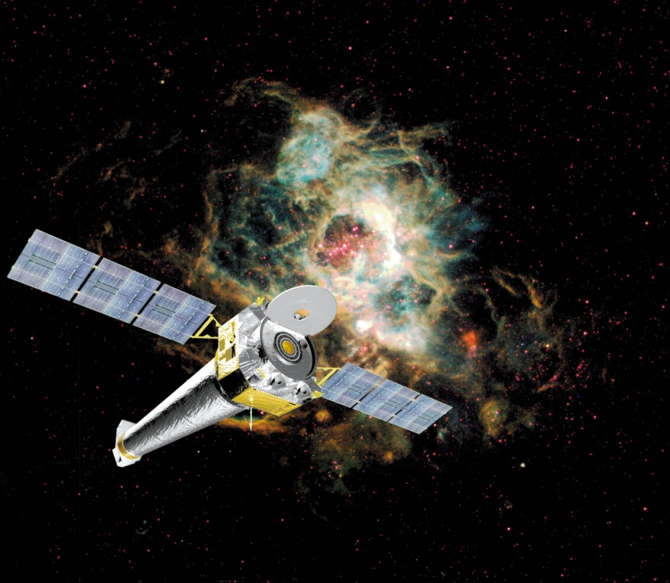

Famous X Ray Telescopes:-
Chandra telescope by NASA
XMM-Newton by ESA

Slide 15
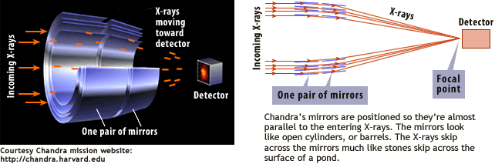
How does an Xray Telescope focus Xrays?
We cannot use a spherical mirror to focus the x ray beam at the centre.
Because the x ray photon gets absorbed upon normal incidence. Hence we use
Parabaloid or hyperboloid mirror. These mirrors reflect x ray photons at a gazing
Angle. So to focus x ray the length can be very large so we use nested mirrors
As in case of CHANDRA.

Slide 16
Future Scope in X-Ray Astronomy
The evolving violent universe
finding massive black holes growing in the centers of galaxies.
The universe taking shape
revealing how the baryonic component of the Universe formed large- scale structures and understanding how and when the Universe was chemically enriched by supernovae.
Matter under extreme conditions
studying how matter behaves in the strongest gravitational fields around black holes and at very high densities in the interiors of neutron stars and accretion disks.

