Slide 1
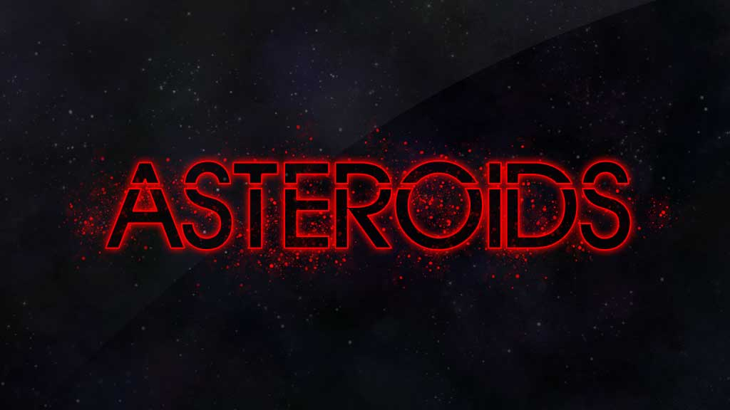

Slide 2
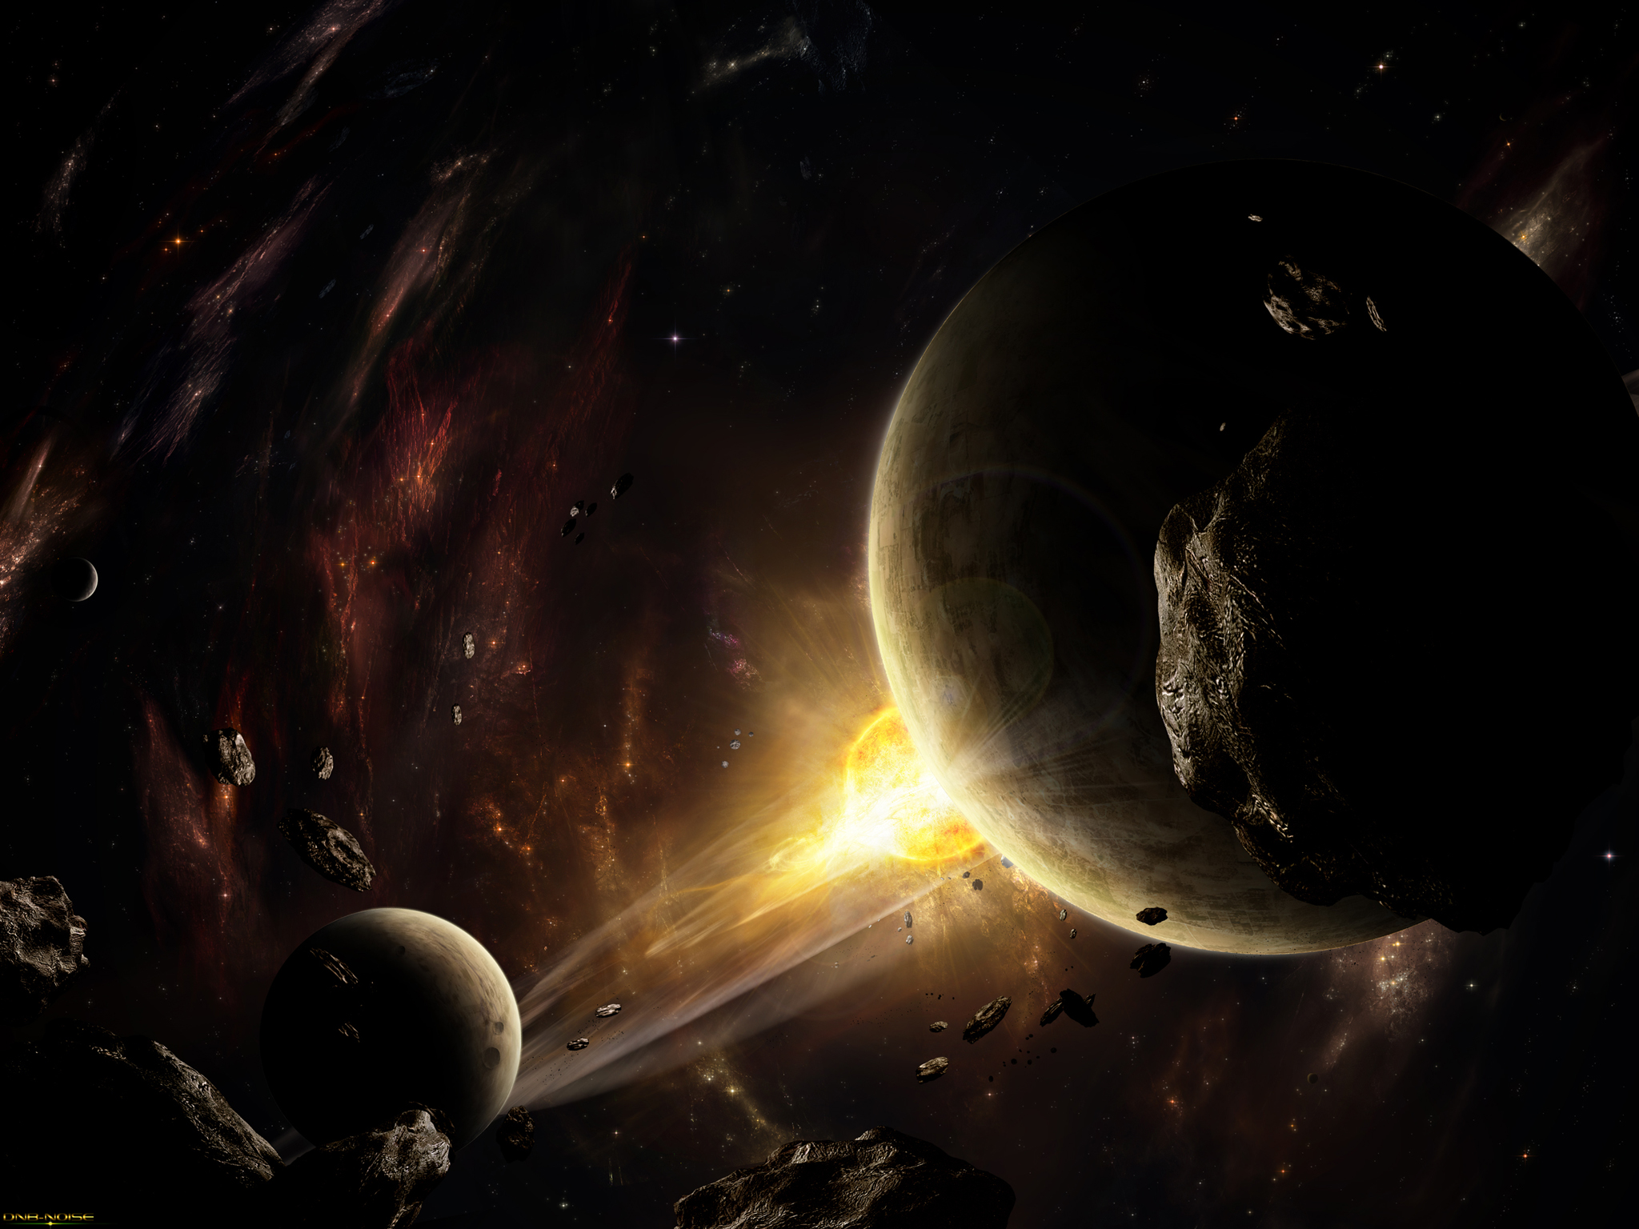
What is an ASTEROID
Asteroids are the rocky remnants of the material from which the planets formed.
They have also been called planetoids, especially the larger ones

Slide 3
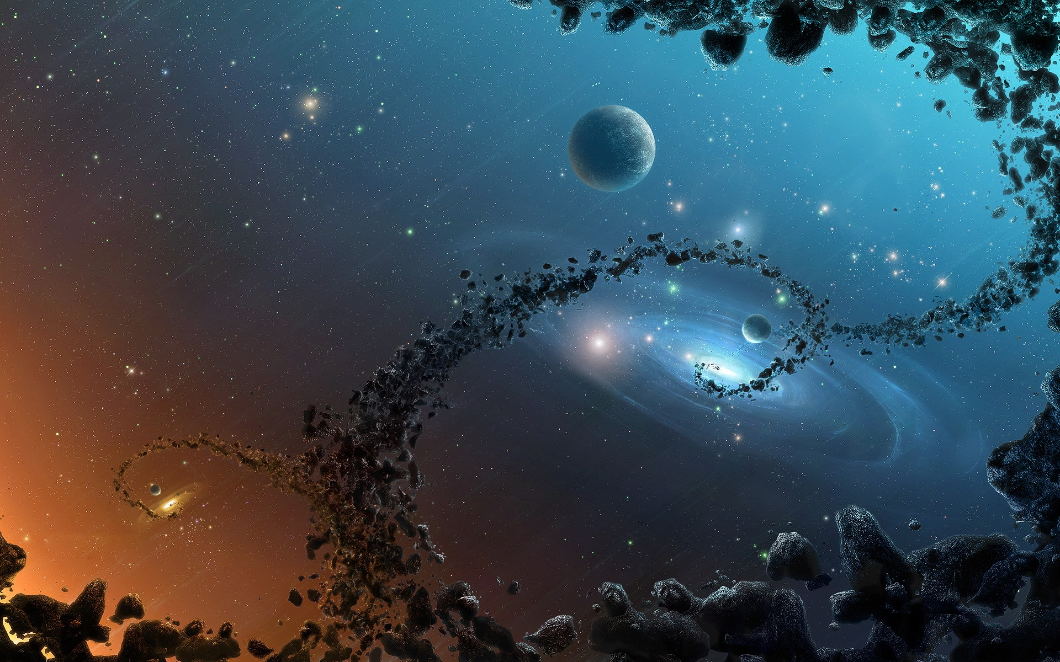
Formation
The most obvious and general thought
“ A Planet would some how been destroyed millions of years and that resulted to asteroid belts ” .
The chemical composition of asteroids vary greatly
total mass of asteroid belt is just 4% of that of earth

Slide 4
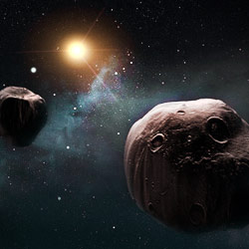
Formation of asteroids
http://www.youtube.com/watch?v=F3Xzr2KVsR8

Slide 5
But Actual Facts
Asteroids are leftovers from the formation of our solar system about 4.6 billion years ago. Early on, the birth of Jupiter prevented any planetary bodies from forming in the gap between Mars and Jupiter, causing the small objects that were there to collide with each other and fragment into the asteroids seen today.
Also , it is said that Some were ejected from planets following a collision, such as when Mars was hit by a Pluto-sized object .

Slide 6
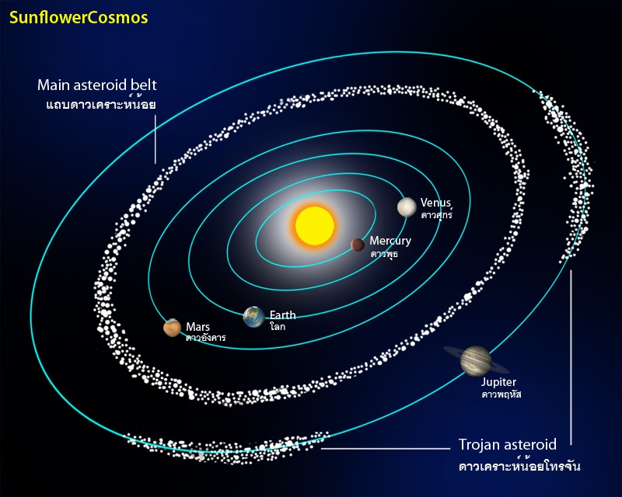
Asteroid Belt

Slide 7
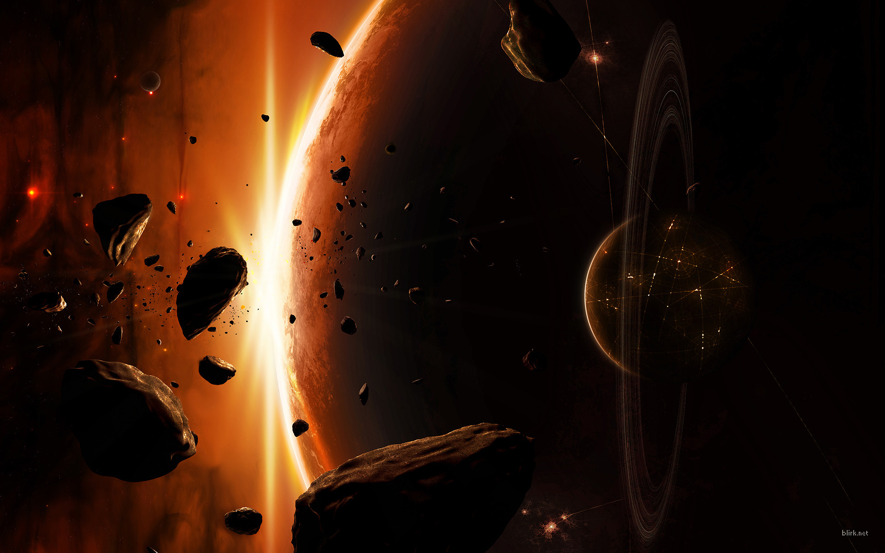
Asteroid Belt
http://www.youtube.com/watch?v=ZCuFf70fgYc

Slide 8
Asteroid Belt
The majority of known asteroids orbit within the asteroid belt between the orbits of Mars and Jupiter, generally in relatively low-eccentricity (i.e. not very elongated) orbits.

Slide 9
2. This belt is now estimated to contain between 1.1 and 1.9 million asteroids larger than 1 km (0.6 mi) in diameter , and millions of smaller ones.
3. These asteroids may be remnants of the accretion of planetsimals into planets during the formative period of the Solar System was prevented by large gravitational perturbations by Jupiter.

Slide 10
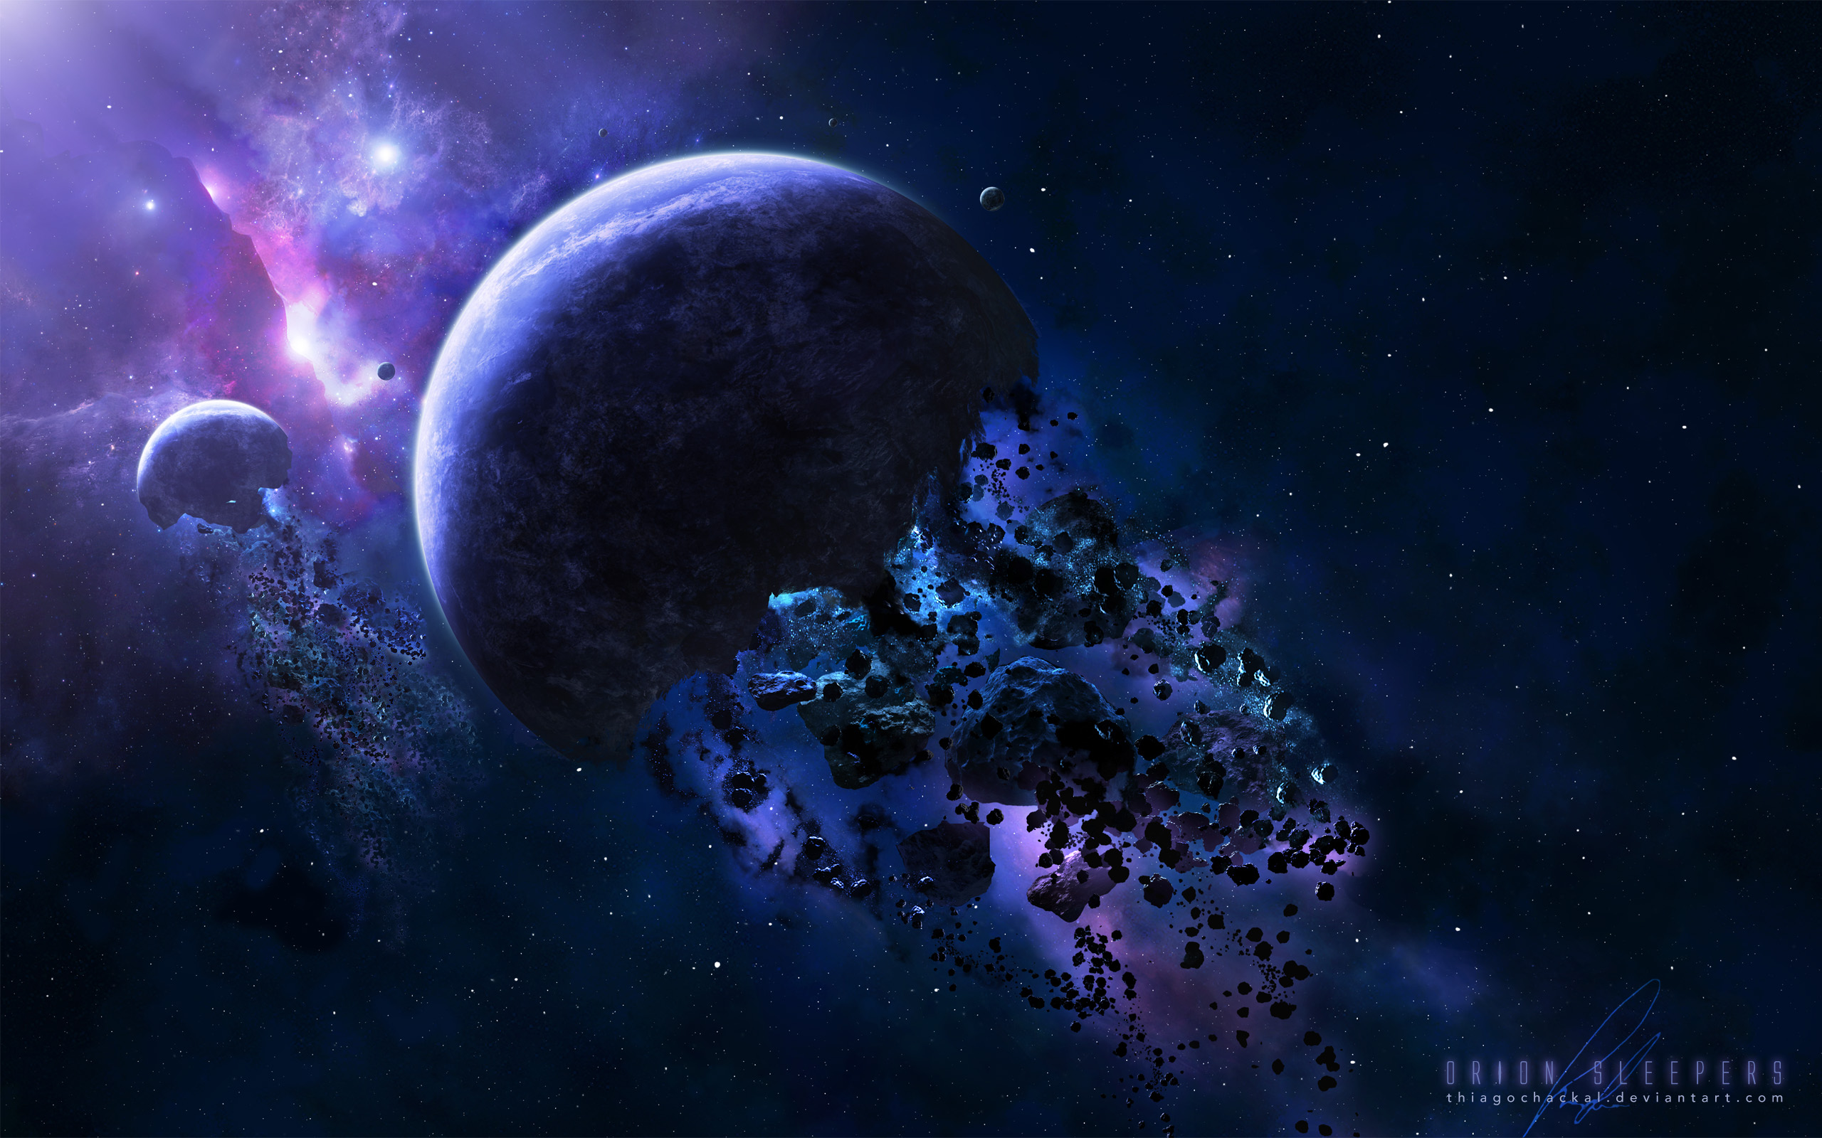
Discovery Of Asteroids
In 1801, while making a star map, Italian priest and astronomer Giuseppe Piazzi accidentally discovered the first and largest asteroid, Ceres, orbiting between Mars and Jupiter. Ceres accounts for a quarter of all the mass of all the thousands of known asteroids in or near the main asteroid belt.

Slide 11
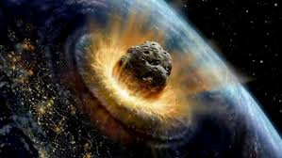
Bodes law
The Titius-Bode Law is rough rule that predicts the spacing of the planets in the Solar System. The relationship was first pointed out by Johann Titius in 1766 and was formulated as a mathematical expression by J.E. Bode in 1778. It lead Bode to predict the existence of another planet between Mars and Jupiter in what we now recognize as the asteroid belt. origin

