Slide 1
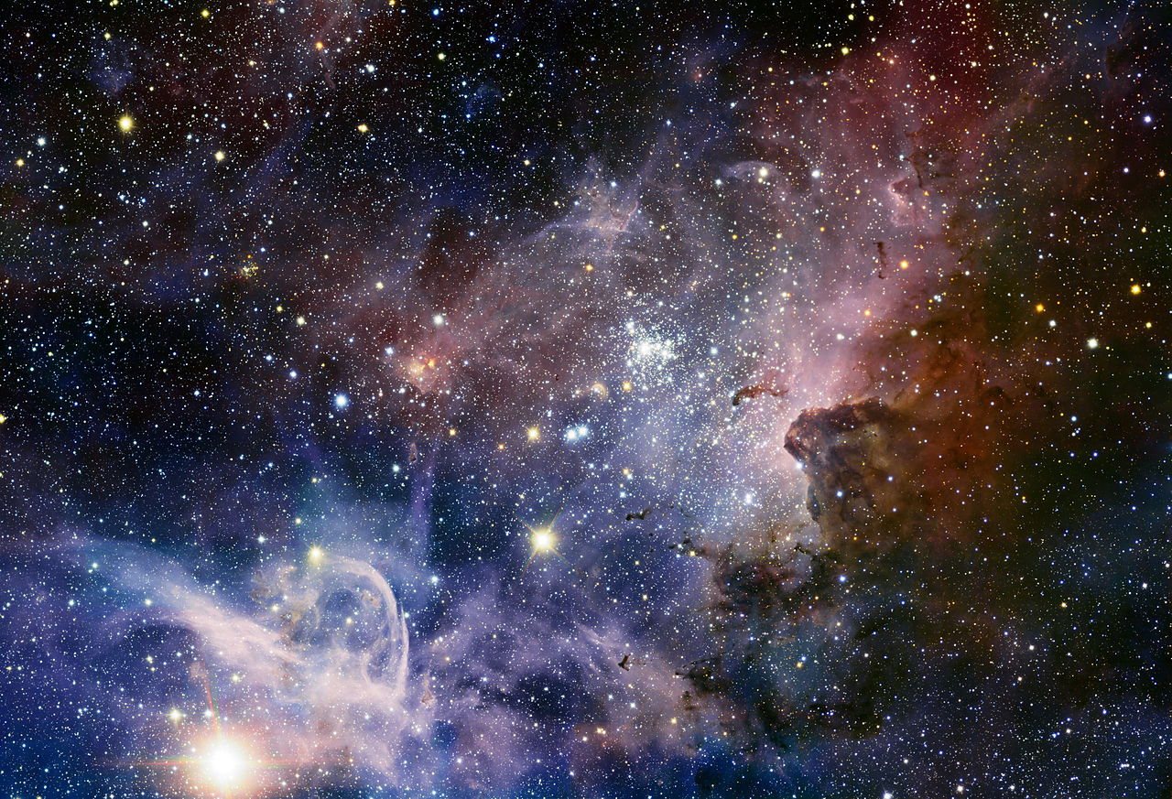
GENESIS
A STORY OF STAR FORMATION
Presented by Aditya Shubham Keshaw
The Great Nebula in Carina by ESO VLT telescope

Slide 2
STAR’S BIRTH
Stars are born in a region of high density Nebula, and condenses into a huge globule of gas and dust that contracts under its own gravity.
A region of condensing matter will begin to heat up and start to glow forming Protostars. If a protostar contains enough matter the central temperature reaches 15 million degrees centigrade.
At this temperature, nuclear reactions in which hydrogen fuses to form helium can start.
The star begins to release energy, stopping it from contracting even more and causes it to shine. It is now a Main Sequence Star.
*The first 4 stages of all the stars are same and the stages which follow differs with the mass of the given star .

Slide 3
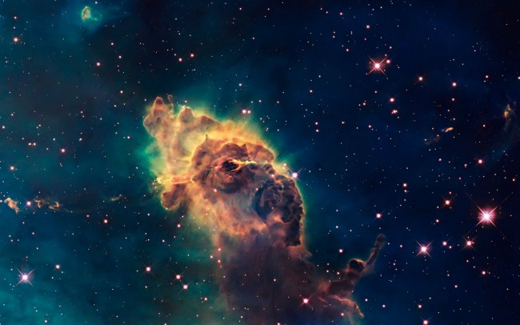
INTERSTELLAR CLOUDS
Interstellar means between stars . In astronomy, the interstellar medium (or ISM) is the matter that exists in the space between the star systems in a galaxy. This matter includes gas in ionic, atomic, and molecular form, dust, and cosmic rays .
About 99% of the interstellar medium is in a gaseous state, with hydrogen making up 90% of the atoms. About half of this gas is tied up in interstellar gas clouds which have different properties depending on the temperature of the gas.
In the coldest and densest regions of the interstellar medium we find clouds whose cores contain molecular gases, primarily molecular hydrogen (H2) gas.
These giant molecular clouds have typical densities of 100 particles per cm3, diameters of 100 light-years (9.5×1014 km), masses of up to 6 million solar masses, and an average interior temperature of 10 K.
These types of clouds are known as stellar nursery .
A portion of the Carina nebulae

Slide 4
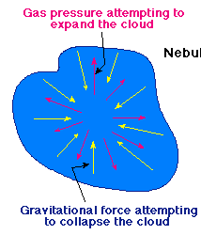

CLOUD COLLAPSE
An interstellar cloud of gas will remain in hydrostatic equilibrium as long as the kinetic energy of the gas pressure is in balance with the potential energy of the internal gravitational force.
For a spherical cloud, to be in hydrostatic equilibrium :
Where,
M(r) is the enclosed mass,
p the pressure,
p(r) the density of gas at radius r
This can be expressed using the virial theorem, which states that, to maintain equilibrium, the gravitational potential energy must equal twice the internal thermal energy.

Slide 5
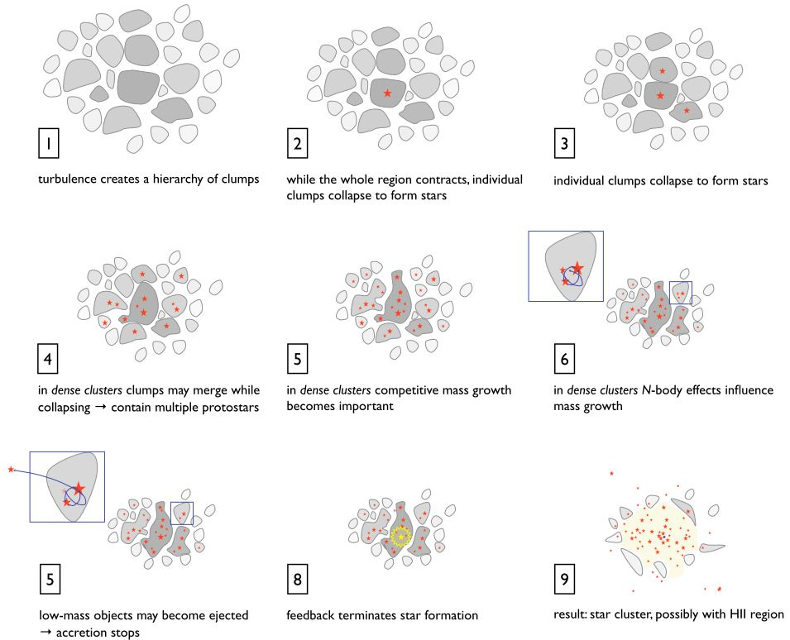
CLOUD COLLAPSE
If a cloud is massive enough that the gas pressure is insufficient to support it, the cloud will undergo gravitational collapse.
As it collapses, a molecular cloud breaks into smaller and smaller pieces in a hierarchical manner, until the fragments reach stellar mass.
The fragments condense into rotating spheres of gas that serve as stellar embryos after radiating energy released by gravitational potential energy.

Slide 6
PROTOSTAR
Clouds continue to collapse as long as the gravitational potential energy is eliminated .
During the collapse, the density of the cloud increases toward the center and thus the middle region becomes optically opaque first.
Particles fall towards the centre of the sphere and the kinetic energy increases . The kinetic energy of a group of particles is the thermal kinetic energy, or temperature, of the cloud. The more the cloud contracts the more the temperature increases.
When the temperature is large enough so that the gas is hot enough for the internal pressure to support the cloud against further gravitational collapse and at this point the cloud is known as PROTOSTAR.

Slide 7
WHAT HAPPENS AFTER THIS ?
If the ball of gas formed does not have enough mass i.e. not enough atoms have been collected at the centre then it remains glowing dimly for the rest of its life also known as BROWN DWARF .
The centre of the ball of gas is the densest and the hottest region and If the temperature reaches about 15 million degree Celsius then pressure becomes very high and then it starts fusing hydrogen and it is said that star’s true life starts here .
Once fusion starts star becomes a MAIN SEQUENCE STAR .

Slide 8
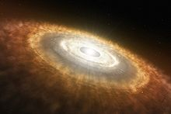
T TAURI STAR
T Tauri stars represent an intermediate stage between protostars and low-mass main sequence (hydrogen burning) stars like the Sun.
Protostars forms from molecular clouds. When a portion of a molecular cloud reaches a critical mass it begins to collapse under its own gravity. The initial collapse takes about 100,000 years. After that time the star reaches a surface temperature similar to that of a main sequence star of the same mass and becomes visible. It is now a T Tauri star.
T Tauri stars are the youngest visible F, G, K, M spectral type stars. Their surface temperatures are similar to those of main sequence stars of the same mass, but they are significantly more luminous because their radii are larger. Their central temperatures are too low for hydrogen fusion. Instead, they are powered by gravitational energy released when the stars contract.
Eventually they start fusing hydrogen in their core after about 10 million years
An artists impession of a T Tauri star with a protoplanetary disk

Slide 9
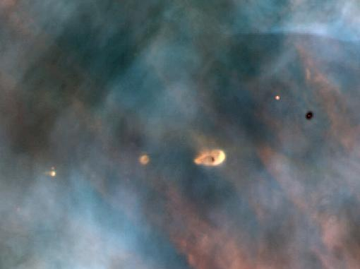
PROTOPLANETARY DISK
A protoplanetary disk is a rotating circumstellar disk of dense gas surrounding a young newly formed T Tauri star.
The protoplanetary disk may be considered an accretion disc because gaseous material may be falling from the inner edge of the disk onto the surface of the star.
As the collapsing cloud, called a solar nebula, becomes denser, random gas motions originally present in the cloud average out in favor of the direction of the nebula's net angular momentum. Conservation of angular momentum causes the rotation to increase as the nebula radius decreases. This rotation causes the cloud to flatten out—much like forming a flat pizza out of dough—and take the form of a disk, the protoplanetary disk.
A protoplanetary disk in the Orion Nebula

Slide 10
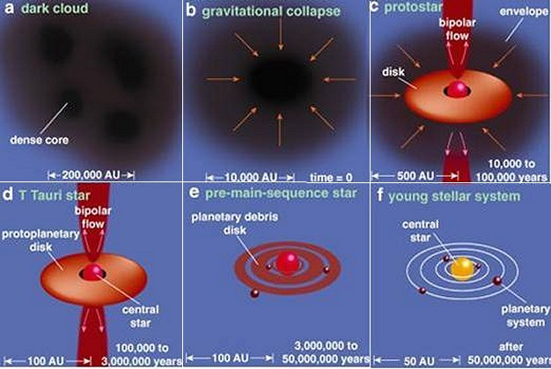
STAR’S BIRTH

Slide 11
MAIN SEQUENCE STARS
The most common star which is very dim and has very low mass known as RED DWARF STAR . It transports energy from the core to the surface by convection alone .
For a medium sized star like the sun the energy transported is by photons via radiation and convection from core to the surface known as photosphere .
As we know the gravitational pull acts inwards and the radiation pressure acts outwards , the star lives like this for million or billion of years .
After this what happens depend upon the mass of the star formed .

Slide 12
Small Stars- mass upto one and a half times that of the Sun
Massive Stars- mass can be 3 to 50 times that of the Sun
These remain in main sequence for about 10 billion years, until all of the hydrogen has fused to form helium.
The helium core now starts to contract further and reactions begin to occur in a shell around the core.
The core is hot enough for the helium to fuse to form carbon. The outer layers begin to expand, cool and shine less brightly. The expanding star is now called a Red Giant.
The helium core runs out, and the outer layers drift of away from the core as a gaseous shell, this gas that surrounds the core is called a Planetary Nebula.
The remaining core (thats 80% of the original star) is now in its final stages. The core becomes a White Dwarf the star eventually cools and dims. When it stops shining, the now dead star is called a Black Dwarf.
These remain in main sequence for about only millions of years and shines readily until all the hydrogen has fused to form helium.
The massive star then becomes a Red Supergiant and starts of with a helium core surrounded by a shell of cooling, expanding gas.
In the next million years a series of nuclear reactions occur forming different elements in shells around the iron core.
The core collapses in less than a second, causing an explosion called a Supernova, in which a shock wave blows of the outer layers of the star.
Sometimes the core survives the explosion. If the surviving core is between 1.5 - 3 solar masses it contracts to become a a tiny, very dense Neutron Star. If the core is much greater than 3 solar masses, the core contracts to become a Black Hole.

Slide 13
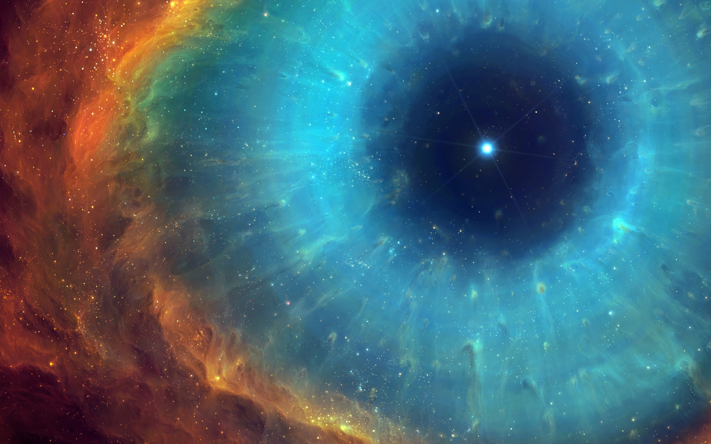
THANK YOU

