Slide 1
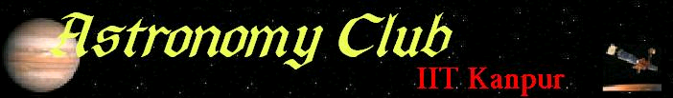

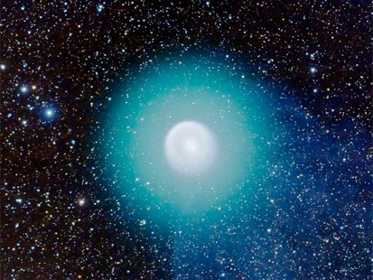
The Wall magazine – January 08

Slide 2
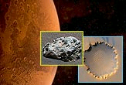
NEWS
Four Years on Mars, Rovers roll on
Two robots the size of golf carts were given 90 days to squeeze as much science as possible from the barren, dust-swept terrain of Mars. After that, scientists expected nothing more from them than death.
Nearly four years after their warranties expired, however, the Mars Explorations Rovers (MERs) "Spirit" and "Opportunity" continue to play productively in the red dirt.
Spirit celebrates its fourth anniversary of Martian work on Jan. 4, the day it landed in 2004, followed by Opportunity on Jan. 25. Those four Earth years since landing convert to 2.25 Martian years, or 1,422 Martian days called "sols.“ Scientists have used the information gathered by the rovers through the years to crank out more than 100 studies about the planet's geologic past.
The year 2007 inflicted a global dust storm on the rovers. Although indirect sunlight powered the rovers through the dusty conditions, more than 96 percent of direct sunlight to their solar panels was filtered out.
Despite the nerve-wracking task of keeping both rovers power-positive — and their electronic circuits from snapping in the Martian cold — new science is still trickling out as a result of the weather event.
Spirit has one wheel in a stuck condition and it’s solar panels were greatly obscured by the recent dust storms. As a result Spirit can be considered effectively parked. Opportunity, however, is in good shape to continue exploring and the team has no definitive date for parking the adventurous machine.
While Opportunity continues to maneuver around Victoria Crater, Spirit is presently resting on a slope of Home Plate — a layered outcrop of rock in the shape of a diamond.
That science includes watching the sky for water-crystal clouds and taking atmospheric measurements, but the rover may also witness a potential asteroid impact later this month.

Slide 3
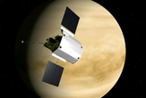
SPACEFLIGHT
Messenger Probe to fly past Mercury
The MErcury Surface, Space ENvironment, GEochemistry and Ranging (or MESSENGER for short) is a NASA mission, launched August 3, 2004, designed to study the characteristics and environment of Mercury from orbit. Specifically, the objectives of the mission are to characterize the chemical composition of Mercury's surface, the geologic history, the nature of the magnetic field, the size and state of the core, the volatile inventory at the poles, and the nature of Mercury's exosphere and magnetosphere over a nominal orbital mission of one Earth year. The mission will be the first to return to Mercury in over 30 years — the only previous probe to visit Mercury was Mariner 10, which completed its mission in March, 1975. In addition to being an acronym, MESSENGER was chosen as the probe's name because Mercury was the messenger of the gods in Roman mythology.
This probe will make the first flyby of Mercury in more than 30 years on Jan. 14, cruising within 125 miles of the planet's surface. It will be the first of three close passes the spacecraft will make before dropping into orbit around the planet in 2011.
Once there, scientists hope to test a theory that the planet is shrinking, contracting in on itself as its core slowly freezes. The probe will look for signs of surface buckling on Mercury's unobserved hemisphere, as well as collect surface composition data on material that may have once spewed out of the planet's interior. The idea that Mercury's surface was somehow shrinking arose when Mariner 10 returned images of great scarps biting deep into the planet's surface. One such scarp, Discovery Rupes, cuts one mile (1.6 kilometers) into Mercury's crust.
The spacecraft is equipped with five science instruments : the Mercury Dual Imaging System (MDIS), Gamma-Ray and Neutron Spectrometer (GRNS), X-ray Spectrometer (XRS), Mercury Laser Altimeter (MLA), and Atmospheric and Surface Composition Spectrometer (MASCS).

Slide 4
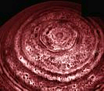
SCIENCE
Saturn's Spots Mystify Astronomers
Both of Saturn's poles have surprising swirling hotspots that persist even through years of polar winter, a new study reveals. The hotspots are localized areas in Saturn's gaseous atmosphere over its poles that are considerably warmer than the surrounding air — they're actually about as warm as the atmosphere at Saturn's equator, said Leigh Fletcher of the University of Oxford.
The hotspot over the southern hemisphere was imaged by the Keck Observatories prior to arrival of the Cassini spacecraft, but the northern hemisphere has faced away from Earth for over a decade, so its hotspot was revealed only this year by Cassini.
Scientists had thought that solar irradiation might be generating the hotspot in the southern hemisphere (currently in its summer phase, facing the sun), but the existence of a similar hotspot in the northern hemisphere, which has been plunged in wintry darkness for many years, suggests that isn't the case.
Instead, dynamic processes in Saturn's atmosphere may create the hotspots, the new findings, detailed in the Jan. 4 issue of the journal Science, suggest, Fletcher says.
Air being sucked downward at the poles may cause the hotspots, while air moving upward in the atmosphere may be creating a cold "collar" around the hotspots. These air movements could be responsible for the raging hurricane-like storm imaged over the south pole in 2006.
As unusual as the hotspots themselves is the warm hexagonal ring of air surrounding the cold collar of the northern hemisphere hotspot. Stranger still is the lack of such a shape around the south pole.
Other missions have provided hints that Jupiter and Neptune have hotspots over their poles as well, suggesting they could be a feature of the atmospheres of all gaseous planets — even extrasolar planets, Fletcher said.

Slide 5
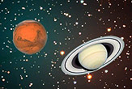
NIGHTSKY
The Winter Sky: Planets, Stars and Cool Shapes
The Winter sky is truly a celestial showcase, and the time around Winter solstice is best for astronomers and enthusiasts. One reason for the clarity of a winter's night is that cold air cannot hold as much moisture as warm air can. Hence, on many nights in the summer, the warm moisture-laden atmosphere causes the sky to appear hazier.
Soon after sunset, we can enjoy the sight of the brightest evening planet, Mars, shining brilliantly in the east-northeast sky. It fades ever-so-slightly since its Christmas Eve opposition brilliance to magnitude –1.5. This is a trifle brighter than Sirius, the brightest star in the sky.
Saturn rises soon after 9 p.m. from the east-northeast, a bright yellowish-white interloper among the stars of Leo, the Lion. It's rings can be made out by a telescope with a magnification of as low as 30. Currently, the rings are tipped only about 7 degrees to our line of sight, but as the winter progresses they'll be opening up a bit more. On Dec. 20, Saturn began its retrograde motion – reversing its course against the background stars and appearing to move back to the west toward Leo's brightest star, Regulus .
And if you're still up in the predawn morning hours, you'll see Venus, the brightest of all the planets, emerging from the east-southeast horizon like a brilliant silvery "star" .
High toward the south, we see what astronomy author Hans A. Rey (1898-1977) called a "Great Hexagon" of bright winter stars. To the south and a little east lies Sirius; up to the west, Rigel. Still higher, reddish Aldebaran; then at the north end of the circle, Capella. South and slightly east, we come to Castor and Pollux, the heads of the Gemini twins. Finally, south again to Procyon: in all, seven bright stars in six constellations.
In the center of the hexagon, more or less, you have the ruddy star Betelegeuse, while soaring high above Orion, between the horns of Taurus is pumpkin-hued Mars; an interloper this winter season. This is the rich region that gives the winter sky its splendor.

Slide 6
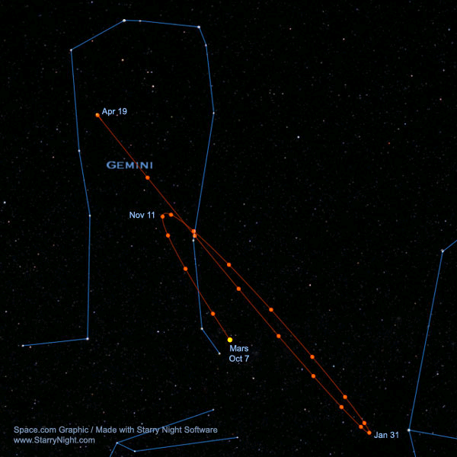
Mars loops backward
All the planets exhibit "retrograde motion" at one time or another. But for the longest time, the ancient astronomers were unable to come up with a satisfactory explanation for it. For one thing, while behaving in this strange manner, Mars will also appear to deviate somewhat from its normal course; the retrograde motion will appear to bring it a little above its regular orbital track. In other words, for those of us watching from Earth, Mars will appear to travel in a loop.
The Greeks explained away this anomaly by assuming that the planets moved around the Earth in smaller "epicycles" – that is, a small circle whose center moves along its main orbital circle around Earth, resulting in complex, almost coil-like curves.
It was not until the year 1543 when the great Polish astronomer Nicolaus Copernicus (1473-1543) had his lifelong work "De revolutionibus" published, that the secret of the odd retrograde loops were finally revealed. By demoting the Earth from its hallowed position at the center of the solar system and replacing it with the Sun, he was able to triumphantly explain the riddle of the apparent "backwards motion effect" of the planets.
Retrograde motion of Mars
Credits
References - www.space.com, www.skyandtelescope.com, wikipeia
Edited by: Saurabh Chatterjee
Front page picture – Comet Holmes
Visit our website (http://students.iitk.ac.in/astro/)

