Slide 1
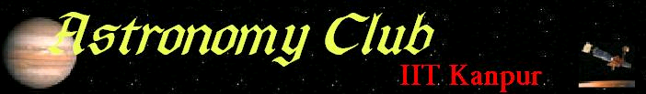

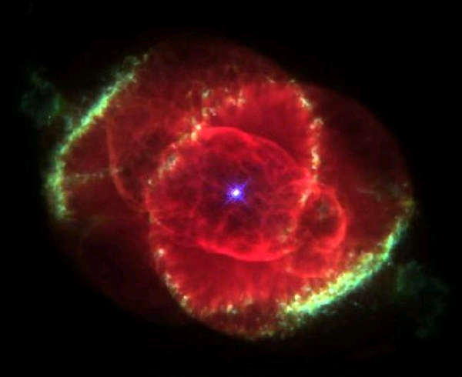
The Wall magazine

Slide 2

NEWS
Nasa’s DAWN mission
NASA's Dawn mission, scheduled for launch in July 2007 will help scientists understand the first stages of planet formation by studying Vesta and Ceres, two asteroids whose growth stalled 4.5 billion years ago when they failed to gather enough raw materials to become planets themselves. By targeting both worlds, Dawn will be the first spacecraft to orbit and study the two objects after leaving Earth.
Vesta is a bone-dry asteroid, while Ceres is a dwarf planet suspected of harboring a layer of ice up to 75 miles (120 kilometers) deep or even liquid water beneath its dusty surface. Both are located in the solar system's asteroid belt, a 130-million-mile wide rock-strewn corridor located between the orbits of Mars and Jupiter. Ceres is spherical and about as wide as the state of Texas. Vesta is more elongated, and has a diameter about the width of Arizona.
Dawn will carry an infrared and visible camera to study Vesta and Ceres' surfaces, a gamma ray and neutron spectrometer to determine their composition, and instruments to measure their gravity fields and reveal details about their interiors.
Dawn is scheduled to enter orbit around Vesta in October 2011. Past observations of features such as lava flows and magma oceans on the asteroid's surface suggest it was partially molten early in its history. Studies of meteorites believed to have come from Vesta suggest the asteroid's surface was once soft enough for heavy elements like iron to sink and form a dense core.
What Dawn finds on Vesta could change how scientists think about planet formation.
Dawn is scheduled to arrive at Ceres by February 2015, a few months before NASA's New Horizon probe reaches the dwarf planet Pluto. Scientists think Ceres could help answer some longstanding questions about the role water played in planetary evolution.

Slide 3
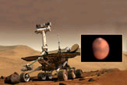
SPACEFLIGHT
Mars Rovers face dust storms
A giant dust storm that now covers nearly the entire southern hemisphere of Mars could permanently jeopardize the future of the Mars Exploration Rovers mission. The first and largest dusty squall has reduced direct sunlight to Mars' surface by nearly 99 percent, an unprecedented threat for the solar-powered rovers. If the storm keeps up and thickens with even more dust, officials fear the rovers' batteries may empty and silence the robotic explorers forever.
The rovers, named Spirit and Opportunity have been operating on Mars since January 2004. They have now lasted for over 3 years, well beyond their intended lifetime of 90 days. That they are still in good condition, is a testament to the quality of engineering of NASA. However electrical connections and moving parts are showing signs of temperature-related fatigue.
Caused by Martian dust devils and steady wind, the "cleaning events" doubled the rovers' power to around 800 watt-hours last week and boosted hopes of Opportunity's planned descent into Victoria Crater. As the small storm gathered fury, however, Opportunity's energy-gathering ability has been slashed to a dangerous 280 watt-hours each day.
Both rovers have extensively analyzed Martian geology and scientists are certain that water once flowed on Mars. The geologic signs of Martian water include Opportunity's discovery that an outcrop was full of sulfate salt deposits arranged in layers, with embedded spherical particles that can be formed by liquid water. Spirit made its find by studying a 60 cm. tall rock at Gusev Crater. The rover found that despite the rock's volcanic beginnings, water apparently seeped through it at one time, allowing minerals to crystallize inside.
Nasa has scheduled the Phoenix Mars Mission for launch in August 2007. Phoenix is designed to study the history of water and habitability potential in the Martian arctic's ice-rich soil.

Slide 4
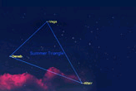
NIGHTSKY
The Summer Triangle
Well up in the eastern sky during the late-evening hours is the "Summer Triangle," not a constellation, but a very noteworthy star pattern of the summer sky consisting of three bright stars from three constellations. Brightest of the three is Vega, in the constellation of Lyra, the Lyre. Next in brightness is Altair in Aquila, the Eagle. Finally, there is Deneb in Cygnus, the Swan.
To our eyes, Altair appears to shine only half as bright as Vega and Deneb seems only one-third as bright as Vega. So at first glance, Vega appears to rule this section of the sky. In reality, however, a bit of celestial deception is at work here, for Vega is appears very bright chiefly because of its proximity to us. Vega is 25 light-years away.
Altair is 17 light-years away, closer than Vega, yet appearing somewhat dimmer. That tells us that in terms of overall luminosity between the two, Vega is indeed the brighter star: it is 48 times brighter than our sun, while Altair is only 12 times brighter.
But what about the third star in the triangle, Deneb? Here, there is no comparison between either Altair or even Vega, for Deneb is one of the greatest supergiant stars known. It shines about 80,000 times brighter than our sun, but because of its vast distance from us – 1,467 light-years away – it appears as just a fairly conspicuous but by no means noteworthy star.
With the bright moon now pretty much out of the evening sky this week, there is no better time than now to observe the beautiful summer Milky Way. With a good pair of binoculars or a telescope you can now observe millions of sparkling little stars that make up this glowing, irregular belt of luminosity. It appears to arch from the north-northeast to the south-southeast, with its brightest and most spectacular region running across the Summer Triangle and beyond toward the south-southeast horizon.

Slide 5

SCIENCE
Glimpse of Time Before Big Bang
It may be possible to glimpse before the supposed beginning of time into the universe prior to the Big Bang, researchers now say. The Big Bang is often thought as the start of everything, including time, making any questions about what happened during it or beforehand nonsensical.
To see how far into history one might gaze, theoretical physicist Martin Bojowald at Pennsylvania State University ran calculations based on loop quantum gravity, one of a number of competing theories seeking to explain how the underlying structure of the universe works.
Past research suggested the Big Bang was preceded by infinite energies and space-time warping where existing scientific theories break down, making it impossible to peer beforehand. The new findings suggest that although the levels of energy and space-time warping before the Big Bang were both incredibly high, they were finite. If evidence of the past persisted after the Big Bang, its influence could be spotted in astronomical observations and computational models.
However, some knowledge of the past was irrevocably lost. For instance, the sheer size of the present universe would suppress precise knowledge of how the universe changed in size before the Big Bang. One implication of this "cosmic forgetfulness," as Bojowald calls it, is that history does not repeat itself-the fundamental properties of the current era of the universe are different from the last, Bojowald explained. "It's as if the universe forgot some of its properties and acquired new properties independent of what it had before.“
These findings differ from a cyclic model of the cosmos from cosmologist Paul Steinhardt at Princeton and theoretical physicist Neil Turok at Cambridge, which envisions an infinite series of Big Bangs preceding our universe caused by additional membranes or "branes" of reality perpetually colliding and bouncing off each other.

Slide 6

ENTERTAINMENT
Star Wars Droid to collect mail
Thirty years ago, in theaters near and far, far away, a movie opened the imaginations of millions, combining the magic of mythology and special effects to launch the ‘Star Wars' phenomenon.
A star of those films - the brave little robot R2-D2 - is about to take a turn collecting mail as the Postal Service and Lucasfilm Ltd. commemorate that movie launch. About 400 mailboxes will be covered to look like the stout droid. The resemblance to R2-D2 really good indeed.
On the lighter side
Error 406: File corrupt: config.earth – reboot universe?
Black holes really suck…
Space isn't remote at all. It's only an hour's drive away if your car could go straight upwards. - Fred Hoyle
There are 10^11 stars in the galaxy. That used to be a huge number. But it's only a hundred billion. It's less than the national deficit! We used to call them astronomical numbers. Now we should call them economical numbers. - Richard Feynman
Credits
Reference - www.space.com, www.nasa.gov
Edited by Saurabh Chatterjee (saurc@iitk.ac.in)
Front page picture – Cat’s Eye nebula
Visit our website (http://students.iitk.ac.in/astro/)
Mail us at astro@iitk.ac.in

