Slide 1
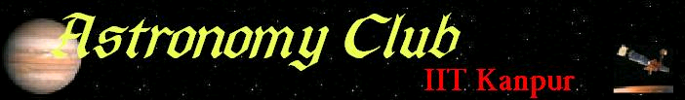

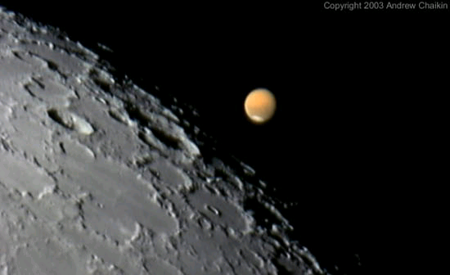
The Wall magazine – November 07

Slide 2
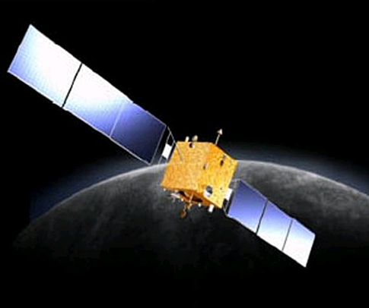
NEWS
China sends Chang'e-1 to the Moon
The Chinese National Space Administration (CNSA) launched a bold new mission to the Moon on October 24th, 2007. Chang'e-1 blasted off from the Xichang Satellite Launch Centre, Sichuan, atop a Long March 3A rocket.
Chang'e-1 has four mission goals to accomplish. The first is to make three-dimensional images of many lunar landforms and outline maps of major lunar geological structures. This mapping will include the first detailed images taken of some regions near the lunar poles.
Chang'e-1 is also designed to analyze the abundance of up to 14 chemical elements and their distribution across the lunar surface. Thirdly it will measure the depth of the lunar soil and lastly it will explore the space weather between the Earth and the Moon.
The spacecraft is large, weighing in at 2350 kg and it will operate from a low, circular lunar orbit, just 200 km above the surface of the Moon. From here, it will perform its science mission for a full year.
ESA is collaborating with the Chinese on this mission by providing spacecraft and ground operations support services to CNSA. The two agencies will also share data and encourage a visitors' programme so that researchers can learn from each other.
During ESA's SMART-1 mission, the Agency provided the Chinese with details of the spacecraft's position and transmission frequencies, so that the Chinese could test their tracking stations and ground operations by following it. This was part of their preparation for Chang'e-1. Now it is time for Chang'e-1 itself to fly.
To perform its science mission, Chang'e-1 carries a variety of instruments: a CCD stereo camera, a laser altimeter, an imaging interferometer, a gamma-ray/X-ray spectrometer, a microwave radiometer, a high-energy particle detector, and a solar wind particle detector

Slide 3
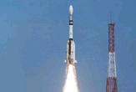
SPACEFLIGHT
India’s GSLV returns to flight
It was a day of redemption for India's space program, when the nation's most
powerful rocket returned to the skies for the first time since a booster engine failure doomed a launch last year.
The Geosynchronous Satellite Launch Vehicle, making its fifth flight since debuting in 2001, blasted away from the Satish Dhawan Space Center on Sriharikota Island. Liftoff was at 1250 GMT (8:50 a.m. EDT), the exact time of sunset on India's east coast on 3 September 2007 . The 161-foot-tall rocket flew east over the Bay of Bengal on track to deposit the INSAT 4CR communications satellite into orbit.
INSAT 4CR was released into an elliptical transfer orbit stretching from a low point of about 104 miles to a high point of 21,568 miles. The apogee mark was 786 miles lower than pre-launch predictions, and the achieved inclination was one degree off the target of 21.7 degrees. Despite the rocket's underperformance, Indian space officials declared the critical mission a success. ISRO officials also confirmed the payload unfurled its two solar panels a few minutes after spacecraft separation. The power-generating arrays stretch about 31 feet from tip to tip.
The three-stage rocket's last flight ended in disaster about one minute into another communications satellite delivery mission in July 2006. A committee appointed to analyze the failure determined a propellant regulator inside one of four liquid-fueled strap-on boosters malfunctioned, which allowed excess propellant to flow into the Vikas engine.Pressures and temperatures inside the engine soared above operational limits, which led to the power plant's premature shutdown just moments after liftoff. The four strap-on engines burn hydrazine and nitrogen tetroxide during the first two-and-a-half minutes of launch. The boosters are clustered around a solid-fueled core stage.
Expected to operate for at least ten years, INSAT 4CR will specialize in direct-to-home television broadcasting, video picture transmission and digital satellite news gathering services. INSAT 4CR carries 12 Ku-band transponders that will reach across India.

Slide 4
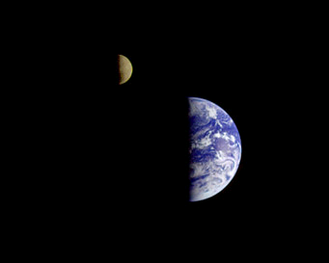
SCIENCE
Lonely Planets of the Cosmos
Scientists think free-floating planets — occasionally with moons — should exist in the cold depths of interstellar space, but without any sunlight they will be very difficult to find.
A brief letter in Nature was John Debes's inspiration. The 1999 piece, by David J. Stevenson (Caltech), proposed that planets with liquid water oceans — and even life — could exist in the cold, dark depths of interstellar space far from any star. Based on the knowledge that some fraction of planets must get gravitationally ejected from their systems during the systems' formation, the paper theorized that some of these ejected planets could, with enough internal heat, keep their atmospheres and stay warm enough to support liquid water below a thick frozen crust.
What might happen if such an outcast had a big moon? To find out, Debes (at the Carnegie Institution of Washington) ran 2,700 computer simulations based on an Earth-mass planet and a lunar-mass companion.
"The ejection process can be very intense," says Debes. "It wasn't clear to us if any bound systems would actually survive." But in 123 of the cases, or between 4 and 5 percent of the time, the "Earth-Moon" system did survive ejection from its solar system intact.
"Anytime something happens in astronomy a few percent of the time, it is interesting to us because on the grand scale of things, it means it's happening a lot and people should probably know about it," says Debes.
And these pairs have a better chance to harbor life, since the dissipation of tidal energy between the moon and the spinning planet causes the interior of the planet to warm. Debes' models predict that this heating would match what happened in Earth's case more than 4 billion years ago, when the young Moon was much closer and Earth was rotating faster.

Slide 5
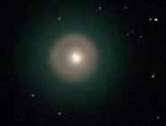
NIGHTSKY
Comet Holmes beckons
skygazers worldwide
Amateur astronomers the world over have been stunned and amazed by the weirdest new object to appear in the sky in memory. And it's one of the brightest, too — it's easy to spot with your eyes alone if you know where to look.
Observers worldwide had no trouble spotting Comet Holmes through the full moonlight on the evening of October 25, 2007. Comet Holmes (17P) brightened dramatically — by nearly a million times — virtually overnight. For no apparent reason, the comet erupted from a very dim magnitude 17 to about magnitude 2½. Within a day its starlike nucleus had expanded into a perfectly round, bright little disk visible in binoculars and telescopes. It looked like no comet ever seen.
Its startling outburst, however, has a precedent. The comet was also in a major eruption 115 years ago, in November 1892, when English amateur Edwin Holmes was the first to spot it. It reached 4th or 5th magnitude, faded in the following weeks, and then underwent a second eruption 2½ months after the first.
While large telescopes showed fine-scale cometary details, naked-eye views of the object revealed a view similar to looking at a star until October 26. After October 26 the object began to appear more comet-like to naked-eye observers. During the 2007 outburst, its orbit took it to near opposition with respect to Earth, and since comet tails point away from the Sun, this means Earth observers were looking nearly straight down along its tail, making it appear as a bright sphere in telescopes.
Based on orbital computations and luminosity before the comet's 2007 outburst, its nuclear diameter is estimated at 3.4 km. In late October 2007 the diameter of its coma increased from 3.3 arcminutes to over 13 arcminutes, about half the diameter that the Moon subtends in the sky.

Slide 6
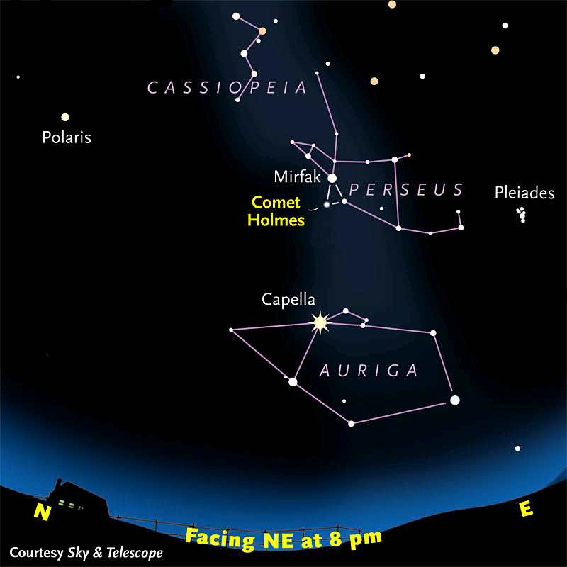
The Club
Here we are again trying to bring back interest in astronomy and space among IITK junta. Now we are hoping to get a lot of better equipment soon and will also be having projects and workshops including astrophotography during winter vacation. Stay tuned…
Coordinators
Ananya Pareek (apareek@)
Saurabh Chatterjee (saurc@ )
Credits
References - www.space.com, www.skyandtelescope.com, wikipeia
Editors: Rahul Khandelwal, Saurabh Chatterjee
Front page picture – Mars being occulted by the moon
Visit our website (http://students.iitk.ac.in/astro/)
Mail us at astronomy.iitk@gmail.com
‘Starry night’ software can be downloaded from DC
Star map to locate Comet Holmes

