Slide 1
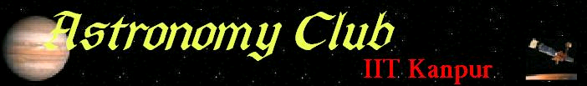

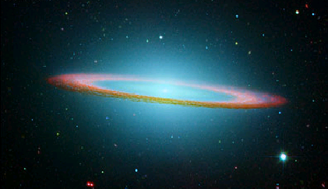
The Wall magazine – September 07

Slide 2
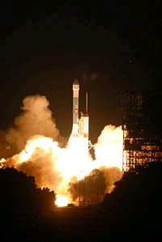
NEWS
Phoenix mission headed for the red planet
NASA's Phoenix Mars Lander lit up the predawn Florida sky , launching spaceward on a mission to determine whether the planet could have once supported primitive life. A United Launch Alliance Delta 2 rocket launched Phoenix towards Mars at 5:26:34 a.m. EDT (0926:34 GMT) on 4th August 2007 from Pad 17A at the Cape Canaveral Air Force Station in Cape Canaveral, Florida. The three-stage booster is bound for the flat northern plains of Vastitas Borealis near the martian north pole.
Phoenix is due to land on May 25, 2008, plunging through the martian atmosphere behind its protective aeroshell before deploying a parachute to slow its descent, extending three landing legs and firing a set of pulse rockets to make a smooth touchdown on the surface of Mars. Managed by JPL in Pasadena, California, the Phoenix mission is expected to last at least 90 Martian days, or sols.
If successful, the landing will mark the first soft touchdown on Mars since NASA's massive Viking lander missions in the 1970s. Researchers used imagery from NASA's Mars Reconnaissance Orbiter and other spacecraft to make sure Phoenix's landing site was relatively clear of rocks, steep slopes or other conditions that could pose a hazard to the spacecraft.
In addition to its backhoe-like 2.4m long robotic arm, Phoenix is equipped with a series of science tools to taste, sniff and peer at martian soil and ice. The probe won't hunt for evidence of life itself, but rather the conditions required in which microbes or other organisms could exist, mission scientists said. Tiny ovens and a wet chemistry laboratory mounted to Phoenix's upper surface, or deck, will scan soil and ice samples for signs of organic molecules and compounds - one ingredient useful for life - while cameras and microscopes image the samples. The probe also carries a laser ranging and detection (lidar) instruments and other tools mounted to a meteorology mast to study Mars weather.
But before Phoenix can study Mars, the probe must first reach the red planet, which has proven to be a challenge. More than half of all Mars-bound missions have failed to date, the most recent being the Mars polar lander.

Slide 3
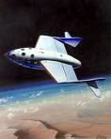
SPACEFLIGHT
Private Space Industry – the new pioneers
In the early decades of the Space Age, the government space agencies of the Soviet Union and United States pioneered space technology in collaboration with affiliated design bureaus and private enterprises. Later on, large defense contractors began to develop and operate space launch systems, derived from government rockets, and commercial satellites. Private spaceflight in Earth orbit includes communications satellites, satellite television, satellite radio and orbital space tourism. Recently, entrepeneurs started designing and flying suborbital spaceplanes. Planned private spaceflights beyond Earth orbit include solar sailing prototypes, deep space burial and personal spaceflights around the Moon. A private orbital habitat prototype is already in Earth orbit, with larger versions to follow.
Scaled Composites Model 316 SpaceShipOne completed the first privately funded human spaceflight on June 21, 2004. SpaceShipOne was an experimental air-launched suborbital spaceplane that used a hybrid rocket motor. The design featured a unique "feathering" reentry system where the rear half of the wing and the twin tail booms folded upward along a hinge running the length of the wing; this increased drag while remaining stable. The achievements of SpaceShipOne are more comparable to the X-15 than orbiting spacecraft like the Space Shuttle. Accelerating a spacecraft to orbital speed requires more than 30 times as much energy as lifting it to 100 km.
SpaceShipOne was developed by Scaled Composites, Burt Rutan's aviation company, in their Tier One program, without government funding. On June 21, 2004, it made the first privately funded human spaceflight, and on October 4, it won the $10-million Ansari X PRIZE, by reaching 100 kilometers in altitude twice in a two-week period with the equivalent of three people on board, with no more than ten percent of the non-fuel weight of the spacecraft replaced between flights. Development costs were estimated to be $25-million, funded completely by Paul Allen.
During its testing regimen, SpaceShipOne set a number of important "firsts", including first privately funded aircraft to exceed Mach 2 and Mach 3, first privately funded spacecraft to exceed 100km altitude, and first privately funded reusable spacecraft.

Slide 4
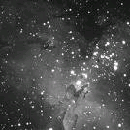
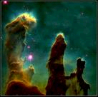
NIGHTSKY
The Eagle Nebula
The Eagle Nebula (also known as Messier Object 16, M16 or NGC 6611), perhaps one of the most famous and easily recognized space objects, is a young open cluster of stars in the constellation Serpens, discovered by Jean-Philippe de Cheseaux in 1745-46. It is associated with a diffuse emission nebula, or H II region, which is catalogued as IC 4703. This region of active current star formation is about 7,000 light-years distant. The brightest star in the nebula has an apparent magnitude of 8.24, easily visible with good binoculars.
Images made in 1995 by the Hubble greatly improved our understanding of processes inside the nebula. Eagle nebula's region known as "Pillars of Creation" is a large region of star formation. Its small dark areas are believed to be protostars. The pillar structure of the region resembles that of another, much larger star formation region, imaged by Spitzer Space Telescope in 2005 in Cassiopeia, which is designated W5 and usually called "Mountains of Creation“.
Combination of an X-ray image from the Chandra observatory with Hubble's famous 'Pillars of Creation' image have shown that X-ray sources (from young stars) do not coincide with the pillars, instead randomly dotting the area. This leads many astronomers to believe that star formation peaked approximately a million years ago in the Eagle Nebula and any protostars in the pillar EGGs are not yet hot enough to emit X-rays.

Slide 5
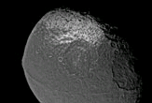
SCIENCE
Walnut-Shaped Moon's Mystery Solved
Iapetus is an oddly shaped a moon of saturn ,best known for its dramatic 'two-tone' coloration. Recent findings indicate it got its nutty shape from a super-fast spin that was frozen into place early in the solar system's formation.
When the Cassini spacecraft snapped close-ups of Saturn's moons in 2005, it revealed a bulging waistline of rock along the equator of the now slowly spinning Iapetus. Astronomers think this characteristic shape persists because Iapetus was cryogenically frozen in time about 3 billion years ago, during the moon's "teen" years. Iapetus spun fast, froze young and left behind lasting curves.
Unlike any other moon in the solar system, Iapetus has retained its immature figure. Running exactly along its midsection, a chain of mountains 808 miles (1,300 kilometers) long and 12 miles (19 kilometers) high adds to the moon's walnut-like appearance.
It is expected that a very fast-spinning moon would have this bulge but not a slow-spinning moon, because the bulge would have been much flatter. Iapetus originally spun once every five to 16 hours, which was fast enough to buckle its surface at the equator, according to the new model detailed in an upcoming online edition of the journal Icarus.
Scientists think radioactive elements heated the moon's interior to permit the crust to stretch and buckle, yet quickly froze the moon into shape as fuel ran out.Iapetus' development literally stopped in its tracks. In order to slow the young moon down its present once-per-80-days rotational speed, its interior had to be much warmer, close to the melting point for water ice.
The finding should help astronomers better understand how the planets and their moon systems formed in the early solar system.

Slide 6

ENTERTAINMENT
Guitarist Brian May Gets Astrophysics Doctorate
Guitarist and songwriter Brian May has completed his doctorate in astrophysics-three decades after he put academia on hold to form the rock group Queen. The rocker was awarded his qualification by London's Imperial College and said submitting his thesis, "Radial Velocities in the Zodiacal Dust Cloud," to supervisors was as nerve-racking as any stadium gig.
May was an astrophysics student at Imperial College when he joined Freddie Mercury and Roger Taylor to form Queen in 1970, but dropped his doctorate as the glam rock band became successful. Queen became one of Britain's biggest music groups in the 1970s, with hits including "Bohemian Rhapsody" and "We Will Rock You."
On the lighter side
Arthur C. Clarke’s rules of prediction
When a distinguished but elderly scientist states that something is possible, he is almost certainly right .When he states that something is impossible, he is very probably wrong.
The only way of discovering the limits of the possible is to venture a little way past them into the impossible.
Any sufficiently advanced technology is indistinguishable from magic.
Credits
References - www.space.com, www.nasa.gov,etc.
Edited by Saurabh Chatterjee (saurc@iitk.ac.in)
Front page picture – Sombrero galaxy
Visit our website (http://students.iitk.ac.in/astro/)
Mail us at astronomy.iitk@gmail.com
‘Starry night’ software can be downloaded from DC

