Slide 1
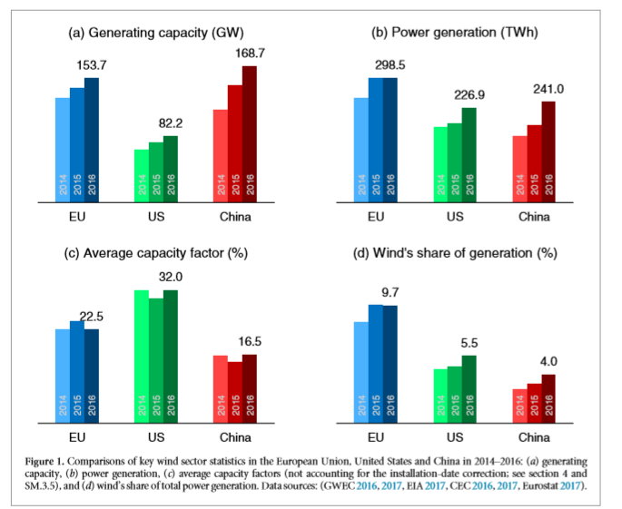
1)Capacity Factor := the ratio of realized electricity generation to potential generation
2) China’s shortfall in comparison to US
-ratio of capacity factor :
US/China = (32 %) /(16.5 %) ~ 2 times
-reasons
1) installation
+site selection
+tower height
+turbine selection(local wind profile)
2)grid connection
+Curtailment
3)Operational Efficiency
1) “Why is China’s wind power generation not living up to its potential?”, Environmental Research Letters, 2018

Slide 2
1)Capacity Factor := the ratio of realized electricity generation to potential generation
2) China’s shortfall in comparison to US
-ratio of capacity factor :
US/China = (32 %) /(16.5 %) ~ 2 times
-reasons
1) installation
+site selection
+tower height
+turbine selection(local wind profile)
2)grid connection
+Curtailment
3)Operational Efficiency
1) “Why is China’s wind power generation not living up to its potential?”, Environmental Research Letters, 2018

Slide 3
China’s Shortfall related to wind power Capacity Factor

