Slide 1
“ Wind Farm research Group”
-The first Meeting-
-2019.10.03. 10AM -

Slide 2
ASTU Windfarm Research Objective :
Increase the efficiency of the Windfarms
Set up and implement wind turbines in ASTU
Increase the capabilities for windfarms to be competitive to the world
Suggest the guide line for the windfarms
Co-research with foreign research centers
Milestone Wind Energy
Wind Energy | Ethiopia
year | Cap. MW | Contract | Remark | ref.
~2012 | 171
~2015 | 324
 |  | 2018. 100MW | Assela Danish | 1)
~2025 | 5,200 |  |  | 2)
1) https://renewablesnow.com/news/denmark-provides-loan-for-100-mw-wind-farm-in-ethiopia-614204/
2) “Accelerating Wind Power Generation in Ethiopia“,2016, Danida

Slide 3
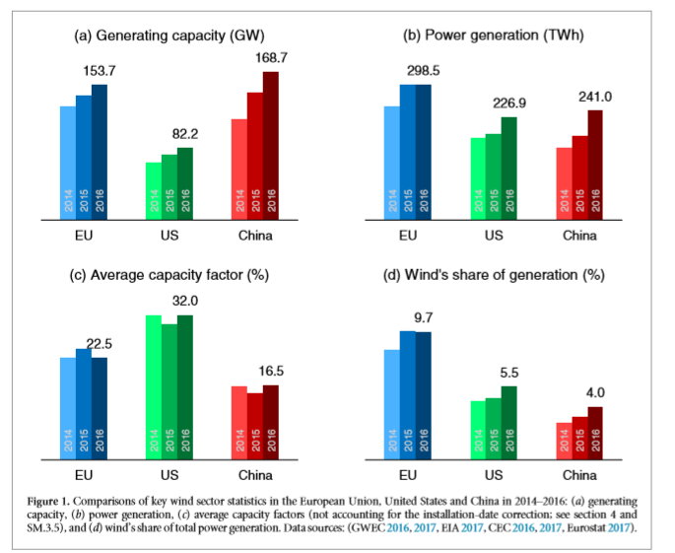
1) “Why is China’s wind power generation not living up to its potential?”, Environmental Research Letters, 2018
1)Capacity Factor := the ratio of realized electricity generation to potential generation
2) China’s shortfall in comparison to US
-ratio of capacity factor :
US/China = (32 %) /(16.5 %) ~ 2 times
-reasons
1) installation
+site selection
+tower height
+turbine selection(local wind profile)
2)grid connection
+Curtailment
3)Operational Efficiency

Slide 4
Milestone of ASTU Wind Research Group
Phase I
- EEP :
+ Increase operational capabilities/maintenance for wind turbines at present
+ Provide new technologies to power improvement
- ASTU : Form “Wind Energy Research Group”
- Government : Propose for Ethiopian Grid Code Regulation
Phase II
- EEP : Propose for “Wind energy research center in ASTU
- ASTU :
+ Establish “Wind Energy Research Center”
+ Provide “Wind Energy System Engineer”
- Government : Enact/Regulate “ Ethiopian Grid Code “

Slide 5
The First meeting with EEP
1) topics to be discussed
- by EEP
+maintenance problem : fault detection, identification / lubrication status
+operational problem : power managements (active / frequency / pitch control / prediction)
-by ASTU
+ new technologies for fault detection / wind farm /
2) Preparation
- ASTU experts (who)
- Arrangement(when / where/how)
- The supervisor

Slide 6
References
. Wind Farm
. Recent_Final
ASTU Wind Energy :
- at present : Personal Github Repository , https://github.com/snkim0701
- in future : organization github repository , “ASTU Wind Research “
: members to be invited
: materials in repository
: discussion as a “Blog”

