Slide 1
CUSTOMER SHOPPING BEHAVIOR
The growth signals inside 3,900 purchases
A data-forward readout of category, customer, subscription, discount, product, and shipping behavior.

Slide 2



Customer shopping behavior: the growth signals inside 3,900 purchases
THE DATASET
The dataset shows a broad, repeat-oriented customer base
3,900
$59.76
18–70
purchases across 18 fields and 4 product categories
average purchase
3.75 average review rating
customer ages across 50 locations
02

Slide 3

Customer shopping behavior: the growth signals inside 3,900 purchases
CATEGORY ECONOMICS
Clothing leads revenue, while accessories are the next engine
Revenue and sales volume follow the same order.
Clothing
Accessories
$100K revenue · 1,800 sales
$75K revenue · 1,200 sales
Footwear
Outerwear
$35K revenue · 600 sales
$20K revenue · 350 sales
03

Slide 4
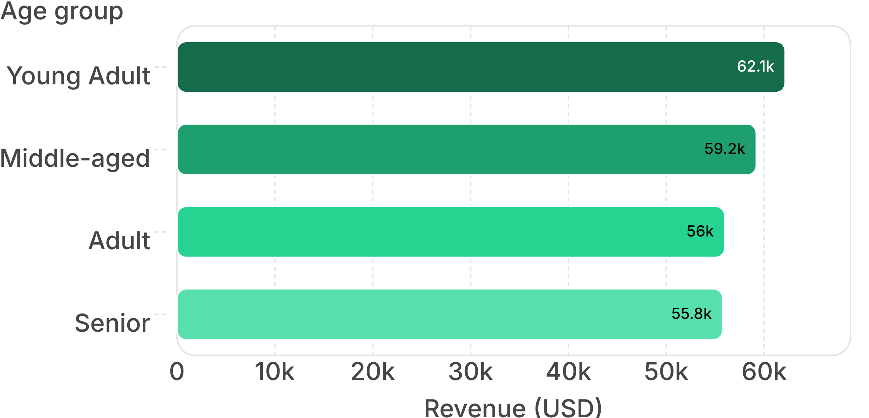
Customer shopping behavior: the growth signals inside 3,900 purchases
CUSTOMER MIX
Young adults contribute the most revenue, but every age group matters
The gap is modest.
Differentiated messaging beats one broad campaign.
04

Slide 5
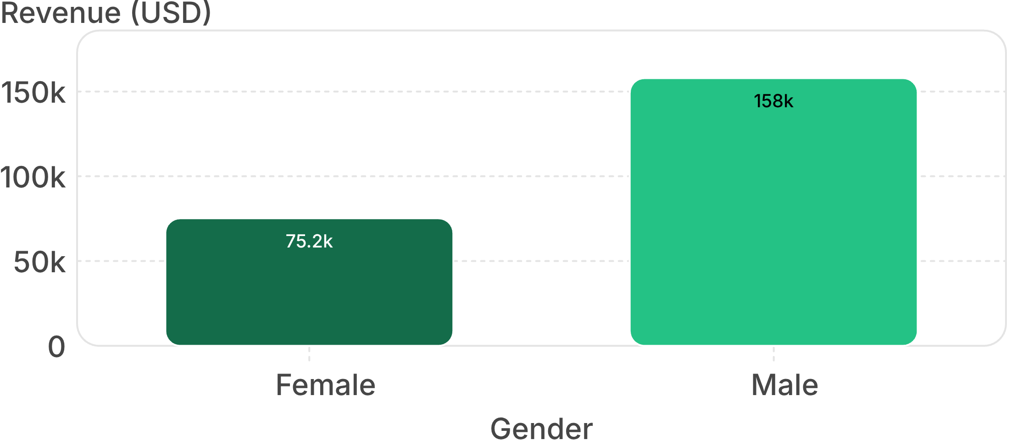
Customer shopping behavior: the growth signals inside 3,900 purchases
REVENUE BY GENDER
Male customers generated more than twice the revenue of female customers
$157,890
Male revenue
Use the difference as a targeting signal, then validate whether it reflects mix, conversion, or basket size before reallocating spend.
05

Slide 6
Customer shopping behavior: the growth signals inside 3,900 purchases
LOYALTY AND SUBSCRIPTION
Loyal customers dominate the file, but subscription is not keeping pace
Customer segments
Subscription mix
3,116
701
83
27%
73%
Loyal
Returning
New
Subscribers
Non-subscribers
$62,645 subscriber revenue · $170,436 non-subscriber revenue
06

Slide 7

Customer shopping behavior: the growth signals inside 3,900 purchases
THE GROWTH GAP
Subscription is the clearest growth gap, not a spend problem
$59.49
$59.87
Average spend · subscribers
Average spend · non-subscribers
Convert existing repeat demand with better benefits.
Do not assume subscribers naturally spend more.
07

Slide 8
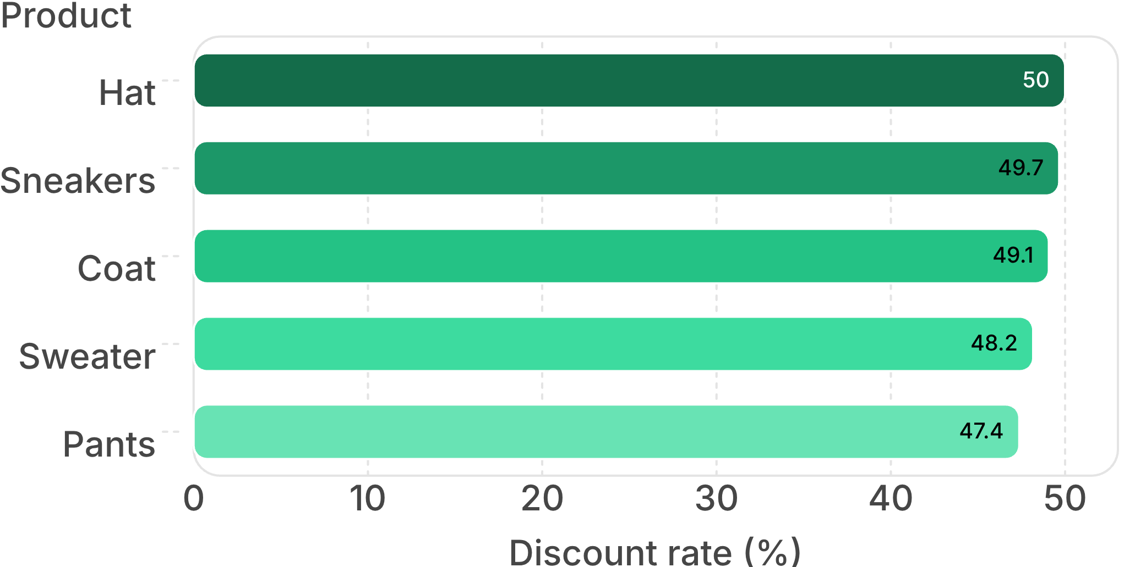
Customer shopping behavior: the growth signals inside 3,900 purchases
DISCOUNT BEHAVIOR
Discounts attract high-value baskets, especially in a few products
839
customers used discounts and still spent above the average purchase amount
Test targeted offers on high-discount products while protecting margin on full-price demand.
08

