Slide 1


The Kite Runner
- Khaled Hosseini
Shen Tao

Slide 2
excerpts
For you, a thousand times over!

Slide 3
Contents
1
Author & Character
2
Story synopsis
3
Well-Known Saying
4
My thoughts

Slide 4
1
Author & Character

Slide 5
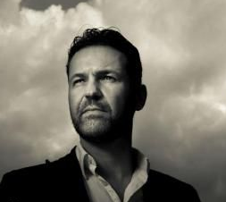
Author
Born in Kabul, Afghanistan in 1965
Fist novel <<The Kite Runner>>
Khaled Hosseini

Slide 6
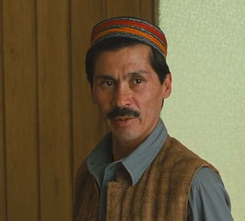
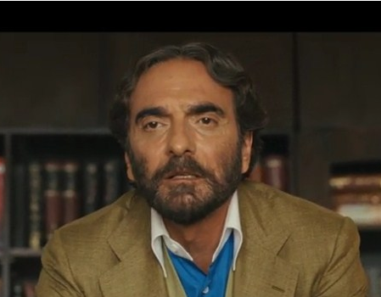
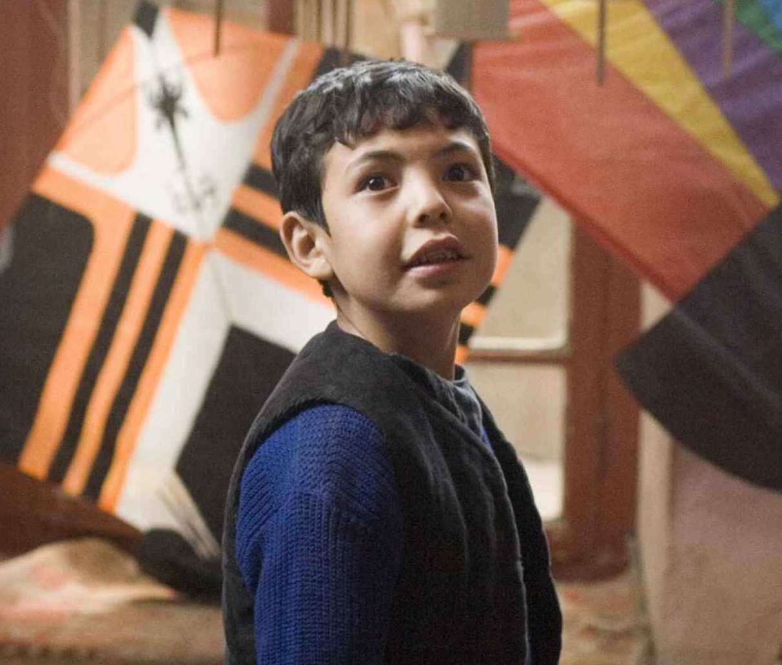
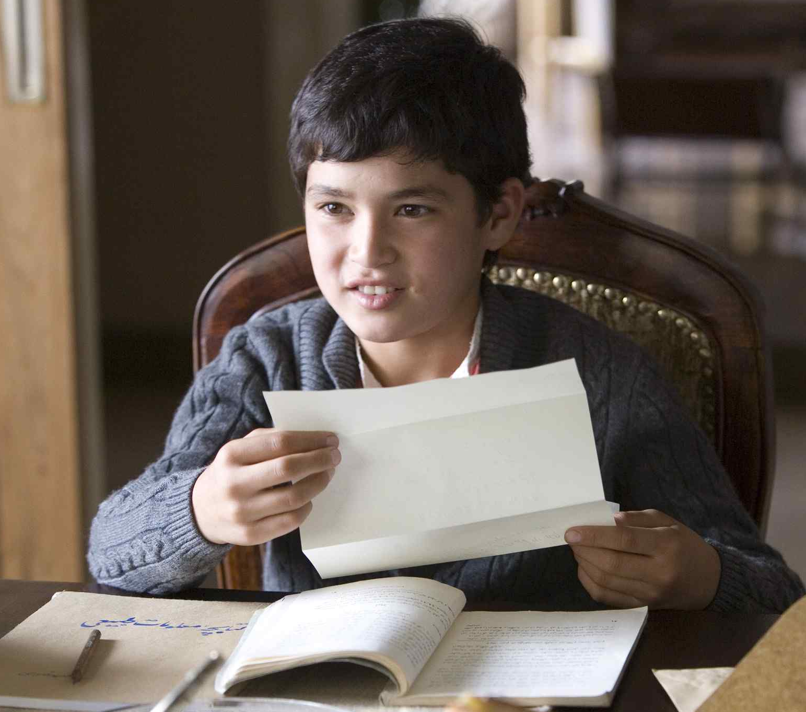
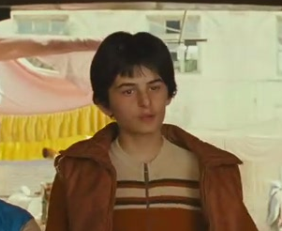
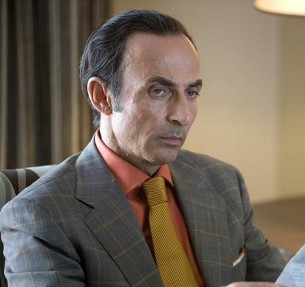
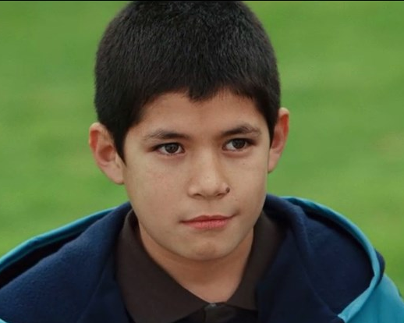
Character
Father and son
Ali
Baba
Father and son
partner
Hassan
Father and son
Friend
Amir
Assef
Rahim
sohrab

Slide 7
2
Story synopsis

Slide 8
1
Kabul
2
California
3
Kabul -> California

Slide 9
3
Well-Known Saying

Slide 10
excerpts
“ For you, a thousand times over! ”

Slide 11
excerpts
"There is a way to be good again".

Slide 12
excerpts
“ only sin that mattered was theft.” Baba said. “ When you kill a man, you steal a life, You steal his wife's right to a husband, rob his children of a father. When you tell a lie, you steal someone's right to the truth. When you cheat, you steal the right to fairness. ”

Slide 13
excerpts
“ My body was broken - just how badly I wouldn’t find out until later – but I felt healed. Healed at last. I laughed. ”

Slide 14
4
My thoughts

Slide 15
1
The Search For Redemption
War destroyed everything
2
Everyone has his kite and everyone is a kite runner at the same time.
3

Slide 16
Thank you !

