Slide 1
intro To Java

Slide 2
Agenda
History
Why Java?
How Computers execute Code?
How JVM executes Code?
Toolchain: jdk, jre, java, javac, jar, etc.
Application structure and elements
Data Types
Java libraries
Flow of Control
Javadoc
Notes:
Duration: - 5 minutes

Slide 3
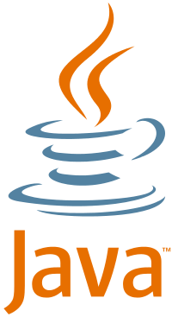
History
Since 1995
- “Green Team”(SUN) – led by James Gosling
JDK 1.0 (January 21, 1996)
JDK 1.1 (February 19, 1997)
J2SE 1.2 (December 8, 1998)
J2SE 1.3 (May 8, 2000)
J2SE 1.4 (February 6, 2002)
J2SE 5.0 (September 30, 2004)
Java SE 6 (December 11, 2006)
Java SE 7 (July 28, 2011)
Java SE 8 (March 18, 2014)

Slide 4
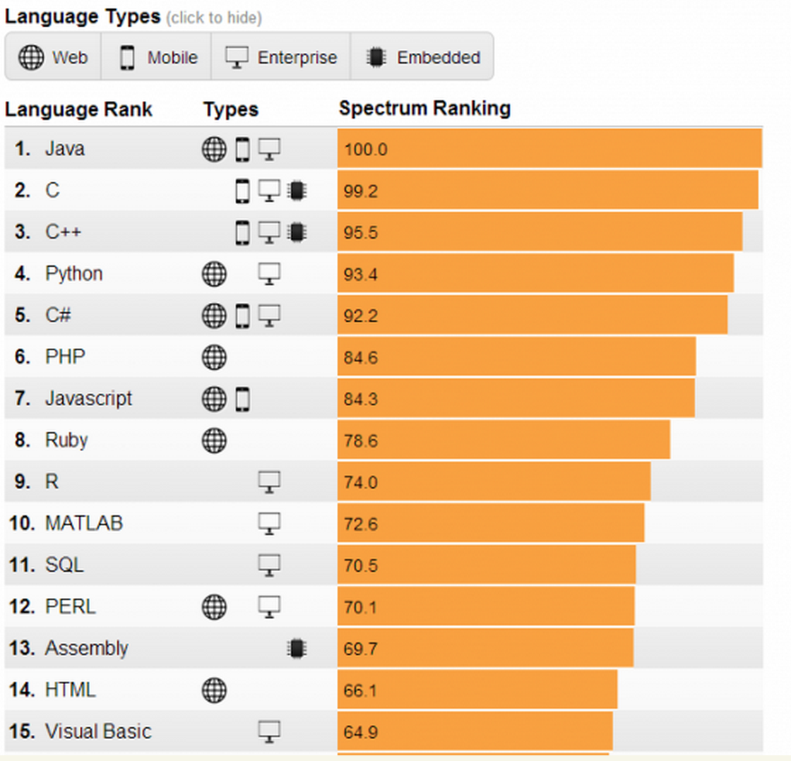
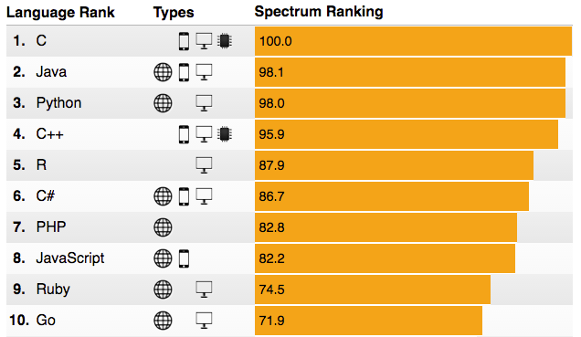
Why Java?
A Ranking of the Top Programming Languages (By Growth, Popularity, and Job Demand)(IEEE 2014 / 2016)

Slide 5
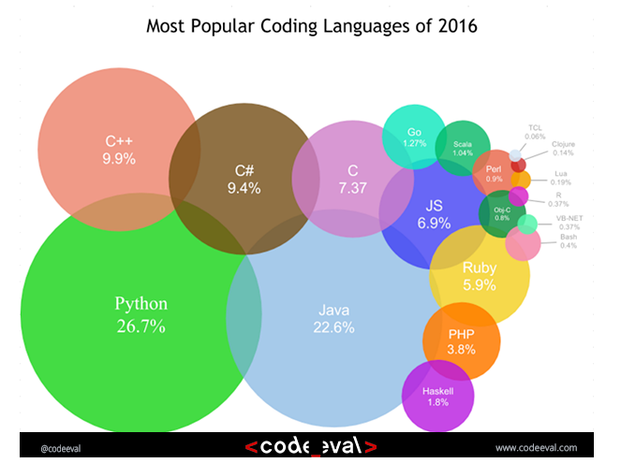
Why Java?

Slide 6
Why Java?
JAVA – general purpose object-oriented programming language
JAVA – write once, run anywhere
Features:
Simple
Object Oriented
Interpreted but compiled
Robust
Secure
Multithreaded
Distributed
Portable
Dynamic
High Performance
Notes:
Distributed
Java facilitates the building of distributed applications by a collection of classes for use in networked applications. By using Java's URL (Uniform Resource Locator) class, an application can easily access a remote server. Classes also are provided for establishing socket-level connections.
Interpreted
Because Java is interpreted, once the Java interpreter has been ported to a specific machine, that machine can instantly run the growing body of Java applications. As an example of the usefulness of this, imagine a hypothetical chip manufacturer, Outtel, that has just finished its newest CPU chip. This new chip, named the Zentium, serves as the foundation of a new line of computers being marketed toward Zen Buddhist monasteries. Once Outtel ports the Java interpreter to work on the Zentium, the new machine will be able to run all of the Java development utilities-the compiler, the debugger, and so on. Contrast this with a traditional language. If Outtel wants to release a C++ compiler with its new computer it must port, or create from scratch, the compiler, the debugger, the runtime library, and so on.
Also, when using an interpreter, programmers are freed from some of the concerns of intermodule dependencies. You no longer have to maintain a "make" file that is sometimes as complicated as the hardest part of your program.
Another advantage is that the time-consuming edit-compile-link-test cycle is broken. Without the compile and link steps, working in an interpreted environment is a much simpler edit-test cycle. Even with today's quick C++ compilers, it is not uncommon for a complete recompile and relink of a large program to be measured in hours and take the better part of a day. Without having to wait for lengthy compiles and links, Java promotes prototyping and easier debugging.
Robust
The designers of Java anticipated that it would be used to solve some very complex programming problems. Writing a distributed, multithreaded program that can run on a variety of operating systems with a variety of processors is not a simple task. To do it successfully, you need all the help your programming language can offer you. With this in mind, Java was created as a strongly typed language. Data type issues and problems are resolved at compile-time, and implicit casts of a variable from one type to another are not allowed.
Memory management has been simplified in Java in two ways. First, Java does not support direct pointer manipulation or arithmetic. This makes it impossible for a Java program to overwrite memory or corrupt data. Second, Java uses runtime garbage collection instead of explicit freeing of memory. In languages like C++, it is necessary to delete or free memory once the program has finished with it. Java follows the lead of languages such as LISP and SmallTalk by providing automatic support for freeing memory that has been allocated but is no longer used.
Secure
Closely related to Java's robustness is its focus on security. Because Java does not use pointers to directly reference memory locations, as is prevalent in C and C++, Java has a great deal of control over the code that exists within the Java environment.
It was anticipated that Java applications would run on the Internet and that they could dynamically incorporate or execute code found at remote locations on the Internet. Because of this, the developers of Java hypothesized the existence of a hostile Java compiler that would generate Java byte codes with the intent of bypassing Java's runtime security. This led to the concept of a byte-code verifier. The byte-code verifier examines all incoming code to ensure that the code plays by the rules and is safe to execute. In addition to other properties, the byte code verifier ensures the following:
No pointers are forged.
No illegal object casts are performed.
There will be no operand stack overflows or underflows.
All parameters passed to functions are of the proper types.
Rules regarding private, protected, and public class membership are followed.
Architecture-Neutral
Back in the dark ages of the early 1980s, there was tremendous variety in desktop personal computers. You could buy computers from Apple, Commodore, Radio Shack, Atari, and eventually even from IBM. Additionally, every machine came with its own very different operating system. Because developing software is such a time-consuming task, very little of the software developed for use on one machine was ever ported and then released for use on a different machine.
In many regards, this situation has improved with the acceptance of Windows, the Apple Macintosh, and UNIX variations as the only valid personal computer options. However, it is still not easy to write an application that can be used on Windows NT, UNIX, and a Macintosh. And it's getting more complicated with the move of Windows NT to non-Intel CPU architectures.
A number of commercially available source code libraries (for example, Zinc, ZApp, and XVT) attempt to achieve application portability. These libraries attempt this by focusing on either a lowest common denominator among the operating systems or by creating a common core API (Application Programming Interface).
Java takes a different approach. Because the Java compiler creates byte code instructions that are subsequently interpreted by the Java interpreter, architecture neutrality is achieved in the implementation of the Java interpreter for each new architecture.
Portable
In addition to being architecture-neutral, Java code is also portable. It was an important design goal of Java that it be portable so that as new architectures (due to hardware, operating system, or both) are developed, the Java environment could be ported to them.
In Java, all primitive types (integers, longs, floats, doubles, and so on) are of defined sizes, regardless of the machine or operating system on which the program is run. This is in direct contrast to languages like C and C++ that leave the sizes of primitive types up to the compiler and developer.
Additionally, Java is portable because the compiler itself is written in Java and the runtime environment is written in POSIX-compliant C.
High-Performance
For all but the simplest or most infrequently used applications, performance is always a consideration. It is no surprise, then, to discover that achieving high performance was one of the initial design goals of the Java developers. A Java application will not achieve the performance of a fully compiled language such as C or C++. However, for most applications, including graphics-intensive ones such as are commonly found on the World Wide Web, the performance of Java is more than adequate. For some applications, there may be no discernible difference in performance between C++ and Java.
Many of the early adopters of C++ were concerned about the possibility of performance degradation as they converted their programs from C to C++. However, many C++ early adopters discovered that, although a C program will outperform a C++ program in many cases, the additional development time and effort don't justify the minimal performance gains. Of course, because we're not all programming in assembly language, there must be some amount of performance we're willing to trade for faster development.
It is very likely that early experiences with Java will follow these same lines. Although a Java application may not be able to keep up with a C++ application, it will normally be fast enough, and Java may enable you to do things you couldn't do with C++.
Multithreaded
Writing a computer program that only does a single thing at a time is an artificial constraint that we've lived with in most programming languages. With Java, we no longer have to live with this limitation. Support for multiple, synchronized threads is built directly into the Java language and runtime environment.
Synchronized threads are extremely useful in creating distributed, network-aware applications. Such an application may be communicating with a remote server in one thread while interacting with a user in a different thread.
Dynamic
Because it is interpreted, Java is an extremely dynamic language. At runtime, the Java environment can extend itself by linking in classes that may be located on remote servers on a network (for example, the Internet). This is a tremendous advantage over a language like C++ that links classes in prior to runtime.
In C++, every time member variables or functions are added to a class, it is necessary to recompile that class and then all additional code that references that class. Of course, the problem is exacerbated by the fact that you need to remember to recompile the files that reference the changed class. Using make files reduces the problem, but for large, complex systems, it doesn't eliminate it.
Java addresses this problem by deferring it to runtime. At runtime, the Java interpreter performs name resolution while linking in the necessary classes. The Java interpreter is also responsible for determining the placement of objects in memory. These two features of the Java interpreter solve the problem of changing the definition of a class used by other classes. Because name lookup and resolution are performed only the first time a name is encountered, only minimal performance overhead is added.

Slide 7
Why Java?
Java
MOBILE
BACKEND
CLOUD
DESKTOP
EMBEDDED
WEB

Slide 8
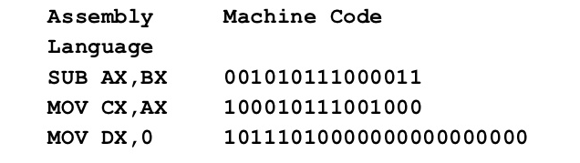
Source → Binary
Computers understand only 1s and 0s
Compilation: source code → object code (semantically equivalent)
Pre-compilation + compilation + linking => machine code
No HLL features (type checking, exception handling, etc.)
Ada, Fortran, C, C++, Go, Objective-C, Swift

Slide 9
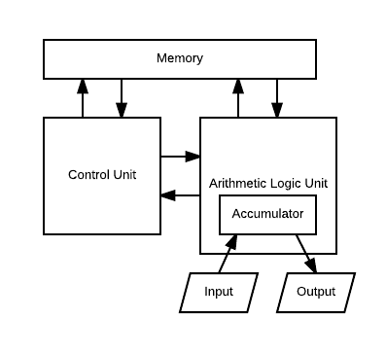
How are these bits executed?
CPU continuously does this:
Loads next instruction from memory: 10000011 (opcode for ADD)
Loads operands from memory: 1011001…001 (some numbers)
Performs operation (ALU)
Stores result back in memory
Von Newmann machine

Slide 10
How are these bits executed?
CPU continuously does this:
Loads next instruction from memory: 10000011 (opcode for ADD)
Loads operands from memory: 1011001…001 (some numbers)
Performs operation (ALU)
Stores result back in memory
Von Newmann machine
JVM does the same!
It emulates a machine

Slide 11
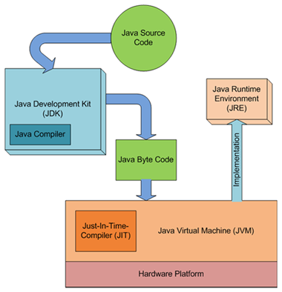
Source → Binary: The Java way
javac Java code => Java byte code: JVM instructions executed on virtual machine
JVM instruction set: dadd d1, d2; daload, dastore, d2f,…
Byte code: interpreted OR transformed into machine code at runtime
Same thing: load instruction (opcode), load operands, execute, and store

Slide 12
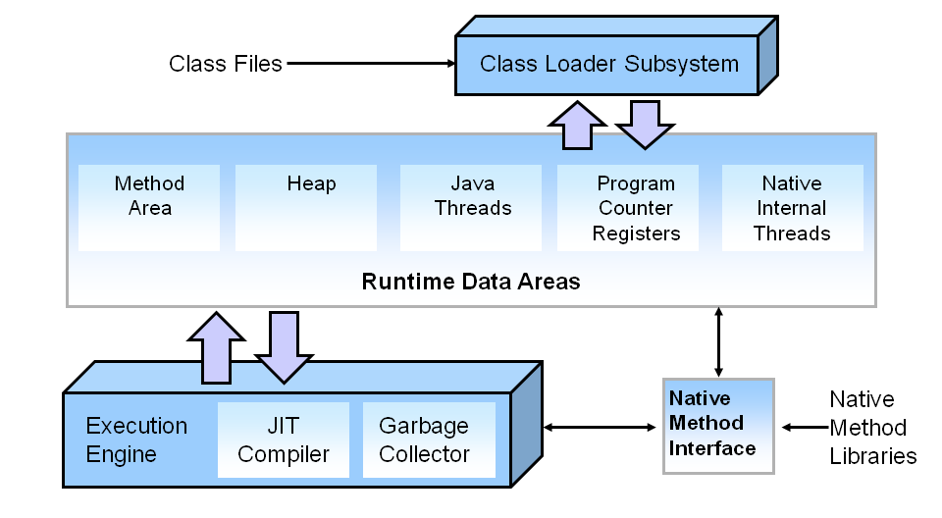
JVM

Slide 13

SETUP
Download JDK
Set JAVA_HOME, path
Run javac
Run java
Notes:
Discuss the parameters for javac and java!

Slide 14
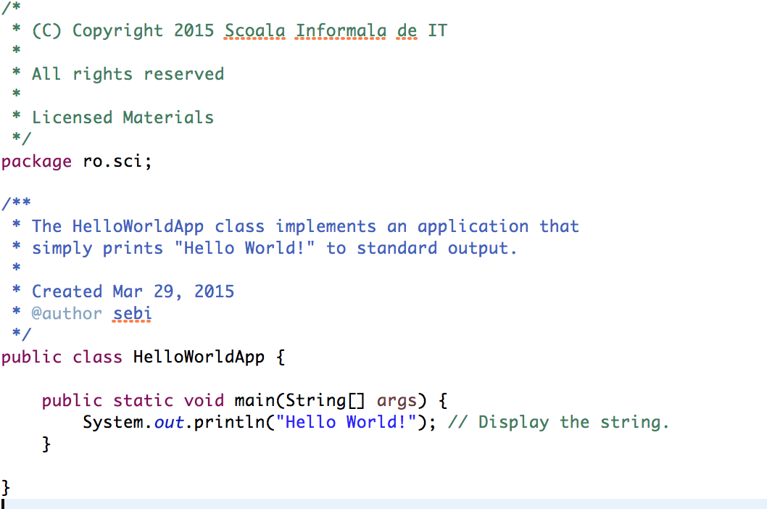
Java Class Structure
Notes:
Explain in detail the java class structure

Slide 15
SETUP
Open a text editor
Write the HelloWorldApp.java
Compile it
Run it

Slide 16
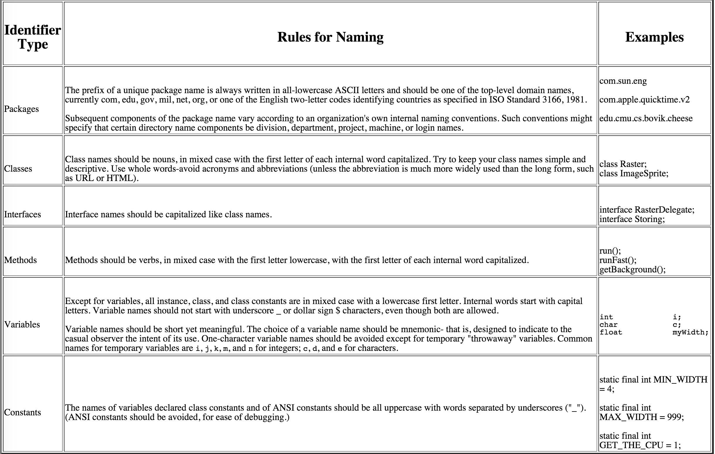
Naming Convention
Notes:
http://www.oracle.com/technetwork/java/codeconventions-135099.html

Slide 17
Data Types
Terminology
Data type = a set of values (definition domain) and a set of operations defined on them
Notes:
http://www.oracle.com/technetwork/java/codeconventions-135099.html

Slide 18
Data Types
Terminology
Data type = a set of values (definition domain) and a set of operations defined on them
8 primitive (built-in) data types in Java, mostly different types of numbers.
Notes:
http://www.oracle.com/technetwork/java/codeconventions-135099.html

Slide 19
Data Types
Terminology
Data type = a set of values (definition domain) and a set of operations defined on them
8 primitive (built-in) data types in Java, mostly different types of numbers.
Other types are provided in Java libraries
Notes:
http://www.oracle.com/technetwork/java/codeconventions-135099.html

Slide 20
Data Types
Terminology
Data type = a set of values (definition domain) and a set of operations defined on them
8 primitive (built-in) data types in Java, mostly different types of numbers.
Other types are provided in Java libraries
OOP is centered around the idea of creating our own data types out of existing ones (we’ll see later)
Notes:
http://www.oracle.com/technetwork/java/codeconventions-135099.html

Slide 21
Built-in Types of Data
Terminology
int a, b, c;
a = 1000;
b = 100;
c = a + b;

Slide 22
Built-in Types of Data
Terminology
int a, b, c;
a = 1000;
b = 100;
c = a + b;
The first statement declares 3 variables with the identifiers a, b, and c to be of type int (integer).
Notes:
Aici, punctul și virgula au vreun rol/înseamnă ceva în limbajul Java, sau ba? Că dacă BA, n-are rost să le păstrezi at the end of the row… Nu știam ce să fac cu ele, așa că le-am lăsat.

Slide 23
Built-in Types of Data
Terminology
int a, b, c;
a = 1000;
b = 100;
c = a + b;
The first statement declares 3 variables with the identifiers a, b, and c to be of type int (integer).
The next 2 assignment statements change the values of the variables using the literals 1000 and 100.

Slide 24
Built-in Types of Data
Terminology
int a, b, c;
a = 1000;
b = 100;
c = a + b;
The first statement declares 3 variables with the identifiers a, b, and c to be of type int (integer).
The next 2 assignment statements change the values of the variables using the literals 1000 and 100.
The last statement assigns c the value of the expression a + b.

Slide 25
Built-in Types of Data
Integers
int: whole number in range -2³¹ and 2³¹-1 (32 bits)
Used frequently in programs!

Slide 26
Built-in Types of Data
Integers
int: whole number in range -2³¹ and 2³¹-1 (32 bits)
Used frequently in programs!
short: whole number in range -2¹⁵ and 2¹⁵-1 (16 bits)

Slide 27
Built-in Types of Data
Integers
int: whole number in range -2³¹ and 2³¹-1 (32 bits)
Used frequently in programs!
short: whole number in range -2¹⁵ and 2¹⁵-1 (16 bits)
long: whole number in range -2⁶³ and 2⁶³-1 (64 bits)

Slide 28
Built-in Types of Data
Integers
int: whole number in range -2³¹ and 2³¹-1 (32 bits)
Used frequently in programs!
short: whole number in range -2¹⁵ and 2¹⁵-1 (16 bits)
long: whole number in range -2⁶³ and 2⁶³-1 (64 bits)
public class IntegerOperations {
public static void main (String… args) {
int a = Integer.parseInt(args[0]);
int b = Integer.parseInt(args[1]);
int sum = a + b;
int prod = a * b;
System.out.println(a + “ + ” + b + “ = “ + sum);
// implement other operations and print results!
}
}

Slide 29
Built-in Types of Data
Characters and Strings
char: alphanumeric symbol, like the ones on your keyboard
We mostly assign values to char variables (anything else, not very often)
String: sequence of characters; we mostly concatenate strings
Note: String is not built-in (it’s part of the java.lang package)

Slide 30
Built-in Types of Data
Characters and Strings
char: alphanumeric symbol, like the ones on your keyboard
We mostly assign values to char variables (anything else, not very often)
String: sequence of characters; we mostly concatenate strings
Note: String is not built-in (it’s part of the java.lang package)
String a, b, c;
a = “My name is ”;
b = “Paul”;
c = a + b;

Slide 31
Built-in Types of Data
Characters and Strings
char: alphanumeric symbol, like the ones on your keyboard
We mostly assign values to char variables (anything else, not very often)
String: sequence of characters; we mostly concatenate strings
Note: String is not built-in (it’s part of the java.lang package)
String a, b, c; // we declare 3 variables of type String
a = “My name is ”;
b = “Paul”;
c = a + b;

Slide 32
Built-in Types of Data
Characters and Strings
char: alphanumeric symbol, like the ones on your keyboard
We mostly assign values to char variables (anything else, not very often)
String: sequence of characters; we mostly concatenate strings
Note: String is not built-in (it’s part of the java.lang package)
String a, b, c; // we declare 3 variables of type String
a = “My name is ”; // we assign values to variables a and b
b = “Paul”;
c = a + b;

Slide 33
Built-in Types of Data
Characters and Strings
char: alphanumeric symbol, like the ones on your keyboard
We mostly assign values to char variables (anything else, not very often)
String: sequence of characters; we mostly concatenate strings
Note: String is not built-in (it’s part of the java.lang package)
String a, b, c; // we declare 3 variables of type String
a = “My name is ”; // we assign values to variables a and b
b = “Paul”;
c = a + b; // concatenate a and b and assign the expression value to c

Slide 34
Built-in Types of Data
Real Numbers
float: 32 bit floating-point numbers with single precision
double: 64 bit floating-point numbers with double precision.
public class DoubleOperations {
public static void main(String… args) {
double a = Double.parseDouble(args[0]);
a = Math.toRadians(a);
System.out.println(“Math.sin(” + a + “) = ” + Math.sin(a));
}
}

Slide 35
Built-in Types of Data
Real Numbers
Write a short program which reads a double number (let’s call it x) from the standard input (keyboard), calculates
sin²(x) + cos²(x)
and prints the result to the standard output (screen).
Is the result always equal to 1?

Slide 36
Built-in Types of Data
Booleans
boolean has just 2 values: true and false.
Operators:
and: a && b is true if both a and b are true
or: a || b is true is either a or b is true
not: !a is true if a is false
Comparisons:
== equality test
!= inequality test

Slide 37
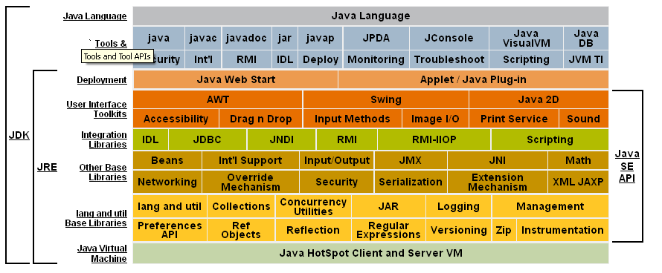
Java libraries

Slide 38
Variables
Instance Variables (Non-Static Fields) - objects store their individual states in "non-static fields", that is, fields declared without the static keyword.
Class Variables (Static Fields) - a class variable is any field declared with the static modifier; this tells the compiler that there is exactly one copy of this variable in existence, regardless of how many times the class has been instantiated.
Local Variables - similar to how an object stores its state in fields, a method will often store its temporary state in local variables.
Parameters - Parameters are the variables that are listed as part of a method declaration.
Notes:
http://www.tutorialspoint.com/java/java_variable_types.htm

Slide 39
Variables
Open a text editor
Define a method to calculate the division of one number by another
Print the result
Calculate and print 1 / 2, 4 / 1, 10 / 0 ☺

Slide 40
Operators
Type
Arithmetic | +, -, /, *, % --, ++
Relational | <, >, >=, <=, ==
Bitwise | &, |, ^, ~, << , >>, >>
Logical | && , ||, !
Assignment | =, +=, -=, *=, /=, %=, >>=, <<=, |= , &=, ^=
Misc | conditional: ( ? : ) instanceof

Slide 41
Operators
Operators’ joy ☺
Groups of students should provide different running code to test one set of operators.

Slide 42
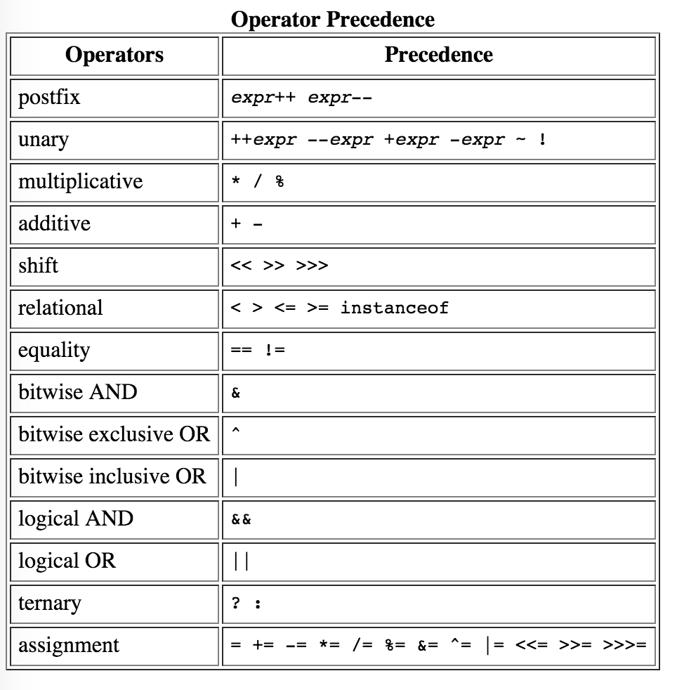
Operators
Notes:
http://docs.oracle.com/javase/tutorial/java/nutsandbolts/operators.html

Slide 43
Operators
Evaluate (no code to be run!)
int a = 10, b = 5, c = 16;
int d = (a >> 2 - 100) > 0 ? 1 : 0;
int e = ++a - b * 2 + 4 / c << 3 - 1;
int f = a >>> 2 - b-- % 4;
boolean g = true || (100 + 4 / 4 - 100 << 4 > 0);
Notes:
d: 0
e:4
f:5
g:true

Slide 44
Flow of control
Terminology
Flow of Control: the sequence of statements that are executed in a program.
Simplest case: statements are executed one after another.

Slide 45
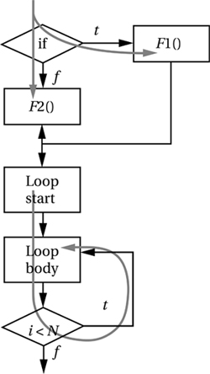
Flow of control
Terminology
Flow of Control: the sequence of statements that are executed in a program.
Simplest case: statements are executed one after another.
Real-life: programs have certain paths of execution

Slide 46
Flow of control
if-else statement
if (<boolean expression>) {
// statements;
} else {
// statements;
}

Slide 47
Flow of control
Switch statement
switch(expression) {
case value:
// do something
break; // optional
case value:
// do something else
break; // optional
default: // optional
// do something if value is none of the cases above
}

Slide 48
Flow of control
Implement an arithmetic calculator!
Notes:
d: 0
e:4
f:5
g:true

Slide 49
Flow of control
While loop
while(<boolean expression>) {
// Statements
}

Slide 50
Flow of control
Do-While loop
do {
// Statements
} while(<boolean expression> is true);

Slide 51
Flow of control
For loop
for(<initialization>; <boolean expression>; <update>) {
// Statements
}
for(declaration : expression) {
// Statements
}

Slide 52
Flow of control
continue and break
int[] numbers = { 10, 20, 30, 40, 50 };
int sum = 0;
for (int x : numbers) {
if (x == 30) {
continue;
}
sum += x;
if (sum > 100) {
break;
}
System.out.print(x);
System.out.print("\n");
}
System.out.print("sum: " + sum);

Slide 53
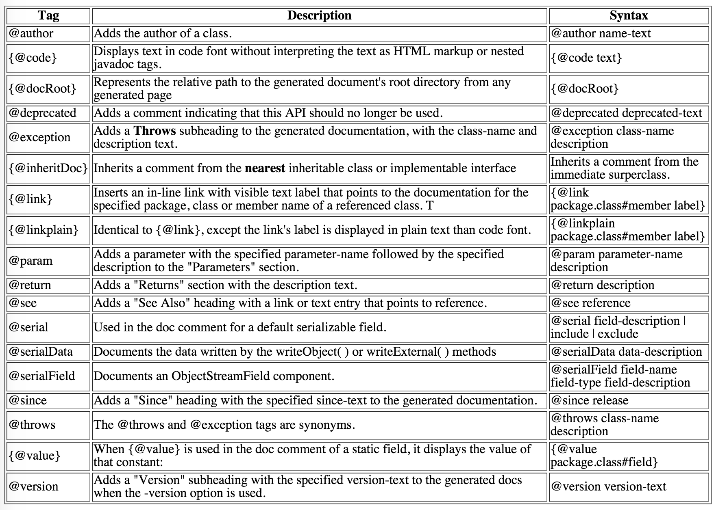
JavaDoc

Slide 54
JavaDoc
/**
* Returns an Image object that can then be painted on the screen.
* The url argument must specify an absolute {@link URL}. The name
* argument is a specifier that is relative to the url argument.
* <p>
* This method always returns immediately, whether or not the
* image exists. When this applet attempts to draw the image on
* the screen, the data will be loaded. The graphics primitives
* that draw the image will incrementally paint on the screen.
*
* @param url an absolute URL giving the base location of the image
* @param name the location of the image, relative to the url argument
* @return the image at the specified URL
* @see Image
*/
public Image getImage(URL url, String name) {
try {
return getImage(new URL(url, name));
} catch (MalformedURLException e) {
return null;
}
}

Slide 55
JavaDoc
Download Java SE docs
Read at home, javadoc best practices:
http://www.oracle.com/technetwork/java/javase/documentation/index-137868.html

Slide 56
Bibliography
https://www.tutorialspoint.com/java/java_basic_operators.htm
https://www.tutorialspoint.com/java/java_loop_control.htm
https://www.tutorialspoint.com/java/java_basic_datatypes.htm
https://docs.oracle.com/javase/tutorial/java/nutsandbolts/operators.html
https://docs.oracle.com/javase/tutorial/java/nutsandbolts/datatypes.html
https://docs.oracle.com/javase/tutorial/java/nutsandbolts/flow.html

Slide 57

Homework
Implement and document the pseudo-code homework, in Java!

