Slide 1
Session 13
CONCURRENCY

Slide 2
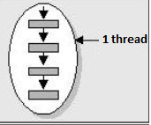
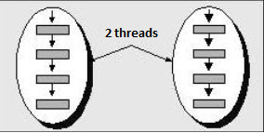
Threads
Thread of execution is a sequence of programmed instructions that are part of a process
Program Program
(Process) (Process)
A thread is managed independently by a scheduler, which is typically a part of the operating system.
Notes:
Fir de executie = succesiune secventiala de instructiuni care se executa ın cadrul unui proces
Proces - mai multe fire de executie
Utilitate: calcule matematice in background; asteptarea eliberarii unei resurse
1

Slide 3
Threads vs Process
Similarities:
Concurrency
Execution planning
Differences:
One thread can exist only inside of a process
Process = code + data
Thread = code
Notes:
Concurenta – in paralel, in acelasi timp
Planificare la executie
1

Slide 4
Defining Threads
A thread is an instance of class java.lang.Thread
An instance of Thread is just…an object.
Like any other object in Java, it has variables and methods, and lives and dies on the heap. But a thread of execution has its own call stack. In Java, there is one call stack per thread.
The main() method, runs in one thread, called (surprisingly) the main thread. If you look at the main call stack (in debugging mode), you'd see that main() is the first method on the stack—the method at the bottom.
As soon as you create a new thread, a new stack materializes and methods called from that thread run in a call stack that's separate from the main() call stack. That second new call stack is said to run concurrently.
Notes:
JVM schedules own threads;
1

Slide 5
Defining Threads
Defining a thread:
extend class Thread and call start() on the object of the extending class
implement interface Runnable and call start() on a new Thread object
Runnable
Defines a common protocol for active objects
Contains method run() - job always starts from a run() method
It is implemented by class Thread
Notes:
You always write the code that needs to be run in a separate thread in a run() method
Implementing Runnable is more common
Extending the Thread class is the easiest, but it's usually not a good OO practic, because subclassing should be reserved for specialized versions of more general superclasses. Chances are, though, that the thread work you want is really just a job to be done by a thread. In that case, you should design a class that implements the Runnable interface, which also leaves your class free to extend some other class.
Sketch advantantages/disadvantages of both approaches
Run vs start
1

Slide 6
Defining Threads
Extending java.lang.Thread
The simplest way to define code to run in a separate thread is to
Extend the java.lang.Thread class.
Override the run() method.
class MyThread extends Thread {
public void run() {
System.out.println("Important job running in MyThread");
}
}
Notes:
The limitation with this approach (besides being a poor design choice in most cases) is that if you extend Thread, you can't extend anything else.
1

Slide 7
Defining Threads
Keep in mind that you're free to overload the run() method in your Thread subclass:
class MyThread extends Thread {
public void run() {
System.out.println("Important job running in MyThread");
}
public void run(String s) {
System.out.println("String in run is " + s);
}
}
Notes:
1

Slide 8
Instantiating Threads
Instantiating a thread:
MyThread myThread = new MyThread();
myThread.start();
If you call directly run() method, you don’t start a new thread with it’s own stack!!!

Slide 9
Defining Threads
Implementing java.lang.Runnable
class MyRunnable implements Runnable {
public void run() {
System.out.println("Important job running in MyRunnable");
}
}

Slide 10
Instantiating Threads
Instantiating a thread:
MyRunnable r = new MyRunnable();
Thread t = new Thread(r); // Pass your Runnable to the Thread
t.start();
When calling start()
A new thread of execution starts (with a new call stack).
The thread moves from the new state to the runnable state.
When the thread gets a chance to execute, its target run() method will run.
Notes:
1

Slide 11
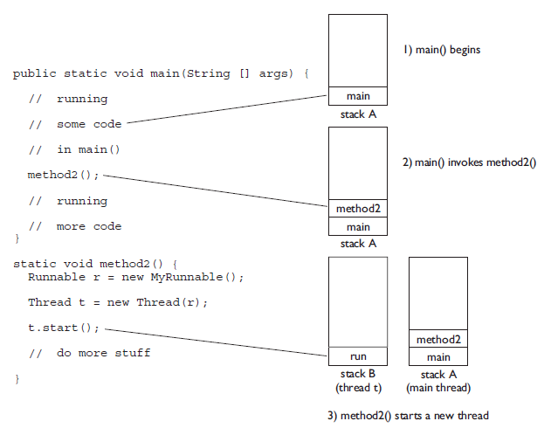
Threads – Call Stacks
Notes:
1

Slide 12
Exercise
Create a simple counting thread. It will count from start to end with a certain step.
Create 3 instances of the thread, that will count from 1 to 100 with the following steps: 2, 3 and 5.
Set a name for each thread and when printing the numbers, print also the name of the thread.
Notes:
1

Slide 13
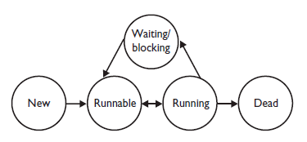
Thread States
New - state of the thread after the Thread instance has been created, but the start() method has not been invoke.
Runnable - state of the thread when it's eligible to run, but the scheduler has not selected it to be the running thread. A thread first enters the runnable state when the start() method is invoked, but a thread can also return to the runnable state after either running or coming back from a blocked, waiting, or sleeping state.
Notes:
1

Slide 14
Thread States
Running - state of a thread when the thread scheduler selects it (from the runnable pool) to be the currently executing process.
There are several ways to get to the runnable state, but only one way to get to the running state: the scheduler chooses a thread from the runnable pool.
Notes:
1

Slide 15
Thread States
Waiting/blocked/sleeping - state of a thread when it's not eligible to run. It is not runnable, but it might return to a runnable state later if a particular event occurs.
A thread may be blocked waiting for a resource (like I/O or an object's lock), in which case the event that sends it back to runnable is the availability of the resource.
A thread may be sleeping because the thread's run code tells it to sleep for some period of time, in which case the event that sends it back to runnable is that it wakes up because its sleep time has expired.
Or the thread may be waiting, because the thread's run code causes it to wait, in which case the event that sends it back to runnable is that another thread sends a notification that it may no longer be necessary for the thread to wait
Notes:
1

Slide 16
Thread States
Dead A thread is considered dead when its run() method completes.
Once a thread is dead, it can never be brought back to life. If you invoke start() on a dead Thread instance, you'll get a runtime (not compiler) exception.
Notes:
1

Slide 17
Thread States
Sleeping
The sleep() method is a static method of class Thread.
You use it in your code to "slow a thread down" by forcing it to go into a sleep mode before coming back to runnable . When a thread sleeps, it drifts off somewhere and doesn't return to runnable until it wakes up.
try {
Thread.sleep(5*60*1000); // Sleep for 5 minutes
} catch (InterruptedException ex) { }
Notes:
1

Slide 18
Exercise
Create a simple counting thread. It will count to 100, pausing one second between each number.
Also, it will output a string every ten numbers.

Slide 19
Thread Priorities
The scheduler does use thread priorities in one important way: If a thread enters the runnable state, and it has a higher priority than any of the threads in the pool and a higher priority than the currently running thread, the lower-priority running thread usually will be bumped back to runnable and the highest-priority thread will be chosen to run.
In other words, at any given time the currently running thread usually will not have a priority that is lower than any of the threads in the pool. In most cases, the running thread will be of equal or greater priority than the highest priority threads in the pool.
Notes:
<number>

Slide 20
Thread Priorities
Setting a Thread's Priority
A thread gets a default priority that is the priority of the thread of execution that creates it. For example, in the code
public class TestThreads {
public static void main (String [] args) {
MyThread t = new MyThread();
}
}
the thread referenced by t will have the same priority as the main thread.
You can also set a thread's priority directly by calling the setPriority() method:
FooRunnable r = new FooRunnable();
Thread t = new Thread(r);
t.setPriority(8);
t.start();
Notes:
Priorities are set using a positive integer, usually between 1 and 10, and the JVM will never change a thread's priority. Default priority is 5
<number>

Slide 21
Daemon Threads
A daemon thread is a thread, that does not prevent the JVM from exiting when the program finishes but the thread is still running.
An example for a daemon thread is the garbage collection.
You can use the setDaemon() method to change the Thread daemon .
When a Java Virtual Machine starts up, there is usually a single non-daemon thread (which typically calls the method named main of some designated class).
The Java Virtual Machine continues to execute threads until either of the following occurs:
All threads that are not daemon threads have died, either by returning from the call to the run method or by throwing an exception that propagates beyond the run method.
The exit method of class Runtime has been called and the security manager has permitted the exit operation to take place.
Notes:
<number>

Slide 22
Join
The non-static join() method of class Thread lets one thread "join onto the end"of another thread.
If you have a thread B that can't do its work until another thread A has completed its work, then you want thread B to "join" thread A. This means that thread B will not become runnable until A has finished (and entered the dead state).
Thread t = new Thread();
t.start();
t.join();
The preceding code takes the currently running thread (if this were in the main() method, then that would be the main thread) and joins it to the end of the thread referenced by t. This blocks the current thread from becoming runnable until after the thread referenced by t is no longer alive. In other words, the code t.join() means "Join me (the current thread) to the end of t, so that t must finish before I (the current thread) can run again."

Slide 23
Exercise
1. Write a program that runs 5 threads, each thread randomizes a number between 1 and 10. The main thread waits for all the others to finish, calculates the sum of the numbers which were randomized and prints that sum. You will need to implement a Runnable class that randomizes a number and store it in a member field. When all the threads have done, your main program can go over all the objects and check the stored values in each object.
2. Modify the program in (1) so that instead of each object keeping its own score, you will use one collection to store all the results in.

Slide 24
Synchronization
Its overall purpose is to only allow one thread at a time into a particular section of code thus allowing us to protect, for example, variables or data from being corrupted by simultaneous modifications from different threads
At its simplest level, a block of code that is marked as synchronized in Java tells the JVM: "only let one thread in here at a time".

Slide 25
Synchronization
Synchronized Instance Methods
public synchronized void add(int value){
this.count += value;
}
A synchronized instance method in Java is synchronized on the instance (object) owning the method.
Only one thread can execute inside a synchronized instance method.
If more than one instance exist, then one thread at a time can execute inside a synchronized instance method per instance. One thread per instance.

Slide 26
Synchronization
Synchronized Static Methods
public static synchronized void add(int value){
count += value;
}
Synchronized static methods are synchronized on the class object of the class the synchronized static method belongs to.
Since only one class object exists in the Java VM per class, only one thread can execute inside a static synchronized method in the same class.

Slide 27
Synchronization
Synchronized Blocks in Instance Methods
public void add(int value){
synchronized(this){
this.count += value;
}
}
Mark a block of code as synchronized. This code will now execute as if it was a synchronized method.

Slide 28
Synchronization
Synchronized Blocks in Static Methods
public class MyClass {
public static synchronized void log1(String msg1,
String msg2){
log.writeln(msg1);
log.writeln(msg2);
}
public static void log2(String msg1, String msg2){
synchronized(MyClass.class){
log.writeln(msg1);
log.writeln(msg2);
}
}
}
Only one thread can execute inside any of these two methods at the same time.

Slide 29
Synchronization
Imagine, for example, that we have a counter that needs to be incremented at random points in time by different threads.
Risk: two threads could simultaneously try and update the counter at the same time, and in so doing corrupt the value of the counter (or at least, miss an increment, because one thread reads the present value unaware that another thread is just about to write a new, incremented value).
Solution: wrap the update code in a synchronized block, we avoid this risk:

Slide 30
Synchronization
public class Counter {
private int count = 0;
public void increment() {
synchronized (this) {
count++;
}
}
public int getCount() {
synchronized (this) {
return count;
}
}
}

Slide 31
Synchronization
Every Java object created, including every Class loaded, has an associated lock or monitor.
Putting code inside a synchronized block makes the compiler append instructions to acquire the lock on the specified object before executing the code, and release it afterwards (either because the code finishes normally or abnormally).
Between acquiring the lock and releasing it, a thread is said to "own" the lock.
At the point of Thread A wanting to acquire the lock, if Thread B already owns the it, then Thread A must wait for Thread B to release it.
Only methods (or blocks) can be synchronized, not variables or classes

Slide 32
Synchronization
Disadvantages:
it doesn't allow concurrent read, which can potentially limit scalability
it can only be used to control access of shared object within the same JVM. If you have more than one JVM and need to synchronized access to a shared file system or database, the Java synchronized keyword is not at all sufficient
performance cost
deadlock or starvation

Slide 33
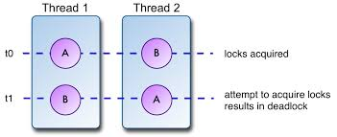
Synchronization
Deadlock - describes a situation where two or more threads are blocked forever, waiting for each other

Slide 34
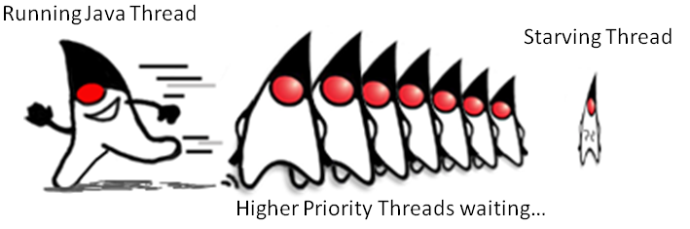
Synchronization
Starvation describes a situation where a thread is unable to gain regular access to shared resources and is unable to make progress. This happens when shared resources are made unavailable for long periods by "greedy" threads

Slide 35
Synchronization
Livelock - occurs when two or more threads are conceptually blocked forever, although they are each still active and trying to complete their task.
Livelock is a special case of resource starvation in which two or more threads actively try to acquire a set of locks, are unable to do so, and restart part of the process.
Livelock is often a result of two threads trying to resolve a deadlock.

Slide 36
Synchronization
Race Condition - is an undesirable result that occurs when two tasks, which should be completed sequentially, are completed at the same time.
Possible Outcomes for This Race Condition
Both users are able to create accounts with username xxx.
Both users are unable to create an account with username xxx, returning an error message to both users.
One user is able to create the account with the username xx, while the other user receives an error message.
Create username xxx
User1
Registration Server
Create username xxx
User2

Slide 37
Share Resources
Producer/consumer
class Buffer {
private int number = -1;
public int get() {
return number;
}
public void put(int number) {
this.number = number;
}
}

Slide 38
Share Resources
class Producator extends Thread {
private Buffer buffer;
public Producator(Buffer b) {
buffer = b;
}
public void run() {
for (int i = 0; i < 10; i++) {
buffer.put(i);
System.out.println("Producatorul a pus:\t" + i);
try {
sleep((int)(Math.random() * 100));
} catch (InterruptedException e) { }
}
}
}

Slide 39
Share Resources
class Consumator extends Thread {
private Buffer buffer;
public Consumator(Buffer b) {
buffer = b;
}
public void run() {
int value = 0;
for (int i = 0; i < 10; i++) {
value = buffer.get();
System.out.println("Consumatorul a primit:\t" + value);
}
}
}

Slide 40
Share Resources
Use synchronized
public synchronized void put(int number) {
// buffer blocked by producer
...
// buffer un-blocked by producer
}
public synchronized int get() {
// buffer blocked by consumer
...
// buffer un-blocked by consumer
}

Slide 41
Cooperation between tasks
wait - notify
class Buffer {
private int number = -1;
private boolean available = false;
public synchronized int get() {
while (!available) {
try {
wait(); // Wait for producer to put a value
} catch (InterruptedException e) {
e.printStackTrace();
}
}
available = false;
notifyAll();
return number;
}

Slide 42
Cooperation between tasks
public synchronized void put(int number) {
while (available) {
try {
wait(); // Wait for consumer to take value
} catch (InterruptedException e) {
e.printStackTrace();
}
}
this.number = number;
available = true;
notifyAll();
}
}

Slide 43
Cooperation between tasks
wait(), notify(), and notifyAll() must be called from within a synchronized context!
A thread can't invoke a wait or notify method on an object unless it owns that object's lock.
When we enter a synchronized non-static method, we automatically acquire the lock
associated with the current instance of the class whose code we're executing (the this instance). Acquiring a lock for an object is also known as getting the lock, or locking the object, locking on the object, or synchronizing on the object

Slide 44
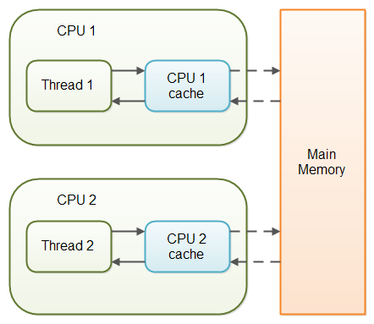
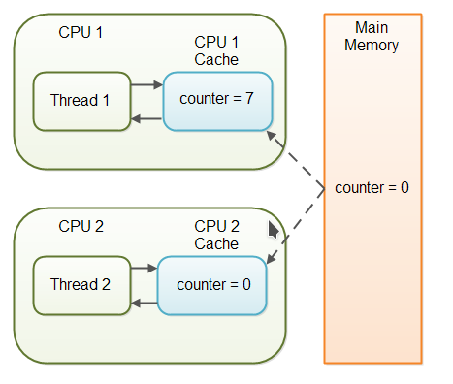
Volatile keyword
Volatile:
volatile keyword in java guarantees that value of the volatile variable will always be read from main memory and that guarantees visibility of changes across threads.
can only be used for variables
Updated by only one thread

Slide 45
Working with Parallel Streams
parallel()
The first way to create a parallel stream is from an existing stream. You just call parallel() on an existing stream to convert it to one that supports multi-threaded processing, as shown in the following code:
Stream<Integer> stream = Arrays.asList(1,2,3,4,5,6).stream(); Stream<Integer> parallelStream = stream.parallel();
Be aware that parallel() is an intermediate operation that operates on the original stream.

Slide 46
Working with Parallel Streams
parallelStream()
The second way to create a parallel stream is from a Java collection class. The Collection interface includes a method parallelStream() that can be called on any collection and returns a parallel stream. The following is a revised code snippet that creates the parallel stream directly from the List object:
Stream<Integer> parallelStream2 = Arrays.asList(1,2,3,4,5,6).parallelStream();
Arrays.asList(1,2,3,4,5,6)
.parallelStream()
.forEach(s -> System.out.print(s+" "));

Slide 47
ExecutorService(interface)
Instantiating ExecutorService:
Using factory methods from Executors class
newSingleThreadExecutor()
newFixedThreadPool(int nThreads)
newSingleThreadScheduledExecutor()
newCachedThreadPool()
And overload versions with ThreadFactory provided
Directly using ThreadPoolExecutor() constructor
ThreadPoolExecutor(int corePoolSize, int maximumPoolSize, long keepAliveTime, TimeUnit unit, BlockingQueue<Runnable> workQueue);

Slide 48
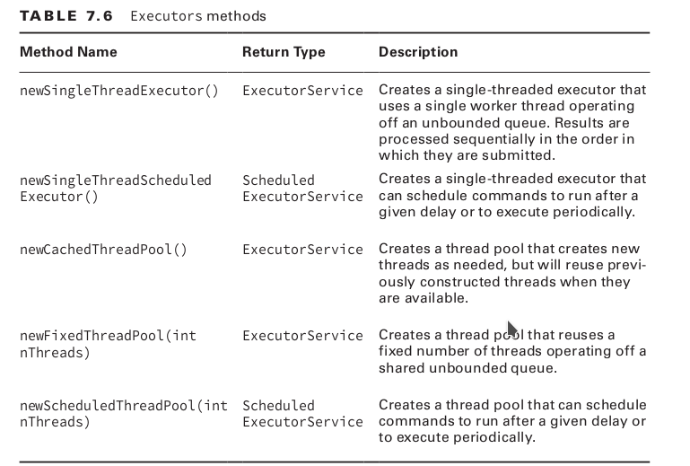
ExecutorService(interface)

Slide 49
ExecutorService(interface)
SingleThreadExecutor
With a single-thread executor, results are guaranteed to be executed in the order in which they are added to the executor service. single thread executor will queue the tasks and wait until the previous task completes before executing the next task.

Slide 50
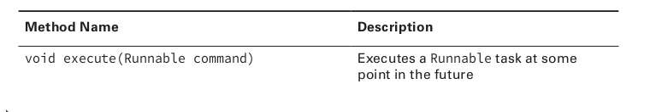
ExecutorService
Submitting Tasks:
The execute() method takes a Runnable lambda expression or instance and completes the task asynchronously. Because the return type of the method is void , it does not tell us anything about the result of the task. It is considered a “fire-and-forget” method, as once it is submitted, the results are not directly available to the calling thread.

Slide 51
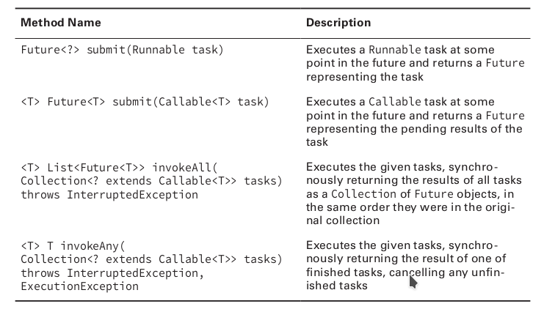
ExecutorService
Submitting Tasks:
Callable method returns a value and can throw an Exception:
V call() throws Exception;

Slide 52
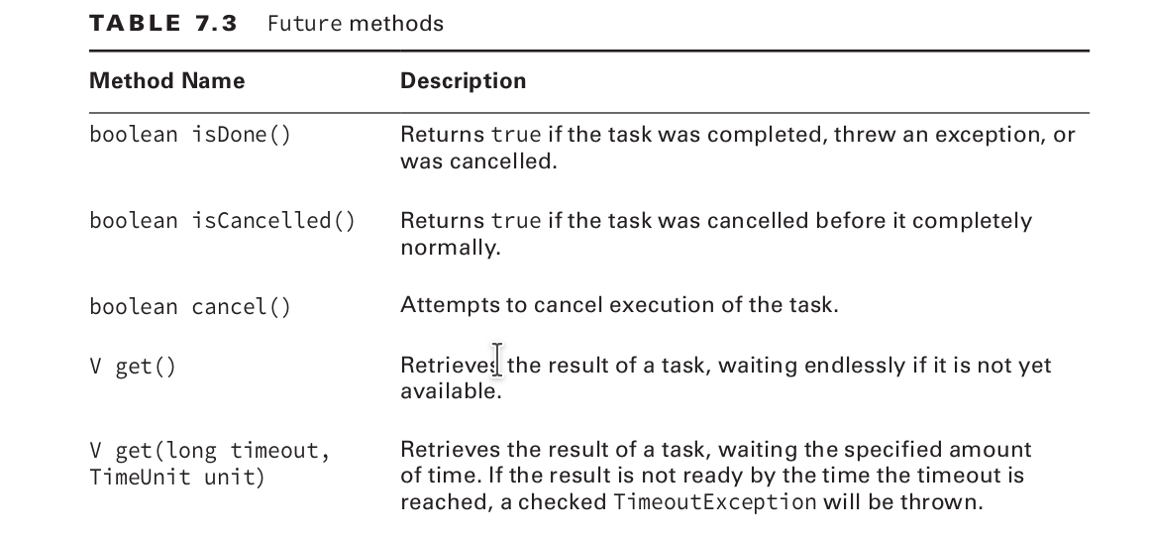
ExecutorService
Waiting for Results:

Slide 53
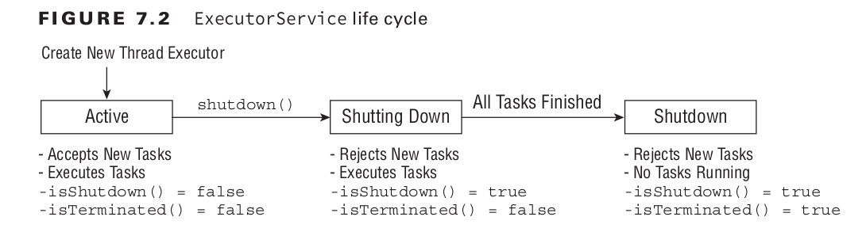
ExecutorService(interface)
Shutting Down a Thread Executor:
Resources such as thread executors should be properly closed to prevent memory leaks. Unfortunately, the ExecutorService interface does not implement AutoCloseable , so you cannot use a try-with-resources statement. You can still use a finally block, while not required, it is considered a good practice to do so.

