Slide 1
Digital Logic Design Experiment
Exp10. Principle and Design of Latch and Flip-flop
Haifeng Liu
haifengliu@zju.edu.cn
http://10.71.45.100/
2016.09

Slide 2
Outline
Experiment Purpose
Instruments and Materials
Experiment Task
Experiment Principle
Content and Steps

Slide 3
Experiment Purpose
Master composing condition and principle of latch and flip-flop
Master the difference between latches and flip-flops
Master the basic functions of SR latch, gated SR latch, D latch, SR latch, D flip-flop
Master the existing timing problem of basic SR latch, gated SR latch, D latch, SR latch, D flip-flop

Slide 4
Instruments and Materials
Experiment Instruments
PC with ISE 14.7 1
SWORD Board 1
Experiment Materials
None

Slide 5
Experiment Task
Realize basic SR latch, and verify function and timing problems
Realize gated SR latch, and verify function and timing problems
Realize D latch, and verify function and timing problems
Realize SR master-slave flip-flop, and verify function and timing problems
Realize D flip-flop, and verify function

Slide 6
Experiment Principle
Sufficient conditions to compose a latch
Maintain long-term stability of a given state
It has two stable states: 0,1
Under certain conditions it can change logic state at any time , namely: set or set to 0
The most basic latch: SR Latch, D Latch
Latch has two stable states, known as bistable circuit

Slide 7
SR Latch (1)
Cross link input and output of two input inverting logic device, the other input as the external information output terminal, it constitutes the most simple SR latch.
R S | Q Q
0 0 | Q Q | Hold
0 1 | 1 0 | Set 1
1 0 | 0 1 | Reset 0
1 1 | 0 0 | Undefined
SR Latch
SR Latch

Slide 8
SR Latch (2)
R S | Q Q
0 0 | 1 1 | Undefined
0 1 | 0 1 | Reset 0
1 0 | 1 1 | Set 1
1 1 | Q Q | Hold
SR Latch
SR Latch

Slide 9
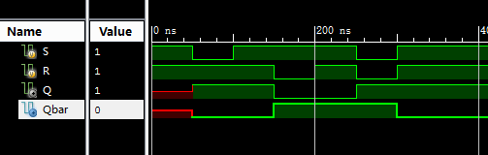
Simulation
R=1;S=1; #50;
R=1;S=0; #50;
R=1;S=1; #50;
R=0;S=1; #50;
R=1;S=1; #50;
R=0;S=0; #50;
R=1;S=1; #50;

Slide 10
gated SR latch
C R S | Q Q
0×× | Q Q | Hold
1 0 0 | Q Q | Hold
1 0 1 | 1 0 | Set 1
1 1 0 | 0 1 | Reset 0
1 1 1 | 1 1 | Undefined
SR Latch
SR Latch

Slide 11
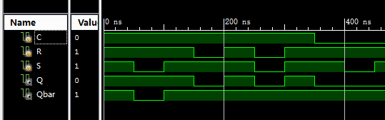
Simulation
C=1;R=1;S=1; #50;
R=1;S=0; #50;
R=1;S=1; #50;
R=0;S=1; #50;
R=1;S=1; #50;
R=0;S=0; #50;
R=1;S=1; #50;
C=0;R=1;S=1; #50;
R=1;S=0; #50;
R=1;S=1; #50;
R=0;S=1; #50;
R=1;S=1; #50;
R=0;S=0; #50;
R=1;S=1; #50;

Slide 12
D Latch
The basic RS latch disadvantage: has uncertain status
Solution: Eliminate uncertain state
Just one data input terminal D
Output Q is equal to the input terminal D
Use Level to control C
C D | Q Q
0 × | Q Q | Hold
1 0 | 0 1 | Reset 0
1 1 | 1 0 | Set 1
D Latch
D Latch

Slide 13
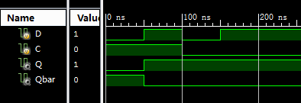
Simulation
C=1;D=1; #50;
D=0; #50;
C=0;D=1; #50;
D=0

Slide 14
flip-flop
The disadvantage D latch: exists data flip——If the D latch directly put in sequential circuit as a state storage elements, when the enable control signal is valid, the component will lead to the internal state value change many times, rather than remain original state value
Solution: Eliminate flip, each trigger the internal state of the latch change only once
Trigger(n.): A transient state that external input enable latch state change.
Trigger(v.)：The latch circuit (bistable) that on the basis of latch while each trigger only one change of state.

Slide 15
flip-flop
Use two latches, the master latch receives input data under pulse control while the slave latch changes state and hold after the end of the pulse.
Master–slave
flip-flop
flip-flop
Use DC feedback theory (Maintain blocking)
Edge-triggered flip-flop
Use different delay time of internal circuit
when clock edge rising or falling the state change, other time hold
Common flip-flop: Master–slave SR flip-flop, D flip-flop, JK flip-flop, T flip-flop

Slide 16
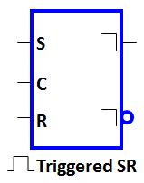
SR master-slave flip-flop
Comprised by two clock-controlled S-R latch series, the second latch's clock is inverted.
When C = 1, the input signal into the first latch (master latch)
When C = 0, the second latch (slave latch) change the output
The path from input to output is disconnect by different clock signal value (C = 1 and C = 0)
S
S
Q
S
Q
Q
C
C
C
R
R
Q
R
Q
Q

Slide 17
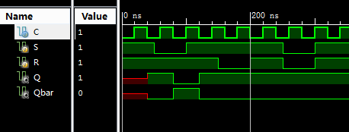
Simulation
initial begin
R=1;S=1; #50;
R=1;S=0; #50;
R=1;S=1; #50;
R=0;S=1; #50;
R=1;S=1; #50;
R=0;S=0; #50;
R=1;S=1; #50;
end
always begin
C=0;#20;
C=1;#20;
end

Slide 18
Positive edge maintain Obstructive D flip-flop
异步控制 |  | 上升沿触发
R | S | C_{P} | D | Q | Q
0 | 1 | × | × | 0 | 1
1 | 0 | × | × | 1 | 0
1 | 1 | ↑ | 0 | 0 | 1
1 | 1 | ↑ | 1 | 1 | 0

Slide 19
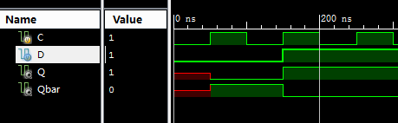
Simulation
initial begin
D = 0; #150;
D = 1; #150;
end
always begin
C=0; #50;
C=1; #50;
end

Slide 20
Experiment Content and Step
Realize basic SR latch, and verify function and timing problems
Realize gated SR latch, and verify function and timing problems
Realize D latch, and verify function and timing problems
Realize SR master-slave flip-flop, and verify function and timing problems
Realize D flip-flop, and verify function

Slide 21
Basic SR Latch
New project MyLATCHS
New source file SR_LATCH.sch
Use schematic diagram to design
Use NAND2 to realize
Simulation

Slide 22
Gated SR Latch
New source file CSR_LATCH.sch
Use schematic diagram to design
Use NAND2 to realize
Simulation (include flip)
Generate symbols CSR_LATCH.sym

Slide 23
D Latch
New source file D_LATCH.sch
Use schematic diagram to design
Use NAND2 to realize
Simulation (include flip)

Slide 24
SR master-slave flip-flop
New source file MS_FLIPFLOP.sch
Use schematic diagram to design
invoke the CSR_LATCH
Simulation (include One-time sampling)

Slide 25
D flip-flop
New source file D_FLIPFLOP.sch
Use schematic diagram to design
Use NAND3 to realize
Simulation

Slide 26
Thank You !

