Slide 1
AR Stealth
Measuring and Comparing QoE and
Simulator Sickness of Omnidirectional Videos in
Different Head Mounted Displays
Nils Merten, Hong Ma
TU Ilmenau
Virtual Worlds and Digital Game Devlop
Project
Master "Media Technology“
TU Ilmenau Campus

Slide 2
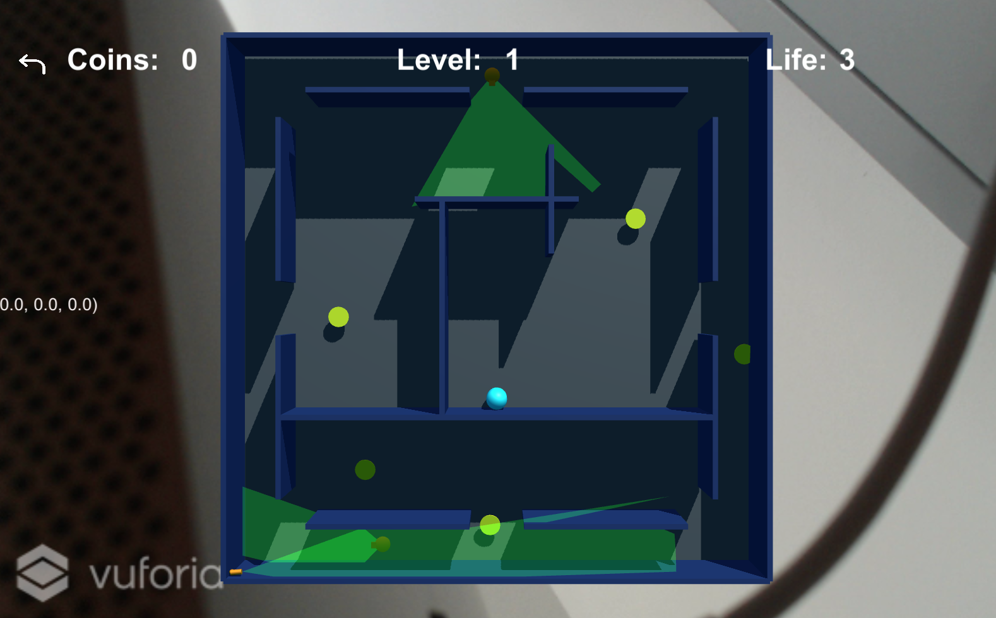
Motivation and General Topic
  AR Game
  (no idea for serious application)
  Stealthy marble game:
  Collect coins
  Avoid enemy field of view
Notes:
01.10.2012
– streng vertraulich, vertraulich, intern, öffentlich – Autor / Thema der Präsentation

Slide 3
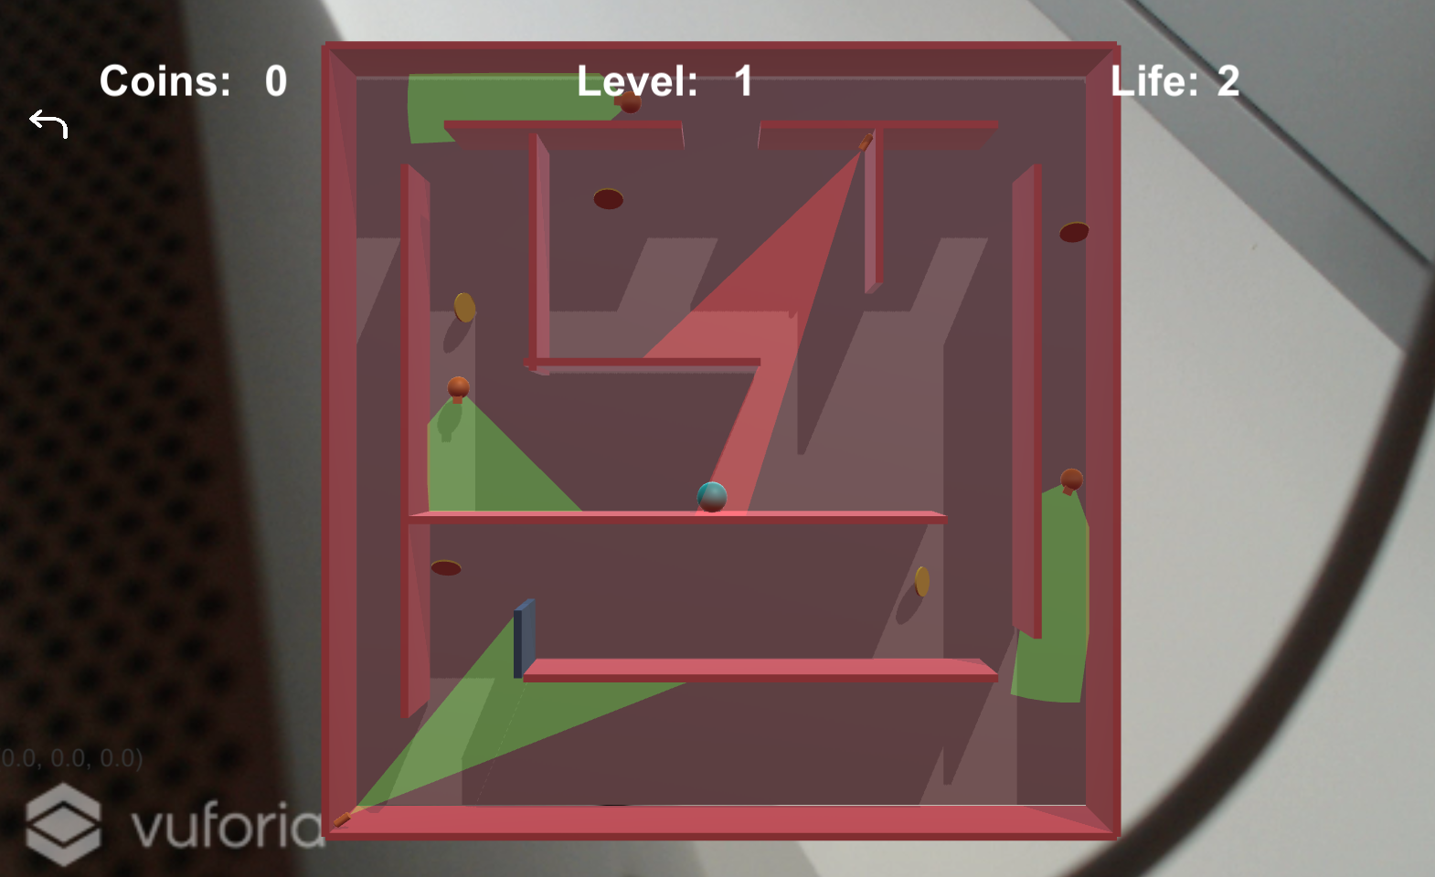
Background and Theory
  Tracking by Vuforia Framework
  Movement entirely physics based
  Field of view by raytracing
    > Procedural mesh for cone
Notes:
01.10.2012
– streng vertraulich, vertraulich, intern, öffentlich – Autor / Thema der Präsentation

Slide 4
The problem...
Coordinating two hands is hard ☹
  > Level is tilted with the phone

Slide 5
Questions
  Thank you for your attention
  ...... are there any questions?
Notes:
01.10.2012
– streng vertraulich, vertraulich, intern, öffentlich – Autor / Thema der Präsentation

