Slide 1

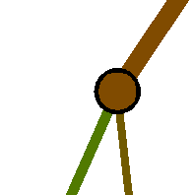


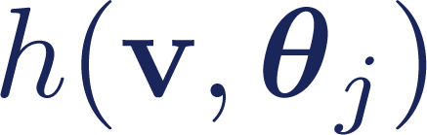
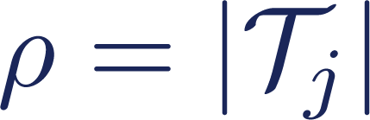






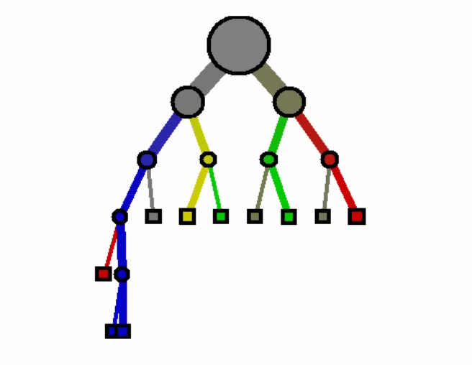
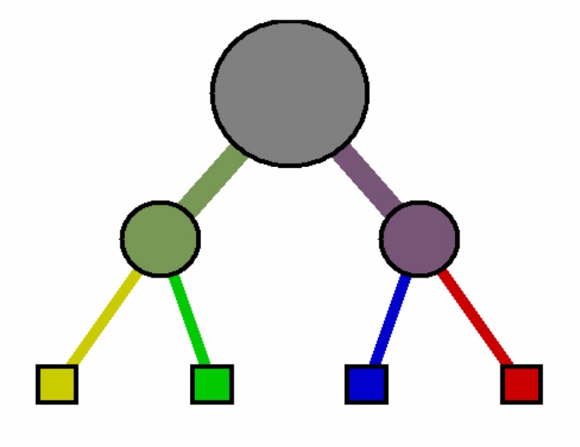
Decision forest model: the randomness model
2) Randomized node optimization (RNO)
The full set of all possible node test parameters
Node training
For each node the set of randomly sampled features
Node weak learner
Randomness control parameter.
For no randomness and maximum tree correlation.
For max randomness and minimum tree correlation.
Node test params
The effect of
Small value of ; little tree correlation.
Large value of ; large tree correlation.
Notes:
|T| can be infinite.
\rho depends on application and data. It is one of the three most important parameters.

