Slide 1
O.C.M.I.D
Acronym for On Click Multiple Image Downloader. An application for downloading multiple images at once through an url repository in text format using python module urllib.request

Slide 2

What does it do? Applications!

Slide 3
Now You must be thinking
why do we need it?
What is wrong with the traditional right click, save As option?
Including that….
We already have many applications for downloading images!

Slide 4
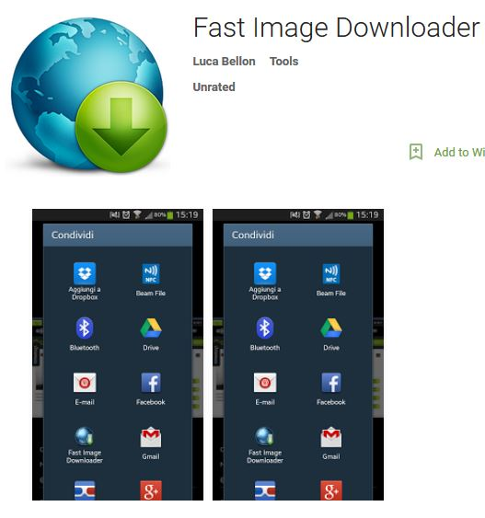
Fast Image Downloader
Windows Platform

Slide 5
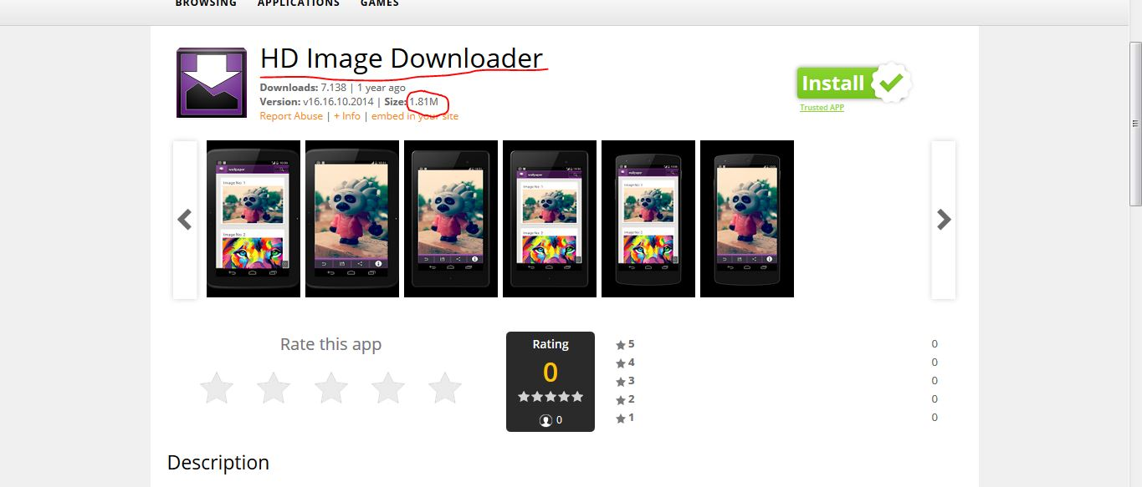
Android : HD IMAGE DOWNLOADER
Android Platform

Slide 6
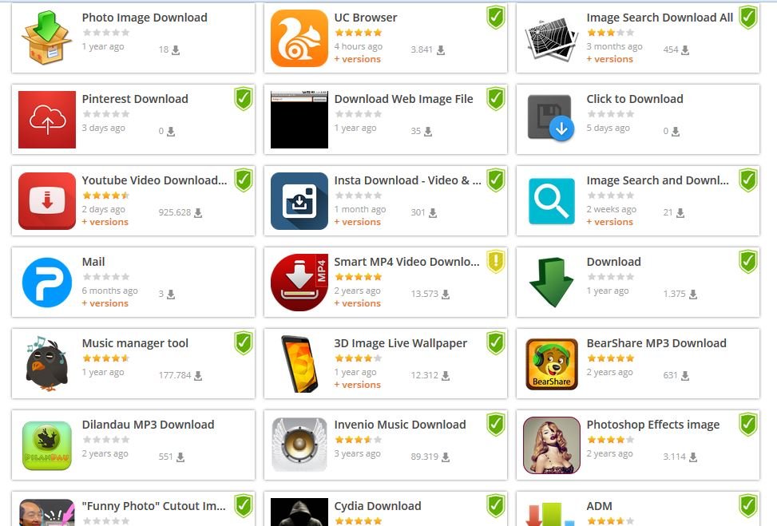
Windows inbuilt application : Snipping tool

Slide 7

Disadvantages of REST
--Expensive Of course! Not the free one.
--Bulkier and takes away a good chunk of both memory space and the processing speed.
--Can throw http errors like 403 in mid of downloading process.
--Cannot be used for multiple image download request at a time.
--Need to open the browser for the download process.
--Cannot download direct images in full resolution from photo repository sites like instagram, Flickr, orkut (now shut), imgur, Pinterest and 100+ other sites.

Slide 8
ADVANTAGES OF : O.C.M.I.D
Multiple Image Requests at One Time
Full Resolution Image Download
No size limit on the download
Overpass HTTP/HTTPS Errors
Free and User-Friendly
Download Image on Click-Shield Sites

