Slide 1
Health care claim submission
HCM portal

Slide 2
Title and Content Layout with List
Problem Statement
Flow Diagram
EER diagram
User stories implementation
Login
Register
Admin flow
Register member to Health Claim Submission portal
Search Member
Submit Claim in Portal
Member flow
View profile
Submit Claim in Portal
Tools

Slide 3
Problem statement
The intention is to build an architecture of “Healthcare Member portal” with Microservices.
About the System :
The client would like to develop an independent application Healthcare Member portal (HCM) to automate the process of managing the activities of member enrollment like member registration, claim submission, etc.
The following section will cover aspects related to HCM.
Member Registration
Claim Submission

Slide 4
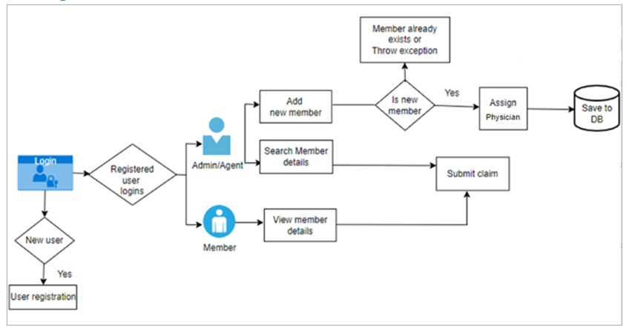
Flow Diagram

Slide 5
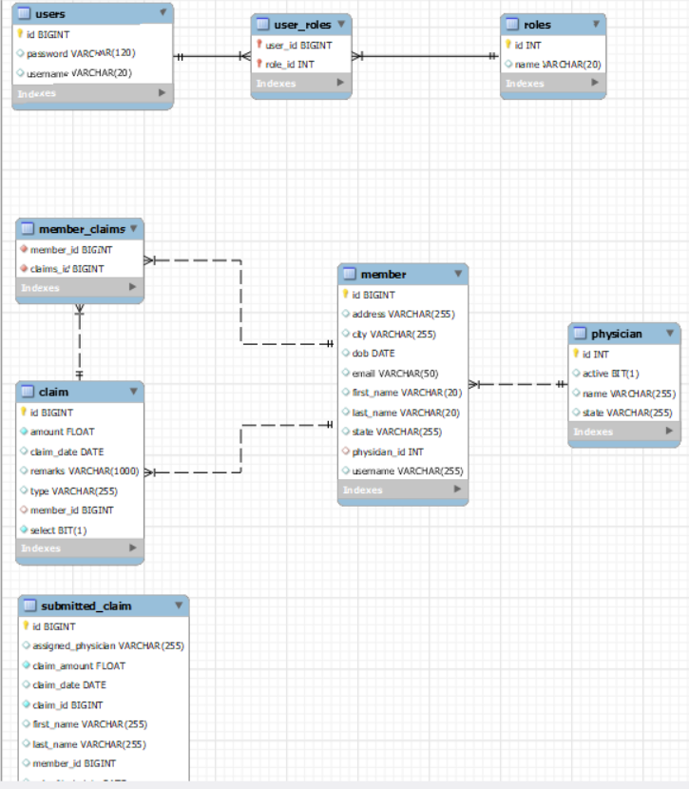
EER Diagram

Slide 6
User stories implementation

Slide 7
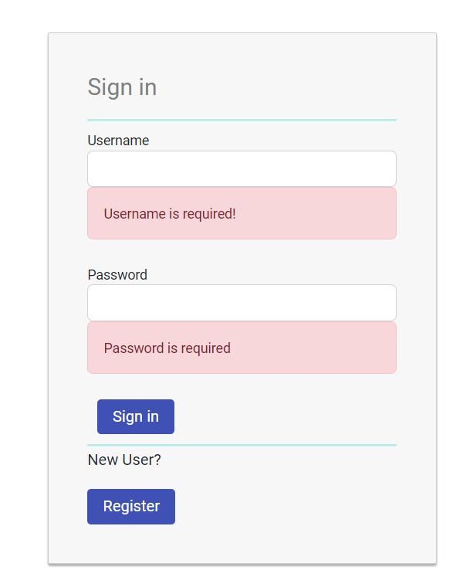
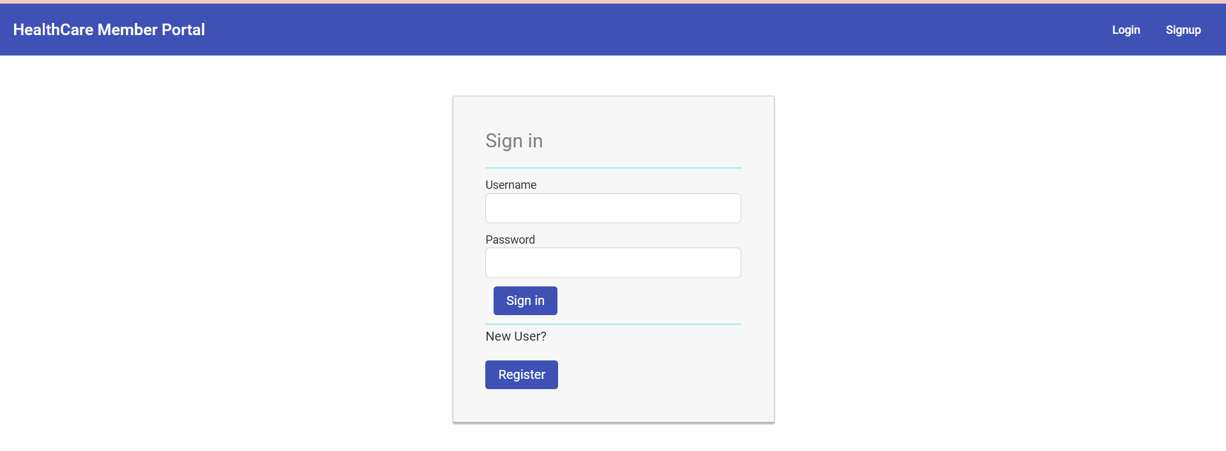
Login & JWT token
When the user logs in, the JWT token gets generated and through interceptor we add that bearer token in authorization header to provide security to API endpoints

Slide 8
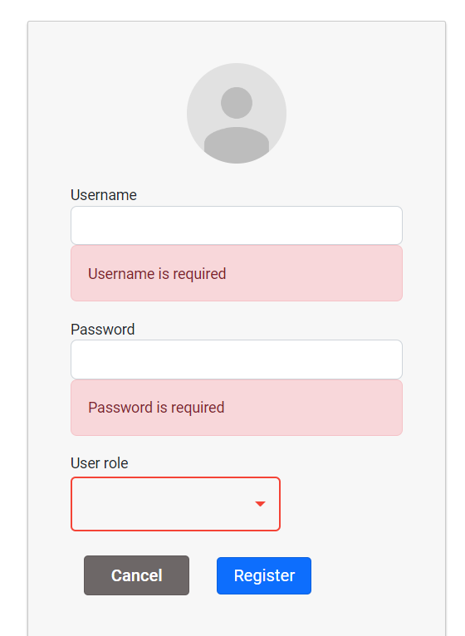
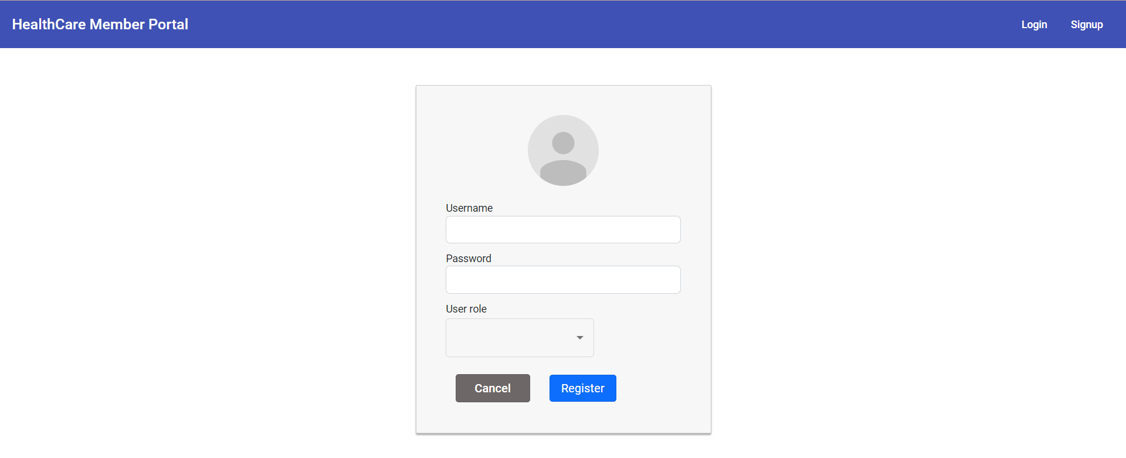
Register
User can register as admin or member
For incorrect data providing error messages

Slide 9
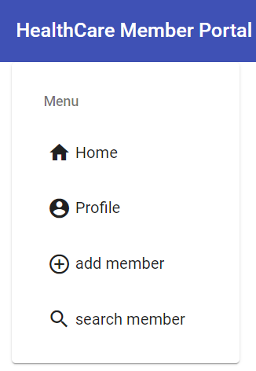
Admin flow

Slide 10
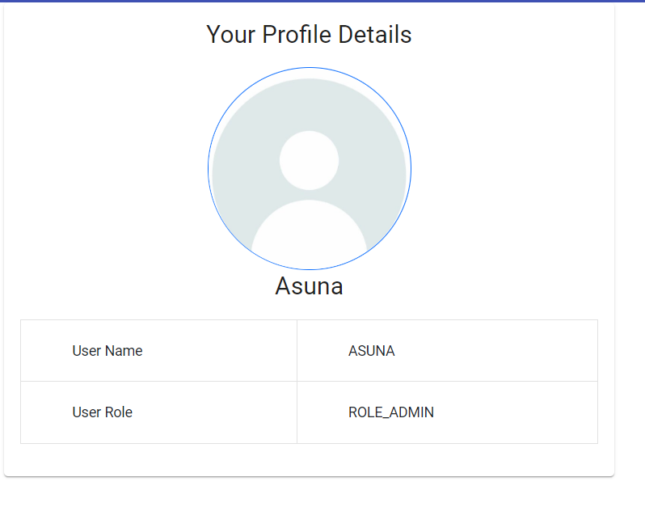
Profile
Admin can view profile

Slide 11
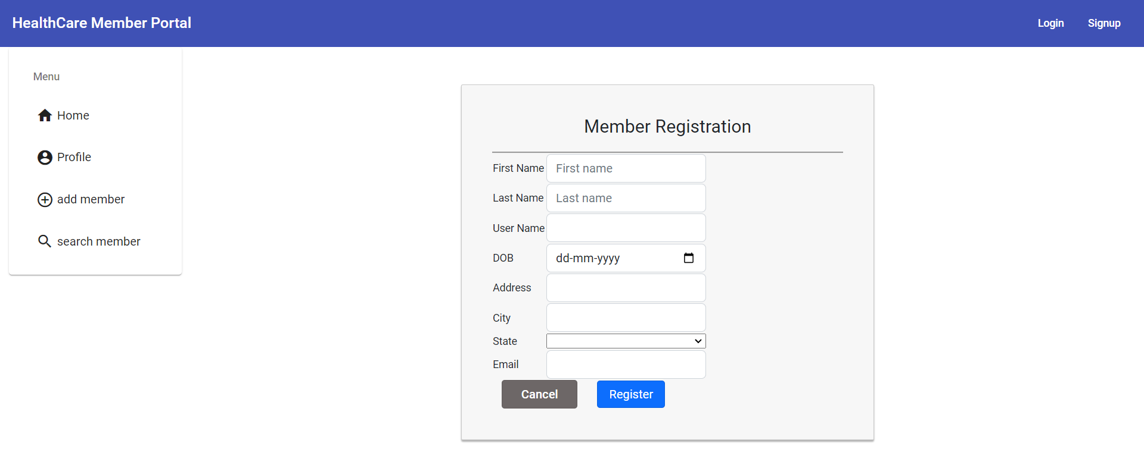
Register member to Health Claim Submission portal
As an admin, I should be able to register member details in the HCM system.
While registration, a random Physician from the database table, should be assigned to the Member and saved in database.

Slide 12
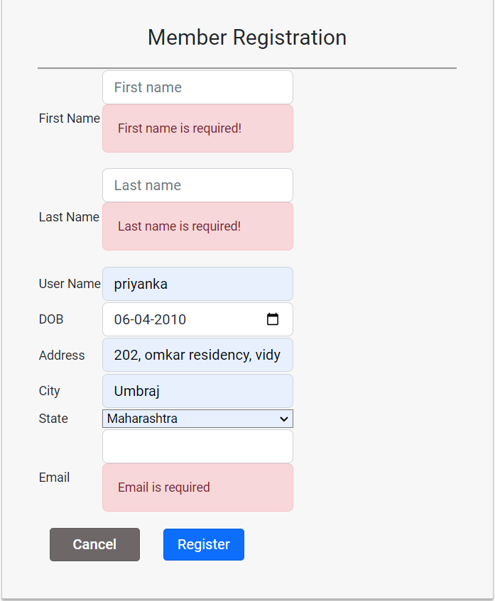
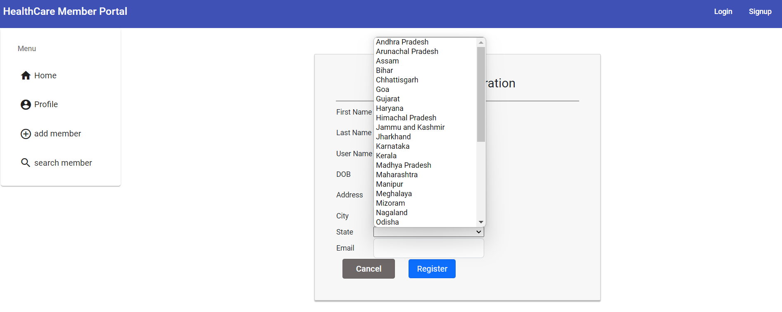
State drop down & validations
If data is not there showing error messages
state dropdown

Slide 13
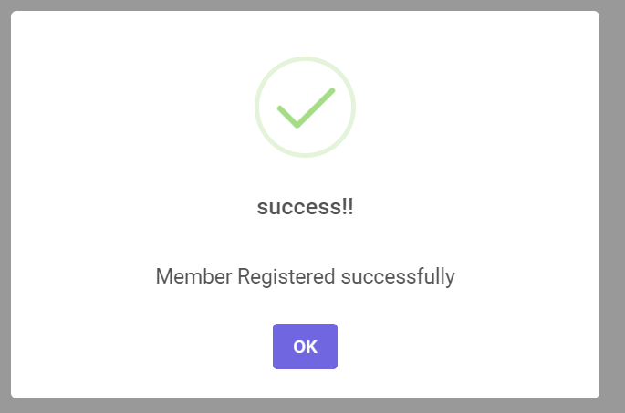
Register member to Health Claim Submission portal
Once member is registered showing sweet alert to user

Slide 14
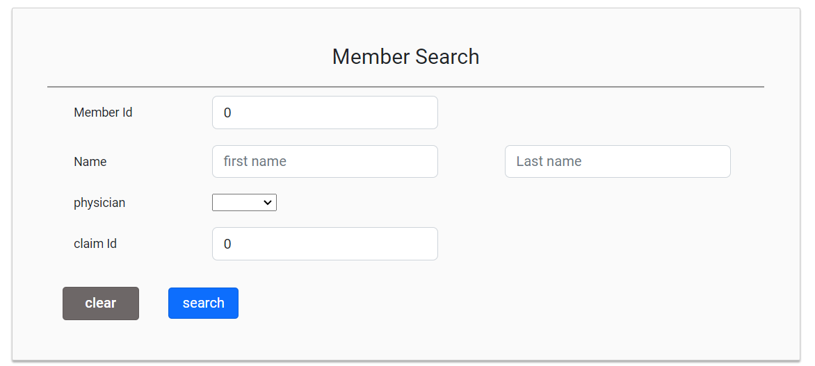
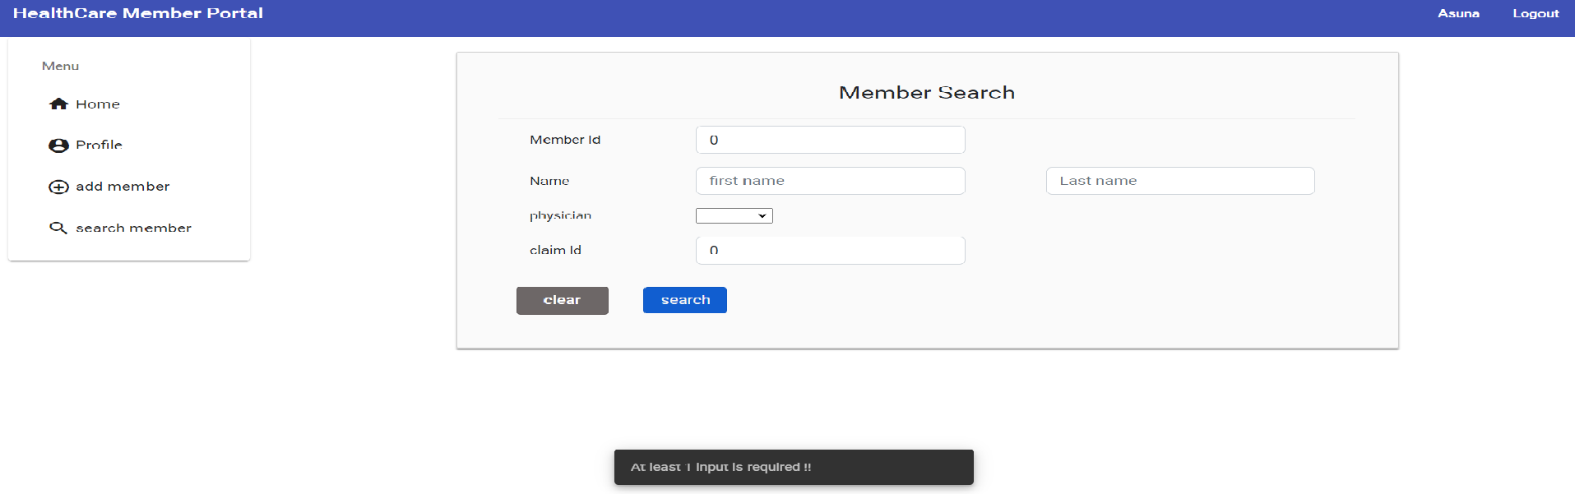
Search member & validations
Admin can search claims
Showing snackbars if required input is not provided

Slide 15
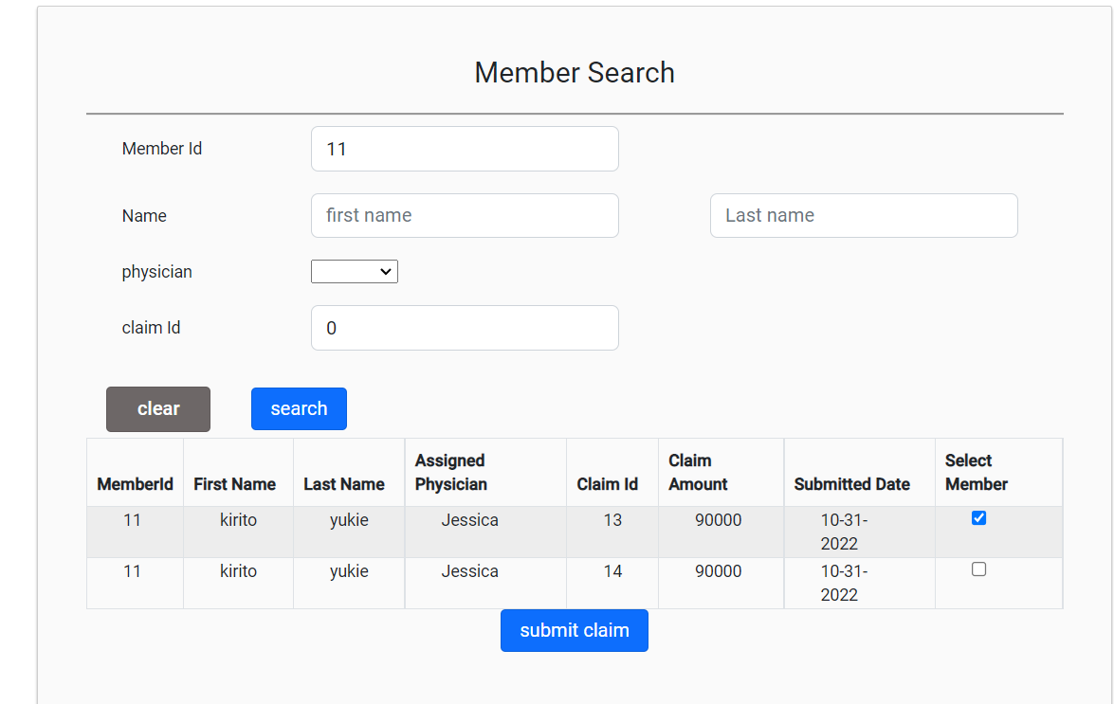
Seach member & select claims
After search admin can select claims

Slide 16
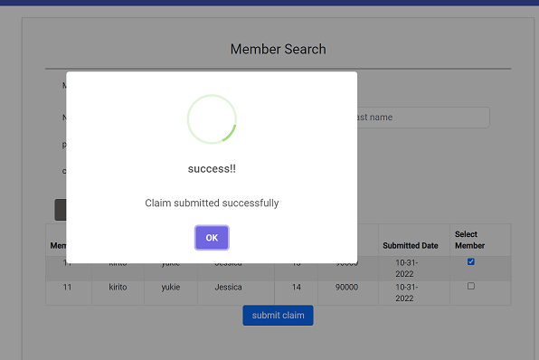
Submit claims
Admin can submit claims

Slide 17
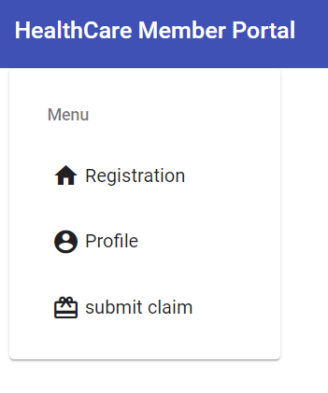
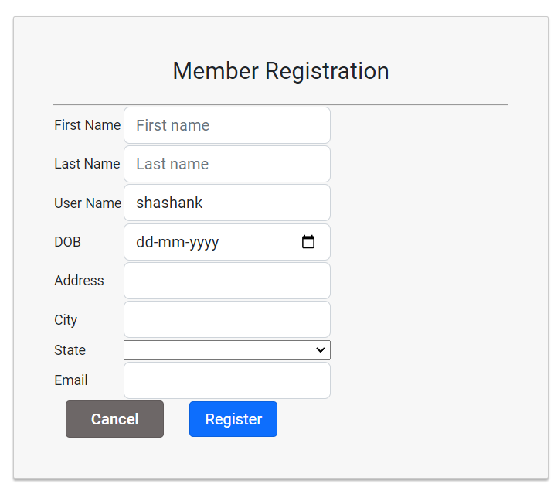
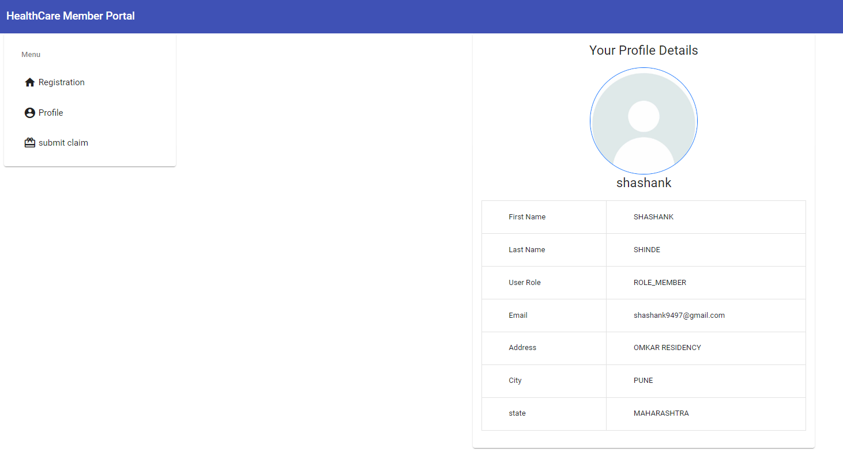
Member flow

Slide 18
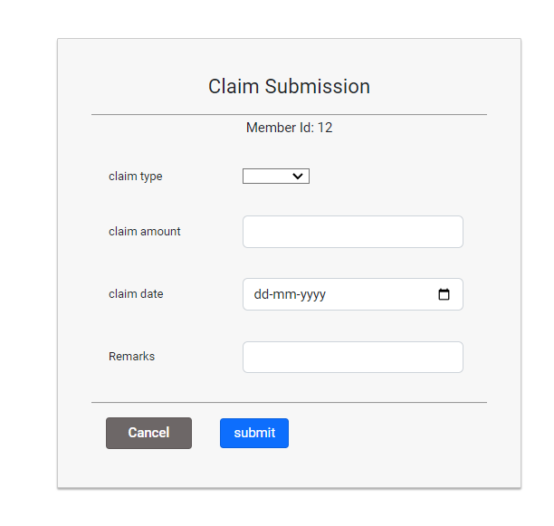
Submit claims
Member can submit claims

Slide 19
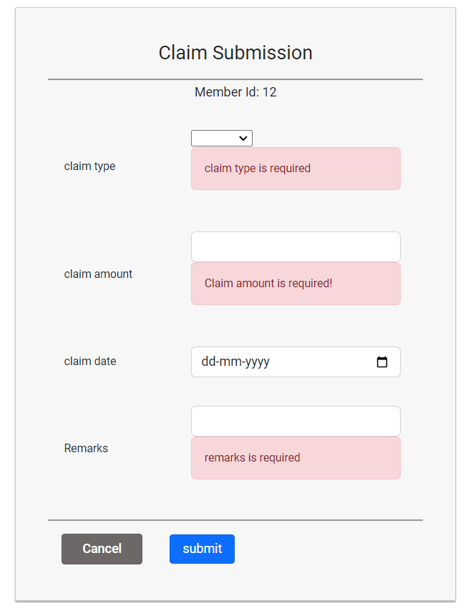
Submit claims
validations

Slide 20
Tools & technologies
Thank you
Java, spring boot, JWT authorization, Micro services ,typescript, angular
STS, postman, VS

