Slide 1

Project Presentation
By Fairy Group

Slide 2
01
CONTENTS
Introduction
02
Agile Scrum about Project
03
Project Requirements
04
Project Challenges
05
Reflation

Slide 3
01
INTRODUCTION

Slide 4
Fairy's group developed a network application project about Royal Al's Hotel, and this PPT describes the whole process of the project.

Slide 5
02
Agile Scrum about Project

Slide 6
Group Member：Eric，Camille， Nelson
Introduction Agile Scrum：prodect backlog，sprint backlog，agile scrum roles

Slide 7
03
Project Requirement

Slide 8
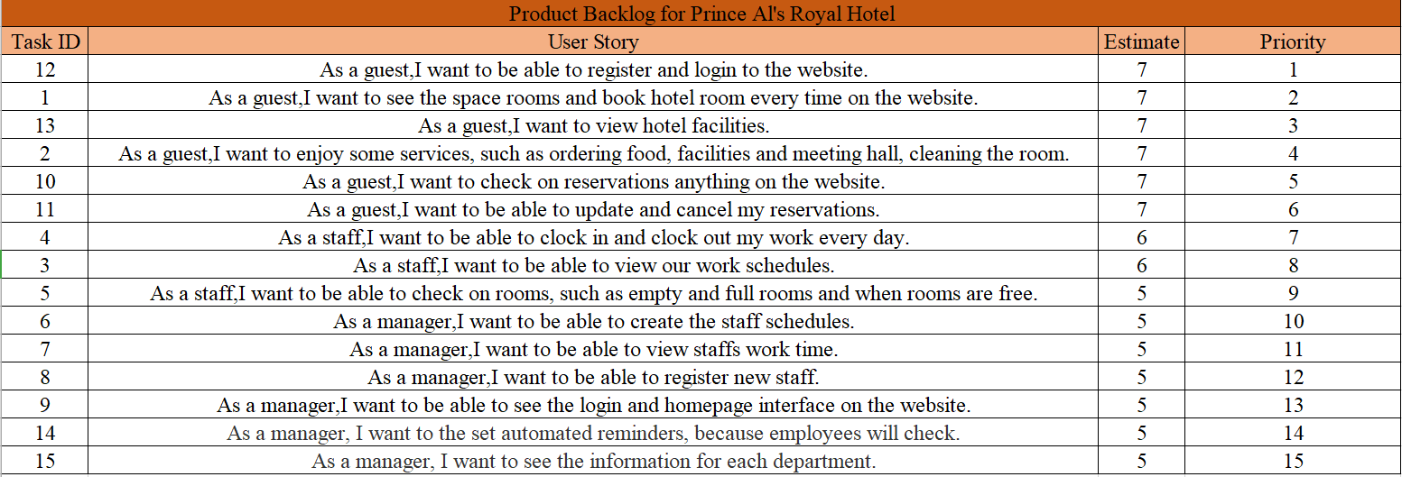
Product Backlog

Slide 9
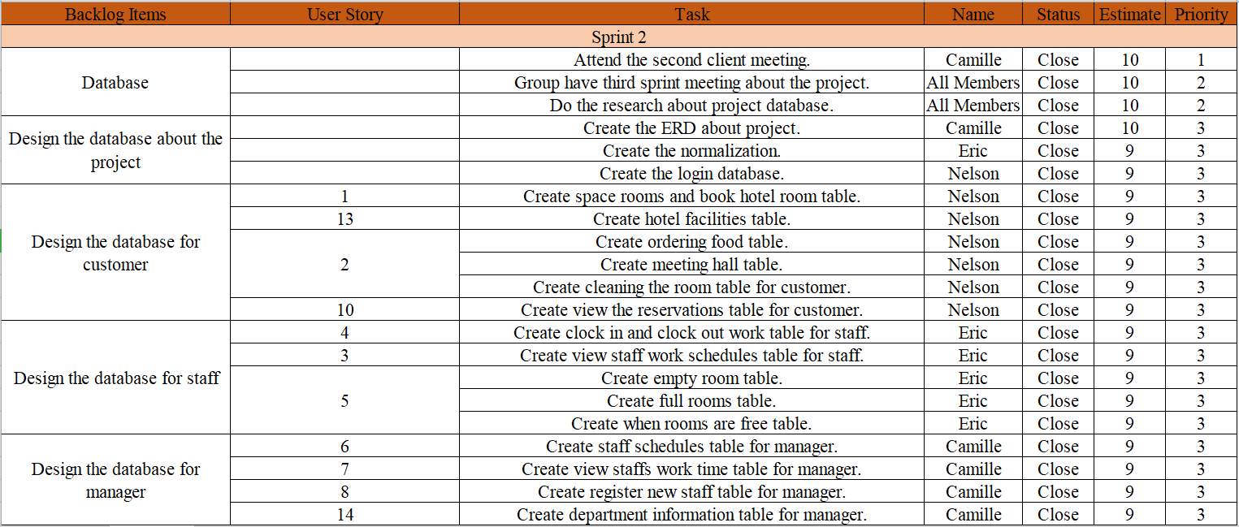
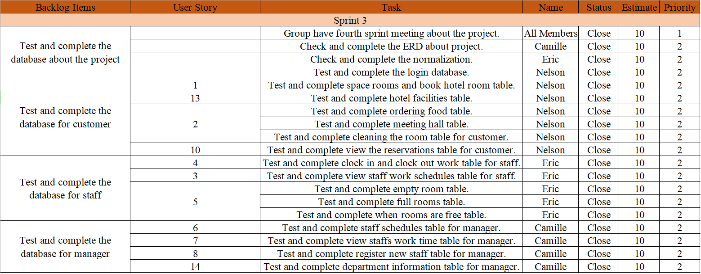
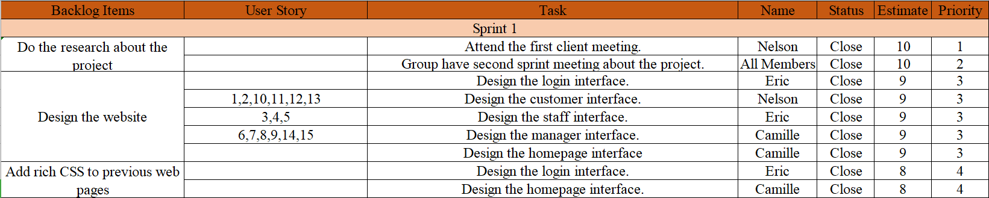
Sprint Backlog

Slide 10
04
Project Challenges

Slide 11
1.Different Opinions
2. Website Challenges
3. Database Challenges

Slide 12
Different Opinions
Different design ideas
Messy thinking
Useless ideas

Slide 13
Website Challenge
1. Code problem
css, php, html, etc.
2. Spend too much time
- On search
- Not ideal interface
- fix error code

Slide 14
Database Challenge
Incorrect use normalization
Not clearly relationship
Data types

Slide 15
05
Reflection

Slide 16
1. Agile has acceptance that requirements will change
2. An adaptable development process short iterations that deliver tangible functionality;
3. Frequent, open communication between software developers and customers
4. A system design as simple as possible

Slide 17
What we have done not good
Bad time concept, we did not follow time plan well
We did not have open communication between we and our customers
We did not have a system design as simple as possible
We did not cooperate with each other in an efficient method

Slide 18
How we should improve
Work on our task on time
Be more persuasive to make his or her own ideas accepted by others
Have more communication with our customer
More efficient system design

Slide 19
Conclusion
As new learner on agile scrum
We go through the process of agile scrum in basic requirements.
We have met some issues and we tried to get over them
We have some experience in team working

Slide 20
Any Question？

Slide 21
THANKS

