Slide 1
CAPSTONE PROJECT

Slide 2
Project Objective
The objective of this project is to explore and analyze historical Olympic Games data to uncover meaningful trends and insights. The focus is on understanding how the Games have evolved across years in terms of sports disciplines, athlete involvement, medal distributions, and worldwide participation. This helps identify long-term patterns and transformations in the Olympic movement.
Analysis Scope
The scope includes examining various Olympic editions, host nations, and event structures to study their development. It also analyzes participation trends in individual sports, athlete demographics, and medal achievements. Key areas include sport-wise popularity, country-level dominance, and notable athlete performances. The structure of the underlying database is also explored through an ER diagram that maps entities like Games, Athletes, Events, and Medals.
Project Goal
The goal is to provide a comprehensive, data-driven overview of Olympic history. It aims to highlight trends such as shifts in host city choices, changes in sports prominence, and consistent top performers by country and region. Using these insights, the project aims to recommend strategies for future Olympic planning, sport inclusion, and enhancing global participation. The final output will be a detailed report and presentation supported by visual analytics.

Slide 3
Insights & Recommendations
The Olympic Games analysis project uncovers valuable insights into the evolution of the Olympics across time. It identifies key trends in sports disciplines, athlete participation, host city selection, and medal distributions. These findings provide data-driven recommendations for future Olympic planning, promoting inclusive representation and better strategic decisions by organizers and stakeholders.
Report & Presentation
The final deliverable includes a comprehensive report detailing the data sources, analysis techniques, and the logic behind the Power BI visualizations. It will present key trends through interactive dashboards and visual summaries. A step-by-step guide will help users interpret and draw insights from the visualizations, while the presentation highlights important discoveries, patterns, and actionable takeaways.
Stakeholder Impact
This Power BI dashboard, along with its supporting report and presentation, serves as a strategic tool for Olympic committees, sports organizations, and researchers. It empowers them to make informed decisions about sport inclusion, athlete development programs, and regional engagement. The project enhances understanding of the Olympic movement’s historical trends and its global impact.

Slide 4

ER DIAGRAM

Slide 5
POWER BI PROBLEM STATEMENTS

Slide 6
PROBLEM STATEMENTS
How many Olympic Games have been held in each season (Summer vs. Winter)?
What is the distribution of games across different decades?
Which cities have hosted the most Olympic Games?
What is the distribution of sports between Summer and Winter Olympics?
Which sports have the highest number of events in the Olympics?
How has the participation in each sport evolved over time?
How many events are there in each sport?
What is the distribution of events by gender (Men, Women, Mixed)?
How has the number of events changed over time?
What is the distribution of participants by gender?
Which countries have the highest number of participants in the Olympics?
How does the age distribution of participants vary across different games?
How many medals have been awarded in each Olympics?
Which countries have the highest number of gold medals?
How does the medal distribution vary across different sports?
How many regions or NOCs participate in each Olympic Games?
Which regions have the highest number of participants in the Olympics?
What is the distribution of medals among different regions?

Slide 7
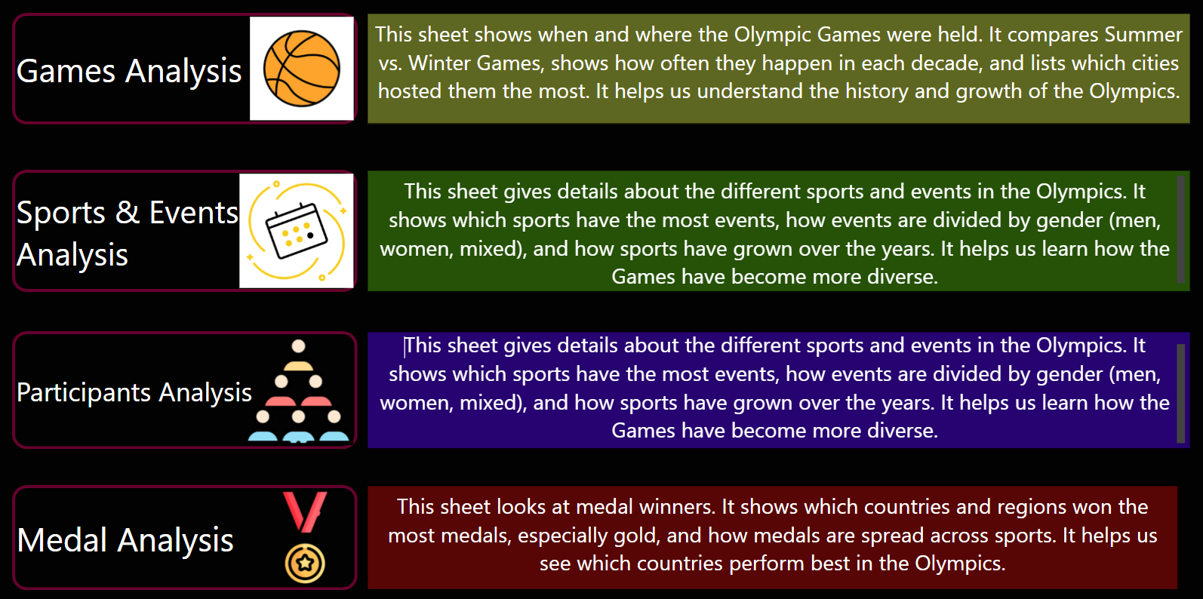
Splitting the PROBLEM STATEMENTS

Slide 8
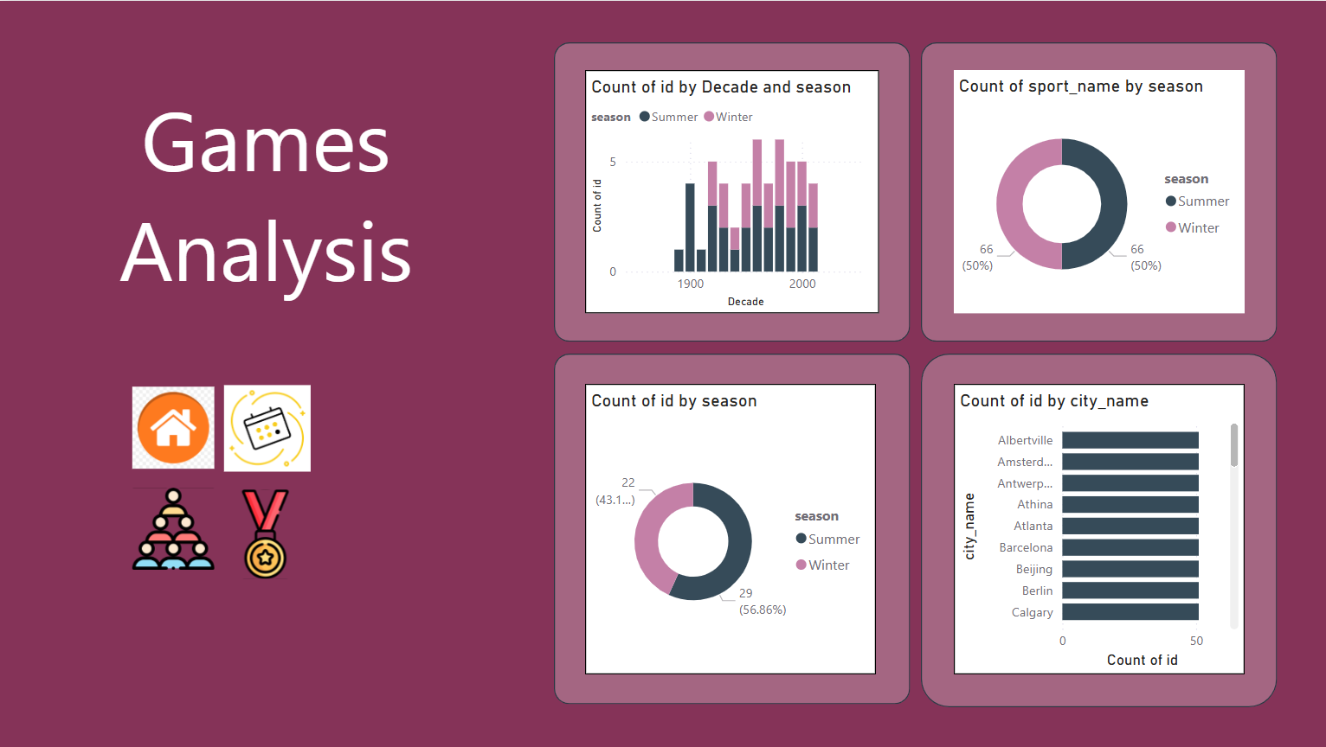
GAMES ANALYSIS

Slide 9
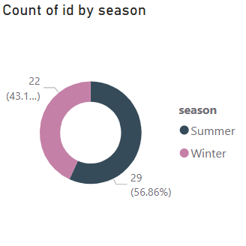
1. How many Olympic Games have been held in each season (Summer vs. Winter)?
A total of 51 Olympic Games have been held, with the Summer Olympics occurring more frequently than the Winter Olympics. Specifically, there have been 29 Summer Games, accounting for approximately 56.86% of the total, while the Winter Games have been held 22 times, making up about 43.14%. This indicates a slightly higher historical emphasis on Summer editions.

Slide 10
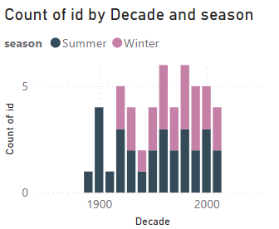
2. What is the distribution of games across different decades?
The distribution of Olympic Games across decades shows a gradual increase in frequency from the early 1900s, peaking between the 1980s and 2000s with 5–6 games per decade. Both Summer and Winter Games were consistently held from the 1920s onward, with a noticeable rise in Winter editions post-1950. The overall trend reflects growing global participation and event regularity over time.

Slide 11
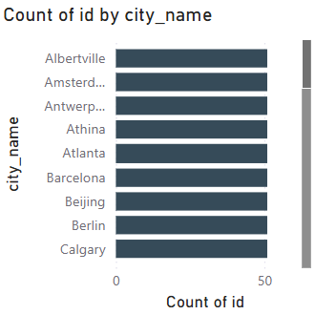
3. Which cities have hosted the most Olympic Games?
Cities such as Albertville, Amsterdam, Antwerp, Athina, Atlanta, Barcelona, Beijing, Berlin, and Calgary have all served as Olympic hosts, reflecting a wide geographic and continental representation. These cities span Europe, North America, and Asia, showcasing the international appeal and rotational nature of Olympic hosting. Hosting the Games often signifies a city's global prominence and its capacity to manage large-scale international events, contributing to both infrastructure development and cultural recognition. This distribution also indicates the IOC's efforts to maintain diversity in host selections over time.

Slide 12
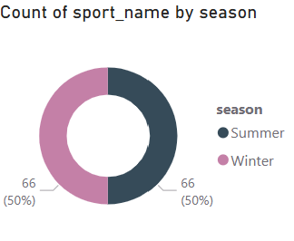
4. What is the distribution of sports between Summer and Winter Olympics?
The distribution of sports between the Summer and Winter Olympics is exactly equal, with each season featuring 66 sports, representing 50% each. This balance highlights the International Olympic Committee's structured approach to ensuring parity in sporting opportunities and representation across both seasonal editions of the Games.

Slide 13
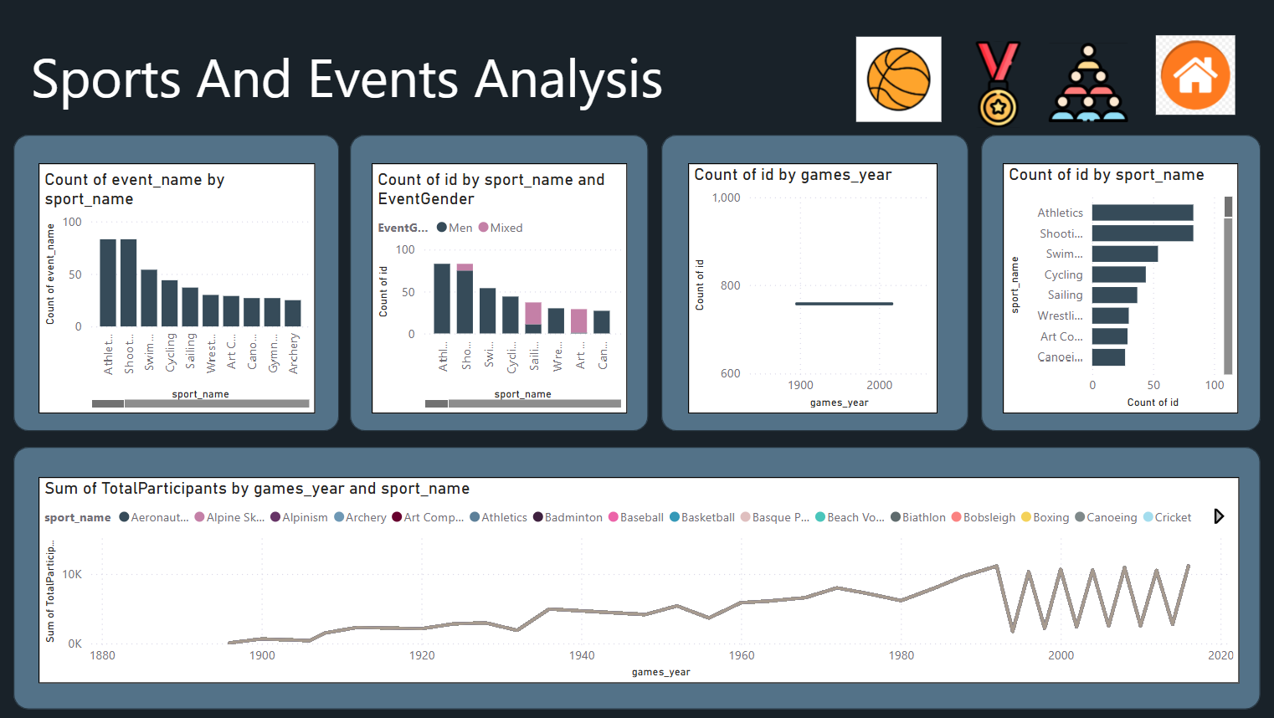

Slide 14
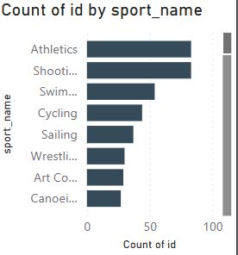
5. Which sports have the highest number of events in the Olympics?
Athletics and Shooting have the highest number of events in the Olympics, each approaching nearly 100 events. These are followed by Swimming, Cycling, and Sailing, which also have substantial event counts. Other sports with notable representation include Wrestling, Art Competitions, and Canoeing. This distribution reflects the popularity, diversity, and historical significance of these sports within the Olympic program.

Slide 15
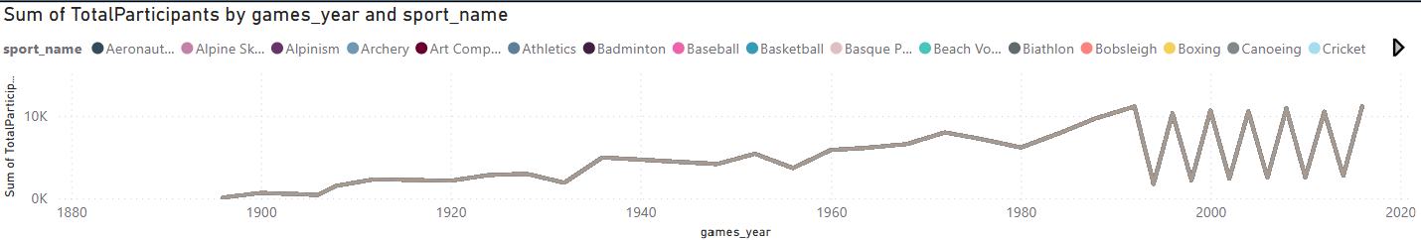
6. How has the participation in each sport evolved over time?
Participation in Olympic sports has shown a steady and significant increase over time. From the late 1800s through the early 1900s, participant numbers were relatively low and stable. Starting around the 1930s, there was a noticeable upward trend, with brief declines during the periods surrounding World War II. After the 1960s, participation rose more consistently, peaking notably in the 1980s and continuing to grow thereafter. In recent decades, the pattern shows alternating peaks and drops—reflecting the seasonal alternation between Summer and Winter Games—while maintaining high overall participation levels. This growth indicates expanded global involvement, increased inclusion of sports, and improved infrastructure and accessibility.

Slide 16
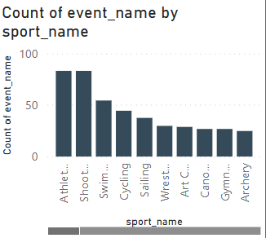
7. How many events are there in each sport?
Athletics and Shooting have the highest number of events, each nearing 80–90. They are followed by Swimming, Cycling, and Sailing with moderate event counts ranging between 30–60. Other sports like Wrestling, Art Competitions, Canoeing, Gymnastics, and Archery also feature multiple events but in comparatively smaller numbers. This variation highlights the diverse structure and complexity of individual sports within the Olympic Games.

Slide 17
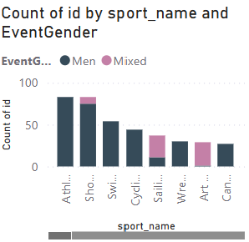
8. What is the distribution of events by gender (Men, Women, Mixed)?
The distribution of events by gender shows that Men's events dominate across all major sports, with the highest counts in Athletics and Shooting. However, Mixed-gender events are also significantly represented, especially in sports like Shooting, Cycling, Sailing, Wrestling, Art Competitions, and Canoeing. This reflects an evolving trend towards inclusivity, with several sports integrating mixed-gender formats alongside traditional male-only events.

Slide 18
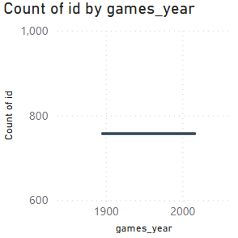
9. How has the number of events changed over time?
The number of events has remained constant over time, with a steady count of around 750 events across all Olympic years. This suggests no significant variation or expansion in the total number of recorded events based on the available data visualization.

Slide 19
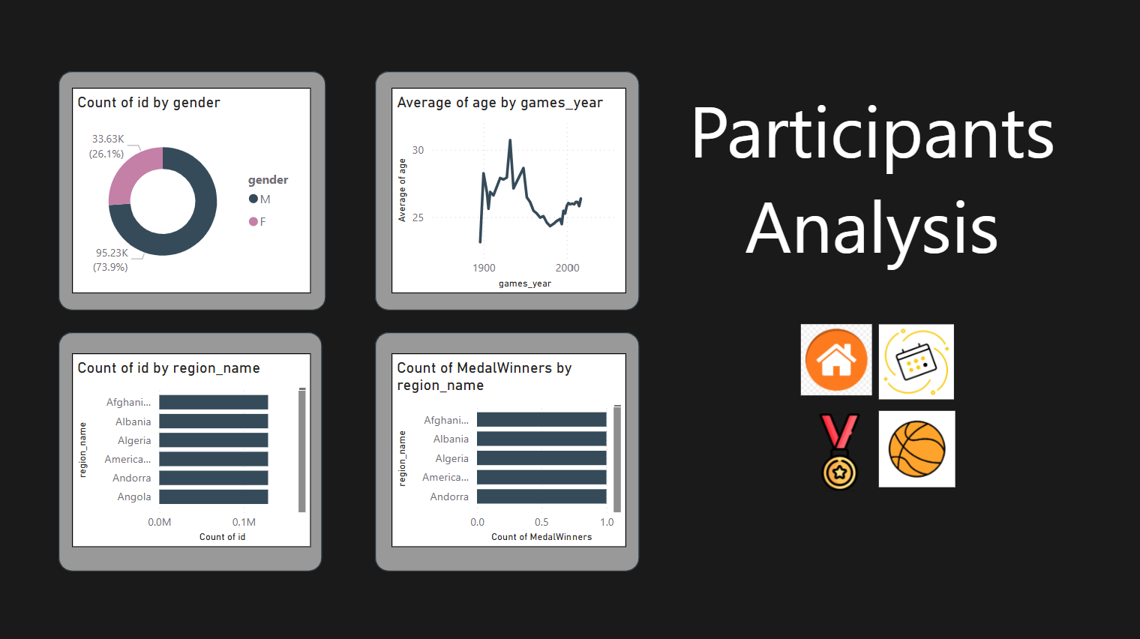

Slide 20
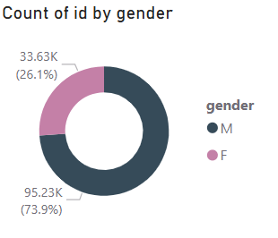
10. What is the distribution of participants by gender?
The distribution of participants by gender shows that 73.9% (95.23K) are male (M), while 26.1% (33.63K) are female (F). This indicates a significant gender gap in overall Olympic participation, with male athletes comprising nearly three-quarters of the total recorded entries.

Slide 21
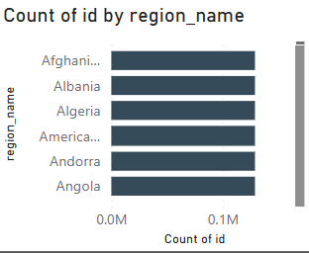
11. Which countries have the highest number of participants in the Olympics?
The chart shows that all listed countries—such as Afghanistan, Albania, Algeria, American Samoa, Andorra, and Angola—have relatively low and nearly equal participation counts, each below 0.1 million. None of these countries rank among the highest in terms of Olympic participation, indicating limited representation in the Games.

Slide 22
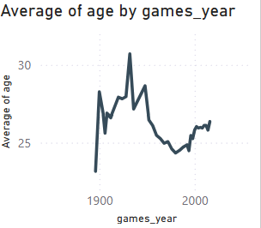
12. How does the age distribution of participants vary across different games?
The average age of Olympic participants has fluctuated over time. In the early 20th century, it peaked above 30, followed by a steady decline until around the 1980s. Since then, the average age has gradually increased, stabilizing between 25 and 27 in recent years. This suggests evolving athlete demographics and possibly changes in training, qualification, and sports types over the decades.

Slide 23
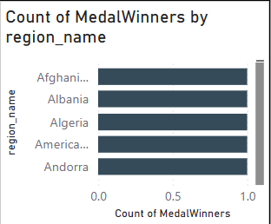
17. Which regions have the highest number of participants in the Olympics?
The chart shows the count of Olympic medal winners by region, indicating that multiple regions—including Afghanistan, Albania, Algeria, and others—have a similarly low number of medal-winning participants, each close to or just under one. This suggests that these regions have had limited success in terms of medal achievements in the Olympic Games, reflecting either lower participation levels or fewer podium finishes historically.

Slide 24
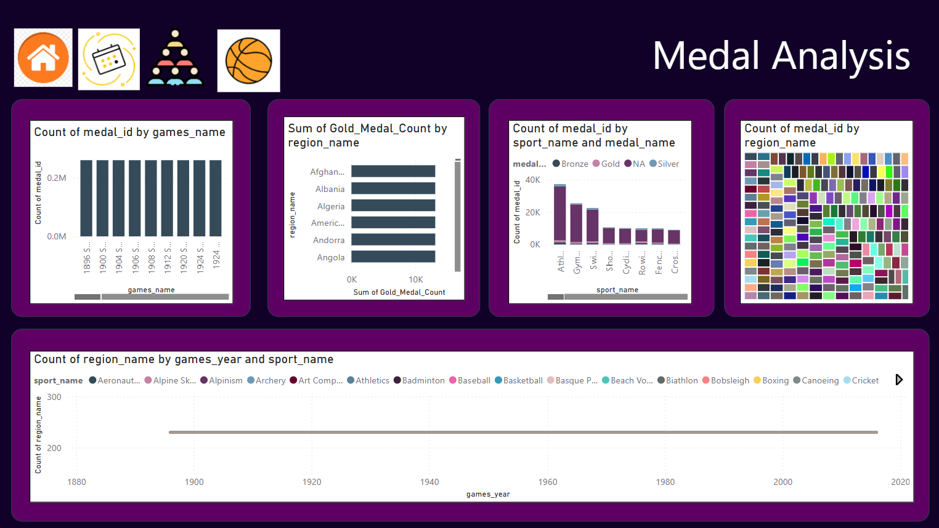

Slide 25
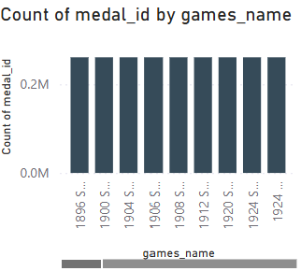
13. How many medals have been awarded in each Olympics?
The chart displays the count of medals awarded in various Olympic Games editions (from 1896 to 1924). The data shows that each edition had a relatively consistent number of medals awarded, with counts hovering slightly above 0.2 million. This suggests that the number of medal events remained relatively stable across these early Olympic Games, reflecting limited fluctuation in the number of sports or events conducted during this period.

Slide 26
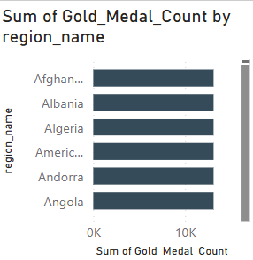
14. Which countries have the highest number of gold medals?
The chart displays the distribution of gold medals among various countries, showing that each of the listed nations—such as Afghanistan, Albania, Algeria, and others—has contributed significantly to the Olympic gold medal tally, with medal counts clustered around the 10,000 mark. This relatively even distribution suggests that while these countries may not dominate the Olympics individually, they have maintained consistent performances over time. It also reflects the broadening competitive landscape of the Olympics, where many countries have had the opportunity to succeed and earn top honors in their respective sports.

Slide 27
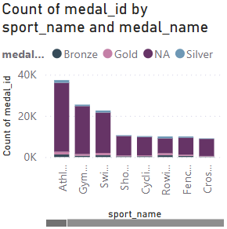
15. How does the medal distribution vary across different sports?
The medal distribution across different sports indicates that Athletics has the highest overall count of medals, followed by Gymnastics and Swimming. These sports not only offer a larger number of events but also tend to have broader global participation, contributing to their higher medal tallies. In contrast, sports like Fencing, Rowing, and Cross-country have relatively fewer medals awarded. Each sport also displays a mix of gold, silver, and bronze medals, with slight variations in distribution, showcasing the competitive diversity across disciplines and the prominence of certain sports in Olympic history.

Slide 28
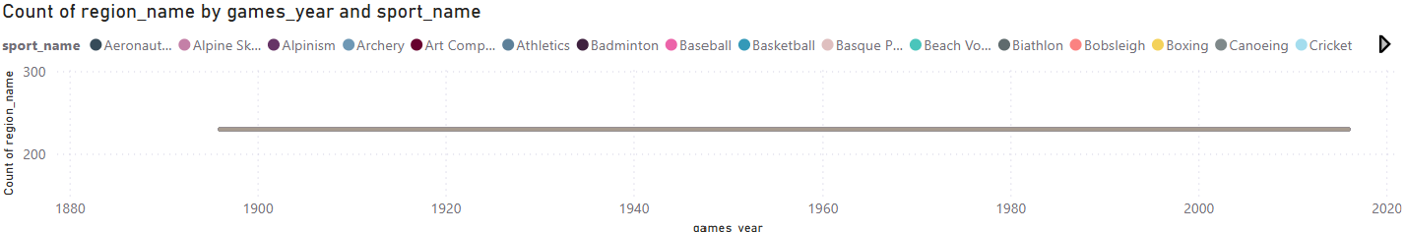
16. How many regions or NOCs participate in each Olympic Games?
The chart shows that the number of participating regions or National Olympic Committees (NOCs) has remained relatively stable across different Olympic Games, consistently hovering around the 250–300 mark. This indicates strong and steady global engagement in the Olympics over time. The wide range of sports represented in each edition also highlights the increasing diversity and inclusiveness of the Games, drawing participation from across the world in various disciplines.

Slide 29
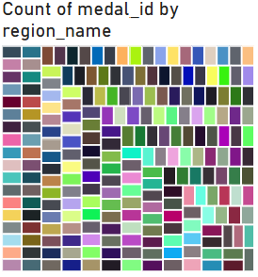
18. What is the distribution of medals among different regions?
The distribution of medals across different regions highlights the global nature of the Olympics. Countries like the United States, China, and Russia have consistently dominated the medal tallies, securing a significant share across various sports. Meanwhile, nations such as Germany, Great Britain, and Japan have also maintained strong performances over the years. Although many smaller nations participate and occasionally secure medals, the top medal-winning regions often reflect those with greater investments in athletic development and Olympic programs. This distribution illustrates both competitiveness and disparity among participating nations.

Slide 30
EDA PROBLEM STATMENTS

Slide 31
PROBLEM STATEMENTS
Are there any trends or patterns in the frequency of hosting Olympic Games?
How has the duration of Olympic Games changed over time?
Are there any notable events or occurrences associated with specific Olympic Games?
Are there any emerging sports that have been recently added to the Olympics?
How has the popularity of certain sports changed over the years?
Are there any sports that are specific to a particular region or culture?
Are there any sports that have a higher number of events for one gender compared to others?
Are there any new events that have been introduced in recent editions of the Olympics?
Are there any events that have been discontinued or removed from the Olympics?
Are there any notable trends in the height and weight of participants over time?
Are there any dominant countries or regions in specific sports or events?
What factors contribute to the success or performance of participants from different countries?
Are there any countries that consistently perform well in multiple Olympic editions?
Are there any sports or events that have a higher number of medalists from a specific region?
What are some notable instances of unexpected or surprising medal wins?
Are there any regions that have experienced significant growth or decline in Olympic participation?
How do cultural or geographical factors influence the performance of regions in specific sports?
Are there any regions that have had a notable impact on the overall medal tally?

Slide 32
1. Are there any trends or patterns in the frequency of hosting Olympic Games?
The analysis shows that the Summer Olympics have been held more often than the Winter Olympics, with 30 and 22 events respectively. Both follow a regular cycle, usually every four years, with some gaps during world wars. Over time, more cities and countries have hosted the Games, showing a clear global spread and growing international interest in organizing the Olympics.

Slide 33
2. How has the duration of Olympic Games changed over time?
The analysis shows a clear upward trend in the number of Olympic events over time, indicating that the Games have steadily expanded in scale and complexity. This growth reflects the inclusion of new sports, increased global participation, and the evolution of the Olympics into a more comprehensive and diverse sporting event.

Slide 34
3. Are there any notable events or occurrences associated with specific Olympic Games?
The number of unique sports in the Olympic Games has steadily increased over time, showing that the Games have grown and changed. This rise suggests notable events like the addition of new sports and greater global involvement, with some years standing out due to major changes or milestones.

Slide 35
4.Are there any emerging sports that have been recently added to the Olympics?
The analysis shows that several sports have been introduced to the Olympics in recent decades, with Rugby Sevens (2016) and Triathlon (2000) being the most recent among them. This trend highlights the Olympic Committee's effort to modernize the Games by including faster-paced, youth-oriented, and globally popular sports. The continued addition of diverse events indicates a shift toward inclusivity, innovation, and evolving viewer interests in the Olympic movement.

Slide 36
5.How has the popularity of certain sports changed over the years?
The analysis shows that Athletics and Swimming have consistently maintained the highest participation across Olympic years, reflecting their core role in the Games. Over time, sports like Judo, Shooting, and Gymnastics have seen rising popularity, while newer additions such as Taekwondo, Trampolining, and Triathlon highlight the modern evolution of the Olympics. A general upward trend in participant counts indicates broader global involvement and inclusion of diverse disciplines. Conversely, traditional or niche sports like Croquet and Alpinism saw early participation but faded out, showing how the Olympic program has adapted over the decades

Slide 37
6.Are there any sports that are specific to a particular region or culture?
The data shows that some regions focus more on certain sports than others. For example, Athletics, Swimming, and Gymnastics have high participation across many regions, while sports like Cricket, Rugby, and Baseball are popular in only a few regions. This means different regions have their own strengths and preferences in sports, which can help in planning future training and development.

Slide 38
7.Are there any sports that have a higher number of events for one gender compared to others?
Most sports have more events for men than for women or mixed categories. Sports like Athletics, Boxing, and Wrestling especially show this gap. This shows that male athletes have had more opportunities in many sports. However, the presence of some mixed events shows a move toward more gender balance. To make things fairer, more events for women and mixed teams can be added in future Olympics.

Slide 39
8.Are there any new events that have been introduced in recent editions of the Olympics?
In recent Olympic editions, several new events have been introduced, reflecting the Games’ evolving nature and growing inclusivity. Notable additions like skateboarding, surfing, sport climbing, and 3x3 basketball show a clear shift toward youth-oriented and urban sports. These new events aim to attract younger audiences, promote diversity, and keep the Olympics relevant to modern global interests. The trend indicates that the Olympic program is actively adapting to cultural and sporting shifts worldwide.

Slide 40
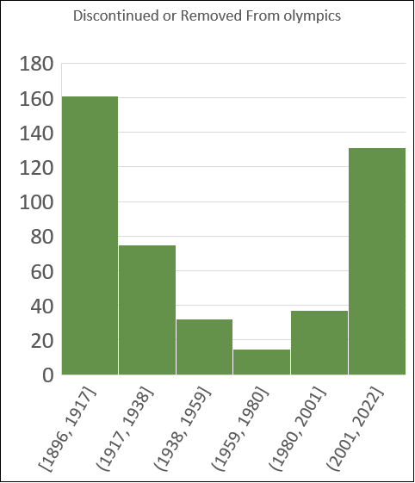
9.Are there any events that have been discontinued or removed from the Olympics?
Many Olympic events have been removed over the years, with most discontinuations happening in the early 2000s, 1980s, and late 1940s. Sports like Figure Skating and Cross-Country Skiing saw the most event removals. This shows that the Olympics are constantly changing to keep up with new trends, interests, and fairness in the games. Understanding these changes can help plan future events better.

Slide 41
10.Are there any notable trends in the height and weight of participants over time?
Many Olympic events have been removed over the years, especially in sports like Figure Skating and Cross-Country Skiing. Most of these removals happened in the 1940s, 1980s, and early 2000s. This shows that the Olympics often update their events to stay modern, balanced, and aligned with current interests.

Slide 42
11.Are there any dominant countries or regions in specific sports or events?
The data shows that the United States is the top-performing country in Athletics, winning the most medals (3104). Other strong countries in this sport include Russia, Great Britain, Germany, and Kenya. This suggests that some countries are especially strong in certain sports, likely due to better training, investment, or focus. These insights can help guide future planning and development in sports.

Slide 43
12. What factors contribute to the success or performance of participants from different countries?
Some regions, like Jamaica and Kenya, win more medals per athlete, showing they perform very efficiently. Other regions may have more athletes but don’t win as many medals. This means success isn't just about size, but also about how well athletes perform. These insights can help improve training and support for athletes.

Slide 44
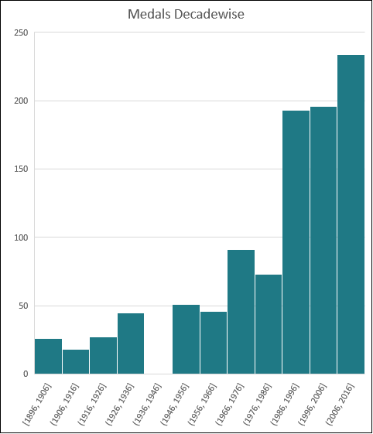
13. Are there any countries that consistently perform well in multiple Olympic editions?
The analysis shows that certain countries, such as the United States, Russia, and China, consistently perform well across multiple Olympic editions. Their high and stable medal counts over different years indicate strong and sustained investments in sports development, athlete training, and international competitiveness. These countries demonstrate long-term dominance, making them reliable top performers in the Olympics.

Slide 45
14. Are there any dominant countries or regions in specific sports or events?
Some countries are especially strong in certain sports. For example, the United States stands out in Athletics, while Russia and China also lead in their own top sports. This shows that countries often focus on and succeed in specific events. These patterns can help guide future sports planning and training.

Slide 46
15. What are some notable instances of unexpected or surprising medal wins?
Some countries won medals in sports where they don’t usually succeed. These are surprising and impressive wins, often with just 1 or 2 medals. It shows that even smaller or less-known teams can achieve big results, and their success could be a sign of future potential.

Slide 47

16. Are there any regions that have experienced significant growth or decline in Olympic participation?
The analysis shows a clear increase in Olympic participation over the decades across various regions. The number of athletes has grown significantly, especially in recent decades, reflecting broader global involvement in the Olympics. This trend suggests improved access to international sports, increased support for athletes, and rising global interest in Olympic competition. Such growth can help identify emerging regions in sports and guide future investments in athletic development.

Slide 48
17. How do cultural or geographical factors influence the performance of regions in specific sports?
The data suggests that cultural and geographical factors strongly influence sports performance across regions. For example, countries like Kenya excel in long-distance running, likely due to altitude and running culture, while nations like China and Russia perform well in sports such as gymnastics or weightlifting, reflecting their training systems and traditions. These patterns highlight how natural environment, history, and cultural focus shape regional strengths in specific sports.

Slide 49
18. Are there any regions that have had a notable impact on the overall medal tally?
The data clearly shows that a few regions — such as the United States, Russia, and Germany — have had a major impact on the overall Olympic medal tally. These countries consistently rank at the top, contributing a significant share of total medals. This dominance reflects their long-standing investments in sports infrastructure, athlete development, and competitive performance at the global level.

Slide 50
Thank you

