Slide 1
Linear Stability Analysis of the Kuramoto model with noise
Alexandre Sureda Croguennoc
Universitat de Barcelona
asuredcr7@alumnes.ub.edu
July 2020
A´lgebra Linear
July 2020

Slide 2
Contents
Kuramoto model
Linear stability analysis
.
Test results
Conclusions
A´lgebra Linear
21 de agosto de 2018

Slide 3



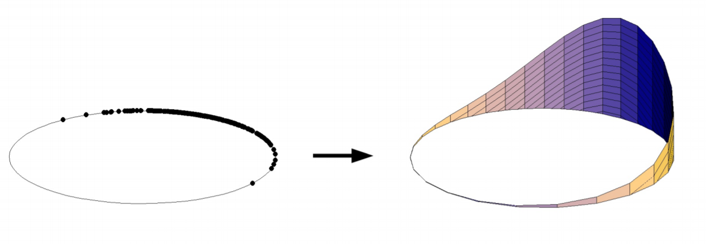

Kuramoto model
A´lgebra Linear
July 2020

Slide 4






Linear stability analysis
.
A´lgebra Linear

Slide 5




Linear stability analysis
.
A´lgebra Linear

Slide 6
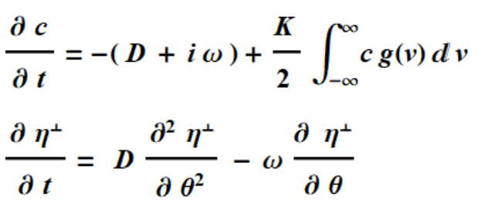






Linear stability analysis
.
A´lgebra Linear

Slide 7


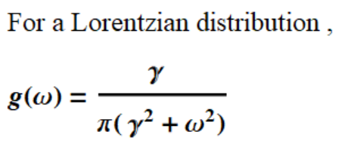
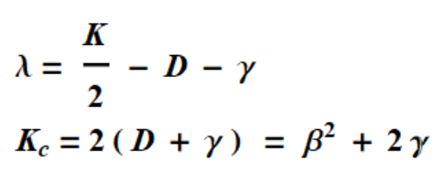
Linear stability analysis
.
A´lgebra Linear

Slide 8




Linear stability analysis
.
A´lgebra Linear

Slide 9

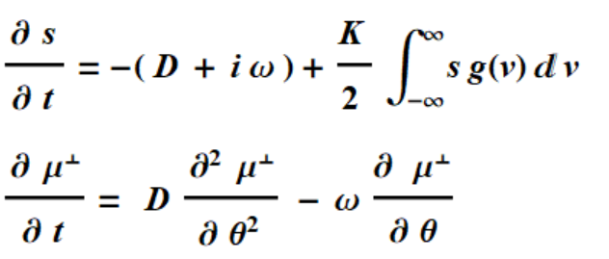
Linear stability analysis
.
A´lgebra Linear

Slide 10



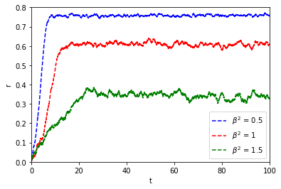
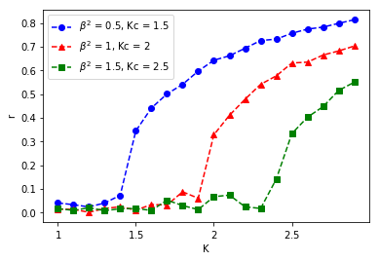

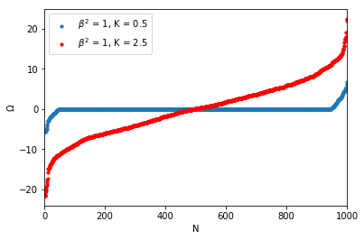
Test results
.
A´lgebra Linear

Slide 11
Conclusions
.
A´lgebra Linear

