Slide 1
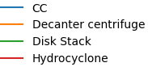
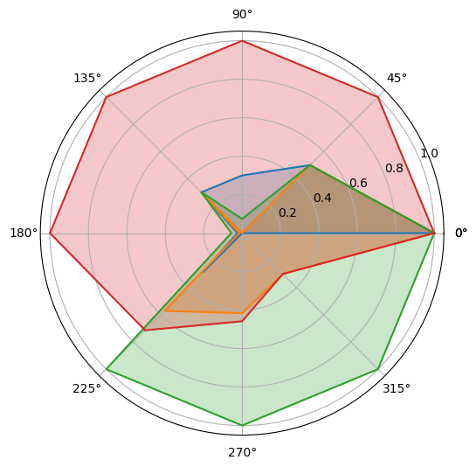
Energy cost
Maintenance
Material comp.
Max. flow rate
Continuous ext.
Centrifugal force
Imp. concentration
Particle size

Slide 2
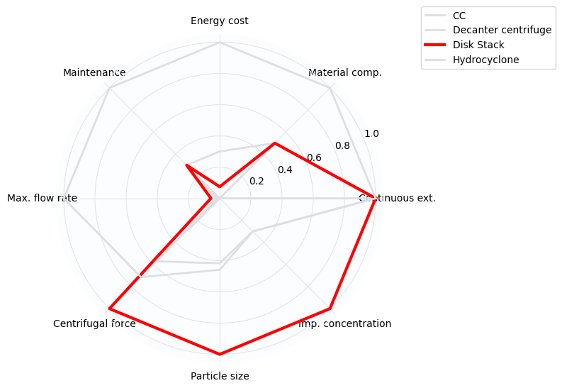

Slide 3
