Slide 1

HINDUSTAN AERONAUTICS LIMITED PROJECT:COMPLAIN MANAGENT SYSTEM

Slide 2
INTRODUCTION
A COMPALINT MANAGEMENT SYSTEM is a structured process used by organisation to receive , record, investigate and resolve customer complaint effectively. It built with the MERNSTACK(mongodb , express.js, react.js, node.js) is a comprehensive frame work design to handle and customer complaints through a streamlined and interactive process. The system not only help in resolving issues but also in gaining valueable insights to improve overall service quality.

Slide 3
OBJECTIVE OF PROJECT
CUSTOMER SATISFACTION : Enhance compliance with regulations and internal policies and internal policies related to complaint handling.
RECORD AND TRACK : Document all complaints promptly and fairly, aiming for satisfactory resolution for the complaint.
Overall our goal is to turn complaints into opportunities to improve and strengthen relationships with user .

Slide 4
KEY FEATURES:
Workflow management: Routes complaint to the appropriate personnel or department based on predefine rules or criteria.
Ticketing system: automatically generates a unique complaint ticket for each submission which helps in tracking and managing complaints individually.
Feedback and closure: collects feedback from complaints on the resolution process and automatically closes complaints once resolved satisfactory.

Slide 5
TECHNOLOGY USED:
MongoDB: it serve as a NOSQL database for storing structure and un structure data related to customer complaint, interaction,and resolution.it facilitates flexible data storage and retrieval.
Express.js: it is a web application framework for node.js, used to develop the backed application and Api endpoint of the cms.

Slide 6
React.js : it is a javascript library for building user interfaces, used to develop the frontend component of the cms.
Node.js : It is a run time environment for executing javascript code server-side, used to built the backend logic and server of the cms.
HTML/CSS: Html defines the structure of web pages, while css defines there appearance and layout in the cms.

Slide 7
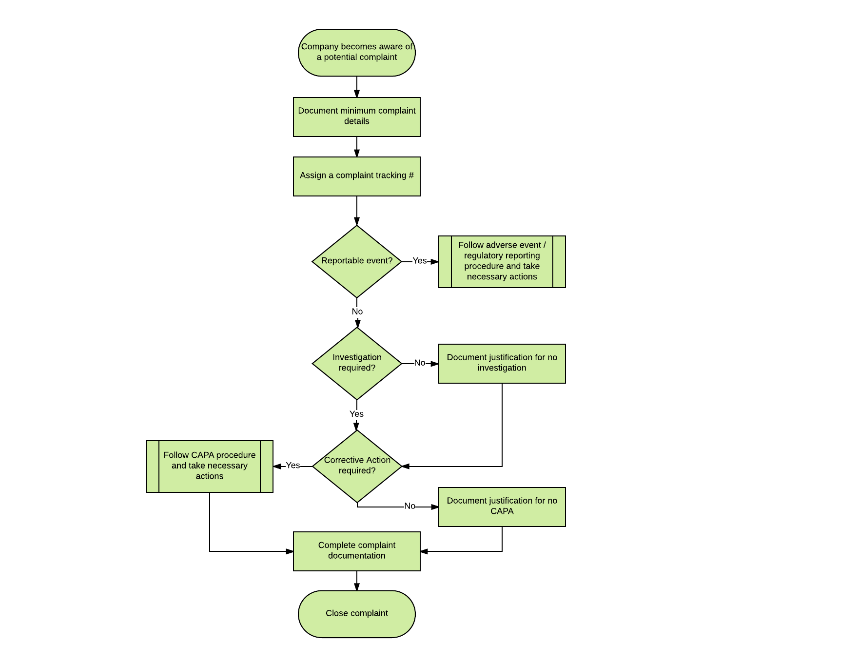
FLOWCHART

Slide 8
WORKING ANALYSIS.
COMPALINT REGISTRATION: Customers submit complaints through various channels web forms, mobile app, email, or phone calls .
COMPLAIN HANDALING WORKFLOW: Upon recipt, complaints are assigned to appropriate personnel or department based on pre defined criteria .
RESOLUTION AND FEEDBACK COLLECTION :
Personnel work toward resolving complaint within different timelines and service level aggrement.

Slide 9
TRACKING AND MONITORING: Monitoring the status and progress of complaints throughout the resolution process.
DATA ANALYSIS AND REPORTING:Analysing complain data to identify trends, root causes, complaints, and areas for improvement.
SYSTEM MAINTENANCE: Regular maintenance and updates to ensure the cms operates efficiently and securely

Slide 10
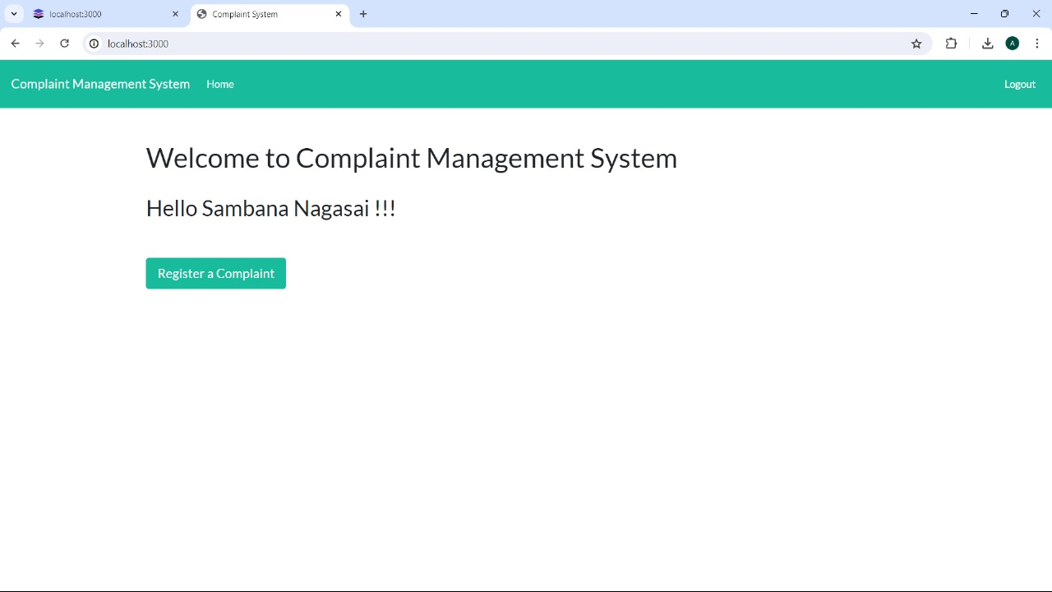
PHOTOS OF PROJECT

Slide 11
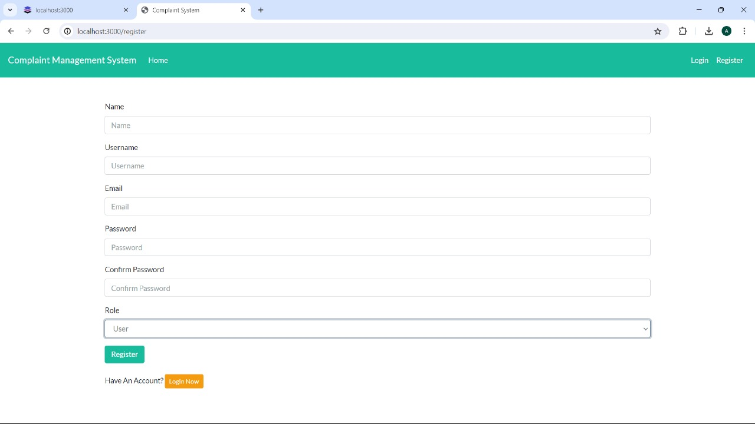

Slide 12
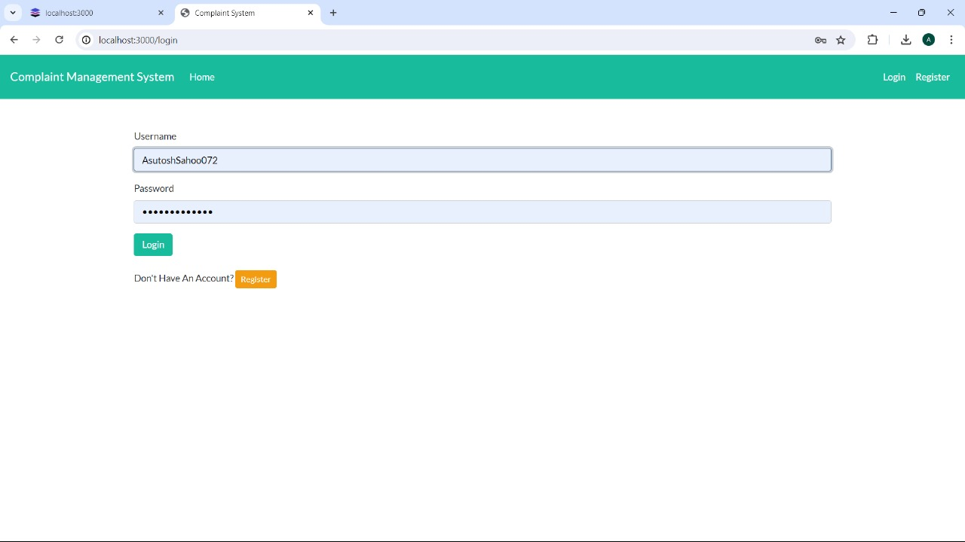

Slide 13
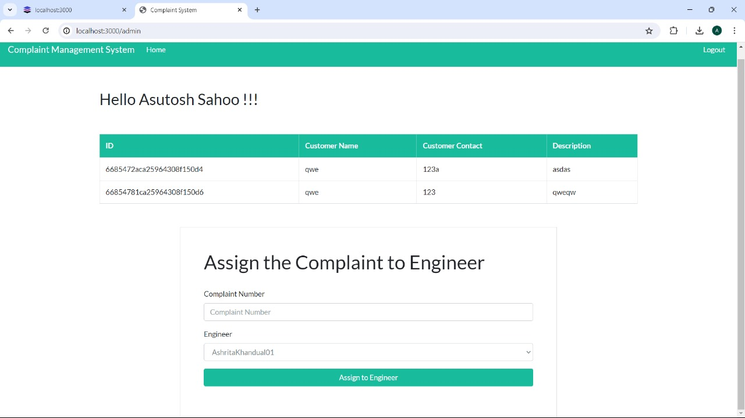

Slide 14
CONCLUSION:
The implementation of a Complaint Management System (CMS) is a strategic initiative that significantly enhances an organization's ability to manage customer complaints effectively.
By integrating modern web technologies the CMS provides a robust and scalable framework that addresses the complexities
of complaint handling in a streamlined manner

Slide 15
THANK YOU

