Slide 1
Derivatives

Slide 2
Introduction
◍ Financial contracts which derive their value from an underlying asset or a group of assets.
◍ The assets could be stocks, bonds, currencies, commodities and market indices.
◍ Can be used to hedge a position, speculate on the directional movement of an underlying asset, or give leverage to holdings.

Slide 3
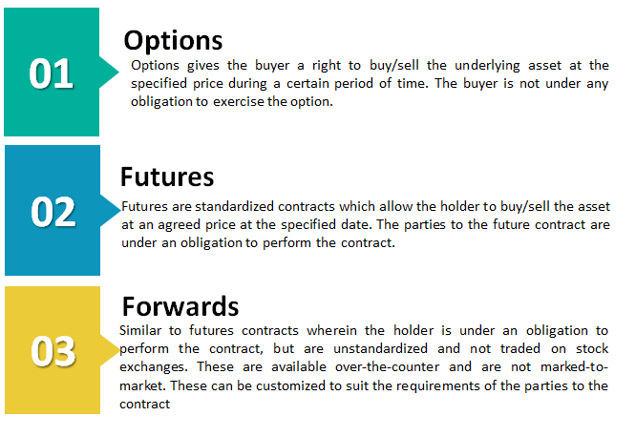
Types of Derivatives

Slide 4
Option Terminology
Strike Price: It is the fixed price at which the owner of the option can buy, or sell, the underlying security or commodity.
Expiration Date: The last date on which the holder of the option may exercise it according to its terms.
Spot Price: The current price of the underlying asset.
Call vs Put Options: A call option gives the holder the right to buy a stock and a put option gives the holder the right to sell a stock.
If the stock's price is below the strike price at expiration, the Call will expire worthless and the call seller will keep the premium. If a stock's price is above the strike price at expiration, the Put will be worthless and the seller gets to keep the premium as the option expires.

Slide 5
Option Terminology
American Options: Can be exercised anytime before the expiration date.
Options
European Options: Can be exercised only on the expiration date. Most of the options are European style.
Option Prices/Premiums :- Composed of Sum of its Intrinsic and Time Value.
Intrinsic value is the price difference between the current stock price and the strike price.
An option's time value or extrinsic value of an option is the amount of premium above its intrinsic value.
Time value is high when more time is remaining until expiry since investors have a higher probability that the contract will be profitable.

Slide 6
Option Terminology
Any option that has an intrinsic value is classified as ‘In the Money’ (ITM) option.
If the strike price is almost equal to spot price, then the option is considered as ‘At the money’ (ATM) option.
Any option that does not have an intrinsic value is classified as ‘Out of the Money’ (OTM) option.
Options with more extrinsic value are less sensitive to the stock's price movement while options with a lot of intrinsic value are more in sync with the stock price.

Slide 7
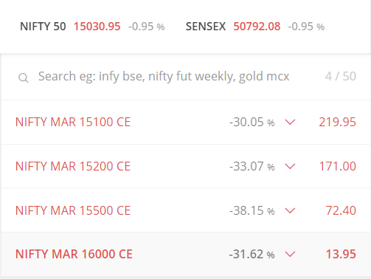
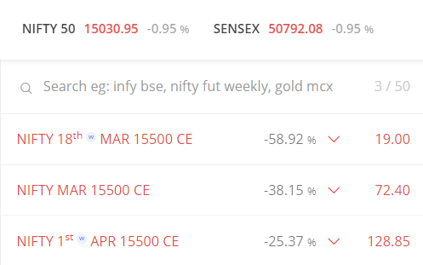

Slide 8

Volatility
How much an option's premium, or market value, fluctuates leading up to its expiration is called volatility.
In the stock market world, we define ‘Volatility’ as the riskiness of the stock or an index. Volatility is a % number as measured by the standard deviation.
Two common types of volatility affect option prices. Implied volatility is a concept specific to options and is a prediction made by market participants of the degree to which underlying securities move in the future. Implied volatility is essentially the real-time estimation of an asset’s price as it trades.
Another form of volatility that affects options is historic volatility, also known as statistical volatility. Historical volatility is often calculated annually, but can also be calculated daily and for shorter time frame.

Slide 9

Volatility Calculation
Step-1
Step-2
Download Data and Calculate Daily Returns using closing price.
Return = (Today’s Price / Yesterday’s Price) – 1
For all practical purposes and ease of calculation:
Return = LN (Ending Price / Beginning Price), where LN denotes Logarithm to Base ‘e’,also called ‘Log Returns’.
Find Standard Deviation of calculated log returns to get Daily Volatility
Now to get annual volatility, multiply by sqrt(t) (t = 252 days)

Slide 10

Greeks
A set of risk measures so named after the Greek letters that denote them, which indicate how sensitive an option is to time-value decay, changes in implied volatility, and movements in the price its underlying security.
The four primary greek measures are known as Delta, Gamma, Theta and Vega

Slide 11
Delta
An option's sensitivity to the underlying stock's movement is called delta. A delta of 1.0 tells investors that the option will likely move dollar for dollar with the stock, whereas a delta of 0.6 means the option will move approximately 60 cents for every dollar the stock moves.
For Puts, Delta is a negative number - demonstrates the inverse relationship of the put compared to the stock movement. A put with a delta of -0.4 should increase by 40 cents in value if the stock drops $1 per share.
An at-the-money option, meaning the option's strike price and the underlying asset's price are equal, has a delta value of approximately 0.5.
Delta changes as the options become more profitable or in-the-money. As the option gets further in the money, delta approaches 1.00 on a call and -1.00 on a put with the extremes eliciting a one-for-one relationship between changes in the option price and changes in the price of the underlying.
When a stock option gets very deep in the money (delta near 1), it will begin to trade like the stock, moving almost dollar-for-dollar with the stock price.

Slide 12
Gamma
Gamma measures the rate of changes in delta over time.
Gamma values are highest for at-the-money options and lowest for those deep in- or out-of-the-money.
While delta changes based on the underlying asset price, gamma is a constant that represents the rate of change of delta. Useful for determining the stability of delta, which can be used to determine the likelihood of an option reaching the strike price at expiration.
Eg: Suppose that two options have the same delta value, but one option has a high gamma, and one has a low gamma. The option with the higher gamma will have a higher risk since an unfavorable move in the underlying asset will have an oversized impact. High gamma values mean that the option tends to experience volatile swings, which is a bad thing for most traders looking for predictable opportunities.

Slide 13
Theta
Theta measures the rate of time decay in the value of an option or its premium. As time passes, the chance of an option being profitable or in-the-money lessens.
Theta is always negative for a single option since time moves in the same direction. Theta values appear smooth and linear over the long-term, but the slopes become much steeper for at-the-money options as the expiration date grows near.
Theta is typically highest for at-the-money options since less time is needed to earn a profit with a price move in the underlying.
Theta will increase sharply as time decay accelerates in the last few weeks before expiration and can severely undermine a long option holder's position, especially if implied volatility declines at the same time.
For at-the-money options, theta increases as an option approaches the expiration date. For in- and out-of-the-money options, theta decreases as an option approaches expiration.

Slide 14
Vega
Vega
Vega measures the risk of changes in implied volatility or the forward-looking expected volatility of the underlying asset price.
Volatility measures fluctuations in the underlying asset. Vega measures the sensitivity of the price of an option to changes in volatility. A change in volatility will affect both calls and puts the same way. An increase in volatility will increase the prices of all the options on an asset.
Higher volatility makes options more expensive since there’s a greater likelihood of hitting the strike price at some point.
Vega can increase or decrease without price changes of the underlying asset, due to changes in implied volatility.

Slide 15
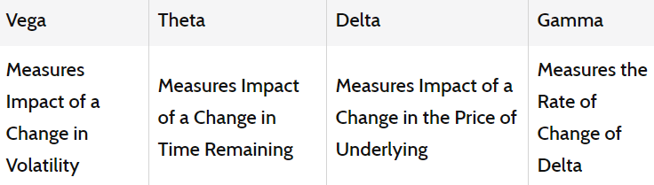

Slide 16
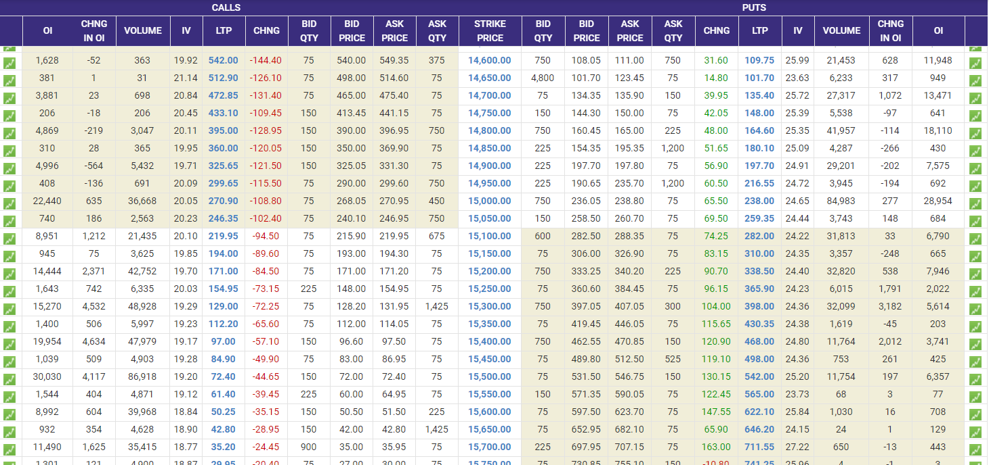
Option Chain Data

Slide 17
Option Chain Data
◘ Options chains are listed in two sections: Calls and Puts.
◘ LTP is the Last Traded Price.
◘ Bid and Ask show the prices that buyers and sellers, respectively, are willing to trade at.
◘ The volume column shows how many options were traded in a particular day.
◘ The open interest column shows how many options are outstanding. Open interest is the number of options that exist for a stock and include options that were opened in days prior. A high number of open interest means that investors are interested in that stock for that particular strike price and expiration date.
◘ Open interest is important because investors want to see liquidity, meaning there's enough demand for that option so that they can easily enter and exit a position.

Slide 18
Open Interest
◍ Open interest is commonly associated with the futures and options markets, where the number of existing contracts changes from day to day. These markets differ from the stock market, where the outstanding shares of a company's stock remain constant once a stock issuance has been completed.
◍ Increasing open interest represents new or additional money coming into the market while decreasing open interest indicates money flowing out of the market.
◍ The open interest number only changes when a new buyer and seller enter the market, creating a new contract, or when a buyer and seller meet, thereby closing both positions.
◍ Open interest is also used as an indicator of trend strength. Rising open interest is generally interpreted to be an indication that the existing market trend is gaining momentum or is likely to continue.

Slide 19
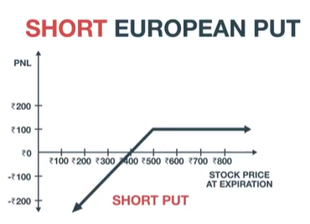
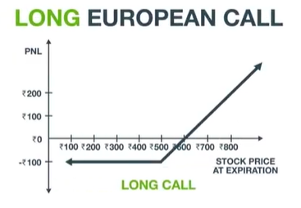
Put-Call Parity
Put-call parity is a principle that defines the relationship between the price of European put options and European call options with the same underlying asset, strike price, and expiration date.
Put-call parity states that simultaneously holding a short (or "write" or "sell") European put and long European call of the same class will deliver the same return as holding one forward contract on the same underlying asset, with the same expiration, and a forward price equal to the option's strike price.
+

Slide 20
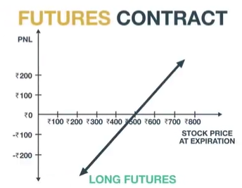
Put-Call Parity
When the prices of put and call options diverge, an opportunity for arbitrage exists, enabling some traders to earn a risk-free profit.

Slide 21
Put-Call Parity
The equation expressing put-call parity is:
C + PV(X) = P + S
Where:
C = Price of the European Call option
PV(x) = the present value of the strike price (X), discounted from the value on the expiration date at the risk-free rate
P = price of the European put
S = spot price of the underlying asset

Slide 22
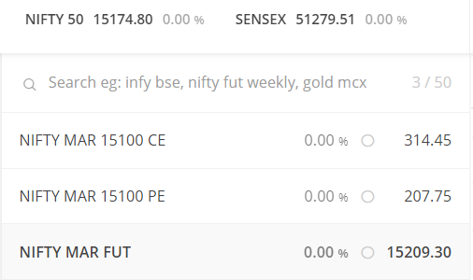
Put-Call Parity
11-03-21
C + PV(X) = P + S
X (Strike Price) = 15100
S = 15174.8
C = 314.45
P = 207.75
Expiration = 26th March 2021
T = 16 days
r (risk free rate) -> 10 yr govt bond yield = 6.25%
PV(X) = 15100/(1+r)^(16/365) = 15059.93
314.45+15059.93 = 207.75+ 15174.8
15374.38 = 15382.55
In reality, opportunities for arbitrage are short-lived and difficult to find. In addition, the margins they offer may be so thin that an enormous amount of capital is required to take advantage of them.

Slide 23
Black Scholes Model

Slide 24
Introduction
Mathematical model simulating the dynamics of a financial market containing derivative financial instruments.
Introduced in 1973 in the Journal of Political Economy, by Fischer Black and Myron Scholes, and later built upon by Robert Merton, the model won the Nobel Prize in economics in 1997
The model is based on a partial differential equation (PDE), the so-called Black-Scholes equation, from which one can deduce the Black-Scholes formula, which gives a theoretical estimate of the correct price of European stock options.

Slide 25

Assumptions
The rate of return on the risk-free asset is constant (thus effectively behaves as an interest rate).
Also, the risky asset does not pay a dividend.
There are no transaction costs in the market (i.e. no commission for buying or selling securities or derivative instruments)
The market consists of at least one risky asset (such as a stock) and one (essentially) risk-free asset, such as a govt bond.
There are no arbitrage (risk-free profit) opportunities in the market.It is possible to buy and sell any amount of the stock (including short selling)

Slide 26
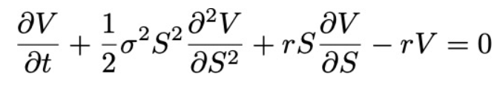
Black Scholes PDE
The Black-Scholes equation is the partial differential equation (PDE) that governs the price evolution of European stock options.
V - Price of the option
S - Stock Price
r - Risk free interest rate
σ - Volatility of the log returns of the underlying security
Derivation

Slide 27
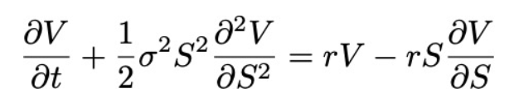
Black Scholes PDE
If we rewrite the equation to the following form:-
Then the left side represents the change in the value/price of the option V due to time t increasing + the convexity of the option’s value relative to the price of the stock.
The right hand side represents the risk-free return from a long position in the option and a short position consisting of ∂V/∂S shares of the stock.

Slide 28
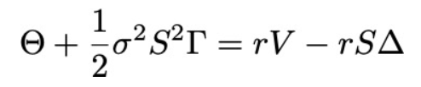
Black Scholes PDE
In terms of the greeks:
The risk-free return of the combined portfolio of stocks and options on the right hand side over any infinitesimal time interval could be expressed as the sum of theta (Θ) and a term incorporating gamma (Γ). “Risk Neutral Argument”
This is because the value of theta (Θ) is typically negative (because the value of the option decreases as time moves closer to expiration) and the value of gamma (Γ) is typically positive.
In sum, the losses from theta and the gains from gamma offset one another, resulting in returns at a risk-free rate.

Slide 29



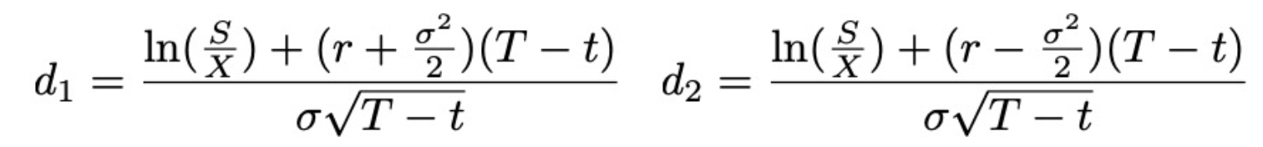
Black Scholes Formula
The Black-Scholes formula is a solution to the Black-Scholes PDE, given the boundary conditions below:-
The functional form of the analytic solution to the Black-Scholes equation is :-
The function N(・) represents the cumulative distribution function for a Normal/Gaussian distribution and may be thought of as the probability that a random variable is less or equal to its input (i.e. d₁ and d₂) for a normal distribution.

Slide 30
Limitations of BS
Risk free rate of return and volatility is assumed to be constant over the option duration none of those may remain constant in the real world.
Dividend payout is not taken into consideration, ignoring its impact on the change in valuations
Assumption that stock prices to follow lognormal pattern, i.e. a random walk (or geometric Brownian motion pattern) ignoring large price swings that are observed more frequently in the real world. Real-world distributions are skewed. This discrepancy leads to the Black-Scholes model substantially underpricing or overpricing an option.
Assumes no early exercise (fits only European options) the model is unsuitable for American options
Underlying stock price, volatility, risk-free rate, and dividend are unknown, and may change in short duration with high variance. This leads to high fluctuations in option prices.
Notes:
The Black-Scholes functional equation becomes a tool to help us understand how the market estimates the volatility of a stock, also known as the implied volatility of the option.
This is information we can disagree over, and trade against.

Slide 31
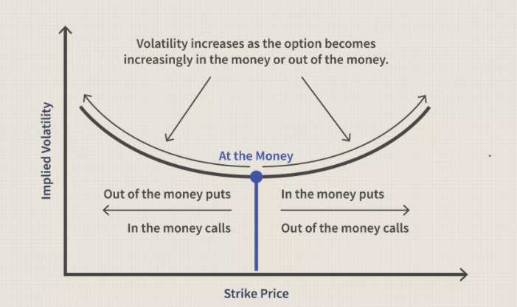
Volatility Smile
Graph shape that results from plotting the strike price and implied volatility of a group of options with the same underlying asset and expiration date.
Implied volatility rises when the underlying asset of an option is further out of the money (OTM) or in the money (ITM), compared to at the money (ATM).
*The u-shape is not always perfectly formed as depicted in the graph.

Slide 32
Volatility Smile
◘ According to the Black-Scholes model the implied volatility curve should be flat when plotted against varying strike prices. i.e. implied volatility would be the same for all options expiring on the same date with the same underlying asset regardless of the strike price. Yet, in the real-world, this is not the case.
◘ The volatility smile is not predicted by the Black-Scholes model.
◘ Volatility smiles started occurring in option pricing after the 1987 stock market crash. They were not present in U.S. markets prior to this, indicating a market structure more in line with what the Black-Scholes model predicts.
◘ After 1987, traders realized that extreme events can occur causing significant price shifts in options. The possibility for extreme events needed to be factored into options pricing.

Slide 33
Volatility Smile
Not all options align with the volatility smile. Before using the volatility smile to aid in making trading decisions, check to make sure the option's implied volatility actually follows the smile model.
Also, due to other market factors, such as supply and demand, the volatility smile may not be a clean u-shape. It may have a basic u-shape, but could be irregular with certain options showing more or less implied volatility than would be expected based on the model.

Slide 34
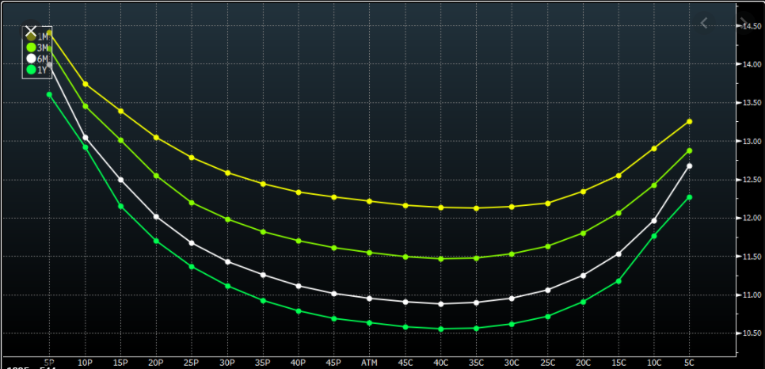
Volatility Smile

Slide 35
Binomial Option Pricing Model

Slide 36
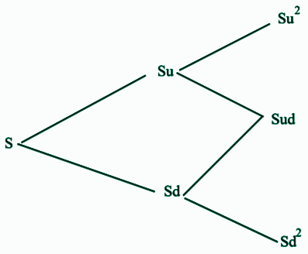
Binomial Option Pricing Model
Based on the simple idea that, in any period of time, the asset price can move to one of two possible prices.
Uses an iterative procedure, specifying nodes in time, during the time span between the current date and the option's expiration date.
Here, S is the current stock price; the price moves up to Su with probability p and down to Sd with probability 1-p in any time period. Here p is called the Risk Neutral Probability.
BOPM is computationally slower than the Black–Scholes formula, but is more usually accurate. For these reasons, various versions of the binomial model are widely used by practitioners in the options markets.

Slide 37
Binomial Option Pricing Model
uS
p
S
1-p
dS
Expected Payoff = p*uS + (1-p)*dS
Risk Free Rate = r
(1+r)*S = puS+(1-p)*dS (Risk Neutral Return)
1+r = pu + (1-p)*d
p = (1+r-d)/(u-d)

Slide 38
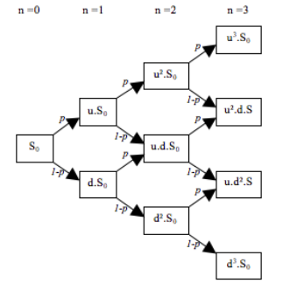
Binomial Option Pricing Model
Divide the total time between valuation and expiration date into n time steps. At each time step, the stock price can either move up by a factor u or down by a factor d. Each node in the lattice represents a possible price of the underlying at a given point in time.
Valuation is performed iteratively, starting at each of the final nodes, and then working backwards through the tree towards the first node. The value computed at each stage is the value of the option at that point in time.
Binomial lattice (Tree)

Slide 39
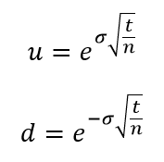

Binomial Option Pricing Model
The up and down factors are calculated using the underlying volatility, σ and the duration of a time step. i.e. t/n
This method ensures that the tree is recombinant, i.e. if the underlying asset moves up and then down (u,d) the price will be the same as if it had moved down and then up (d,u). This property reduces the number of tree nodes, and accelerates the computation of the option price.
This property also allows that the value of the underlying asset at each node can be calculated directly via formula, and does not require that the tree be built first. The node-value will be:

Slide 40


Binomial Option Pricing Model
At each final node of the tree (expiration date) the option value is simply its payoff:
Max [ (S_{n} − K), 0 ], for a call option
Max [ (K − S_{n}), 0 ], for a put option
Under the risk neutrality assumption, today's fair price of a derivative is equal to the expected value of its future payoff discounted by the risk free rate. Therefore, expected value is calculated using the option values from the later two nodes (up and down) weighted by their respective probabilities p of an up move in the underlying, (1−p) of a down move. The expected value is then discounted at r, the risk free rate corresponding to the life of the option.
Here C(t,i) is the option value for i-th node at time t.
Probability p is given by :-

Slide 41
Thank You

