Slide 1
University Admission System

Slide 2
Introduction
This project is to develop an online university Management System(UAS)
It offers 5 service
Program Service
Schedule Program Service
Application Service
Participant Service
Authentication Service

Slide 3
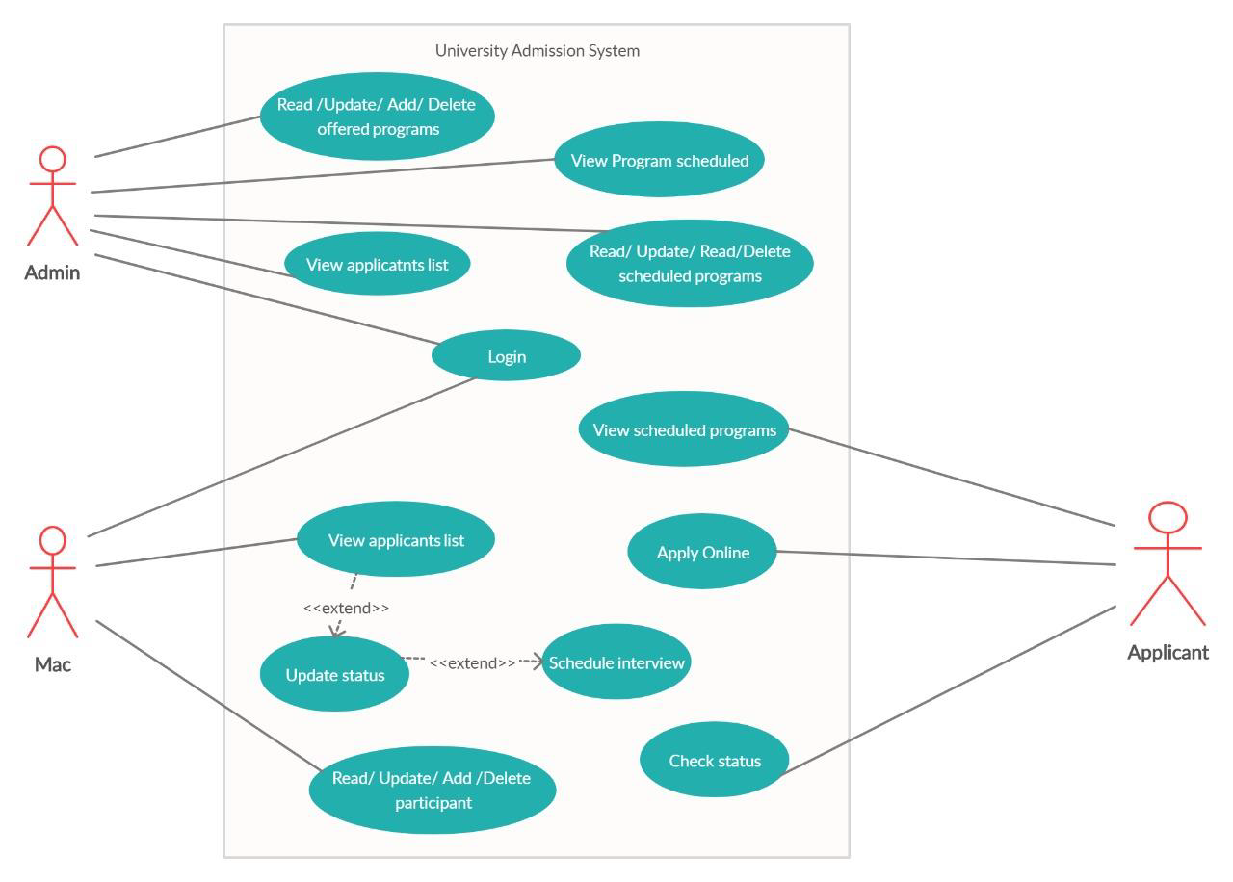
USE CASE DIAGRAM

Slide 4
Schedule Program Service
Schedule program service is to add a schedule to the database
We have 5 Api Endpints Created here
getAllSchedule
getScheduleById
Add Schedule
Update Schedule
deleteScheduleById

Slide 5
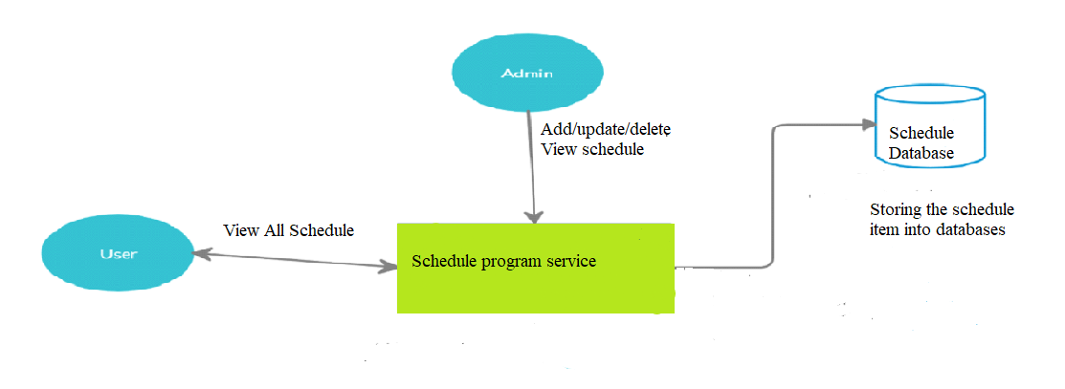
Schedule Program Service-Data flow diagram

Slide 6
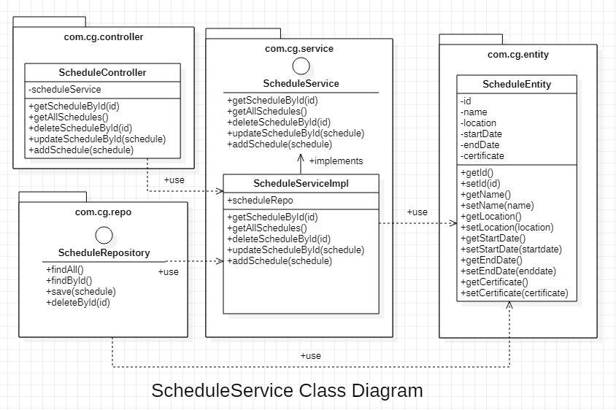
Class Diagram for Schedule Prgramservice

Slide 7
Thank You

