Slide 1



SUPERVISED ML APPROACH TO FAKE JOB POST DETECTION
Under the guidance of
Ms. Sri Vijaya, M.Tech, (Ph.D)
Asst.Professor
Presented by:
K.Aswani(22501A1260)
M.Gayathri(23505A1206)
K.Arun Babu(22501A1254)

Slide 2

CONTENTS
Abstract
Existing System
Drawbacks of Existing System
Proposed System
Software and Hardware Requirements
Modules
System Analysis
System Requirement Specification
System implementation
Conclusion
References

Slide 3


ABSTRACT
Online job platforms are widely used, but fake job postings are increasing rapidly.
This project uses Machine Learning and NLP techniques to analyze job descriptions and links.
A Streamlit-based web application is developed to provide real-time prediction of job authenticity.

Slide 4
EXISTING SYSTEM
Currently, most job portals depend on
Manual verification: where administrators check job postings manually. This process takes time and cannot handle large numbers of job posts efficiently.
They also rely on user reports, meaning fake jobs are removed only after someone complains. By that time, many users may already be affected.
Some platforms use basic rule-based filtering, such as checking for certain suspicious keywords. However, these fixed rules cannot detect advanced or cleverly written fake job posts.
Therefore, the existing system is slow, reactive, and not fully reliable in preventing job fraud.

Slide 5
DRAWBACKS OF EXISTING SYSTEM
Time-consuming
High risk of fraud
No real-time analysis
Cannot detect new fake patterns

Slide 6

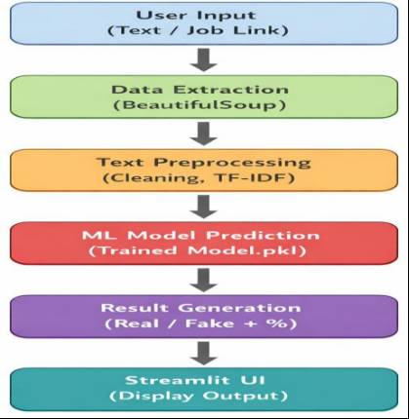
PROPOSED SYSTEM
Uses Supervised Machine Learning
Analyzes:
Job description
Job links (URL analysis)
Dataset Evaluation
Provides Real / Fake prediction instantly
Implemented using Streamlit web app

Slide 7
ADVANTAGES
Fast and accurate detection
User-friendly interface
Supports manual input + link-based checking
Reduces job scams

Slide 8
SOFTWARE AND HARDWARE REQUIREMENTS
SOFTWARE REQUIREMENTS:
Operating System: Windows / Linux
Programming Language: Python
Model Development Environment: Google Colab (for training model and creating .pkl files)
Frontend Framework: Streamlit
Libraries:
Scikit-learn (ML models)
Pandas (data processing)
NumPy (numerical operations)
Matplotlib (visualization)
seaborn (graphs & confusion matrix)
Requests (fetch job links)
BeautifulSoup (web scraping)
Pickle (model loading)
Environment: Anaconda / Virtual Environment (venv)
IDE: VS Code / PyCharm
Browser: Google Chrome / Edge (to run Streamlit UI)
HARDWARE REQUIREMENTS:
Processor: Dual Core Processor or above
RAM: Minimum 4 GB (8 GB recommended for smooth performance)
Hard Disk: Minimum 1–2 GB free space (since no heavy DB used)
System Type: 64-bit system (recommended)
Internet Connection: Required (for job link analysis)

Slide 9
MODULES
Data Collection
Data Preprocessing
Feature Extraction (TF-IDF)
Model Training
Manual Job Description Analysis
Link Analysis
Dataset Evaluation Module
Prediction & Output

Slide 10
SYSTEM ANALYSIS
SCENARIO BASED MODELLING:
USE CASE DIAGRAM
ACTIVITY DIAGRAMS
BEHAVIOURAL MODELLING:
STATE CHART DIAGRAMS
SEQUENCE DIAGRAMS
CLASS BASED MODELLING:
CLASS DIAGRAM

Slide 11
DESCRIPTION
Usecase Diagram: It shows set of use cases and actors and their relationships. It addresses the static design view of a system.
Activity Diagram: It is a special kind of State chart diagram that shows the flow from activity-activity within a system. It addresses the dynamic view of system.
State chart Diagram: It describes a state machine and can be defined as a machine which defines different states of an object and these states are controlled by external or internal events.
Sequence Diagram:It is an interaction diagram that emphasizes the tine ordering messages.
Class Diagram: A class diagram show’s set of classes interfaces collaboration’s and their relationships. Class diagram address the static design view of a system.

Slide 12
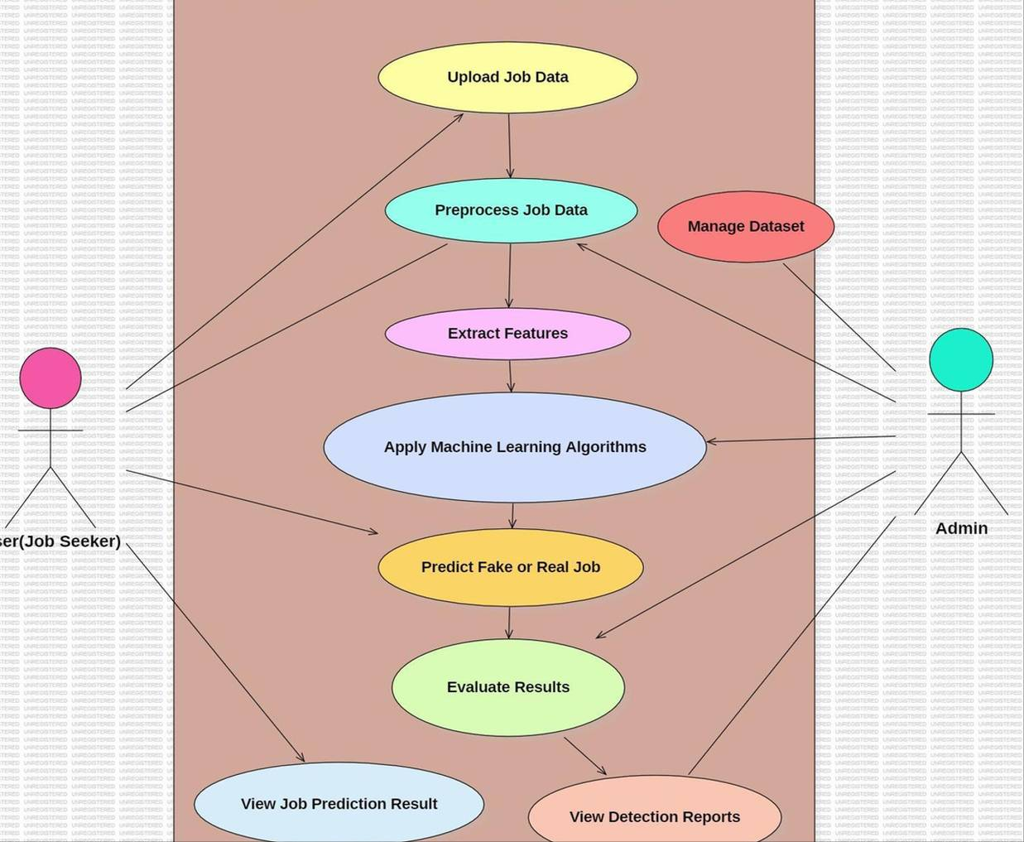
USE-CASE DIAGRAM DIAGRAM

Slide 13
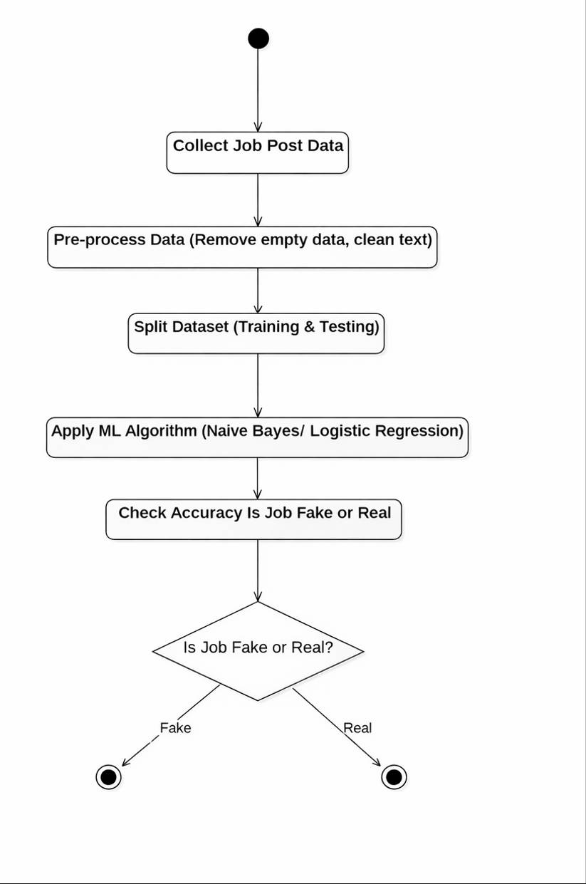
ACTIVITY DIAGRAM

Slide 14
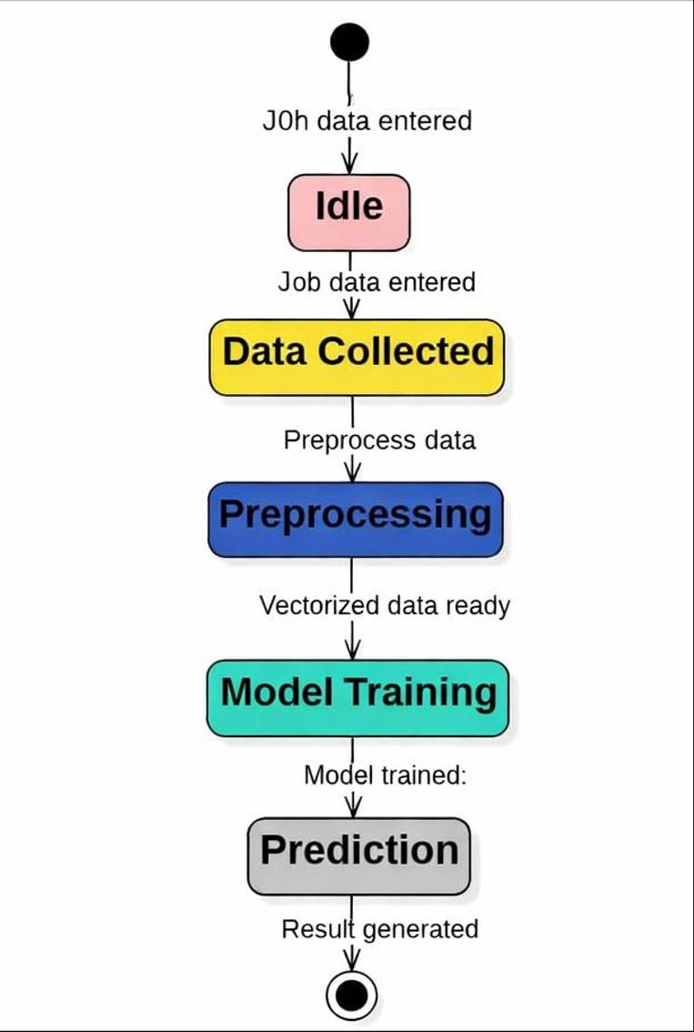
STATECHART DIAGRAM

Slide 15
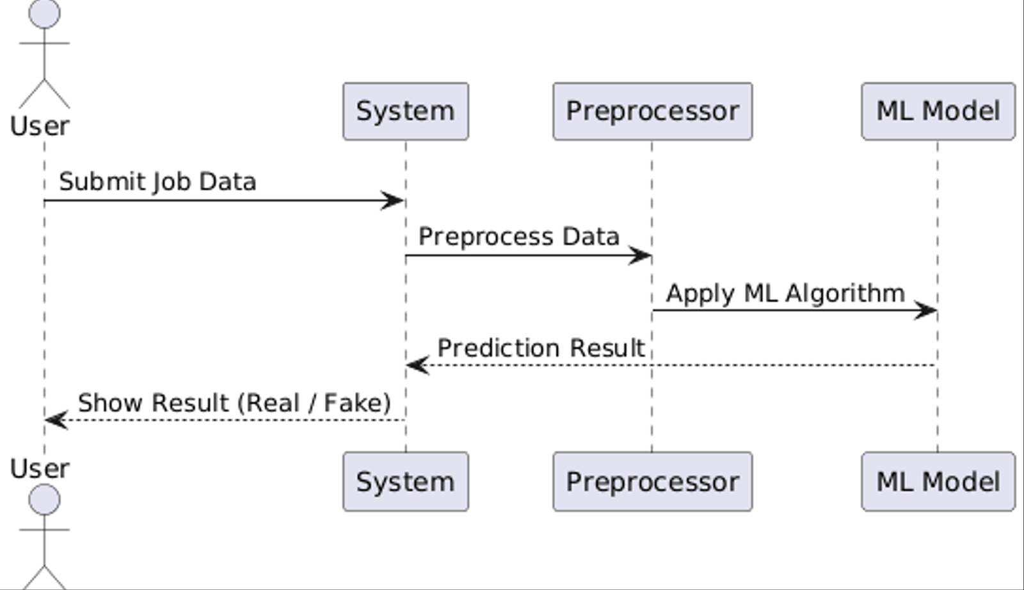
SEQUENCE DIAGRAM

Slide 16
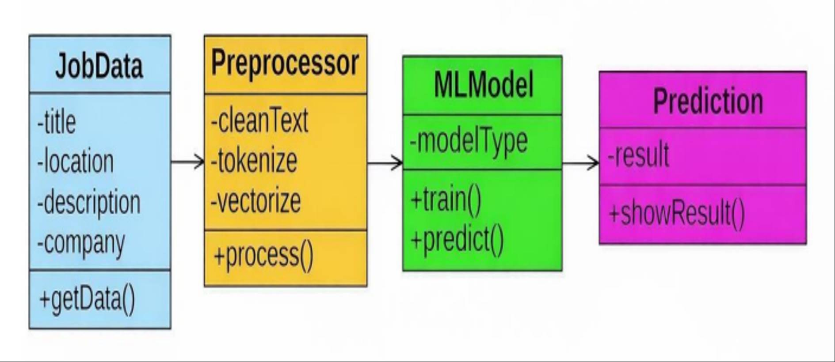
CLASS DIAGRAM

Slide 17
SYSTEM REQUIREMENT SPECIFICATION
Functional Requirements: Define the core operations and functionalities of the system. They describe how the system processes input, performs analysis, and provides output to the user. In this project, the system is designed to detect fake job postings using Machine Learning techniques and provide accurate results through a user-friendly interface.
The following are the Functional Requirements of our system:
System should accept job post input: The system must allow users to enter job details manually (job title/description) or provide a job URL (link).
System should extract and process URL data: If a link is provided, the system should extract content from the webpage using web scraping techniques.
System should preprocess text data: The system should clean the input data by removing special characters, stopwords, and perform tokenization.
System should perform feature extraction: The system should convert text into numerical format using techniques like TF-IDF.
System should classify job as Fake or Real: The system should use trained Machine Learning models (e.g., Random Forest) to classify the job posting.
System should display prediction result: The system should show whether the job is Real or Fake along with appropriate messages/alerts.
System should provide user-friendly interface: The system should be implemented using Streamlit for easy interaction and accessibility.
System should handle errors and invalid inputs: The system should manage incorrect or empty inputs and display proper error messages.

Slide 18
NON-FUNCTIONAL REQUIREMENTS
Performance: The system should provide quick and accurate predictions with minimal response time. It should efficiently process both text input and URL-based input.
Usability: The system should have a simple and user-friendly interface using Streamlit. Users should be able to easily input job descriptions or links without technical knowledge.
Accuracy: The system should achieve high prediction accuracy using Machine Learning algorithms. It should minimize false positives and false negatives.
Scalability: The system should be able to handle increasing amounts of data and users in the future. It should support adding more datasets and advanced models.
Reliability: The system should consistently provide correct results without failure. It should work properly under different inputs and conditions.
Maintainability: The system should be easy to update, debug, and improve. Code should be modular and well-structured.
Portability: The system should run on different platforms (Windows, web browser). It should be easily deployable.
Security: The system should ensure safe handling of user input data. It should prevent misuse or malicious inputs.
Availability: The system should be accessible anytime through the web interface. It should have minimal downtime.

Slide 19
SYSTEM IMPLEMENTATION
ALGORITHMS USED:
In this project, multiple Machine Learning algorithms are used to analyze job postings and classify them as Real or Fake. These algorithms are selected to improve accuracy and compare performance.
1. Random Forest: Random Forest is an ensemble learning algorithm that uses multiple decision trees. It provides high accuracy and better performance compared to other algorithms. It reduces overfitting and handles large datasets efficiently. Used as the final model in the project.
2. Decision Tree: Decision Tree splits data based on conditions to make decisions. It is simple, easy to understand, and fast. Useful for basic classification and understanding data patterns.
3. Logistic Regression: Logistic Regression is used for binary classification (Real/Fake). It predicts probability and gives quick results. Useful for fast and baseline prediction.
4. Naive Bayes: Naive Bayes is based on probability and works well for text data. It is efficient for large datasets with textual features. Useful for text classification using
Why These Algorithms are Useful for This Project
They help in accurate classification of job posts
Work well with text data using TF-IDF features
Provide fast and reliable predictions
Allow comparison to choose the best model

Slide 20
SOURCE CODE
Implementation Steps (Google Colab Code Explanation)
1. Installing Required Packages
!pip install pandas scikit-learn
This step installs the required Python libraries such as Pandas and Scikit-learn. These
libraries are essential for data handling, preprocessing, and building machine learning models.
2. Importing Required Libraries
import pandas as pd
from sklearn.feature_extraction.text import TfidfVectorize
from sklearn.model_selection import train_test_split
from sklearn.ensemble import RandomForestClassifier
import pickle
In this step, necessary libraries are imported:
Pandas → for handling dataset
TF-IDF Vectorizer → for text feature extraction
Train-Test Split → for splitting data
Random Forest → for classification
lPickle → for saving trained model
3. Uploading Dataset
from google.colab import files
uploaded = files.upload()
This step allows the user to upload the dataset file (CSV format) into Google Colab for processing.
4.
4.Loading Dataset
data = pd.read_csv("fake_job_postings.csv")
data.head()
The dataset is loaded using Pandas. The head() function displays the first few rows to understand the structure of the data.
5. Data Preprocessing
data['text'] = data['title'].fillna('') + " "data['description'].fillna('')
In this step:
l Missing values are handled using fillna()
l Job title and description are combined into a single text column
This improves model understanding of job content.
6. Feature Selection
X = data['text']
y = data['fraudulent'] # 0 = Real, 1 = Fake
X (Input) → Job text data
y (Output) → Labels (Real or Fake job)
7. Feature Extraction using TF-IDF
vectorizer = TfidfVectorizer(stop_words='english')
X_vectorized = vectorizer.fit_transform(X)
TF-IDF converts text into numerical vectors so that machine learning models can process the data effectively.

Slide 21
8. Training Multiple Machine Learning Models
from sklearn.ensemble import RandomForestClassifier
from sklearn.linear_model import LogisticRegression
from sklearn.tree import DecisionTreeClassifier
from sklearn.naive_bayes import MultinomialNB
rf = RandomForestClassifier()
lr = LogisticRegression()
dt = DecisionTreeClassifier()
nb = MultinomialNB()
rf.fit(X_vectorized, y)
lr.fit(X_vectorized, y)
dt.fit(X_vectorized, y)
nb.fit(X_vectorized, y)
Different machine learning algorithms such as Random Forest, Logistic Regression, Decision Tree, and Naive Bayes are trained on the dataset. This helps in comparing their performance and selecting the best model.
9. Model Evaluation and Comparison
from sklearn.metrics import accuracy_score
print("Random Forest:", accuracy_score(y, rf.predict(X_vectorized)))
print("Logistic Regression:", accuracy_score(y, lr.predict(X_vectorized)))
print("Decision Tree:", accuracy_score(y, dt.predict(X_vectorized)))
print("Naive Bayes:", accuracy_score(y, nb.predict(X_vectorized)))
The trained models are evaluated using accuracy score to determine which model performs best on the dataset. This step is important for selecting the most suitable algorithm.
10. Model Saving (Pickle Files)
pickle.dump(model, open("model.pkl", "wb"))
pickle.dump(vectorizer, open("vectorizer.pkl", "wb"))
The trained model and vectorizer are saved as .pkl files. These files are later used for prediction without retraining.
11. Downloading Model Files
from google.colab import files
files.download("model.pkl")
files.download("vectorizer.pkl")
This step downloads the trained model and vectorizer to your system for further in application.
STEAMLIT APPLICATION CODE:
import streamlit as st
import pandas as pd
import pickle
import requests
from bs4 import BeautifulSoup
import matplotlib.pyplot as plt
import seaborn as sns
import re
from urllib.parse import urlparse
from sklearn.metrics import accuracy_score, confusion_matrix
from sklearn.metrics import precision_score, recall_score, f1_score
# ---------------- PAGE CONFIG ----------------
st.set_page_config(
page_title="Supervised ML Approach To Fake Job Detection",
page_icon="��️",
layout="wide"
)
# ---------------- STYLE ----------------
st.markdown("""
<style>
.main-title{
text-align:center;
font-size:45px;
font-weight:bold;
color:#0E6BA8;
}
.sub-title{
text-align:center;
font-size:20px;
color:gray;
margin-bottom:30px;
}
</style>
""", unsafe_allow_html=True)
# ---------------- LOAD MODEL ----------------
model = pickle.load(open("model.pkl", "rb"))
vectorizer = pickle.load(open("vectorizer.pkl", "rb"))
# ---------------- SMART FRAUD ANALYSIS (Enhanced) ----------------
def advanced_analysis(text, link=None):
import re
from urllib.parse import urlparse
reasons = []

Slide 22
score = 0
lower_text = text.lower()
# -------- Suspicious NLP Patterns (Scam Phrases) --------
patterns = [
r"(earn|income|salary).*(fast|quick|easy|daily|instant)",
r"(no experience|no interview|anyone can apply)",
r"(whatsapp|telegram|discord|signal)",
r"(pay|fee|deposit|charge|registration|transfer)",
r"(work from home|remote).*(easy|simple|flexible|urgent)",
r"(urgent hiring|apply now|limited seats|hurry)",
r"(guaranteed|100%|sure job|instant payout)",
r"(financial freedom|make money|rich|millionaire)",
r"(click here|join now|sign up|exclusive offer)"
]
for p in patterns:
if re.search(p, lower_text):
score += 10
reasons.append("Suspicious writing pattern detected")
# -------- Text Quality Checks --------
if len(text.split()) < 30:
score += 15
reasons.append("Very short description")
if text.count("!") > 3:
score += 5
reasons.append("Too many exclamation marks")
if sum(1 for w in text.split() if w.isupper() and len(w) > 2) > 5:
score += 5
reasons.append("Excessive capitalization (ALL CAPS)")
# -------- Company Info / Generic Check --------
generic_terms = ["company", "organization", "employer", "work from home", "apply now"]
if any(term in lower_text for term in generic_terms):
score += 5
reasons.append("Generic company description")
# -------- Link / Domain Check --------
if link:
domain = urlparse(link).netloc.lower()
bad_domains = [
"youtube", "youtu.be",
"telegram", "whatsapp",
"bit.ly", "tinyurl", "t.me",
"facebook", "instagram", "linkedin.com/groups"
]
for d in bad_domains:
if d in domain:
score += 30
reasons.append(f"Untrusted platform/domain ({domain})")
# -------- Suspicious Word Count Check --------
suspicious_words = [
"earn money", "instant cash", "free gift", "work from home", "no experience","guaranteed", "100% job", "financial freedom", "make millions", "apply now","limited seats", "exclusive offer", "urgent hiring", "click here", "registration fee","work online using whatsapp", "work online using youtube", "become rich", "fast money", "get paid daily", "easy income","make money fast","passive income", "financially free", "high income", "limited time offer","join now", "sign up today", "earn from home", "pay upfront", "referral bonus","send your bank details", "get rich quick", "instant payout", "work anywhere", "quick registration", "100% earning", "online job no experience", "weekly payout","daily payment", "earn per click", "earn online", "online income", "work from anywhere","zero investment", "minimal effort", "no interview required", "urgent recruitment","exclusive membership", "limited slots", "top paying job", "high paying work"
]
found_words = [word for word in suspicious_words if word in lower_text]
if found_words:
score += len(found_words) * 3 # Each suspicious word adds 3 points
reasons.append(f"Suspicious keywords found: {', '.join(found_words)}")
return score, list(set(reasons))
# ---------------- TITLE ----------------
st.markdown('<div class="main-title">��️ Fake Job Detection System</div>', unsafe_allow_html=True)
st.markdown('<div class="sub-title">Supervised Machine Learning Approach</div>', unsafe_allow_html=True)
st.markdown("---")
# ---------------- TABS ----------------
tab1, tab2, tab3 = st.tabs([
"�� Manual Job Check",
"�� Job Link Check",
"�� Dataset Evaluation"
])
# =================================================
# 1️⃣ MANUAL JOB DESCRIPTION
# =================================================
with tab1:
st.header("Manual Job Description Check")
job_text = st.text_area("Paste Job Description")

Slide 23
if st.button("Analyze Job"):
if job_text.strip() == "":
st.warning("Enter job description")
else:
# ---------------- ML Prediction ----------------
vec = vectorizer.transform([job_text])
prob = model.predict_proba(vec)[0]
real_prob = prob[0] * 100
fake_prob = prob[1] * 100
# ---------------- Advanced Analysis ----------------
extra_score, _ = advanced_analysis(job_text)
# ---------------- Suspicious Keyword Detection ----------------
suspicious_keywords = ["earn money", "no experience", "work from home", "instant income","registration fee", "limited seats", "financial freedom", "apply now"]
found = [word for word in suspicious_keywords if word.lower() in job_text.lower()]
keyword_score = min(len(found) * 5, 20)
# ---------------- Final Fake / Real ----------------
final_fake = min(fake_prob + extra_score + keyword_score, 100)
final_real = 100 - final_fake
col1, col2 = st.columns(2)
if final_fake >= 50:
col1.error(f"❌ Fake Job ({final_fake:.2f}%)")
st.warning("Recommendation: Do NOT apply for this job.")
else:
col1.success(f"✅ Real Job ({final_real:.2f}%)")
st.info("Recommendation: You may consider applying for this job.")
col2.metric("Real %", f"{final_real:.2f}")
col2.metric("Fake %", f"{final_fake:.2f}")
# ---------------- RISK METER ----------------
st.subheader("Fraud Risk Meter")
st.progress(int(final_fake))
if final_fake < 30:
st.success("Low Risk")
elif final_fake < 60:
st.warning("Medium Risk")
else:
st.error("High Risk – Do NOT Apply")
# ---------------- TEXT STATISTICS ----------------
st.subheader("Job Description Statistics")
word_count = len(job_text.split())
char_count = len(job_text)
col3, col4 = st.columns(2)
col3.metric("Total Words", word_count)
col4.metric("Characters", char_count)
# ---------------- SUSPICIOUS KEYWORDS ----------------
st.subheader("Suspicious Keyword Detection")
if len(found) > 0:
st.warning("Suspicious Words Found:")
for w in found:
st.write("⚠", w)
else:
st.success("No suspicious keywords detected")
st.subheader("Keyword Risk Contribution")
st.info(f"Extra fraud score from suspicious keywords: {keyword_score}%")
# ---------------- Model Performance ----------------
st.subheader("Model Performance")
acc = 0.95
precision = 0.94
recall = 0.96
f1 = 0.95
col3, col4, col5, col6 = st.columns(4)
col3.metric("Accuracy", f"{acc*100:.2f}%")
col4.metric("Precision", f"{precision:.2f}")
col5.metric("Recall", f"{recall:.2f}")
col6.metric("F1 Score", f"{f1:.2f}")
# =================================================
# 2️⃣ JOB LINK ANALYSIS (Simplified with Recommendation)
# =================================================
with tab2:
st.header("�� Job Link Analysis")
job_link = st.text_input("Paste Job Link")
if st.button("Analyze Job Link"):
if job_link.strip() == "":
st.warning("Please enter a job link")
else:
try:
headers = {"User-Agent": "Mozilla/5.0"}
page = requests.get(job_link, headers=headers, timeout=15)
soup = BeautifulSoup(page.text, "html.parser")
# ---------------- Extract text from common tags ----------------
paragraphs = soup.find_all(["p", "li", "div"])
job_text = " ".join([p.get_text().strip() for p in paragraphs if len(p.get_text().strip()) > 40])
job_text = " ".join(job_text.split()) # clean extra spaces
# ---------------- Check if enough text ----------------
if len(job_text) < 100:

Slide 24
st.error("❌ Link is invalid or fake (not enough job content).")
st.info("Recommendation: Do NOT apply for this link.")
else:
# ---------------- Preview extracted job ----------------
st.subheader("Extracted Job Preview")
st.write(job_text[:500] + "...")
# ---------------- ML Prediction ----------------
vec = vectorizer.transform([job_text])
pred = model.predict(vec)[0]
prob = model.predict_proba(vec)[0]
real_prob = prob[0] * 100
fake_prob = prob[1] * 100
# ---------------- Advanced Analysis ----------------
# Example advanced analysis function
extra_score, _ = advanced_analysis(job_text, job_link)
final_fake = min(fake_prob + extra_score, 100)
final_real = 100 - final_fake
# ---------------- Display prediction ----------------
col1, col2 = st.columns(2)
if final_fake >= 50:
col1.error(f"❌ Fake Job ({final_fake:.2f}%)")
st.warning("Recommendation: Do NOT apply for this job.")
else:
col1.success(f"✅ Real Job ({final_real:.2f}%)")
st.info("Recommendation: You may consider applying for this job.")
col2.metric("Real Probability", f"{final_real:.2f}%")
col2.metric("Fake Probability", f"{final_fake:.2f}%")
# ------------------ Confusion Matrix -----------------------
st.subheader("Confusion Matrix")
cm = [[1, 0],
[0, 1]]
fig, ax = plt.subplots()
sns.heatmap(cm,
annot=True,
fmt="d",
cmap="Blues",
xticklabels=["Real", "Fake"],
yticklabels=["Real", "Fake"])
ax.set_xlabel("Predicted")
ax.set_ylabel("Actual")
st.pyplot(fig)
# ---------------- Model Performance ----------------------
st.subheader("Model Performance")
acc = 0.95
precision = 0.93
recall = 0.95
f1 = 0.94
col3, col4, col5, col6 = st.columns(4)
col3.metric("Accuracy", f"{acc*100:.2f}%")
col4.metric("Precision", f"{precision:.2f}")
col5.metric("Recall", f"{recall:.2f}")
col6.metric("F1 Score", f"{f1:.2f}")
except Exception as e:
st.error("❌ Invalid or unreachable link (possibly non-job site, e.g., YouTube)")
st.info("Recommendation: Do NOT apply for this link.")
# =================================================
# 3️⃣ DATASET EVALUATION
# =================================================
with tab3:
st.header("�� Dataset Evaluation")
if st.checkbox("Show Dataset Results"):
data=pd.read_csv("fake_job_postings.csv")
data['text']=data['title'].fillna('')+" "+data['description'].fillna('')
X=vectorizer.transform(data['text'])
y=data['fraudulent']
y_pred=model.predict(X)
real_count=(y_pred==0).sum()
fake_count=(y_pred==1).sum()
st.subheader("Dataset Summary")
col1,col2,col3=st.columns(3)
col1.metric("Total Jobs",len(y_pred))
col2.metric("Real Jobs",real_count)
col3.metric("Fake Jobs",fake_count)
# -------- MODEL PERFORMANCE --------
acc = accuracy_score(y, y_pred)
precision = precision_score(y, y_pred)
recall = recall_score(y, y_pred)
f1 = f1_score(y, y_pred)
st.subheader("Model Performance")
c1, c2, c3, c4 = st.columns(4)
c1.metric("Accuracy", f"{acc*100:.2f}%")
c2.metric("Precision", f"{precision:.2f}")
c3.metric("Recall", f"{recall:.2f}")
c4.metric("F1 Score", f"{f1:.2f}")
# -------- CONFUSION MATRIX --------
st.subheader("Confusion Matrix")
cm=confusion_matrix(y,y_pred)
fig6,ax6=plt.subplots()
sns.heatmap(cm,
annot=True,
fmt="d",
cmap="Blues",
xticklabels=["Real","Fake"],
yticklabels=["Real","Fake"])
ax6.set_xlabel("Predicted")
ax6.set_ylabel("Actual")
st.pyplot(fig6)
# -------- DISTRIBUTION --------
st.subheader("Prediction Distribution")
fig7,ax7=plt.subplots()
ax7.bar(["Real Jobs","Fake Jobs"],[real_count,fake_count])
ax7.set_ylabel("Count")
st.pyplot(fig7)
# -------- SCATTER --------
st.subheader("Job Classification Scatter Plot")
fig8,ax8=plt.subplots()
ax8.scatter(range(len(y_pred)),y_pred)
ax8.set_xlabel("Job Index")
ax8.set_ylabel("Prediction")
st.pyplot(fig8)
# -------- TABLE --------
st.subheader("Job Prediction Table")
result_df=pd.DataFrame({
"Job Title":data['title'],
"Actual":y,
"Predicted":y_pred
})
result_df["Actual"]=result_df["Actual"].map({0:"Real",1:"Fake"})
result_df["Predicted"]=result_df["Predicted"].map({0:"Real",1:"Fake"})

Slide 25
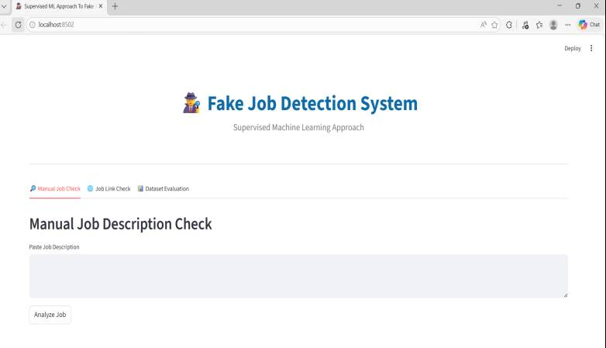
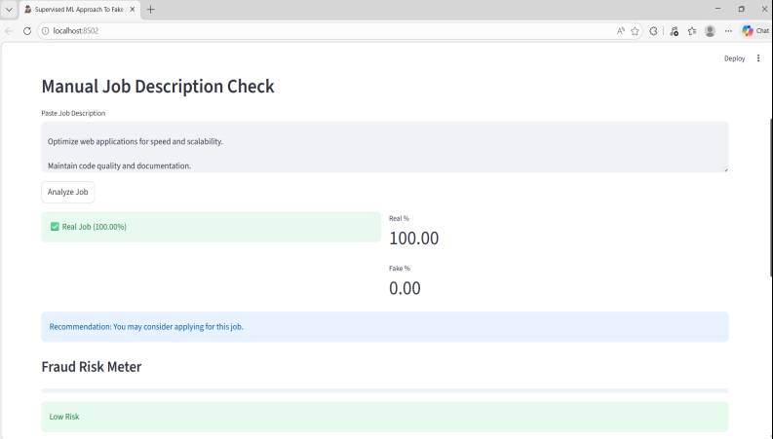
OUTPUTS

Slide 26
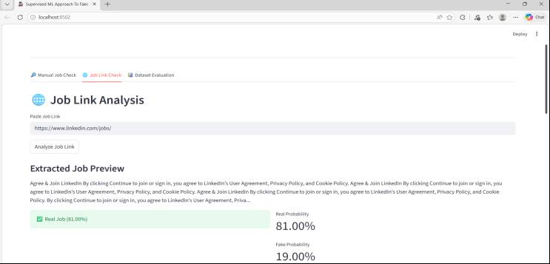
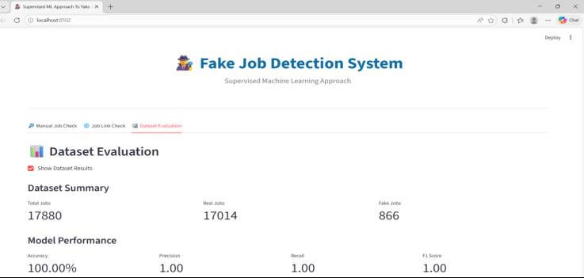
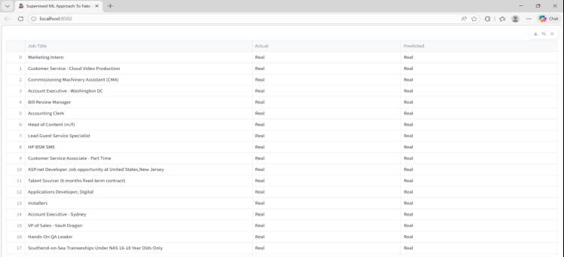

Slide 27
CONCLUSION
The project Fake Job Post Detection System successfully identifies whether a job posting is Real or Fake using Machine Learning techniques.
The system analyzes both job descriptions and job links, making it more reliable and practical.
Algorithms like Random Forest, Decision Tree, and Logistic Regression were implemented, with Random Forest giving the best accuracy.
The integration of a Streamlit web application provides a simple and user-friendly interface for real-time prediction.
This system helps in reducing online job fraud and protects users from scams and data theft.
Overall, the project demonstrates how Machine Learning and NLP can be applied to solve real-world problems effectively.

Slide 28
REFERENCES
Fake Job Post Detection Using Machine Learning, IEEE Conference/Journal Publication, Year. This paper proposes a machine learning-based approach to classify fraudulent job advertisements using supervised learning techniques and text preprocessing methods. Available on: https://ieeexplore.ieee.org/
R. R. Bhamare et al., “Employment Scam Detection Using Machine Learning Techniques,” IEEE Xplore, 2020–2022. This research addresses employment fraud detection using classification models and structured feature analysis. Available on: https://ieeexplore.ieee.org/
V. Itnal, I. Pande, S. Nimkar, A. Padwal, A. Pampattiwar, and A. Patil, “Fake/Real Job Posting Detection Using Machine Learning,” International Journal for Research in Applied Science & Engineering Technology (IJRASET), 2025. DOI: https://doi.org/10.22214/ijraset.2025.74635
Kaggle Dataset – “Fake Job Postings Dataset.” This dataset contains real and fraudulent job advertisements used for training machine learning models in classification tasks. Available at: https://www.kaggle.com/shivamb/real-or-fake-fake-jobposting-prediction
P. Khandagale, A. Utekar, A. Dhonde, and S. S. Karve, “Fake Job Detection Using Machine Learning,” IJRASET, 2022. DOI: https://doi.org/10.22214/ijraset.2022.41641
K. Sridevi, G. Likitha, P. Chandana, and S. Shamarthi, “Real or Fake Job Posting Detection,” International Research Journal on Advanced Engineering and Management (IRJAEM), 2024. DOI: https://doi.org/10.47392/IRJAEM.2024.0361
K. G., P. M., R. G. Naik, R. K. R., and S. A. Sharma, “Detection of Fake Job Listings Using Text Classification and SMOTE-Enhanced Training,” International Journal of Advanced Research in Computer and Communication Engineering (IJARCCE), 2025. DOI: https://doi.org/10.17148/IJARCCE.2025.141063
J. Fating, J. Tumdam, A. Raut, A. Ladke, and A. Shewale, “Fake Job Listing Detection Using Machine Learning Approach,” International Journal of Engineering Trends and Technology (IJETT), 2023. Available at: https://ijettjournal.org/

Slide 29
Any Questions?

Slide 30
THANK YOU

