Slide 1
Lending Club Case Study
Aswani Reddy & Kuldeep Mishra

Slide 2
Discussion topics
Problem statement – Introduction
Analysis of the data frame
Data cleaning process
Treating outliers
Analysis of data elements
Closing Comments

Slide 3
Problem statement – Introduction
Identify attributes which are having influence on the loan repayment
Bad loans can be avoided by looking at the trends

Slide 4
Analysis of the data frame
Data set size => ~33MB
Number of Columns => 111
Number of Rows => 39717
Number of Columns having more than 40% of NaN values => 57 => Dropped them
Number of Columns having only Unique values => 9 => Dropped them
Post cleanup left out with 45 columns
Walk through of the data present => 6 more columns dropped
Number of Columns having missing values => 6
Missing values imputed for 5 columns with mode (Categorical type)
Dropped rows for missing values in 1 column

Slide 5
Data cleaning process & Treating Outliers - 1
Out of 30 Columns, Picked few columns for Numerical type
loan_amnt
funded_amnt
funded_amnt_inv
annual_inc
Out of 30 Columns, Picked few columns for Categorical type
Loan_status
grade
term
Verification status
emp_length
purpose

Slide 6
Data cleaning process & Treating Outliers - 2
Used Boxplot to find the outliers and solved this problem using IQR method.
Created a derived columns for capturing issue year and month
At the time of final clean up
No of columns => 41
No of rows => 37880

Slide 7

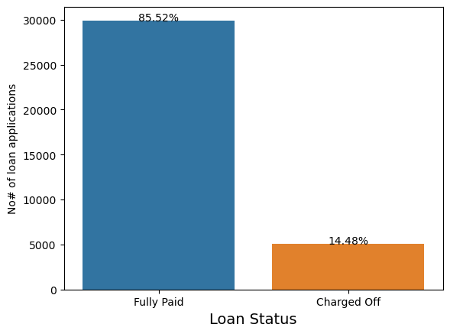
Univariate Analysis - 1
From the current dataset we have 14% of people have defaulted or in chargedoff.

Slide 8
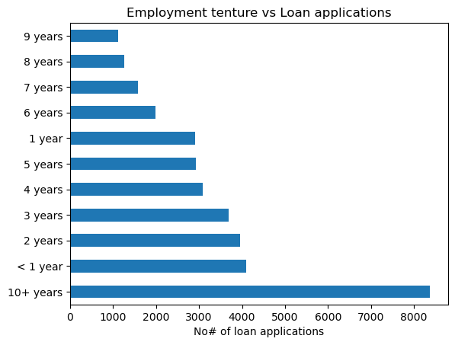
Univariate Analysis - 2
Individuals having experience more than 10+years are taking more loans when compared with other experience levels

Slide 9
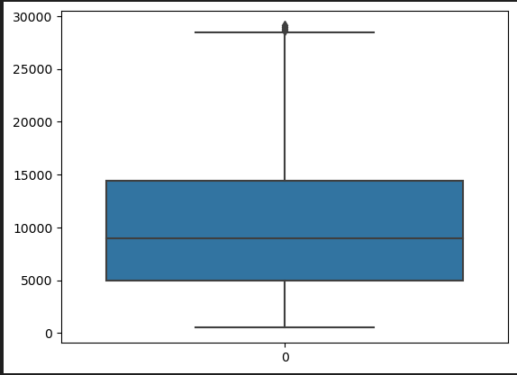
Univariate Analysis - 3
Loan amount is between 500 to ~29,000 (Currency seems to be in USD as the states name and other details in the data set point to US regions)

Slide 10
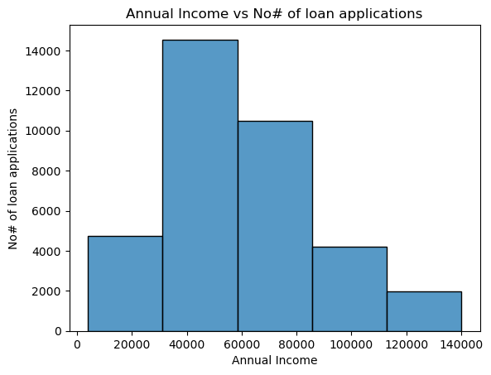
Univariate Analysis - 4
People with Annual Income in range of 30K to 90K are having high chances of getting loan

Slide 11
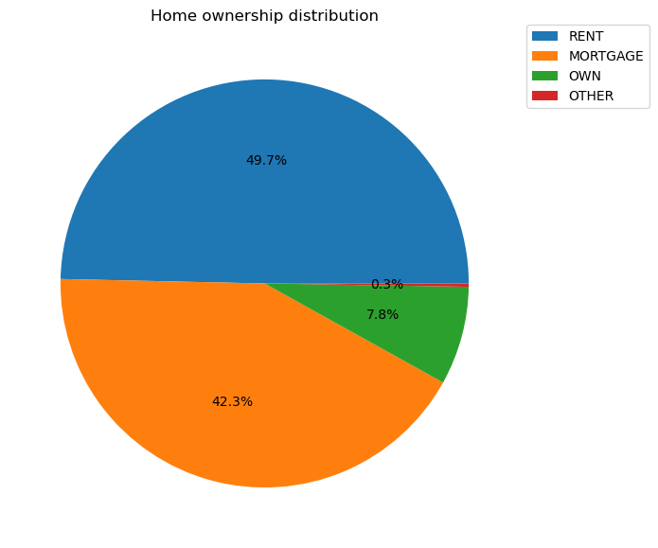
Univariate Analysis - 5
Majority of loan applications are staying in rented house

Slide 12
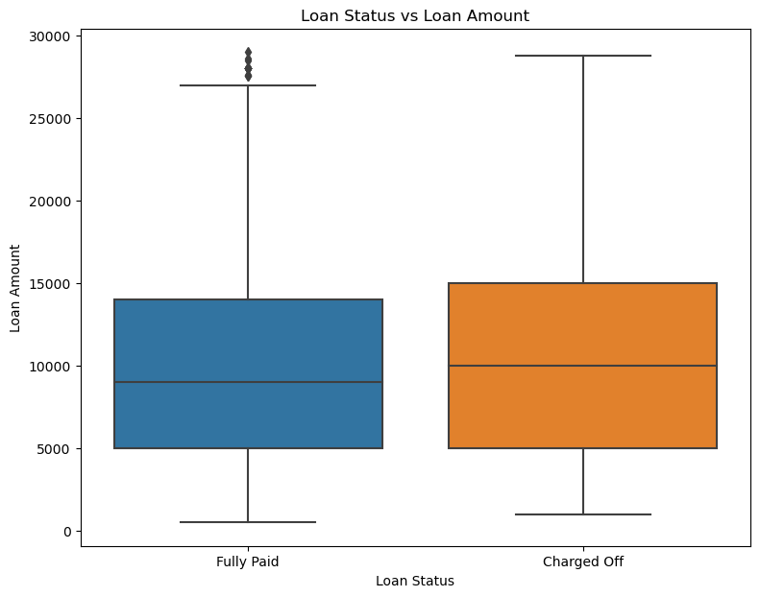
Bivariate Analysis - 1
"Charged_Off" status on Loan seems to high where there is a bigger loan amount

Slide 13
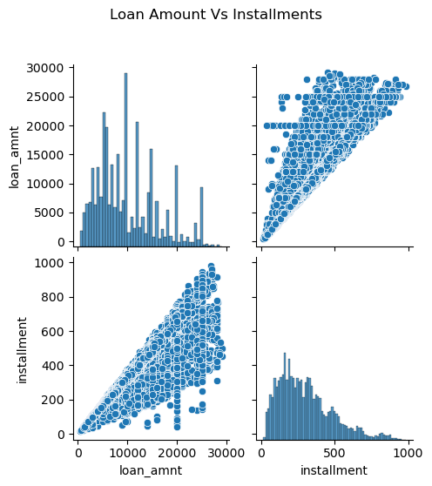
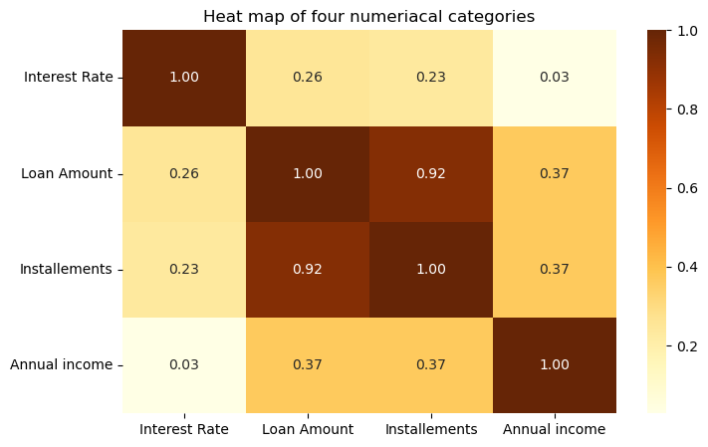
Bivariate Analysis - 2
As the Loan amount is increasing installment amount too increasing in linear way

Slide 14
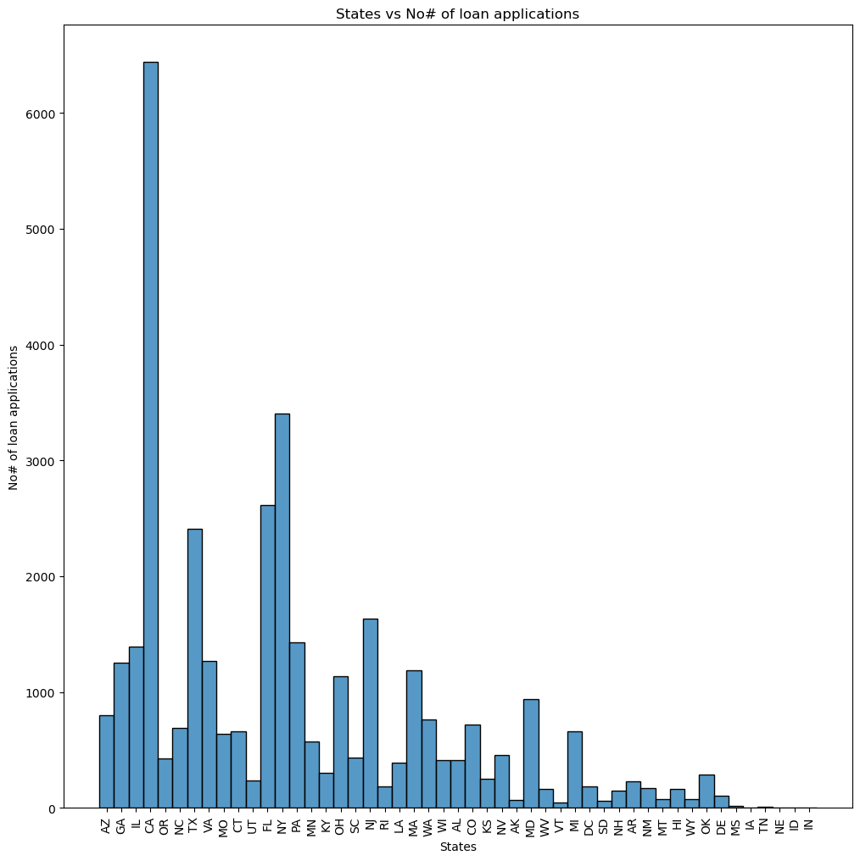
Bivariate Analysis - 3
Larger number of loan applications are from 'CA'

Slide 15
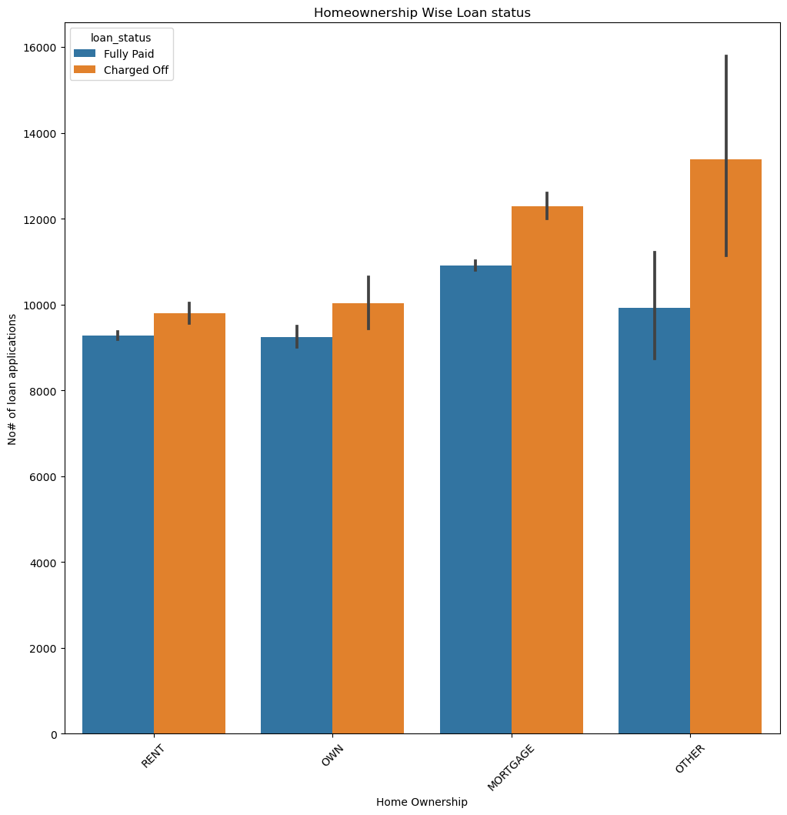
Bivariate Analysis - 4
Maximum amount of loans where defaulters are present with home ownership in category mortgage or others.

Slide 16
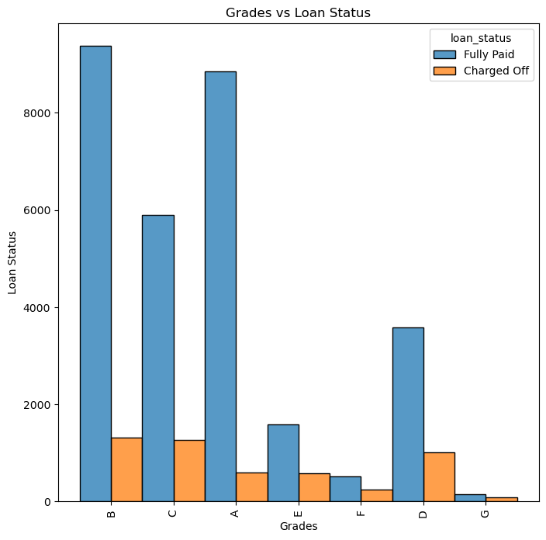
Bivariate Analysis - 5
In Loans of Grade A,B,C there are maximum amount of applications.

Slide 17
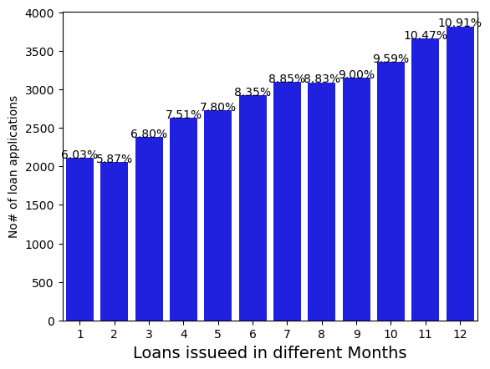
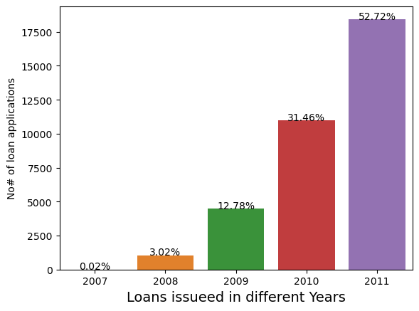
Segmented Analysis - 1
In Dec month there are more number of loans got issued.
In Year 2011 % of loans given are more.

Slide 18
Closing Comments
Columns like Employment tenure, Loan amount, Annual income, Home ownership were taken into consideration for identification of patterns.
Not all combinations of Numerical and Categorical columns considering for EDA
No many derived columns where looked out for creation
Few columns (might be important) got dropped due to lack of domain knowledge

